Slide 1

Polarized Positron Upgrade for CEBAF
Update on scientific motivation
Positron LDRD
  e+ for CEBAF
  spin tracking
  123 MeV model
Positron Beams R&D Working Group
  Start to End facility operation
  Target development
Outlook
Joe Grames

Slide 2
Jefferson Lab Positron Working Group
Users have made a strong case for
positron beams at CEBAF 12 GeV
Complementary charge and spin of e+ would provide a new and unique probe at Jefferson Lab
Jefferson Lab Users Positron Working Group (250 members from 75 institutions):
  2018 – 7 letters of intent to PAC
  2020 – 2 conditionally approved PAC proposals
    Hall B ~ 100 nA polarized (>60%)
    Hall C ~ 3 uA unpolarized

Slide 3
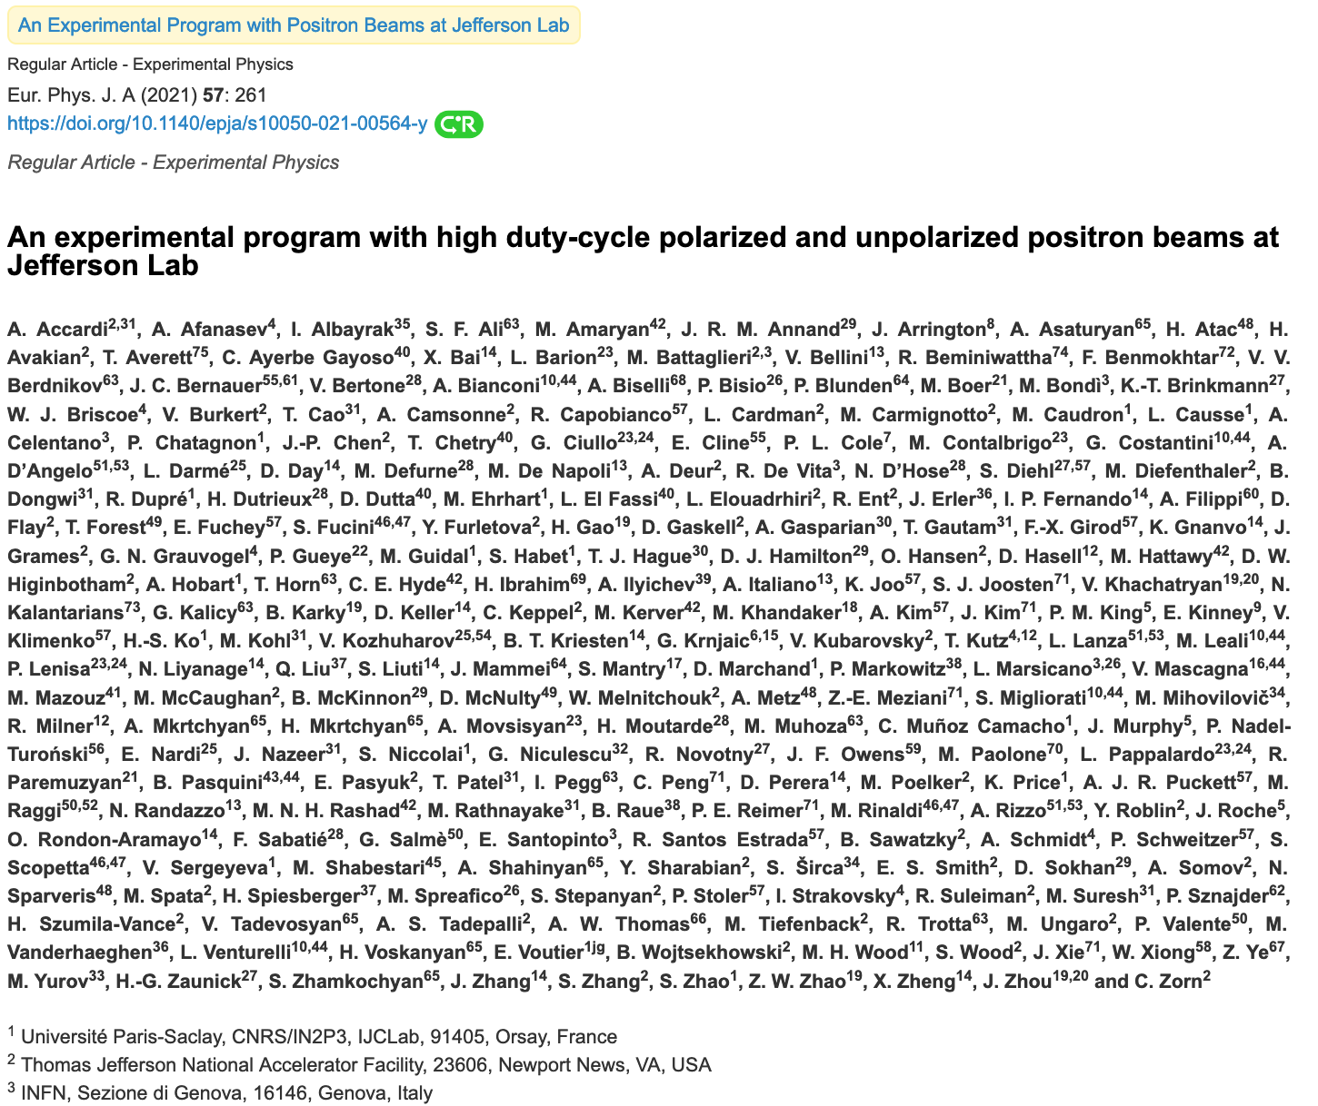
2021 – Dedicated Topical Issue of the European Physics Journal A
Comprises 20 contributions from a community of 230 physicists representing 75 institutions
Physics reach of e+ beams at Jefferson Lab:
  Two-photon effects in elastic scattering
  Radiative effects in elastic scattering
  The charge radius of the proton
  The Parton Distributions
  The Generalized Parton Distributions
  Electroweak couplings
  The search for light dark matter particles
  Charged lepton-flavor violation

Slide 4

12 GeV CEBAF : Polarized Electron or Polarized Postron Beams
 | Electrons | Positrons
Hall Multiplicity | 4 | 4
Max Energy | 12 GeV | 12 GeV
Beam Frequencies | 249/499 MHz – cw | 249/499 Mhz – cw
Unpolarized experiments | 170 uA (limit) | >1 uA
Polarized experiments | 170 uA (limit) | > 50 nA
Polarization requirement | > 85% | > 60%
Fast/Slow Helicity Reversal | Yes | Yes
2020 JLAAC Recommendations
  “R6: Augment the scientific case with a plan to translate the R&D into a realistic facility.”
  “R7: Include radiation protection considerations into the evaluation of the electron beam energy choice.”

Slide 5
Positron Beams for Jefferson Lab
Bremsstrahlung production of positrons using a high-energy cw e- beam
High e+ polarization achieved from polarization of superlattice GaAs/GaAsP photocathodes (~90%)

Slide 6
LDRD #2104 – Assembling the team
Our Year 1 objectives
Evaluate polarized positron generation for CEBAF
Add spin tracking to the code GPT for polarized collection optimization
Create a first-pass injector model for the north linac

Slide 7
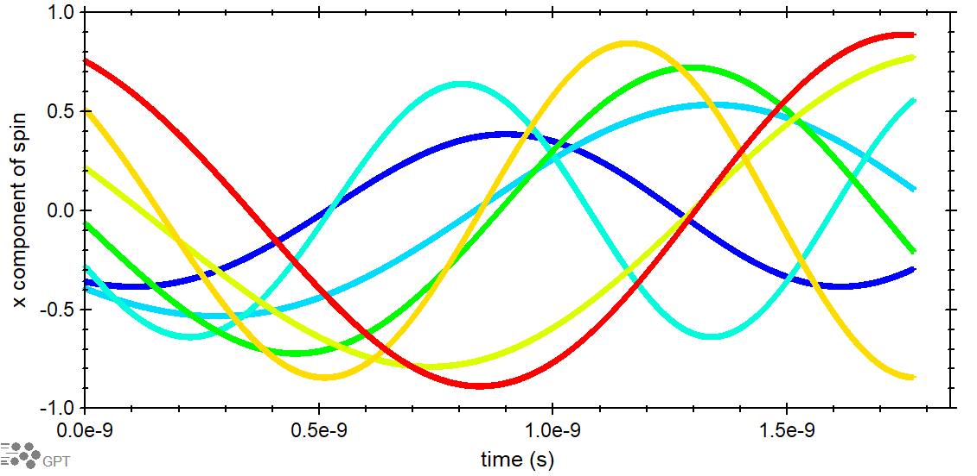
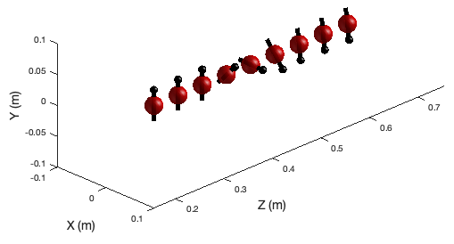
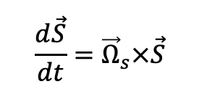
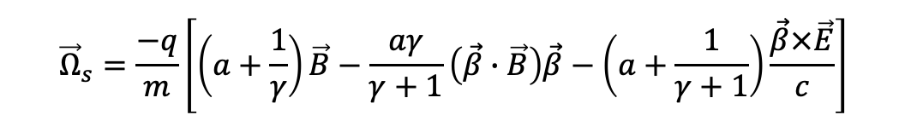
“GPT –s” – work of M. Stefani, A. Hofler, R. Suleiman
Sophisticated commercial software GPT is used to track the swarm of positrons
a genetic algorithm negotiates non-linear parameters optimization for collecting particle orbits
spin-tracking was implemented in GPT to follow e+ “spin trajectories” via the Thomas-BMT equation
$$\frac{d\vec{S}}{dt}={\vec{Ω}}_{s}×\vec{S}$$
$${\vec{Ω}}_{s}=\frac{−q}{m}\left[\left(a+\frac{1}{γ}\right)\vec{B}−\frac{aγ}{γ+1}\left(\vec{β}∙\vec{B}\right)\vec{β}−\left(a+\frac{1}{γ+1}\right)\frac{\vec{β}×\vec{E}}{c}\right]$$
“GPT –s” fully developed for Windows and will be launched very soon on the lab’s Scientific Computing platform

Slide 8
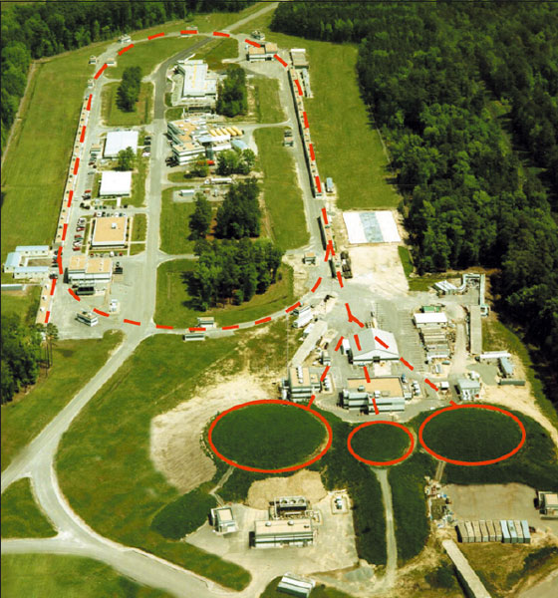
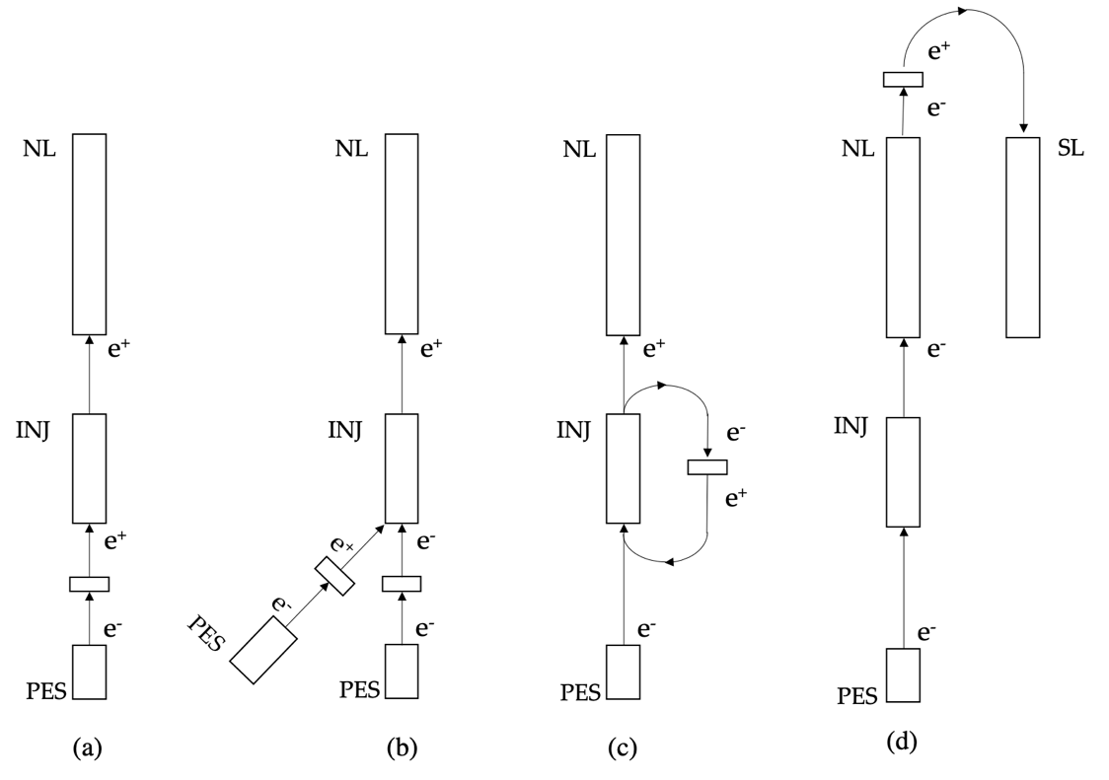
LDRD – injection schemes for evaluation
We can achieve high spin polarization with any electron beam energy (10 MeV, 12 GeV, etc)
The Yield (e+/e-) depends most on beam power, i.e what Beam Energy x Beam Current to choose
E_{e-} < 10 MeV
E_{e-} = 100 – 200 MeV
E_{e-} > 1000 MeV

Slide 9
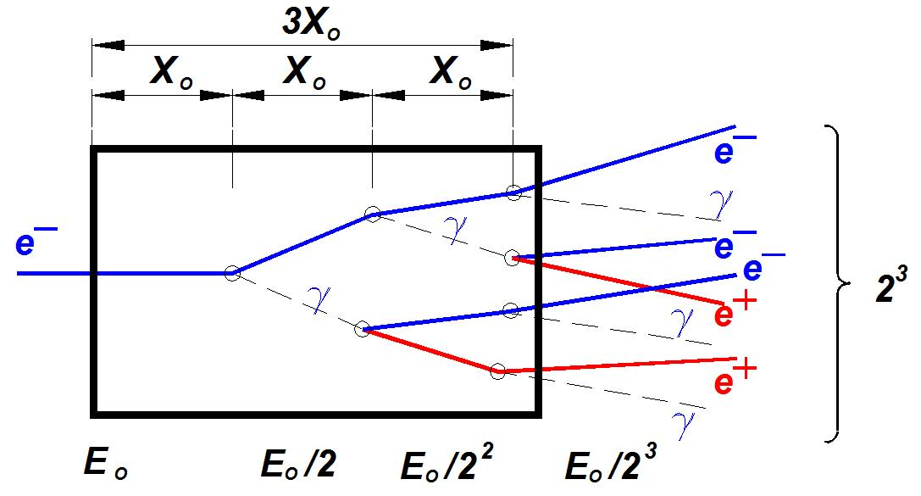
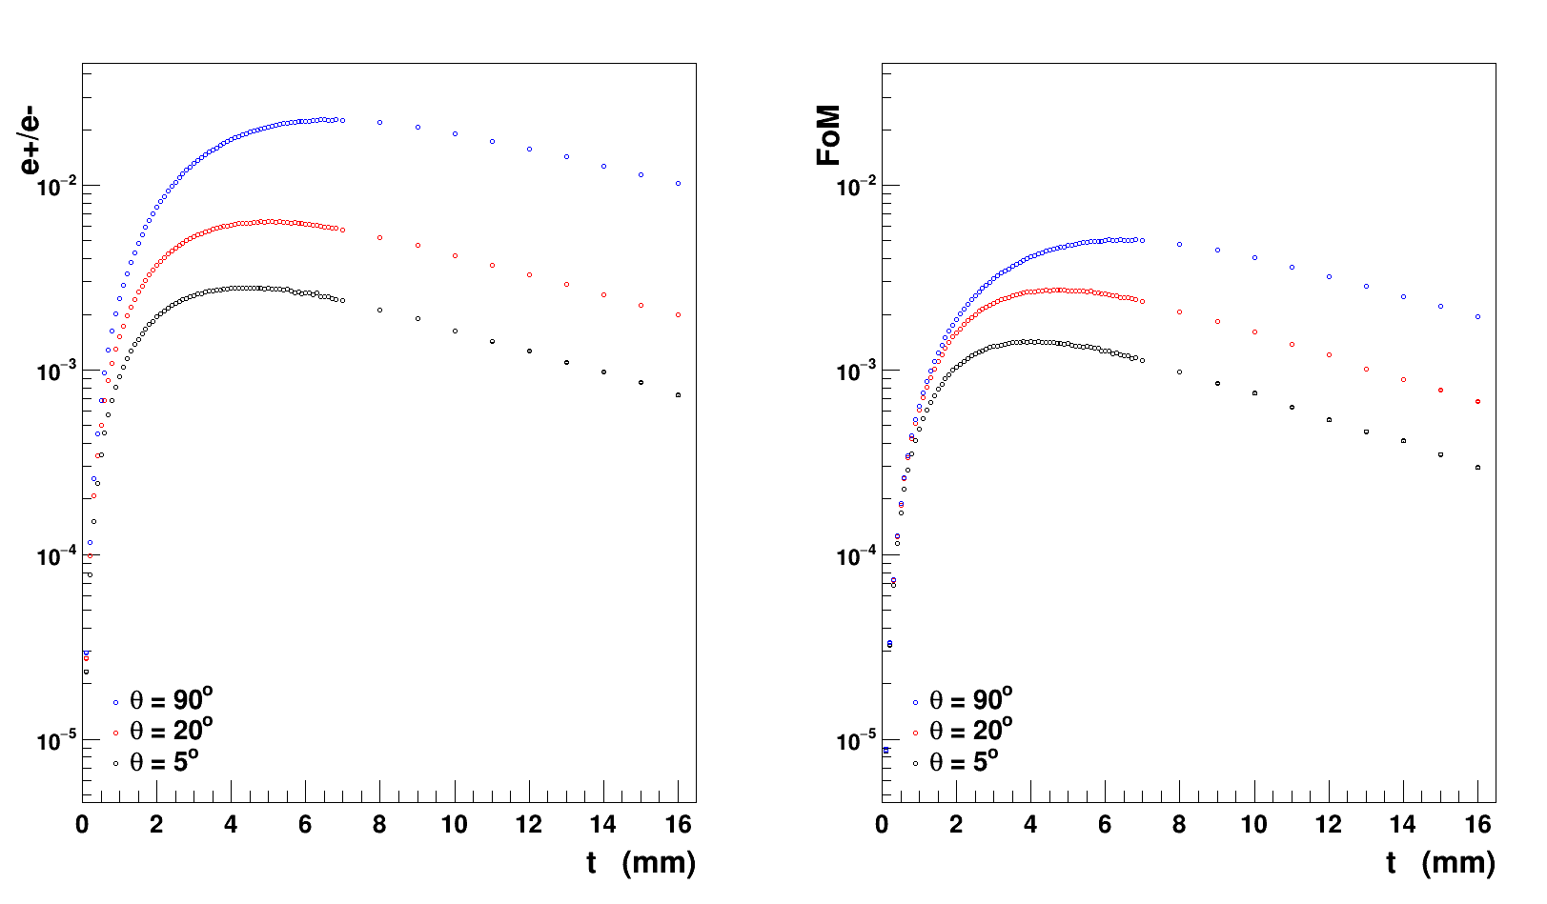
Positron production with E_{e-} = 123 MeV – work of Sami Habet (IJCLab/JLab)
The optimum target thickness is critical
  Too thin and the electron energy is not well spent
  Too thick and positrons are absorbed
The parameters of interest:
efficiency (ε=e⁺/e⁻)
average polarization (P_{z})
figure-of-merit (FoM= ε∗P_{z}²)

Slide 10
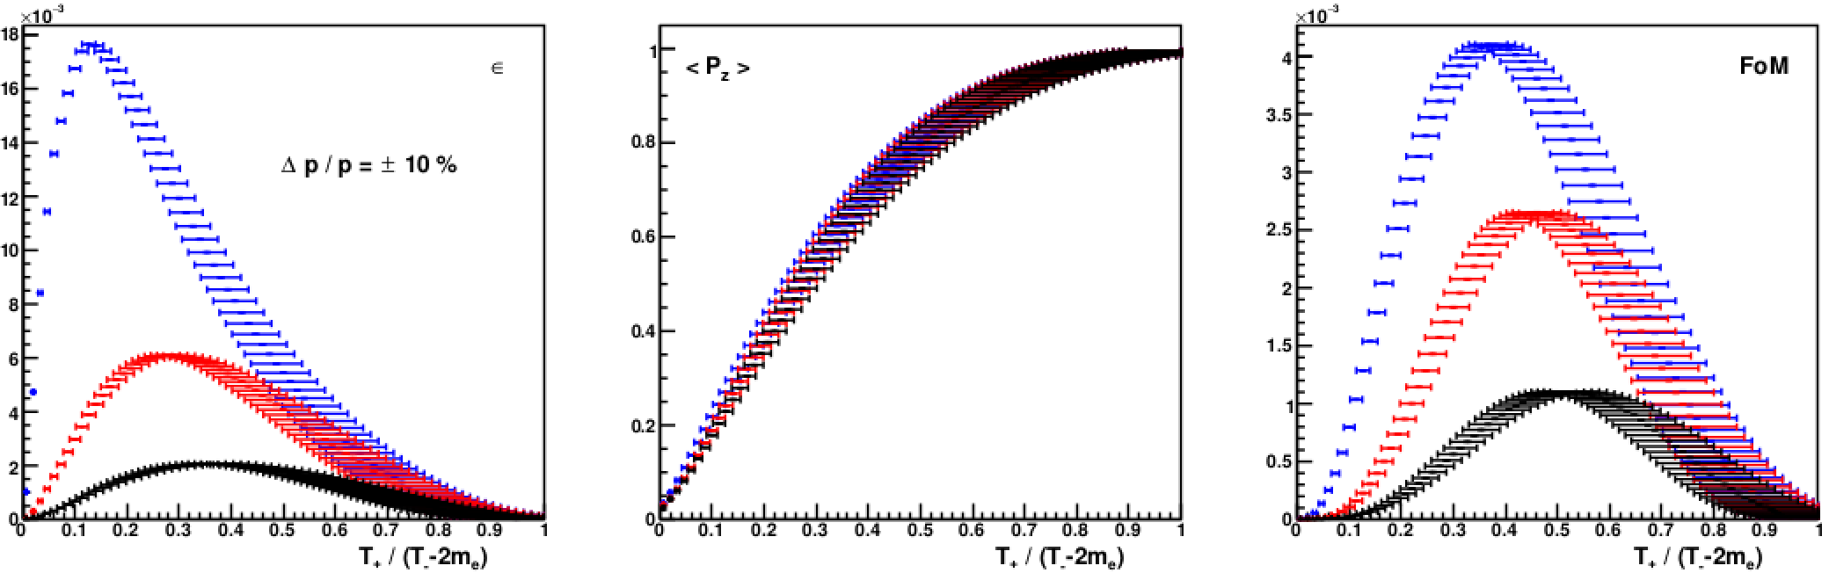
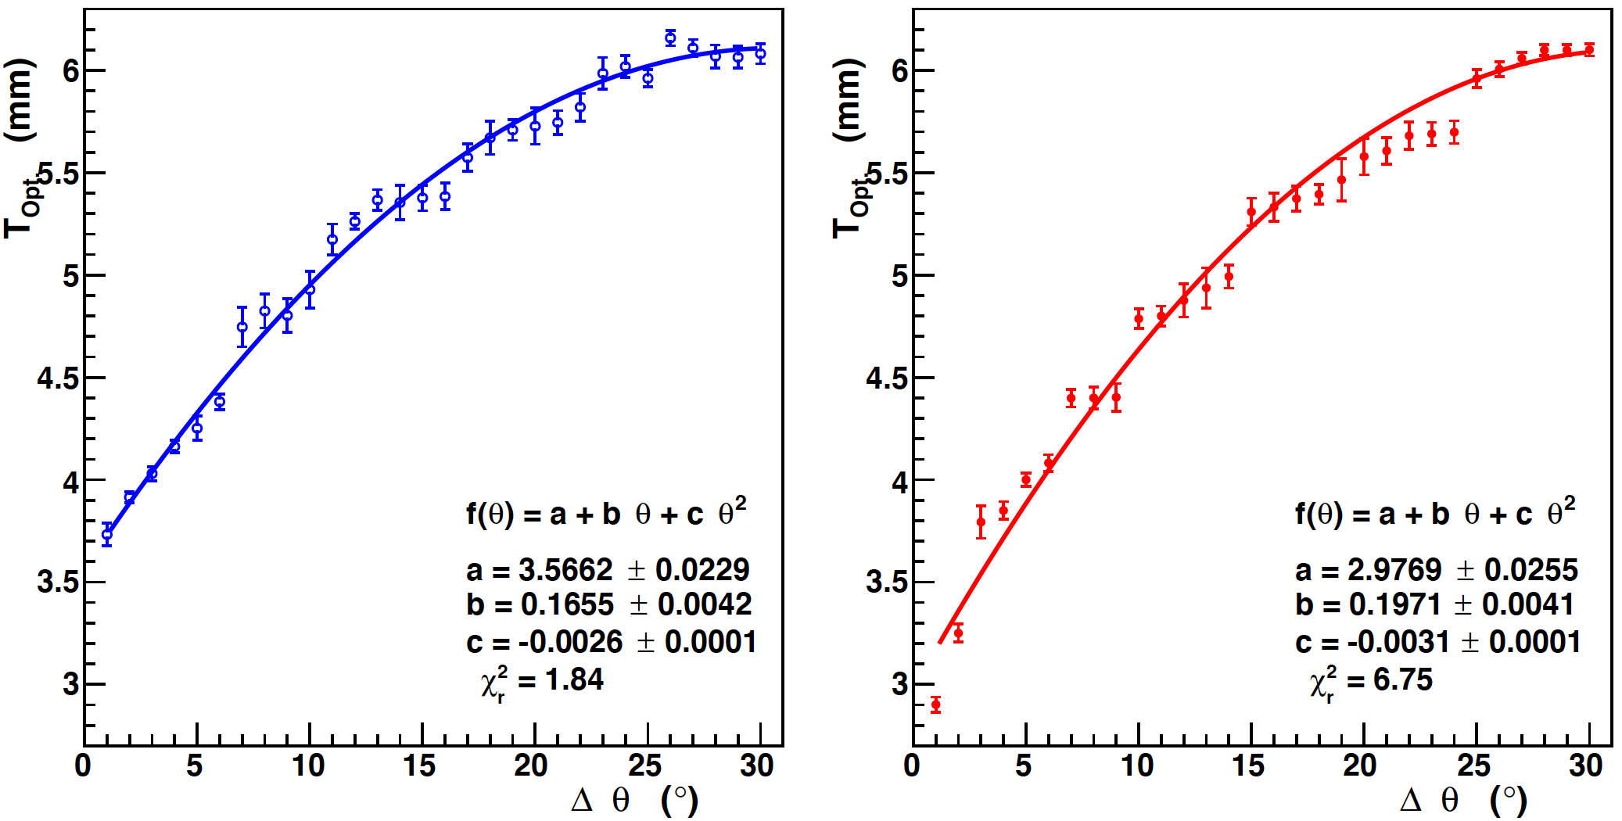
Positron production with E_{e-} = 123 MeV – work of Sami Habet (IJCLab/JLab)
Positron source performance depends strongly on transverse & longitudinal acceptance of the collection system.
Τ₋ = 120 MeV
t_{W} = 4 mm
Technical Note in preparation
Δθ = 60°
Δθ = 10°
Δθ = 4°
Optimum thickness of target
sensitive to the angular acceptance
different for unpolarized and polarized positron collection

Slide 11
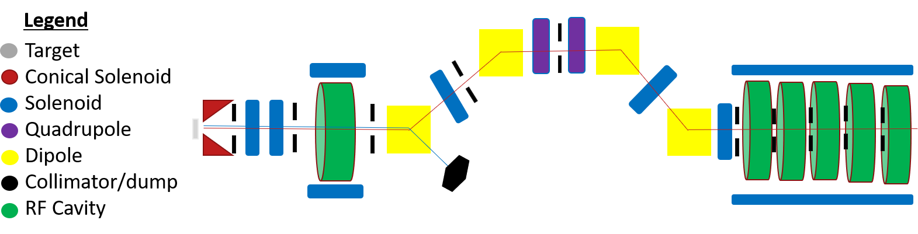
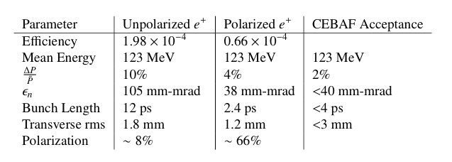
Polarized Positron Capture for CEBAF – work of M. Stefani
A positron injector model was “built” to demonstrate feasibility
e+ bunch compression
e+ chirp
e+ acceleration
e+/e- production
e+/e- separation
adiabatic focusing
Collimation defines normalized emittance
Dipoles separate particle species
Dispersion selects final dp/p
Bunching achieve with R56 chirper/chicane

Slide 12
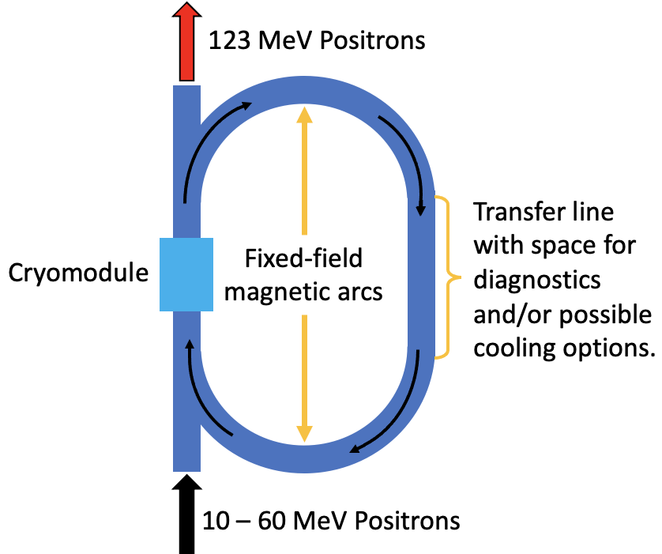
Alternative e+ acceleration scheme – work of R. Bodenstein, A. Bogacz
Traditional e+ acceleration requires protecting many SRF cavities from unintentional beam losses
  Can be expensive and limits collection.
An alternative recirculates e+ through a single protected SRF cavity several times.
  Fixed Field Alternating Gradient (FFA) technology uses fixed-field, multipurpose magnets to transport a wide range of energies through the same transport line.
    Can also use permanent magnets.
Currently looking into the ability to cool the positron beam during recirculation.

Slide 13
Positron Beams Research & Design Working Group
LDRD recently transitioned into Accelerator Division R&D
  Project essentially “outgrew” parameters of what is permitted by the LDRD
  Expanding e+ research within JLab (~1.8 FTE total)
    Center for Injectors and Sources (0.75 FTE)
    Center for Advanced Studies of Accelerators (0.5 FTE)
    Injector Operations Group (0.25 FTE)
    Engineering Group - Magnets, Radiation Shielding (0.3 FTE)
  Creating and re-investing in e+ partnerships outside JLab
    Targets - Laboratoire de Physique des 2 Infinis Irène Joliot-Curie, France
    Injection beamline - Universidad Autónoma de Sinaloa, Mexico
    Targets – Xelera proposing a project to DOE’s Small Business Innovation Research Program
    FFA - Brookhaven National Lab, Cornell
    Targets - International Linear Collider positron working group
  Opportunities to cross-cut with FFA 24 GeV R&D and vice-versa

Slide 14
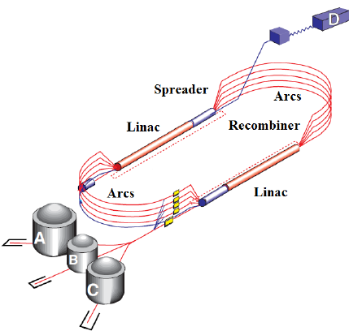
CEBAF 12 GeV : Transverse Emittance* and Energy Spread† - work of Y. Roblin
Damping
Growth
Values are provided at the end of each segment. For positron this is up to pass 5 extraction, for electrons it goes all the way to hall D.
* Emittances are geometric
† Quantities are rms

Slide 15
CEBAF 12 GeV : Magnetic Transport System
Joe finish

Slide 16
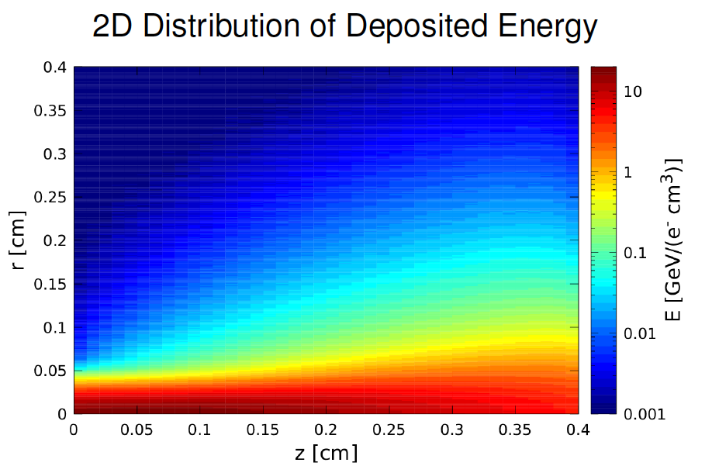
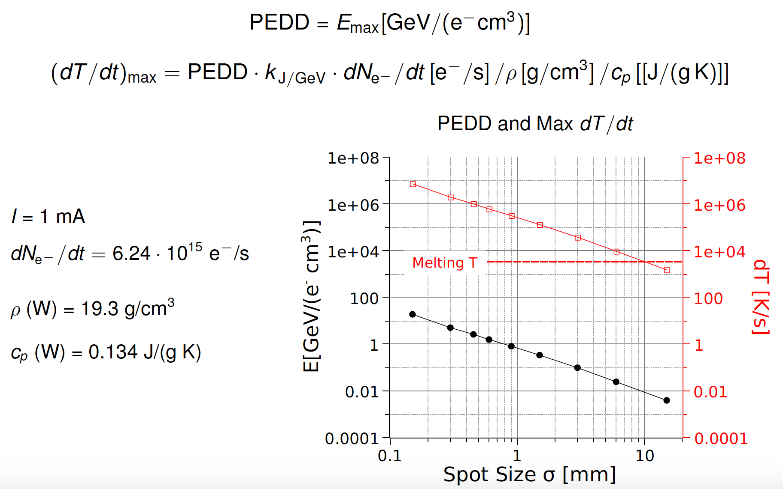
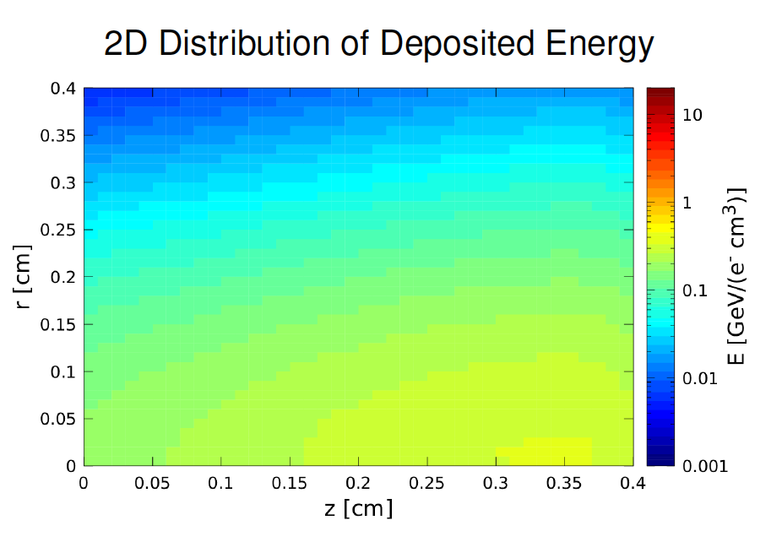
Target Development Studies – work of A. Ushakov (IJCLab)
120 MeV x 1 mA => 17 kW in 4mm W
R=0.15 mm
R=1.50 mm

Slide 17
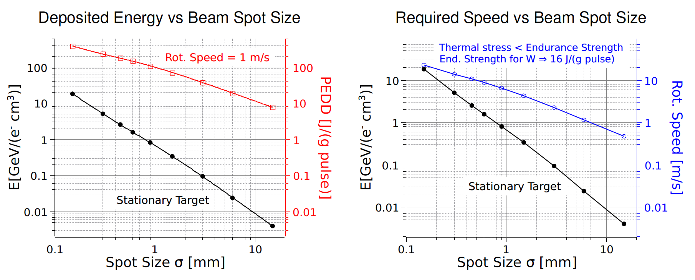
Target Development Studies – work of A. Ushakov (IJCLab)
A rotating target allows one to have a higher PEDD

Slide 18
Target Development Studies – work of A. Ushakov (IJCLab)
Recently work started to develop design parameters for rotating target
Assumes 120 kW (1 mA x 120 MeV)
17 kW is deposited in 4mm tungsten
Power density at r=50 cm is 1.35 W/mm³
Radiation cooling assumptions
  Emissivity of W and Cu is 0.5
  Ambient temperature is 22 °C
Conduction cooling asumptions
  Thermal conductance = 0.4 W·K⁻¹·cm⁻²
  Temperature of cooling water is 22 °C

Slide 19
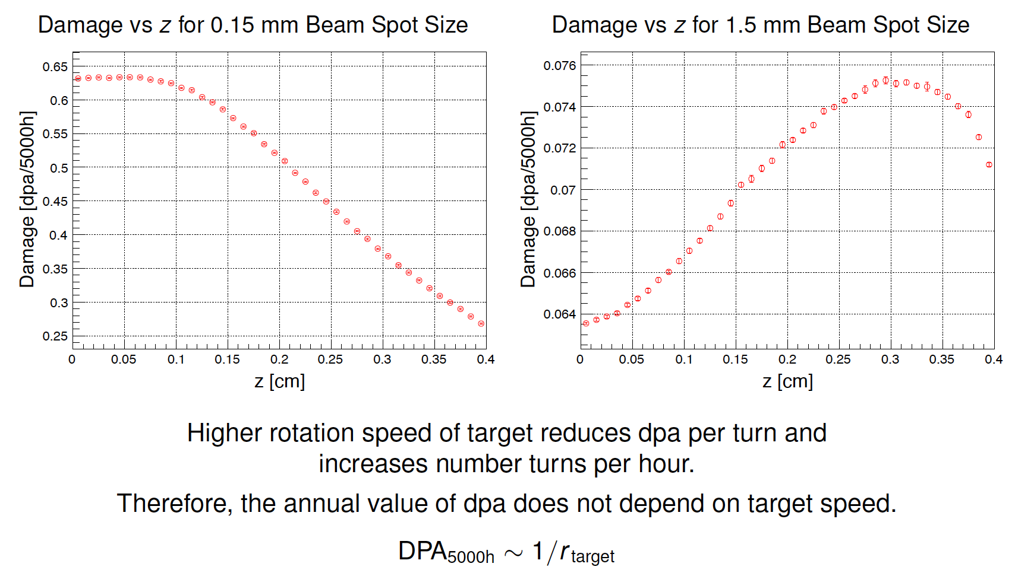
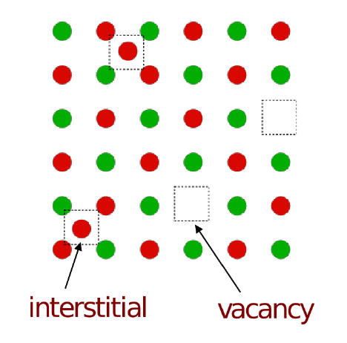
Target Development Studies – work of A. Ushakov (IJCLab)
Radiation induced damage limits the integrity (lifetime) of the target
DPA = # ions displaced in material

Slide 20
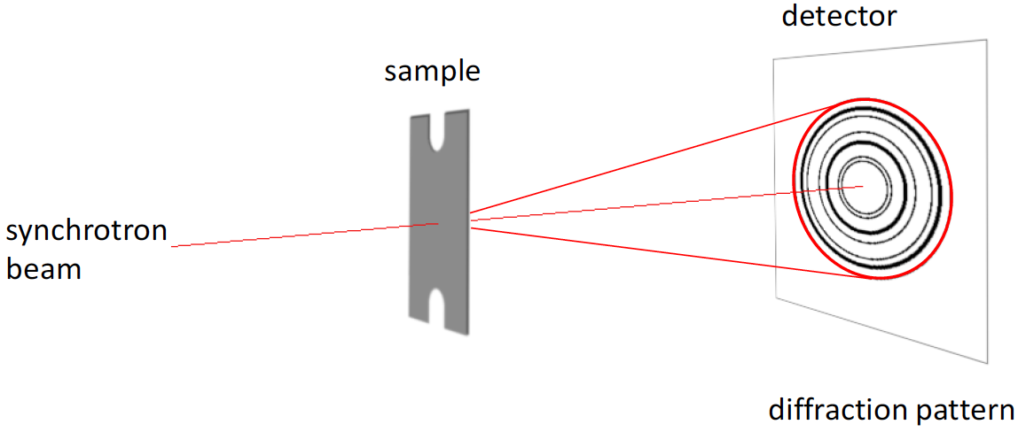
Target Development Studies – collaboration of European H2020 P3
Partner with European/ILC colleagues studying candidate target materials
Irradiation studies are essential to test target performance.
Ti-6Al-4V alloy targets have been irradiated with a 3.5 MeV electron beam at MAMI, under PEDD and thermal load conditions similar to ILC expectations.
Structural damages are characterized with the HEMS beam line at PETRA III using a 87.1 keV photon beam.
Perform similar tests with 120 MeV electrons, studying W and Ti-alloy materials under exposure conditions similar to JLab expectations.

Slide 21
Slide from Val

Slide 22
Potential for US DOE Cross-Cutting between NP and Materials Science
Slide from Farida

Slide 23
Conclusions & Outlook
Conclusions
  Physics Users propose a broad program positron beam experiment at CEBAF
  Laboratory support has been critical to seriously resume evaluating e+ beams
  LDRD
    developed software framework for simulations and modeling
    created a preliminary 123 MeV positron injector model
  Strengthening Positron working group (CIS, OPS, CASA, ENG) essential
Outlook
  Continue the start-to-end concept for 123 MeV e+ CEBAF facility (address R6)
  Started evaluating High-Energy 12 GeV e+ production option
  Evaluation of the target concept is ramping rapidly – bodes well
  Returning to spin rotators at low (100 MeV) and high (1-12 GeV) e+ energies
  Starting to look into schemes for simultaneous e- and e+ program
  Strengthen Positron Working Group collaboration
Deliverables
  Submit a technical conceptual report by the end of 2022
  Propose to engineer and build a prototype system starting in 2023

Slide 24
Acknowledgments
List everybody’s names, send me affiliations, icons, etc

