Slide 1
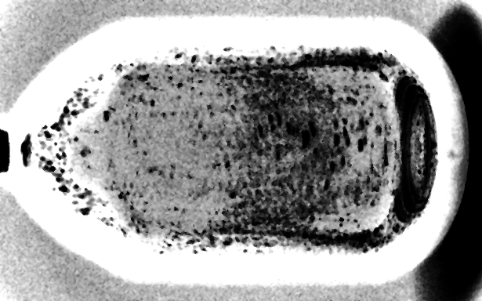
May 2018. Composite all runs, all events.

Slide 2
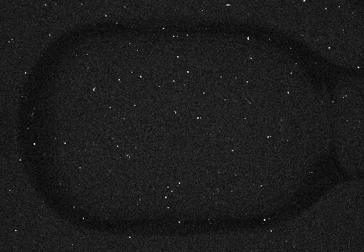
Background from CCD scintillation
Scintillation from gamma rays
interacting with CCD
September 2015, ~1500s

Slide 3
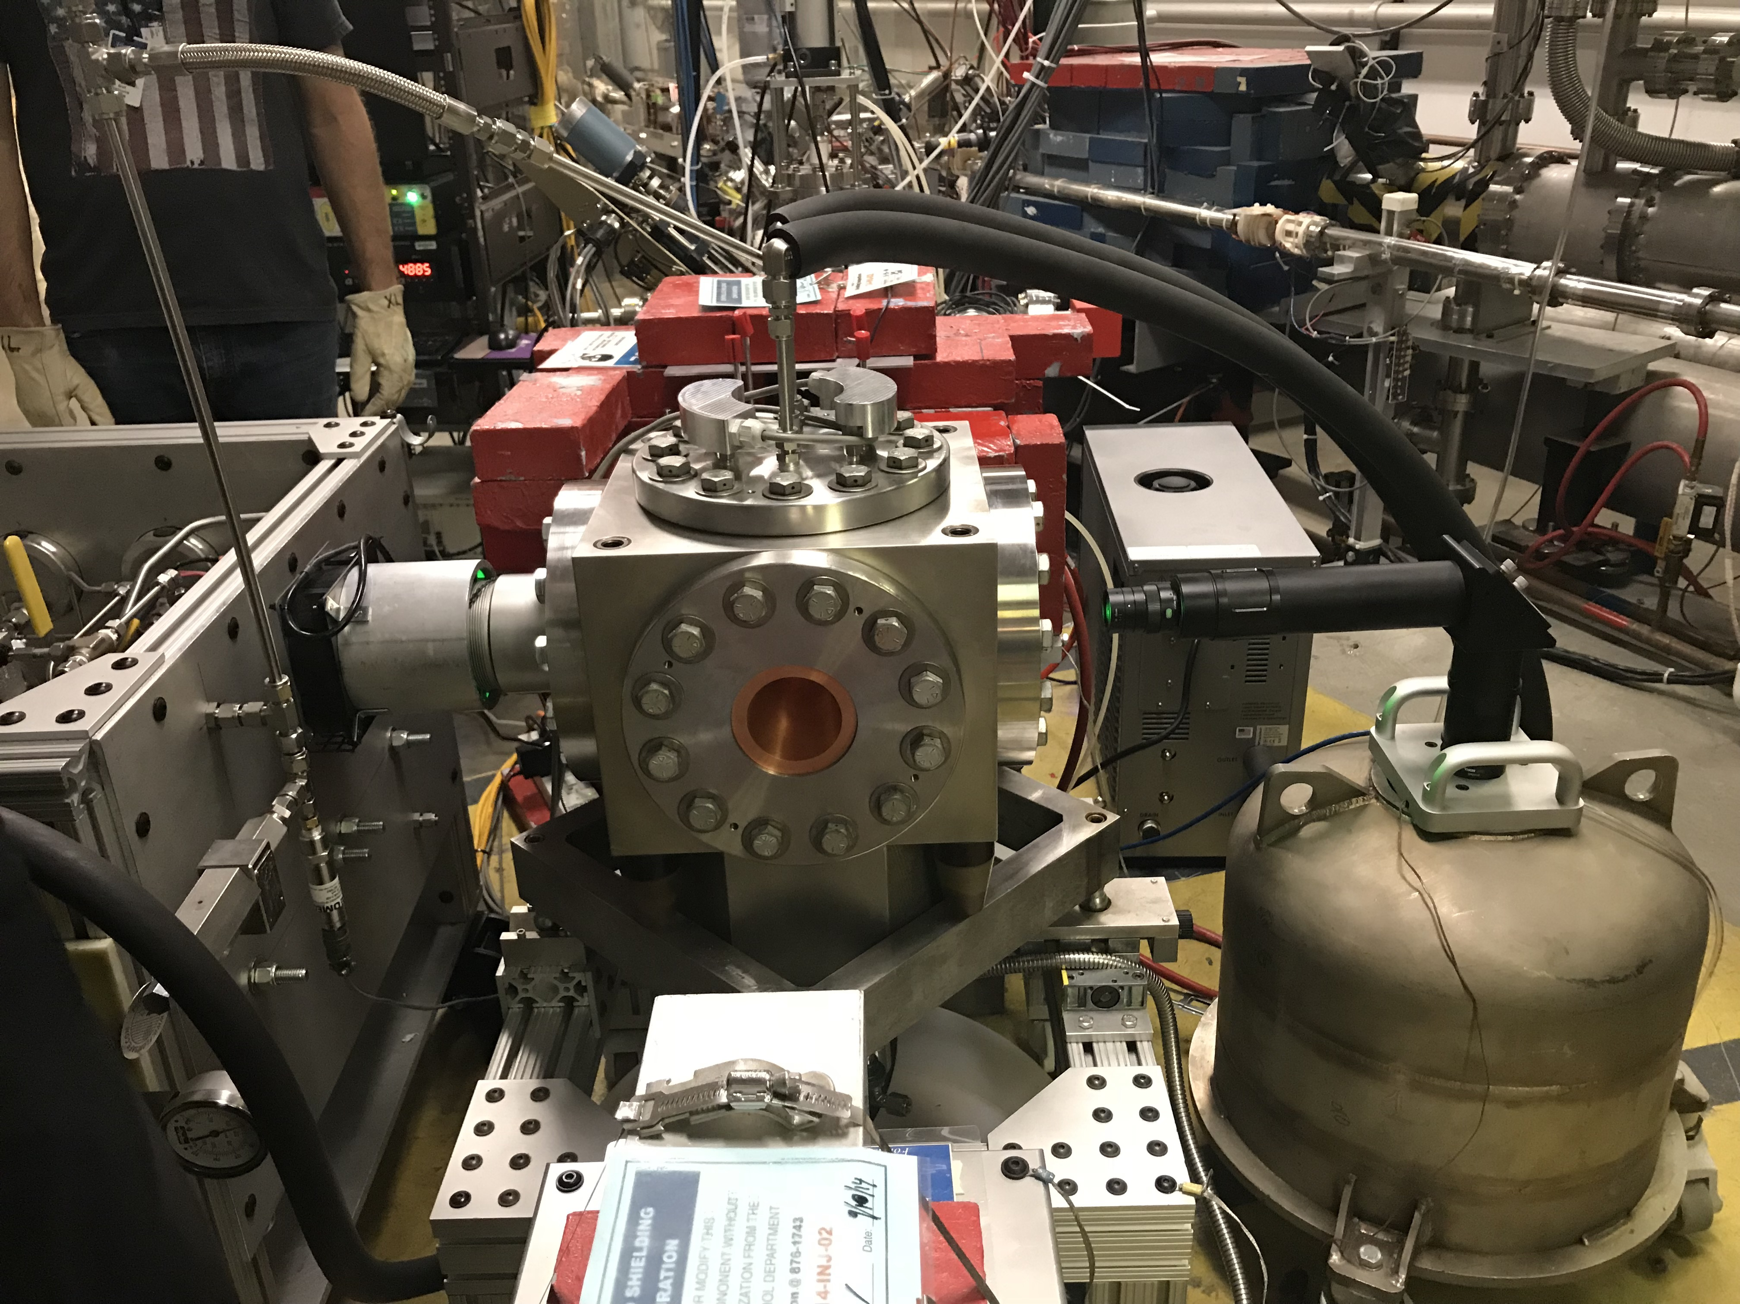
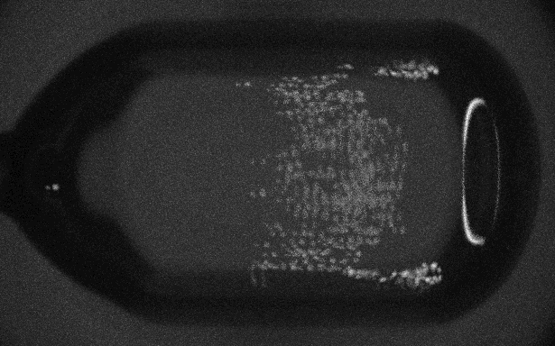
Background from CCD scintillation
September 2015
Pb shielding
May 2018

Slide 4
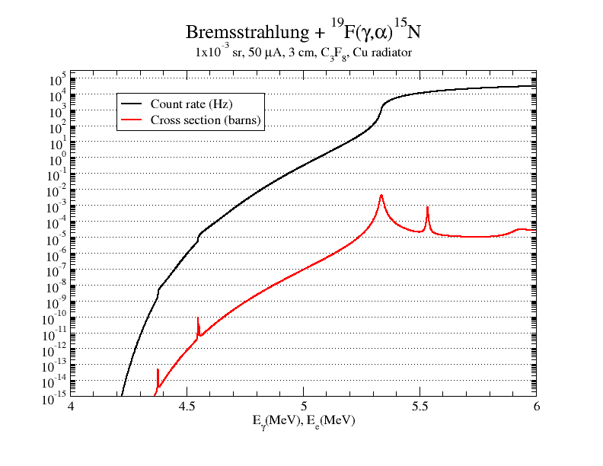

Slide 5
Plotted is the yield per second/current in microA,
Y=[counts in fiducial volume/(time-10*total counts)]/(I_microA)].
Counts are corrected for background.
The curves are the calculated yield and the background yield (Horizontal line) assuming that the background was stable during the duration of the run.
The red points are runs before run100 and the open circles are from 101-140.
Two things that need to be explained:
1. the red circles are earlier runs (before 100) and are a little lower than the later runs. Did we do something at run 100 that might have changed things?
2. the 5.25 MeV data are again away from the calculated yield.

Slide 6
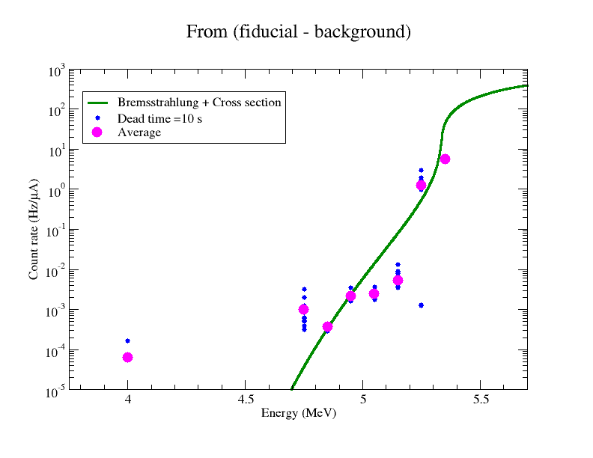
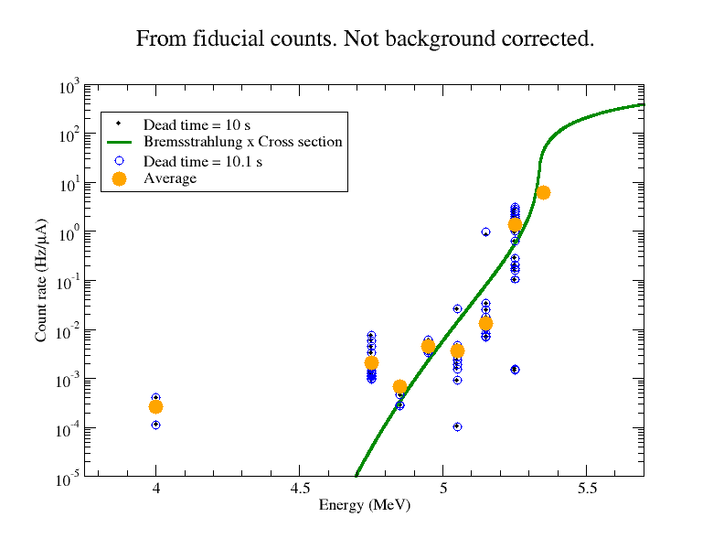
Defined a “fiducial region” and a separate background region of the same size.
Run times had to be extracted from timeSpectrum files. Some times from the logbook need corrections.
Total dead time was computed from the total number of triggers per run and at 10 seconds per event. Small change in time introduced to correct for exponential tail in pressure drop. No significant change in rate observed.
All runs were included in analysis. Average is also provided.
Main effect of background correction is a reduction in spread of count rates.

Slide 7
Summary (prelim)
Count rate limits
E_{e}(MeV) σ(α,γ) σ(γ,α) count rate (Hz)
4.75 12 pb 1 nb 2x10⁻²
4.87 80 pb 8 nb 2x10⁻¹
background (cosmics) ~5x10⁻³
Cross section sensitivity
Wilmes et al. 30 nb
HIγS 3 nb
JLab 80 pb (measured), 9 pb (upper limit at 4 MeV)
In future, may benefit from higher beam currents.

