Slide 1
UITF Project Status Meeting
Matt Poelker
October 21, 2015

Slide 2
Outline
Purpose: to inform Lab Leadership of the UITF status
Action Items (from previous meetings)
Project Update
Progress Update
Milestones Update
Budget Update
Highlights & Concerns
Next meeting agenda
Notes:
RW=Roy Whitney

Slide 3
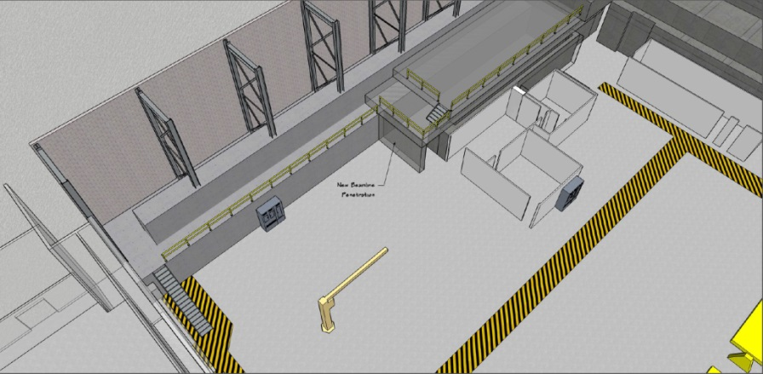
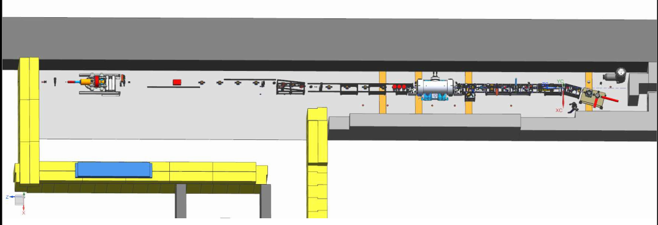
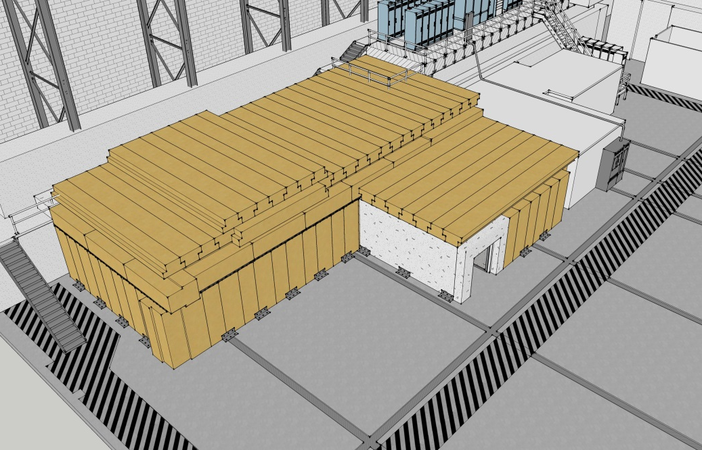
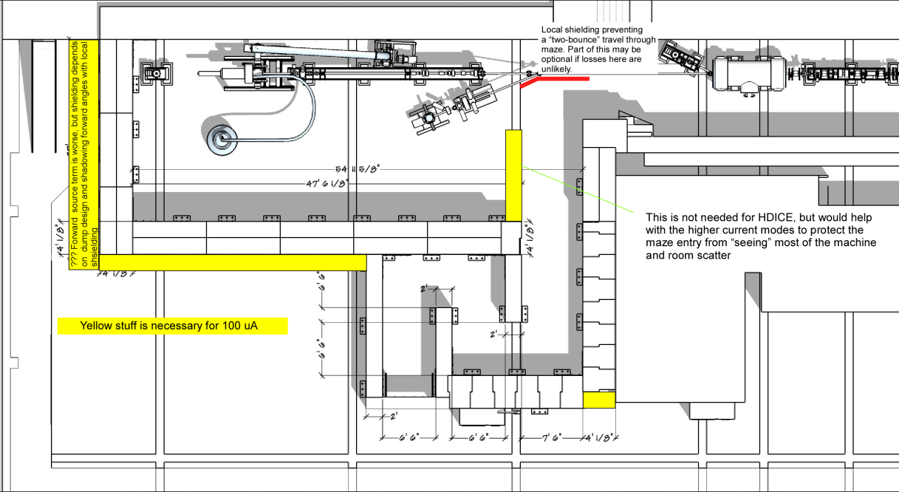
To refresh your memory…
What we started with…
UITF as imagined

Slide 4
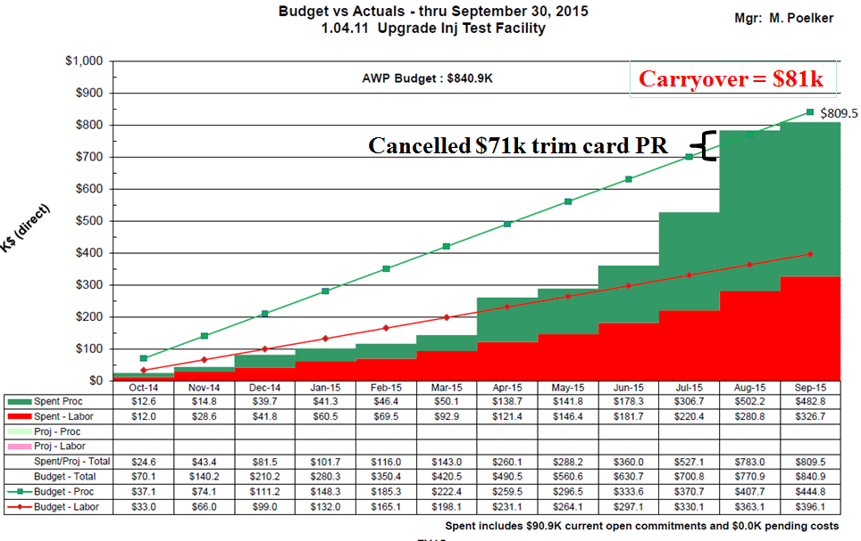
Action Items – October 21, 2015 Minutes
Recall, UITF spending lockdown toward end of August…
Cancelled trim card PR, “Electricity to top of Cave1” PR held up
Electricity PR approved Nov. 11
No other procurements since then
20 PW of labor approved, devoted to Cryo and Facilities
UITF costs approaching some DOE project limit….
New Action Items:
Nov. 11, 2015: meet to re-scope the project, distribute costs within four “fences”
Notes:
RW=Roy Whitney

Slide 5
Progress Update
Major components
Facilities
Engineering
Mech Design
Cryo
Safety Systems
I&C
DC Power
Low Level RF systems
High Power RF
Survey & Alignment
SRF
Commission with RF
Operations
Network and communications
Green means we can see progress

Slide 6
Progress Update
Major components
Source Group
Reliable 350kV ops
Beam to cup in front of ¼ CM
Beam to cup in front of HDIce
EHSQ
Shielding approval, ODH assessment
Global hazard review
FSAD
Accel Readiness Review
Commissioning Plan
HDIce
Installation at Cave
Beam on HDIce
Green means we can see progress

Slide 7
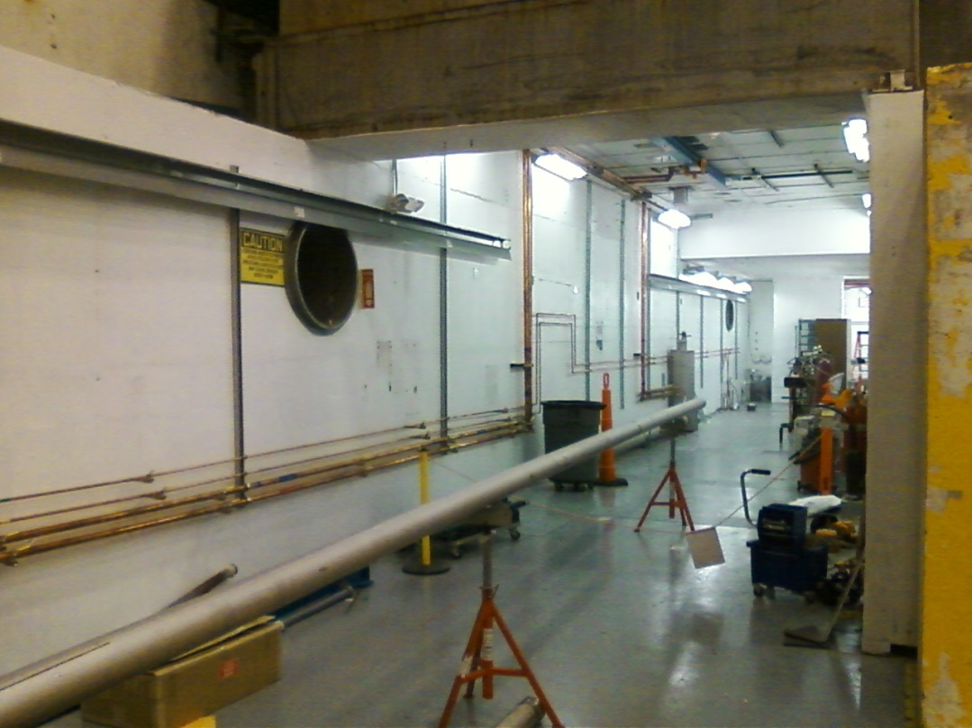
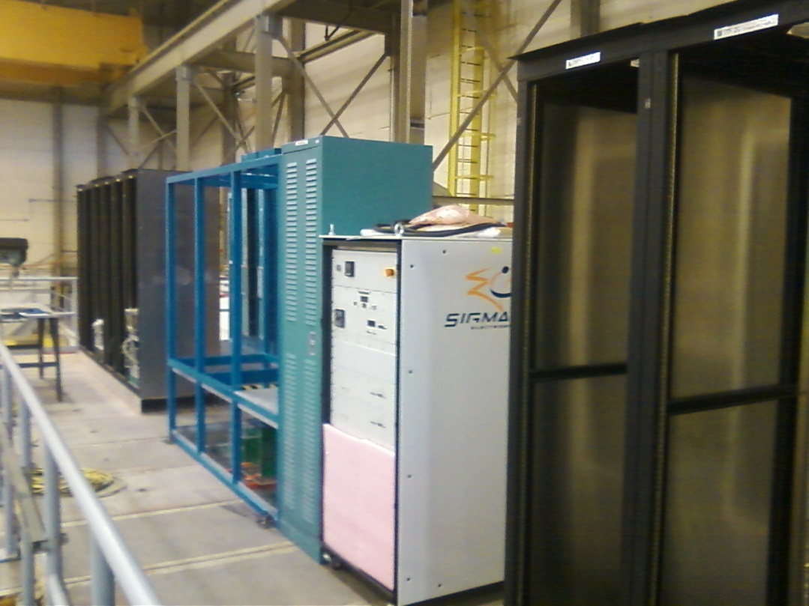
Installation Group (safety related)
PSS conduit added to wall, more to do still
Racks bolted down, side panels added
Need machine shop help for klystron racks
Cryo has delivered some transfer line

Slide 8
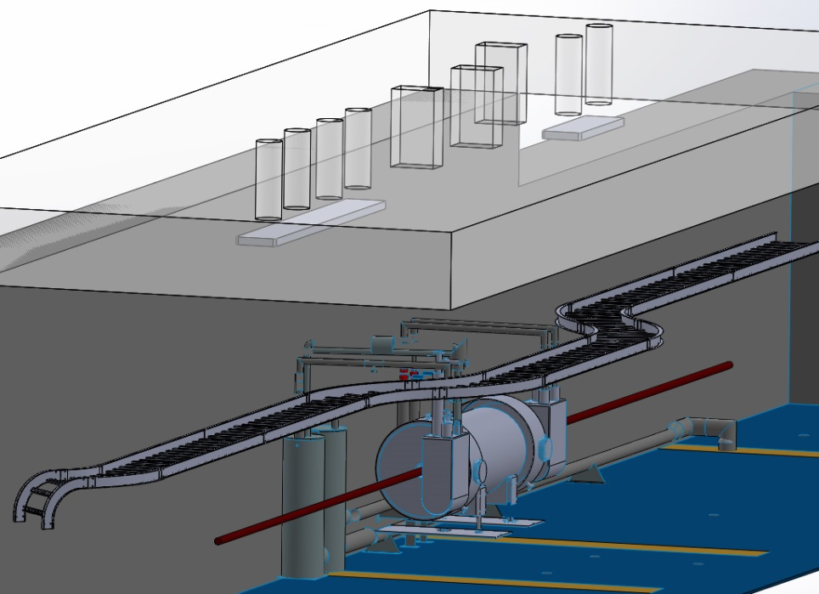
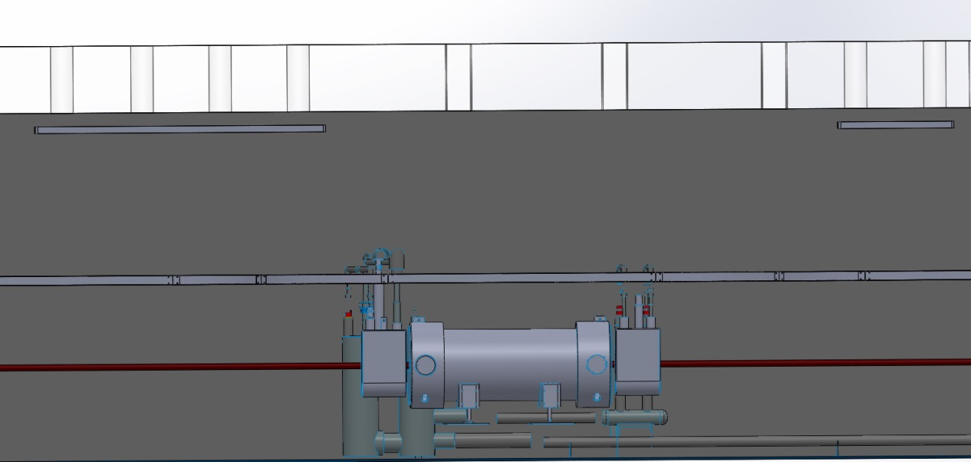
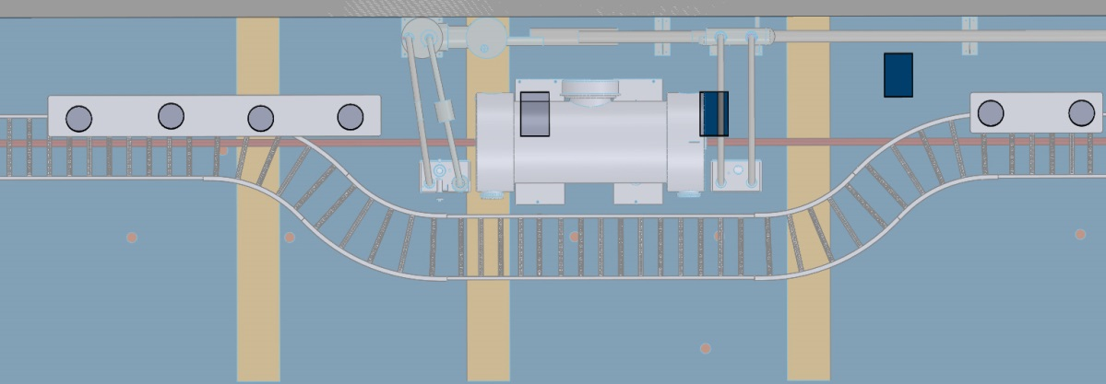
Shielding at Penetrations
Working with Vashek to specify shielding at penetrations

Slide 9
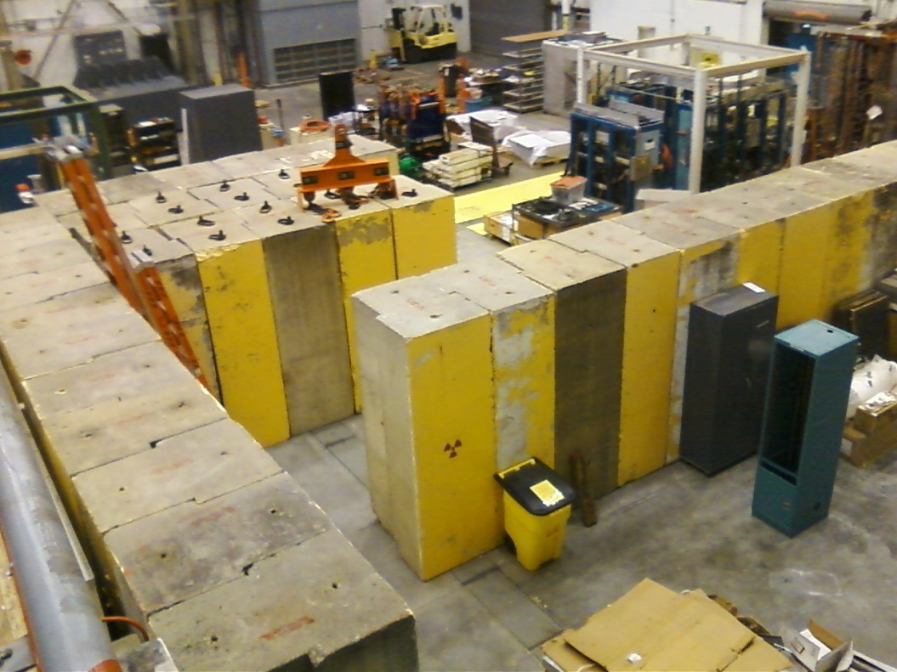
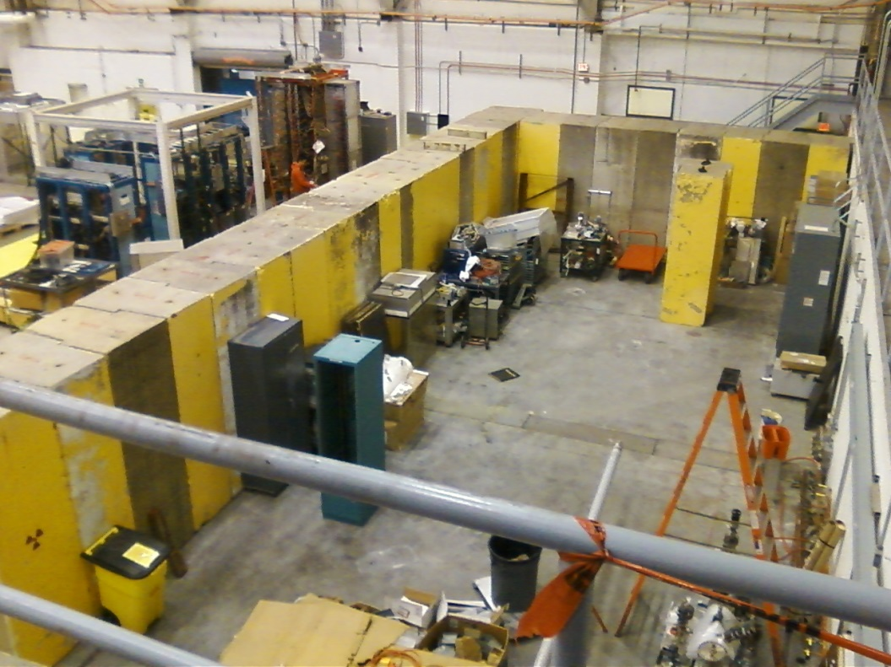
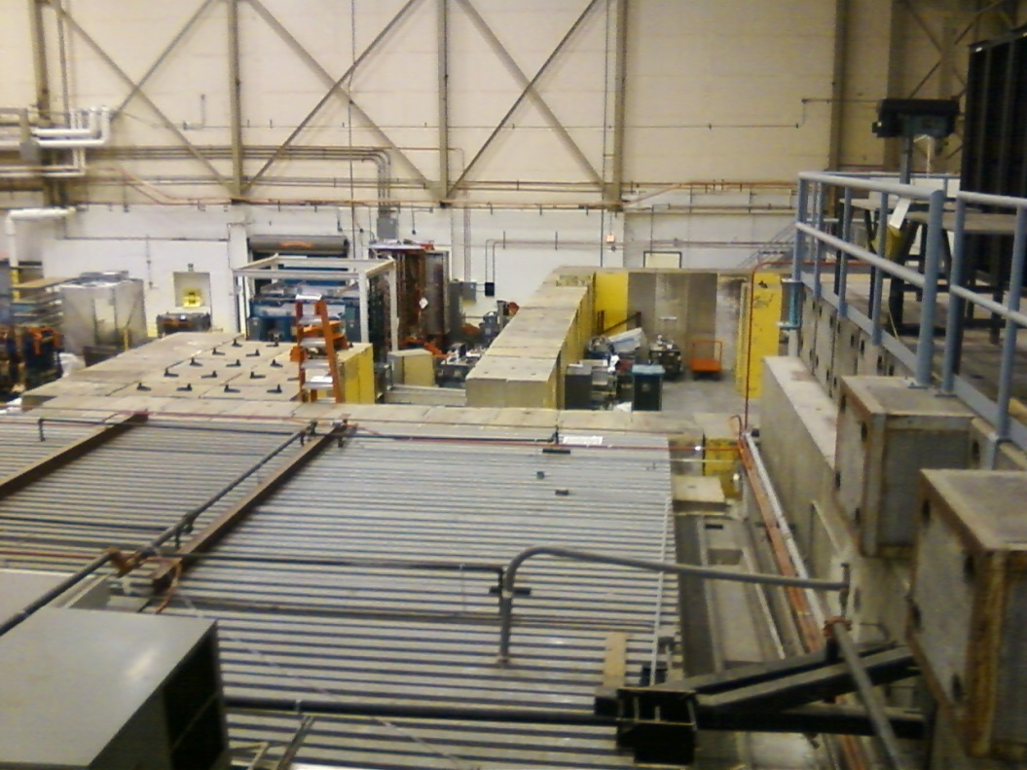
Cave 2
All big “T” shaped yellow blocks have been moved to building 58. Waiting for “Big Bite” to clear out to complete the labyrinth perimeter, waiting for Facilities to secure 2nd layer

Slide 10
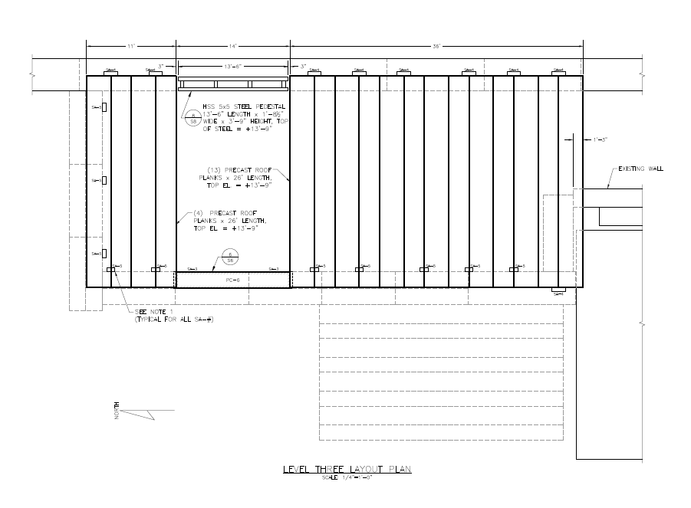
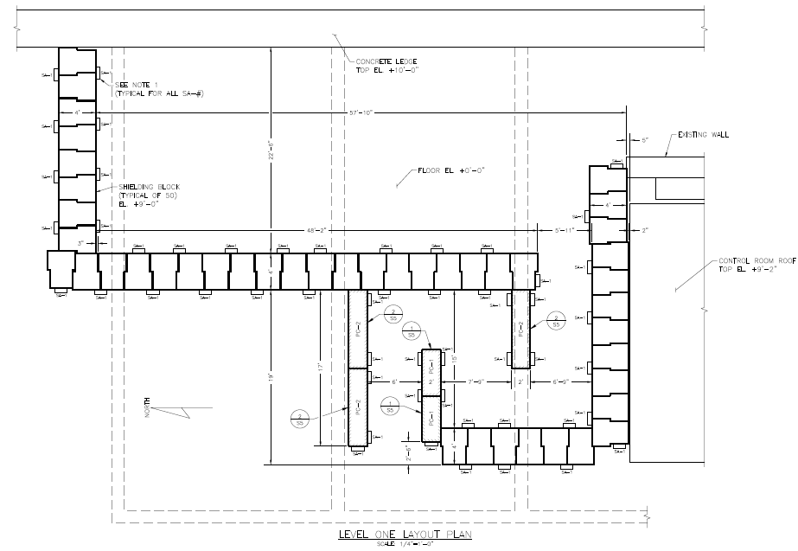
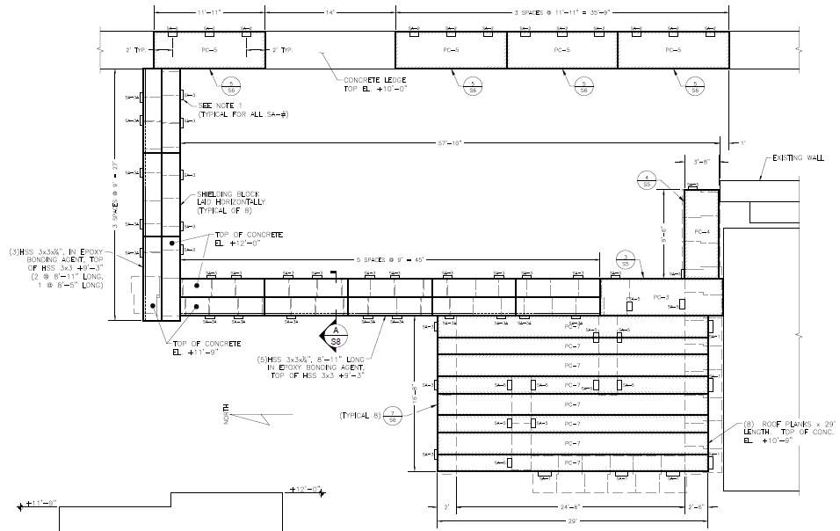
Facilities (T. Renzo)

Slide 11
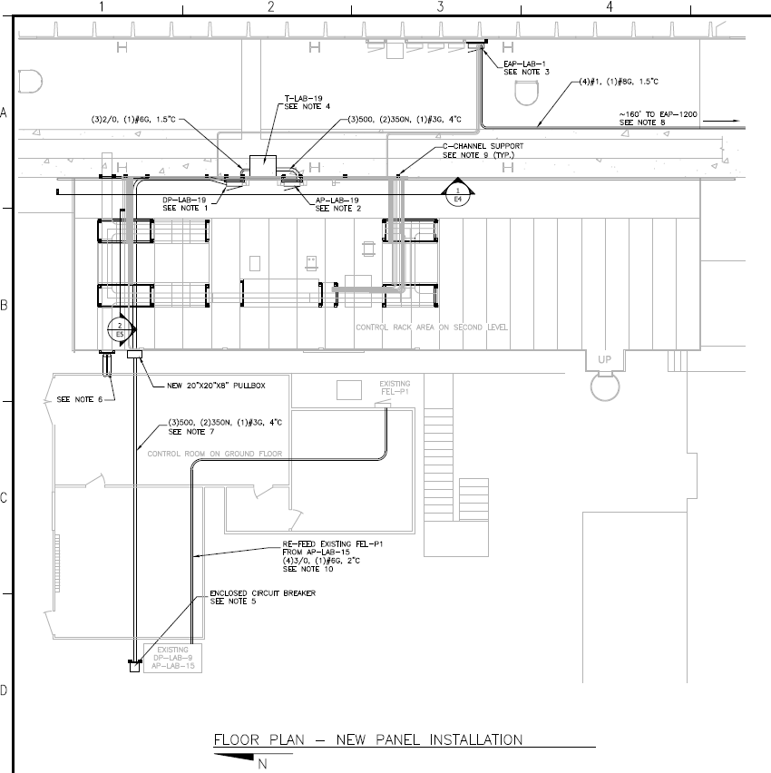
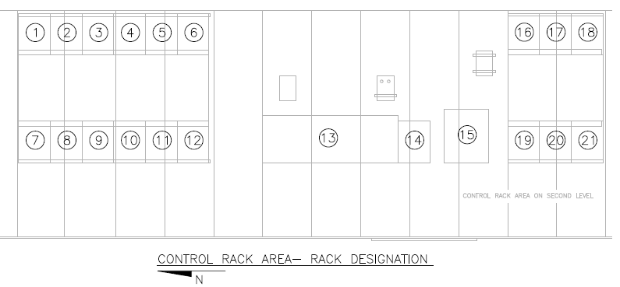
Facilities: Electrical part1
Low bid $78k, hope to complete by end of December (moved off UITF project?)
Another PR for network cables, 18k$, waiting for approval

Slide 12
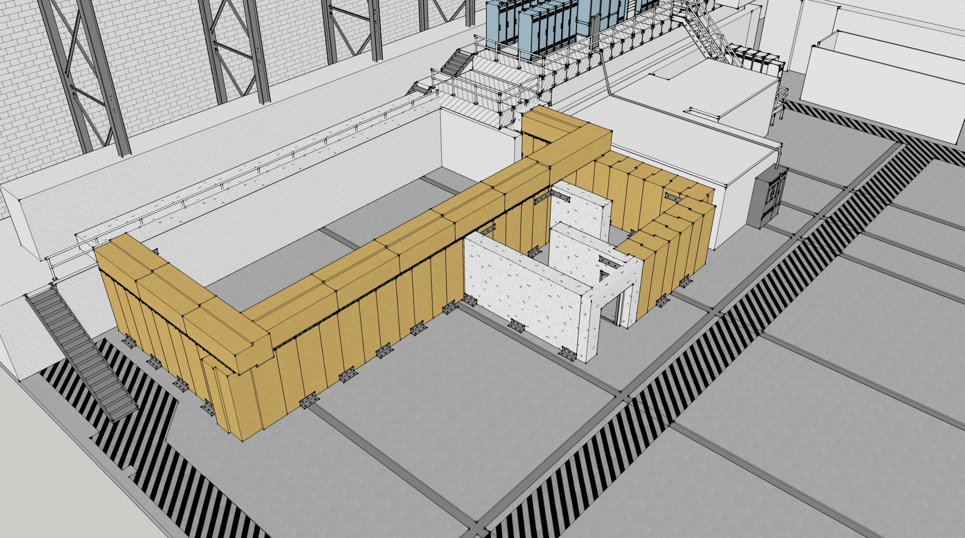
Simple ODH solution: passive venting
Two 30” vent pipes in Cave1
Add pipe to vent the primary and secondary relief valves on ¼ CM through small penetration on wall
Large entry/exit with chain-link gate
Large rectangular opening near HDIce
Some added radiation shielding required

Slide 13
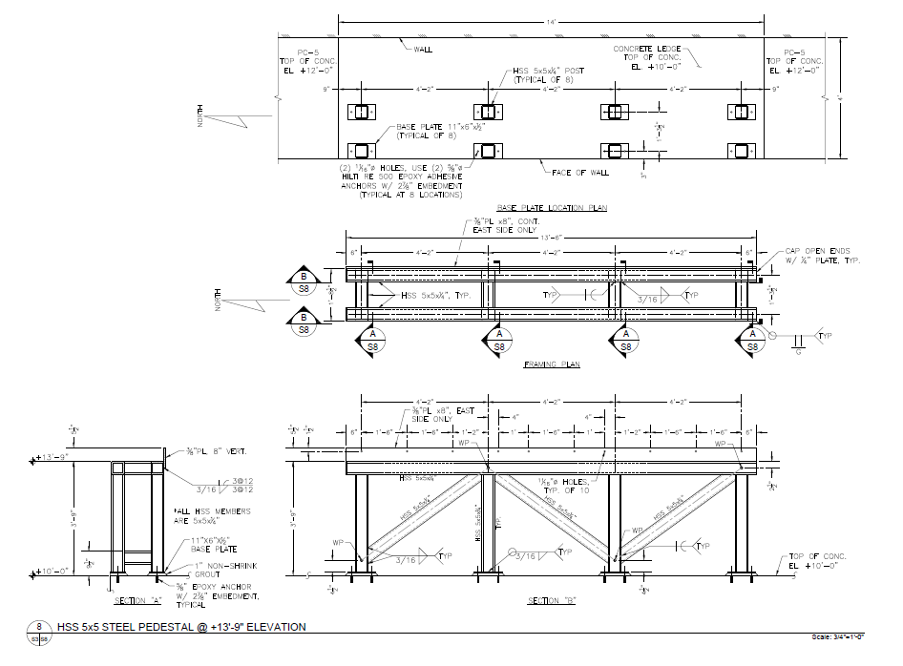
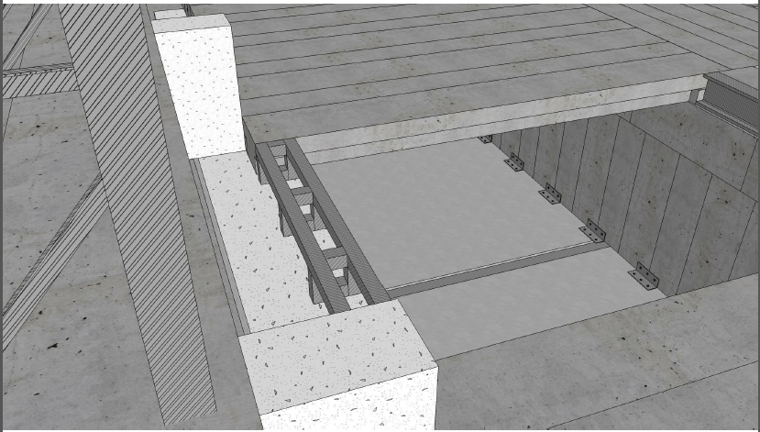
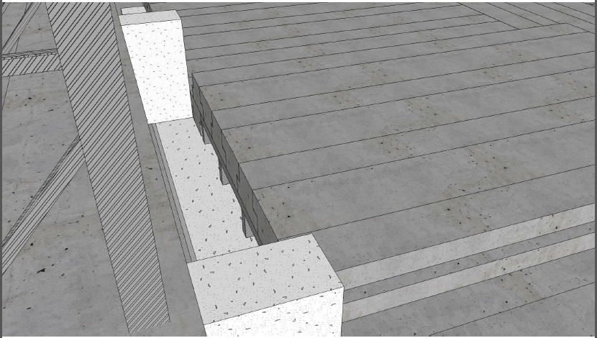
Big Chimney near HDIce
Helium source terms identified for ¼ CM and CTF, and also HDIce
Strategy still focused on using passive exhaust vents to maintain ODH0 (or ODH1) conditions
Large vent 30 ft² near HDIce, 10 ft² vents inside Cave1, ceiling penetration with chimney, chain link gate, Test Lab high bay equivalent to “outside”
Will Oren working with Cryo, SRF, HDIce to complete the assessment

Slide 14
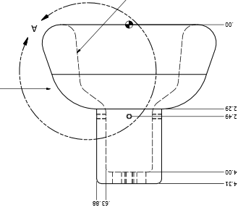
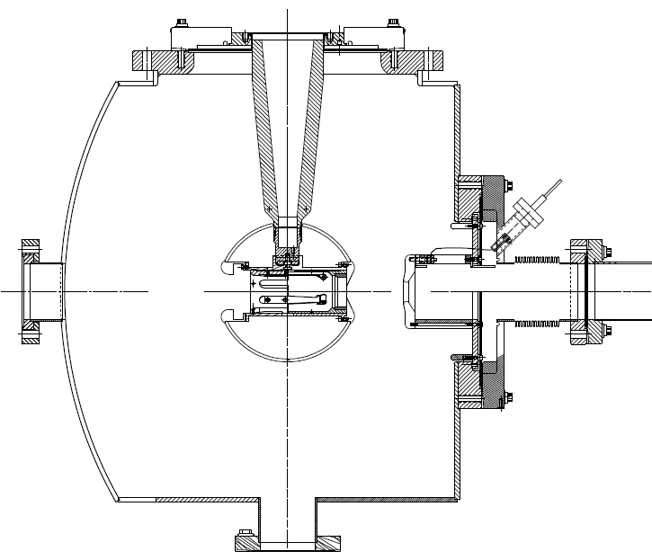
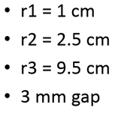
Next test late September
Combine the two features that provided incremental success: shed and doped insulator

Slide 15
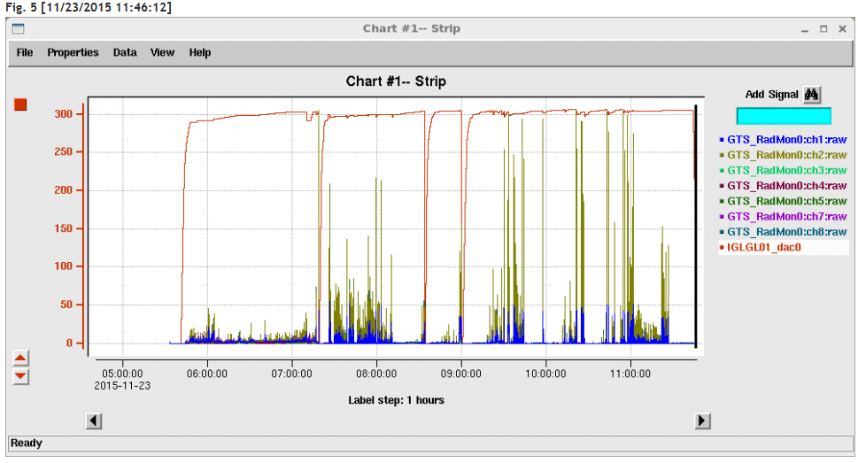
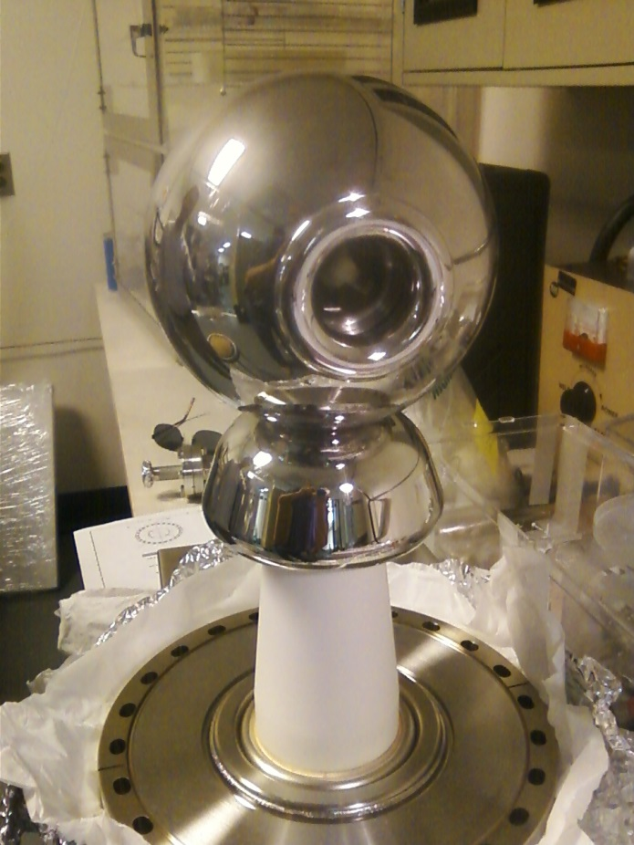
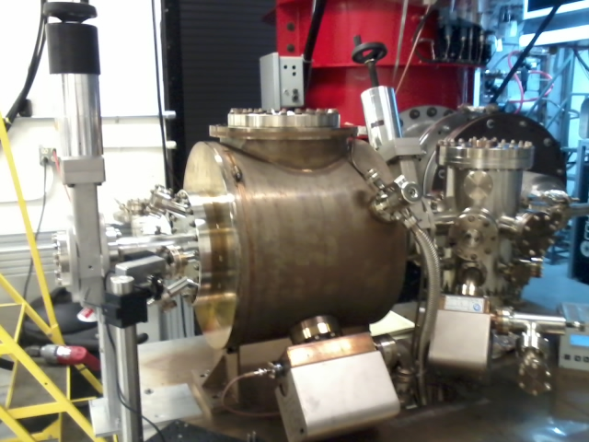
Will know if we have a gun by end of year
At 305 kV today
Cathode electrode with screening electrode and dummy photocathode installed, under vacuum, now undergoing HV conditioning
Repeat with black, mildly conductive insulator, now in-house
Field emitters burning OFF

Slide 16
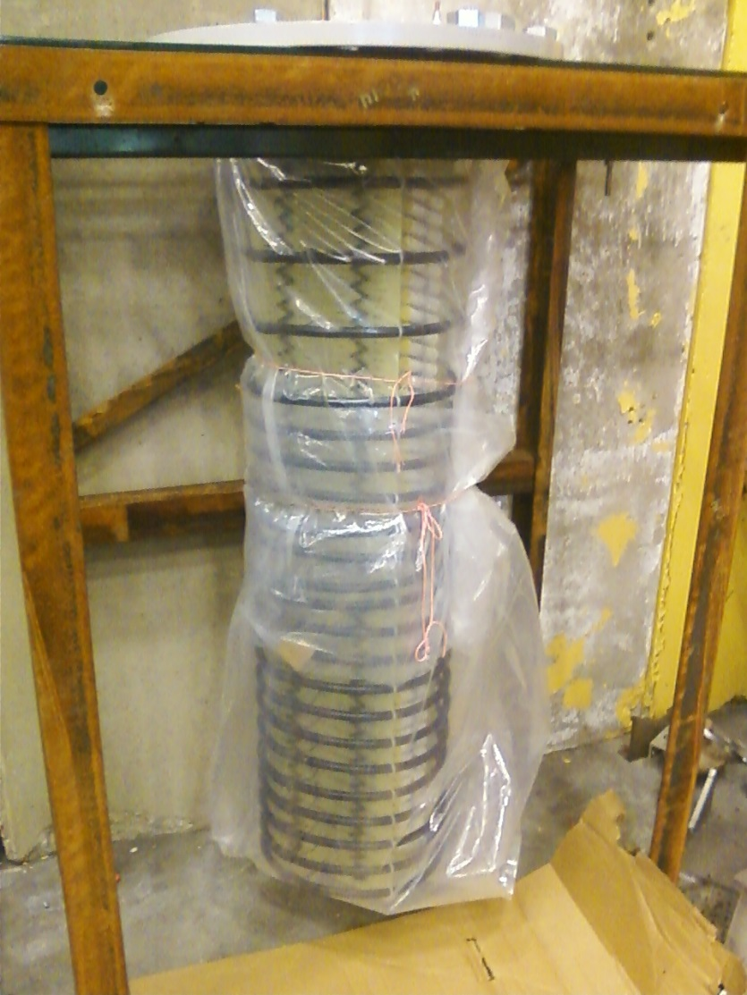
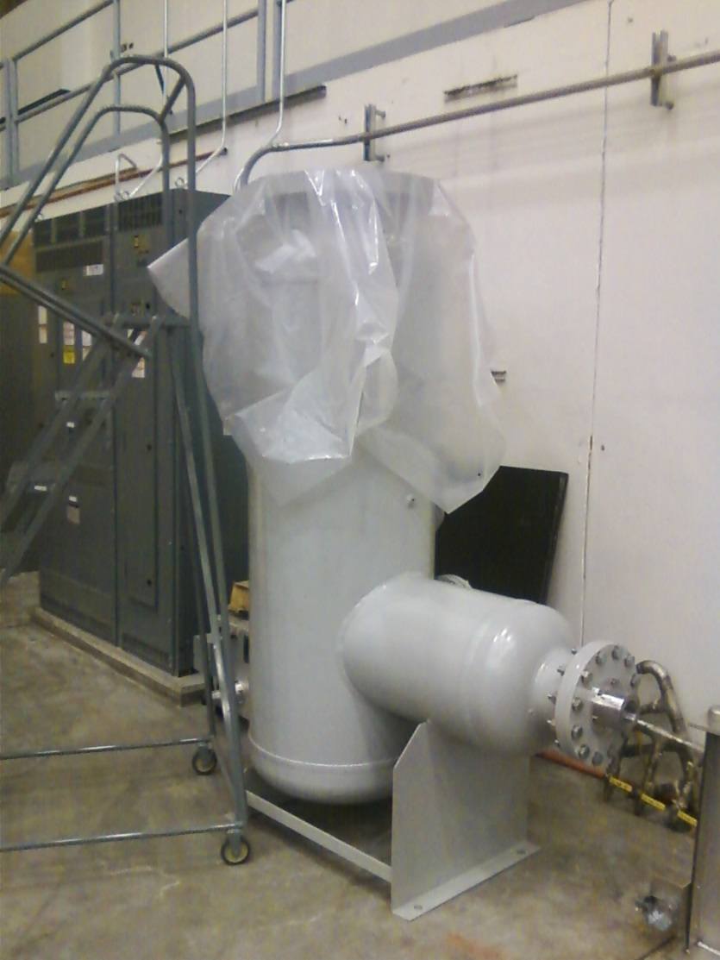
UITF High Voltage Power Supply
J. Hansknecht putting UITF 400 kV power supply together, inside SF6 tank

Slide 17
Milestones Update
WBS | Item | Milestone Description | Start Date | Projected Finish | % Complete | Days Float? | Change (%) | Change (Days)
1.04.xxx | Facilities | Civil work complete | 6-4-15 | Feb 2016 | 50% |  | 10 to 50%
 | Gun | Demonstrate gun ok at 350 kW at FEL GTS |  | Dec 2015 | 80% |  | 0
 | CM | Commission cold ¼ CM, no beam |  | Jan 2016 | 20% |  | 10 to 20%
 |  | Beam from Gun to Cup in front of ¼ CM |  | Mar 2016 | 20% |  | 10 to 20%
 |  | Beam thru ¼ @ MeV energy delivered to cup in front of HDIce |  | Jun 2016 | 0
 |  | Beam to HDIce |  | Aug 2016 | 0
Tom Renzo happy with ODH vent plans, now working on aspects of Cave2 structure, taking credit for Electricity procurement
Not as much progress on Gun Plan Y: my guys working on LERF, bubble chamber and CEBAF

Slide 18
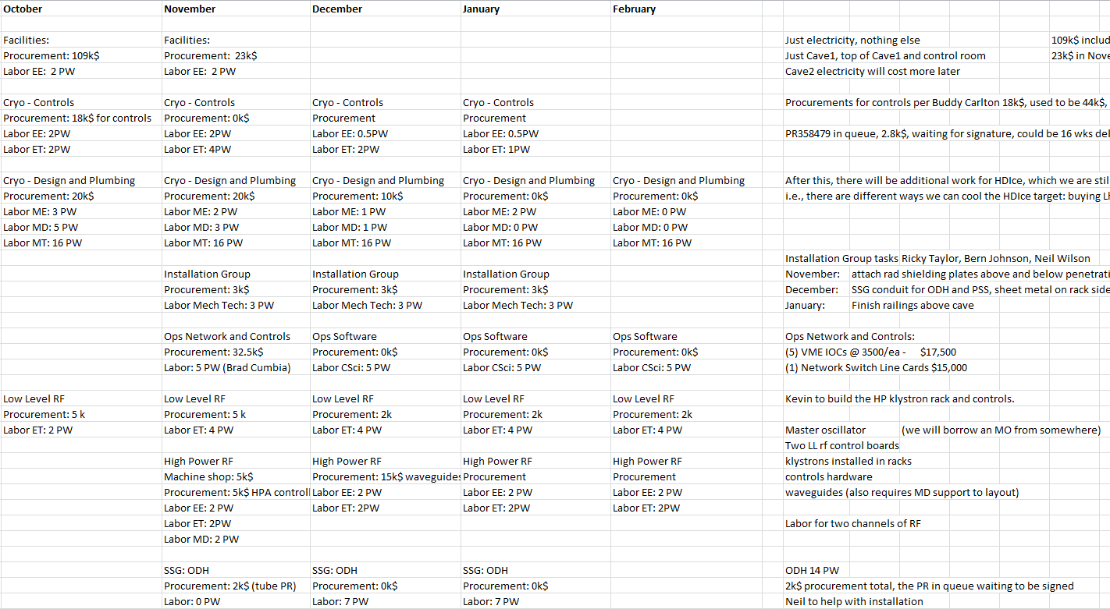
Month by Month Spending Profile

Slide 19
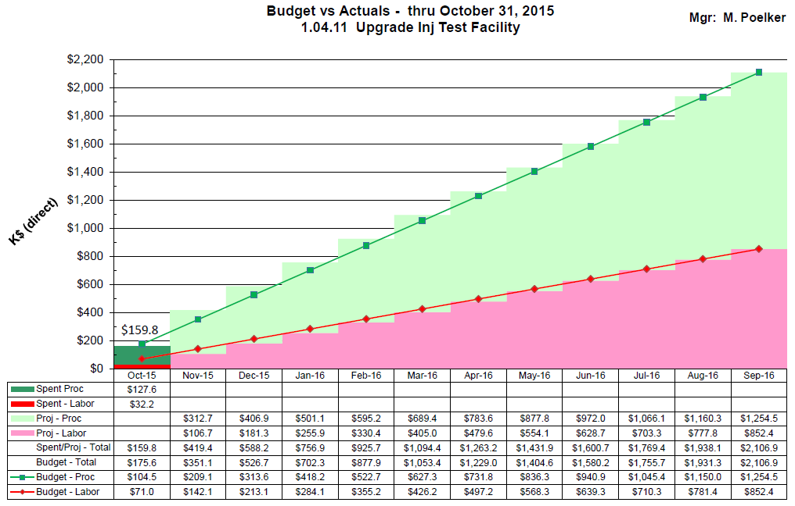

Slide 20
Proposed re-scoping
Cryo Infrastructure
HDice
New UITF
Facilities
Cryo Infrastructure including some RF
HDIce/Polarized Target Beamline
New UITF
Facilities

Slide 21
Four “Fences”
Facilities (fairly well defined)
$269k and 34 PW
Cryo Infrastructure (some confusion over procurements, lots of labor)
$68 to 139 and 111 PW for cryo portion
$41k and 34 PW for klystron portion
HDIce/Polarized Target Beamline
$130k
New UITF
$467k (I’ve double counted procurements…number too large)

Slide 22
Schedule Ramifications
Current status:
Installation Group, under auspices of Safety, continues to do truly useful work (racks, penetrations, shielding, PSS conduit)
T. Renzo has submitted Cave2 structural package for review, but not in Rusty’s budget scope
Jason W. thinks electricity can be supplied to racks by end of December. Hope network PR can get approved
Cryo still thinks they can have the old transfer lines removed and some portion of new plumbing installed by end of 2015. This let’s my group begin installing keV beamline starting January. Creel would love to get past UITF. UITF cryo controls and CTF upgrade are intertwined….
Source group making progress on gun at LERF GTS
Will Oren and HDIce have created spec for purchasing helium (our dewar approach to cooling HDIce)
Oren and Areti finalizing ODH assessment (ODH0)

Slide 23
Schedule Ramifications
Current status:
Proposed re-scoping into four “fences”: Facilities, Cryo infrastructure including high power RF, HDIce/Polarized Target Beamline, and new-UITF
Facilities and Cryo fairly well defined. Need to itemize the HDIce and new-UITF costs.
Waiting for charge codes…
I think schedule has slipped by at least two months
No final word yet on CTF schedule, or whether Physics will support HDIce budget request for required work that precedes beam tests at UITF. These factor help gauge the relevance of August 2016 schedule milestone.

Slide 24
Schedule Ramifications
Recall, next big milestone…commission ¼ CM (no beam), scheduled for Feb. 2016 (cryo, ODH, LL and HP RF, software, adequate shielding, EHS&Q approvals)
This requires:
Klystron rack finished, R. Nelson building control panel, rf procurements approved
Low level rf boards complete, installation in racks begins
IOCs installed, Software group installing software
Installation group working opportunistically: shield plates, PSS conduit, cable trays, waveguides, vent stacks for relief valves
Safety System Group working on ODH system
Cryo group installing new transfer lines…
Procurements for Cryo control system approved, installed

Slide 25
Schedule Ramifications
Commission ¼ CM (no beam), scheduled for Feb 2016
Electric/FM – ($78k + $23k for com. conduit) 101 k$
Control room – -
SRF checkout of ¼ CM present condition – -
Low Level RF – 16 k$
High Power RF – 25 k$
Network controls – 33 k$
Software control of RF – -
adequate shielding (Cave2 with a roof) – -
Cryo – (controls and pipe) 68 +/- k$
Installation group 9 k$
ODH - SSG 2 k$
EHS&Q approvals… -
Total 254 k$

Slide 26
Status Cryo
Related to ¼ Cryomodule
A challenge: appreciating the best way to connect to CTF, so as not to do it again
How to cool HDIce (need to downselect)
“Parking” the ¼ CM can influence design
Anticipated CTF upgrades
Related to HDIce
Purchase LHe (expensive), Cryo group provides dewars (was our Plan A), connect HDIce to CTF
Message1: Need to stop thinking and start marching
Message2: 4K cold box work scheduled for August 2016

Slide 27
Labor-focused Tasks
Installation Group
Cable trays, PSS conduit, penetration shielding, rack prep in advance of electric work, removal of rails and LCW piping Cave2, silver solder the quad magnet cooling tubes, waveguides
Have our electricians install network cable
Ops staff to install network switches, IOCs and software
Magnet Mapping, quads and solenoids
Mechanical Design: finish keV region, resume MeV region design
DC Power: refurbish the racks for trim cards, re-install trim cards
Low Level RF – finish construction of rf control boards
High Power RF – work on the control panel and klystron rack
Cryo: remove old transfer lines, install new ones, controls

Slide 28
Summary
Doing what we can without spending much money
I will go over the procurement and labor estimate again, group by group
Waiting for guidance

Slide 29
Backup Slides
Backup slides from past meetings, P&C meetings

Slide 30
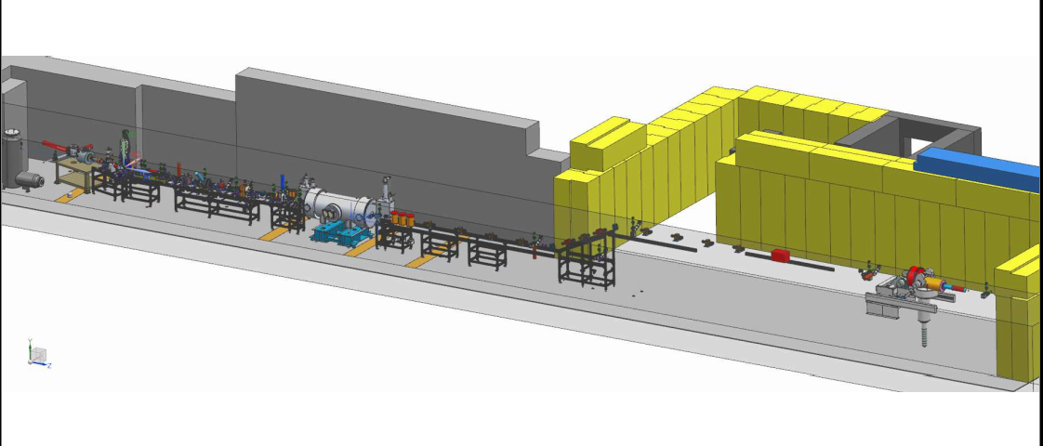
Design work was stopped…would like it to continue

Slide 31
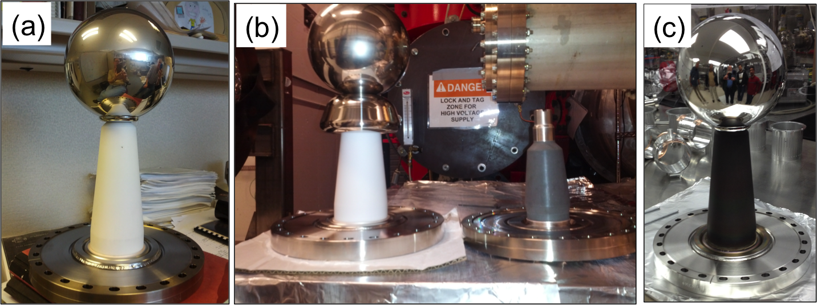
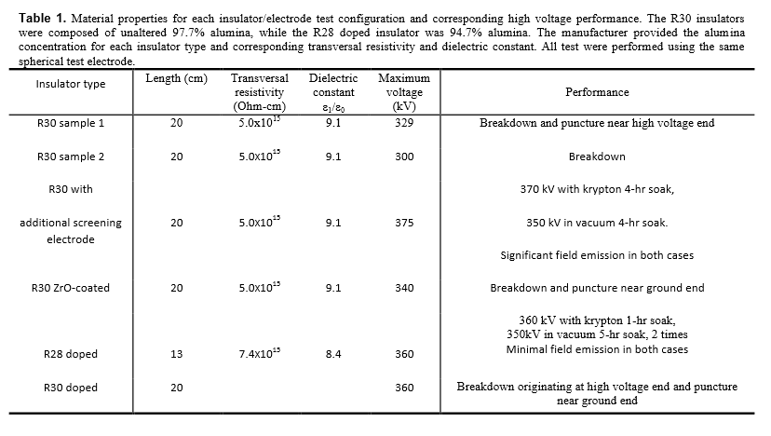
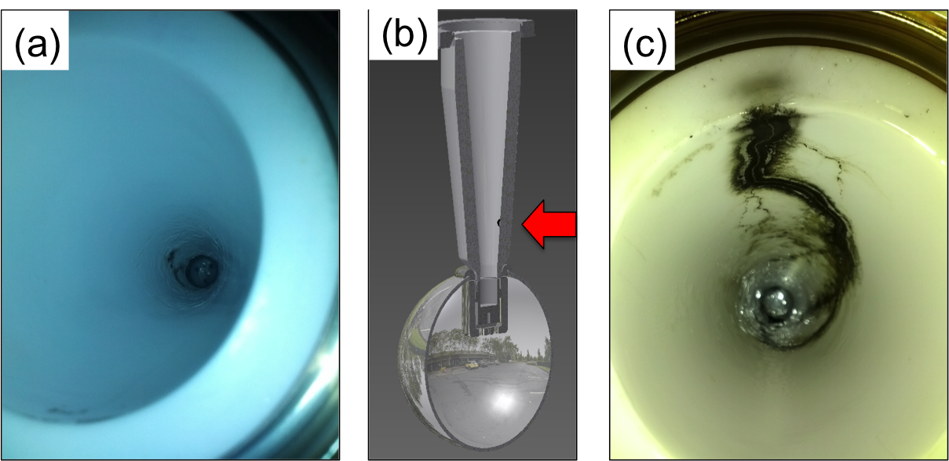
Notes:
Interior Page Design 2

Slide 32
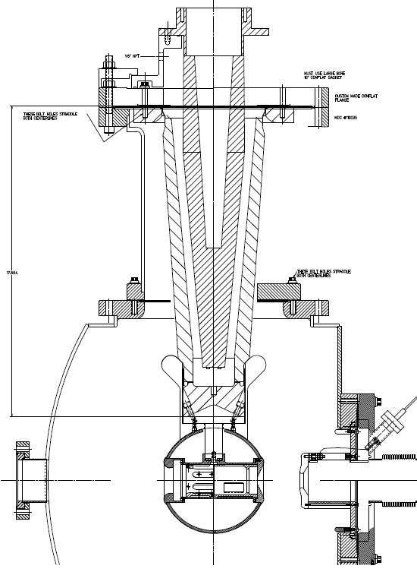
R350 epoxy receptacle
…then in October
Combination of doped insulator and shed, SF6 and epoxy receptacle, plus added length
Yan Wang has modeled the shed, a good design…
SF6
Doped insulator
“Shed” triple-point protection

Slide 33
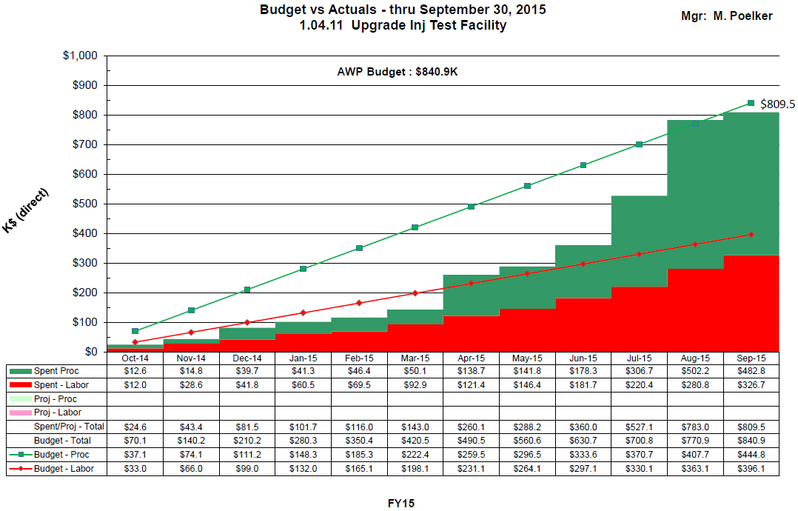
Carryover = $81k
Cancelled $71k trim card PR

Slide 34
FY16 Procurements?
 | ~ required | spent in FY14 FY15 | To purchase in FY16
Facilities: | 300 | 56.2 | 245
Cryo | 90.8 | 0 | 90.8 | waiting for update
RF | 252.5 | 121.4 | 131.1
Gun | 451.2 | 265.5 | 130 | includes beamline components + contract designer
I&C | 219.5 | 7.6 | 211.9 | Hope to reduce this number using PLC technology
SSG | 45.7 | 1 | 44.7
DC power | 144.5 | 100 | 8 | Trim cards…
Magnets | 120 | 119.3 | 0 | shop to make quads, assumed 100k but could be less Still need three dipoles
Network | 58 | 58 | 0
Total | 1682 | 671 | 862 | Of course, hope the number comes in lower: 750 k$

Slide 35
Original vs Current Cost Estimate
Presented at UITF meeting May 13, 2015:
Direct $
Loaded $
Original Est. by Hari Areti |  | FTEs | Labor | Proc | Total |  | Labor | Proc | Total
on 2-7-2014 | FY14 | 3.7 | 462.54 | 478.95 | 941.49 |  | 682.70 | 671.23 | 1,353.94
 | FY15 | 2.5 | 312.08 | 557.10 | 869.18 |  | 465.00 | 830.07 | 1,295.07
 | FY16 | 0 | - | - | - |  | - | - | -
 | Total | 6.2 | 774.62 | 1,036.05 | 1,810.66 |  | 1,333.458 | 1,501.306 | 2,649.011
Revised Est. |  | FTEs | Labor | Proc | Total |  | Labor | Proc | Total
by Matt Poelker | FY14 | 1.2 | 160.32 | 189.48 | 349.80 |  | 233.08 | 274.29 | 507.37 | 47.6%
on 5-13-2015 | FY15 | 8.6 | 937.36 | 611.17 | 1,548.53 |  | 1,396.67 | 907.95 | 2,304.62 | 49.0%
 | FY16 | 7.9 | 940.39 | 881.33 | 1,821.72 |  | 1,422.80 | 1,333.46 | 2,756.26 | 51.3%
 | Total | 17.7 | 2,038.07 | 1,681.98 | 3,720.05 |  | 3,052.56 | 2,515.70 | 5,568.26
Dfference from original estimate |  | (11.5) | (1,263.46) | (645.93) | (1,909.39) |  | (1,719.10) | (1,014.40) | (2,919.25)
Total cost estimate. The specific allocations for FY15 and 16 are not correct

Slide 36
Revised Estimates Breakdown
Original request to DOE: $2.6M (loaded)
Current estimate for completion: $5.6 M (loaded)
Delta increase of $2.9M (loaded)
Labor estimates
Underestimated effort by 11.5 FTEs
Increased labor by $1.7M (loaded)
Procurements
Underestimated by ~$1M (loaded)
Several sub-system components were not included in the original estimate and later determined were necessary to complete the scope

Slide 37
Comparison Procurement Estimates (Direct $)
System | Prev | Now | Delta | Comment
Facilities | 305 | 300 | -5 | (numbers are Proc and Labor)
Safety System | 59 | 46 | -13
RF Systems | 125 | 253 | +128 | rf control boards, klystron PS
Cryogenics | 40 | 91 | +51 | Pipe, heat exchanger
Polarized Source | 255 | 262 | +7 | Gun insulators, beamline parts
I&C | 131 | 220 | +89 | BPMs, viewers, picoammeters
DC Power | 0 | 145 | +145 | Trim cards and parts
Magnets | 58 | 120 | +62 | Addl. quads, correctors, dipoles
SRF | 50 | 0 | -50
HDIce | 5 | 0 | -5
Network, IOCs | 0 | 58 | +58
CIS FY14 Actuals | 0 | 189 | +189 | FY14 actuals
Total | 1,028 | 1,684 | +656

Slide 38
FY14 and FY15 UITF Procurements
FY14 |  |  |  | FY15 |  |  | Addl. expected FY15 procurements
Solid Works CAD |  | 2.2 |  | Insulator flange | 1 |  | Contract Mech Designer | ~ 30
450kV HV power supply |  | 31.1 |  | bpm components | 7.6 |  | stairs | ~ 20
semiconducting R30 insulators |  | 52.6 |  | semiconducting R30 insulators_v2 | 22.3 |  | trim cards | ~100
gun HV chamber |  | 7.8 |  | Klystron HV power supply | 55.5 |  | quad magnets (machine shop) | 70 to 130
ion pumps |  | 15.1 |  | concrete wall removal | 32 |  | Chopper rf amplifiers (x2) | 44
beamline Y chamber |  | 5 |  | LLRF parts | 15.1 |  | water skid for chopper | 3
photocathode prep chamber |  | 4.5 |  | steering magnets | 19.3 |  | keV beamline support structure | 6.5
drill penetrations in concrete |  | 4.2 |  | SF6 tank | 11.3 |  | Addl. FY15 procurement total | 303.5
assorted |  | 3.9 |  | waveguide | 3.8
Credit card |  | 21.8 |  | SSG sensor | 1
Machine shop |  | 40.8 |  | assorted | 9.4
total | 189 |  |  | total | 178.3
FY14 + FY15 Procurements: 670.8
UITF Total Procurements 1682

