Slide 1
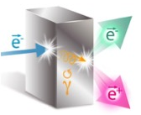
Production of Highly Polarized Positrons Using Polarized Electrons at MeV Energies
(…or why polarized positrons are like Red-Billed Oxpeckers)
Joe Grames
Center for Injectors & Sources, Jefferson Laboratory
University of Illinois Alumnus
On Behalf of the PEPPo Collaboration

Slide 2
Outline
Motivation
PEPPo Experiment
Polarized Positron Accelerator R&D
Summary
Jefferson Lab Positron Working Group
J. Grames, SPIN 2016 @ UIUC, Sep 26-30 2016
2

Slide 3
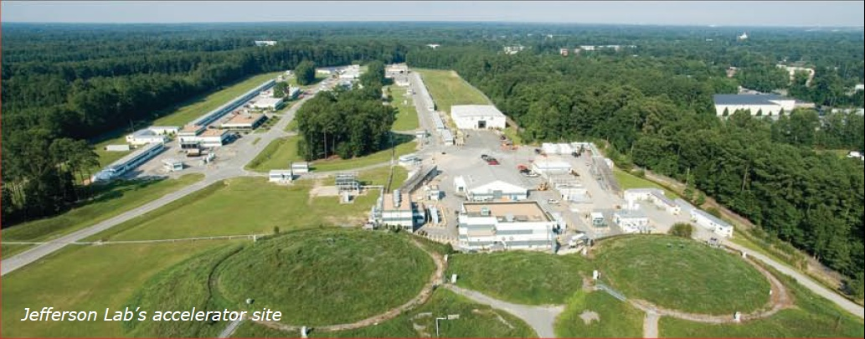

Polarized Positron Beam Applications
Jefferson Lab’s CEBAF Accelerator
CW electron beams to 4 Halls
Electron Polarization 85-90%
Max Energy: 11 GeV(ABC) / 12GeV(D)
Max Current: 85 μA
Beam Quantity | User Interest
Intensity | > 10 nA
Duty Factor | 100 % (cw)
Bunch Frequency | 499 MHz (or sub-harmonic)
Polarization | > 50 %
Helicity | Rapid reversal (> 30 Hz)
CEBAF physics would benefit from a polarized positron beam:
  Interference (Two Photon, GPD’s, WNC)
  Standard Model Test (Dark Matter, C_{3q})
Other facilities may benefit from polarized positrons:
  Electron Ion Collider (spin EMC, Strange/Charm PDF’s)
  Low Energy Source (spintronic devices, ferromagnetics)
The charge and polarization of the probe beam provide degrees of freedom which isolate physical observables of great interest.
J. Grames, SPIN 2016 @ UIUC, Sep 26-30 2016
3
3

Slide 4
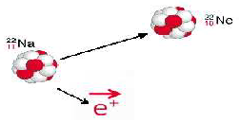




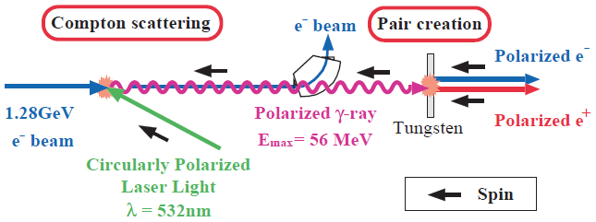
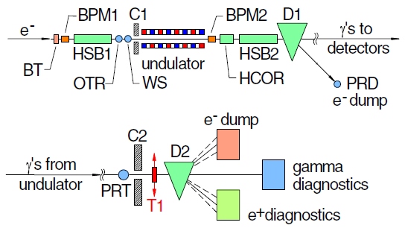
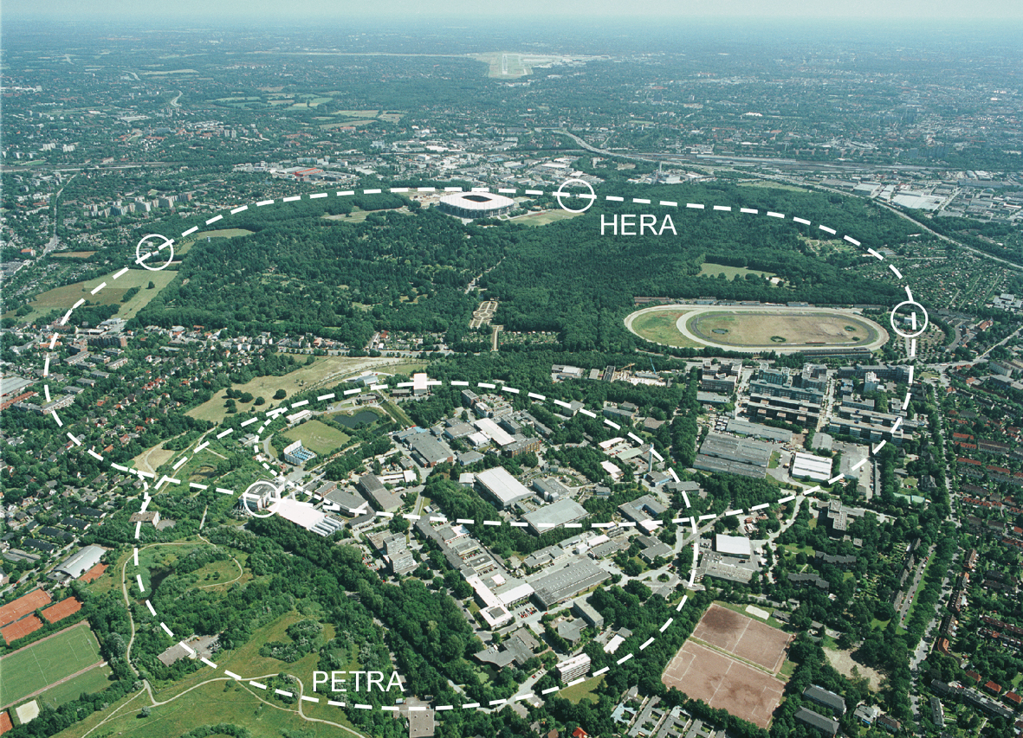
Polarized Positron Options
Polarized β⁺ Decay
L.A. Page & M. Heinberg. Phys. Rev.
106(6):1220-1224 (1957)
Sokolov-Ternov Effect
D. Barber , AIP Conf. Proc. 588, 338 (2001)
HERA 27.5 GeV e+/e-
Polarized due to parity non-conservation in the weak interaction
P(e⁺) ~ 40 %
P(e⁺) ~ 70 %
Compton Backscattering (KEK)
T. Omori et al, PRL 96 (2006) 114801
Helical Undulator (SLAC E166)
G. Alexander et al, PRL 100 (2008) 210801
47.7GeV
P(e⁺) = 73 ± 15_{(stat)} ± 19_{(syst)} %
P(e⁺) = 80 ± 7_{(stat)} ± 9_{(syst)} %
J. Grames, SPIN 2016 @ UIUC, Sep 26-30 2016
4

Slide 5



Polarized Electrons for Polarized Positrons
E.G. Bessonov, A.A. Mikhailichenko, EPAC (1996) A.P. Potylitsin, NIM A398 (1997) 395
Bremsstrahlung
Pair Creation
P_{circ}(γ) / P_{z} (e⁻)
P_{z} (e⁺) / P_{circ} (γ)
E_{γ} / T_{e-}
T_{e+} / (E_{γ} – 2m_{e+})
E.A. Kuraev, Y.M. Bystritskiy, M. Shatnev, E.Tomasi-Gustafsson, PRC 81 (2010) 055208
J. Grames, SPIN 2016 @ UIUC, Sep 26-30 2016
5
5

Slide 6
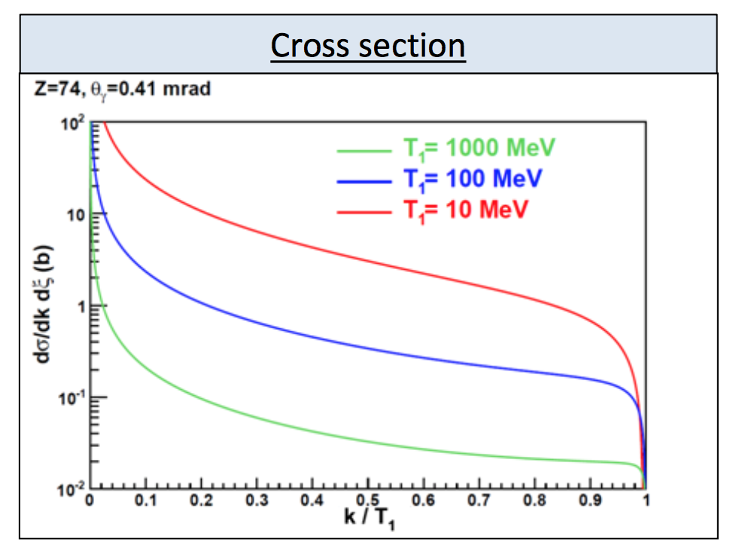
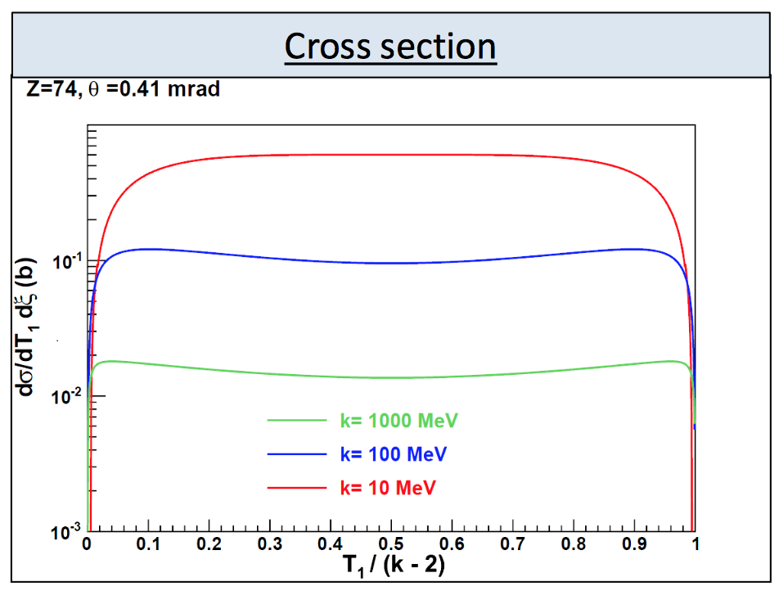
Positron Yield
Bremsstrahlung
Pair Production
Photon energy k up to electron energy T1
Cross section decreases as 1/k
Yield scales with electron energy T1
Positron energy T1 to photon energy k-2mc²
Cross section essentially energy independent
>10nA useful for CEBAF NP
J. Grames, SPIN 2016 @ UIUC, Sep 26-30 2016
6

Slide 7
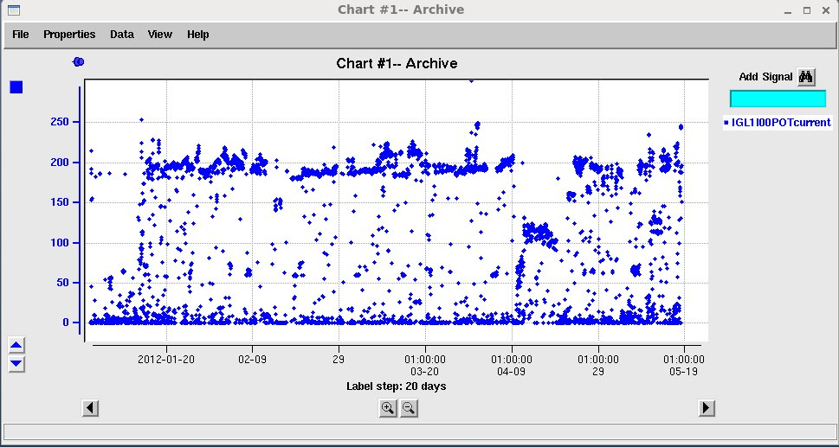
CEBAF GaAs Photocathode Evolution
Bulk GaAs
Strained GaAs:
GaAs on GaAsP
Superlattice GaAs:
Layers of GaAs on GaAsP
100 nm
100 nm
Gun ~200 μA for 4 months (QWeak)
2 μm
14 Layers
625 μm
350 μm
QE ~ 5%, 30 μA/mW
Pol ~ 35% @ 780 nm
QE ~ 0.2%, 1 μA/mW
Pol ~ 75% @ 850 nm
QE ~ 1%, 6 μA/mW
Pol ~ 85% @ 780 nm
P_{e-} 35% 35% 75% 75% 85% 89%
I_{e-} 30μA 100μA 50μA 100μA 150μA 200μA
1995 1998 1999 2000 2004 2012 2016
Spin Polarized program at JLab (particularly our PV Users) have
driven the need for improved performance over last 20+ years
J. Grames, SPIN 2016 @ UIUC, Sep 26-30 2016
7

Slide 8
Polarized Electron Source Intensity Frontier
Parameter | Value | Value
Laser Rep Rate | 499 MHz | 1500 MHz
Laser Pulse Length | 30 ps | 50 ps
Laser Wavelength | 780 nm | 780 nm
Laser Spot Size | 0.45 mm | 0.35 mm
Photocathode | GaAs/GaAsP | GaAs/GaAsP
Gun Voltage | 100 kV | 200 kV
Beam Current | 1 mA | 4 mA
Run Duration | 8.25 hr | 1.4 hr
Extracted Charge | 30.3 C | 20 C
Charge Lifetime | 210 C | 80 C
Fluence Lifetime | 132 kC/cm² | 83 kC/cm²
Bunch Charge | 2.0 pC | 2.7 pC
Peak Current | 67 mA | 53 mA
Peak Current Density | 42 A/cm² | 55 A/cm²
SLAC: First GaAs photogun
JLAB: Low-P Bulk GaAs
JLAB: High-P GaAs/GaAsP
Intensity (mA)
Year
Sustained operation (e.g. 1 mA ~ 86 C/day) requires improving charge lifetime.
J. Grames et al., PAC07, THPMS064
R. Suleiman et al., PAC11, WEODS3
J. Grames, SPIN 2016 @ UIUC, Sep 26-30 2016
8

Slide 9
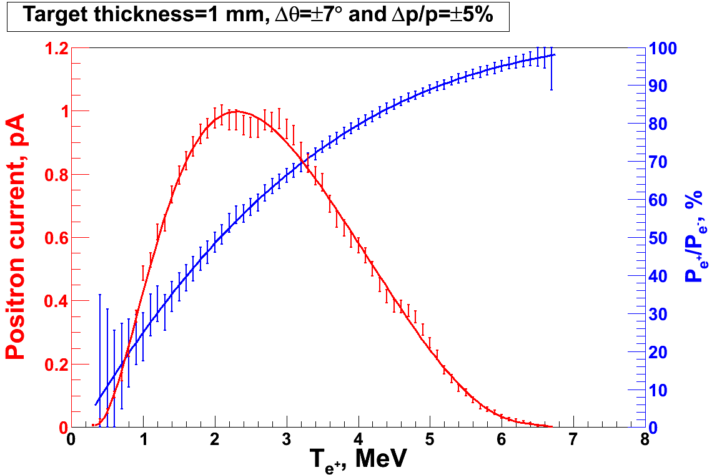
Measuring Polarization Transfer <10 MeV
Geant4
Polarized Electrons
(< 10 MeV/c) strike production target
Positron Transverse and Momentum Phase Space Selection
J. Dumas, PhD Thesis (2011)
E_{e} = 6.3 MeV
I_{e} = 1 µA
T₁ = 1 mm W
P_{e-}
S₁
e⁻
D
T₁
PEPPo
COMPTON TRANSMISSION
Polarized e⁺ convert into polarized γ (P_{γ}) whose transmission through a polarized iron target (P_{T}) depends on P_{γ}.P_{T}
BREMSSTRAHLUNG
Longitudinal e⁻ (P_{e-}) produce elliptical γ whose circular (P_{γ}) component is proportional to P_{e-}
PAIR PRODUCTION
In the same target, γ produce e⁺e⁻ pairs and transfer Pγ into longitudinal (P_{e+}) and transverse polarization averages to zero
S₂
P_{e+}
P_{T}
D
Calorimeter
e⁺
T₂
Compton Transmission Polarimeter
PEPPo measured the longitudinal polarization transfer from 8.25 MeV/c e⁻ to e⁺ in the 3.07-6.25 MeV/c momentum range.
J. Grames, SPIN 2016 @ UIUC, Sep 26-30 2016
9

Slide 10
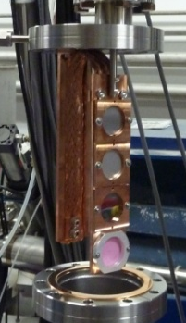

PEPPo @ CEBAF Injector
Compton
Polarimeter
(DESY/Cornell)
Pair
Creation
Target
Mott
Polarimeter
Positron Collection
Magnets
(Princeton/SLAC)
J. Grames, SPIN 2016 @ UIUC, Sep 26-30 2016
10

Slide 11
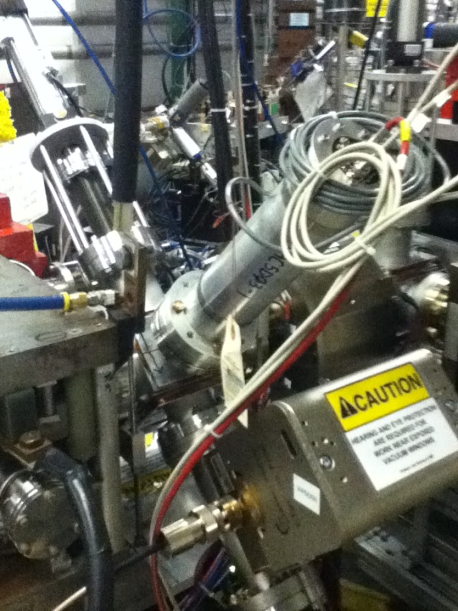
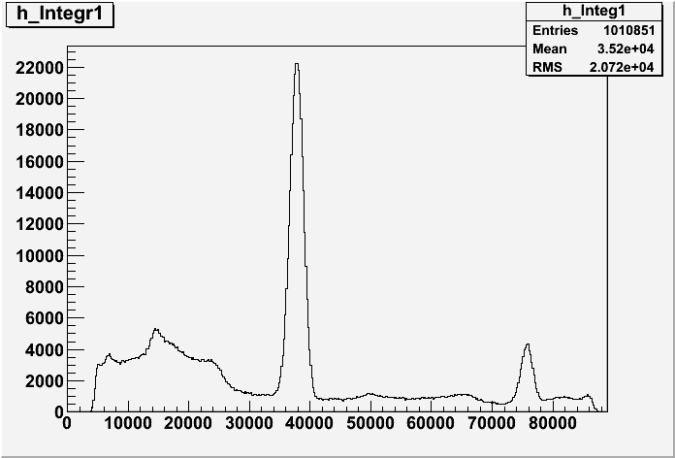
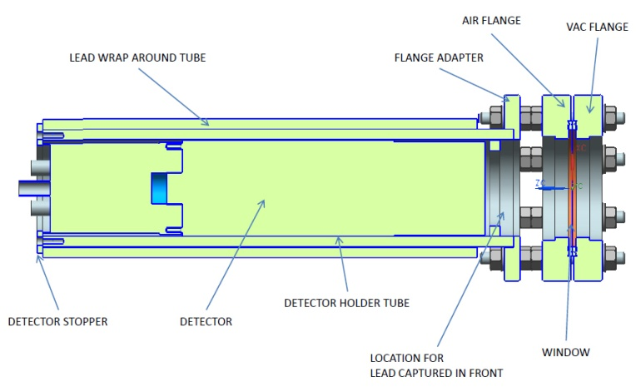
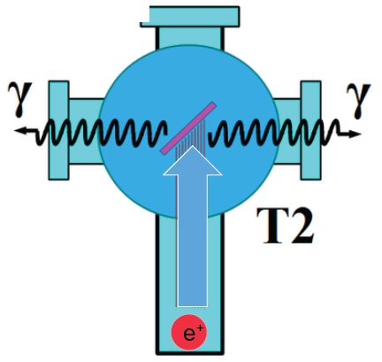
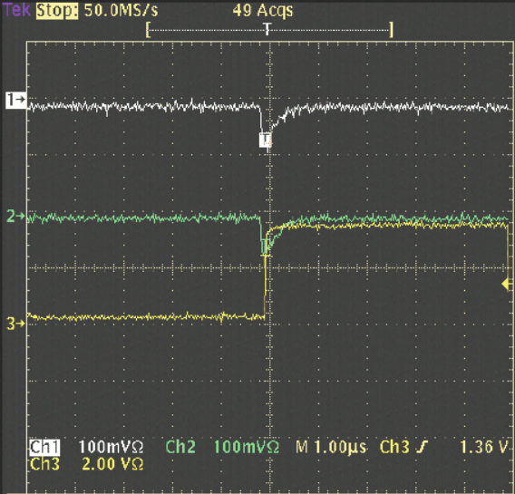
Positron Detection
Positron Collection
Two NaI detectors measured coincidence of back-to-back photons emitted by annihilation of positrons in a viewscreen.
S₁
e⁻
e⁺
D
p_{e-}= 8.2 MeV/c
T₁
Na²²
S₂
D
e⁺
T₂
Viewscreen 0.011 thick @ 45 deg to beam line
99.5% aluminum oxide Al₂O₃
0.5% chromium doped Al₂O₃/Al₂O₃Cr₂O₃
4 MeV/c e+
11
J. Grames, SPIN 2016 @ UIUC, Sep 26-30 2016
11

Slide 12
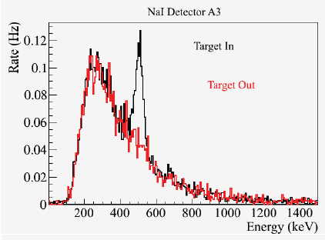
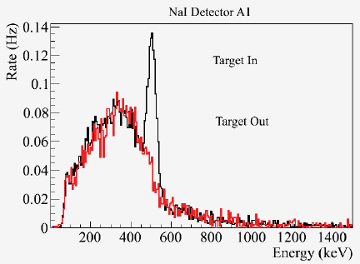
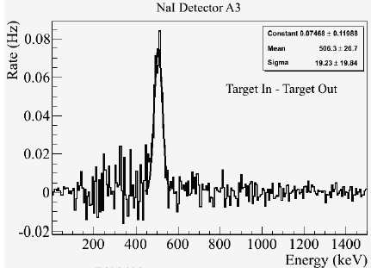
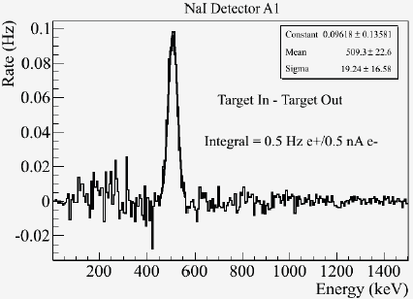
Positron Yield
Detected e+ rate (1 e⁺ per 10⁹ e⁻)
Solid Angle (0.1 sr)
GEANT annihilation probability (1/400)
Coincidence detector efficiency (0.49 @ 511keV)
1 e⁺ per 10⁵ e⁻
12
J. Grames, SPIN 2016 @ UIUC, Sep 26-30 2016
12

Slide 13
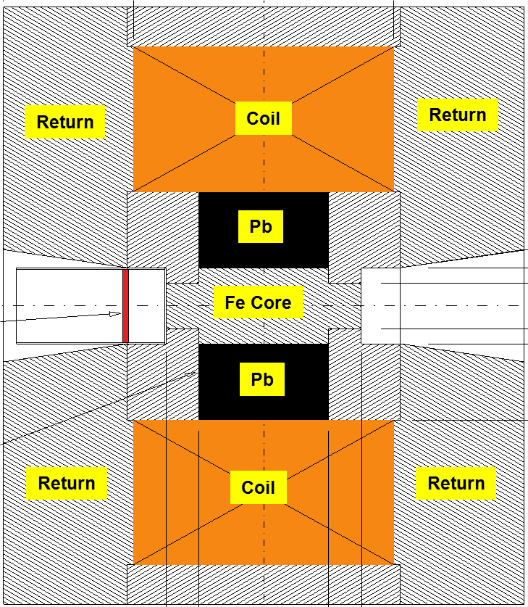
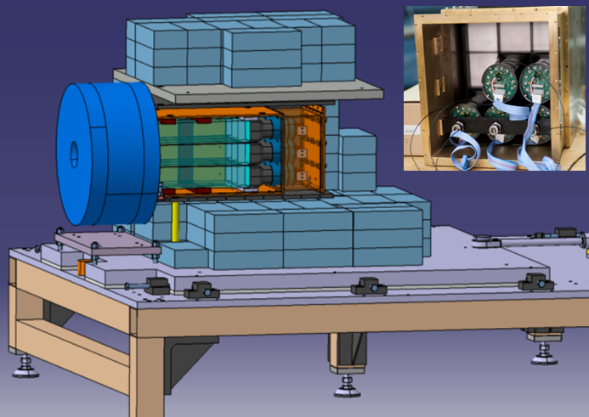
Compton Transmission Polarimetry
Electrons or Positrons radiate polarized photons by Bremmstrahlung in reconversion target. Energy dependent Compton scattering of photons transmitted through polarized target correspond to polarization of incoming Electrons or Positrons (aligned or anti-aligned).
P_{e-}
e⁻
γ
P_{e+}
e⁺
Target (Densimet D17K) 90.5% W, 7%, 2.5% Cu
P_{T} = 7.06% ± 0.05% _{(sys1)} ± 0.07% _{(sys2)}
μ1 - Compton absorption coefficient
L - target length
P₃ - photon polarization (long.)
P_{e} - electron/positron polarization
P_{T} - target polarization
A_{e} - analyzing power
J. Grames, SPIN 2016 @ UIUC, Sep 26-30 2016
13

Slide 14
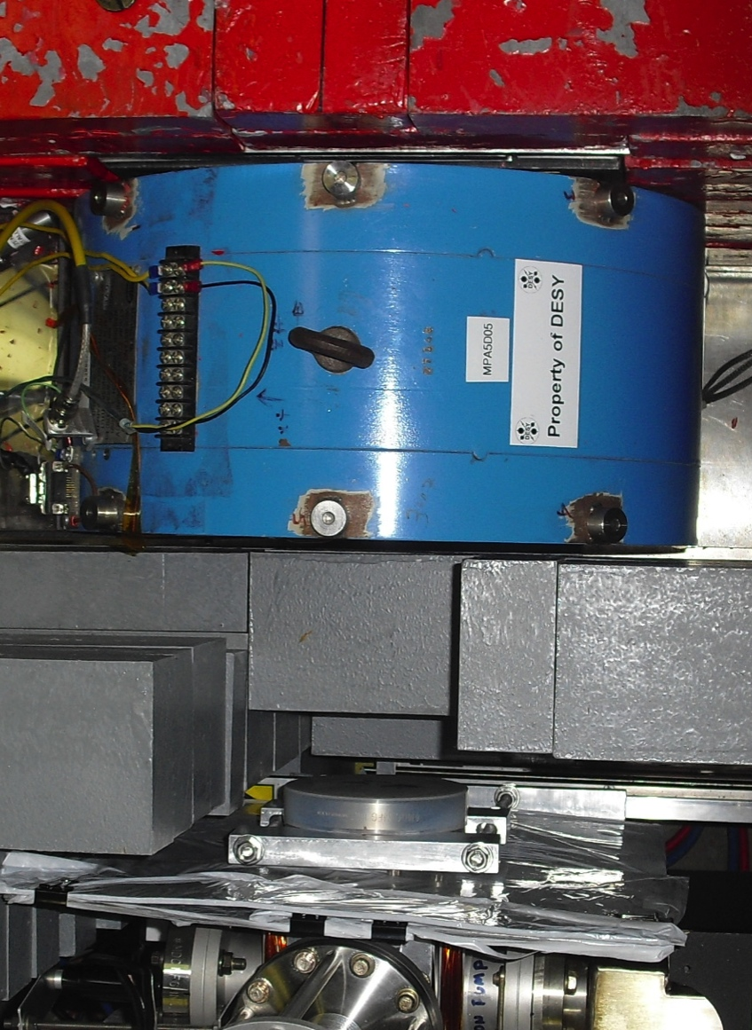
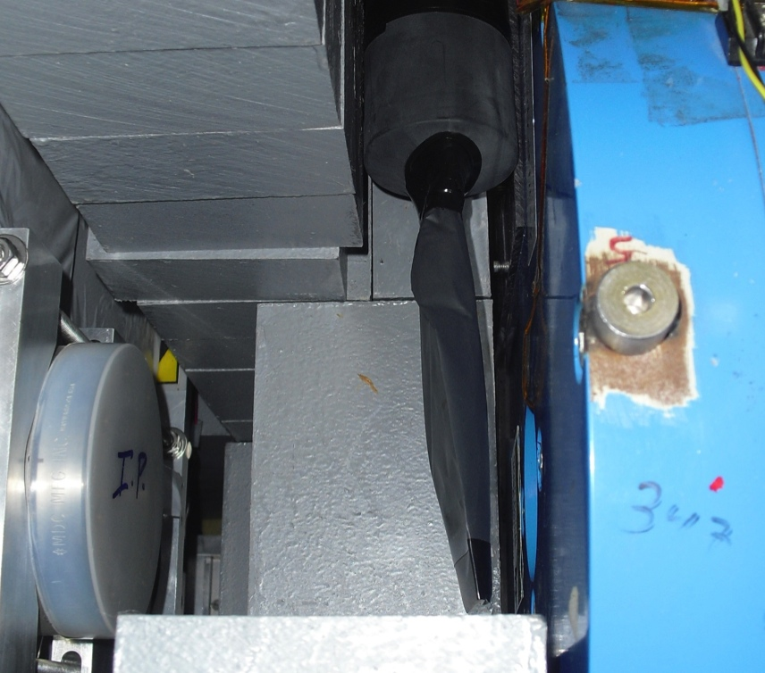
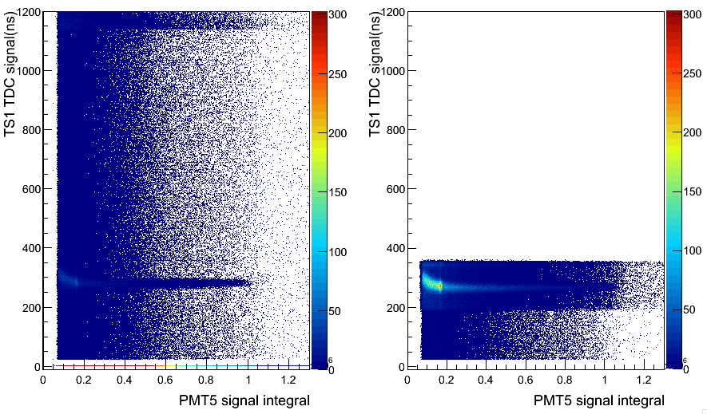
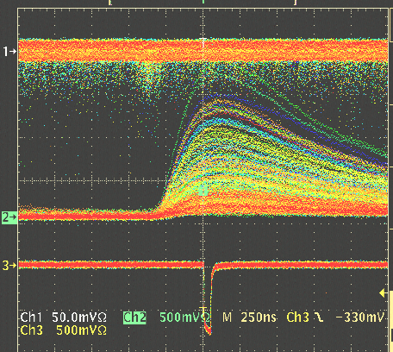
Positron Identification
Positrons are detected in coincidence between a thin trigger scintillator placed prior to the reconversion target and the central crystal and tagged by e- helicity.
C
A
L
O
R
I
M
E
T
E
R
e+
γ
WITHOUT
Coincidence
Reconversion
Target
10mil Al window
Trigger Scintillator
Trigger Scintillator
Calorimeter
WITH
Coincidence
Coincidence
J. Grames, SPIN 2016 @ UIUC, Sep 26-30 2016
14

Slide 15
Positron Energy Integrated Asymmetry
511 keV from e+ annihilation at rest
Bremsstrahlung
end-point
Energy (FADC units)
Accidentals
Time (TDC units)
J. Grames, SPIN 2016 @ UIUC, Sep 26-30 2016
15

Slide 16
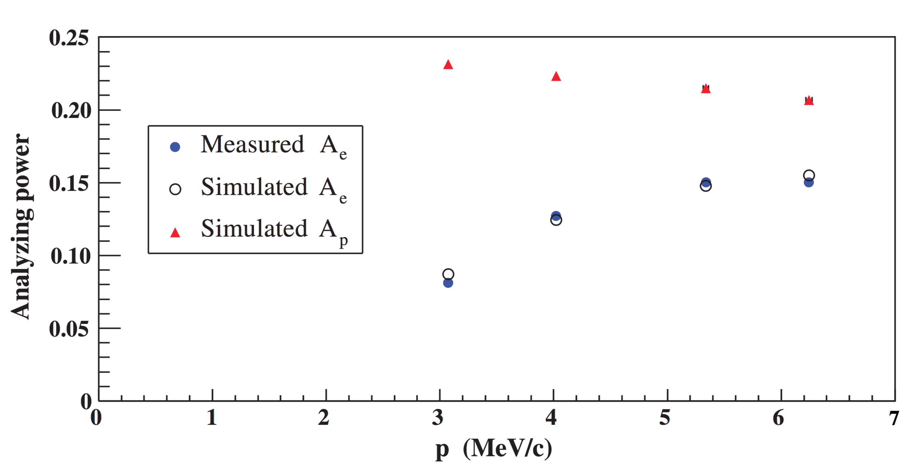
Electron/Positron Analyzing Power
Experimental measurements of electron analyzing power allows us to benchmark GEANT4 model of the PEPPo Compton transmission polarimeter for the purpose of simulating the positron analyzing power.
Electron calibration performed with precisely known electron beam energy/polarization, and target polarization:
Electron beam polarization
P_{e-} = 83.7% ± 0.6% _{(stat)} ± 0.7% _{(sys)}
Target polarization
P_{T} = 7.06% ± 0.05% _{(sys1)} ± 0.07% _{(sys2)}
P_{e} – e⁻/e⁺ polarization
P_{T} - target polarization
A_{e} - analyzing power
See A. Adeyemi talk for calibration of the Compton transmission polarimeter
J. Grames, SPIN 2016 @ UIUC, Sep 26-30 2016
16

Slide 17

Positron Polarization Results
Electron polarization (~85%) efficiently transferred from 8.2 MeV/c electron beam to positrons (measured 3.2 – 6.7 MeV/c).
e⁻ beam polarization
85.2 ± 0.6 ± 0.7 %
Whenever producing e⁺ from e⁻, polarization is coming for free
if initial electrons are polarized.
(PEPPo Collaboration) D. Abbott et al., Phys. Rev. Lett. 116 (2016) 214801
J. Grames, SPIN 2016 @ UIUC, Sep 26-30 2016
17

Slide 18
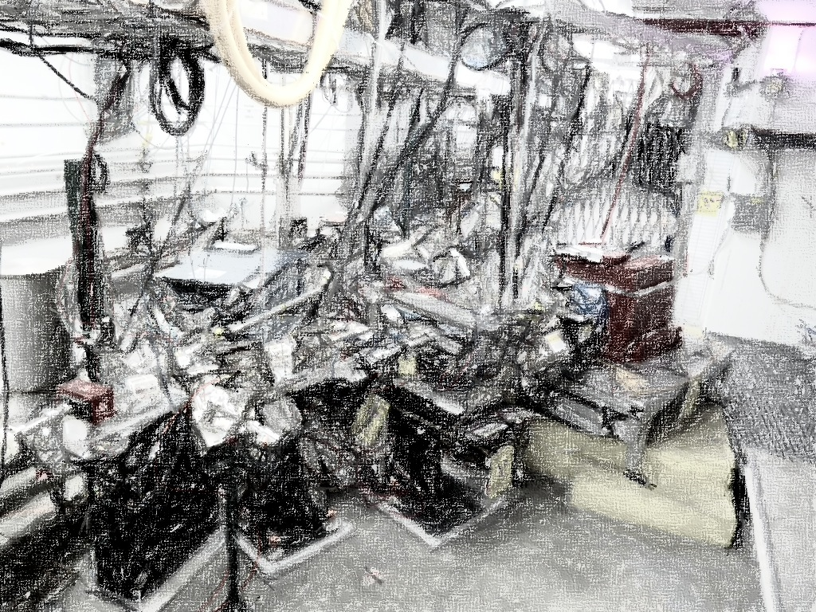
PEPPo Collaboration
P. Aderley¹, A. Adeyemi⁴, P. Aguilera¹, M. Ali¹, H. Areti¹, M. Baylac², J. Benesch¹,
G. Bosson², B. Cade¹, A. Camsonne¹, L. Cardman¹, J. Clark¹, P. Cole⁵, S. Covert¹,
C. Cuevas¹, O. Dadoun³, D. Dale⁵, J. Dumas^{1,2}, E. Fanchini², T. Forest⁵, E. Forman¹,
Freyberger¹, E. Froidefond², S. Golge⁶, J. Grames¹, P. Guèye⁴, J. Hansknecht¹,
P. Harrell¹, J. Hoskins⁸, C. Hyde⁷, R. Kazimi¹, Y. Kim^{1,5}, D. Machie¹, K. Mahoney¹,
R. Mammei¹, M. Marton², J. McCarter⁹, M. McCaughan¹, M. McHugh¹⁰, D. McNulty⁵, T. Michaelides¹, R. Michaels¹, C. Muñoz Camacho¹¹, J.-F. Muraz², K. Myers¹²,
Opper¹⁰, M. Poelker¹, J.-S. Réal², L. Richardson¹, S. Setiniyazi⁵, M. Stutzman¹,
R. Suleiman¹, C. Tennant¹, C.-Y. Tsai¹³, D. Turner¹, A. Variola³, E. Voutier^{2,11},
Y. Wang¹, Y. Zhang¹²
¹ Jefferson Lab, Newport News, VA, US ² LPSC, Grenoble, France ³ LAL, Orsay, France
⁴ Hampton University, Hampton, VA, USA ⁵ Idaho State University & IAC, Pocatello, ID, USA
⁶ North Carolina University, Durham, NC, USA ⁷ Old Dominion University, Norfolk, VA, US
⁸ The College of William & Mary, Williamsburg, VA, USA ⁹ University of Virginia, Charlottesville, VA, USA ¹⁰ George Washington University, Washington, DC, USA ¹¹ IPN, Orsay, France
¹² Rutgers University, Piscataway, NJ, USA ¹³ Virginia Tech, Blacksburg, VA, USA
Many thanks for support from SLAC E166, DESY, Princeton, Cornell, International Linear Collider Project and Jefferson Science Associates
J. Grames, SPIN 2016 @ UIUC, Sep 26-30 2016
18

Slide 19

Polarized Positrons at JLEIC
A group (J. Grames, J. Guo, F. Lin, V. Morozov, E. Voutier, Y. Zhang) is exploring a polarized positron injector suitable for Jefferson Lab Electron Ion Collider (JLEIC).
L ≥10³³cm⁻²s⁻¹ P_{e+}≥40%
(An Early Career Award proposal will be submitted.)
Bunch structure from the injector:
See F. Lin’s talk: Spin dynamics at Jefferson Lab Electron Ion Collider (JLEIC)
68.1 MHz bunch train, 1.6 us
110 bunches (I = 4.6 uA)
67 fC
×30
A pulsed positron beam with low average current (>10 nA) is required for injection into JLEIC with a reasonably short injection time (minutes) and reasonably high equilibrium polarization (>40%).
…
35 μs
1.05 ms
20 ms
~ 50 Hz, I_{ave}= 10.5 nA
J. Grames, SPIN 2016 @ UIUC, Sep 26-30 2016
19

Slide 20
JLEIC/CEBAF Positron Injector
Polarized
Electron
10 MeV Injector
500-Turn
Accumulator Ring
(22m)
Harmonic
Extraction Ring
(22m)
Positron Conversion/Collection Efficiency ~ 10⁻⁴
Bunch
Management
to CEBAF/JLEIC
10 MeV polarized e⁻
1.33 pC @ 1500 MHz
10 MeV pol e⁻
0.67 nC bunches
@ 1500 MHz
10 MeV polarized e⁻
0.67 nC @ 68.1 MHz
5-7 MeV Polarized e⁺
67 fC @ 68.1 MHz
 | Polarized Electron Source | Accumulator/ Extractor Rings | Electrons at Converter | Polarized Positron Source | R&D Challenge
JLEIC | Ave = 100 uA 1.33 pC @ 1500 MHz 2 mA w/ DF=5% | Ave = 1 A 1500 MHz | Ave = 100 uA 68.1 MHz 44 mA @ DF=0.23% | Ave = 10 nA 68.1 MHz 4.4 uA @ DF = 0.23% | Electron accumulator Harmonic extraction Target: 440kW peak
CEBAF | Ave = 1-10 mA 4-40 pc @ 250 MHz (cw) | Not Necessary | Ave = 1-10 mA 250 MHz (cw) | Ave = 100nA - 1 uA 250 MHz (cw) | High-QE photocathode High voltage gun Target: 10-100 kW ave
J. Grames, SPIN 2016 @ UIUC, Sep 26-30 2016
20

Slide 21
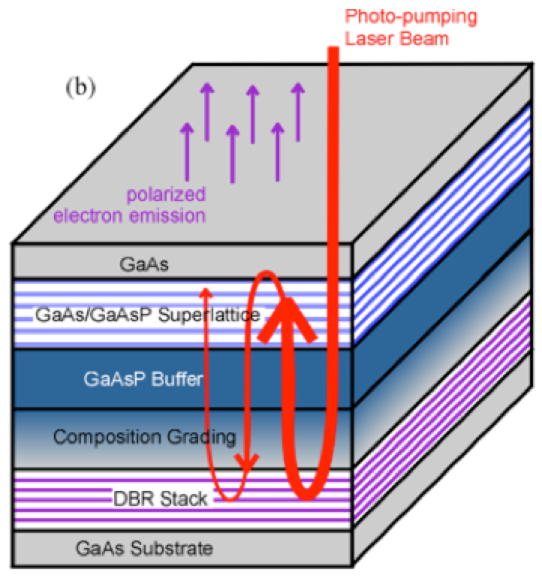
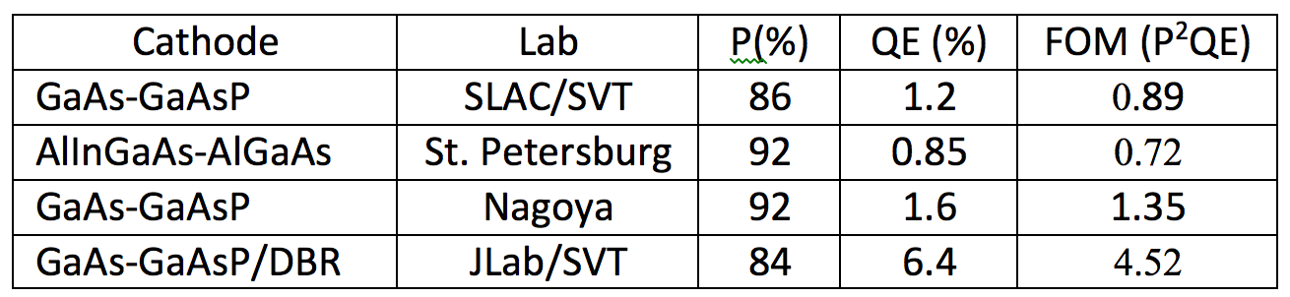
High Polarization Photocathode R&D
6.4% QE & 84% polarization at 776 nm from strained GaAs/GaAsP superlattice photocathode with GaAsP/AlAsP Distributed Bragg Reflector (DBR)
The highest QE & FOM of any reported high polarization photocathode
Possible to improve both QE & Pol
SBIR partnership
See talk by W. Liu talk
Photo-cathode
DBR
Substrate
Paper ready for SPIN and APL submission: W. Liu, S. Zhang, M. Stutzman, M. Poelker, Y. Chen, W. Lu, and A. Moy
J. Grames, SPIN 2016 @ UIUC, Sep 26-30 2016
21

Slide 22
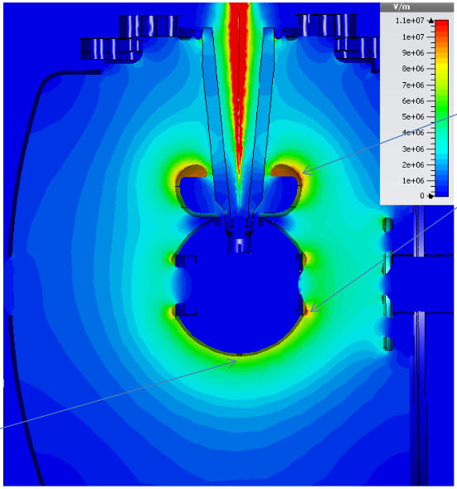
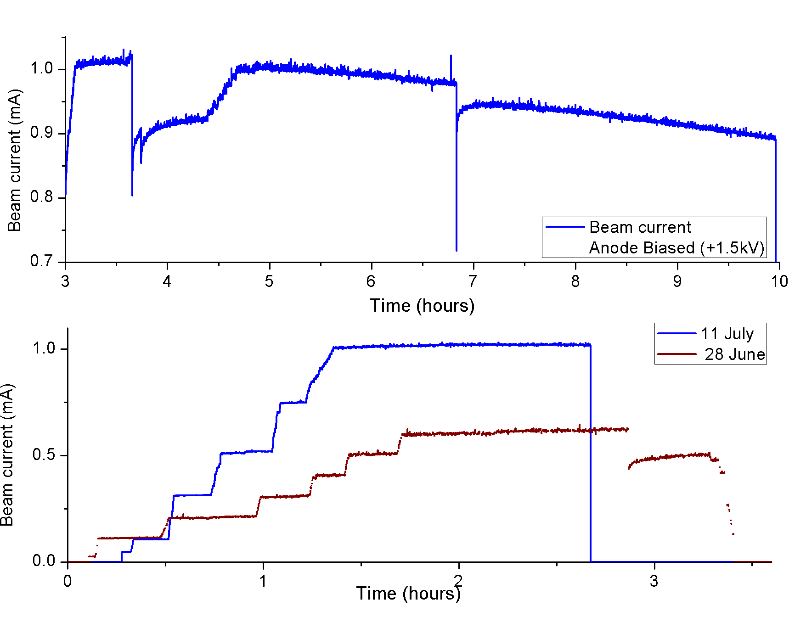
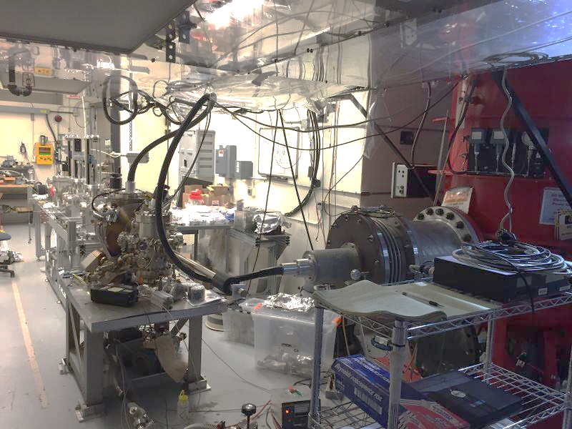
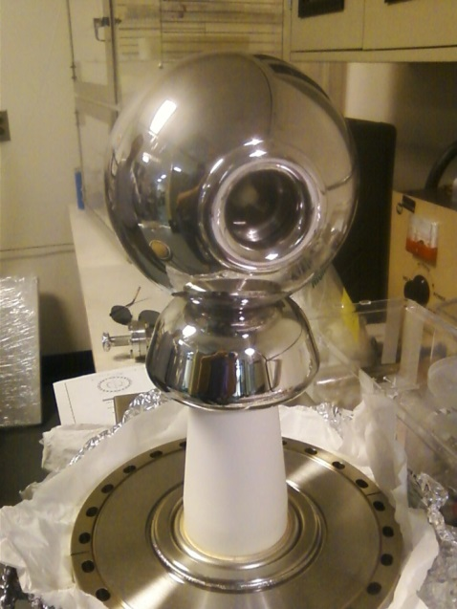
Higher Voltage (300 kV) Inverted Photo Gun
11 MV/m
CsK₂Sb 1mA
8 MV/m
First insulator commissioned to 325 kV
New insulator, getting installed now, supports higher voltage operation
J. Grames, SPIN 2016 @ UIUC, Sep 26-30 2016
22

Slide 23
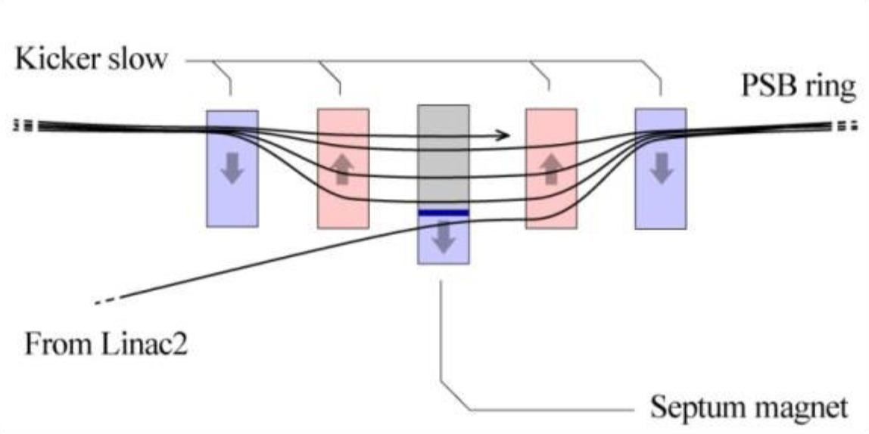
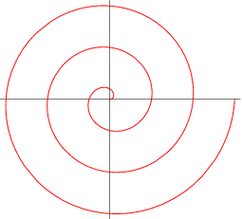
Multi-Turn Injection
Concept: an orbit bump created near a septum and then slowly reduced as beam being injected (phase-space painting)
A number of painting schemes has been developed
Process can also be simultaneously occurring
in vertical and longitudinal dimensions
CERN’s LEIR has a design for 75-turn injection of Pb⁵⁴⁺,
we plan to push this number to a few hundred to
a thousand using low electron emittance
Main injection system components
  Magnetic or electrostatic septum
  Four bumper magnets with ~1 μs rise time, reasonably
  fast fall-off time and ~10 mrad maximum deflection
x′
> Septum thickness +
bunch width
Accumulator ring
x
Injected beam
J. Grames, SPIN 2016 @ UIUC, Sep 26-30 2016
23

Slide 24
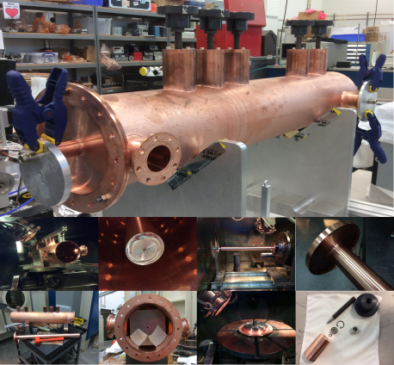
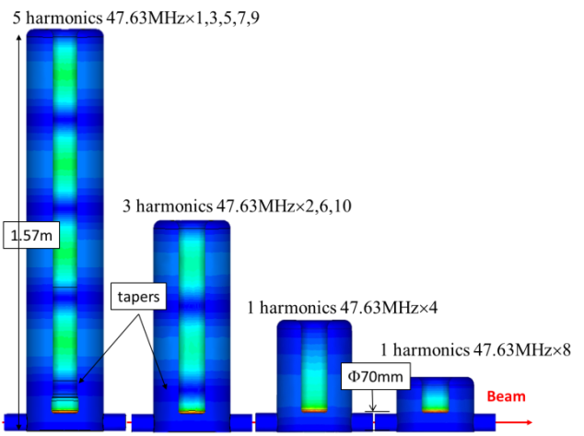
Harmonic Kicker Extraction
Y. Huang. Phys. Rev. Accel and Beams, 19, 084201 (2016)
Empty ring buckets already kicked out to linac
Ring buckets still occupied by bunches
Empty linac buckets
Linac buckets occupied by extracted bunches
Harmonic kicker that kicks every 3rd bunch
J. Grames, SPIN 2016 @ UIUC, Sep 26-30 2016
24

Slide 25
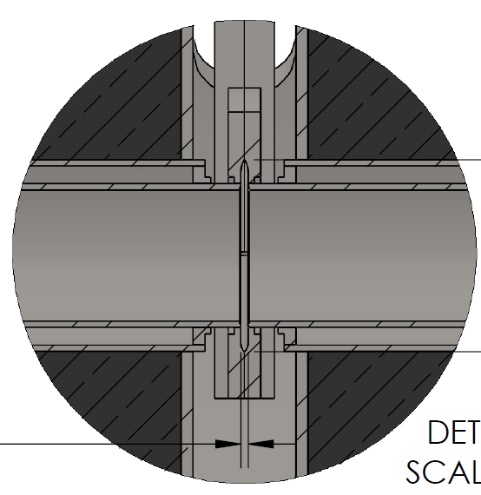
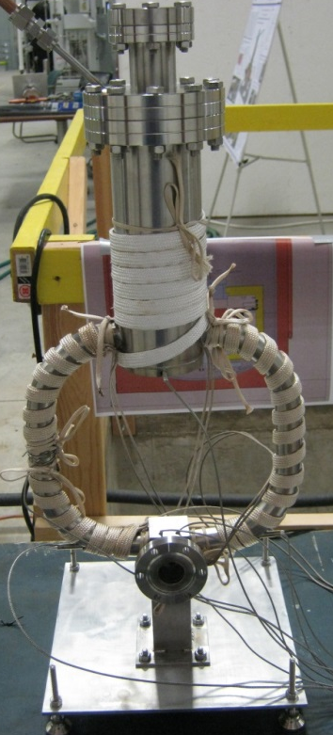
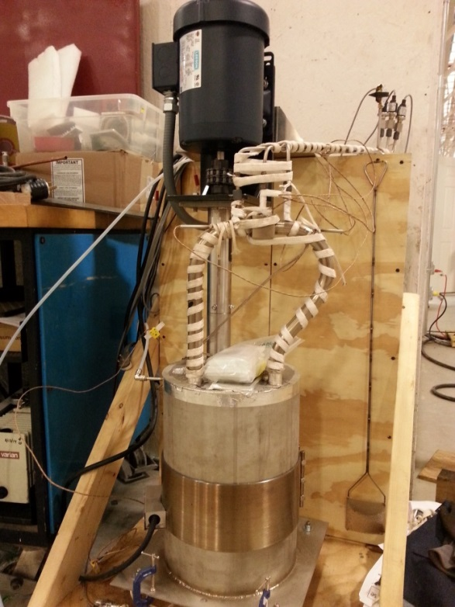
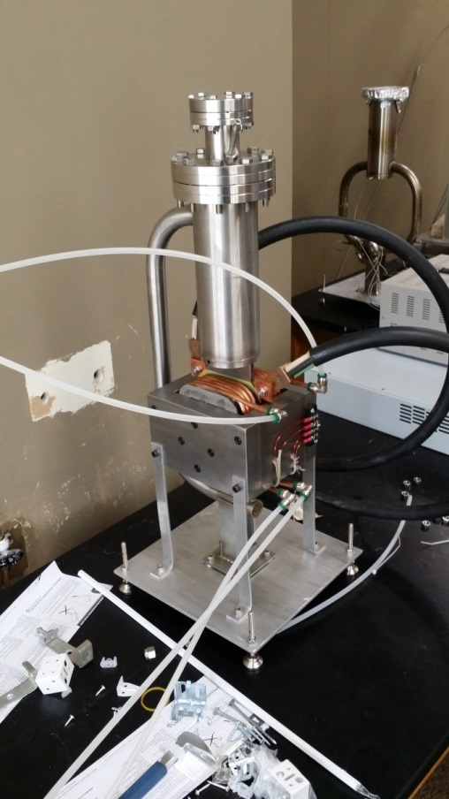

High Power Target R&D
Liquid Metal Target - lead-bismuth eutectic (LBE)
  High Z = 82, 83
  Low melting point: 124°C
  High boiling point: 1670 °C
Multiple LBE targets tested on various accelerators
  Natural Circulation
  Mechanical Pumping
  Electromagnetic Pumping
Approaching 10 kW power level, CW
Stainless Steel Windows (0.25mm)
LBE (2mm)
Output (e⁻,e⁺,γ)
Input (e⁻)
Courtesy J. McCarter, Niowave
J. Grames, SPIN 2016 @ UIUC, Sep 26-30 2016
25

Slide 26
Summary
The PEPPo technique provides an efficient, reliable, radioactive-less, and low cost method opening access to polarized positron beam to a wide community.
Next steps in low energy scheme of e+ source R&D is optimizing for beam intensity and beam quality.
An experimental program in context of CEBAF 12 GeV, JLEIC and LERF is being explored. If you would like to participate in the newly formed Jefferson Lab Positron Working Group please visit: wiki.jlab.org/pwg
J. Grames, SPIN 2016 @ UIUC, Sep 26-30 2016
26

Slide 27

Synergy
The Hippopotamus and Red-Billed Oxpecker share a positive and synergistic relationship.
J. Grames, SPIN 2016 @ UIUC, Sep 26-30 2016
27

Slide 28
Backup Slides
J. Grames, SPIN 2016 @ UIUC, Sep 26-30 2016
28

Slide 29
Electromagnetic Form Factors
M.P. Rekalo, E. Tomasi Gustafsson, NPA 742 (2004) 322 C. Carlson, M. Vanderhaeghen, ARNPS 57 (2007) 171
Unpolarized e± elastic scattering and polarization transfer observables from the nucleon involve up to 5 unknown quantities.
Cross Section
Polarization
Transfer
5 unknown contributions for 6 independent observables
Combining Polarized electrons and positrons allows a model independent separation of the electromagnetic form factors of the nucleon.
J. Grames, SPIN 2016 @ UIUC, Sep 26-30 2016
29

Slide 30
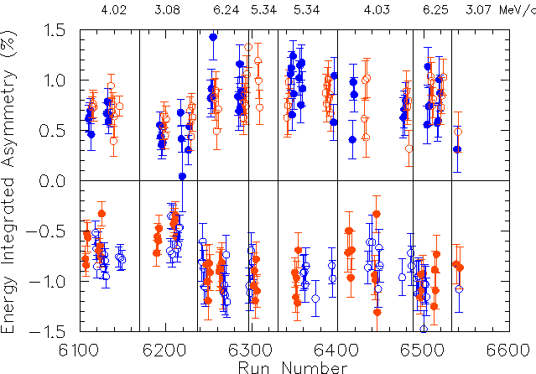
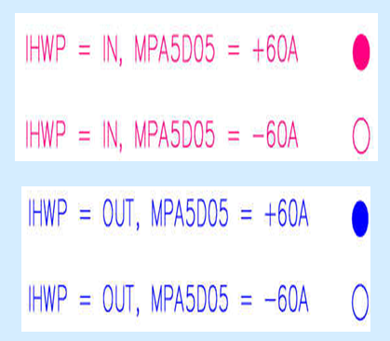
Summary of Positron Asymmetries
J. Grames, SPIN 2016 @ UIUC, Sep 26-30 2016
30

Slide 31
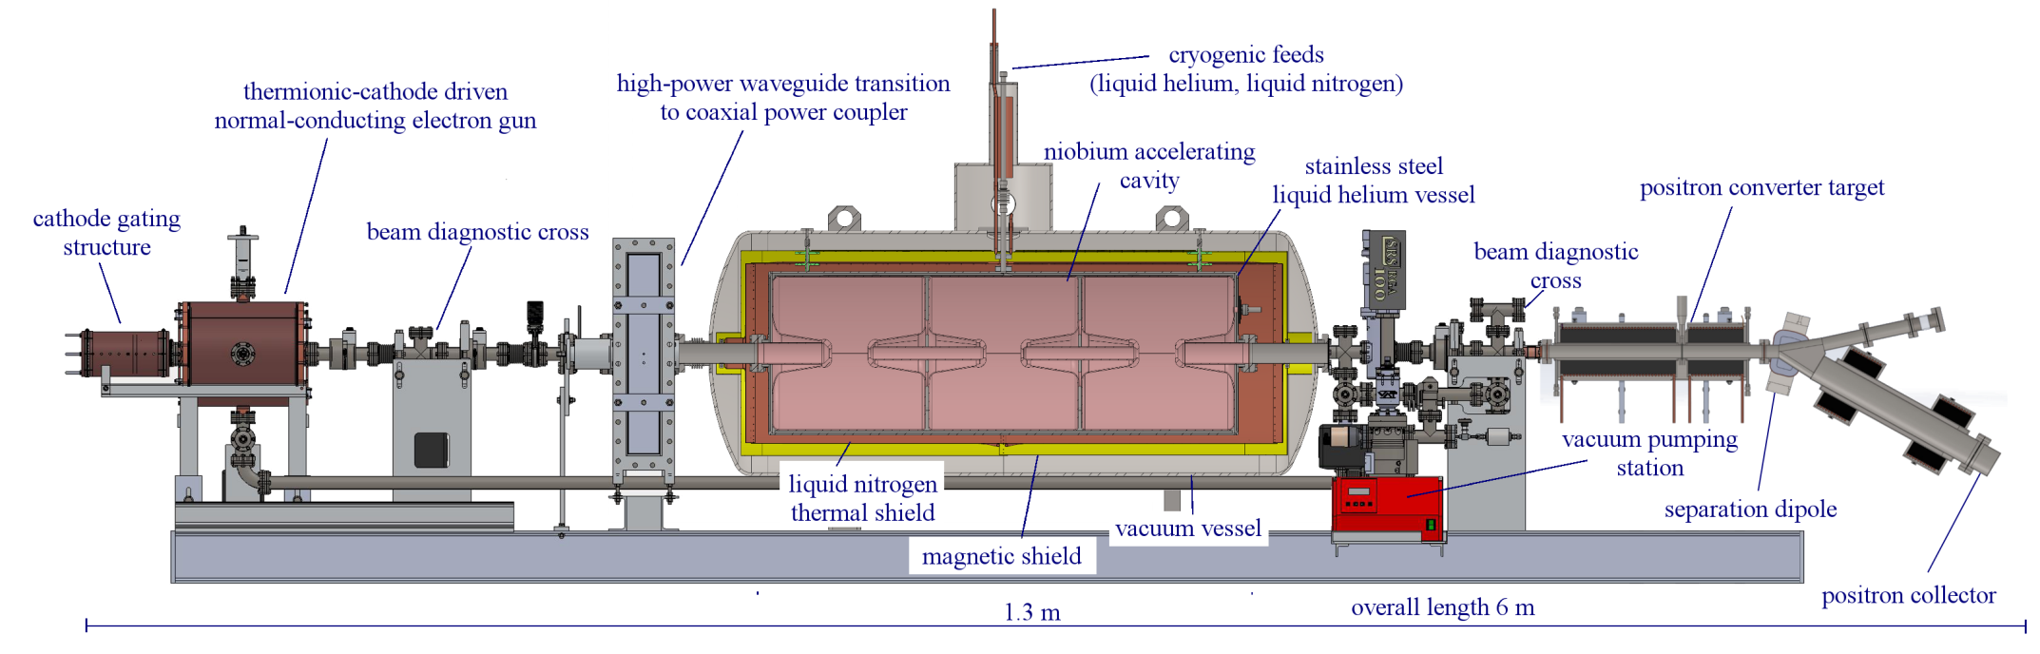
10 MeV Accelerator with Positron Target
Electron Source
  350 MHz, 100 kV normal-conducting resonant cavity
  integrated, gated thermionic cathode
10 MV superconducting cryomodule
  3-cell, 350 MHz niobium resonator
  thermal and magnetic shields
Proof of concept test successfully complete with simplified LBE target
J. Grames, SPIN 2016 @ UIUC, Sep 26-30 2016
31

Slide 32
Liquid Metal Target Design
Input electron beam passes through:
0.25 mm SS
2 mm LBE, for highest rate of production of e⁺
0.25 mm SS
Prototype target expected to handle >10 kW
Stainless Steel
Thin layer of lead-bismuth eutectic
Output (e⁻,e⁺,γ)
Input (e⁻)
Lead-bismuth eutectic (LBE)
  Low melting point: 124°C
  High boiling point: 1670 °C
  Z = 82, 83
J. Grames, SPIN 2016 @ UIUC, Sep 26-30 2016
32

Slide 33
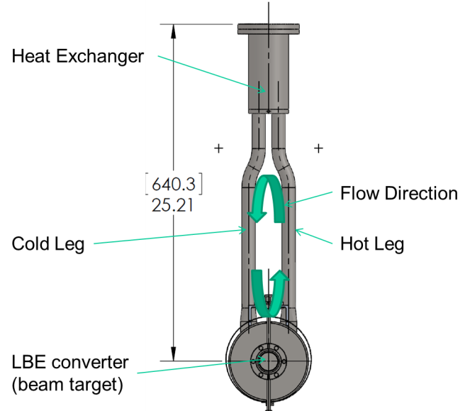
Liquid Metal Target Testing
~1 m
Successfully tested LBE target systems based on:
Natural Circulation
  Multiple targets tested on various accelerators
  Approaching 10 kW power level, CW
Mechanical Pumping
  Submerged impellor
Electromagnetic Pumping
  Current through LBE in magnetic field
J. Grames, SPIN 2016 @ UIUC, Sep 26-30 2016
33

Slide 34
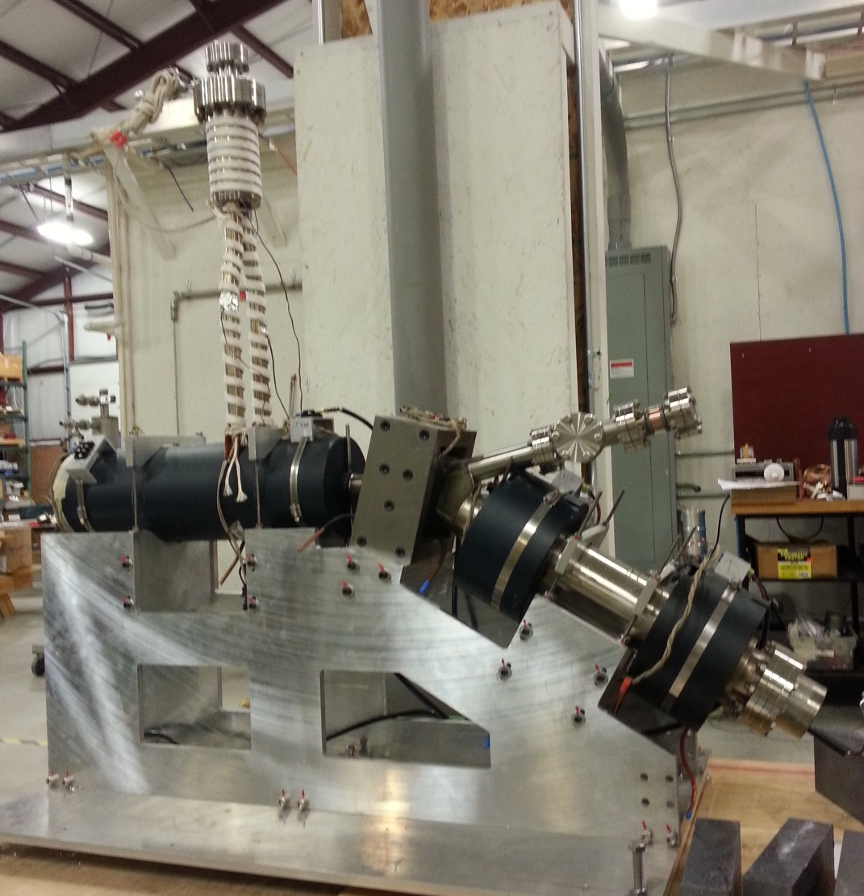
Positron System Hardware
Liquid Metal
Converter
Electron Dump
Separation
Dipole
Positron Target
Converter Solenoid
Capture Solenoid
Positron Solenoids
J. Grames, SPIN 2016 @ UIUC, Sep 26-30 2016
34

