Slide 1

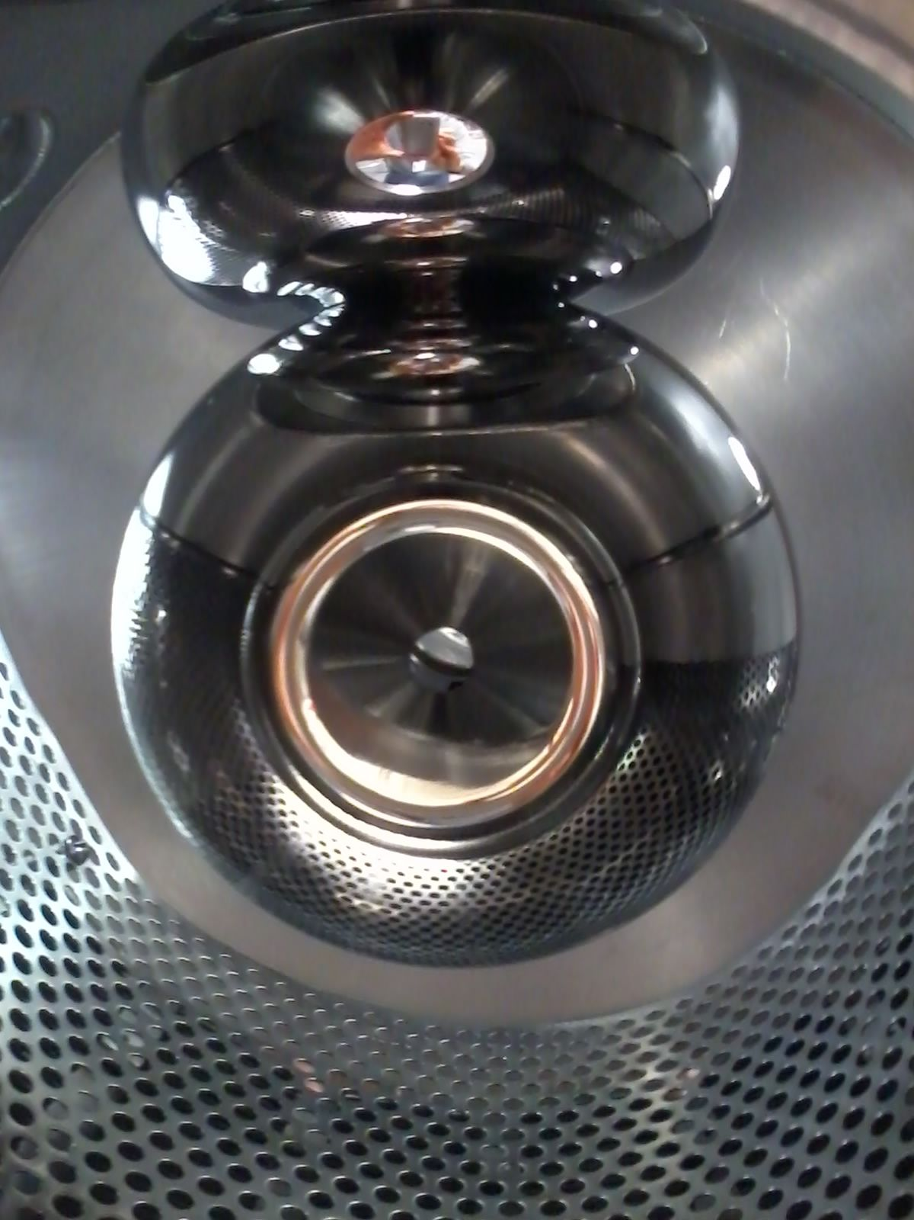
300 kV DC High Voltage Photogun with Inverted Insulator Geometry
Carlos Hernandez-Garcia
Jefferson Lab Accelerator Advisory Committee Mtg., September 13-15, 2017

Slide 2
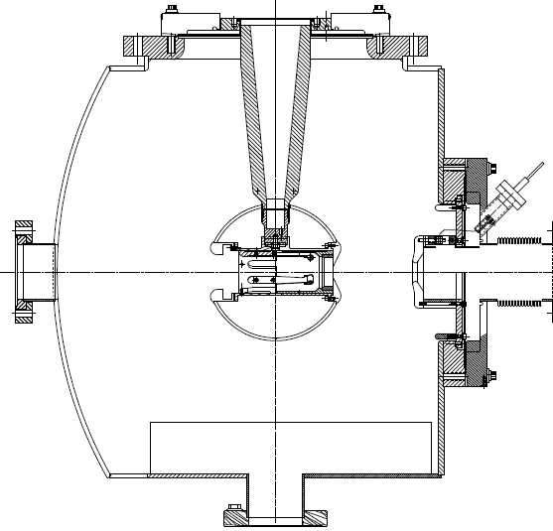
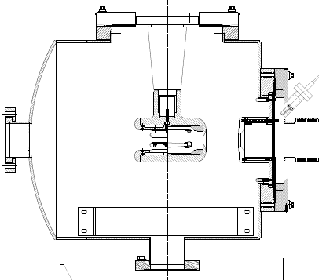
Inverted Insulator Photoguns
CEBAF 130 kV, used since 2010
350 kV gun for GTS and UITF
Longer “R30” insulator
Spherical electrode

Slide 3
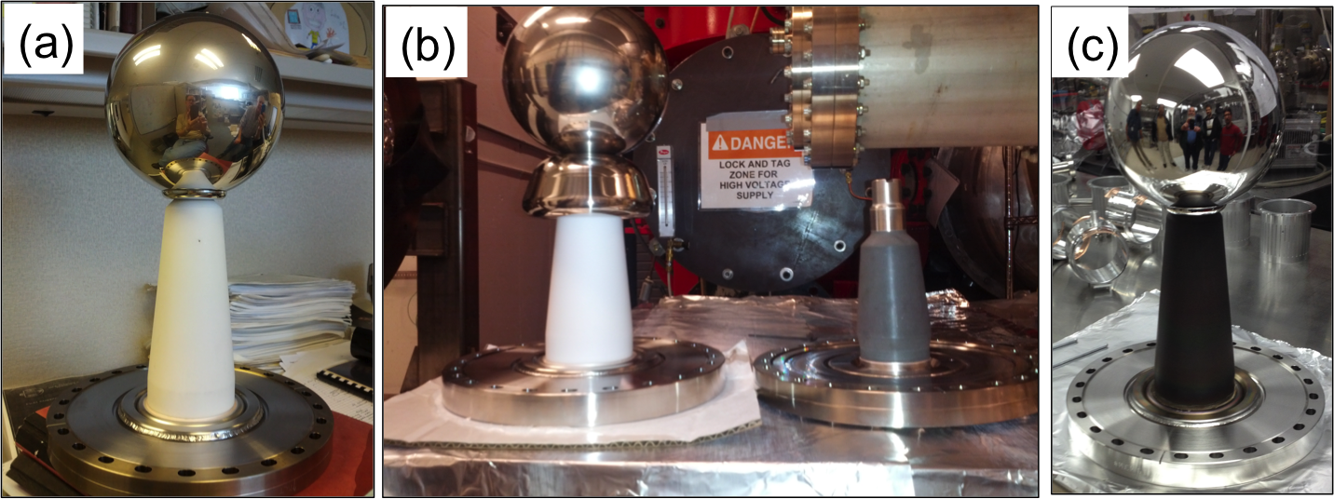
Building the 350 kV Gun
Start with “dummy” electrode (no photocathode) and test different insulators and cathode screening electrodes to prevent high voltage breakdown
C. Hernandez-Garcia, M. Poelker, and J. Hansknecht, “High Voltage Studies of Inverted-geometry Ceramic Insulators for a 350kV dc Polarized Electron Gun,” IEEE Transactions on Dielectrics and Electrical Insulation, Vol. 23, No. 1; February 2016

Slide 4
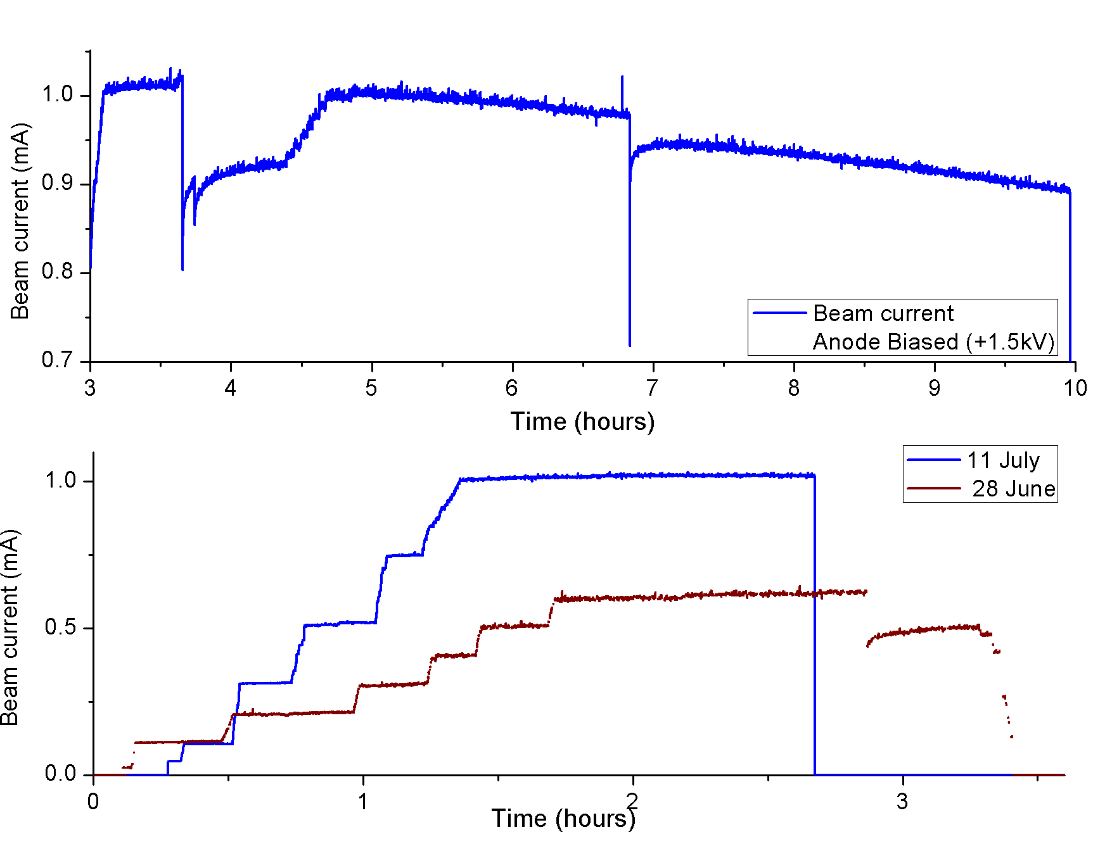
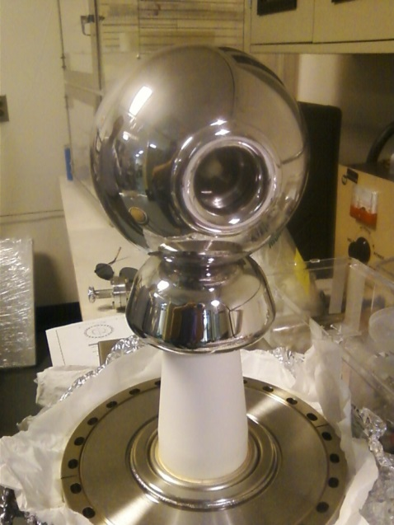
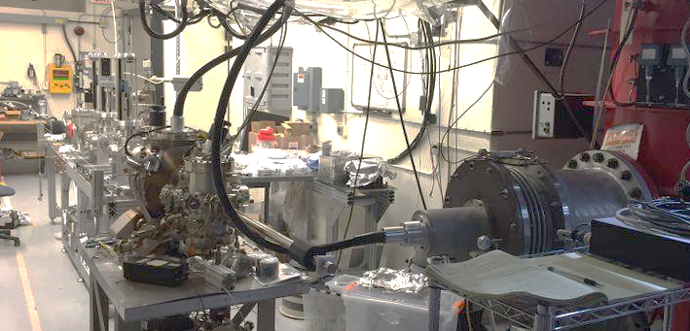
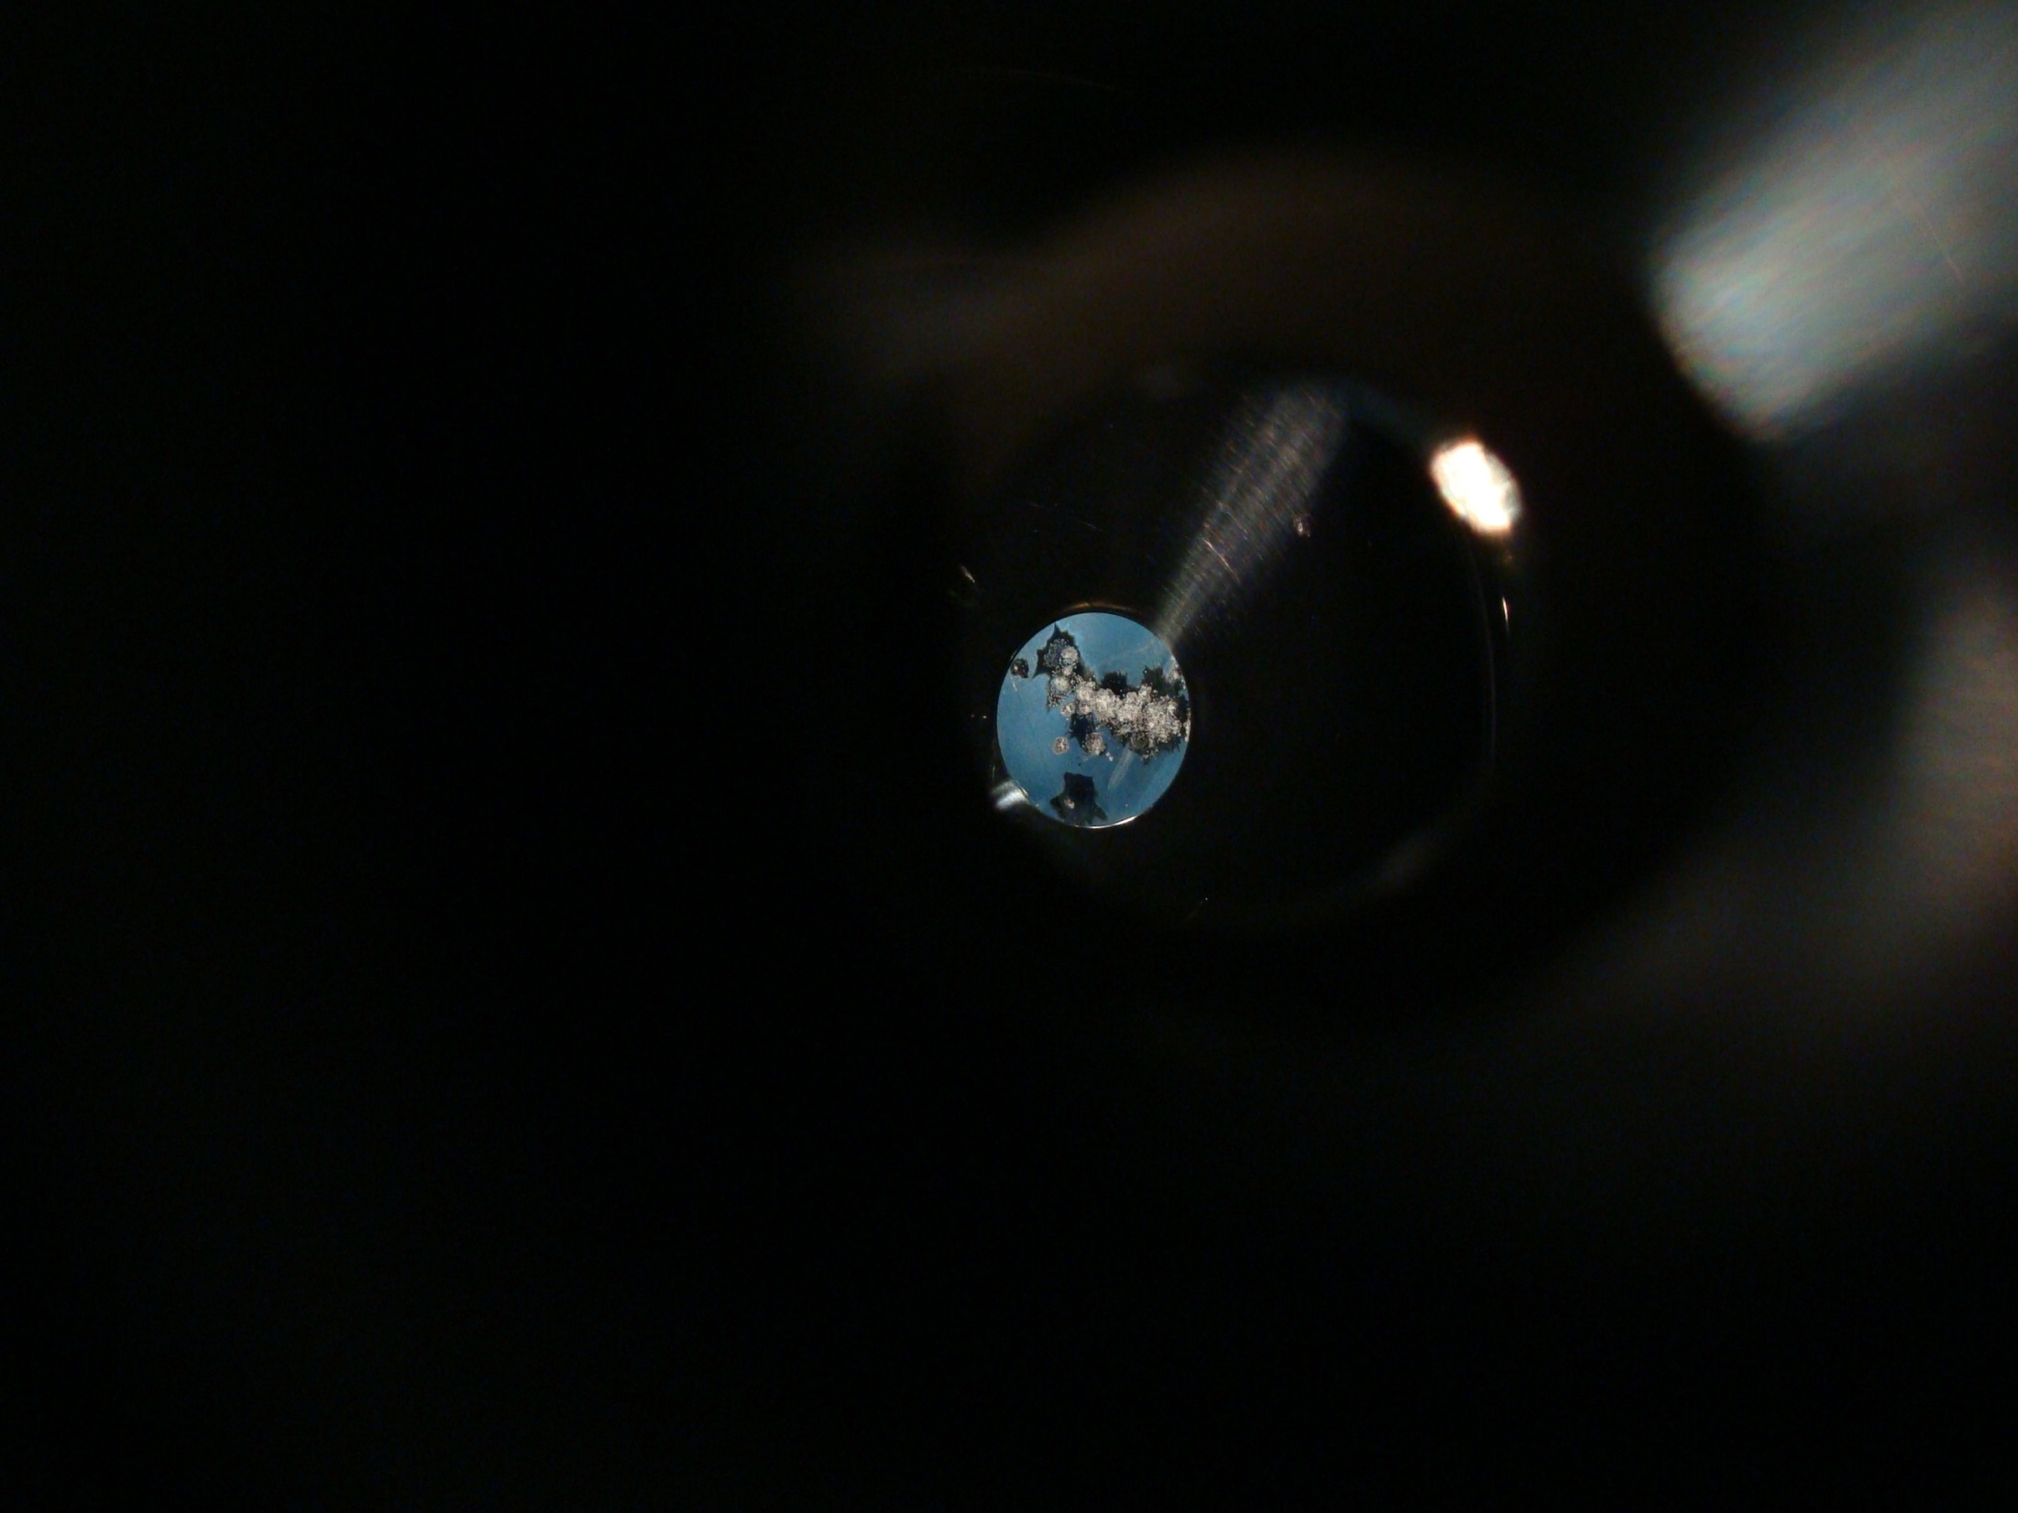
300 kV Inverted Gun and CsK₂Sb Photocathode
Electrode with preliminary triple-junction shield conditioned to 325 kV
Multi-alkali cathode preparation chamber attached to photogun
1 mA beam demonstrated summer 2016
1 mA
Beam Current (mA)
Need mask and ion precipitator
Learning how to use the new photocathode
4
Slide 4

Slide 5
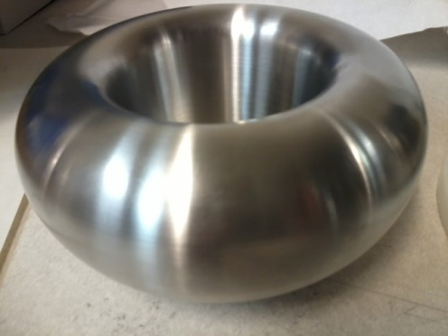
Careful design of triple-junction-shield
Gradients shown for 350 kV
HV plug
Ceramic
Overall shape designed for low gradient here !!
Simulationsby Y. Wang

Slide 6
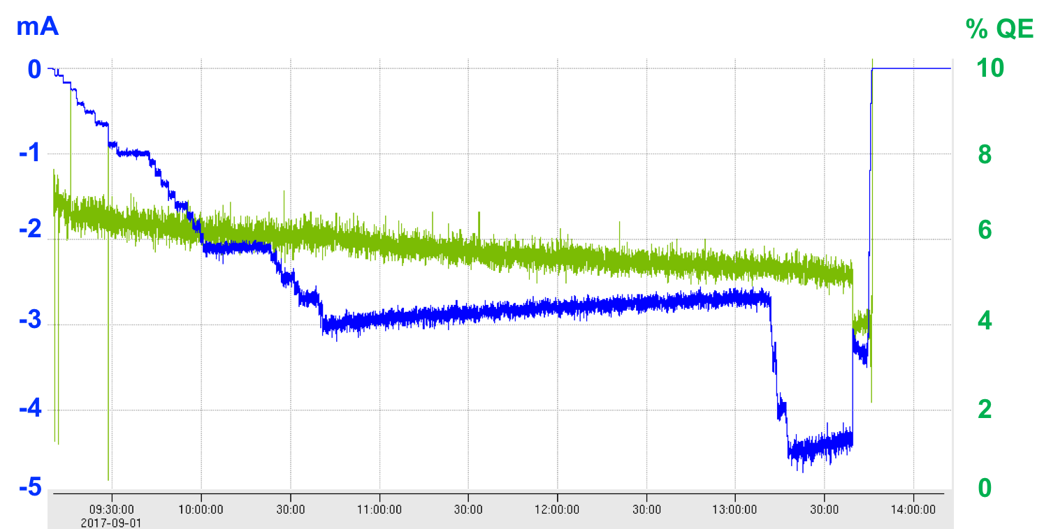
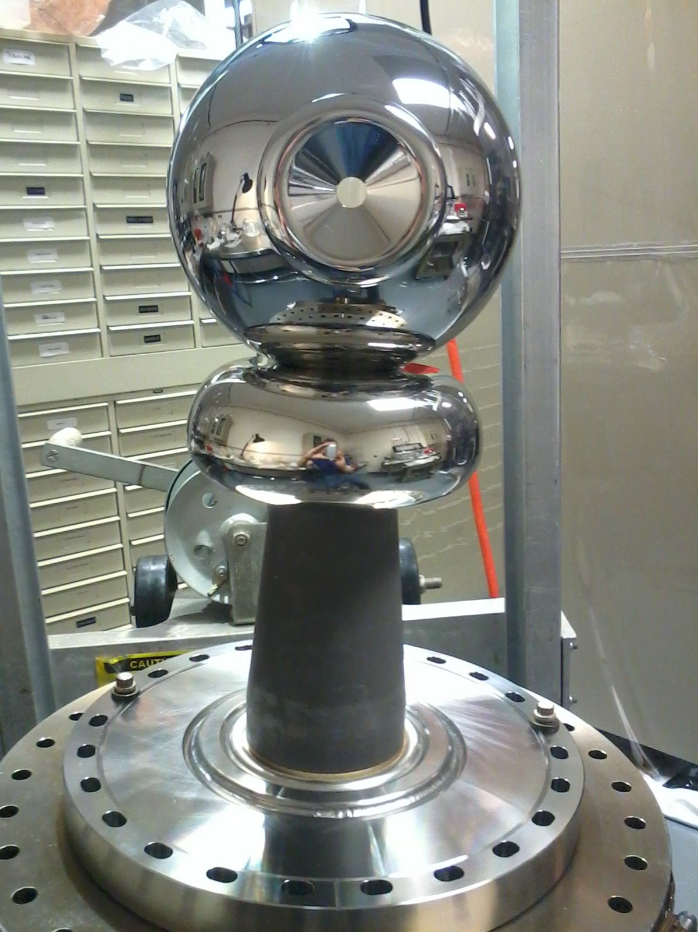
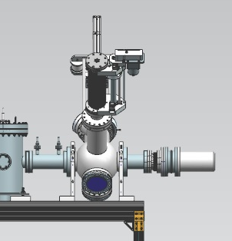
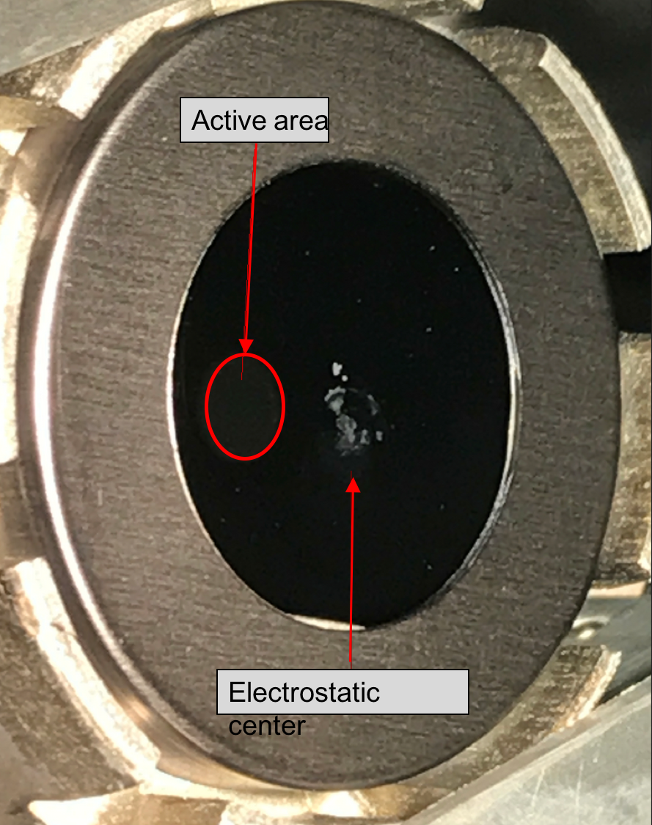
Rebuilt 300kV gun
New insulator: mildly conductive
Improved triple-junction shield electrode
Masked photocathode
Beamline ion precipitators
4.5mA
0
1
2
3
4
Time (hours)
Ion precipitator
Active area
Beam dump
Notes:
Interior Page Design 2

Slide 7
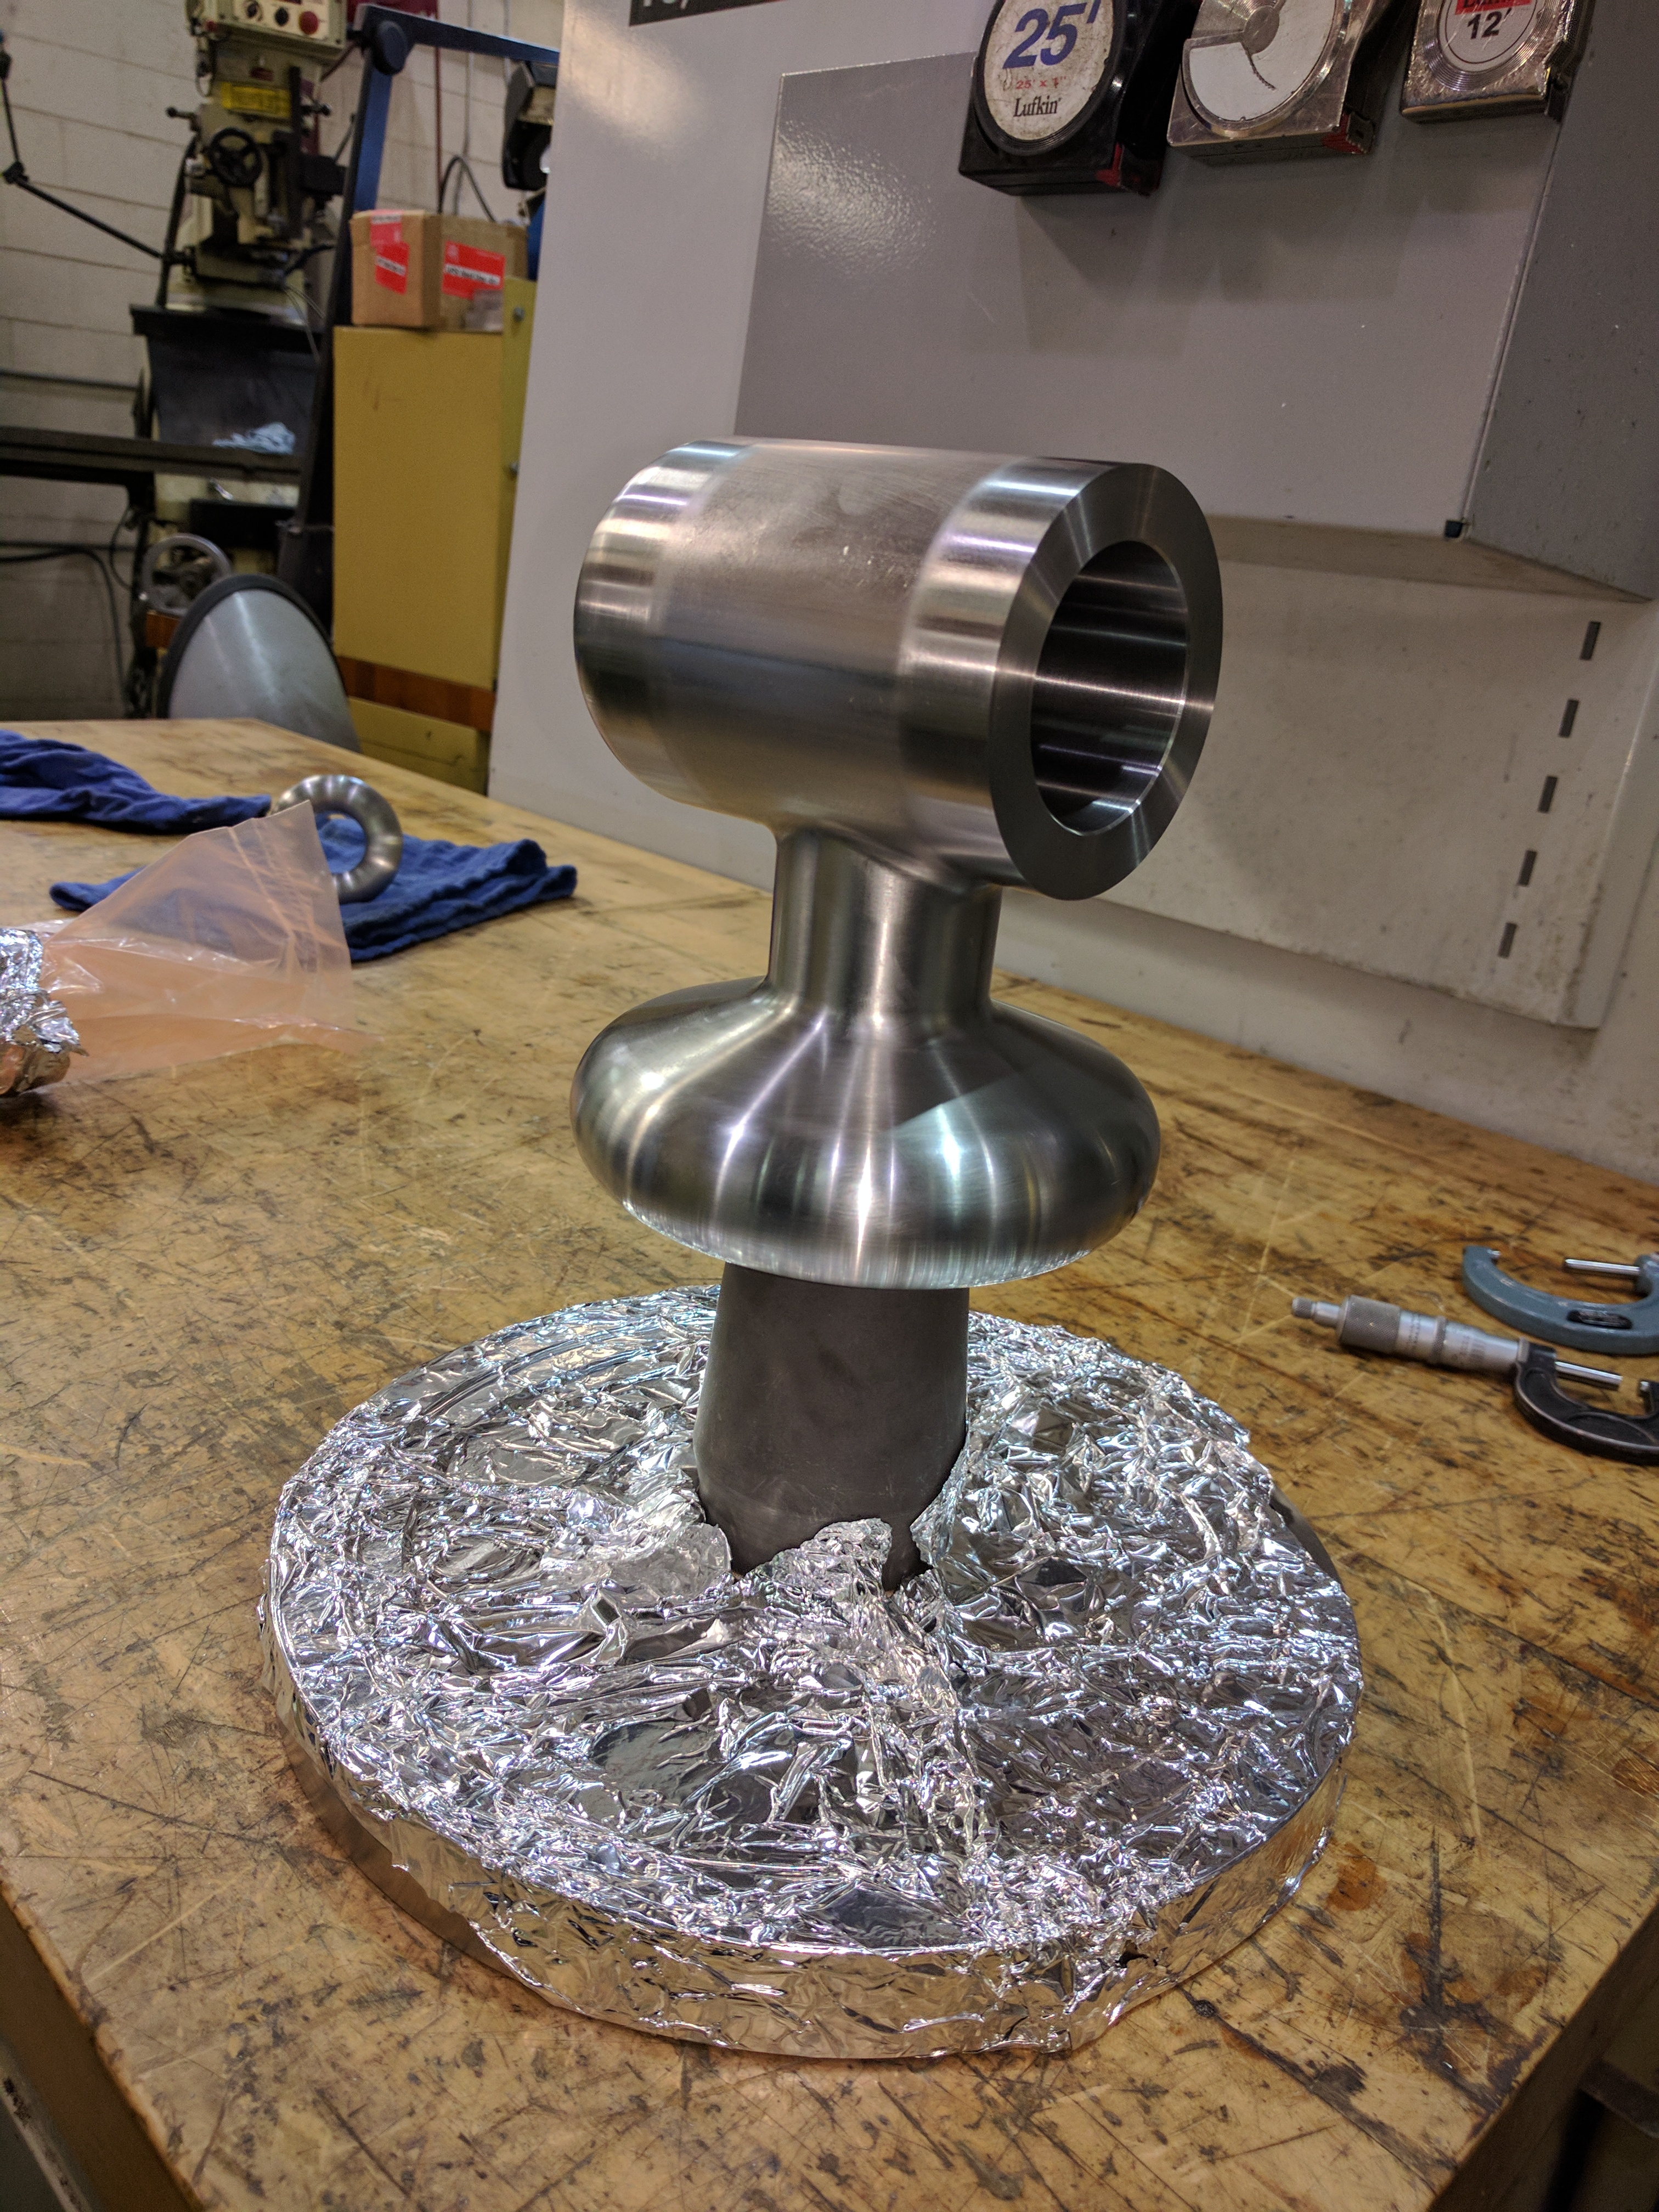

Hand-Polishing Nightmare!
New CEBAF 200 kV Gun

Slide 8
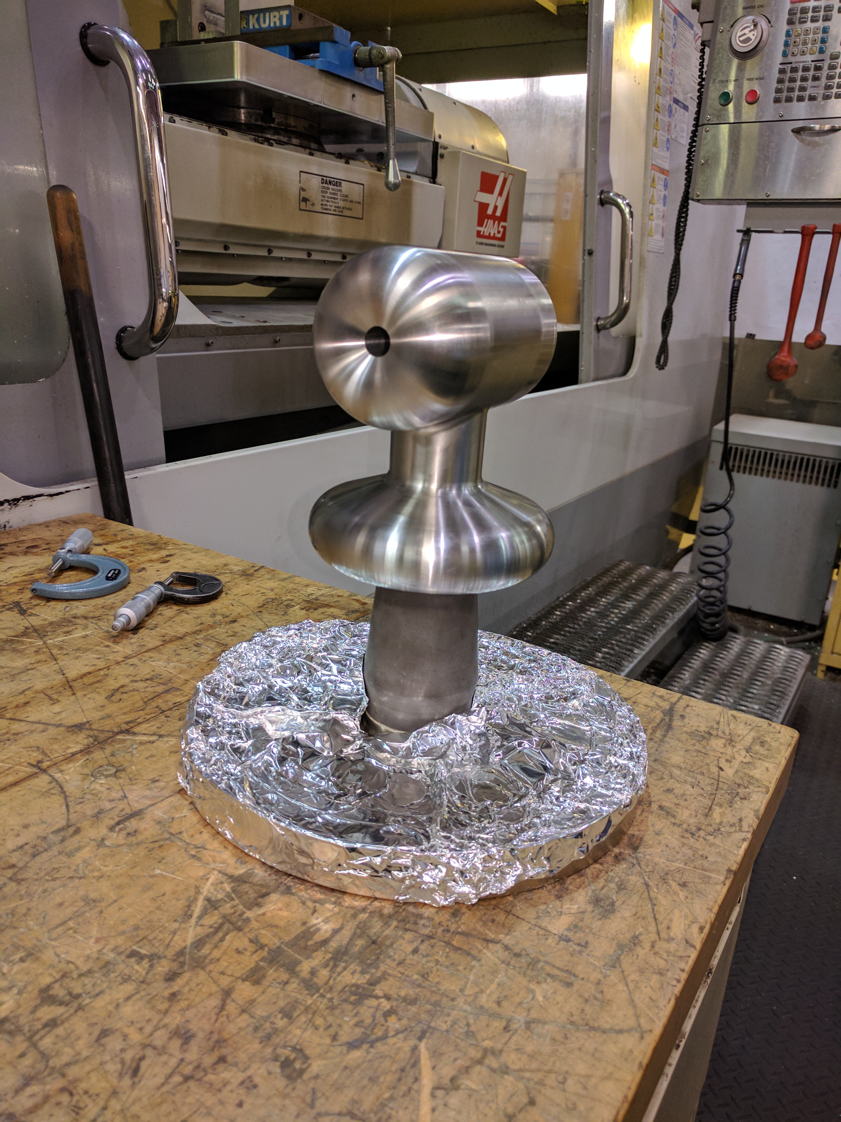
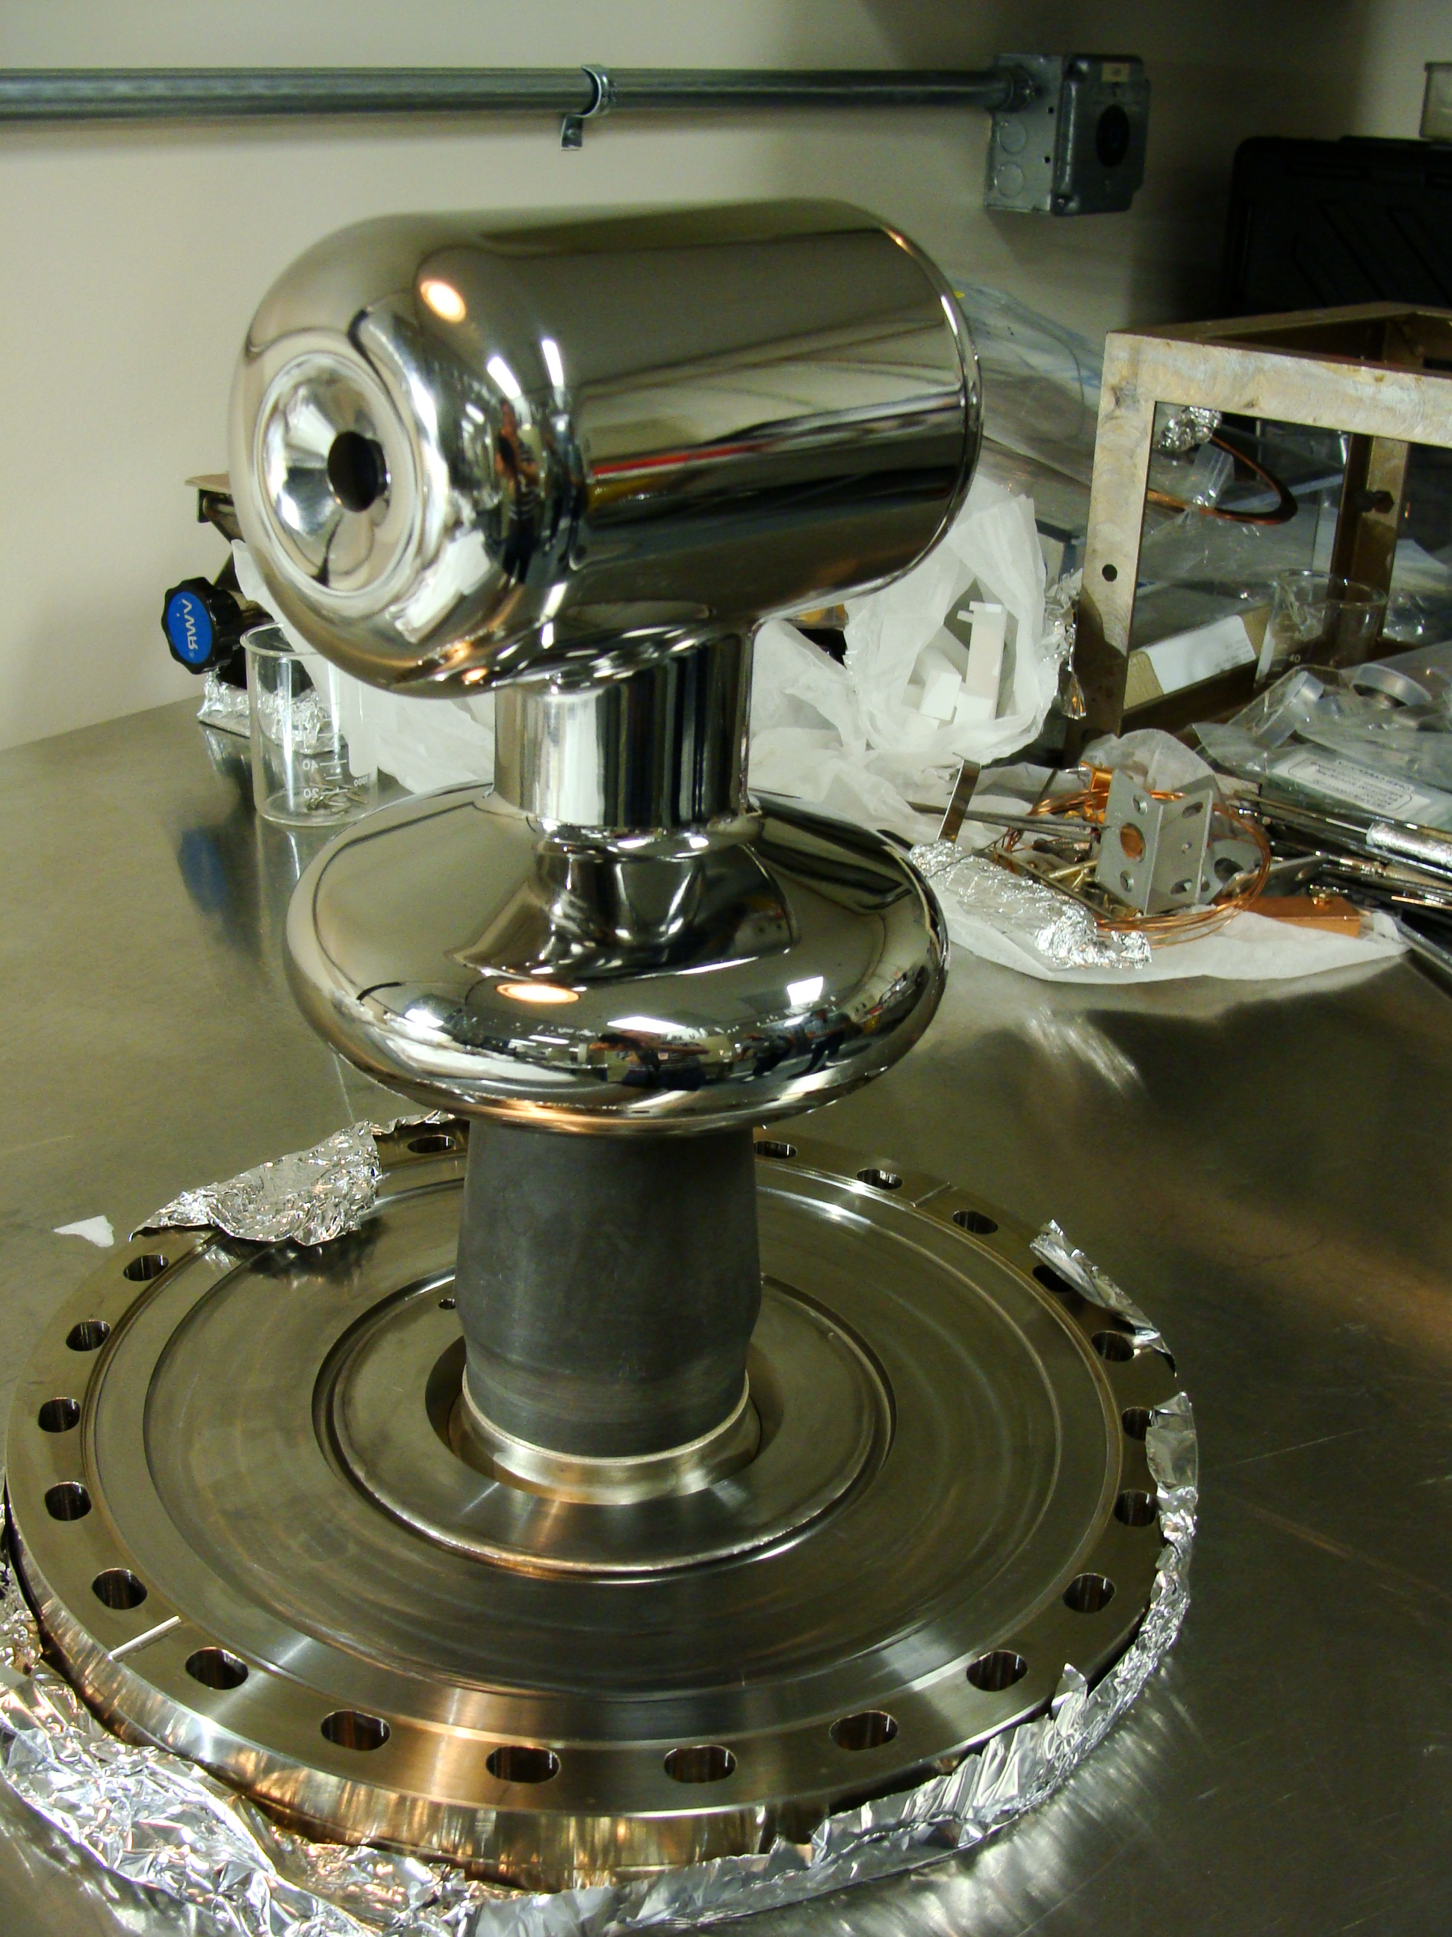
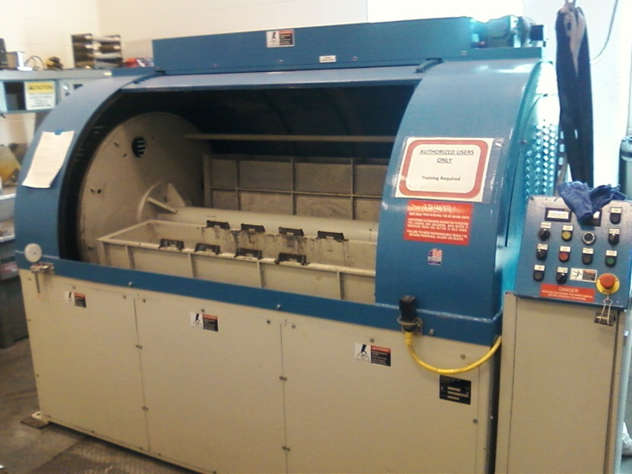
Centrifugal Barrel Polishing to Rescue
Reduced polishing time from Months to hours !!!
30 min. plastic cones
30 min. crushed corncob
  From machine shop
  Barrel polishing machine at JLab SRF
C. Hernandez-Garcia, D. Bullard, F. Hannon, Y. Wang, and M. Poelker, “High voltage performance of a dc photoemission electron gun with centrifugal barrel-polished electrodes,” accepted Rev. Sci. Instrum, 22 August 2017

Slide 9
Excellent Surface Finish
Similar to traditional hand polishing with sand paper and diamond grit
Diamond paste polishing Ra 30 nm*
* M. BastaniNejad, A. A. Elmustafa, E. Forman, S. Covert, J. Hansknecht, C. Hernandez-Garcia, M. Poelker, L. Das, M. Kelley, P. Williams, “Evaluation of electropolished stainless steel electrodes for use in DC high voltage photoelectron guns,” J. Vac. Sci. Technol. A, Vol. 33, No. 4, Jul/Aug 2015

Slide 10
Ultimate metric of success: High Voltage
Reached
360 kV in 70 hours
10 MV/m at 350 kV
Vacuum and radiation levels indistinguishable from bkgd at 350kV

Slide 11
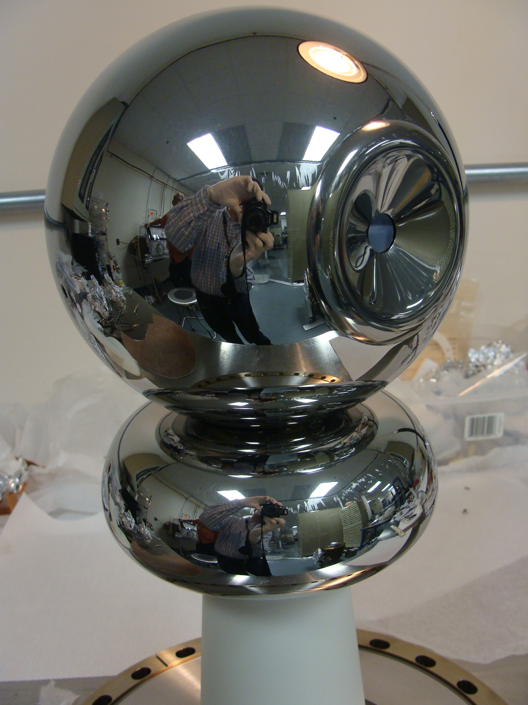
3 photoguns with barrel polished electrodes
CEBAF 200 kV
Conditioned to 216 kV,
No FE at 200kV, ready for installation
UITF 350 kV
Vacuum bakeout underway
GTS 350 kV
In operation since Nov. 2016 with CsK₂Sb photocathode:
3 mA magnetized beam
4.5 mA non-magnetized

Slide 12
Summary
Photogun operates reliably at 300 kV
  Improved triple-junction shielding electrode
  Mildly conductive ceramic
  No field emission with cathode solenoid operational
Increased current from1 mA to 4.5 mA
  Masked photocathode
  Beamline ion precipitators
In-house developed electrode barrel polishing technique
  Reduced time from months to hours!
JLab is now in the multi-alkali photocathode business!
Thanks to: P. Adderley, J. Benesch, B. Bullard, J. Grames, J. Guo, F. Hannon, J. Hansknecht, R. Kazimi, G. Krafft, M. A. Mamun, M. Poelker, R. Suleiman, M. Stutzman, Y. Wang, S. Wijiethunga, J. Yoskovitz, S. Zhang
ODU Graduate Students, Postdoc

Slide 13
Backup slides

Slide 14
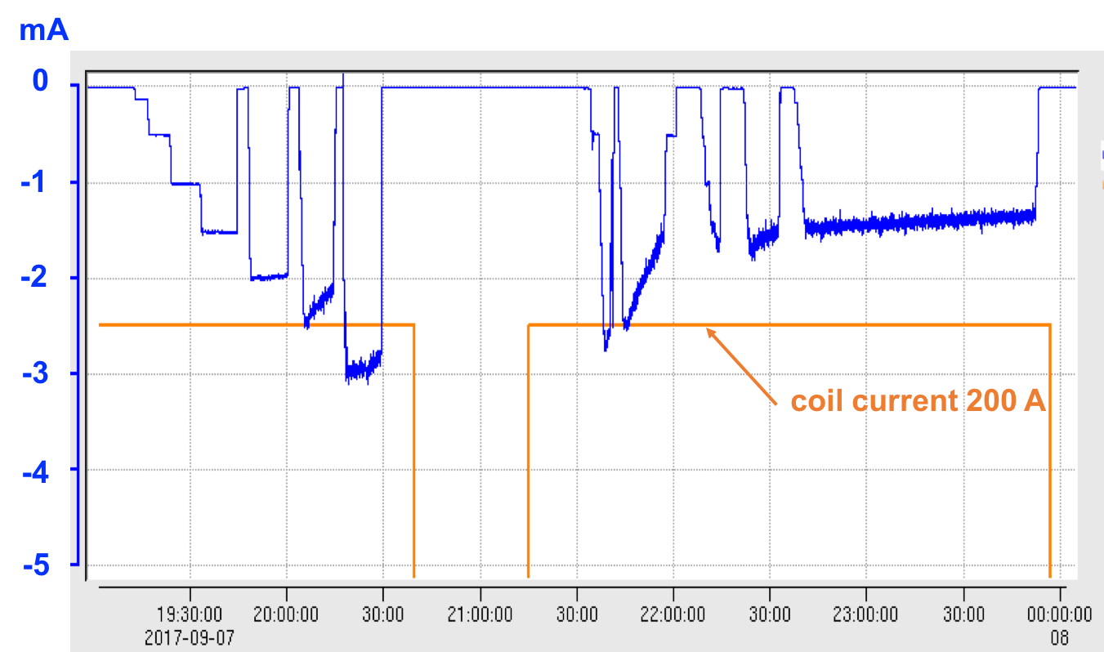
Magnetized beam current
3 mA

Slide 15
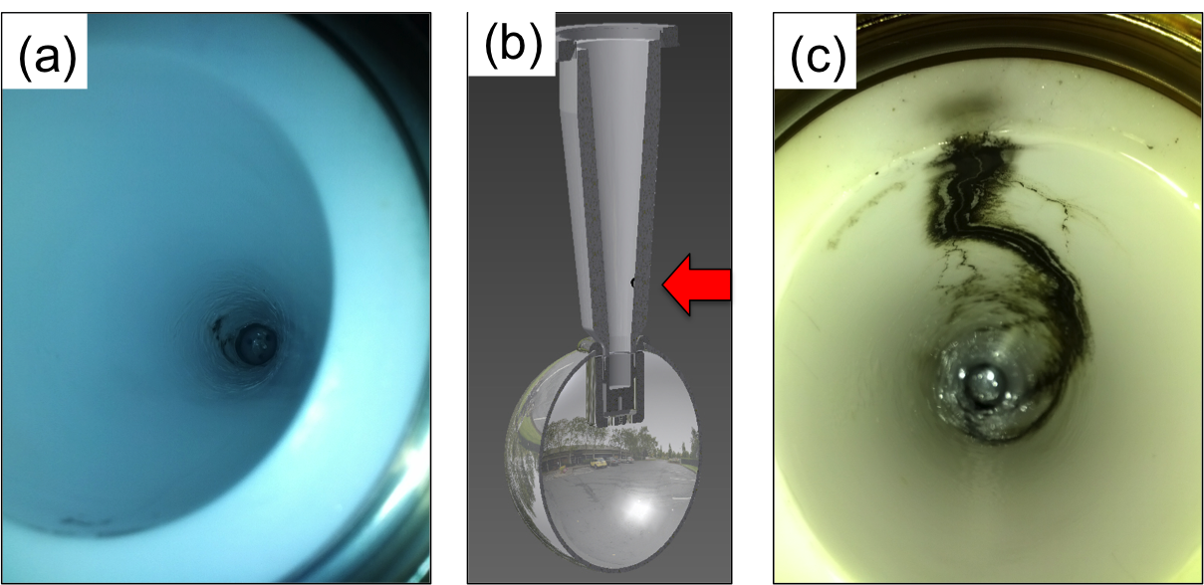
Face the Realities of HV Breakdown
The first test with R30 pure alumina ceramic suffered breakdown at ~315kV with subsequent puncture at 330kV.
A second test with a new R30 pure alumina suffered breakdown at ~315 kV.
Field emission managed via krypton-processing*, i.e., voltage applied with ~10⁻⁵ Torr krypton added to gun chamber
* M. BastaniNejad, A. A. Elmustafa, E. Forman, J. Clark, S. Covert, J. Grames, J. Hansknecht, C. Hernandez-Garcia, M. Poelker and R. Suleiman, “Improving the performance of stainless-steel DC high voltage photoelectron gun cathode electrodes via gas conditioning with helium or krypton,” Nucl. Instr. and Meth. in Phys. Res. A, Vol. 762, pp. 135–141, 2014

Slide 16
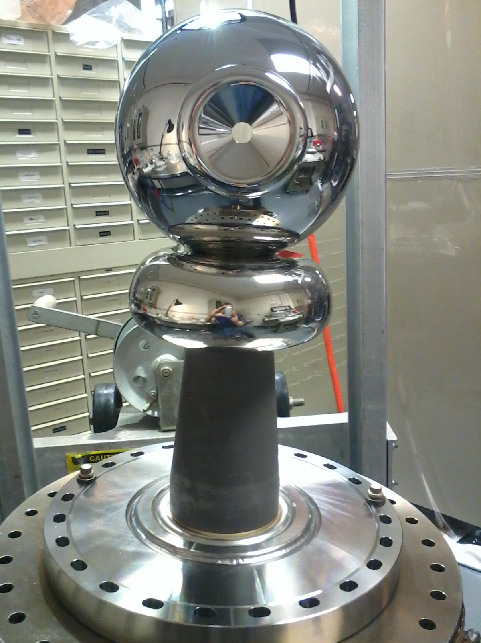
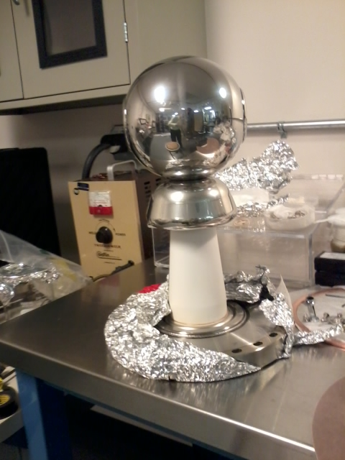
Optimizing the Electrode Design
Pure alumina insulator replaced with doped alumina for higher voltage stand-off and robust operations
Electrode ‘shed’ (triple junction shield) re-designed by Yan Wang to lower gradient from 12 MV/m to 10 MV/m at 350kV
Pure alumina insulator
Doped alumina insulator

Slide 17
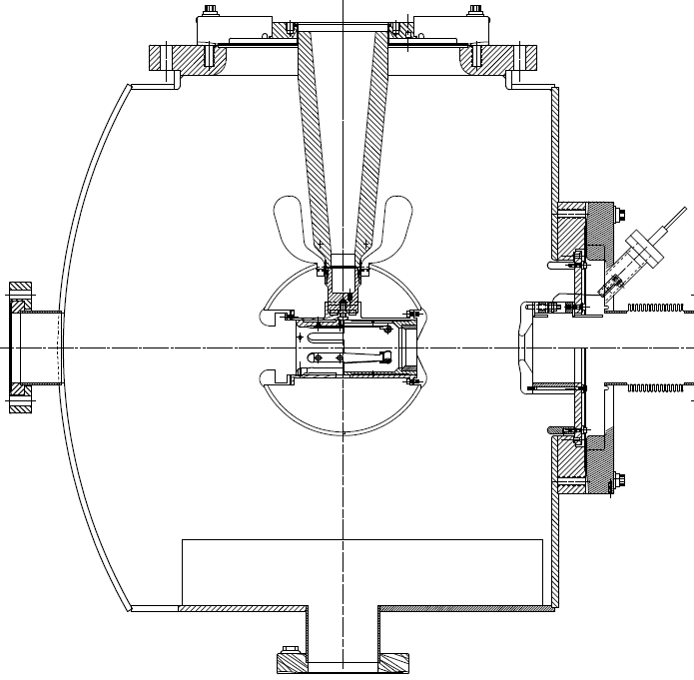
Inverted-Insulator Photoguns
with optimized triple point shields and mildly conductive insulators
CEBAF 200 kV Gun
350 kV gun for GTS and UITF
Both designs, maximum field strength < 10 MV/m
Notes:
Interior Page Design 2

Slide 18
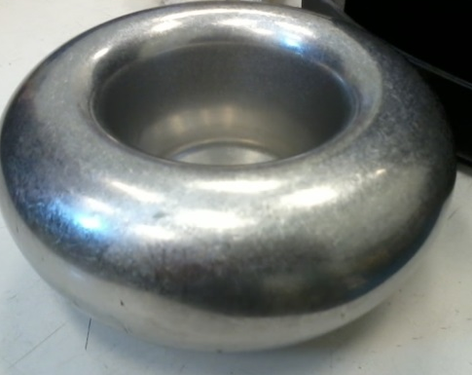
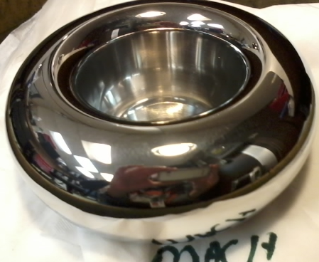
Barrel polished electrodes…
Gun electrodes traditionally polished using sand paper and diamond paste
Tedious process, takes about 30 days to complete
Now performed in 1 day using SRF barrel polishing machine
  From machine shop
30 minutes in plastic cones
30 minutes with corncob
C. Hernandez-Garcia, D. Bullard, F. Hannon, Y. Wang, and M. Poelker, “High voltage performance of a dc photoemission electron gun with centrifugal barrel-polished electrodes,” accepted Rev. Sci. Instrum, 22 August 2017

