Slide 1
Cooler e-source Magnetized Beam LDRD Progress Report
June 29, 2017

Slide 2
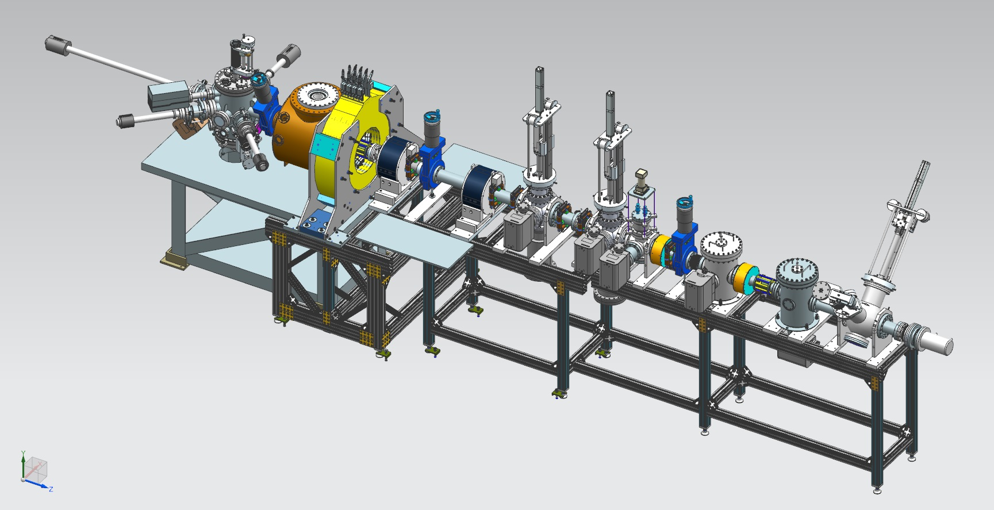
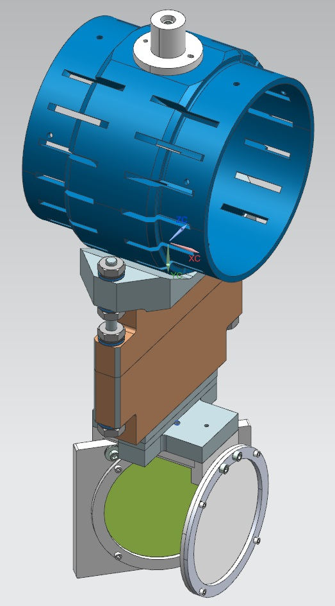
Magnetized Electron Source at GTS
Gun HV Chamber
Photocathode
Preparation
Chamber
Beamline
Gun Solenoid
Shield Tube
Viewer 3 Screen
Beam Dump
Slit
Viewer Screen

Slide 3
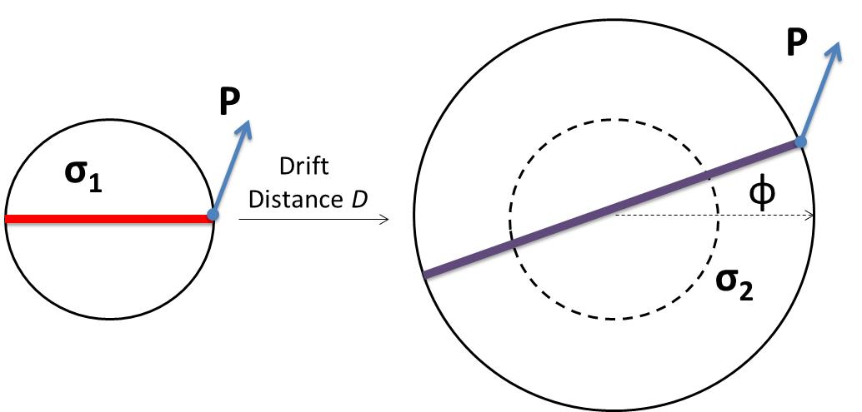
Measuring Beam Magnetization
Use slit and viewscreens to measure mechanical angular momentum:
$B_{z}$: solenoid field at photocathode
$a_{0}$: laser rms size
Φ: rotation (sheering) angle

Slide 4
0 G
at photocathode
1088 G
at photocathode

Slide 5
Work of M. Mamun

Slide 6
Outlook: July – September
Simulation of magnetized beam sizes and rotation angles
Run 5 mA magnetized beam
Design TE₀₁₁ cavity

