Slide 1

High Voltage Studies at JLab
Can our experience building DC high voltage photoguns help the Proton Ring EDM effort?
M. Poelker, P. Adderley, D. Bullard, J. Grames, J. Hansknecht,
C. Hernandez-Garcia, M. Stutzman, R. Suleiman, S. Zhang
Students: M. BastaniNejad, E. Forman, Md. Abdullah A. Mamun, R. Taus
Ring EDM Collaboration Meeting, November 10-11, 2014
Brookhaven National Lab,
Notes:
Interior Page Design 2

Slide 2

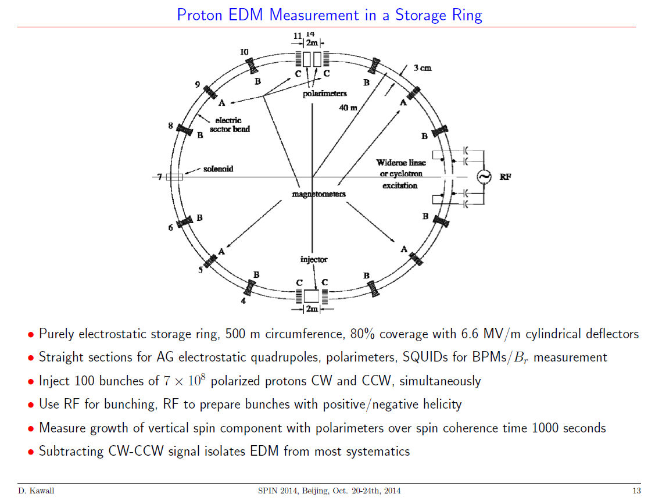
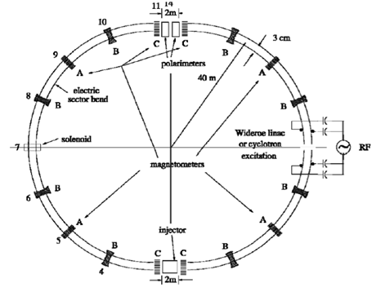
at AGS, field strength ~ 4.5 MV/m
3 cm gap, +/- 67.5 kV?
~ 650 m x 2 = 1300 m of electrode,
height 20 cm
Notes:
Interior Page Design 1

Slide 3
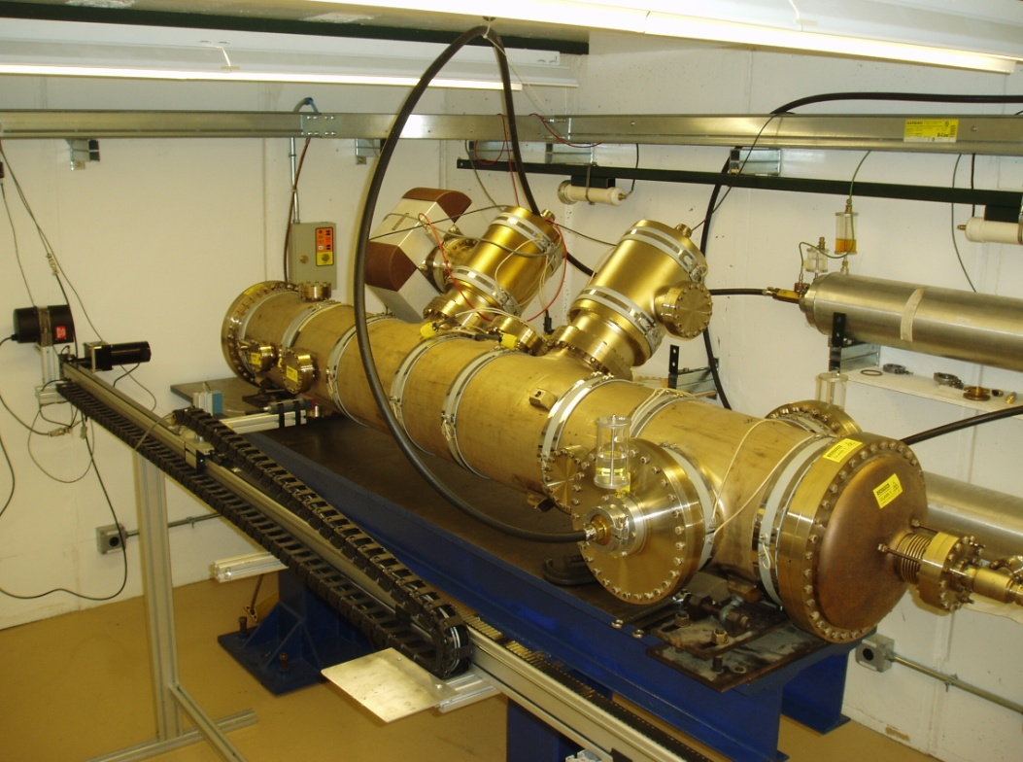
E-field plate module: Similar to the (26) FNAL Tevatron ES-separators
Beam position
0.4 m
How is field emission a problem for Ring EDM?
3 m

Slide 4
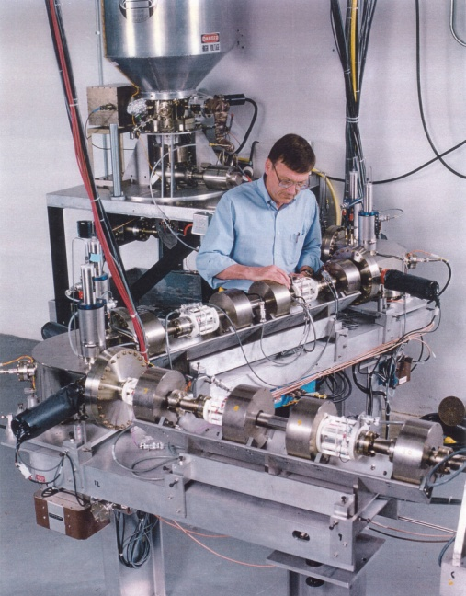
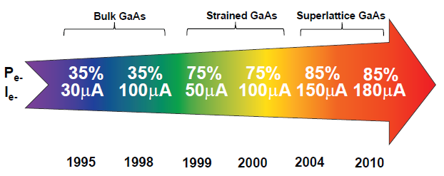
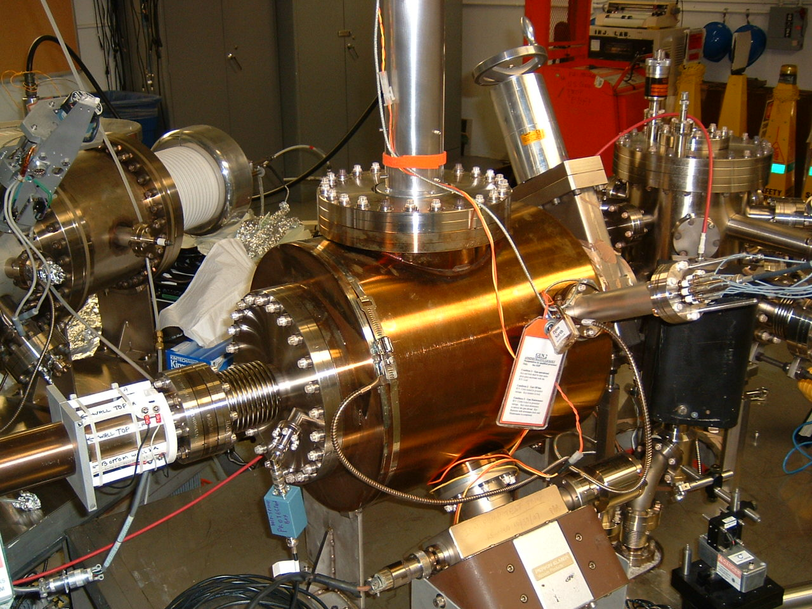
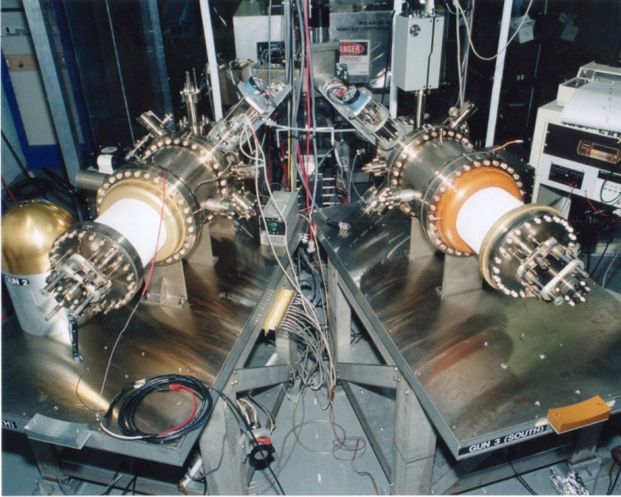
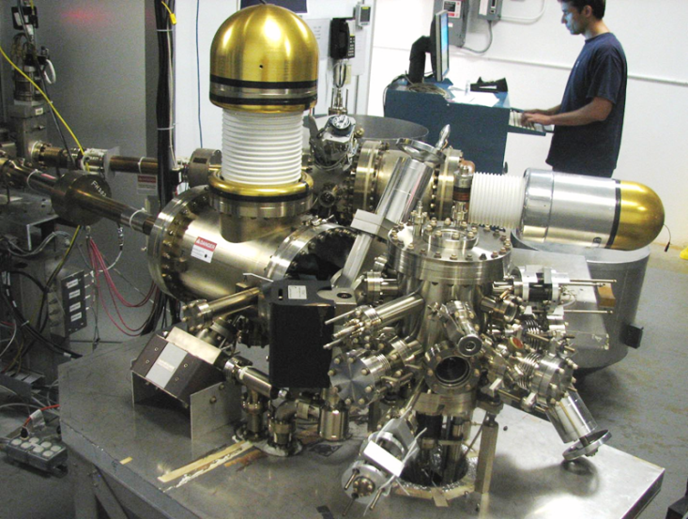
Always Tweaking the Design
1
Text goes here
4
Endless (?) quest for perfection
2
3
Notes:
Interior Page Design 1

Slide 5
Benefits of Higher Gun Voltage
Reduce space-charge-induced emittance growth, maintain small transverse beam profile and short bunch-length. In other words, make a “stiff” beam right from the gun
Reduce problems associated with Surface Charge Limit (i.e., QE reduction at high laser power)
Prolong Charge Lifetime (?)
Compact, less-complicated and less-expensive injector, compatible with JLab FEL
Biggest Obstacle: Field Emission and HV Breakdown… which lead to bad vacuum and photocathode death
Notes:
Interior Page Design 2

Slide 6
Field Emission
Sources of Field Emission: micro-protrusions, contamination on surface, material defects and impurities, ionization of desorbed gas, etc.,
Material choices: hardness, work function, grain structures and grain boundaries, electrical conductivity, thermal conductivity
Surfaces: generally people assume smooth is better than coarse, although experiments indicate smooth does not guarantee “good”
Mostly, people assume 5 MV/m is “easy”
Notes:
Interior Page Design 2

Slide 7
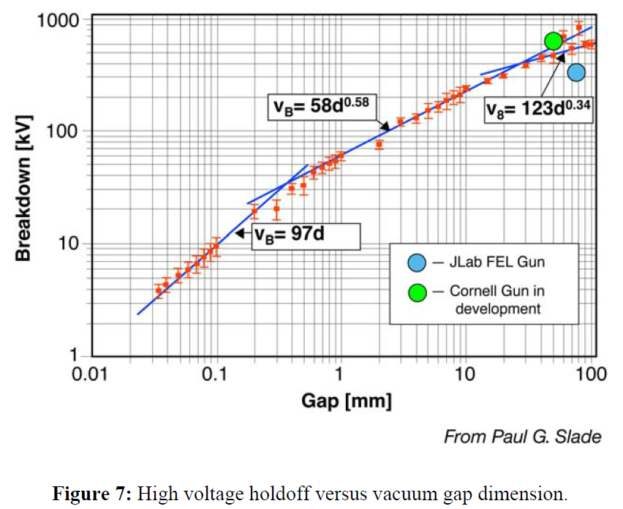
Breakdown
Inside vacuum
  Conditioning resistor can help protect electrodes
  But cables have stored energy
Outside vacuum, at the cable connection
  Do you need SF6? Probably not
Notes:
Interior Page Design 2

Slide 8
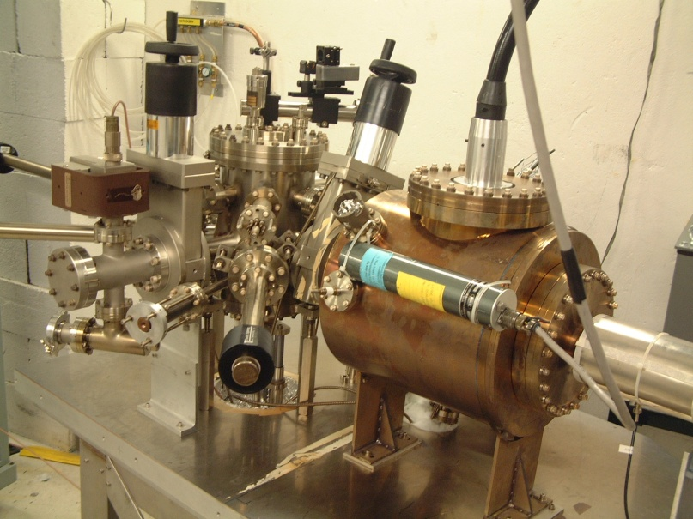
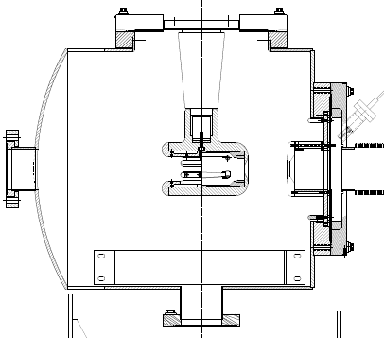
The CEBAF - ILC 200kV Inverted Gun
Maximum field strength ~ 7 MV/m
New design
Higher voltage = better beam quality
The inverted design might be the best way to reach voltages > 350kV
Notes:
Interior Page Design 2

Slide 9
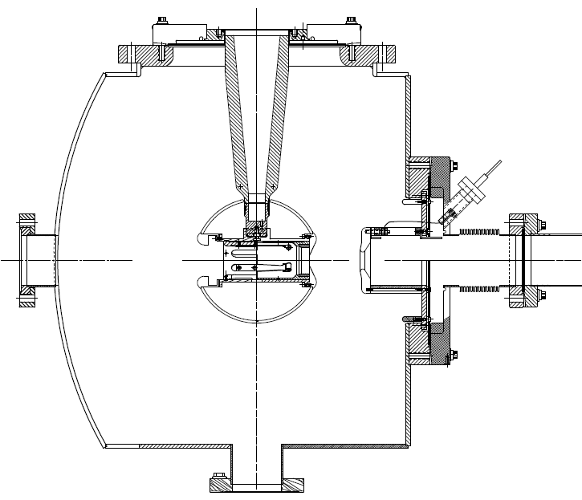
The 350 kV Photogun at Jlab FEL
Maximum Field strength ~ 10 MV/m
CEBAF 200kV Inverted Gun
Longer “R30” insulator
Spherical electrode
Thin NEG sheet to move ground plane further away
Notes:
Interior Page Design 2

Slide 10
Things we’ve been Studying
Fowler-Nordheim Theory: a good place to start, but it will disappoint you…
Diamond-paste polished stainless steel
  Is it necessary to have such a smooth surface?
Gas conditioning: an essential tool
Electropolished stainless steel: might be an option
Barrel-polished stainless steel: another option
BCP-d niobium: pricey
TiN-coated aluminum: promising…
900 ºC degas, CO₂ snow, high pressure rinsing…?
Small inverted insulators and breakdown,
What about high voltage ripple?
Notes:
Interior Page Design 2

Slide 11
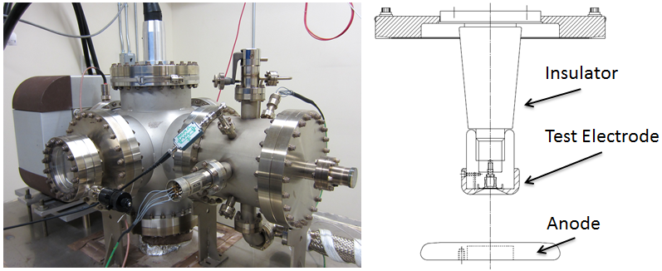
Field Emission Test Stand
Spellman -225kV supply, small “R28” inverted insulators, variable cathode/anode gap from to 10 to 50mm, field strength to ~ 20 MV/m
Build a test stand that resembles an actual gun (tests with small gaps and high field strength but low voltage, don’t appear to be very useful)
Notes:
Interior Page Design 2

Slide 12
Diamond-Paste Polishing
Receive the electrode from the machine shop with “32” surface finish
Silicon carbide polishing with 300 grit paper to remove obvious visible scratches
Solvent cleaning in ultrasonic bath of alkali solution
Silicon carbide polishing with 600 grit paper
Solvent cleaning in ultrasonic bath of alkali solution
Polish with 6mm grit
Ultrasonic clean
Polish with 3mm grit
Ultrasonic clean
High pressure rinsing (1200 psi) for 20 minutes with ultrapure de-ionized water with resistivity > 18 MΩcm.
High temperature (900ºC) vacuum degas for one hour
Notes:
Interior Page Design 2

Slide 13
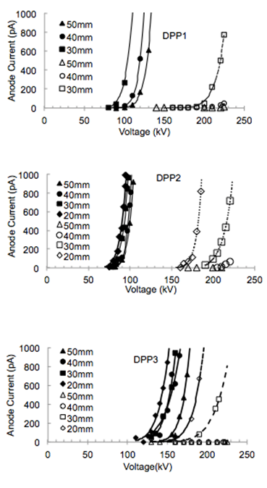
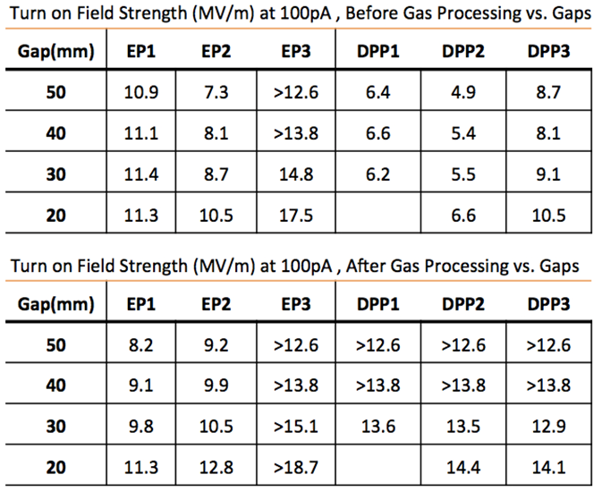
Diamond-Paste Polished Stainless Steel
Variable performance is common
Favorable response to gas conditioning
Notes:
Interior Page Design 2

Slide 14
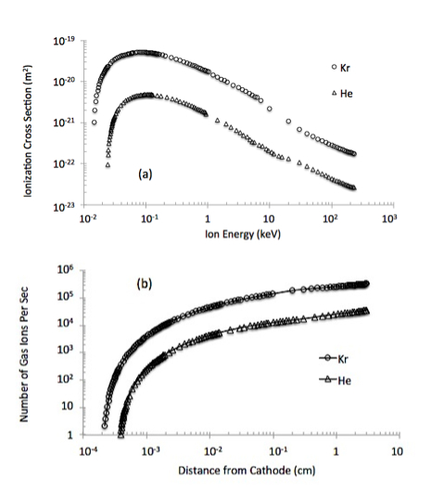
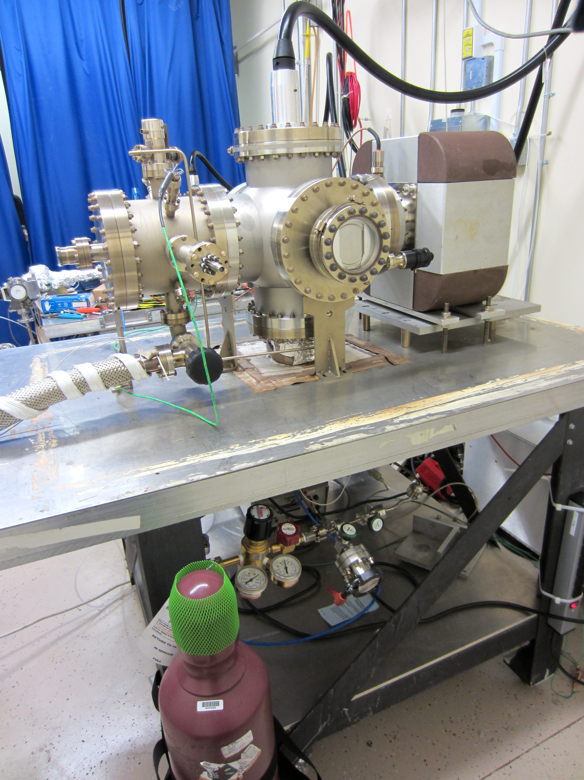
Gas Conditioning
Field emission ionizes inert gas
Ions bombard electrode, hopefully near field emitter, which can be sputtered away
And ions get implanted, increasing work function
Gas Bottle
Notes:
Interior Page Design 2

Slide 15
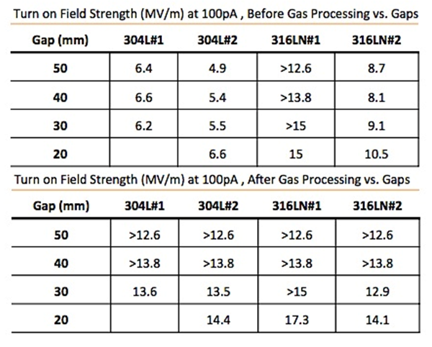
A Powerful Technique
Gas conditioning can turn a BAD electrode into a GOOD electrode
TURN OFF ion pump
NEG pumps don’t pump inert gas
Set voltage to excite field emitter
Add gas at 10⁻⁵ Torr, apply voltage and watch for sharp decrease in FE current
Perhaps 316L is better than 304L?
Notes:
Interior Page Design 2

Slide 16
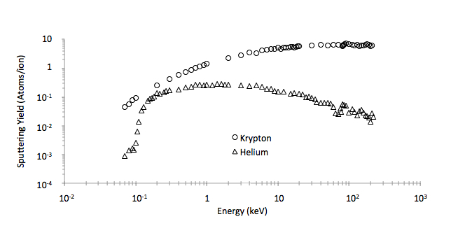
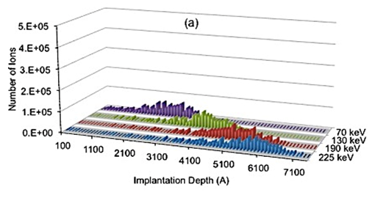
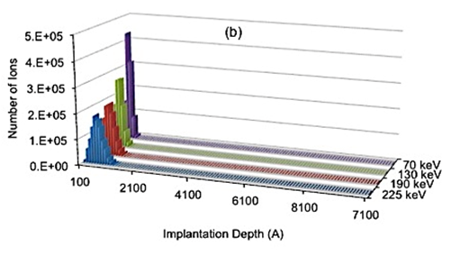
What Does Gas Conditioning Do?
Helium: we want a shallow implantation depth, so it seems to work best when FE turns ON at lower voltages, and/or with small gaps (10 to 20mm)
Krypton: can work at any voltage, good for larger gaps (30 to 50mm), sometimes too much sputtering
Helium
Krypton
Sputtering Yield
Notes:
Interior Page Design 2

Slide 17
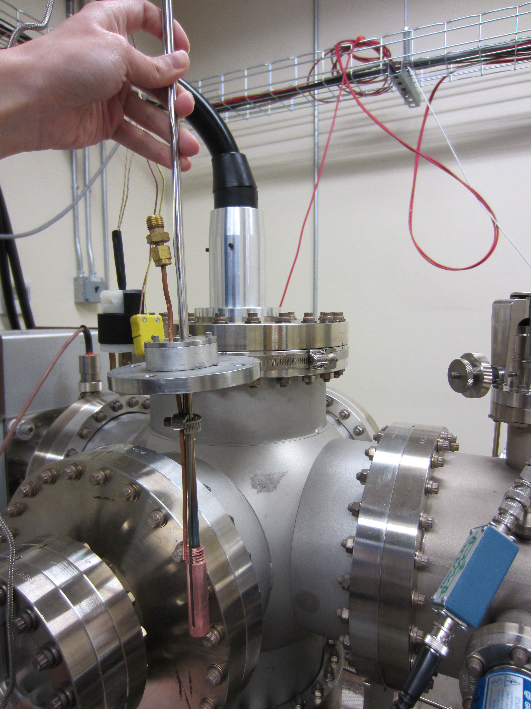
What Does Gas Conditioning Do?
Benefits of implantation are reversible
Notes:
Interior Page Design 2

Slide 18
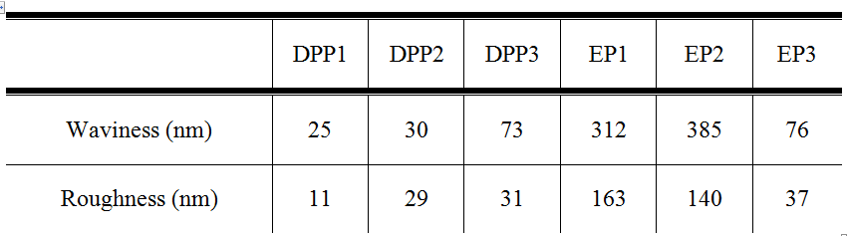
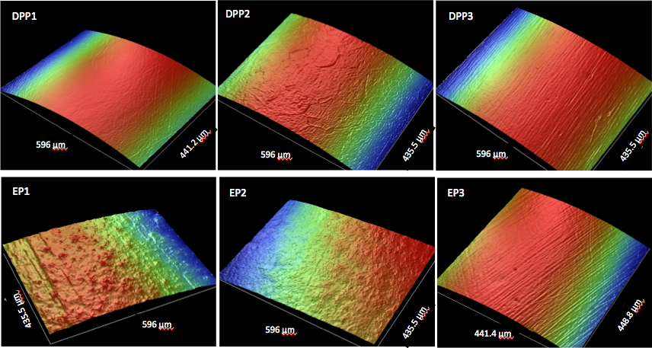
Electropolished Stainless Steel
Can we avoid time-consuming diamond-paste polishing?
Start with three test electrodes having different surface finish, and send them to commercial electropolishing company
Notes:
Interior Page Design 2

Slide 19
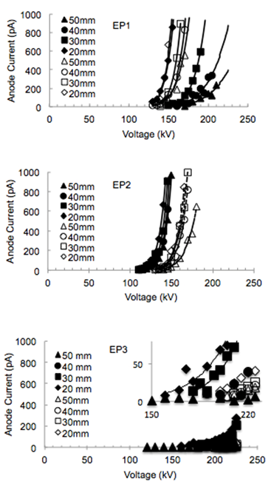
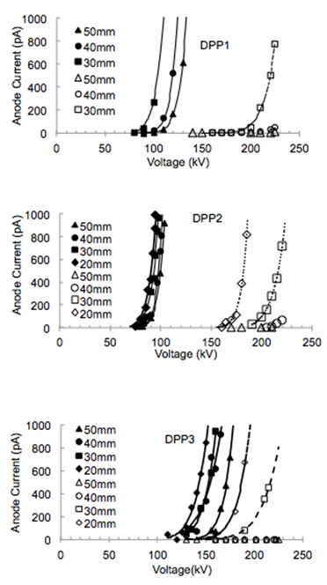
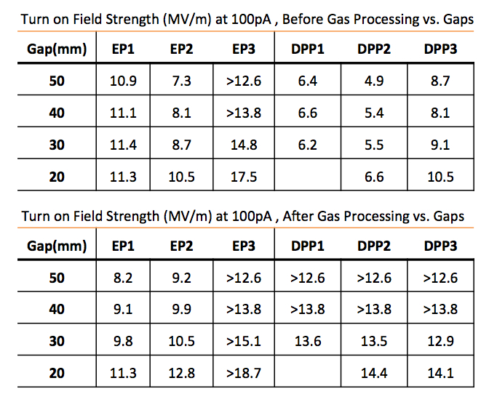
Electropolished Stainless Steel
EP-d electrodes exhibited less variability
EP-d electrodes did not respond favorably to gas conditioning
Best electrode was DPP-d and EP-d
Notes:
Interior Page Design 2

Slide 20
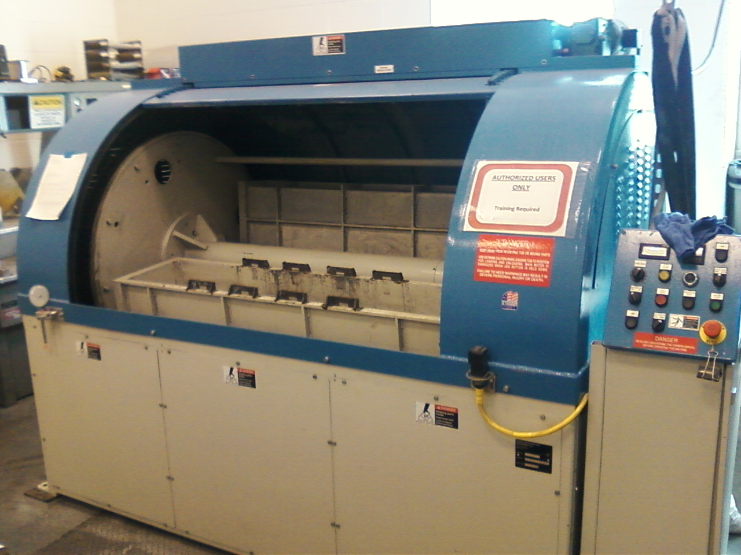
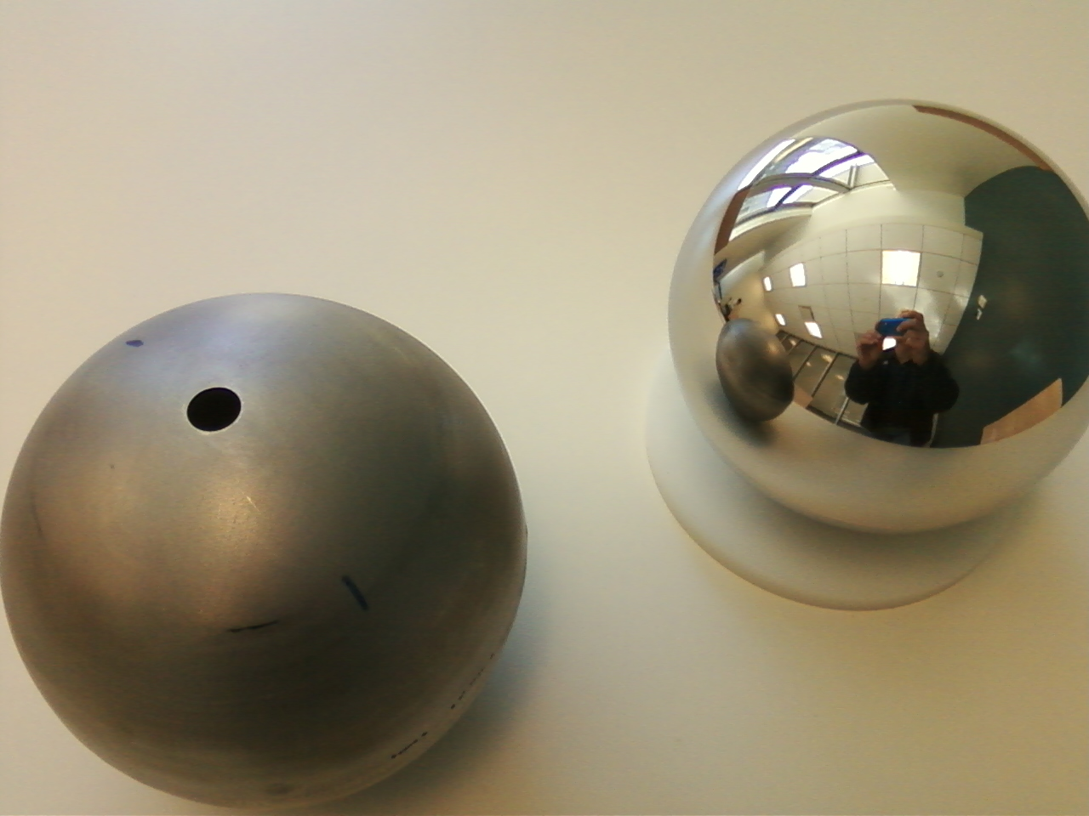
Barrel Polishing of Stainless Steel
On our to-do list for testing
Notes:
Interior Page Design 2

Slide 21
Buffered Chemical Polishing of Niobium
Receive the electrode from the machine shop with “32” surface finish
Silicon carbide polishing with 600 grit paper, if necessary, to remove obvious visible scratches
Solvent cleaning in ultrasonic bath of alkali solution
Buffered-chemical polishing to remove ~ 100 μm material
High pressure rinsing (1200 psi) for 20 minutes with ultrapure de-ionized water with resistivity > 18 MΩcm.
High temperature (900ºC) vacuum degas for one hour
Notes:
Interior Page Design 2

Slide 22
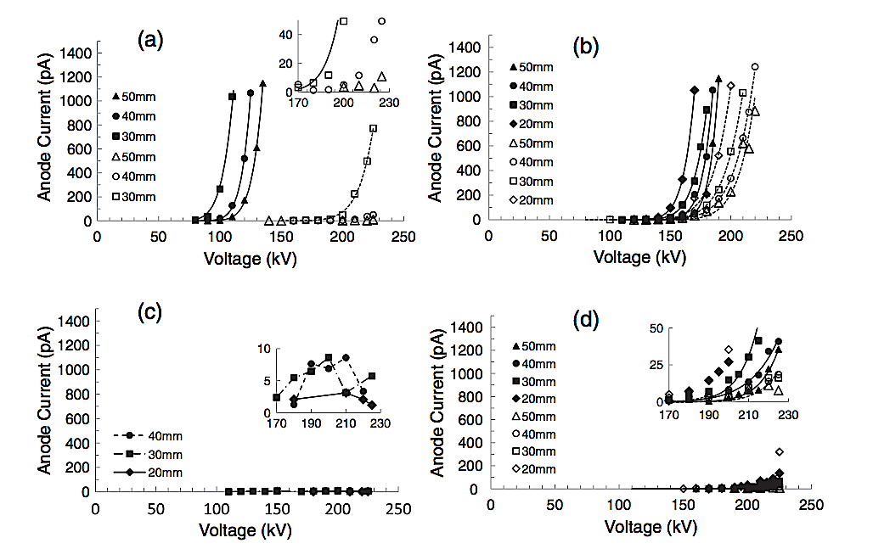
I to V curves for Niobium
Text goes here
304-SS
Fine Grain Nb
Large Grain Nb
Single Crystal Nb
Notes:
Interior Page Design 2

Slide 23
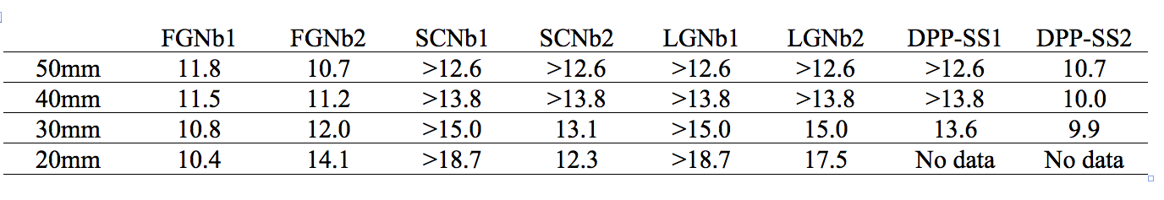
FE results of BCP-ed Niobium
Field strength at which the electrode exhibited 100pA of field emission, post krypton gas conditioning
“>” symbol….the electrode did not produce 100pA of field emission
Notes:
Interior Page Design 2

Slide 24
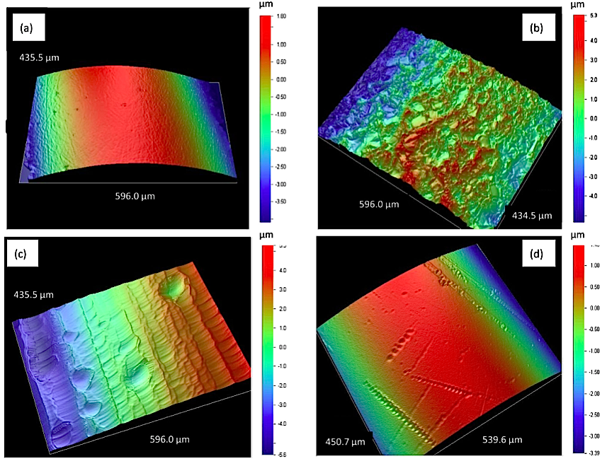
Niobium Electrodes
More evidence that there’s more to field emission than topography
SS Roughness: 10.9 nm
FGNb Roughness: 215.1 nm
LGNb Roughness: 141.01 nm
SCNb Roughness: 17.6 nm
This one performed best!
Notes:
Interior Page Design 2

Slide 25
TiN-coated aluminum
Aluminum is cheap and easy to machine
Takes just hours to polish to mirror-like finish with silicon-carbide paper
Good thermal conductor, compared to steel
We used a “boutique” vendor to coat our small electrodes
Can an industrial TiN-coating provide the same benefit? Need to test
Notes:
Interior Page Design 2

Slide 26
TiN-coated aluminum
Bare aluminum
TiN-coated
aluminum
Diamond-paste polished Ti-alloy
Notes:
Interior Page Design 2

Slide 27
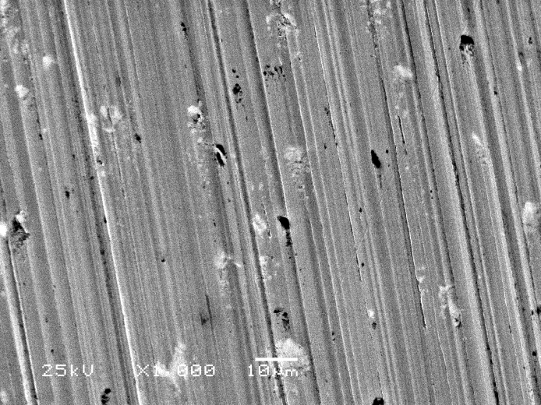
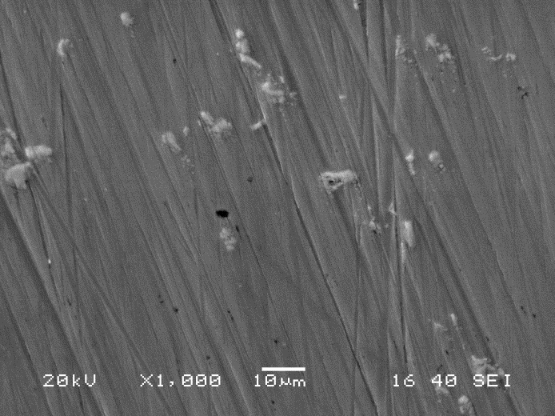
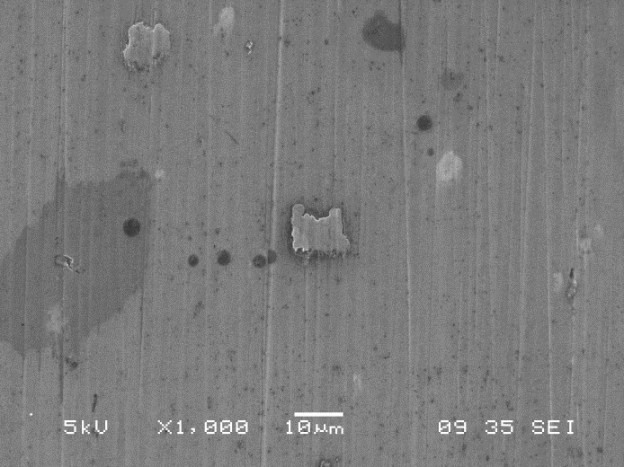
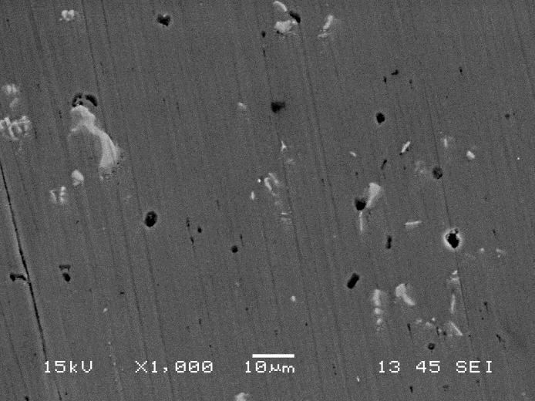
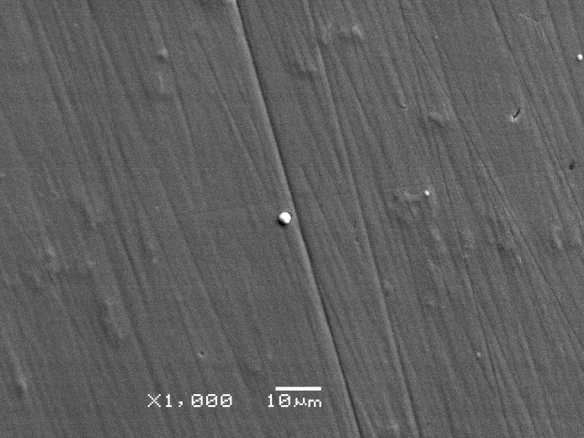
Surface Images Al and TiN-Al
Al: 400 grit
Al: 600 grit
Al: 800 grit
Al: 1200 grit
TiN coated: 1200 grit
Note, the black spots are voids and defects, not particulate contamination from sand paper polishing
Notes:
Interior Page Design 2

Slide 28
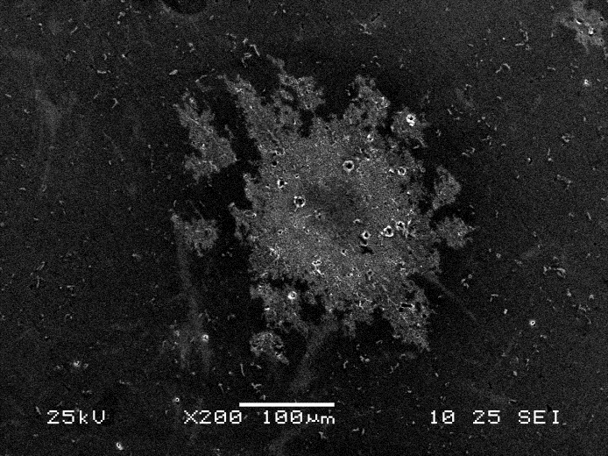
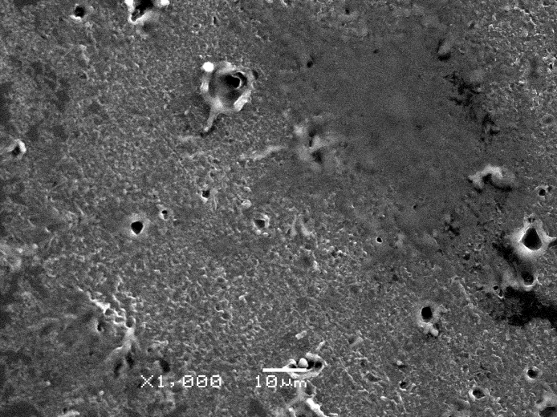
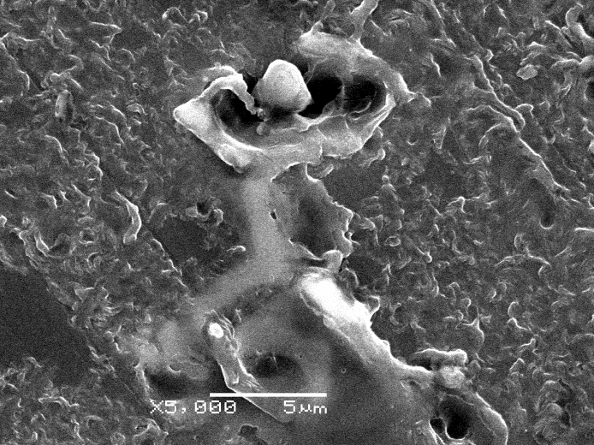
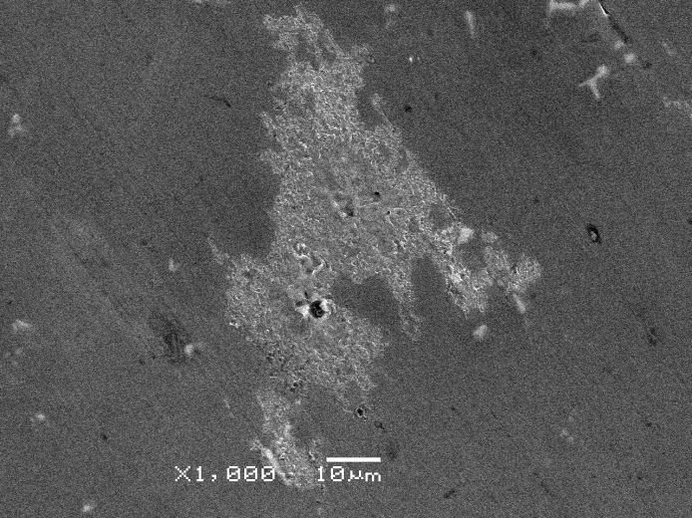
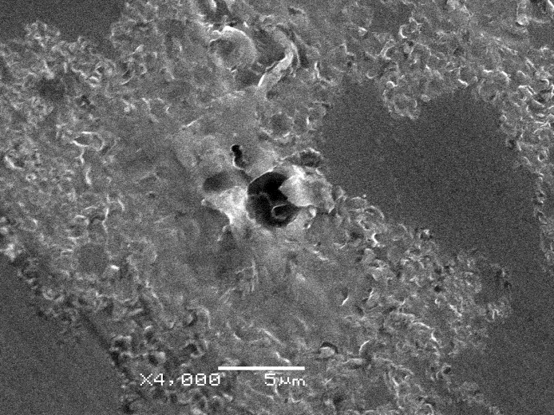
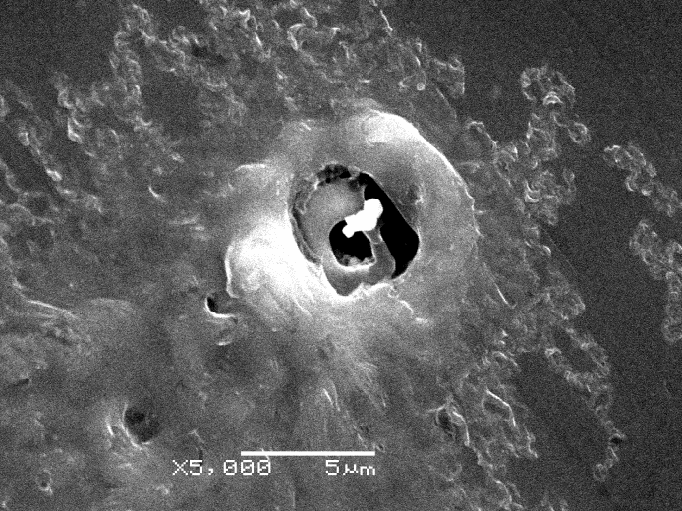
Bare Aluminum
Intense localized heating from sputtering & ion bombardment during gas processing
Notes:
Interior Page Design 2

Slide 29
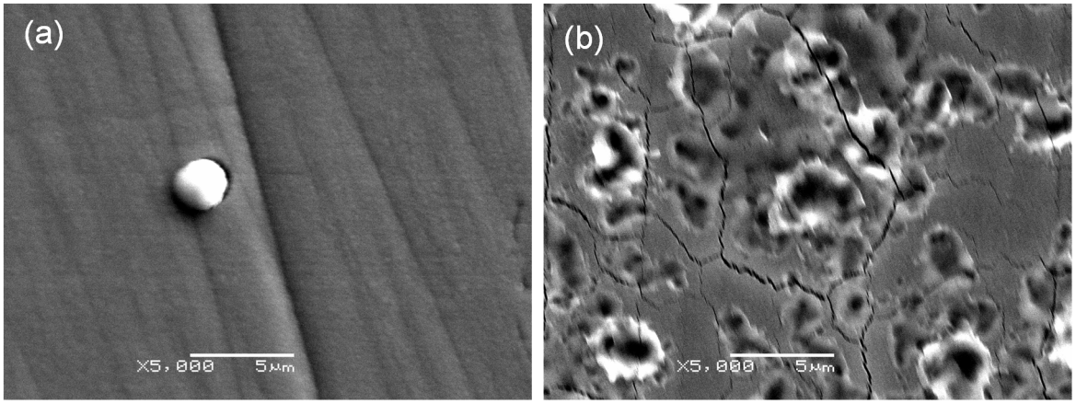
TiN-coated Aluminum
Can be pushed too hard
“happy” at 18.7 MV/m the small white “globs” don’t seem to be a problem
Breakdown at 22.4 MV/m
We pushed all our samples too hard…
Notes:
Interior Page Design 2

Slide 30
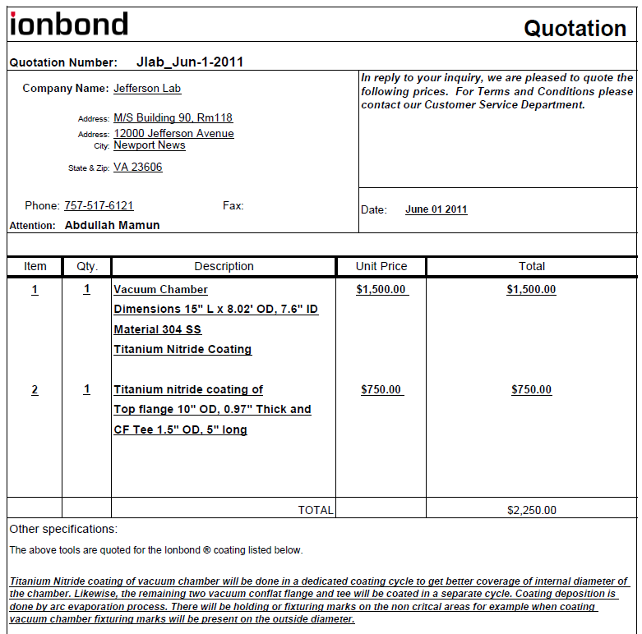
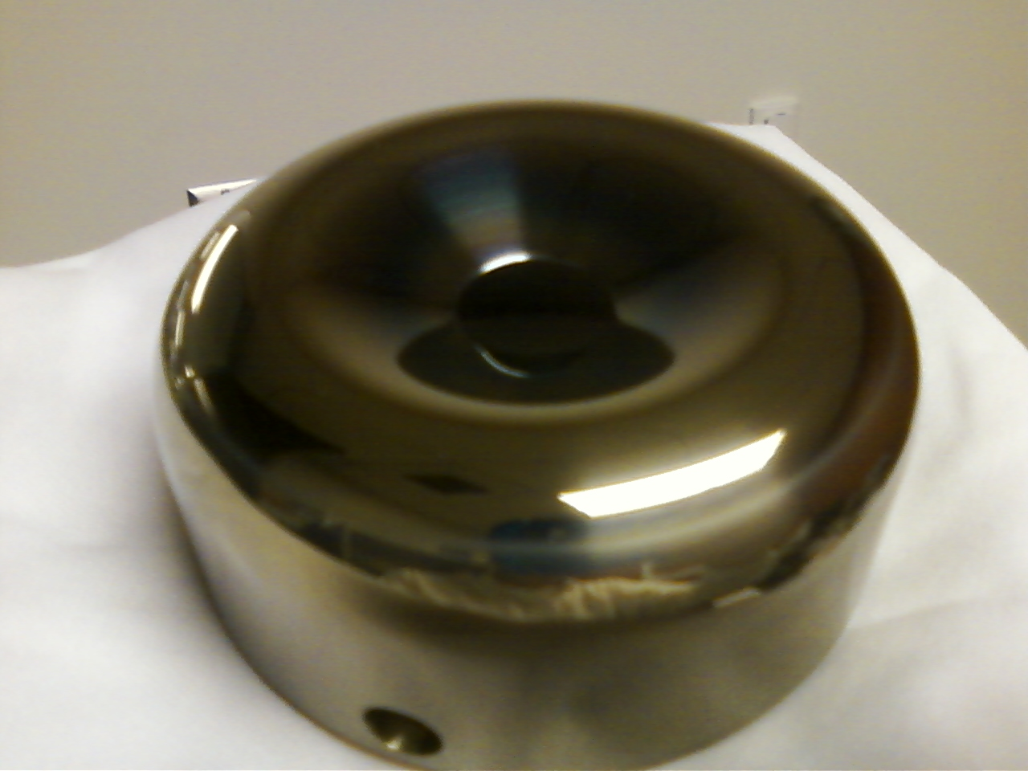
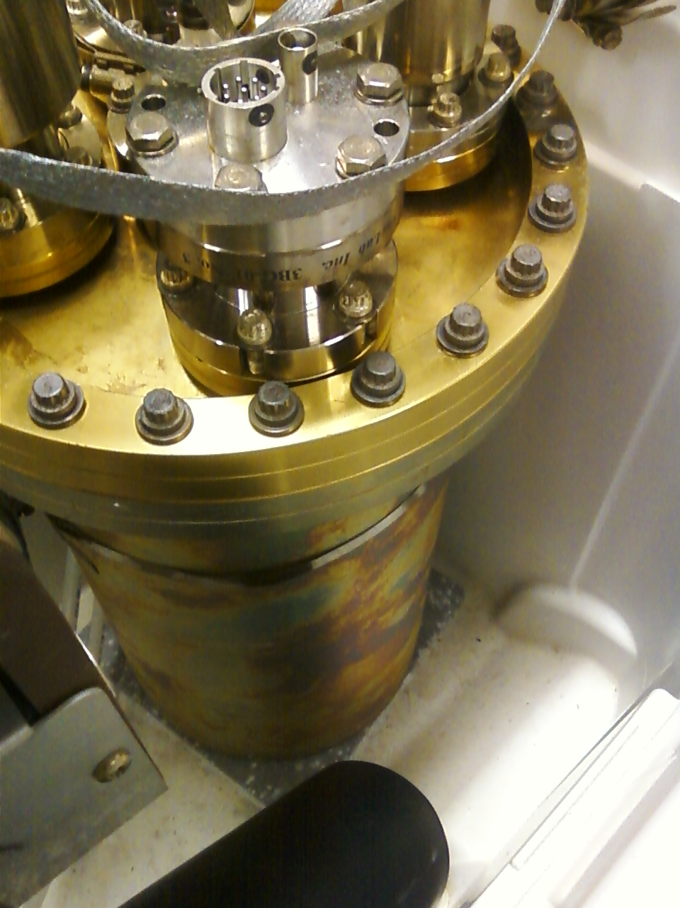
TiN-coatings
Ion-assisted implantation, small pieces
Industrial arc-evaporation, fine for big pieces
Vacuum diffusion barrier
Notes:
Interior Page Design 2

Slide 31
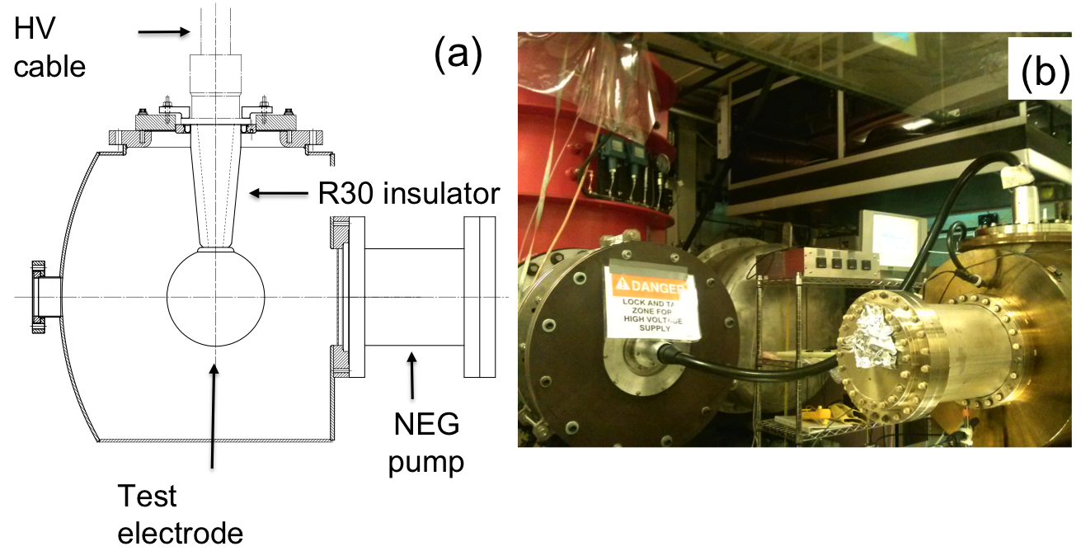
Building the 350 kV Gun
Start with “dummy” electrodes and test different insulators and cathode screening electrode
Notes:
Interior Page Design 2

Slide 32
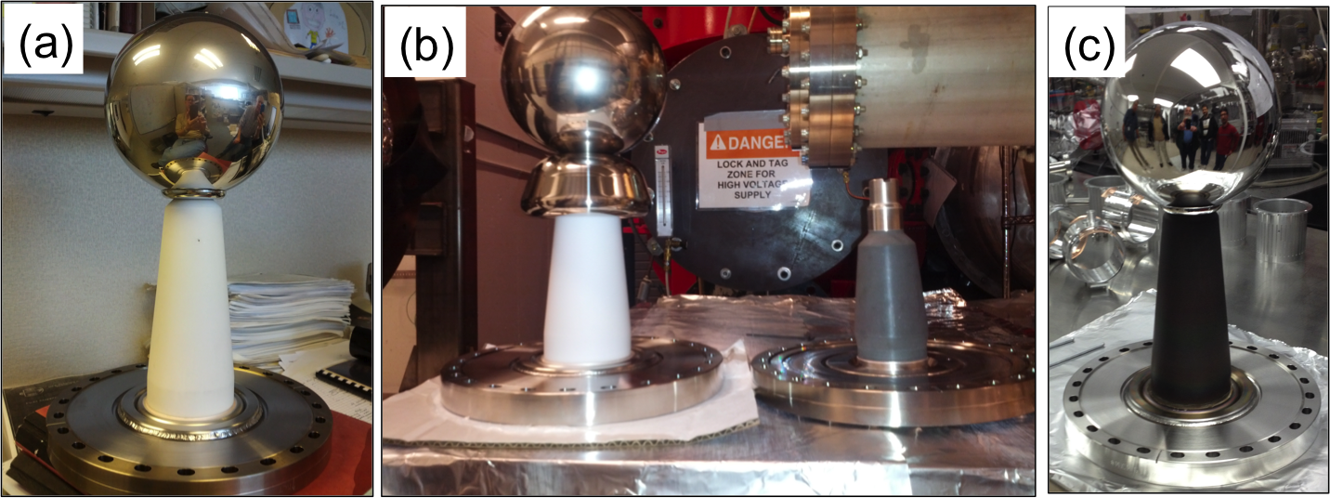
Insulators and Screening electrode
Longer R30 insulators, conventional alumina
Short R28 insulator, bulk resistivity, mildly conductive
ZrO-coated R30 insulator, also mildly conductive
dummy electrode and with a screening electrode
Notes:
Interior Page Design 2

Slide 33
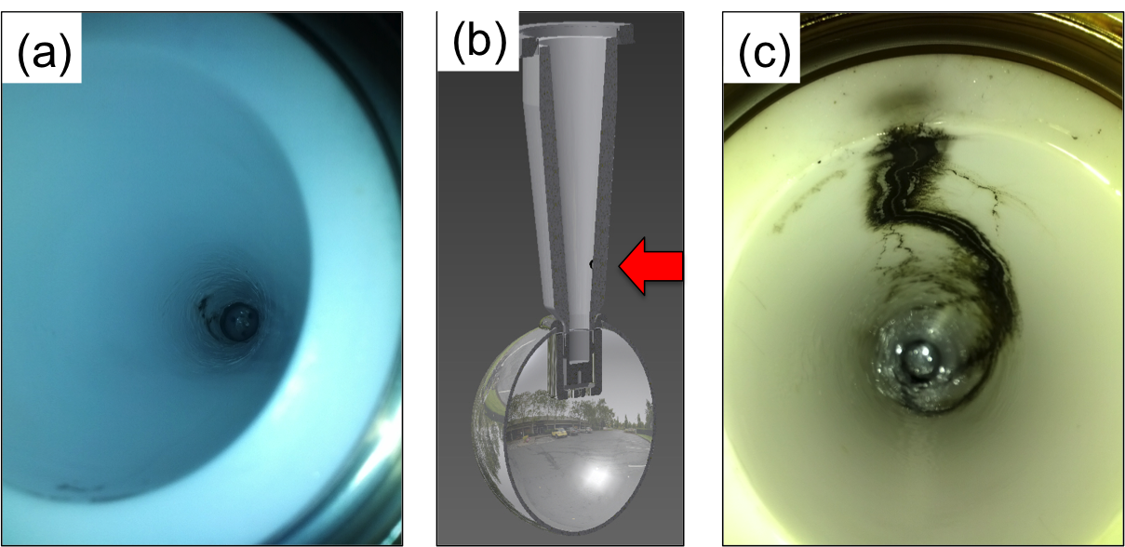
Breakdown
Problems at the cable junction, atmosphere side
Notes:
Interior Page Design 2

Slide 34

Summary of Tests
Two configurations reached our voltage goal
Notes:
Interior Page Design 2

Slide 35


Linear Potential Drop
Want a linear potential gradient along length of the insulator
Notes:
Interior Page Design 2

Slide 36




Fowler-Nordheim Line Plots
$$I= C_{1}{A_{e}β}^{2}E^{2}e^{{−C_{2}}/{βE}}$$
$C_{1}=\frac{1.54x{10}^{−6 }∙{10}^{4.52⋅φ^{−0.5}}}{φ}$
$C_{2}=6.53x{10}^{9}φ^{1.5}$
$slope= \frac{d(\log_{10}I/{E^{2})}}{d(1/E)}$= - $\frac{2.84×{10}^{9}φ^{1.5}}{β}$
intercept = ${{Log}_{10}({I_{F}}/{E^{2})}}_{E→∞}={Log}_{10}[\frac{1.54×{10}^{−6}A_{e}β^{2}{×10}^{4.52φ^{−0.5}}}{φ}]$
But it’s wrong to assume work function, Φ , is a constant
With three variables, there are an infinite number of solutions that provide a good fit
These plots tell you β, the field enhancement factor, and A_{e}, the field emitter area
Notes:
Interior Page Design 2

Slide 37


Fowler-Nordheim Line Plots
Text goes here
Notes:
Interior Page Design 2

Slide 38
Conclusions
Scale-up the tests, from small electrodes to large electrodes
Electropolished stainless steel vs TiN-coated aluminum
Test the industrial TiN:Al coating process
Vacuum requirements: NEGs + ion pump, with valves to allow gas conditioning?
Need electrostatic model of entire chamber, field strength should be modest everywhere, not just between plates
Questions: 480 electrodes each 2.5 m long, what capacitor shape, length, parallelism, allowed levels of field emission, how to monitor field emission, moveable capacitor plates, required vacuum, types of pumps, will chamber be baked, insulators and how to attach to electrodes, how many HV supplies, HV supply ripple, cable lengths and stored energy, etc.,
Notes:
Interior Page Design 2

Slide 39
Backup Slides
Thank You
Notes:
Interior Page Design 2

Slide 40

HV Issues: inside and outside the gun
600 kV supply at FEL gun test stand, with SF6 tank
Inverted insulator
4.5” long CEBAF insulator
reached 470kV before arcing to ground
Learn to apply high voltage without breakdown, dielectric plug inside insulator,
Then address the field emission problems inside the gun

Slide 41




Niobium
Capable of operation at higher voltage and gradient?
Buffer chemical polish (BCP) much easier than diamond-paste-polish
Conventional geometry: cathode electrode mounted on metal support structure
Replace conventional ceramic insulator with “Inverted” insulator: no SF6 and no HV breakdown outside chamber

Slide 42




Plan B
Insulator sleeve
Plan A
No Improvement
Plan D
Plan C
In hand, but untested

Slide 43


Second Inverted Gun @ Injector Test Cave
Large grain Niobium (Nb) cathode electrode
HV Power Supply: Spellman 225 kV, 30 mA
Why a Niobium electrode?
  Buffered-chemical polishing (BCP) for ~ 1 hour, no need for hand-polishing (takes weeks)
  No field emission at high field gradients (up to12 MV/m)

Slide 44



HV Conditioning and Field Emission
Inside the Gun Chamber
Floating Anode
connected to
Pico-ammeter
Macor glass-ceramic
spacer
100 MΩ
Conditioning
Resistor
We now have 200kV gun with no field emission:
Hand and Buffered Chemical Polished Large Grain Niobium material
Transformer
Oil Tank
A Short for Beam
Delivery

Slide 45
Benchmarking PARMELA Simulation Results Against Beam-Based Measurements at CEBAF/Jefferson Lab – work of Ashwini Jayaprakash, JLab
Measurements at CEBAF/JLab
PARMELA Simulation Results
Similar Trends
Message: Beam quality, including transmission, improves at higher gun voltage

Slide 46


Surface Appearance before HV testing
1200 grit polished
Uncoated Al
TiN Coated Al
41st ICMCTF, April 28 - May 2, 2014, San Diego, CA, USA

Slide 47

Surface images of bare aluminum
SEM images of HV conditioned Al electrode
(a) prior to He processing and (b) post-He processing.
Lots of craters developed during gas conditioning at the field emitted sites
41st ICMCTF, April 28 - May 2, 2014, San Diego, CA, USA

Slide 48

Surface images of bare aluminum
SEM and EDS of post-He processed and HV conditioned bare Al electrode depicting
(a) a field emitted area and (b) the chemical analysis of the emitted area.
No silica contamination
Lots of oxide formation in the FE sites
41st ICMCTF, April 28 - May 2, 2014, San Diego, CA, USA

Slide 49

Surface images of TiN coated Al6061 electrode
As fabricated and before HV application
(a) prior to TiN coating and (b) post-TiN coating.
TiN coating effectively serves to hide the underlying material defects
800 grit 1200 grit 1200 grit uncoated uncoated TiN coated
RMS roughness 20 nm 16 nm 13 nm
(form 2 mm line scans using profilometer on representative coupons)
41st ICMCTF, April 28 - May 2, 2014, San Diego, CA, USA

