Slide 1
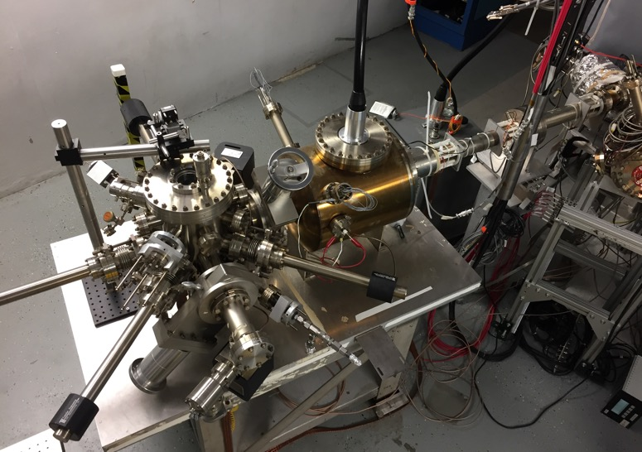
Polarized Electrons for Polarized Positron Beams
This work is supported by the U.S. Department of Energy contract DE-AC05-06OR23177 and the U.S.-Japan Science and Technology Cooperation Program in High Energy Physics
Joseph Grames, Carlos-Hernandez Garcia,
Md. Abdullah Mamun, Matt Poelker, Josh Yoskowitz
Jefferson Laboratory, USA
International Workshop on Future Linear Colliders
LCWS2019 Sendai, October 28 – November 1

Slide 2
Electron Polarization History at JLab

Slide 3
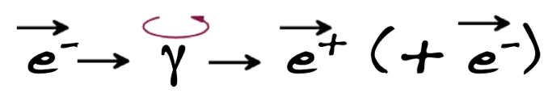
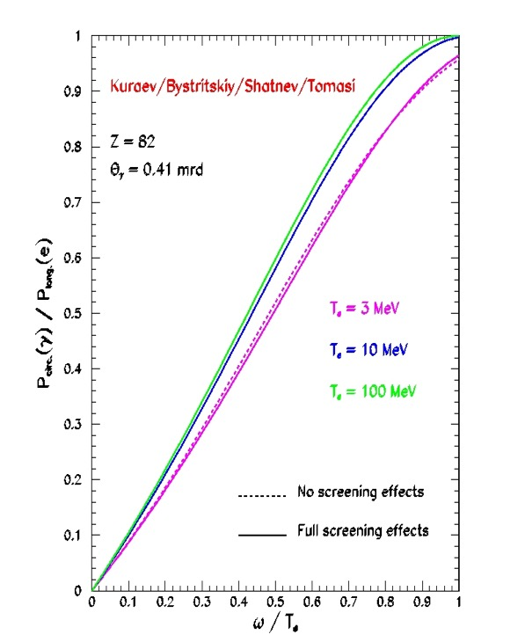
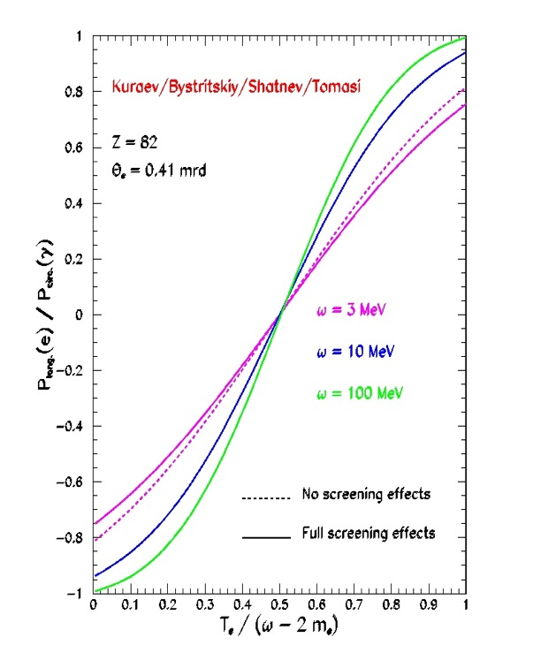

Polarized Bremsstrahlung & Pair Creation at Low Energy
Polarized Bremsstrahlung
Polarized Pair Creation
P_{circ}(γ) / P_{z} (e⁻)
P_{z} (e⁺) / P_{circ} (γ)
Longitudinal spin polarization passes from incident electrons to outgoing pair-produced positrons in the electromagnetic shower, when incident on a target, e.g. high-Z material useful.
E_{γ} / T_{e-}
T_{e+} / (E_{γ} – 2m_{e+})
E.A. Kuraev, Y.M. Bystritskiy, M. Shatnev, E.Tomasi-Gustafsson, PRC 81 (2010) 055208

Slide 4
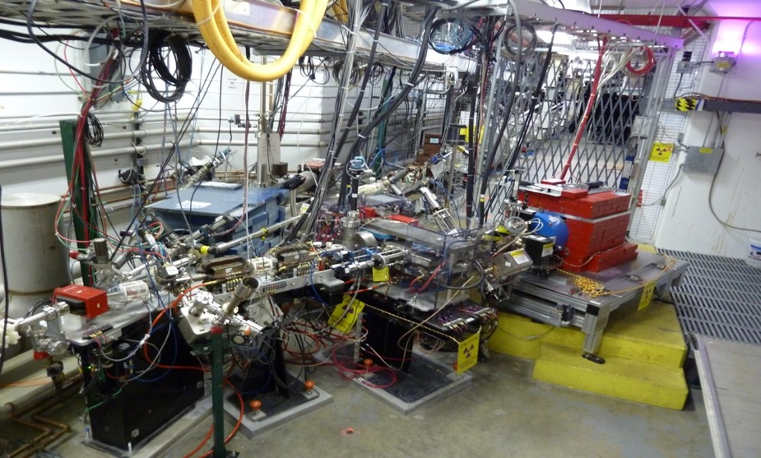
PEPPo Experiment at CEBAF
J. Grames, E. Voutier et al.,
JLab Experiment E12-11-105 (2011)
(PEPPo Collaboration) D. Abbott et al., Phys. Rev. Lett. 116 (2016) 214801
8 MeV, 1μA, 85% polarization
PEPPo possible due to support from SLAC E166, DESY, Princeton, Cornell, International Linear Collider Project and the Jefferson Science Associates

Slide 5
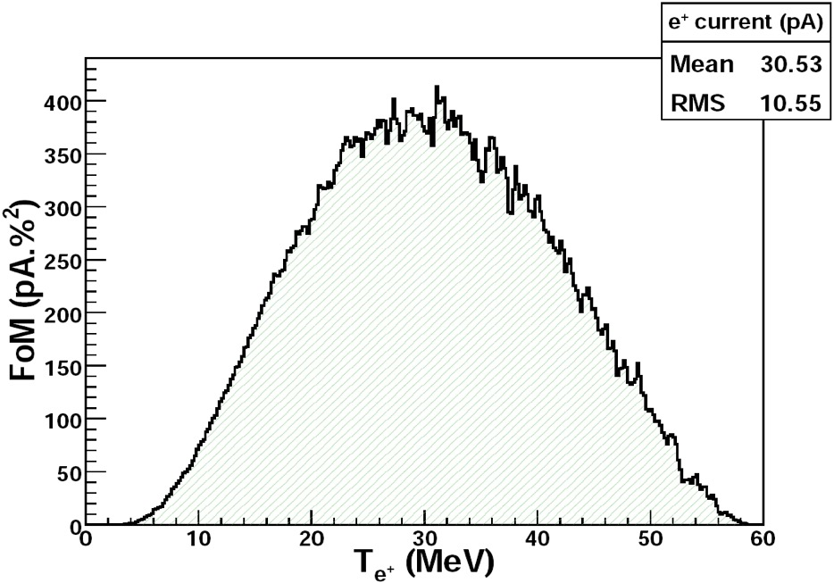
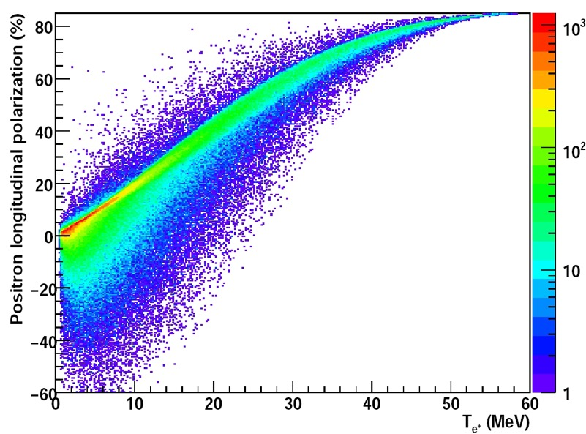

PEPPo : Advantages & Disadvantages
The polarization transfer can be high but the distribution is dominated by low-energy events.
A general feature is the positron energy at the optimum FoM (P²I) is about half of the electron beam energy.
Optimum
FoM
Optimum energy
J. Dumas, J. Grames, E. Voutier, JPos09, AIP 1160 (2009) 120

Slide 6
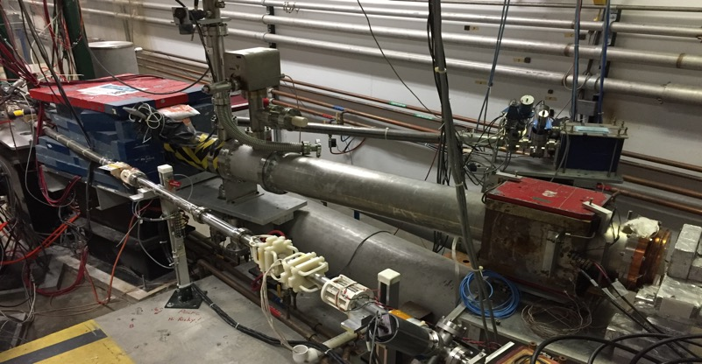
>85% electron beam polarization at milli-amp current
First measurement of beam polarization at JLab from superlattice (GaAs/GaAsP photocathode at milli-Ampere current
CEBAF 5 MeV Mott polarimeter: on-going effort to ascribe sub-percent accuracy (collaborators D. Moser, X. Roca-Maza, Charles Sinclair, M.J. McHugh, and Tim Gay)
CEBAF 5 MeV Mott Polarimeter

Slide 7

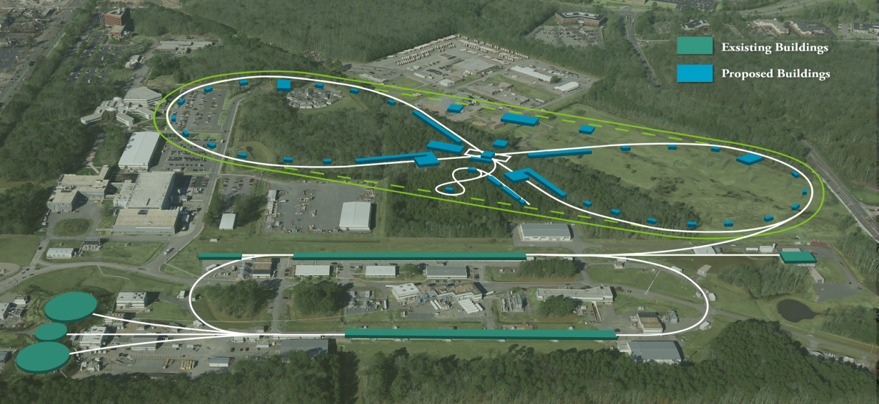
Polarized Positrons at Jefferson Lab
Publication of the JPos17 proceedings
(free access at https://aip.scitation.org)
describing the science of polarized positron beams and physics for JLab 12 GeV and JLEIC, and their applications for fundamental research in Atomic Physics and Material Science
User Parameter | CEBAF | JLEIC
Positron Polarization | >50% | >40%
Average Current | >100 nA | >10 nA
Duty Factor | 100% (499 MHz) | 50 Hz (17 MHz)

Slide 8
ILC and JLab GaAs photogun parameters
Parameter \ Machine => | CEBAF | SLC | JLab/FEL | Cornell ERL | LHeC | eRHIC | CLIC | ILC | JLEIC(e+) | CEBAF (e+)
Polarization | Yes | Yes | No | No | Yes | Yes | Yes | Yes | Yes | Yes
Number electrons/microbunch | 2.5 x 10⁶ | 1 x 10¹¹ | 8.3 x 10⁸ | 4.8 x 10⁸ | 1 x 10⁹ | 2.2 x 10¹⁰ | 6 x 10⁹ | 3 x 10¹⁰ | 1.2 x 10¹⁰ | 2.5 x 10⁸
Number of microbunches | CW | 2 | CW | CW | CW | CW | 312 | 3000 | 900 | CW
Width of microbunch | 50 ps | 2 ns | 35 ps | 2 ps | 100 ps | ~ 100 ps | ~ 100 ps | ~ 1 ns | 100 ps | 50 ps
Time between microbunches | 2 ns | 61.6 ns | 13 ns | 0.77 ns | 25 ns | 71.4 ns | 0.5002 ns | 337 ns | 1.33 ns | 4 ns
Microbunch rep rate | 499 MHz | 16 MHz | 75 MHz | 1300 MHz | 40MHz | 14MHz | 1999 MHz | 3 MHz | 750 MHz | 250 MHz
Width of macropulse | - | 64 ns | - | - | - | - | 156 ns | 1 ms | 1.1 ms | -
Macropulse repetition rate | - | 120 Hz | - | - | - | - | 50 Hz | 5 Hz | 50 Hz | -
Charge per micropulse | 0.4 pC | 16 nC | 133 pC | 77 pC | 500 pC | 3.6 nC | 0.96 nC | 4.8 nC | 2 nC | 40 pC
Charge per macropulse | - | 32 nC | - | - | - | - | 300 nC | 14420 nC | 1800 nC | -
Average current from gun | 200 uA | 2 uA | 10 mA | 100 mA | 20 mA | 50 mA | 15 uA | 72 uA | 88 uA | 10 mA
Average current in macropulse | - | 0.064 A | - | - | - | - | 1.9 A | 0.0144 A | 0.034 A | -
Duty Factor | 2.5 x 10⁻² | 2.8 x 10⁻⁷ | 2.6 x 10⁻³ | 2.6 x 10⁻³ | 4 x 10⁻³ | 1.4 x 10⁻³ | 0.2 | 3x10⁻³ | 2.6 x 10⁻³ | 1.2 x 10⁻²
Peak current of micropulse | 8 mA | 8 A | 3.8 A | 38.5 A | 5 A | 35.7 A | 9.6 A | 4.8 A | 20 A | 0.8 A
Current density* | 4 A/cm² | 10 A/cm² | 19 A/cm² | 500 A/cm² | 100 A/cm² | 182 A/cm² | 12 A/cm² | 6 A/cm² | 20 A/cm² | 16 A/cm²
Laser Spot Size* | 0.05 cm | 1 cm | 0.5 cm | 0.3 cm | 0.5 cm | 0.5 cm | 1 cm | 1 cm | 1 cm | 0.10 cm
* Loose estimates
Demonstrated
Proposed (excuse outdated values)
My Speculations

Slide 9
R&D aligned with e-driven (polarized) positron source
Photocathode Lifetime
Higher voltage guns
PEPPo-II

Slide 10
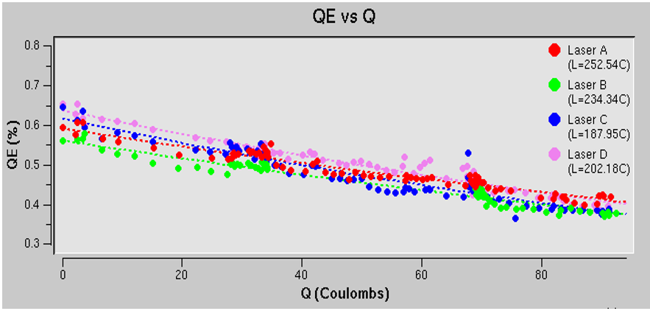
Recent CEBAF Polarized Source Performance
  Strained Superlattice GaAs/GaAsP (SVT #5756-4)
  Good Polarization 85-87%
  Good QE > 1% after activation => 6 mA/Watt/% @ 780 nm
  Lifetime about 200 C (σ_{4D} ~ 1mm) at currents < 200 uA
  Heat and re-activate during scheduled long shutdowns

Slide 11
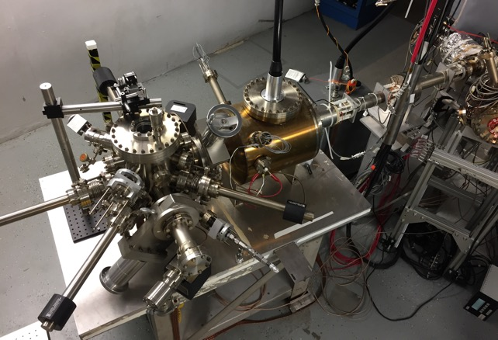
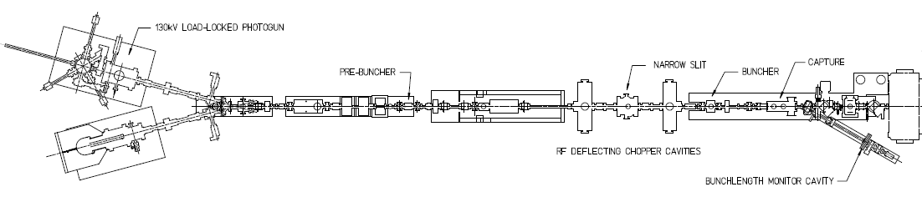
Lifetime Studies at mA Beam Current
Polarized positrons for CEBAF
High Current eRHIC EIC
Test the limits of lifetime scaling vs. laser spot size
Test biasing anode positively
Make beam here
(-130kV, 0-1.5mA, 0-3pC)
Monitor vacuum and radiation levels along beam line
Deliver beam here
(Faraday cup)
Vary the laser beam size
(f=499 MHz, σ_{t} ~ 50 ps)

Slide 12
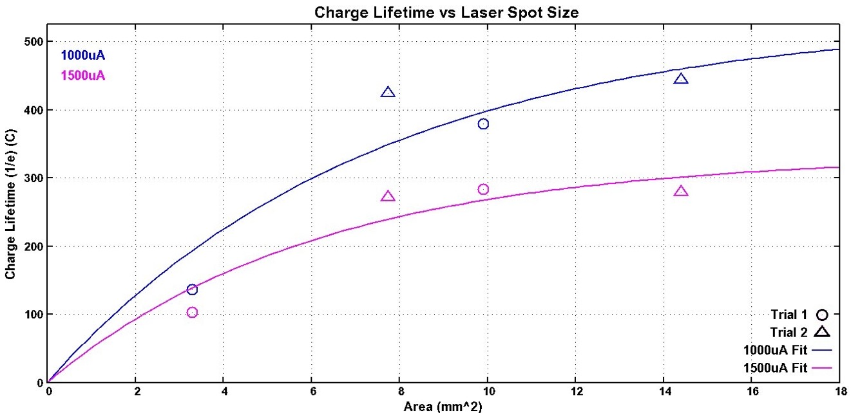
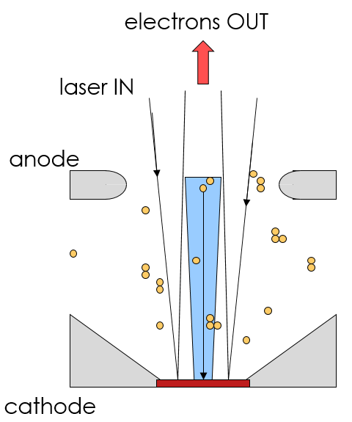
GaAs/GaAsP charge lifetime at mA Current
  CEBAF charge lifetime improves with larger laser spot size, as expected, but eventually beam size becomes “too large”
  Small amounts of beamloss adversely impact lifetime – to reap the reward of large laser spot size, no beamloss allowed!!
  Must consider intended and unintended photoemission….
1 mA for 4.7 days
1mA(2007)
CEBAF
4mA(2011)

Slide 13
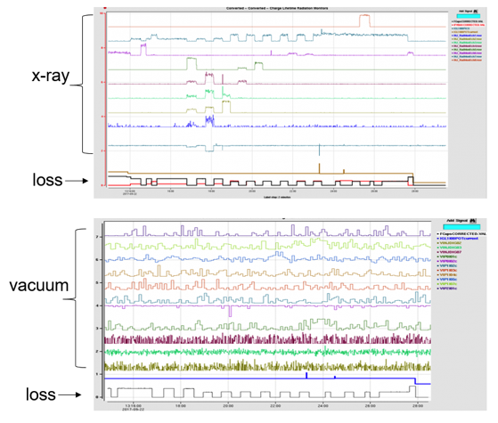
Detecting beam loss: x-ray detectors and ion pumps
X-ray monitors detect low level beam loss, sensitive to ~ 1 to 5 nA loss –
Even this level of beamloss adversely impacts lifetime
We always use ion pumps as beam loss monitors, but in this study, beamline pressure appeared constant

Slide 14
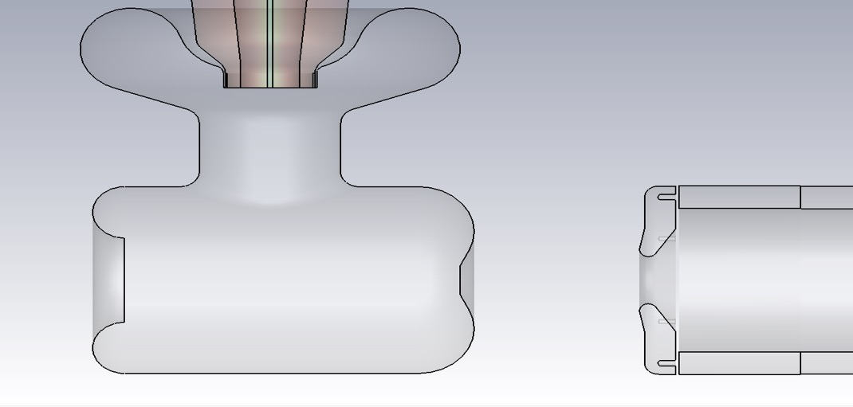
Motivation: Ion back-bombardment leads to QE reduction
Work of J. Yoskowitz
Anode
Cathode
Ions
Ions
e-beam
Residual gas in the photo-gun or adjacent beam line may be ionized by the electron beam
These ions may strike the photocathode, generate secondary electrons or x-rays, and desorb gas from surfaces; all leading to a reduction of the photocathode quantum efficiency (QE).
A positively biased anode should improve photocathode lifetime by limiting ion back-bombardment of the GaAs photocathode.

Slide 15
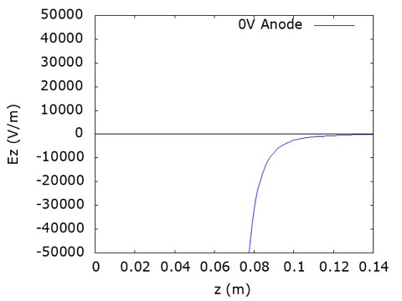

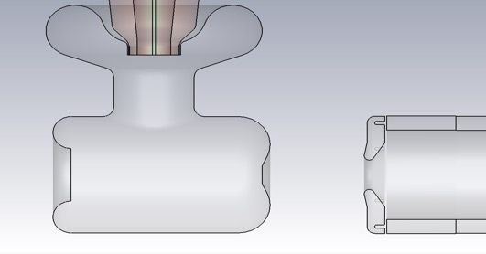
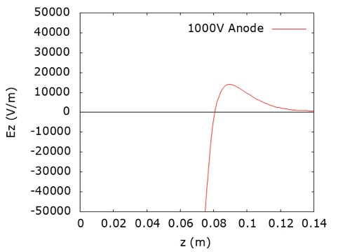
GPT Ion Tracking of CEBAF Gun with Anode Bias
Work of J. Yoskowitz
0 kV
Ions
Ions
-130 kV
e-beam
+1 kV
Ions
Ions
-130 kV
e-beam

Slide 16
Charge lifetime of CEBAF photocathode vs anode bias
Work of J. Yoskowitz
Region | Anode Bias (V) | Laser A Lifetime (C) | Laser B Lifetime (C) | Laser C Lifetime (C)
1 | 0 | 181 ± 8 | 161 ± 9 | 169 ± 7
2 | 961 | 424 ± 53 | 392 ± 23 | 346 ± 16
3 | 0 | 288 ± 39 | 304 ± 14 | 297 ± 5
4 | 961 | 303 ± 18 | 302 ± 9 | 314 ± 11
Charge lifetime improved with biased anode by ~2x over first ~125 C of the test
Interestingly lifetime increased, but not as much, over second ~125 C of the test
On average the lifetime improved by ~50% over the 3 month run period.

Slide 17
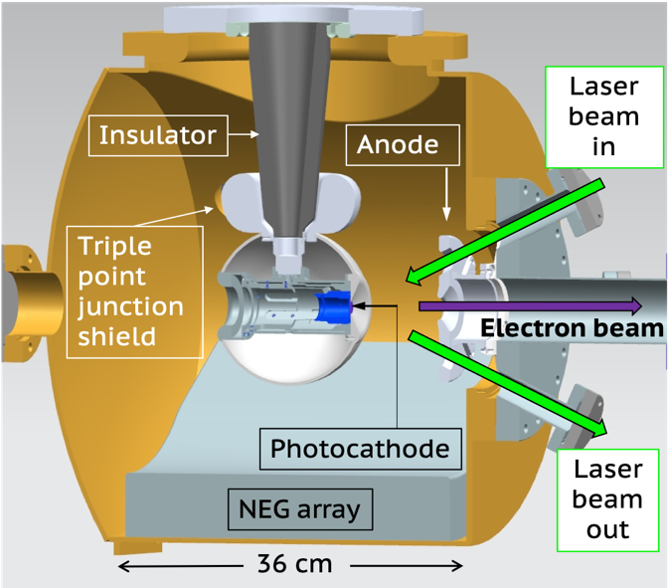
Higher voltage GaAs photoguns
500 kV cERL KEK GaAs Photogun
300 kV Magnetized JLab CsKSb Photogun
Processed to 539 kV, Operated 500 kV
Processed to 360 kV, Operated 300 kV

Slide 18
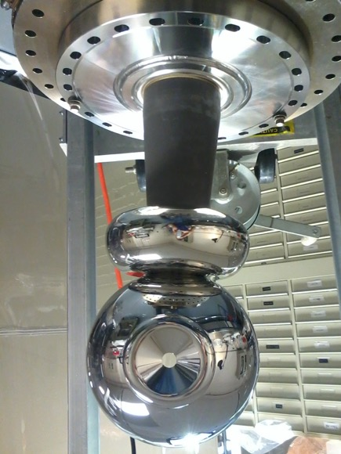
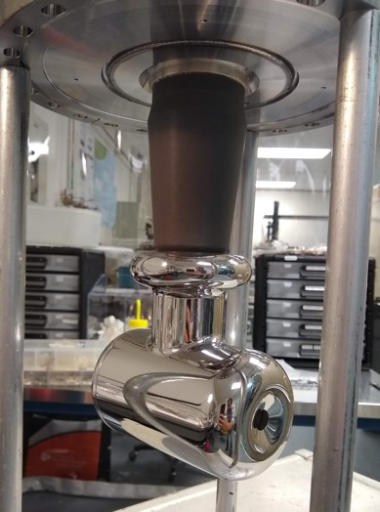
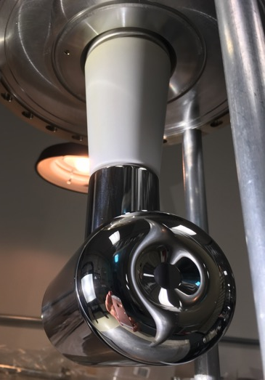
Progression of JLab inverted insulator electrodes
“Tee Electrode”
Operated 130 keV at CEBAF 2008-2010
Tested > 150 kV without field emission
Another candidate for 200 kV
“Tee with Shed Electrode”
Operated 200 keV at UITF 2019 w/o FE
Installed at CEBAF, but FE > 100 kV
Removed because could not eliminate field emission even with Kr processing
“Ball with Shed Electrode ”
Reached 360 kV in 70 hours
No field emission or vacuum activity 350 kV
Reliable operation at 300 kV
GaAs photo-guns must achieve and maintain XHV vacuum (10⁻¹² Torr) while at high voltage and while producing beam.

Slide 19
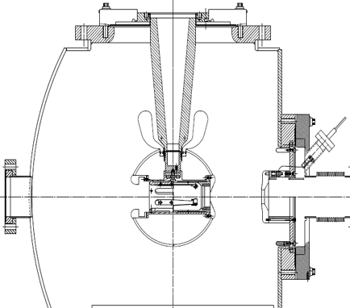
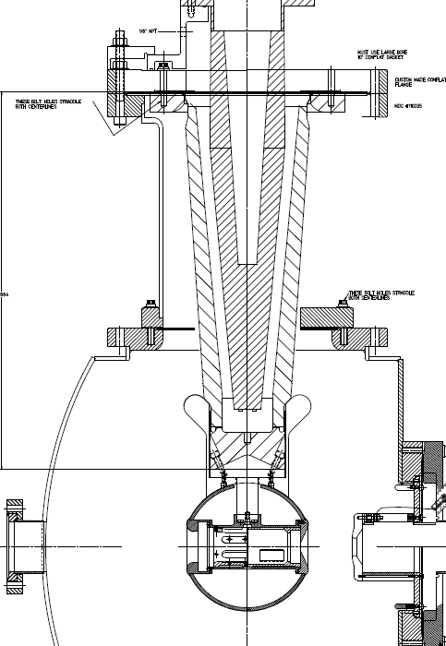
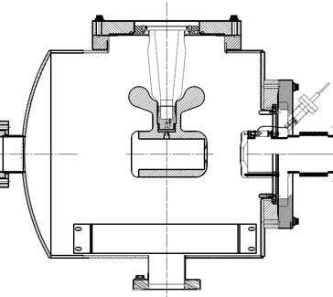
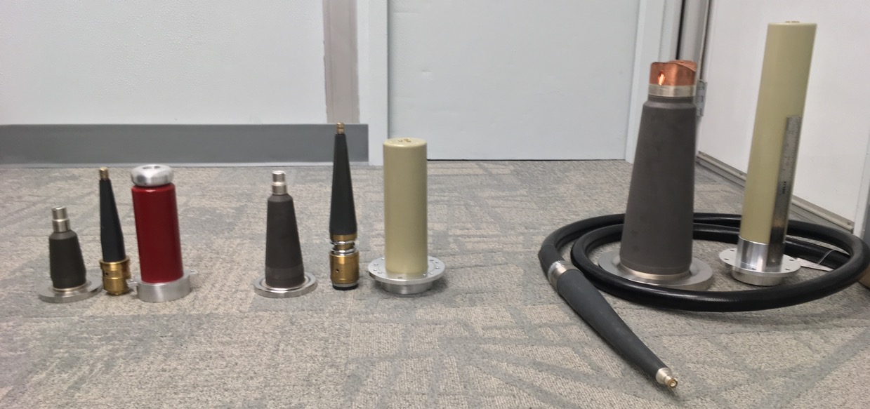
Progression of JLab high voltage insulators and connections
CEBAF 200 kV Gun
350 kV GTS Gun
The next step:
400 kV R&D !
We have 6 of these customized insulators, they do not fit the cable shown below
CONCEPT !
The idea is to modify commercial epoxy receptacle designed for 350kV cable to mate with inverted
12"
R28 200kV
R30 300kV
350kV commercial cable

Slide 20

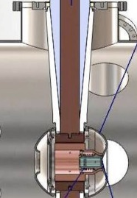
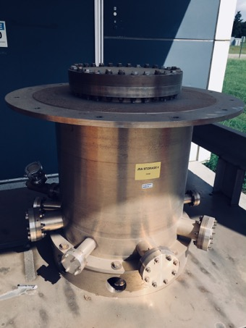
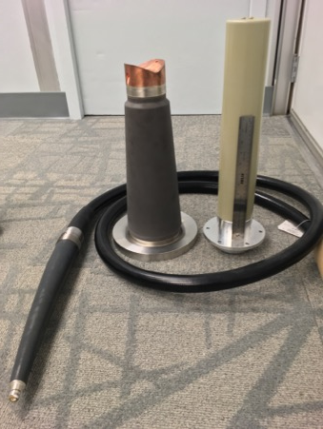
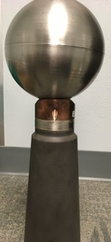
Roadmap for JLab 400 kV inverted photogun
Can the commercial plugs and receptacles be operated reliably to 400kV?
What is the highest voltage limit before breakdown?
Our plan is to first design coupling between large inverted insulator (on hand) and commercial 350kV cable plug
Then test cable, plug and insulator in SF6-filled chamber using dummy ball electrode and triple junction shield
Design electrode to hold photocathode puck
Build and high voltage condition for nominal 400kV operation in vacuum without field emission
Success? Then:

Slide 21
PEPPo-II
We have a developed proposal with a detailed 2-3 year work package for the simulation and optimization of a polarized positron beam for Jlab.
DIVERSE SET OF PARENT PARAMETERS
  Electron Drive Beam (energy, intensity, radiation, polarization)
  Single- & Double- Targets (bremsstrahlung and e+/e- converters)
  Electron Beam Power (radiation, activation, thermal management)
  Positron Collection (adiabatic matching, acceleration, optics)
  Positron Beam (emittance, damping, transport, acceleration)
  Positron Polarization (PEPPo concept, self-polarization)
  Value (cost, size, scale)
IMPLEMENT MULTI-OBJECT GENETIC ALGORITHM (MOGA)
  Principles of biological evolution to optimize multi-dimensioned non-linear problems
  Application to modern sophisticated problems
    Operating highest brightness high current photoinjector (Cornell)
    Design of optimized luminosity for ILC
    Optimized design and operating costs of an SRF linac
  JLAB expertise

Slide 22
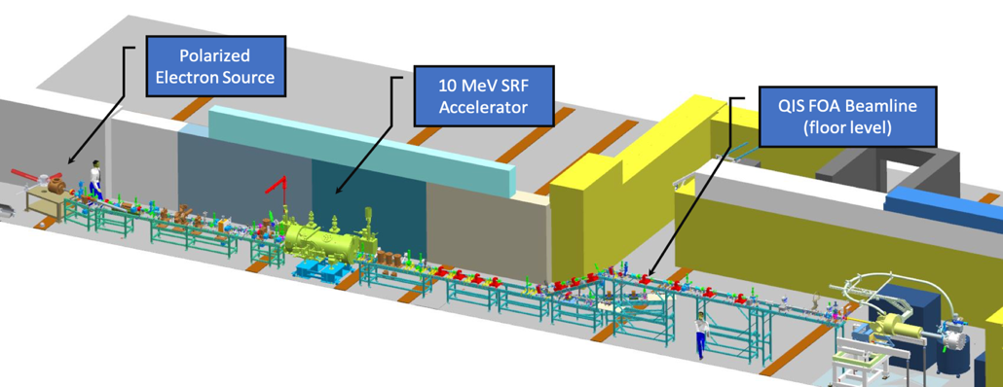
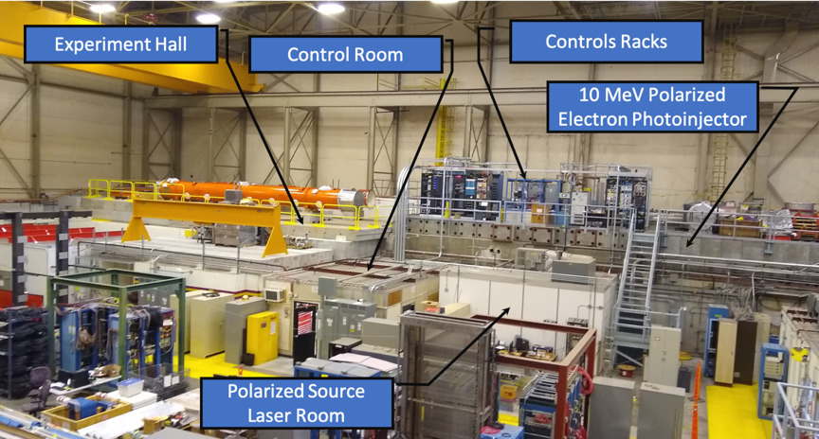
PEPPo-II
We seek funding to support an experimental demonstration for positron collection and beam formation at the recently constructed 10 MeV Upgrade Injector Test Facility at JLab.
Many components from PEPPo exist or have been offered for loan again; including the possibility to test the quality using the 100 kW PbBi target developed at Niowave, Inc. (but operated at low-duty factor for UITF testing)

Slide 23
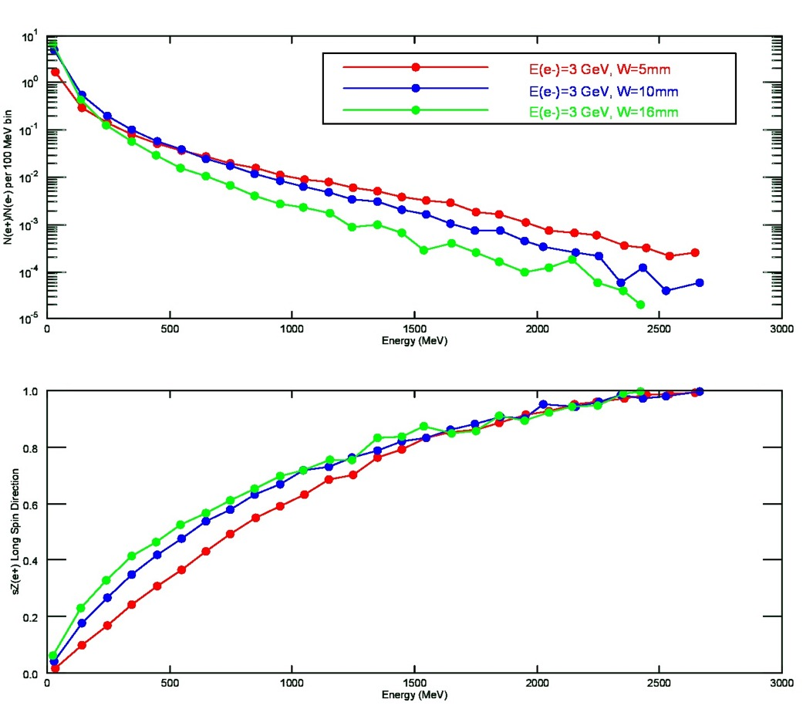
e-driven polarized positron source for ILC
What is expected (w/o any cuts) for a 3 GeV spin polarized electron beam over range of target thickness (5mm – 16 mm)
Thicker targets improve yield of lowest energy positrons, and provide a degree of spin filtering.
Thinner targets conversely improve yield of highest energy positrons, and with less impact by spin filtering.
E(e+) | N(e+)/N(e-) | <Sz> | P (%)
150 MeV | 0.436 | 0.23 | 21
350 MeV | 0.056 | 0.41 | 37
E(e-)=3 GeV
W=16mm

Slide 24
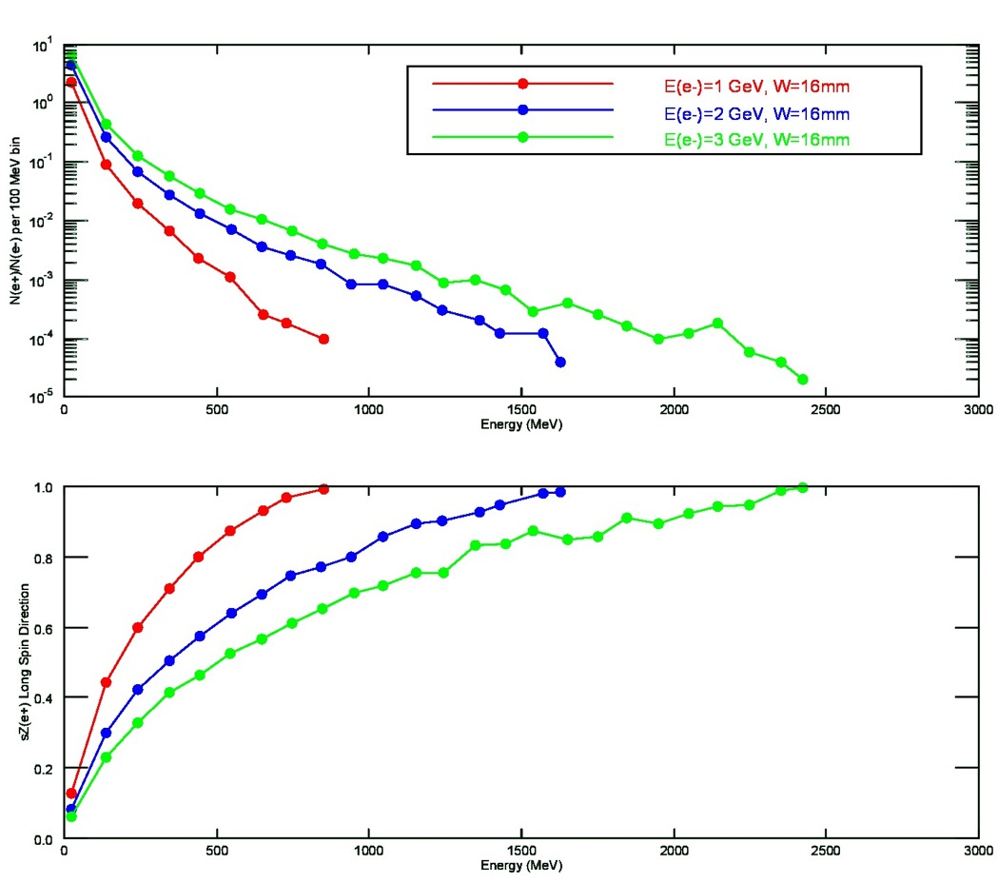
e-driven polarized positron source for ILC
What is expected (w/o any cuts) if the electron beam energy were lowered, for the same target thickness (16mm).
Lower electron beam energy results in lower yield, expectedly, preferentially at low positron energy.
Lower electron beam energy results in high spin polarization at same positron energy
E (e-) | N(e+)/N(e-) | <Sz> | P (%)
3 GeV | 0.436 | 0.23 | 21
1 GeV | 0.091 | 0.44 | 40
E(e+)=150 MeV
W=16mm
E (e-) | N(e+)/N(e-) | <Sz> | P (%)
3 GeV | 0.056 | 0.41 | 37
1 GeV | 0.007 | 0.71 | 64
E(e+)=350 MeV
W=16mm

Slide 25
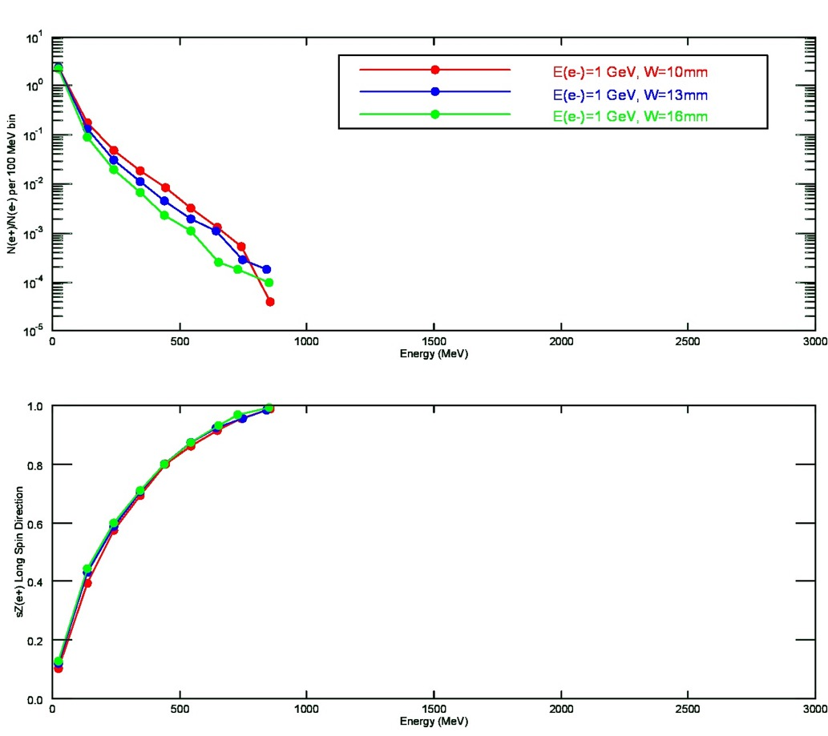
e-driven polarized positron source for ILC
What is expected (w/o any cuts) if the electron beam energy were 1 GeV, and target thickness reduced.
Small reduction in target thickness has the effect of increasing yield (at this lower electron beam energy).
Target thickness has less impact when positron energy large fraction of electron energy.
E (e-) | Target | N(e+)/N(e-) | <Sz> | P (%)
3 GeV | 16 mm | 0.436 | 0.23 | 21
1 GeV | 10 mm | 0.178 | 0.39 | 35
E(e+)=150 MeV
E (e-) | Target | N(e+)/N(e-) | <Sz> | P (%)
3 GeV | 16 mm | 0.056 | 0.41 | 37
1 GeV | 10 mm | 0.018 | 0.69 | 62
E(e+)=350 MeV

Slide 26
Summary
GaAs/GaAsP strain-layer superlattices reliably yield QE>1% to provide ~6 mA/W/% polarization >85% (at 780 m) at milliamp current.
Increasing laser spot size yielded higher charge lifetime of >400C at current 1-2 milliAmps, but aparently limited by correlated beam loss at the ~ppm level, simulations are being done to support this claim.
Managing the application of high voltage necessary for high bunch charge application w/o breakdown and eliminating field emission are both essential for operating GaAs photocathodes.
A DC photogun to produce magnetized beam has been reliably operated at 300 kV. Work is on-going to build a higher voltage >400 kV polarized gun counterpart.
Proposals with detailed work plans exist to design and test collection efficiency for low-energy e-driven polarized source (PEPPo-II) exist, but funding to proceed is missing.
We would be very pleased to continue together to explore promising parameters for an e-driven polarized positron source option for ILC.

