Slide 1

Polarized Positron Beams at JLab
Joe Grames
Center for Injectors & Sources
Jefferson Laboratory

Slide 2
Outline
  Physics Motivation for CEBAF 12 GeV
  CEBAF Injector PEPPo Experiment
  Proposed Polarized Positron Beam R&D
  Outlook

Slide 3
Why Polarized Positrons at JLab?
Polarized Electrons have supported some of the highest impact results from the JLab program:
  The strangeness distribution in the nucleon (HAPPEX and G0)
  Precision Tests of the Standard Model (Q_{Weak})
  Measurement of the neutron skin in ²⁰⁸Pb
  Polarization transfer measurement of G_{E}/G_{M} for the proton
Unpolarized positron beams provide a key tool for further pushing the precision of electron scattering experiments
  Comparison of e⁻ with e⁺ tests our understanding of two photon effects
Polarized positrons beams provide essential tool
  Unraveling nucleon structure through the measurement of charge-sensitive General Parton Distributions
  Expand the nature of these tests (e.g. for G_{E}/G_{M} via polarization transfer)
Beam Quality | Electron Beam (Delivered) | Positron Beam (Desired)
Average Intensity | > 200 μA | > 100 nA (5 x 10¹¹ e+/s)
Duty Factor | 100% (cw) | 100% (cw)
Bunch Frequency | 499 MHz (or sub-harmonic) | 499 MHz (or sub-harmonic)
Polarization (orientation) | > 85% (4π control) | > 50% (4π control)
Helicity Control | Rapid reversal (> 30 Hz) | Rapid reversal (> 30 Hz)

Slide 4
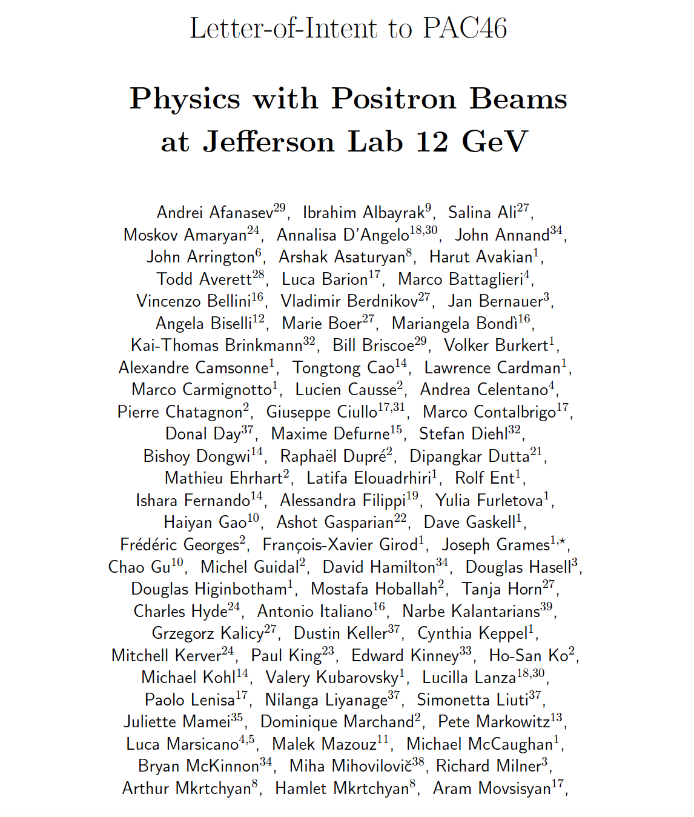

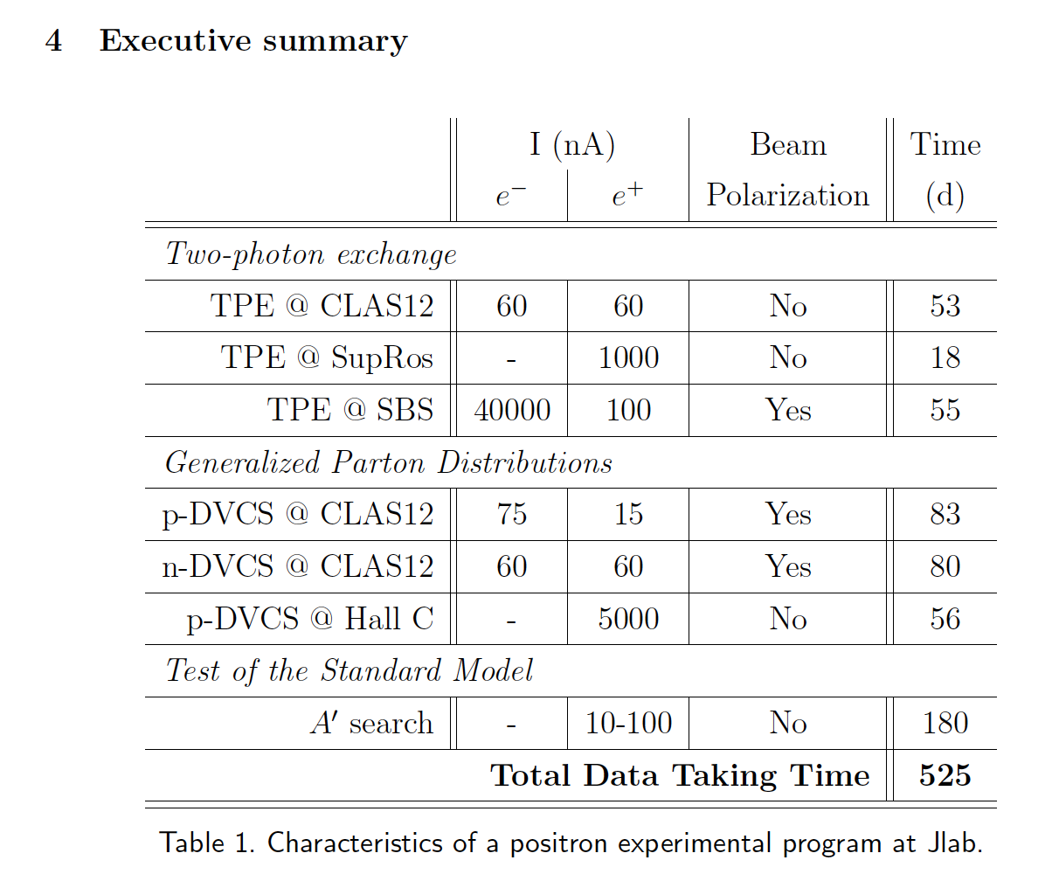


Letter of Intent (LOI12-18-004) to PAC-46
Jefferson Lab Positron Working Group (JLAB-PWG) formed in the summer 2016
  120 members, and growing
  39 institutions
Letter of Intent submitted to PAC-46 (July 2018) motivating a discussion by our Users for a Physics Program with Positron Beams at CEBAF 12 GeV
“Summary: These measurements all have significant physics interest. The proposers should carefully evaluate feasibility and present the best case possible in a future proposal. The justification must be very strong to enable the significant changes needed in the accelerator, both in equipment and in schedule. Any proposal should have a section on the linkage between a realistic plan for beam and the way the measurement is made.”

Slide 5

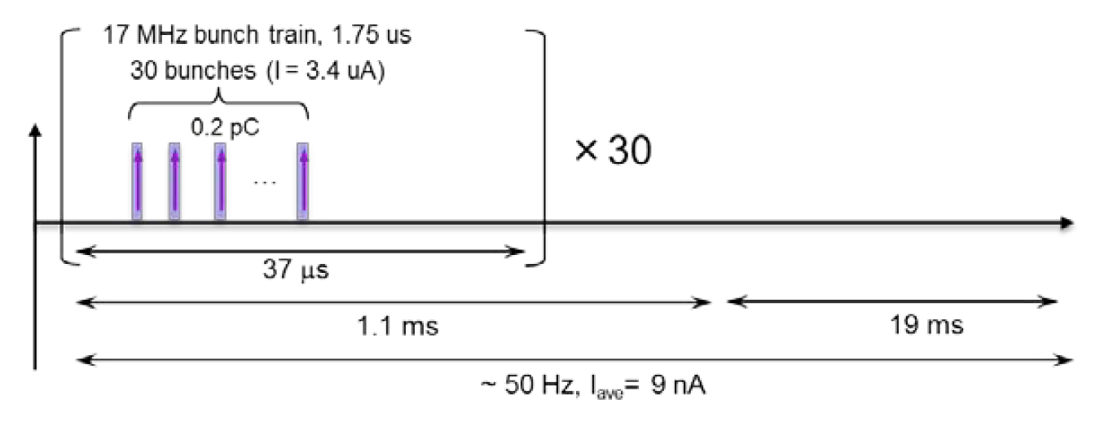
Polarized Positrons at an Electron Ion Collider
A polarized positron injector suitable for the Jefferson Lab Electron Ion Collider (JLEIC) has also been considered.
L ≥10³³cm⁻²s⁻¹ P_{e+}≥40%
I_{ave} > 10 nA (~10¹⁰ e+/s)
I_{peak} > 4 μA (~10¹³ e+/s)
e⁺
Challenge is accumulating high positron bunch charge with high rep rate.

Slide 6
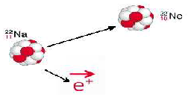




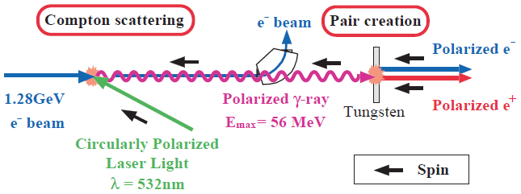
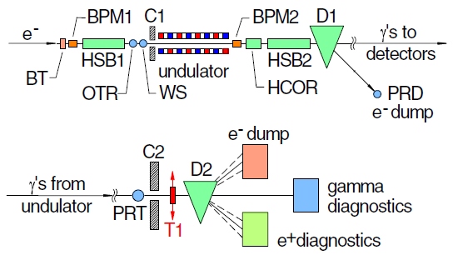
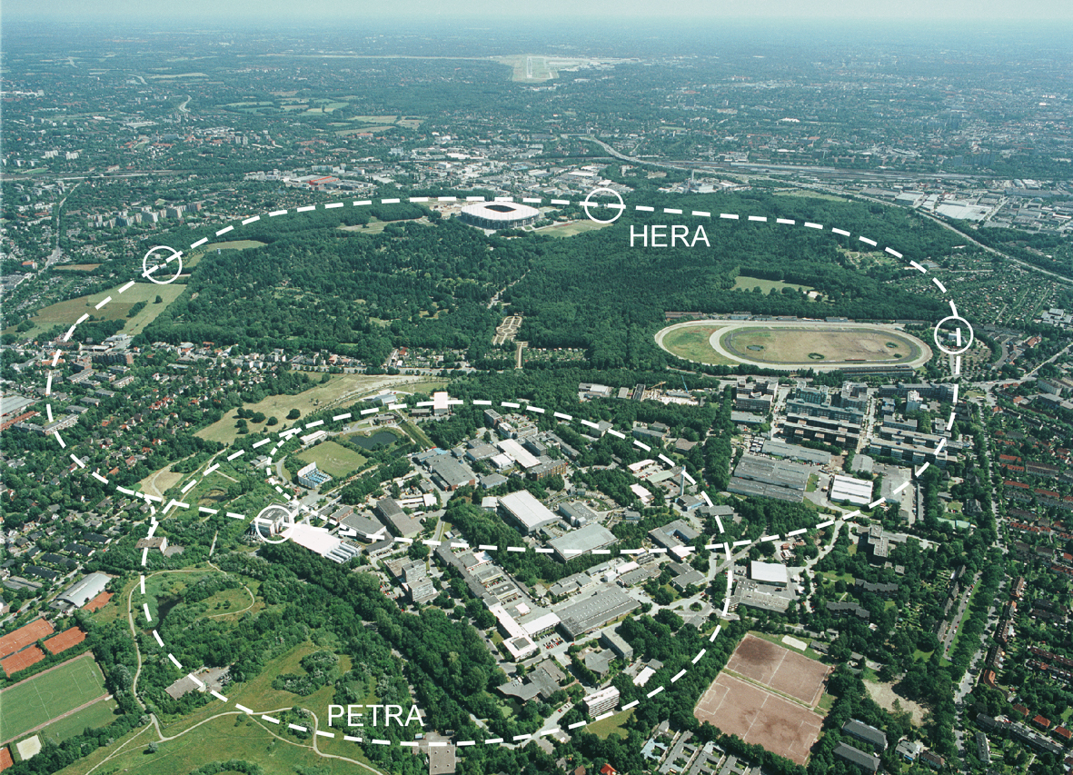
Methods for Generating Polarized Positrons
Polarized β⁺ Decay
L.A. Page & M. Heinberg. Phys. Rev.
106(6):1220-1224 (1957)
Sokolov-Ternov Effect
D. Barber , AIP Conf. Proc. 588, 338 (2001)
Polarized due to parity non-conservation in the weak interaction
HERA 27.5 GeV e+/e-
P(e⁺) ~ 40 %
P(e⁺) ~ 70 %
Compton Backscattering (KEK)
T. Omori et al, PRL 96 (2006) 114801
Helical Undulator (SLAC E166)
G. Alexander et al, PRL 100 (2008) 210801
KEK 1.28 GeV
SLAC 47.7GeV
P(e⁺) = 73 ± 15_{(stat)} ± 19_{(syst)} %
P(e⁺) = 80 ± 7_{(stat)} ± 9_{(syst)} %

Slide 7
JLab’s e⁻ Beams Provide the Basis for e⁺ Beams
Strained GaAs:
GaAs on GaAsP
Strained Superlattice GaAs:
Layers of GaAs on GaAsP
Bulk GaAs
100 nm
100 nm
625 μm
2 μm
14 Layers
350 μm
QE ~ 5%, 30 mA/W
Pol ~ 35% @ 780 nm
QE ~ 0.2%, 1 mA/W
Pol ~ 75% @ 850 nm
QE ~ 1%, 6 mA/W
Pol ~ 89% @ 780 nm
P_{e-} 35% 35% 75% 75% 85% 89%
I_{e-} 30μA 100μA 50μA 100μA 150μA 200μA
1995 1998 1999 2000 2004 2012 2018
Figure-of-Merit (P²I) has improved by a factor of 43
over the span of the CEBAF “6 GeV era”

Slide 8



Polarized Electrons for Polarized Positrons
E.G. Bessonov, A.A. Mikhailichenko, EPAC (1996) A.P. Potylitsin, NIM A398 (1997) 395
Polarized Bremsstrahlung
Polarized Pair Creation
P_{circ}(γ) / P_{z} (e⁻)
P_{z} (e⁺) / P_{circ} (γ)
E_{γ} / T_{e-}
T_{e+} / (E_{γ} – 2m_{e+})
E.A. Kuraev, Y.M. Bystritskiy, M. Shatnev, E.Tomasi-Gustafsson, PRC 81 (2010) 055208

Slide 9
The PEPPo Collaboration
P. Adderley¹, A. Adeyemi⁴, P. Aguilera¹, M. Ali¹, H. Areti¹, M. Baylac², J. Benesch¹, G. Bosson²,
B. Cade¹, A. Camsonne¹, L. Cardman¹, J. Clark¹, P. Cole⁵, S. Covert¹, C. Cuevas¹, O. Dadoun³,
D. Dale⁵, J. Dumas^{1,2}, E. Fanchini², T. Forest⁵, E. Forman¹, A. Freyberger¹, E. Froidefond²,
S. Golge⁶, J. Grames¹, P. Guèye⁴, J. Hansknecht¹, P. Harrell¹, J. Hoskins⁸, C. Hyde⁷, R. Kazimi¹,
Y. Kim^{1,5}, D. Machie¹, K. Mahoney¹, R. Mammei¹, M. Marton², J. McCarter⁹, M. McCaughan¹,
M. McHugh¹⁰, D. McNulty⁵, T. Michaelides¹, R. Michaels¹, C. Muñoz Camacho¹¹, J.-F. Muraz²,
K. Myers¹², A. Opper¹⁰, M. Poelker¹, J.-S. Réal², L. Richardson¹, S. Setiniyazi⁵, M. Stutzman¹,
R. Suleiman¹, C. Tennant¹, C.-Y. Tsai¹³, D. Turner¹, A. Variola³, E. Voutier^{2,11}, Y. Wang¹, Y. Zhang¹²
¹Jefferson Lab, Newport News, VA, US, ² LPSC, Grenoble, France, ³LAL, Orsay, France
⁴ Hampton University, Hampton, VA, USA ⁵ Idaho State University & IAC, Pocatello, ID, USA
⁶ North Carolina University, Durham, NC, USA ⁷ Old Dominion University, Norfolk, VA, US
⁸ The College of William & Mary, Williamsburg, VA, USA ⁹ University of Virginia, Charlottesville, VA, USA ¹⁰ George Washington University, Washington, DC, USA ¹¹ IPN, Orsay, France
¹² Rutgers University, Piscataway, NJ, USA ¹³ Virginia Tech, Blacksburg, VA, USA
PEPPo possible due to support from SLAC E166, DESY, Princeton, Cornell, International Linear Collider Project and the Jefferson Science Associates

Slide 10

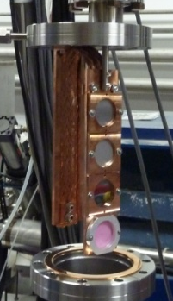
PEPPo Demonstrated Efficient e⁺ Production
The purpose of the PEPPo (Polarized Electrons for Polarized Positrons) experiment at the CEBAF Injector was to demonstrate the feasibility of using bremsstrahlung radiation of MeV energy Polarized Electrons for the efficient production of Polarized Positrons.
J. Grames, E. Voutier et al., JLab Experiment E12-11-105 (2011)

Slide 11
PEPPo: Principle of Operation
Polarized Electrons
(< 10 MeV/c) strike production target
Polarized Electrons
(< 10 MeV/c) strike production target
Positron Transverse and Longitudinal Phase Space Selection
S₁
e⁺
D
e⁻
e⁻
e⁻
T₁
T₁
1. BREMSSTRAHLUNG
Longitudinal e⁻ (P_{e-}) produce elliptical γ whose circular (P_{γ}) component is proportional to P_{e-}
2. PAIR PRODUCTION
In the same target, γ produce e⁺e⁻ pairs and transfer Pγ into longitudinal (P_{e+}) and transverse polarization averages to zero
S₂
P_{T}
D
Calorimeter
e⁺
T₂
3. Phase Space Definition
The emittance of the positron beam is defined by slits and magnetic fields
Compton Transmission Polarimeter
4. COMPTON TRANSMISSION POLARIMETER
Polarized e⁺ convert into polarized γ (P_{γ}) whose transmission through a polarized iron target (P_{T}) depends on P_{γ}.P_{T}

Slide 12
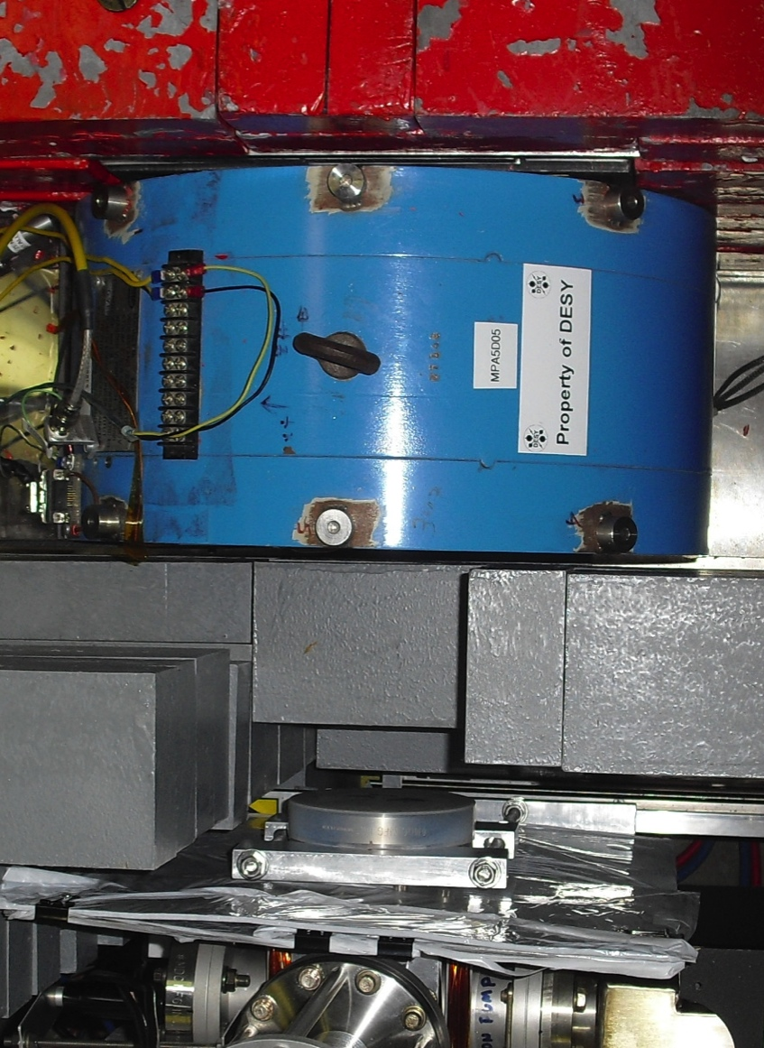
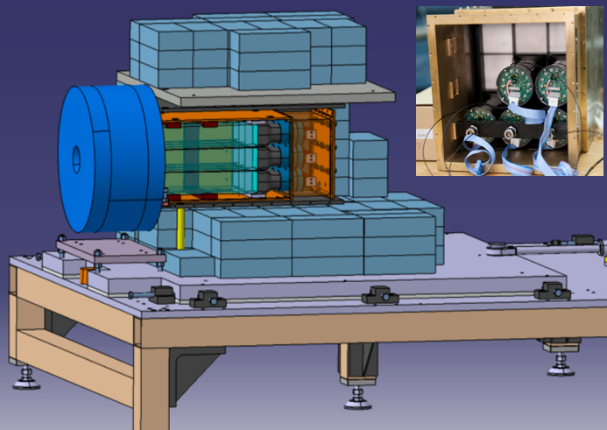
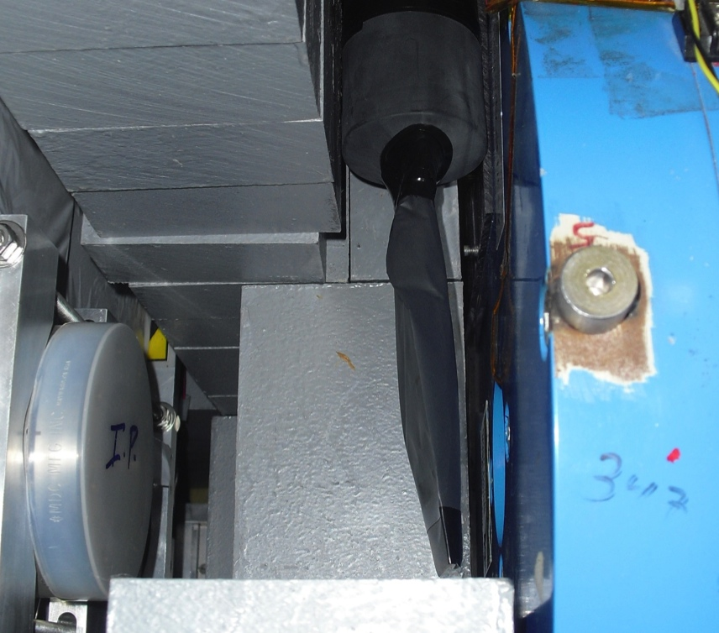
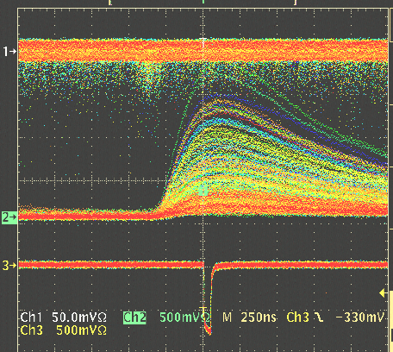
Compton Transmission Polarimeter
Polarized positrons incident on a target produce polarized bremsstrahlung, which is then analyzed via the Compton scattering transmission asymmetry through a magnetized target.
C
A
L
O
R
I
M
E
T
E
R
Background
e+
γ
Reconversion
Target
10mil Al window
Trigger Scintillator
Trigger Scintillator
P_{T} = 7.06% ± 0.05% _{(sys1)} ± 0.07% _{(sys2)}
Calorimeter
P_{e} - electron/positron polarization
P_{T} - target polarization
A_{e} - analyzing power
Coincidence

Slide 13

PEPPo Experiment Result
(PEPPo Collaboration) D. Abbott et al. , Phys. Rev. Lett. 116 (2016) 214801
PEPPo demonstrated efficient polarization transfer of 8.2 MeV/c polarized electrons to positrons, expanding polarized positron production using MeV electron beam energies.
electron beam polarization
85.2 ± 0.6 ± 0.7 %
Whenever producing e⁺ from e⁻, polarization is coming for free, if initial electrons are polarized.

Slide 14
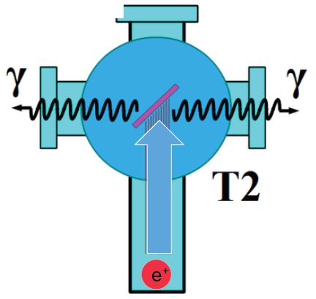
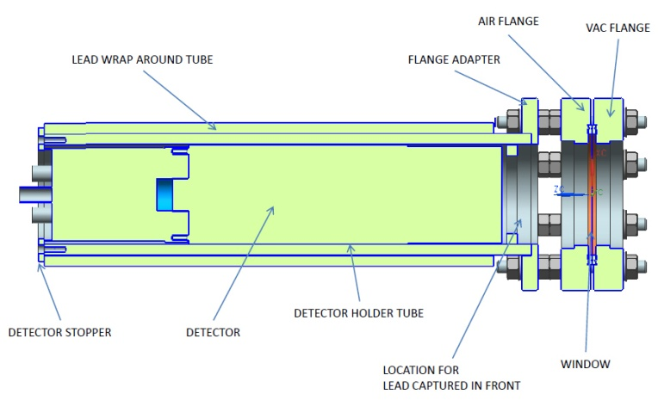
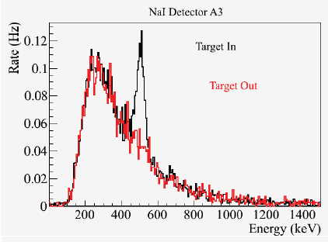
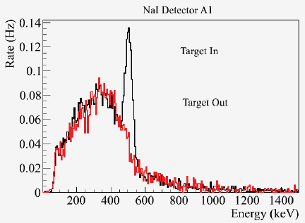
Positron Yield at MeV Energies
S₁
Two NaI detectors measured coincidence of back-to-back photons emitted by annihilation of positrons in a viewscreen.
e⁻
e⁺
D
T₁
p_{e-}= 8.2 MeV/c
A3
Viewscreen 0.011 thick @ 45 deg to beam line
99.5% aluminum oxide Al₂O₃
0.5% chromium doped Al₂O₃/Al₂O₃Cr₂O₃
D
e⁺
T₂
S₂
p_{e+}= 4 MeV/c
A1
For these data we had a yield of ~10⁻⁵ e⁺/e⁻
A3
A1

Slide 15



15
Figure of Merit (E_{e-} = 60 MeV)
R. Dollan, K. Laihem, A. Schälicke, NIM A 559 (2006) 185,
J. Dumas, J. Grames, E. Voutier, JPos09, AIP 1160 (2009) 120
J. Dumas, Doctorate Thesis (2011)
The polarization distribution of generated positrons is dominated by low-energy events.
The positron energy at the optimum FoM (P²I) is about half of the electron beam energy.
Producing highly polarized positron beams with intensities > 100 nA with typical injector energies (10-100 MeV) requires polarized electron beam intensities of >1-10 milliAmps
Optimum
FoM
Optimum energy

Slide 16
  Superlattice Performance >1 mA Encouraging
W. Liu et al., Appl. Phys. Lett. 109, 252104 (2016)
SLAC: First GaAs photogun
JLAB: Low-P Bulk GaAs
JLAB: High-P GaAs/GaAsP
?
Intensity (mA)
Year

Slide 17


Source Operation using GaAs/GaAsP >1 mA
  A electron source operating at 1 mA for one week produces 605 C.
  Recent tests demonstrate photocathode charge lifetimes 300-450 C for beam intensities > 1 mA.

Slide 18
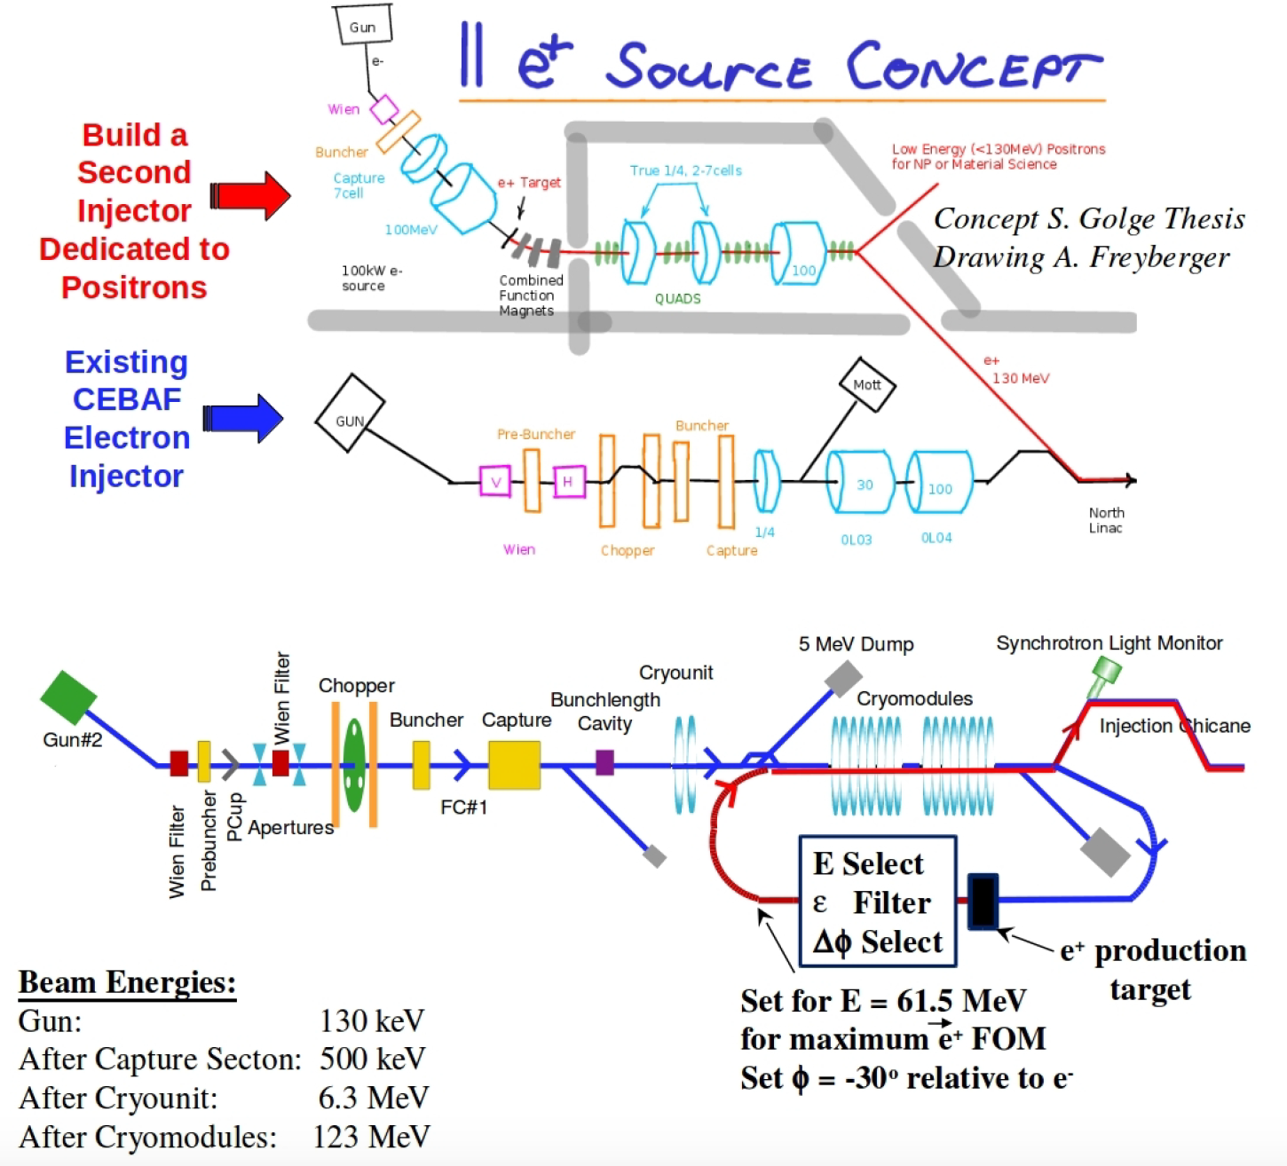
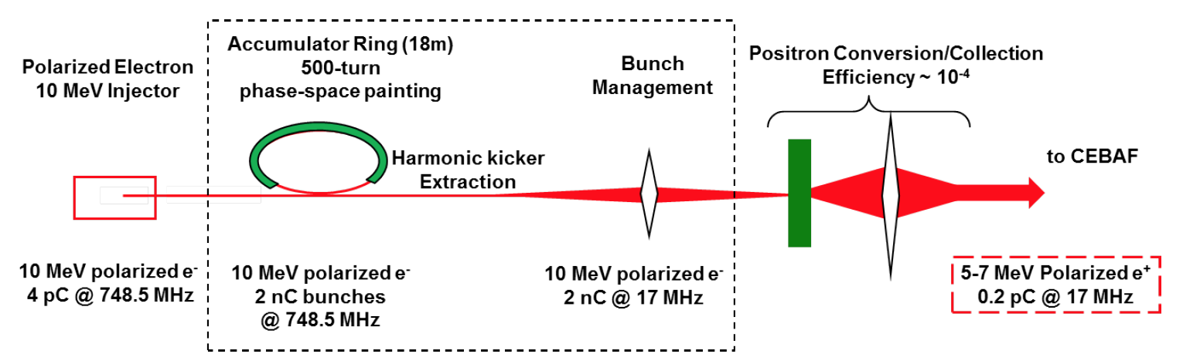
Polarized Positron Injector Concepts Abound
We have explored concepts with varying level of detail (theses, proposals, and yes…napkins).
The common denominator at JLab is leveraging our skills: Polarized Beams, SRF, Photoinjectors, High energy beams, etc).
A polarized e+ injector at Jlab would be novel in various ways:
  mA polarized e- source
  fast helicity reversal
  cw/short pulse bunches
  high power target > 10 kW
  srf acceleration

Slide 19
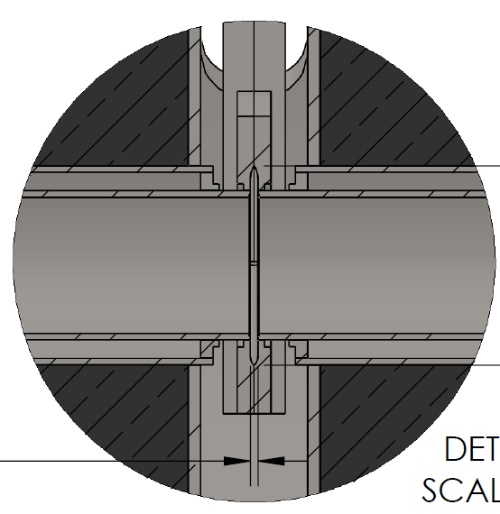
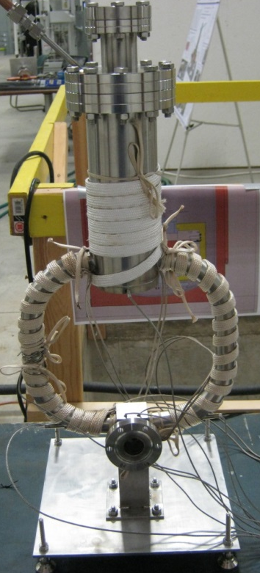
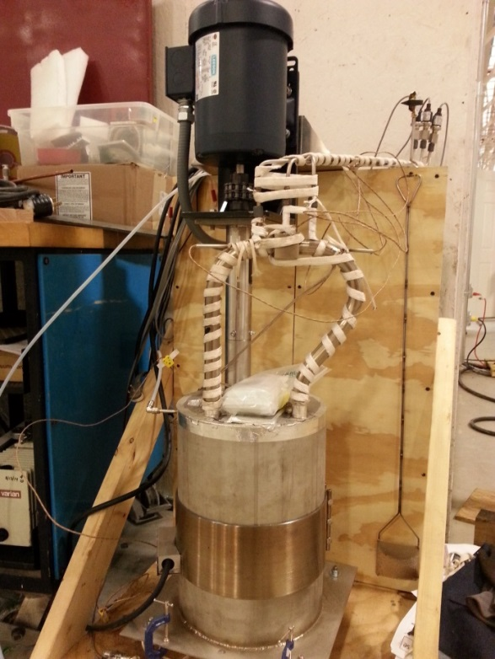
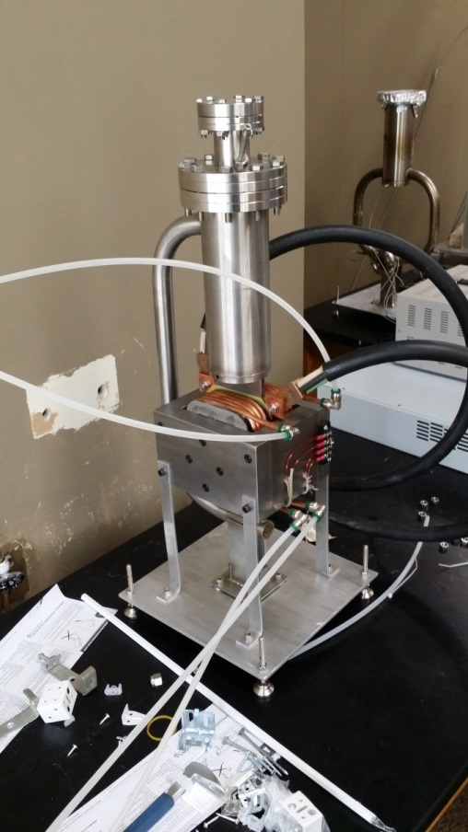

High Power Target R&D
Liquid Metal Target – lead-bismuth eutectic (LBE)
  High Z = 82, 83
  Low melting point: 124°C
  High boiling point: 1670°C
Multiple LBE targets tested on various accelerators
  Natural Circulation
  Mechanical Pumping
  Electromagnetic Pumping
Approaching 10 kW power level, CW
Stainless Steel Windows (0.25mm)
LBE (2mm)
Output (e⁻,e⁺,γ)
Input (e⁻)

Slide 20
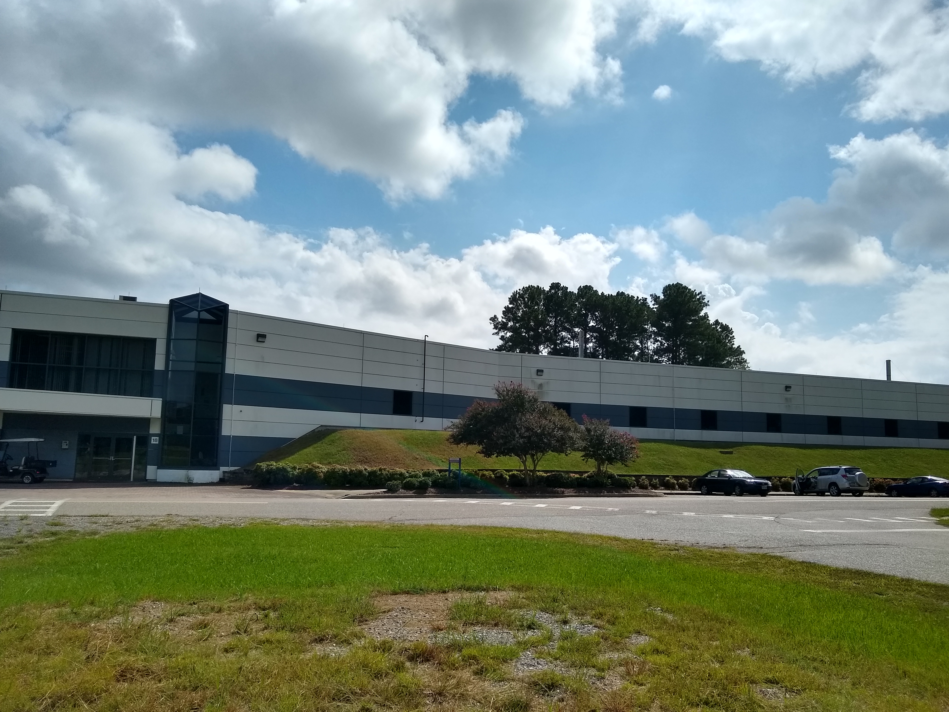
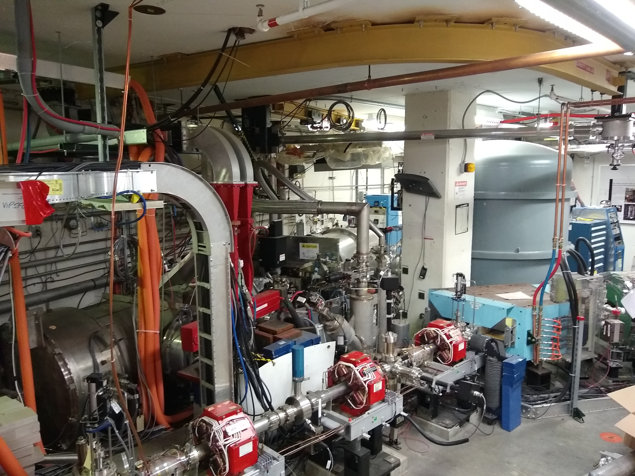
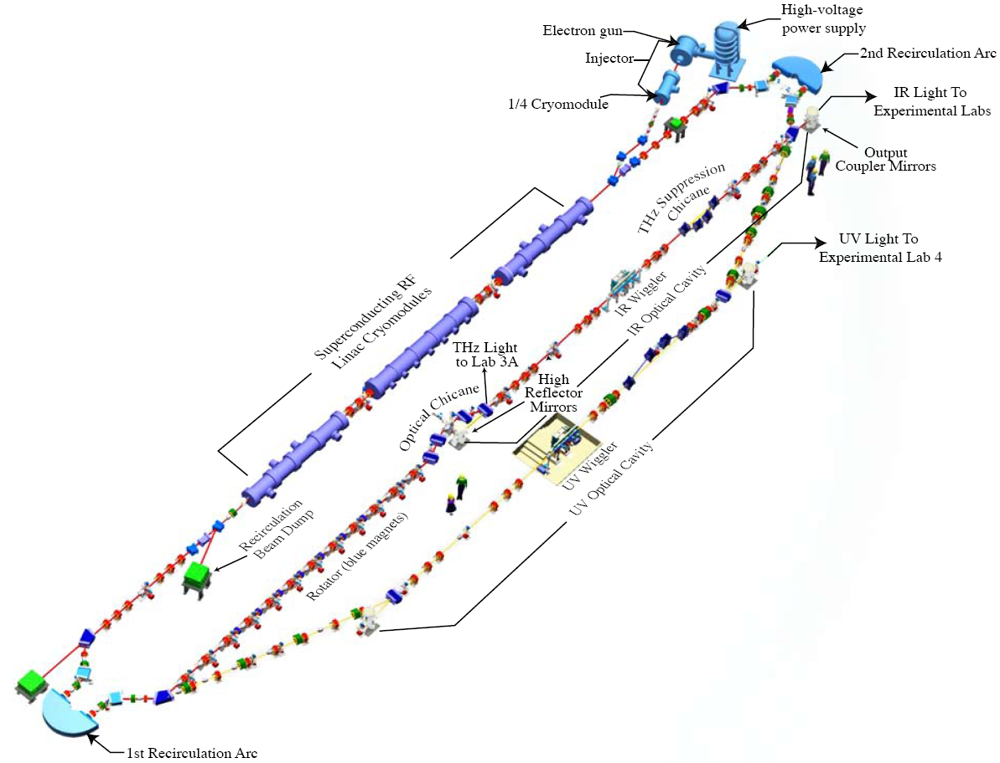
Jefferson Lab ERL (LERF)
350kV Vent Bake Gun
GaAs (500C @ 5mA)
500kV, 10mA HVPS
Powerful light source
IR and UV FEL
THz light
Search for Dark Matter
Fixed Target Options
SRF Booster 10 MeV
HPC for mA current, nC bunch charge

Slide 21
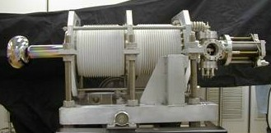
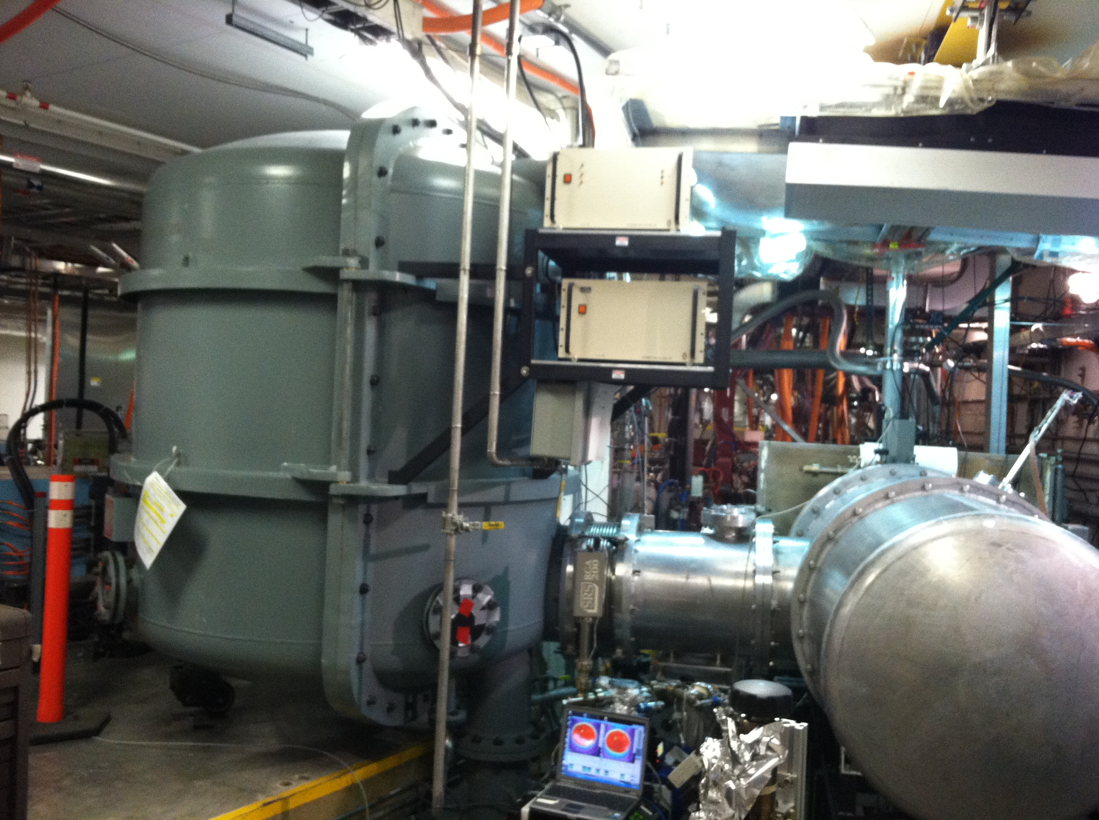
LERF Vent Bake Gun
350kV Vent Bake Gun
Single photocathode material
4 weeks to replace photocathode
Repeated vacuum/HV conditioning
500kV, 10mA HVPS
Physically connected to gun SF6
2 days for each gun access
Repeated HV conditioning
Slide Courtesy: C. Hernandez-Garcia

Slide 22
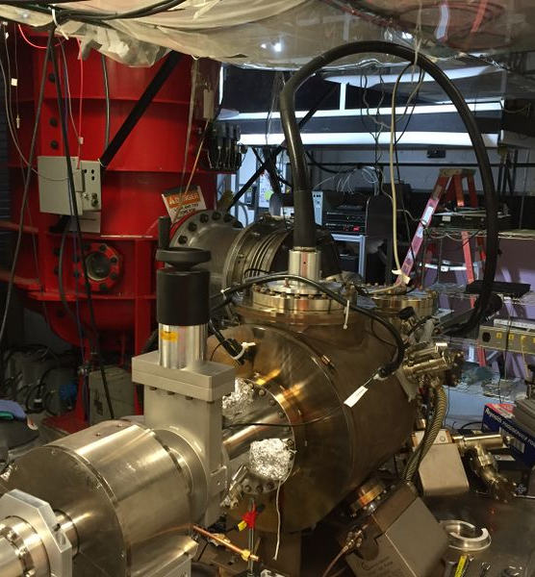
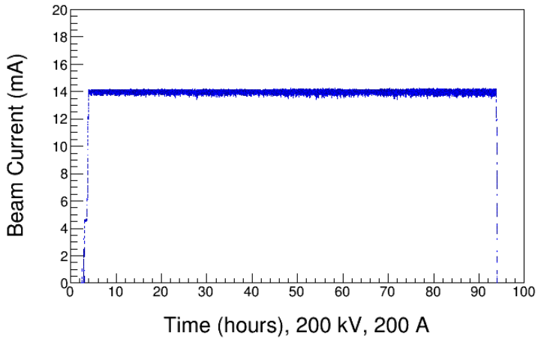
GTS Magnetized Beam Photogun
Load-lock inverted insulator photogun (multiple photocathodes) like CEBAF
Cable connection from HVPS to gun
Over 1000 hours operating >300kV; HV conditioning about 1 week
Operating with CsKSb photocathodes at >10 mA average current
Slide Courtesy: C. Hernandez-Garcia

Slide 23
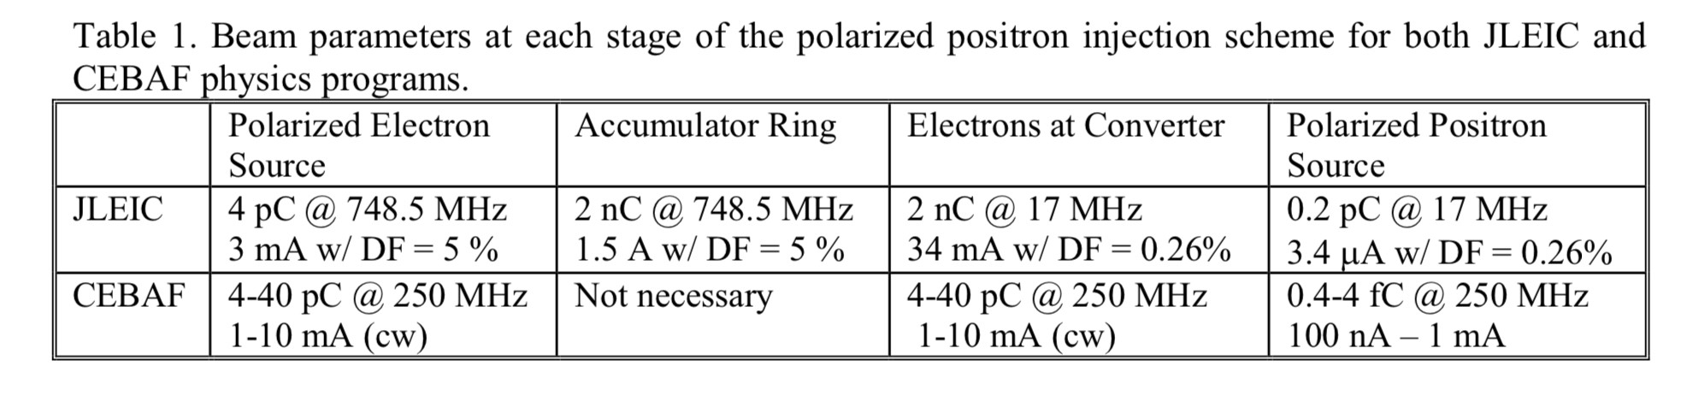
Polarized Positron Source
Upgrading the LERF injector with a >350kV inverted photogun and dual photocathode (GaAs or multi-alkali) photo-gun provides capability to:
  achieve predicted lifetime scaling of spin polarized photocathodes
  demonstrate reliable operation of high power conversion targets
  supports on-going unpolarized beam operations at LERF
  opens door to new polarized beam operations
Next priority should be designing, building and testing a positron beam collection system to define and optimize the transverse & longitudinal phase space and spin polarization for RF acceleration.

Slide 24
Integrated Positron Beams Program
Only scratching the surface…there are still many issues to consider related to the operation of positron beam in CEBAF (magnet reversal and reproducibility, managing beam loss and diagnostics of low current beams).
However, simulations of the various concepts to date suggest that a CW polarized positron source can be built to meet the CEBAF requirements.
The next most important questions to answer are, however, related to the technical aspects of the positron source:
  What is the e+ yield in an optimized CW target and captured system?
  What is the energy, emittance and phase filter design, and how well does it work?
  Demonstrate the resulting e+ beam is suitable for SRF acceleration.

Slide 25
Outlook
Jefferson Lab Users are making the physics case to lab management for high energy polarized positron physics program at CEBAF.
PEPPo demonstrated high positron polarization from moderate energy polarized electrons with a small footprint (cost, energy, radioactivity)
Progress of mA-sources is promising for the development of polarized positron beams with intensity >100 nA (5 x 10¹¹ e+/sec).
Next priority should be building and testing a collection system to define and optimize the transverse/longitudinal phase space for RF acceleration.
A comprehensive plan, supported by JLab Management, that can be successfully executed is essential for future success.

