Slide 1
Magnetized Electron Beam Development
JLEIC Collaboration Meeting
April 3, 2017
R. Suleiman, D. Bullard, F. Hannon, C. Hernandez-Garcia, A. Mamun, Y. Wang,
J. Grames, J. Hansknecht, R. Kazimi, G. Krafft, M. Poelker,
S. Wijethunga, P. Adderley, J. Benesch, S. Zhang

Slide 2
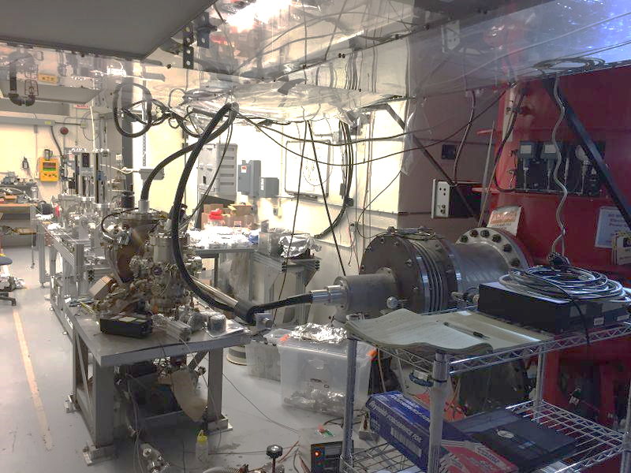
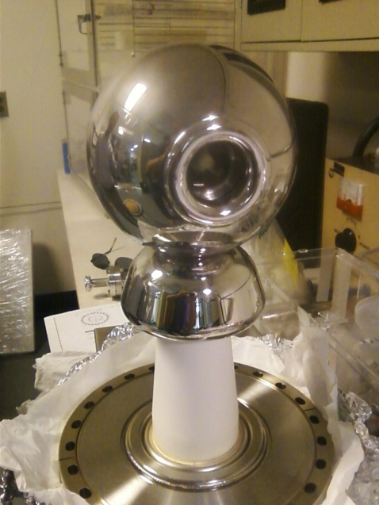
Recall Old Results – Summer 2016
First insulator conditioned to 325 kV
Learning how to use new photocathode
1 mA non-magnetized
Need mask and ion precipitator
Notes:
Interior Page Design 2

Slide 3
Outline
Magnetized Electron Source
K₂CsSb Photocathode
Gun HV Chamber
Gun Solenoid
Steel Photocathode Holders (Pucks)
Beamline
Generation of Magnetized Beam
Measuring Magnetization
Slit and Viewscreens
TE₀₁₁ Cavity: new method
Outlook

Slide 4
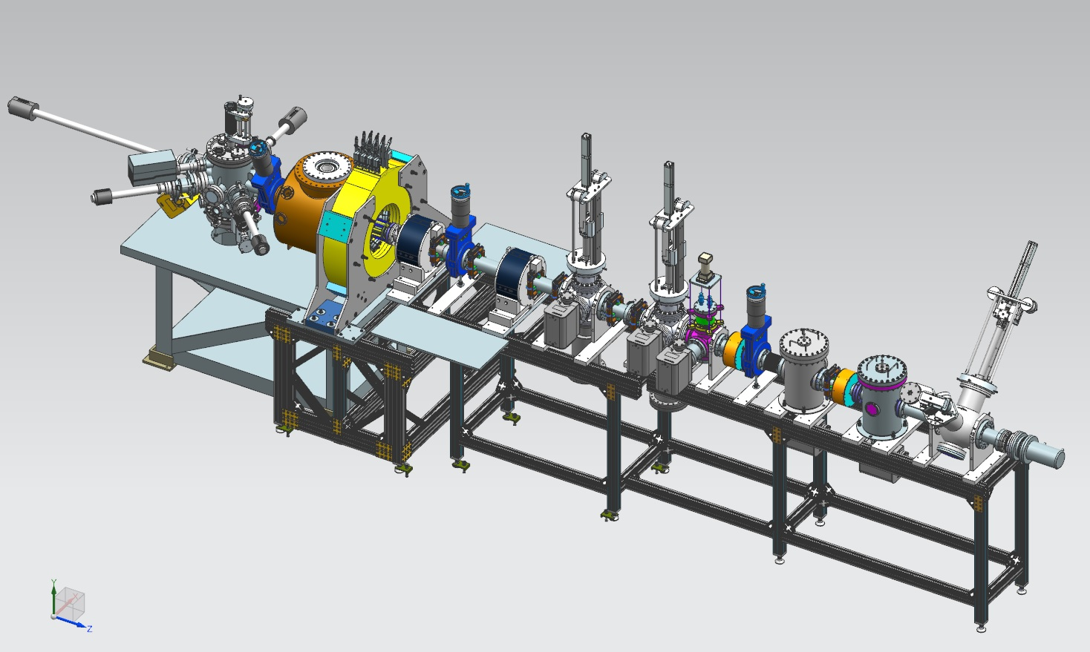
Gun HV Chamber
Gun Solenoid
Beamline
Photocathode
Preparation
Chamber
We are now running magnetized beam to Faraday Cup – to dump in two weeks

Slide 5
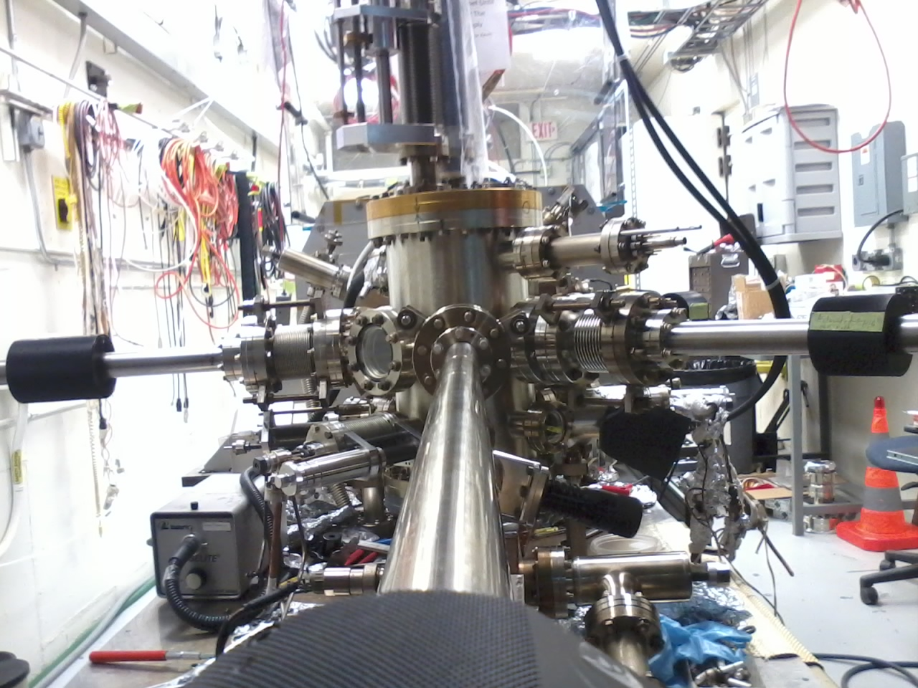
Photocathode Preparation Chamber
Bias puck to monitor photocurrent during activation and measure QE in-situ
Control gap between puck and Cs-K effusion source for precise film growth
Use a mask for reducing active area to minimize beam halo

Slide 6
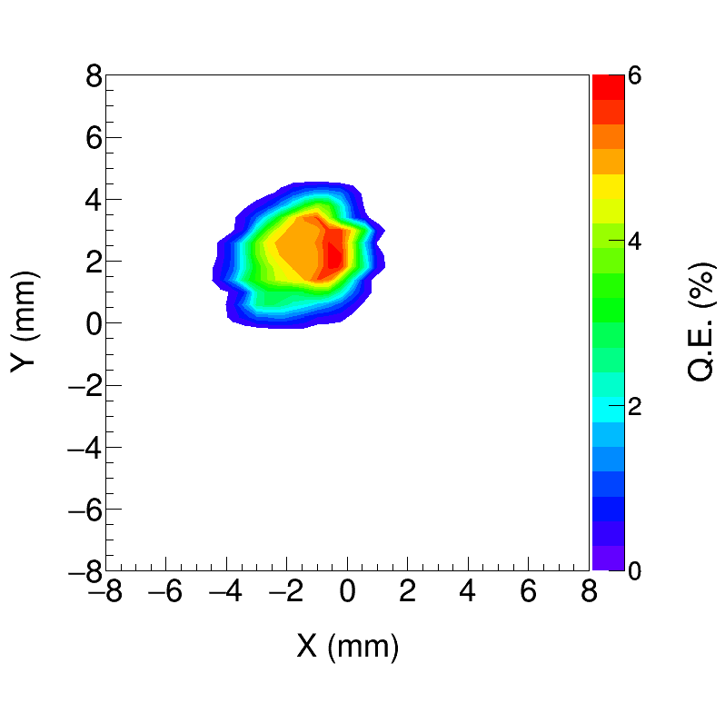
K₂CsSb Quantum Efficiency ~ 6%
K₂CsSb grown with a mask – limit photocathode active area (3 mm ɸ) to reduce beam halo
Active area can be offset from electrostatic center
5 mm active area also available
Entire photocathode can be activated too
Work of M. Mamun and Y. Wang

Slide 7
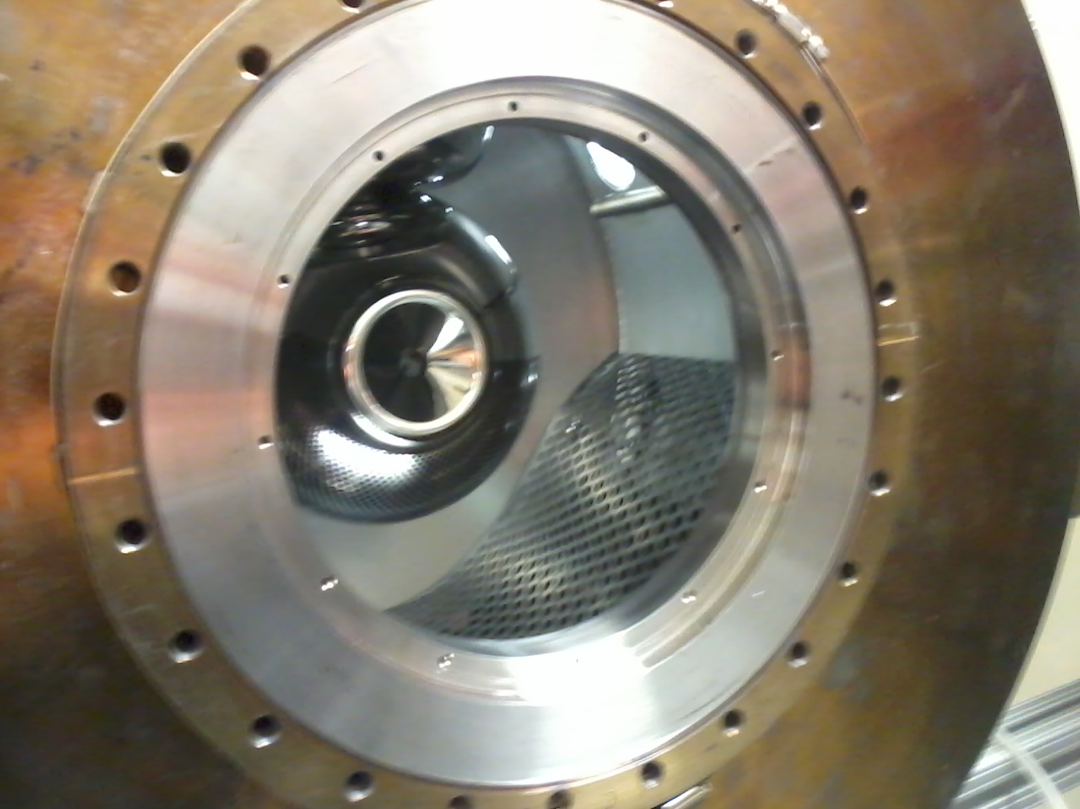
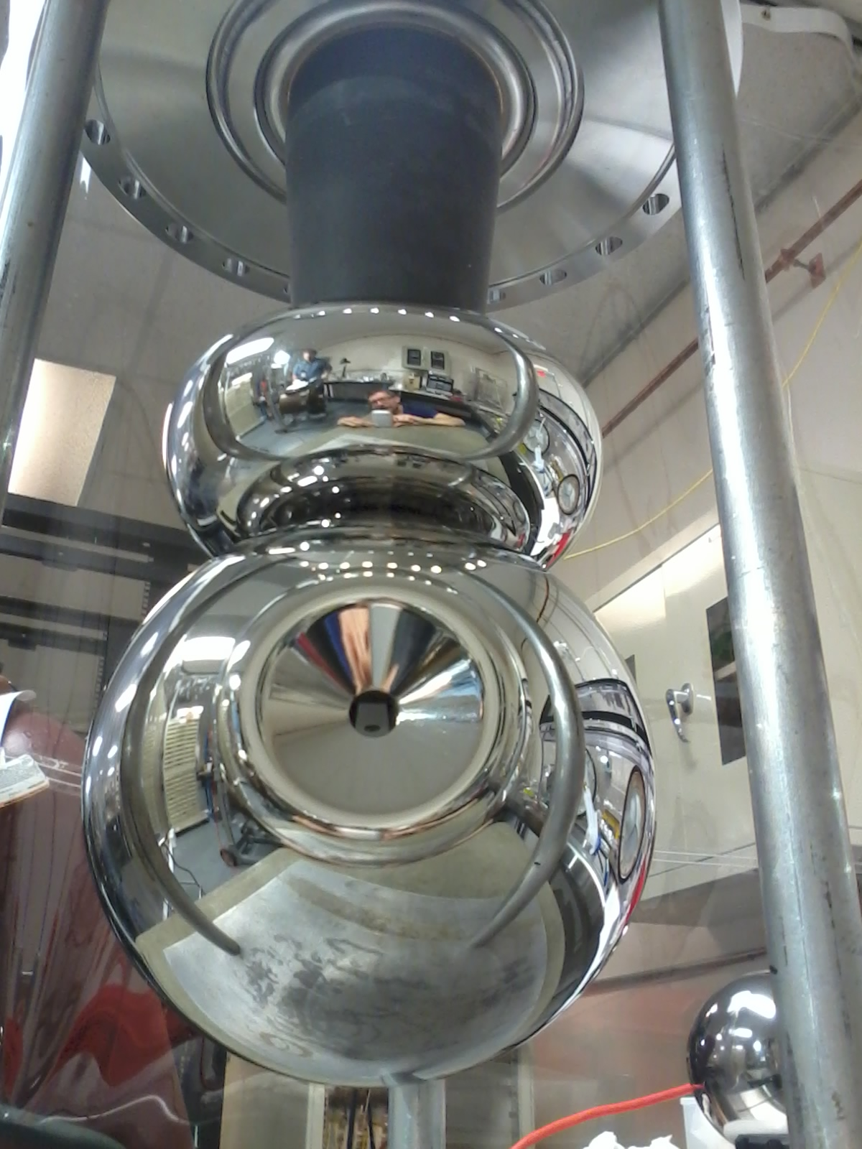
Gun HV Chamber
Upgraded HV Chamber with new doped alumina insulator and newly designed HV shed (triple point junction shield) to lower gradient from 12 MV/m to 10 MV/m at 350 kV
Gun HV operating at 300 kV with gun solenoid at 400 A

Slide 8
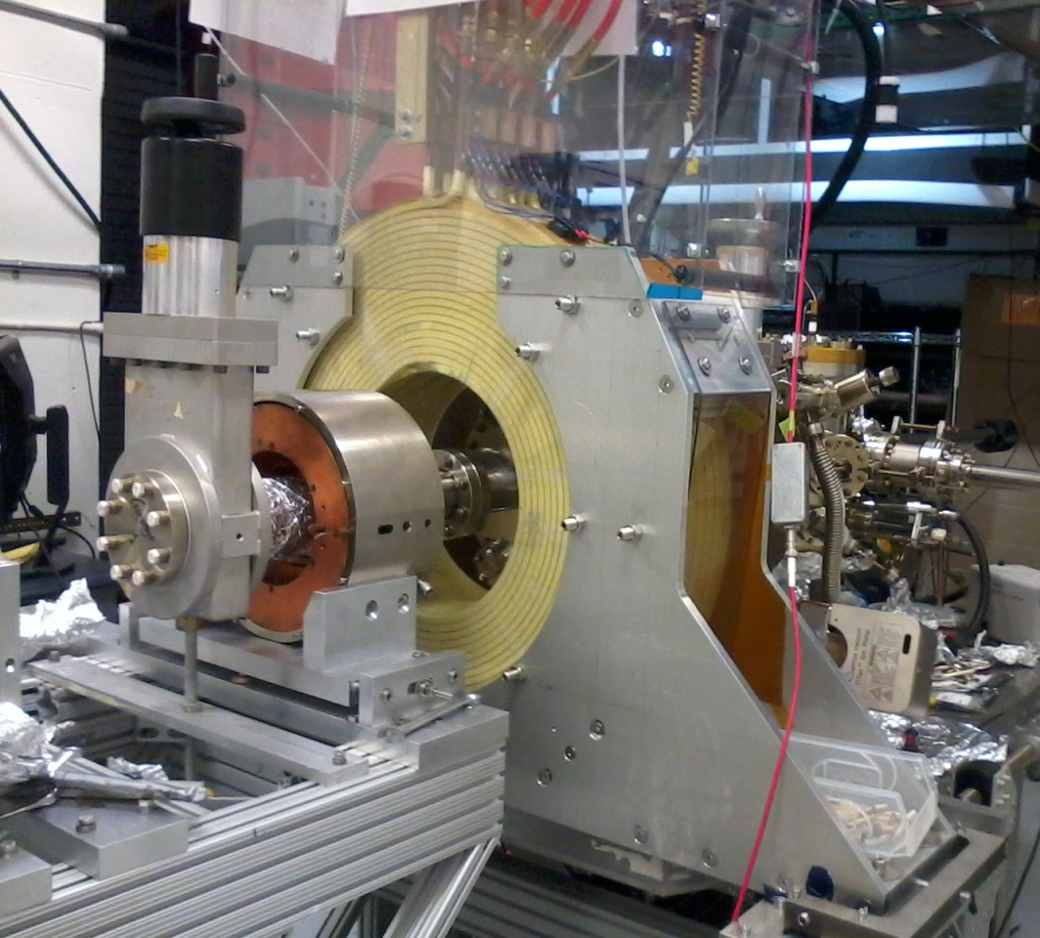
Gun Solenoid
Size | 11.811" ID, 27.559" OD, 6.242" Z
Conductor | L=500 m, A=0.53 cm² 16 layers by 20 turns
Coil Weight | 254 kg (560 lbs)
Resistance | 0.198 Ω
Field at Photocathode | 1.4 kG
Voltage | 79 V
Current | 400 A
Mapped and installed at GTS
Using new spare CEBAF Dogleg magnet power supply (500A, 80V)
Learned that gun solenoid can influence field emission
First trials with gun at HV and solenoid on resulted in field emission and vacuum activity
HV conditioned gun with solenoid up to 400 A

Slide 9
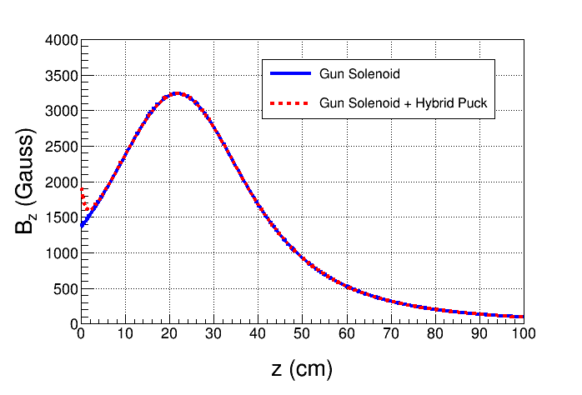
New Steel Photocathode Holders
Molybdenum
Steel
New steel holders (pucks) to enhance field to 2.0 kG at photocathode. Two types:
Molybdenum and carbon steel hybrid puck
Carbon steel puck
Steel

Slide 10
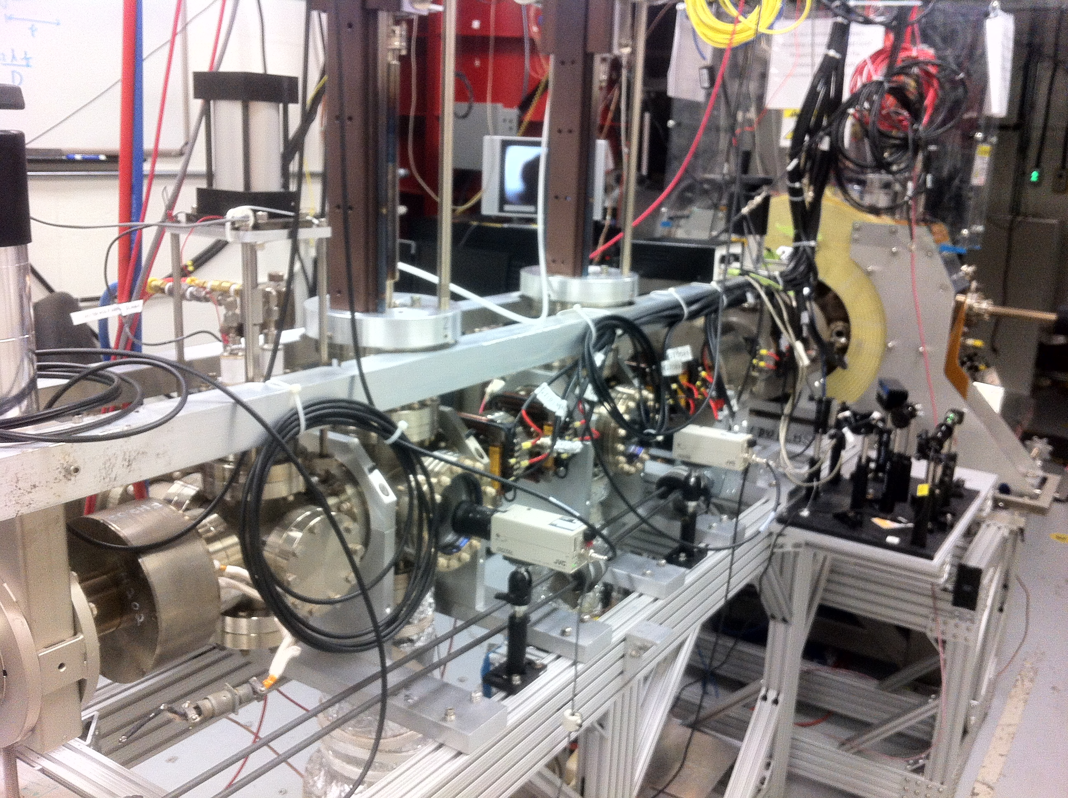
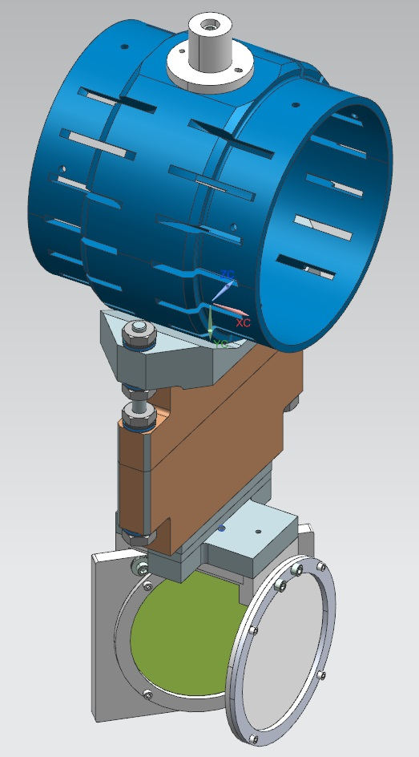
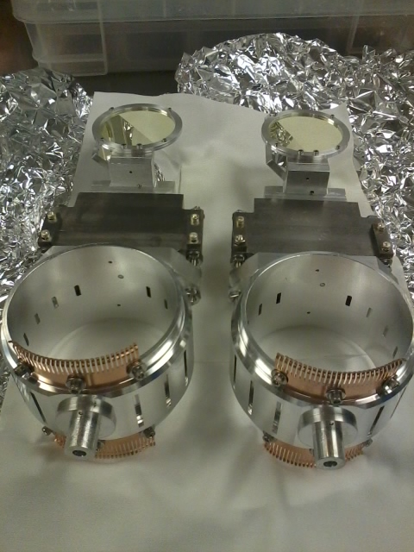
Beamline
Shield Tube
Slit
YAG Screen

Slide 11
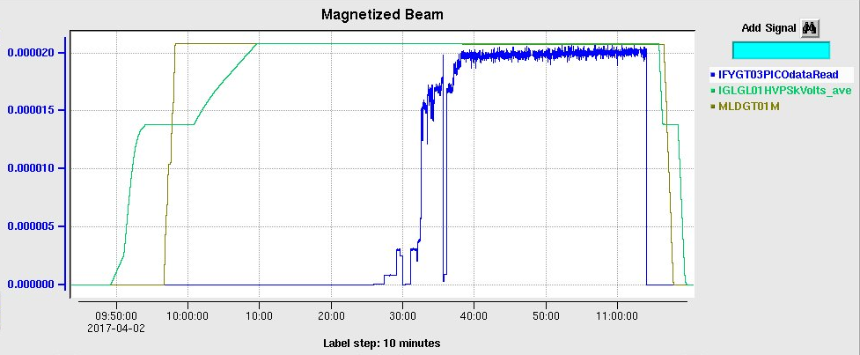
Magnetized Beam at GTS
Generated magnetized beam on March 8
Measured magnetization at 300 kV and solenoid field from 0 – 1.4 kG
Delivered 20 µA to Faraday Cup – higher currents once beamline to dump is ready

Slide 12
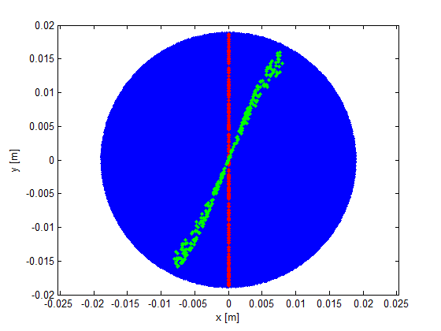
Measuring Magnetized Beam – I
Use slit and viewscreens to measure mechanical angular momentum:
$B_{z}$: solenoid field at photocathode
$a_{0}$: laser rms size

Slide 13
0 A
400 A
σ₁ = 3.7 mm
σ₂ = 4.9 mm
φ = 15°
$\left\langle L\right\rangle$ = 38 neV s
$eB_{z}a_{0}^{2}$ = 38 neV s

Slide 14
Measuring Magnetized Beam – II
Having a non-invasive technique to measure beam magnetization is very critical for JLEIC e-cooler. An RF cavity could be right device. Cavities distributed around e-cooler will monitor magnetization and others installed inside cooling solenoid will ensure magnetization is completely removed during cooling process. Once beam exists solenoid, cavities measure whether magnetization is fully restored.
RF field will be excited by rotating bunched beam producing an easily detectable signal – beam will deposit longitudinal energy into cavity, but not angular momentum
Coupling to both electric and magnetic fields – expect main contribution to signal from electric field

Slide 15
TE₀₁₁ Mode in Pill-box Cavity
$$H_{r}=\frac{iωε}{k_{c}}AJ_{0}^{′}(k_{c}r)e^{−ik_{z}z}$$
$$E_{r}=0$$
$$E_{φ}=\frac{iωμ}{k_{c}}AJ_{0}^{′}(k_{c}r)e^{−ik_{z}z}$$
$$H_{φ}=0$$
$$E_{z}=0$$
$$H_{z}=AJ_{0}(k_{c}r)e^{−ik_{z}z}$$

Slide 16
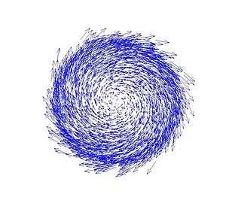
Magnetic Moment of Magnetized Beam
Magnetic moment along beam axis:
$$M=\frac{e}{2mc}L$$
$$L=\frac{1}{2}B_{z}r^{2}$$
at photocathode
$$L=γmr^{2}\dot{φ}$$
at cavity
For Gaussian beam with sigma of $a_{0}$= 1 mm and $B_{z}$= 2 kG :
Average canonical angular momentum is$〈L〉=eB_{z}a_{0}^{2}$ = 200 (neV s) at photocathode
After exiting solenoid $〈L〉=2γm_{e}a_{0}^{2}\dot{φ}$ = 200 (neV s) = 3x10⁸ ħ
Beam angular frequency, $\dot{φ }$= 1.1x10¹⁰ rad/s

Slide 17
TE₀₁₁ Cavity Magnetized Beam Test
Plan to build and install a cavity at GTS to measure beam magnetization in collaboration with Electrodynamic, NM (Brock Roberts) and SRF Institute (Jiquan Guo et al.) – good project for a student
Will be part of year 3 LDRD proposal – requires $20k for shop and materials
Axially-symmetric electric field mode cannot create angular momentum for a passing electron beam – one must take into account presence of associated RF magnetic field – due to conservation of canonical angular momentum before and after cavity
Can we generate magnetized beam with TE₀₁₁ cavity?

Slide 18
Outlook: April – September
Measure magnetization vs gun solenoid field and laser size
Benchmark simulation against measurements
Measure photocathode lifetime vs magnetization at 5 mA and 300 kV
Measure magnetization with steel/hybrid puck
Study beam halo and beam loss vs magnetization
Install RF laser
Install TE₀₁₁ cavity and commission with magnetized beam
Sajini Wijethunga, student from ODU started her Ph.D. thesis on magnetized beam (advisor: Jean Delayen, funded by 75% JLab + 25% ODU)
Plan to submit LDRD proposal for 3rd year funding – TE₀₁₁ cavity included

