Slide 1
GTS gun with John’s Shed
9/25

Slide 2
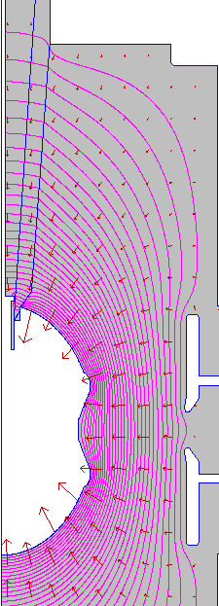
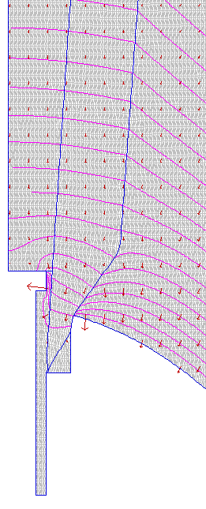
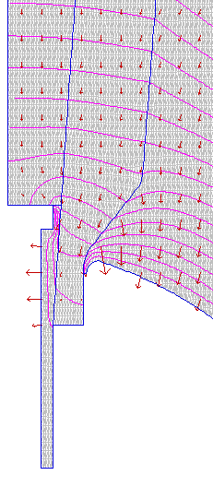
R30 Insulator With No Shed
100 MV/m
100 MV/m
30 MV/m
80 MV/m

Slide 3
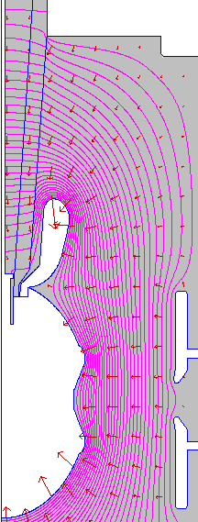
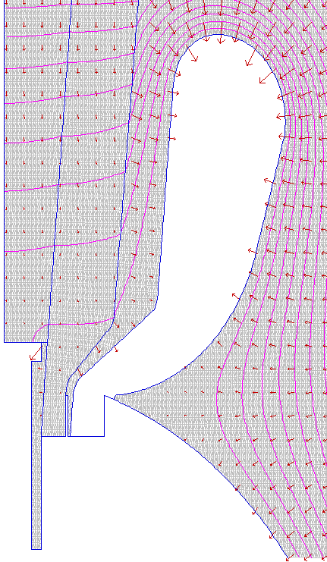
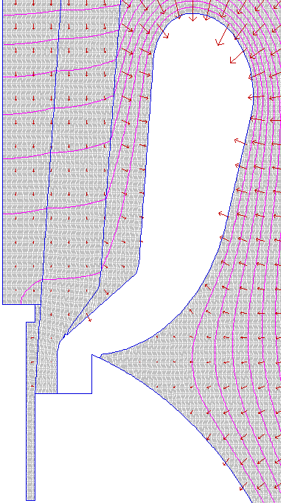
R30 with Shed
15 MV/ m
13 MV/m
2 MV/m
6.8 MV/m

Slide 4
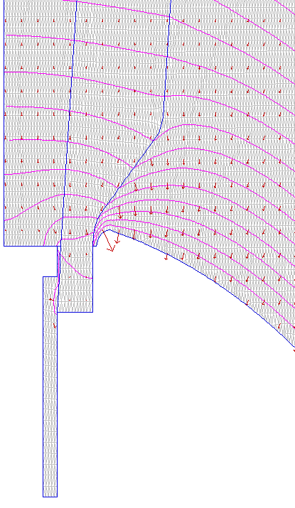
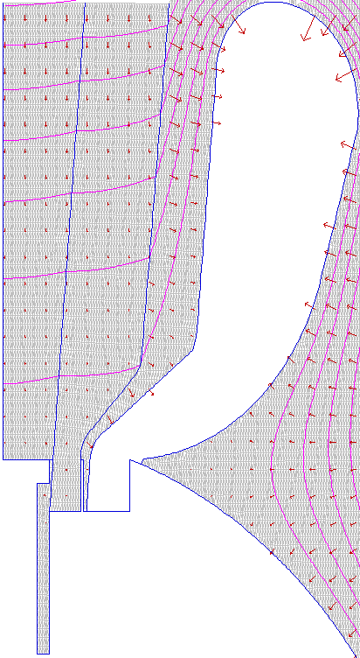
Different Plug Configuration
100 MV/m
350 MV/m
13 MV/m
42 MV/m
6.8 MV/m
2.1 MV/m
30 MV/m
30 MV/m

Slide 5
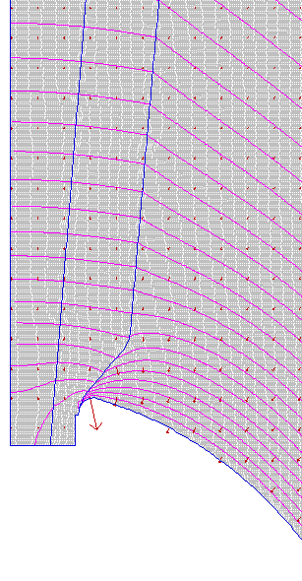
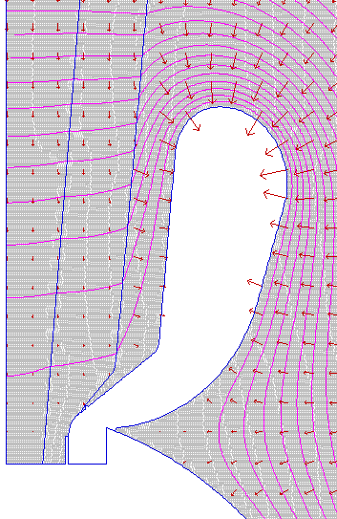
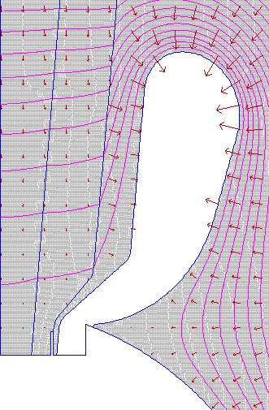
Different Plug Configuration
10.8 MV/m
10.8 MV/m
12.3 MV/m
12.3 MV/m
60 MV/m
7.0 MV/m
4.5 MV/m

