Slide 1

Capability and Prospects for Polarized Beams from GaAs DC Photoguns
Outline
High-P GaAs DC photo gun
Status of User facilities
Provoke Ideas
Joe Grames
CEBAF Polarized Photogun

Slide 2
Acknowledgments
I would like to thank and acknowledge those who contributed to this presentation.
  Kurt Aulenbacher, Mainz
  Maud Baylac, CNRS
  Joachim Enders, Darmstadt
  Carlos Hernandez-Garcia, JLab
  Max Herbert, Darmstadt
  Wolfgang Hillert, DESY
  Masao Kuriki, U. of Hiroshima
  Matt Poelker, JLab
  Riad Suleiman, JLab
  Michael Switka, Univ. of Bonn
  Erdong Wang, BNL
  Josh Yoskowitz, ODU

Slide 3

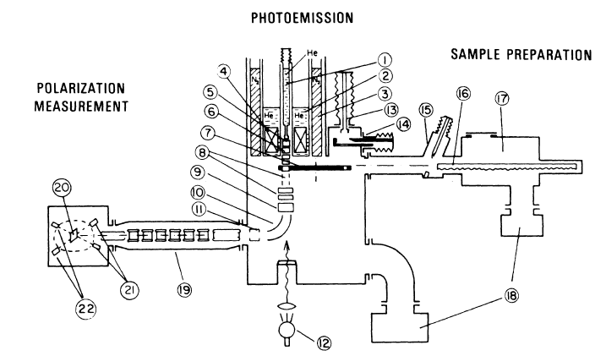
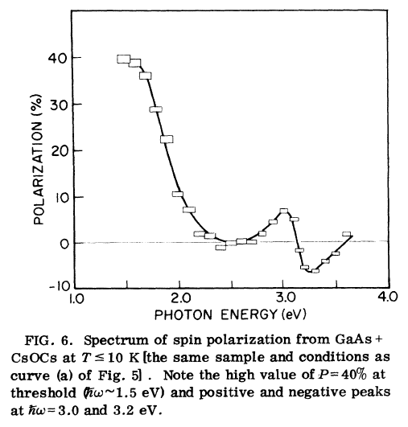
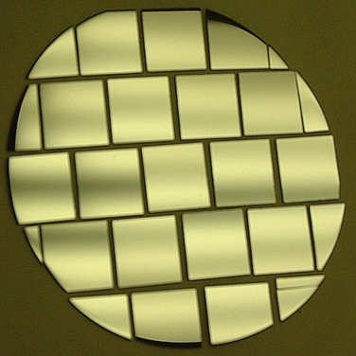
First Observation of Polarization from GaAs reported in 1976
QE
polarimeter
NIR
bias
vacuum
Diced GaAs wafer
light

Slide 4
Why does the GaAs source prevail at accelerators after 45 years?
Various ideas explored to produce polarized e- beams
  Electron Scattering : Mott scattering
  Photo-ionization: Fano Effect
  Photo-ionization alkali atoms
  Optically Pumped He Discharge
  Field Emission from EuS
  Spin filtering
  Photo-emission from GaAs
GaAs is well-suited for particle accelerators
  Suitably fast RF response (ps)
  Suitably small emittance (μm = mm-mrad)
  Rapid helicity reversal (kHz)
  Reproducible and reliable for accelerator operations (months)
  Minimizes excessive technologies (k$ and pw)
    giant lasers, reactive materials
    very large B-fields near low energy beams
    very hot and cold materials near one another
  Very high spin polarization available today (%)
SLAC “PEGGY” lithium source, first polarized e- source at an accelerator

Slide 5
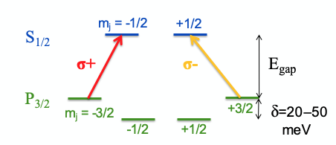

Strained-superlattice GaAs/GaAsP
QE 1% and Polarization >85%
GaAsP
30 A
Strained GaAs
30 A
Lighted
Absorbed
here
1000 A
Active Region
GaAs_{0.64}P_{0.36}
Buffer
GaAsP
2.5μm
Strained GaAs
GaAs_{(1-x)}P_{x} Graded Layer
2.5μm
GaAsP
Strained GaAs
GaAs Substrate
D. Luh et al, SLAC, PESP2002
From Aaron Moy, SVT Assoc and SLAC, PESP2002

Slide 6
Spin polarization from GaAs photocathodes
See M. Poelker’s talk Wed
Represents expectation for User facilities proposed today
….…
Laser power < 100 mW makes 100’s μA (avg)

Slide 7
Parity Violation Experiments at CEBAF

Slide 8
Schematics of Parity Setup at CEBAF
GaAs photocathode in HV DC gun is integrated into all levels of the experiment from the source, to accelerator, to end user

Slide 9
Checklist for the HV DC GaAs polarized photo-gun
Photocathode
  High Polarization
  High QE
  Large Charge Lifetime => (Current x Time)
Vacuum
  Gun chamber with low outgassing, and high pump speed
  Excellent vacuum, good isolation from lesser vacuum
High Voltage
  Meet requirement for peak current
  Reliable, and without eliminate field emission
Drive Laser
  Reliable, and phase locked to machine RF
  Adequate Power i.e. Amps/Watt

Slide 10
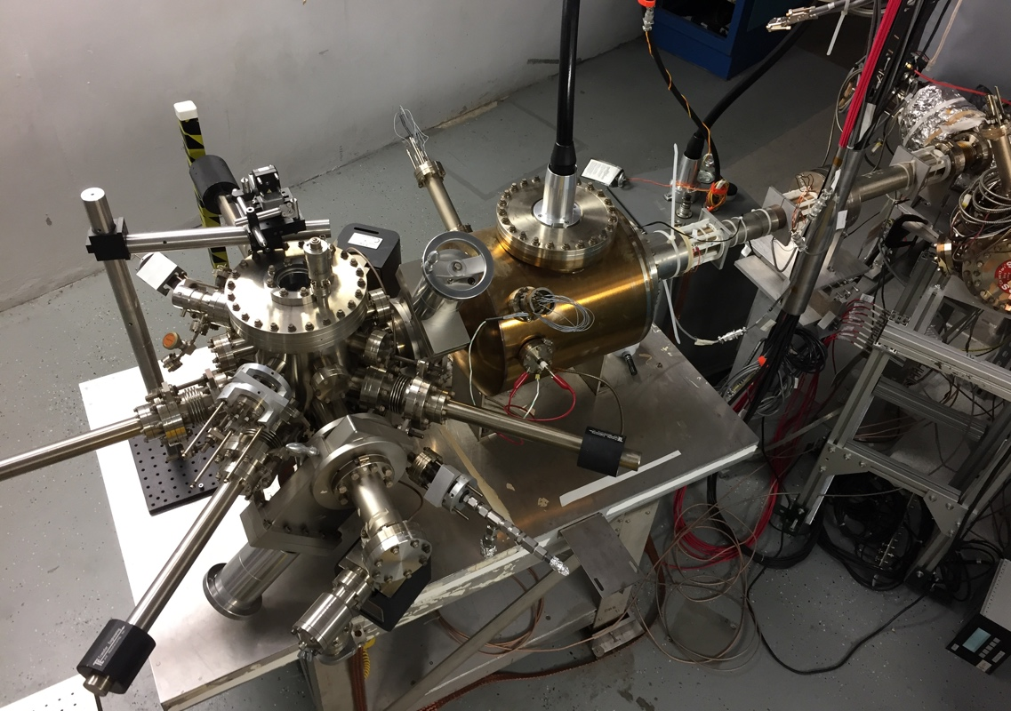
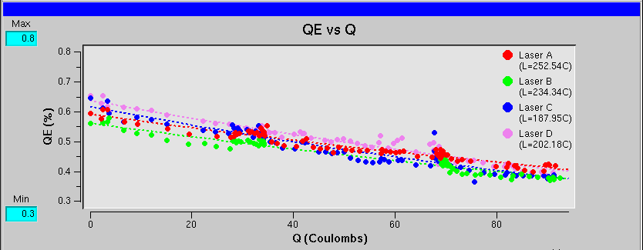
CEBAF Polarized Electron Load Lock Photogun
P. Adderley et al., Phys. Rev. Accel. Beams 13, 010101 (2010)
Gun2 Photocathode (Fall 2016 – Spring 2017)
  Strained Superlattice GaAs/GaAsP #5756-4
  Good Polarization >85% (measured at Mott polarimeter)
  Good QE > 1% after activation => 6 mA/Watt/% @ 780 nm
  Lifetime about 200 C (σ_{4D} ~ 1mm) with intensity < 200 μA
  CW rep. rate >250 MHz => bunch charge < 1 pC
Preparation
Chamber
Activation Laser
HV Chamber
GaAs
Storage
Loading
Chamber

Slide 11
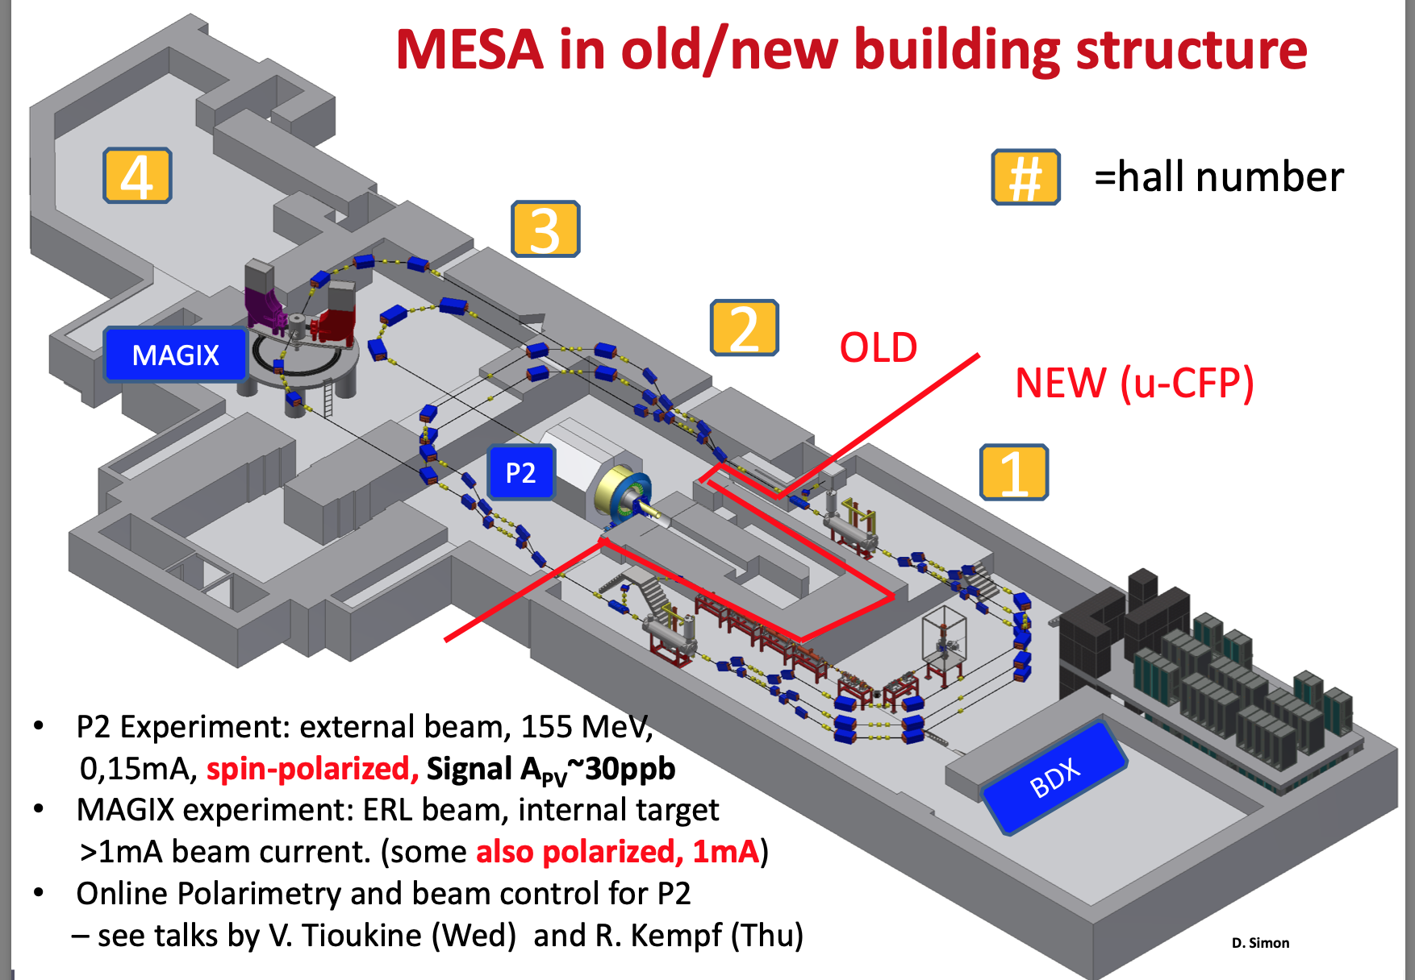
Small ThErmalized source At Mainz (STEAM) – MESA
Slide courtesy Kurt Aulenbacher
DC HV Inverted GaAs Photogun
Fixed target (150 uA)
ERL (>1 mA)
CW 1.3 GHz, <1 pC
150 kV, excellent vacuum
S. Friederich et al .doi:10.18429/JACoW-IPAC2019-TUPGW028
STEAM installed at test apparatus “MELBA”
December 2021
Final commissioning of STEAM at MESA
has started.
→ Commissioning of injector in 2022-2023

Slide 12

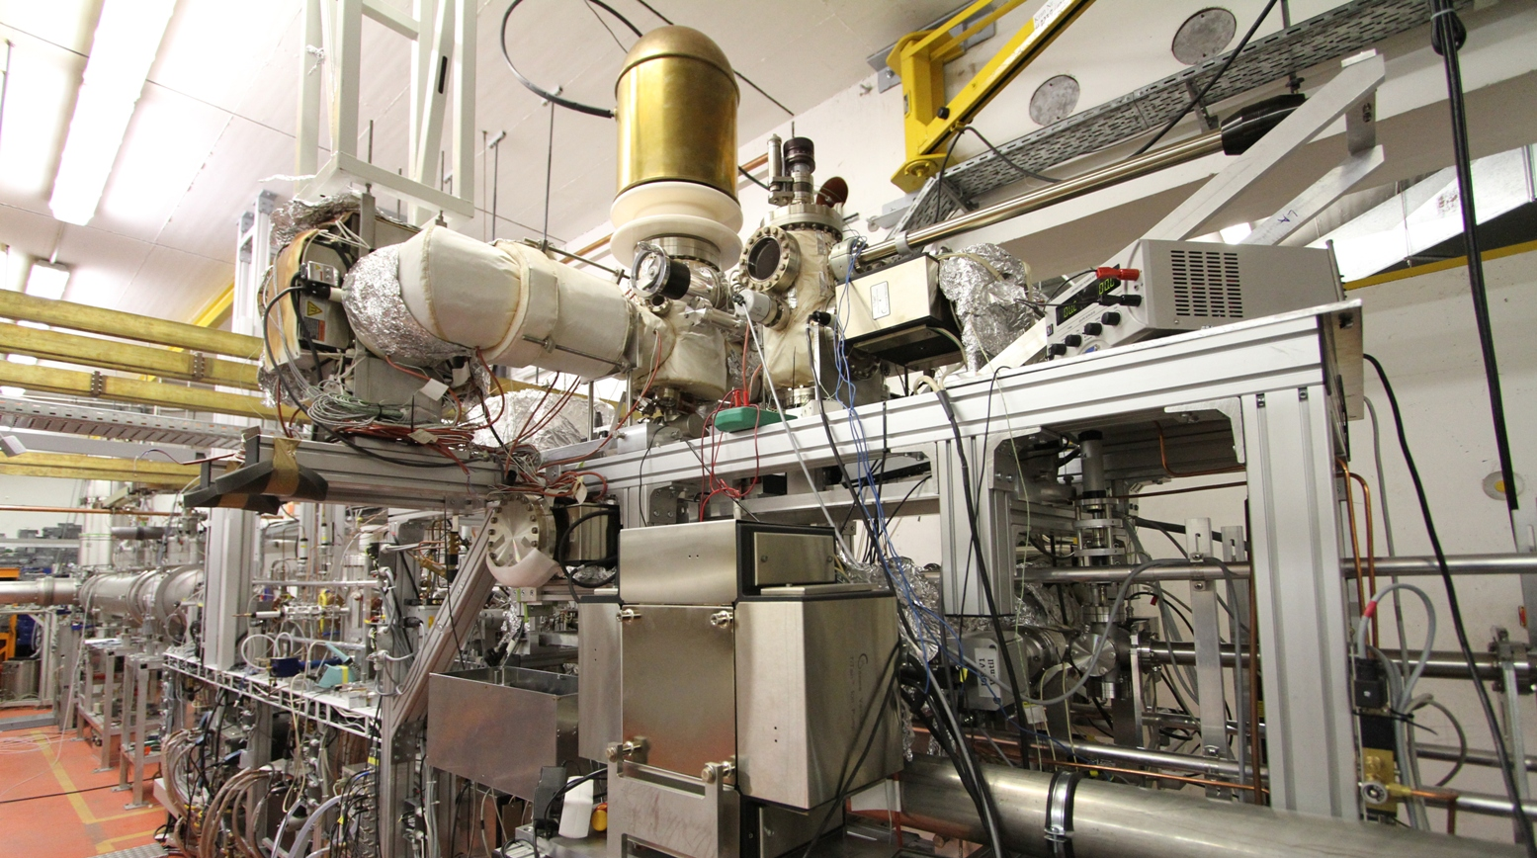
S-DALINAC Polarized Injector (SPIn)
Slide courtesy Joachim Enders
Bulk and Superlattice GaAs
Titanium-Sapphire Laser:
  380 fs pulse length
  75 MHz repetition rate
  40 m fibre/stabilized transfer
Diode laser: DC or 3 GHz
Load-lock system
Total height ~ 1.8 m
Vacuum < 10⁻¹¹ mbar
Performance
  Vacuum lifetime ~ 1000 h
  Charge lifetime ~ 10 C @ 7 μA
  90-115 keV, I < 50 μA
  86% polarization
  0.15 mm mrad emittance
Y. Poltoratska et al.,
J. Phys.: Conf. Series 298, 012002 (2011)
Implementation complete
Insufficient capture at 100 keV

Slide 13
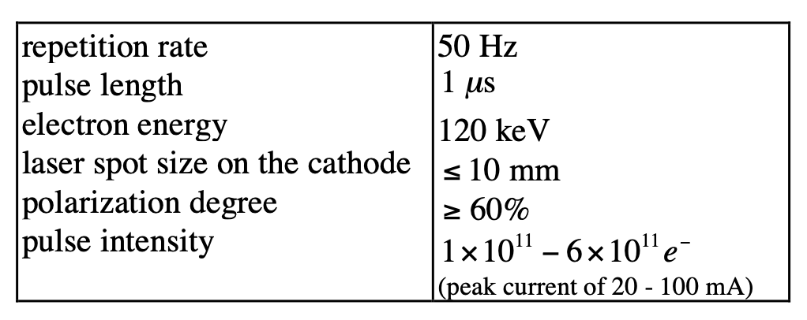
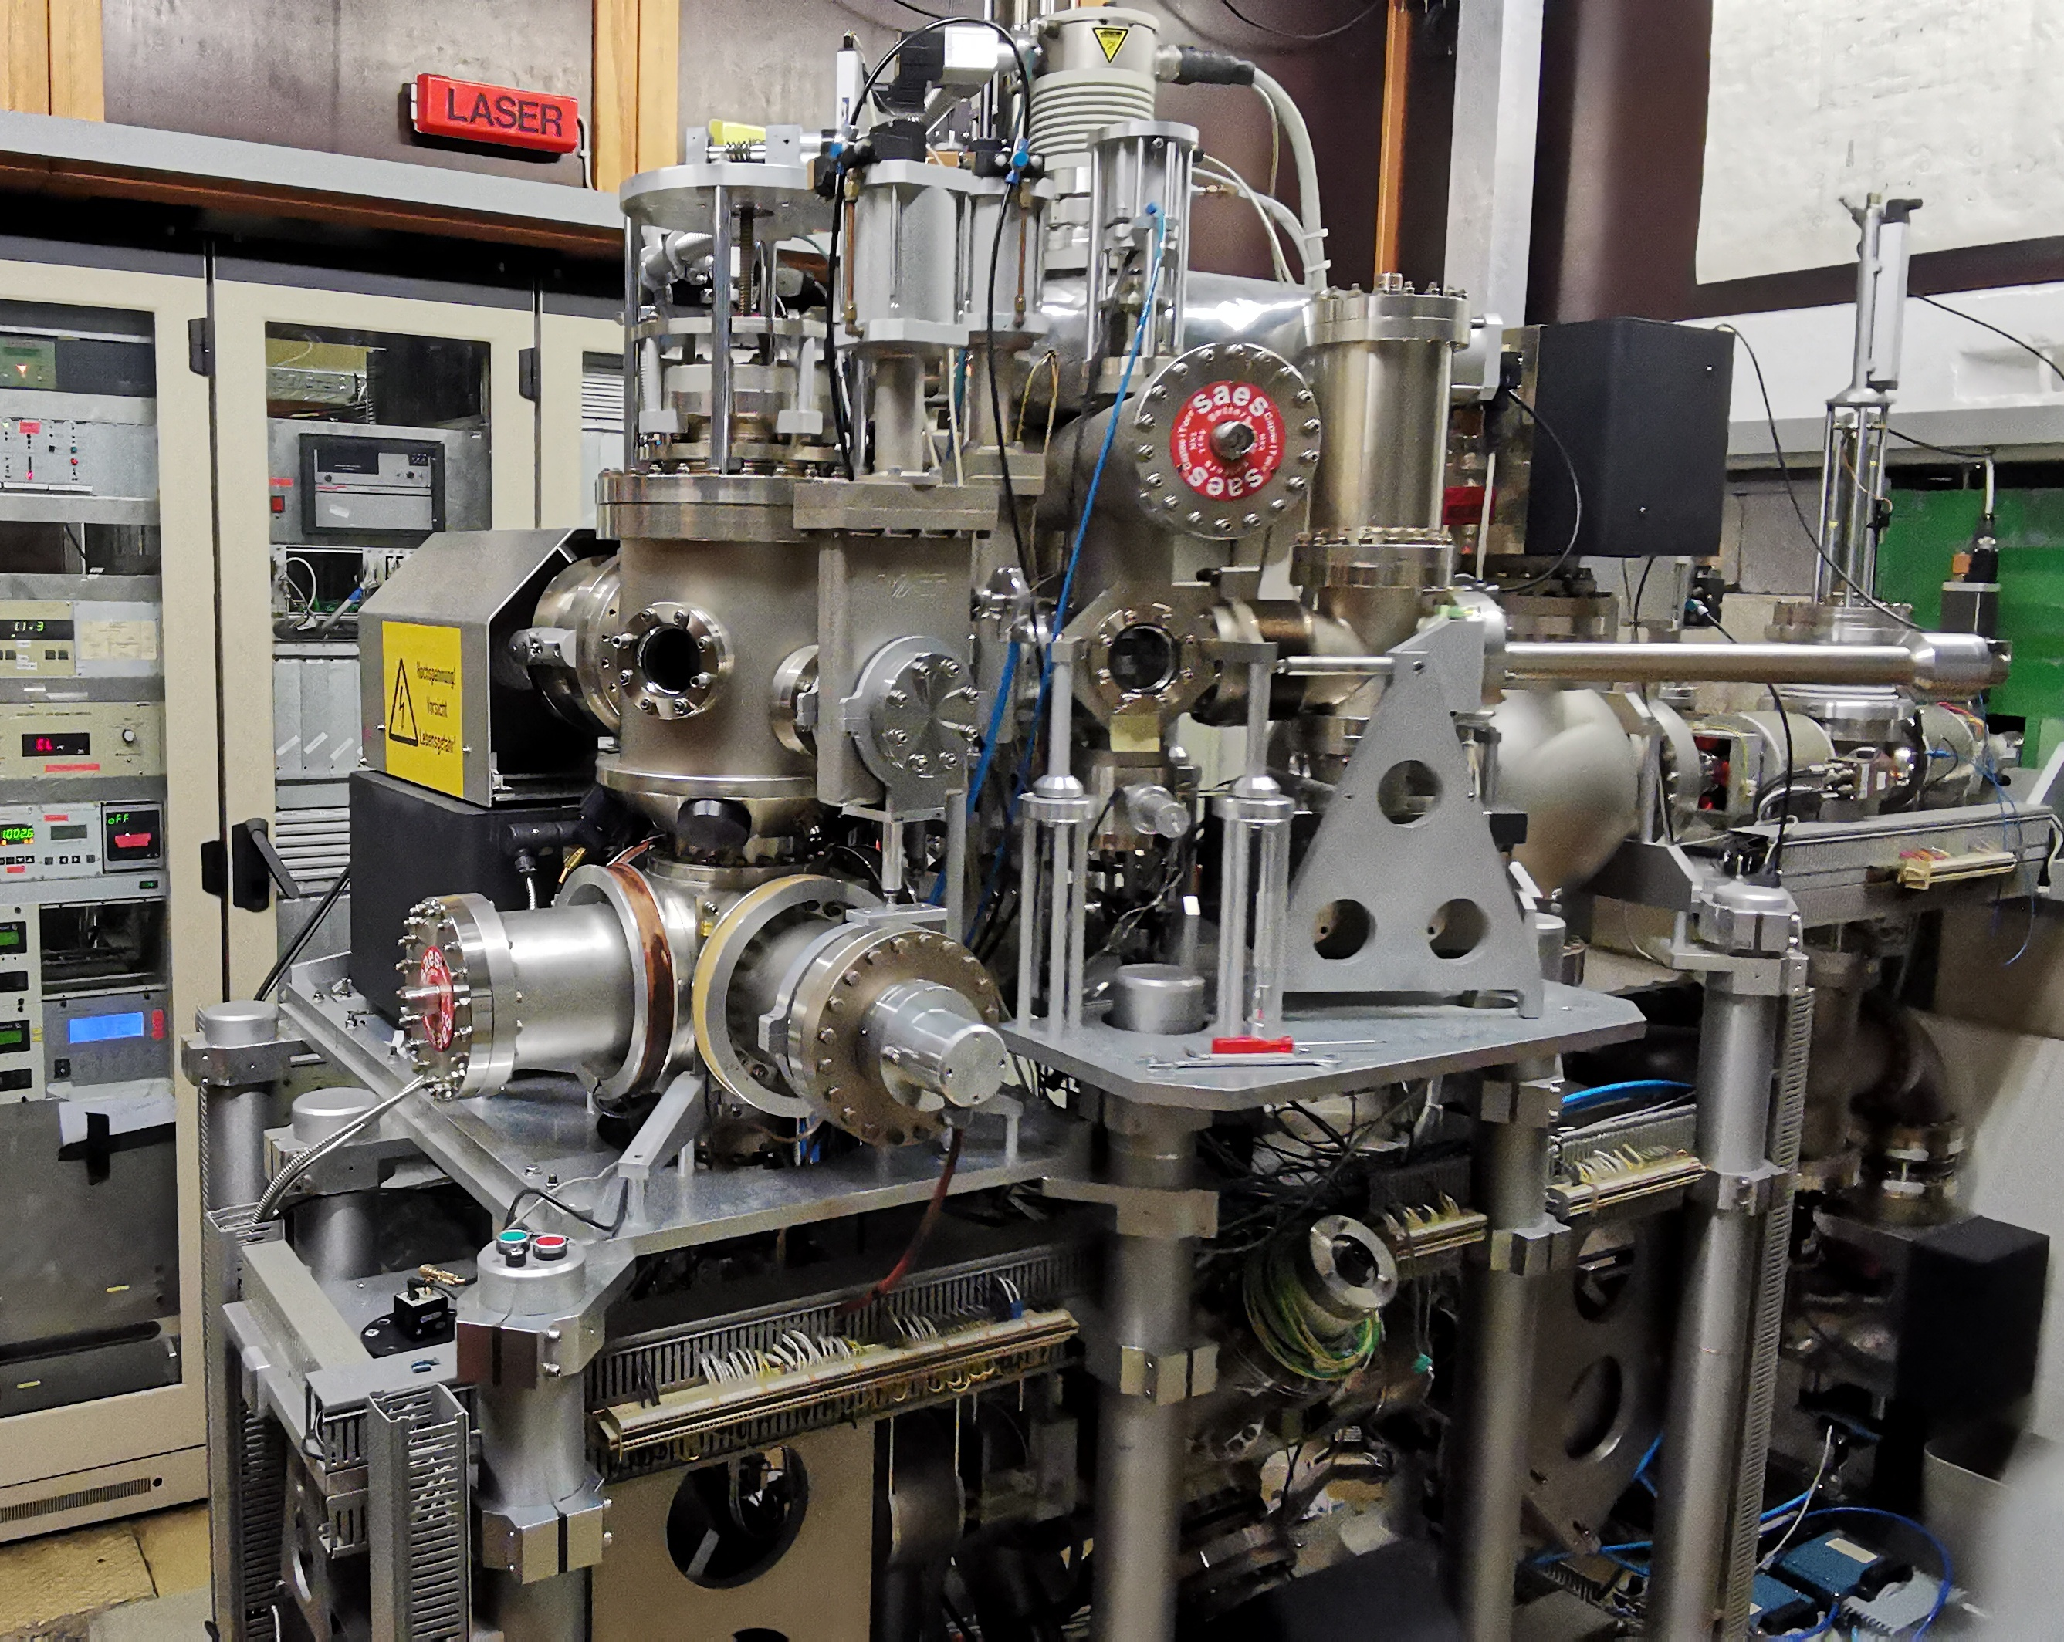
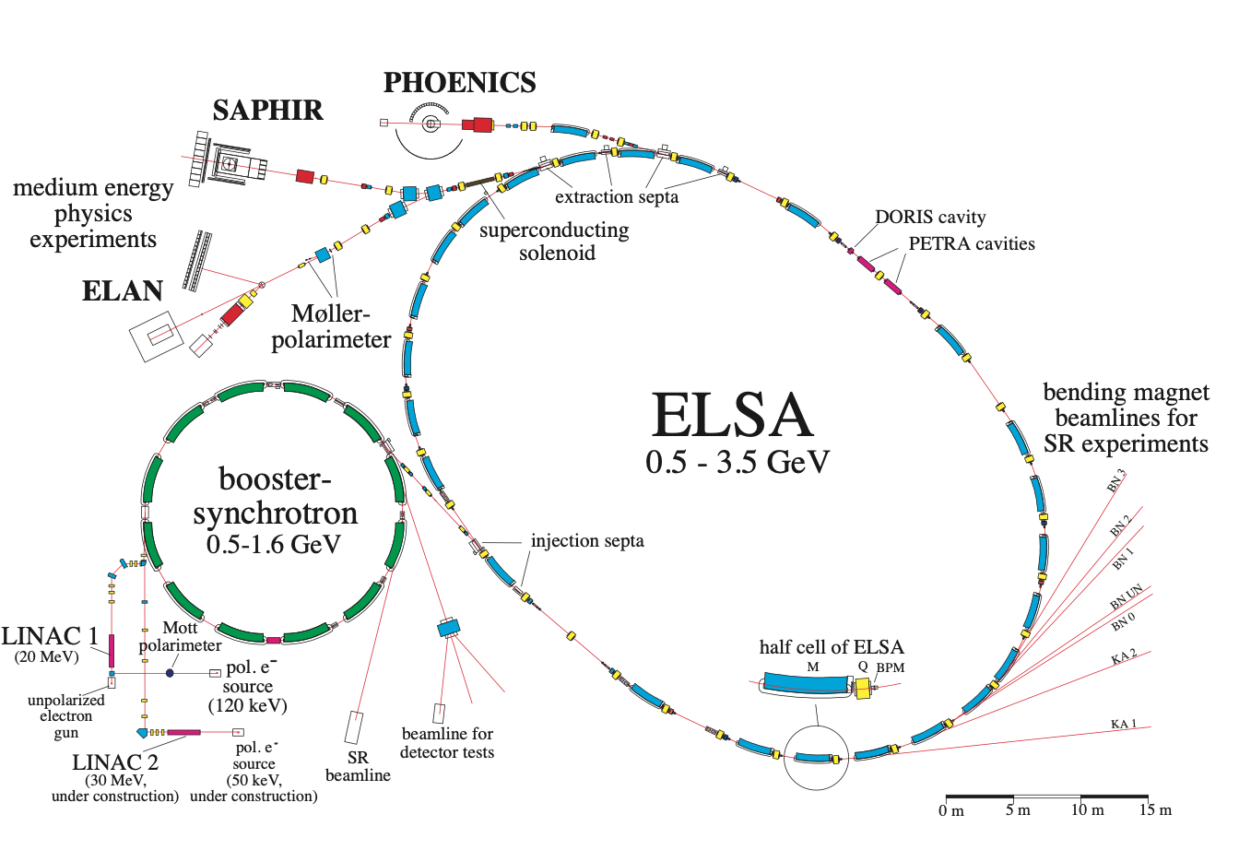
ELSA (Bonn, Germany)
Slide courtesy Michael Switka
EPJ Web of Conferences 134, 05002 (2017)

Slide 14
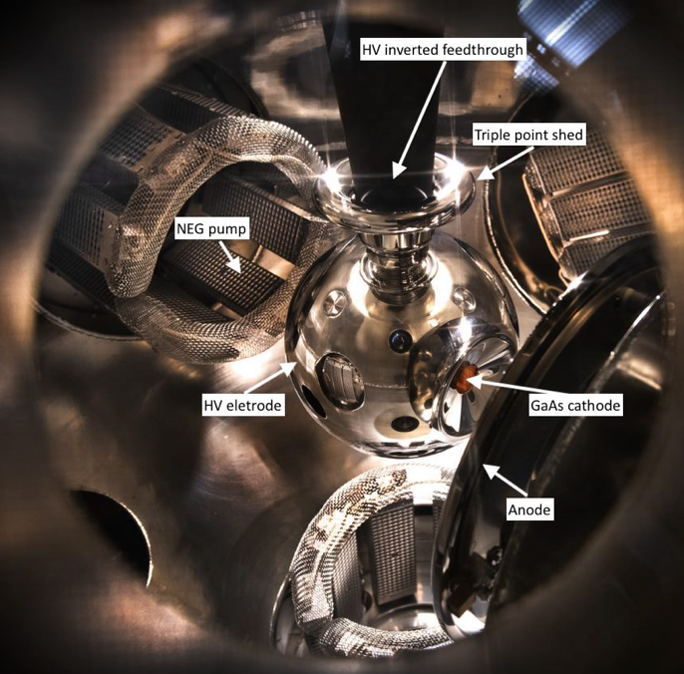
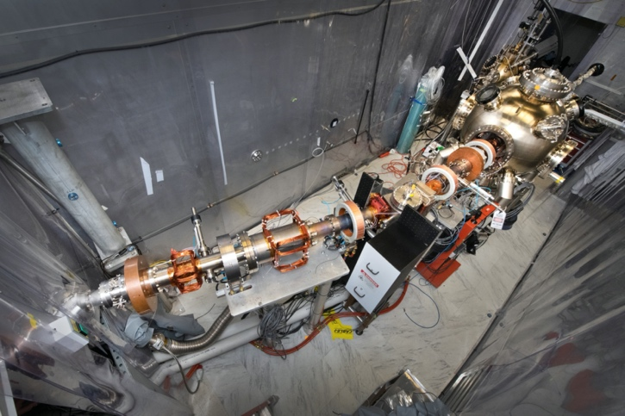
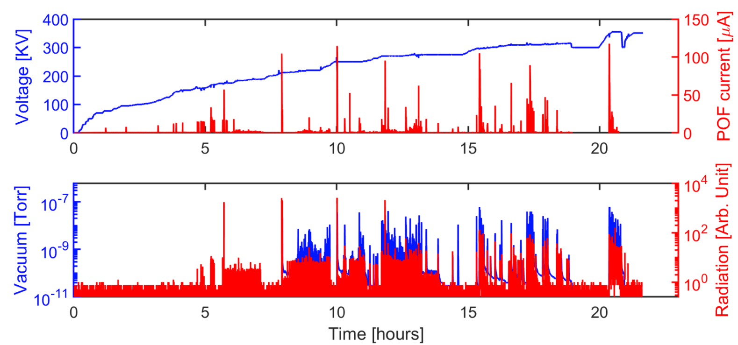
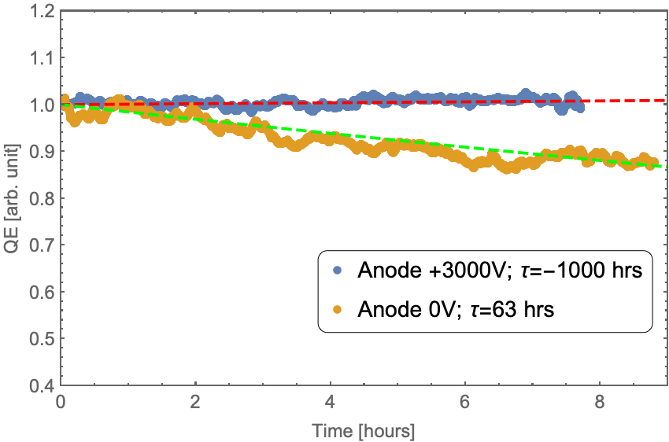
Electron Ion Collider – Polarized Gun R&D
Slide courtesy Erdong Wang
352kV
Using 7.5 nC bunch charge polarized beam, 5000 pulses/s ~37.5 uA;
Without anode bias 1/e lifetime is 63 hrs. Dominated by the outgassing from FC.
With anode bias, we didn’t observe QE drop.
Charge from 7 hours test= 33 weeks of EIC operation
No field emission
Radiation noise level
Vacuum into 10e-12 torr

Slide 15
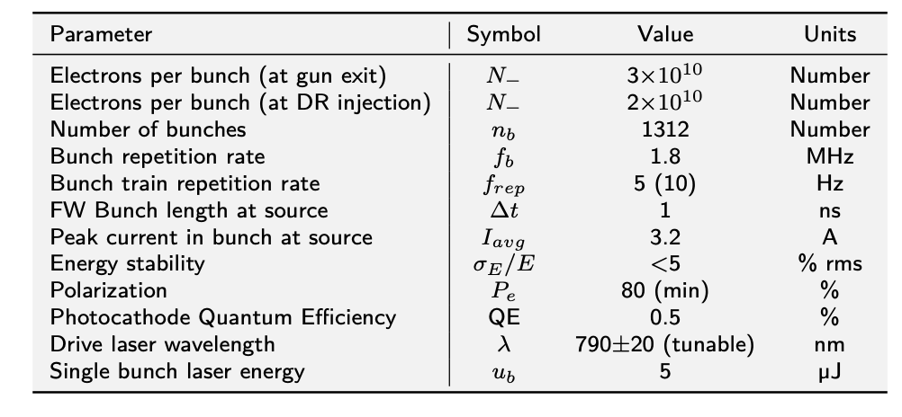
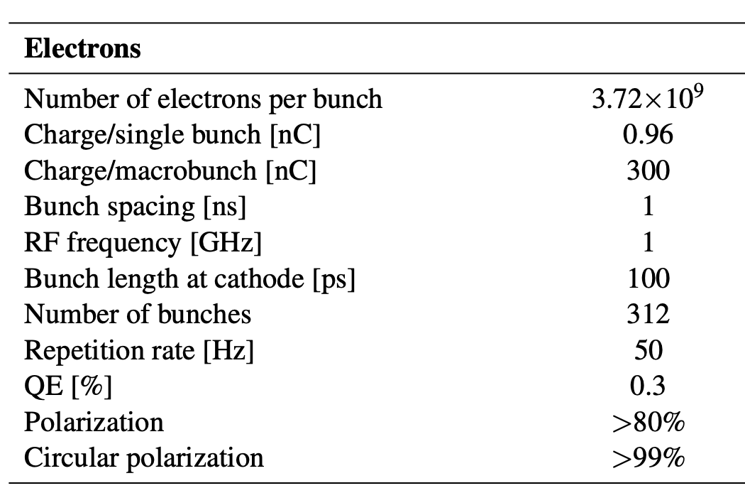
Linear Colliders Requiring High Bunch Charge
ILC Source Parameters TDR (2013)
4.8 A
6.1 A/cm²
CLIC Source Parameters CDR (2012)
9.6 A
12.2 A/cm²
Factor 2 in charge
Factor ½ in pulse
Factor 0.7 in size

Slide 16
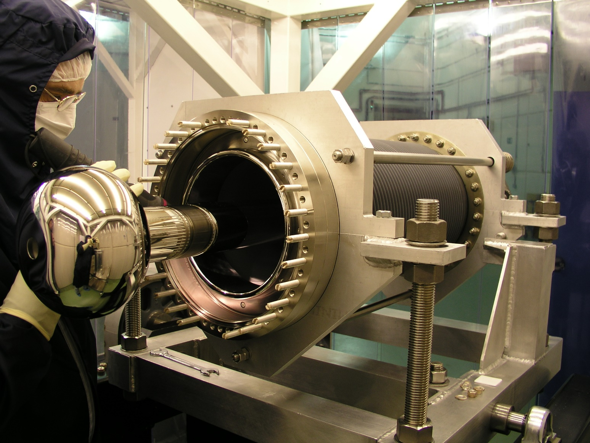
PERLE (Orsay, France)
Slide courtesy Maud Baylac
PERLE (Orsay, France) : a high power, multi-turn energy recovery linac (20 mA, 500 MeV)
PERLE to be driven by the ALICE DC photogun
ALICE gun provided by STFC Daresbury (Boris Militsyn)
Initial operation with unpolarized beam using Sb-based photocathodes (e.g. Cs₂SbK)
Additional work required on the ALICE gun for photocathode preparation and transportation
Design from the JLab IR – FEL gun, operation at 350 kV
Main goal : demonstration of the 500 pC bunches with repetition rate 40 MHz
Polarized beam with GaAs photocathode to be considered at a later stage
CDR is the reference document (arXiv:1705.08783v1)
Courtesy of JLab
Courtesy of STFC

Slide 17
Conclusions
The facilities that are operating, under construction or planned for operations are all in relatively good shape.
  Good progress at BNL, Mainz and JLab to build & operate required photo-gun programs
  Adoption of the inverted geometry pays off, has been a wonderful experience for JLab
  New techniques like biased anode becoming standard too, fruitful
Reliable availability of high-polarization superlattice photocathodes (and DBR) needs to be addressed
  (see cathode session talks), this needs to be highlighted in the Snowmass summary
Yet, there remains opportunities to improve performance or extend capability for future guns
  Lower outgassing rate vacuum chambers, better isolation from accelerator or beam vacuum
  Higher QE photocathodes
  Cooled photocathodes
  Managing or reducing reflected laser power
  Photocathodes which are more robust to FE or ion bombardment
  Higher average current
  Higher operating lifetime
  Higher operating voltage

Slide 18
Summary of polarized GaAs DC HV Photogun Guns at User Facilities
CW <1 pC
Pulsed > 1 nC
CW > 10-100 pC
Older sources
Newer sources

Slide 19



Polarized Electrons for Polarized Positrons (PEPPo)
D. Abbott et al, "Production of Highly Polarized Positrons Using Polarized Electrons at MeV Energies", Phys. Rev. Lett, 116, 214801 (2016)
electron beam polarization
85.2 ± 0.6 ± 0.7 %
PEPPo demonstrated efficient transfer of polarization from electrons to positrons by bremsstrahlung + pair creation at low energy (<10 MeV).

Slide 20
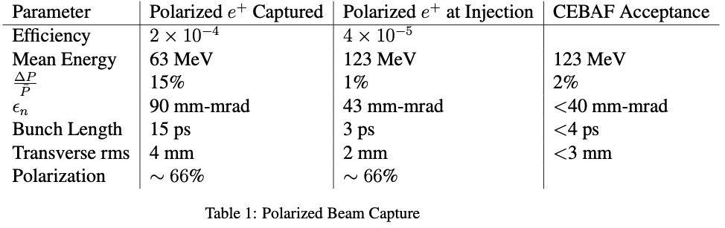
Polarized e+ @ CEBAF : motivates greater current, longer lifetime, higher voltage
Jefferson Lab the Users are asking for polarized e+ beams with intensities >100 nA.
>5 x 10⁻⁵
>60%
A GaAs source source providing 10 mA for a week = 600 Coulombs Lifetime must be longer than this!

Slide 21
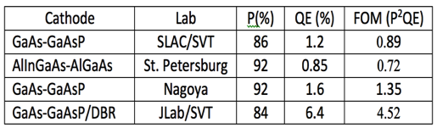
Higher Quantum Efficiency Photocathode – high current with less Watts
Diffracted Bragg Reflector SLSP
DBR strained-superlattice
  QE = 6.4%
  Polarization = 84%
Standard strained-superlattice
  QE ~1 %
  Polarization ~90 %
~ 30 mA/W
~ 6 mA/W
Difference between Watts (cooling!) or 100’s mW of (no cooling)
The highest reported QE of any high polarization photocathode
Candidate for EIC, polarized positrons
U.S. DOE SBIR partnership

Slide 22


Longer lifetime – reducing ion energy density by increasing laser spot size
Ion back-bombardment of photocathode degrades QE, defines useful operating lifetime in a gun with good vacuum and no field emission, i.e. a “good polarized gun”.
J. Grames, et al., Phys. Rev. ST Accel. Beams 14 043501 (2011)
GaAs @ 532nm

Slide 23

Longer lifetime – reducing ion energy density by increasing laser spot size
Indeed, we enhanced the Charge Lifetime for CEBAF parity-violating QWeak Experiment by a factor of four when doubling the laser spot size from 0.5 mm to 1.0 mm (fwhm)
but milliampere applications require kiloCoulomb charge lifetime to provide uninterrupted operation of reasonable duration

Slide 24
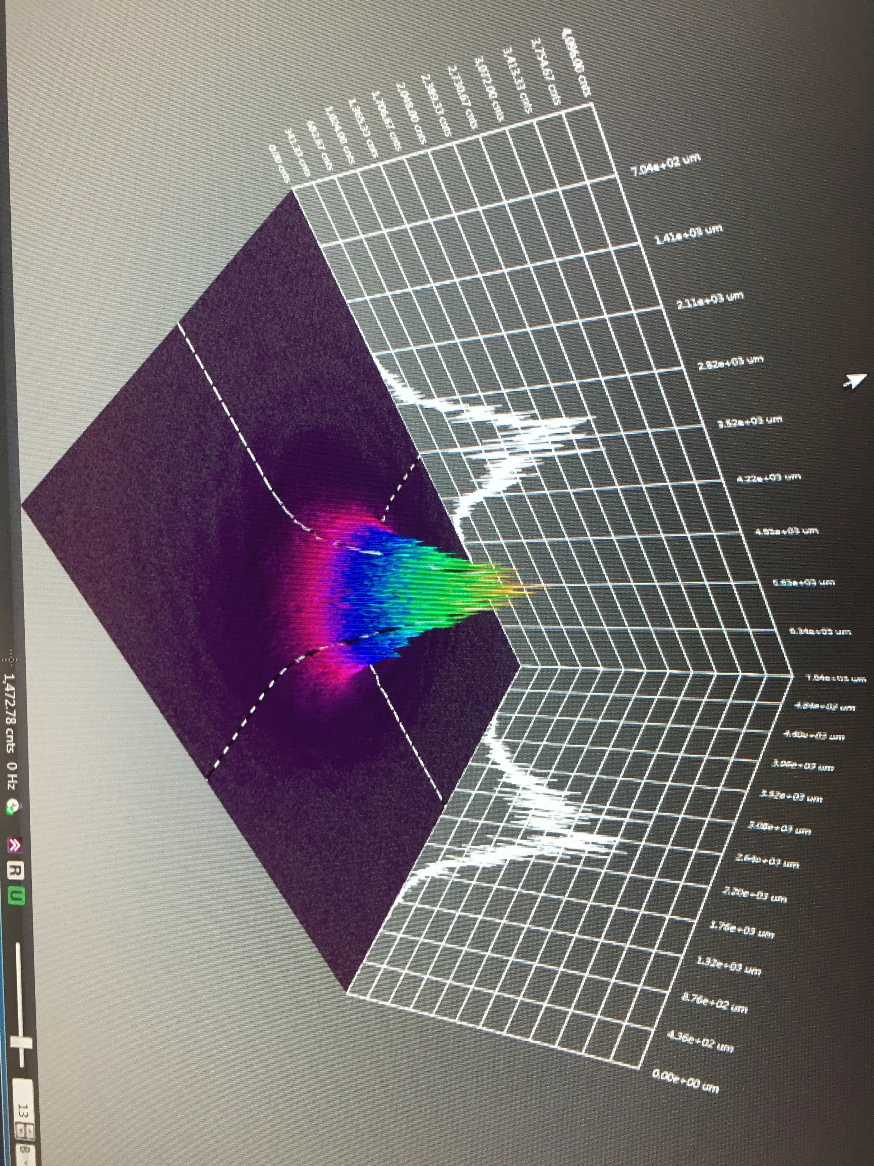

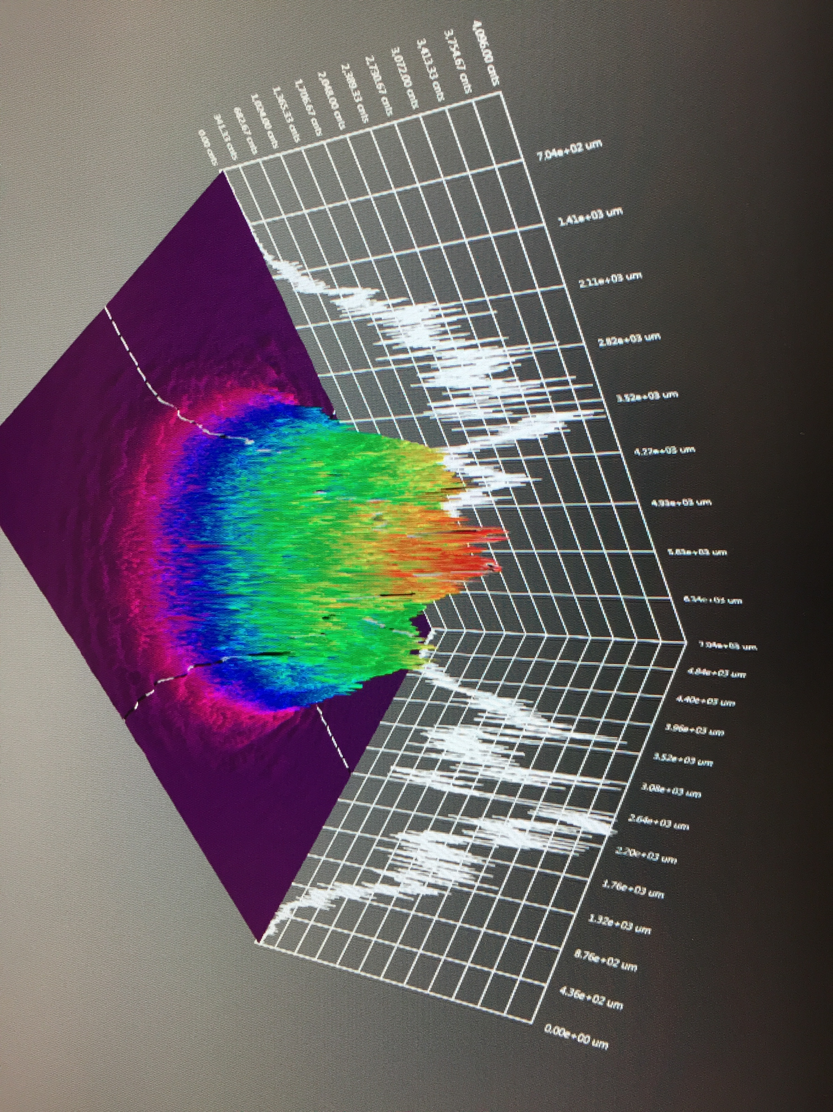
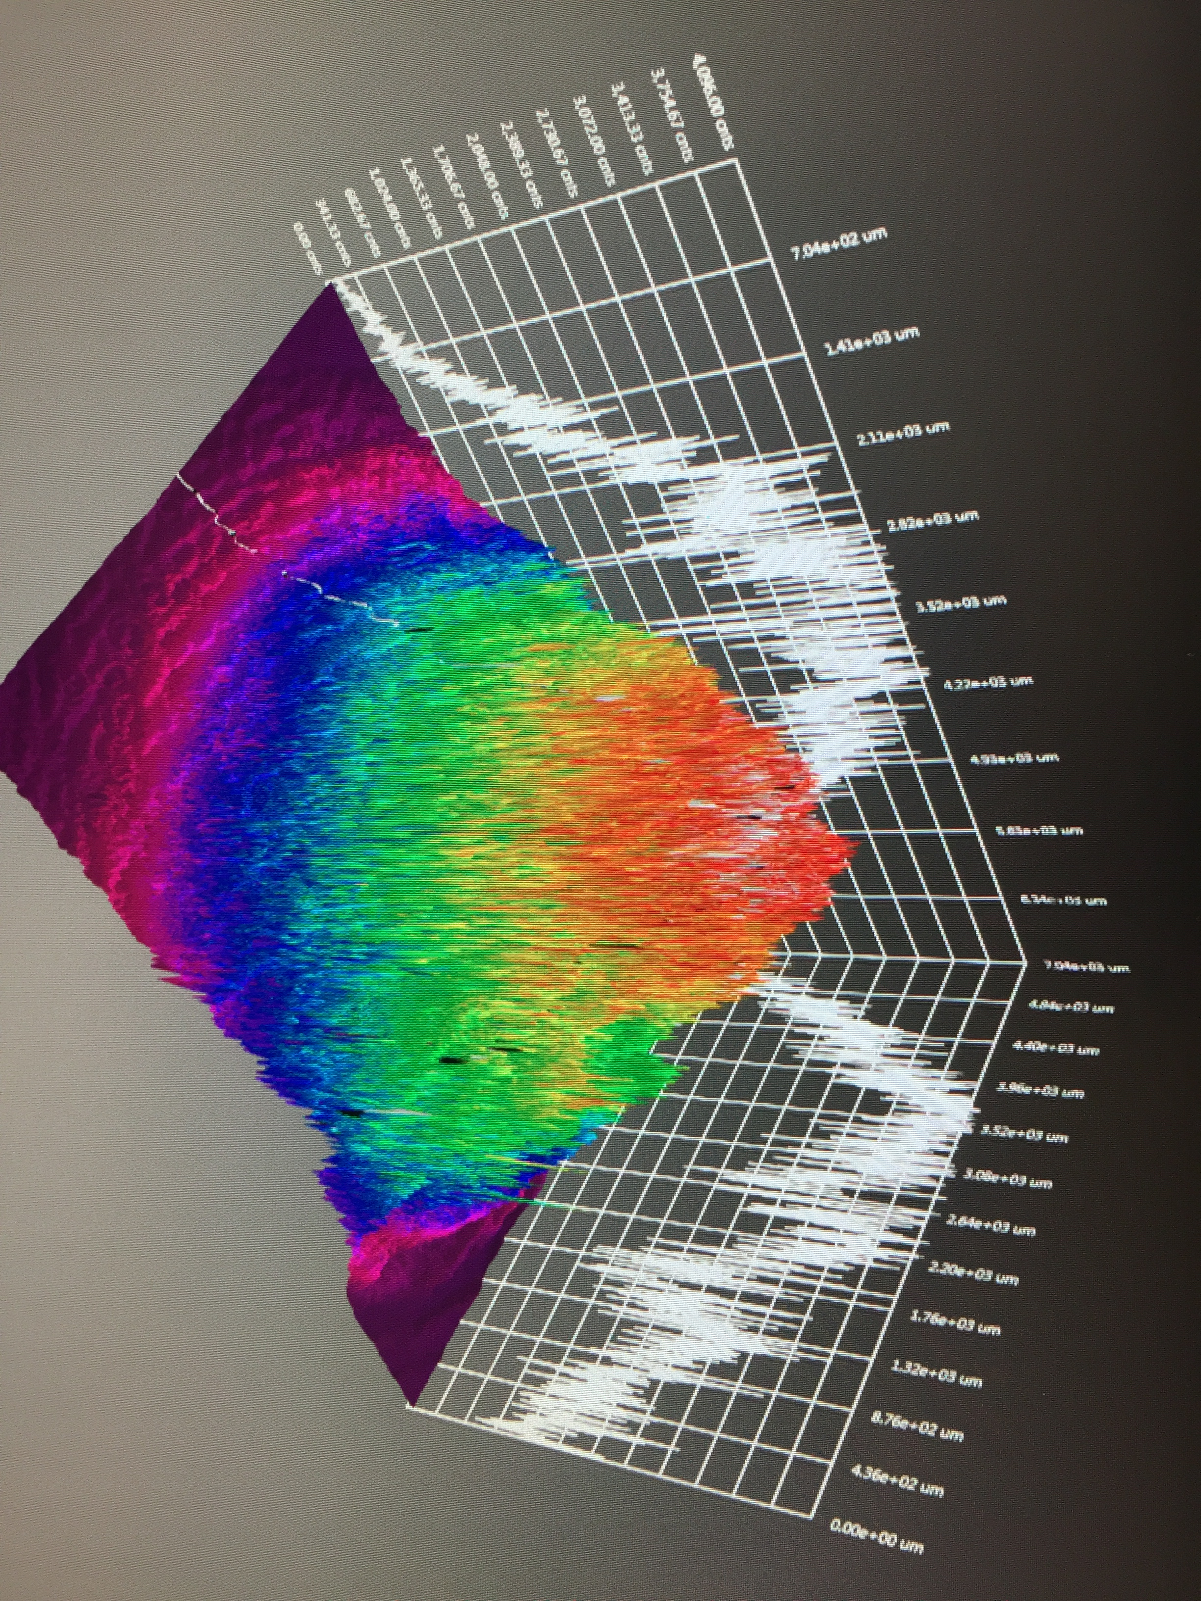
Longer lifetime – increasing laser spot size
  Initial testing shows increasing laser size extend milliamp operations into the “Week” regime
  Active R&D simulation efforts to “straighten the curve”
J. Grames, P. Adderley, J. Hansknecht, R. Kazimi, M. Poelker, D. Moser, M. Stutzman, S. Zhang, “Milliampere beam studies using high polarization photocathodes at the CEBAF Photoinjector” Polarized Sources, Targets and Polarimeters Workshop, Dajeon South Korea (2017)
Days
Trend we want to realize

Slide 25
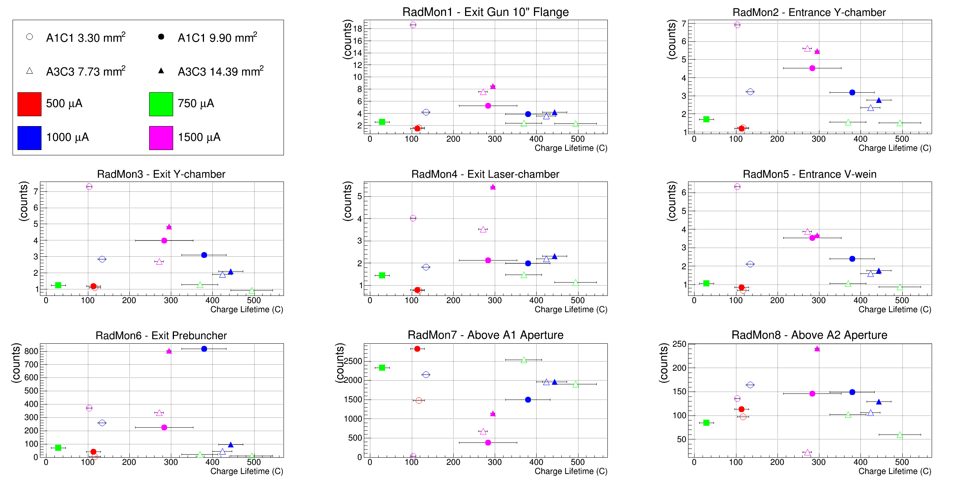
Longer lifetime – increasing laser spot size
The best charge lifetime is achieved when x-ray levels are smallest.

Slide 26
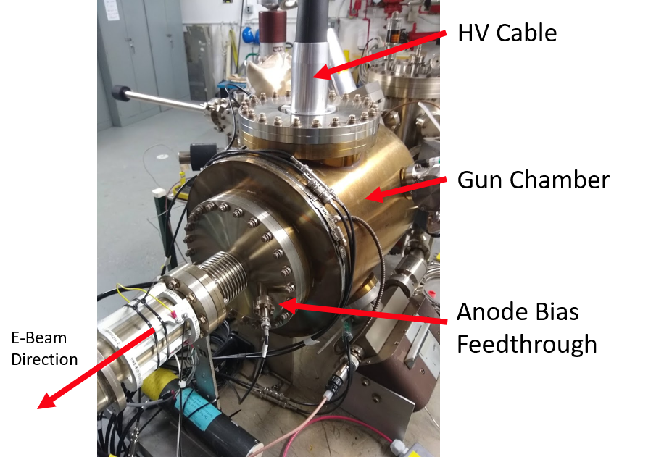
Longer lifetime – biased anode
PhD work of J. Yoskowitz
Theory: Electron beam ionizes residual gas molecules, which accelerate towards and strike the photocathode, leading to reduced quantum efficiency (QE) and lower charge lifetime.
Solution: Bias the anode with a positive voltage to repel ions downstream of the anode and increase the charge lifetime.
J. Yoskowtiz, J. Grames, J. Hansknecht, C. Hernandez-Garcia, G.A. Krafft, M. Poelker, R. Suleiman, G. Palacios-Seranno, S. Wijenthunga, S. B. Van Der Geer, “New Simulations for Ion-Production and Backbombardment in GaAs Photo-guns”, in Proc. of Polarized Sources, Targets and Polarimetry Workshop (2019)

Slide 27
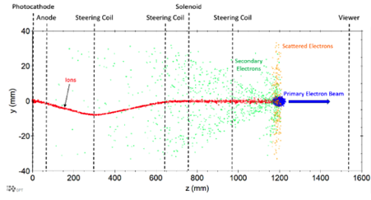
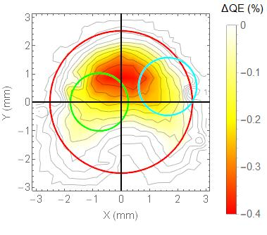
Longer lifetime – quantifying ion back-bombardment
PhD work of J. Yoskowitz
New custom code was developed in the GPT framework to simulate electron-impact ionization of residual vacuum gasses and then track the ion/secondary dynamics.
Simulations of ion back-bombardment predict ions created within the cathode-anode gap, depositing their energy at the photocathode, closely resembles the measured damage pattern.
Simulated
Simulated
Measured
QE Loss

Slide 28
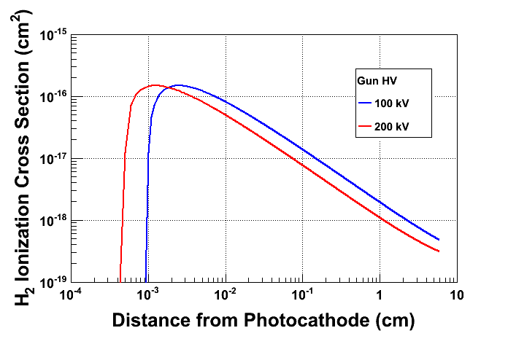
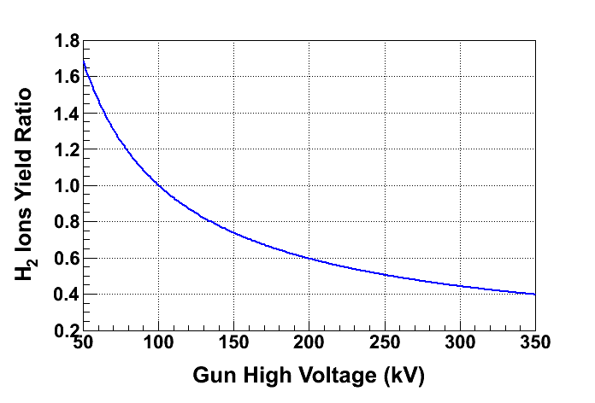
Higher voltage – longer lifetime
Work of R. Suleiman
Motivations for high gun (beam) voltage
  Meet requirement for facility peak current (Child’s law – in real 3D space)
  Being closer to “c” – minimize space charge (long beam lines)
  Improve charge lifetime ?
Most ions created close to GaAs surface
Number of ions decreases with gun voltage

Slide 29
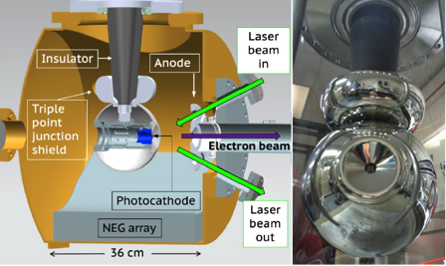
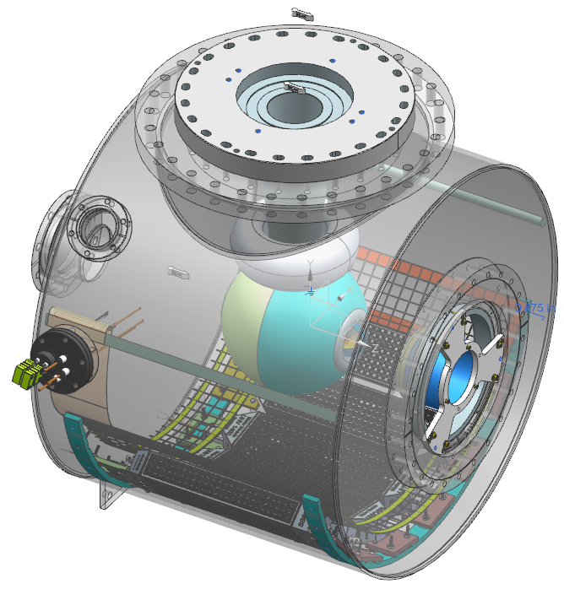
Building a higher voltage Polarized Gun for CEBAF
  Applying the experience and lessons learned from the 300 kV magnetized beam photogun to build a 200 kV UHV polarized electron source for SSL operation
300 kV Magnetized Beam Electron Source (CsKSb)
Model of CEBAF 200 KV Polarized Gun (GaAs/GaAsP)
C. Hernandez-Garcia et al., Phys. Rev. Accel. Beams 22, 113401 (2019)
R30 inverted geometry ceramic insulator
Conditioned to 350 kV
Demonstrated 4.5 mA CW 300 keV
Operate at >200 kV without field emission
HV conditioning >350 kV (uses R30 inverted ceramic insulator)
Dynamic pressure (during beam delivery) ~ 1x10⁻¹² Torr

Slide 30
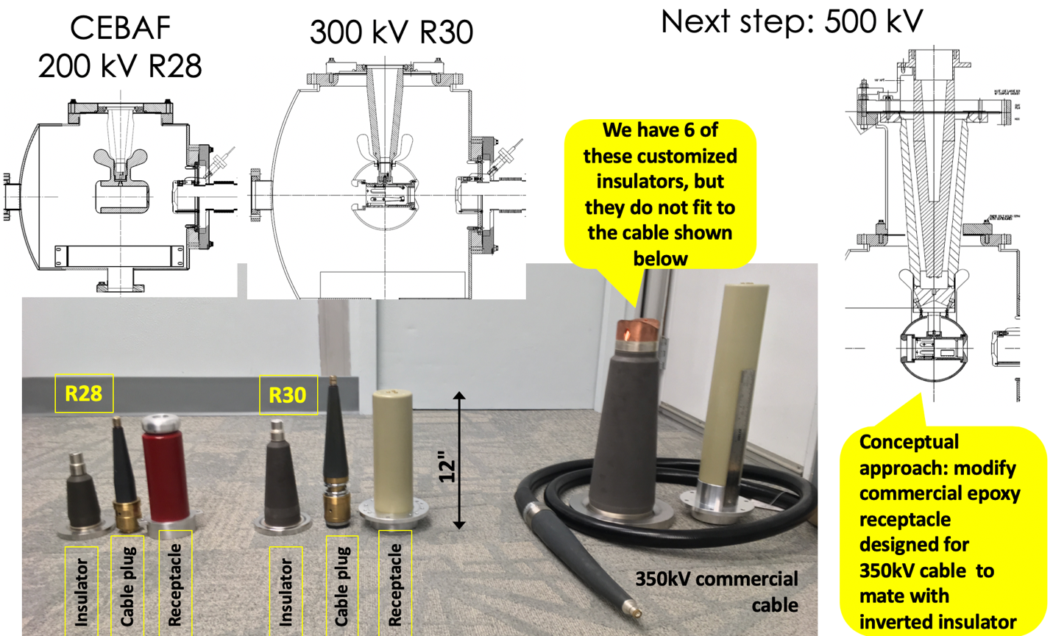
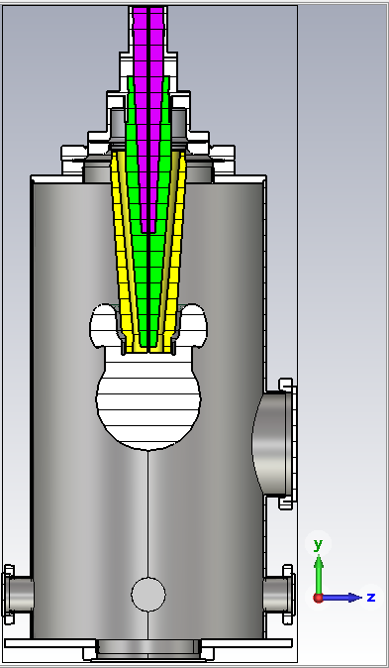
Developing custom ceramic insulator for operating 400-500 kV
C. Hernandez-Garcia et al., “Inverted Geometry Ceramic Insulators in High Voltage DC Electron Guns for Accelerators”, in proceedings of the 021 IEEE Conference on Electrical Insulation and Dielectric Phenomena-Vancouver-Canada

Slide 31
Conclusions
The facilities that are operating, under construction or planned for operations are all in relatively good shape.
  Good progress at BNL, Mainz and JLab to build & operate required photo-gun programs
  Adoption of the inverted geometry pays off, has been a wonderful experience for JLab
  New techniques like biased anode becoming standard too, fruitful
Reliable availability of high-polarization superlattice photocathodes (and DBR) needs to be addressed
  (see cathode session talks), this needs to be highlighted in the Snowmass summary
Yet, there remains opportunities to improve performance or extend capability for future guns
  Lower outgassing rate vacuum chambers, better isolation from accelerator or beam vacuum
  Higher QE photocathodes
  Cooled photocathodes
  Managing or reducing reflected laser power
  Photocathodes which are more robust to FE or ion bombardment
  Higher average current
  Higher operating lifetime
  Higher operating voltage

