Slide 1
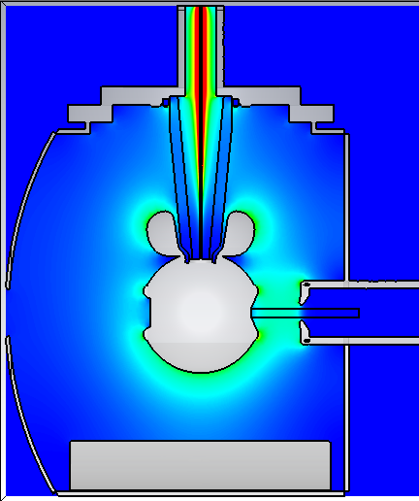
CST model at 200 kV T-electrode on R28 white insulator vs spherical electrode on R30 insulator 6 cm anode-cathode gap and CEBAF anode
5.5MV/m
29MV/m at cusp
6.5MV/m
6.3MV/m
7.9MV/m
7.2MV/m
4.87 MV/m
4.6 MV/m

Slide 2
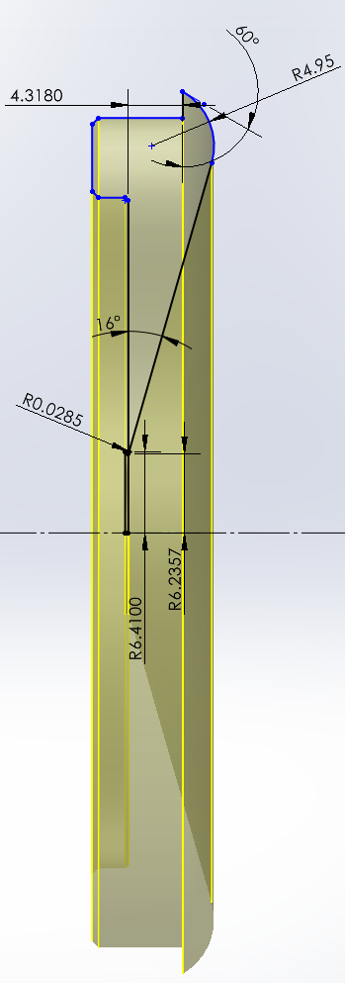
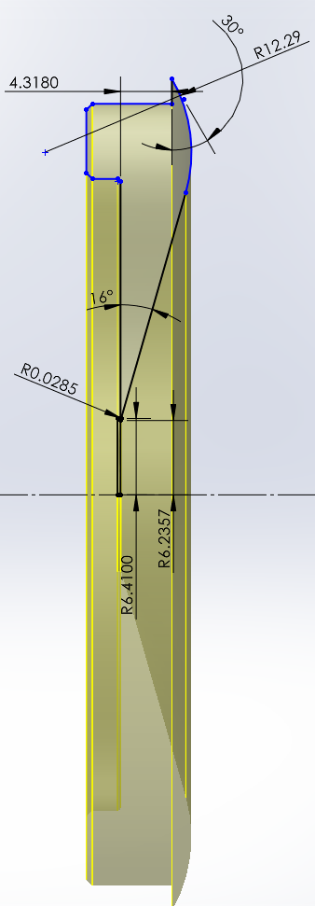
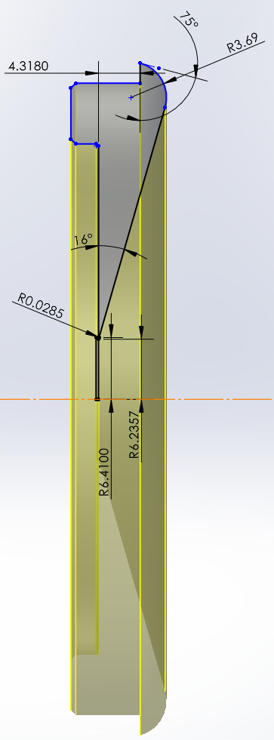
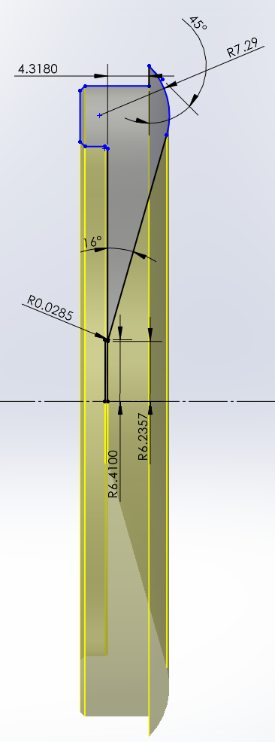
Junction angle

Slide 3
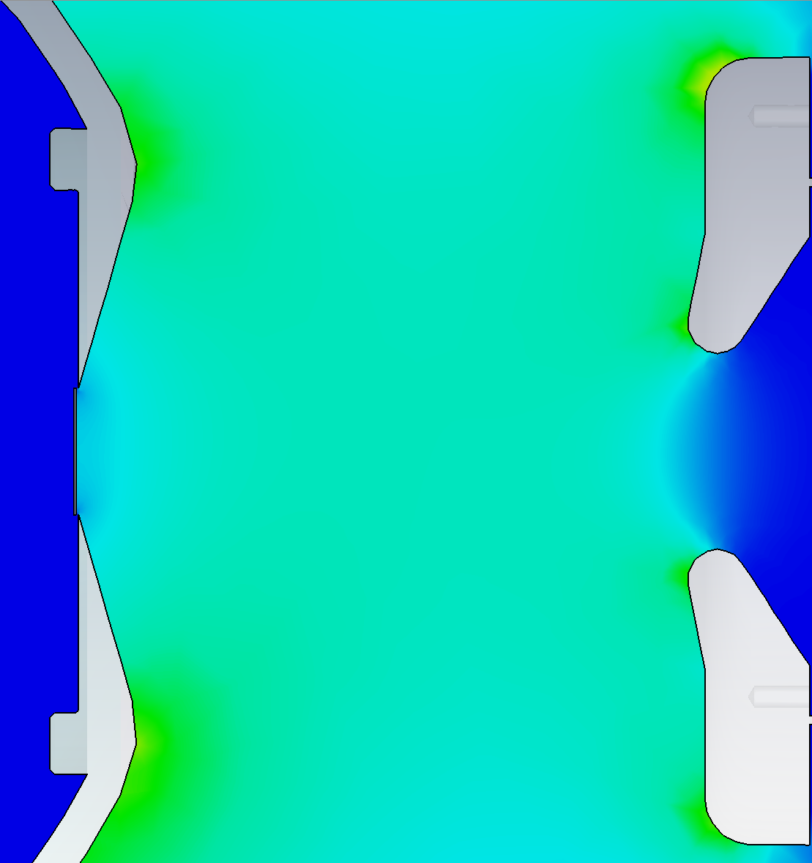
Junction angle 30°
5.8 MV/m
5.4 MV/m

Slide 4
Junction angle 45°
6.7 MV/m
4.4 MV/m

Slide 5
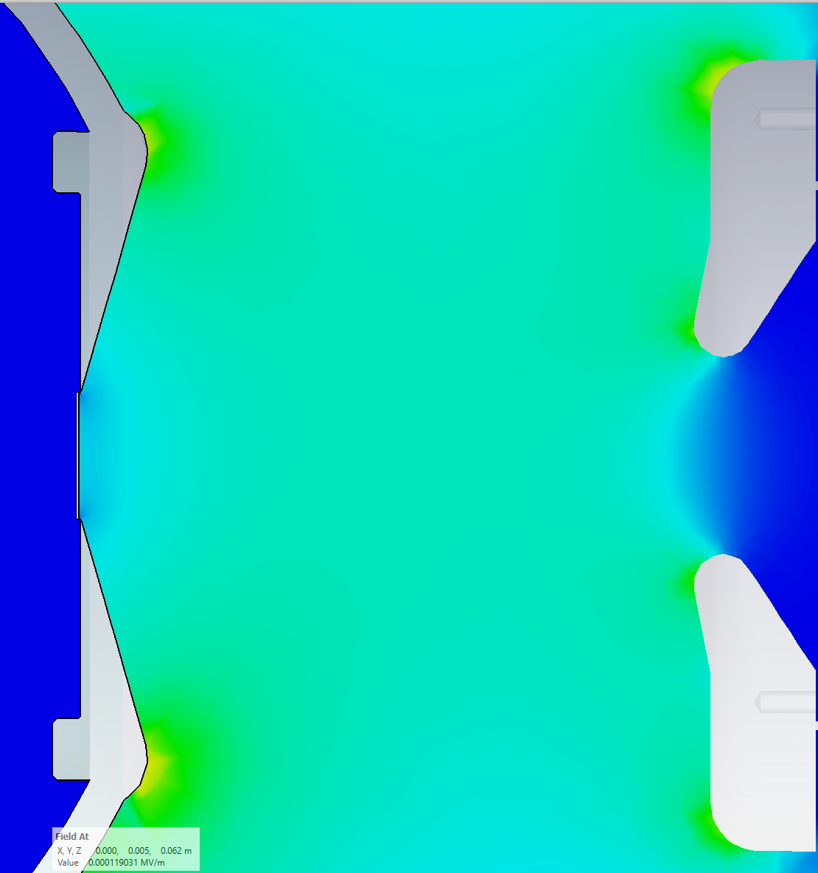
Junction angle 60°
7.2 MV/m
3.8 MV/m

Slide 6
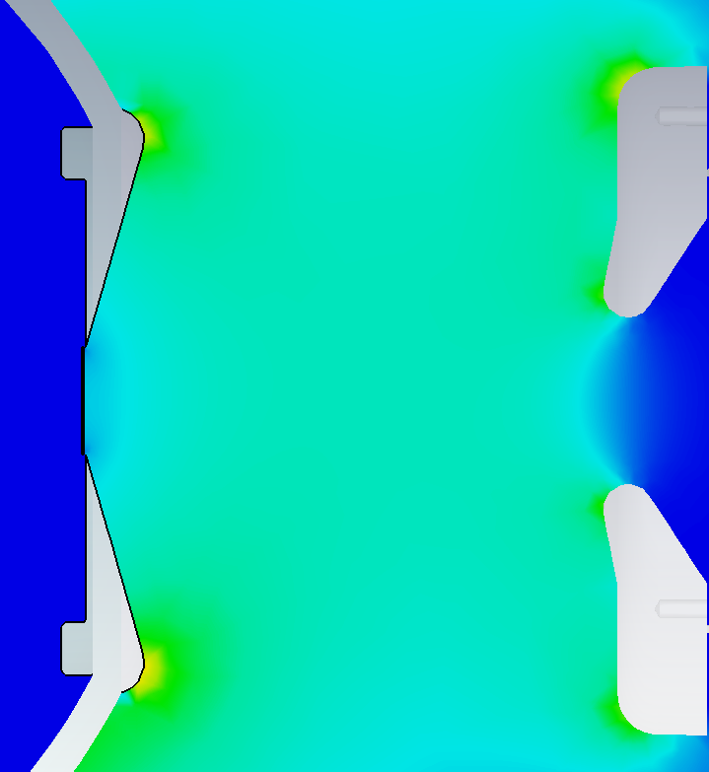
Junction angle 75°
7.8 MV/m
2.4 MV/m

