Slide 1
Wien filter 4
Proposed fix for the 200 kV Wien filter
06/19/2019
Gabriel Palacios

Slide 2
Content
What do we need?
Why do we need this?
Are there things in the MIT Wien filter that we can repurpose?

Slide 3
What do we need then?
From the point of view of electrostatics, using the Wien filter installed at UITF (06/19/2019) as a base.

Slide 4
HV spring guide mods to be compatible with 40 kV feedthrough.
CeramTech part number 21194-01-CF
Based on Electrical feedthrough CAD 32893-0020
How deep indentation?
We need to change HV spring guide (and spring) to be compatible with the CeramTech feedthrough. We can not use mine until we measure indentation (CeramTech failed to provide info). Marcy: Rounded or flat tip for vacuum? Phil: Attach spring to prevent falling inside chamber?

Slide 5
Electrode insulator CAD 32893-0112.
Use the longer version (installed at the UITF)

Slide 6
Electrode mounting spring BENT
Electrode mounting spring CAD 32893-0010
Modification to allow bending
If we want to change this: Danny’s input to allow for bending, yet still provide force to push electrode plates.

Slide 7
Why do we need this?
Check my presentation on the 40 kV feedthrough and the following slides.

Slide 8
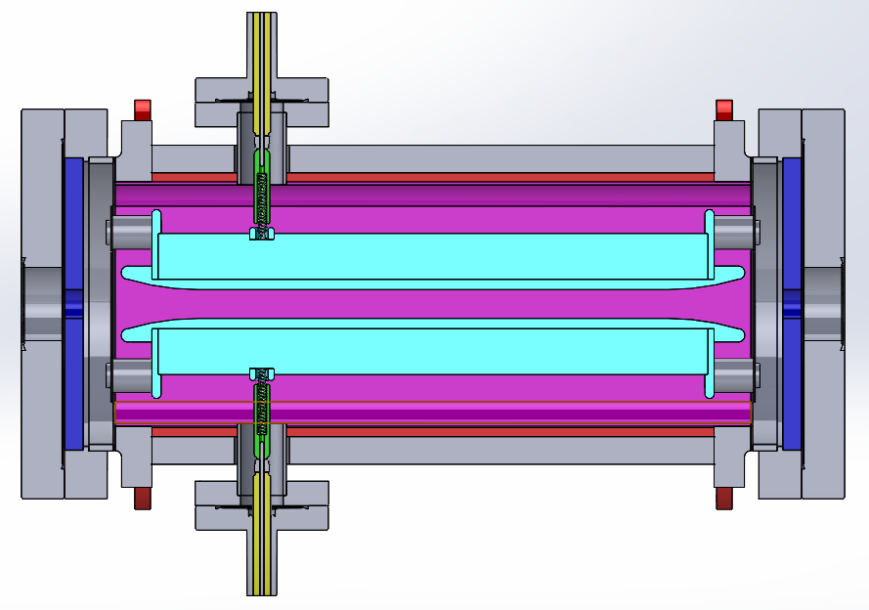
Solidworks model: CEBAF Wien filter

Slide 9
|E|: CEBAF Wien filter

Slide 10
CEBAF Wien filter
Electric field norm |E|, lateral cross section.
Electric field norm |E|, lateral cross section zoomed

Slide 11
Solidworks model : Proposed 200 kV Wien filter

Slide 12
|E|: Proposed 200 kV Wien filter

Slide 13
Proposed 200 kV Wien filter
Electric field norm |E|, lateral cross section.
Electric field norm |E|, lateral cross section zoomed

Slide 14
Comparing CEBAF (left), Proposed (right)
This vacuum region is better in the proposed when we use the longer insulators, since it pushes the grounded electrode mounting spring further away from the biased electrode plates.

Slide 15
Comparing CEBAF (left), Proposed (right)
No issues on the plates surfaces!

Slide 16
Comparing CEBAF (left), Proposed (right)
No issues on the plates surfaces!
~4 MV\m
~2.8 MV\m
~4 MV\m
~2.8 MV\m

Slide 17
Are there things in the MIT Wien filter that we can repurpose?
Check my presentation on this

Slide 18
Fin

