Slide 1

Ce⁺BAF Concept and High Power Target
e⁺ Production by Polarized e‒ Beam
e⁺ LERF Concept
Radiation Damage and Heat Load in Target
Design of High Power Target
Target Material Tests with e‒ Beam and Laser
Andriy Ushakov (Ce⁺BAF WG)

Slide 2




Ce⁺BAF Working Group
J. Benesch, A. Bogacz, L. Cardman, J. Conway, S. Covrig, J. Grames, J. Gubeli, C. Gulliford, S. Habet, C. Hernandez-Garcia, A. Hofler, R. Kazimi, V. Kostroun, F. Lin, V. Lizarraga-Rubio, M. Poelker, Y. Roblin, A. Seryi, K. Smolenski, M. Spata, R. Suleiman, A. Sy, D. Turner, A. Ushakov, C. Valerio, E. Voutier, S. Zhang, Y. Zhang

Slide 3
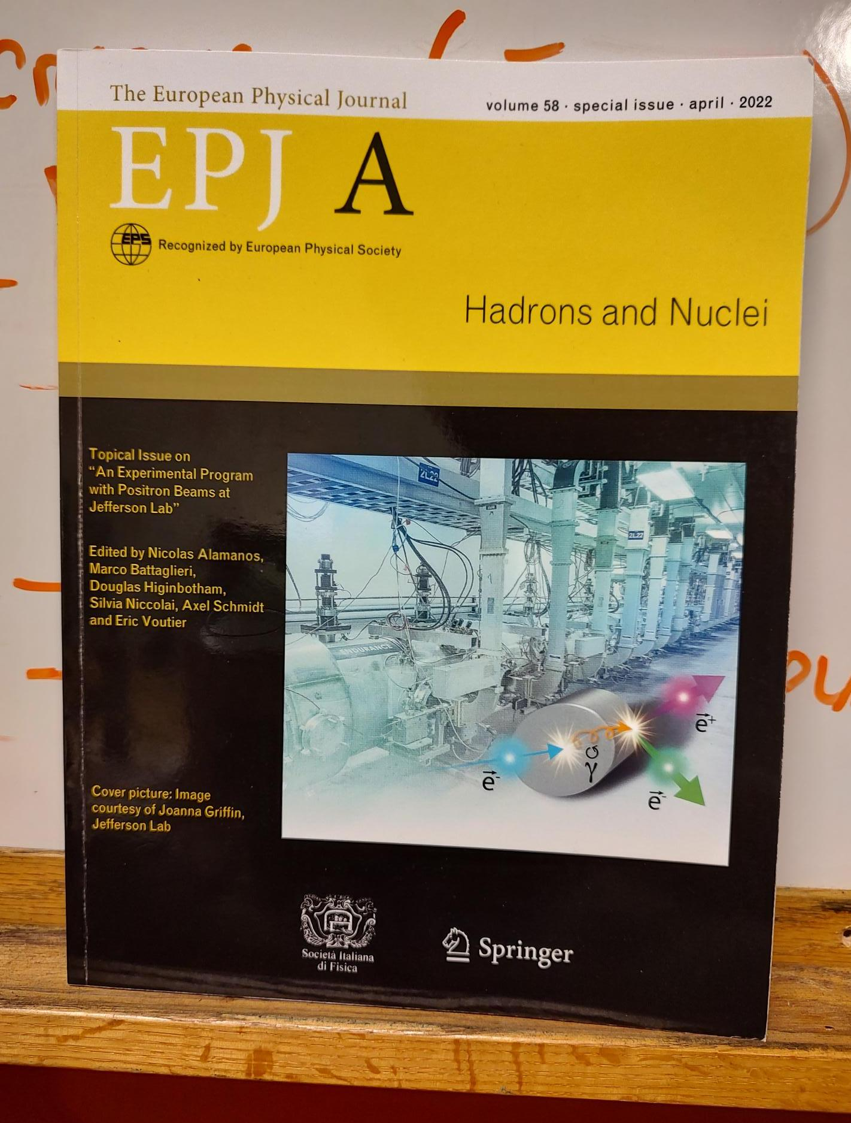
Jefferson Lab Positron Users Group
Jefferson Lab Users have made a strong case for positron beams at CEBAF 12 GeV
Complementary charge and spin of e⁺ would provide a new probe at Jefferson Lab
  2018 – 7 letters of intent to PAC
  2020 – 2 conditionally approved PAC proposals
    Hall B ~ 100 nA polarized (>60%)
    Hall C ~ 3 μA unpolarized
2023 – We just returned from a workshop at the University of Virginia where 2 new proposals are being organized for submission to PAC 51.

Slide 4

12 GeV Ce⁺BAF : Polarized Electron or Polarized Positron Beams
2020 JLAAC Recommendations
  “R6: Augment the scientific case with a plan to translate the R&D into a realistic facility.”
  “R7: Include radiation protection considerations into the evaluation of the electron beam energy choice.”
2021 JLAAC Recommendations
  “R4: Elaborate on the possibility for fielding a rapid operational switching mode between e‒ and e⁺ operation in FFA arcs.”
  “Q5: …required photocathodes to enable polarized e⁺ production should continue to be developed.”
  “R20: Work out how efficient magnet polarity switching (~8 hours) could be implemented between e‒ and e⁺ operation.”
Machine Parameter | Electrons | Positrons
Hall Multiplicity | 4 | 2
Energy (ABC/D) | 11/12 GeV | 11/12 GeV
Beam Repetition | 249.5/499 MHz | 249.5/499 MHz
Duty Factor | 100% cw | 100% cw
Unpolarized Intensity | 170 μA | > 1 μA
Polarized Intensity | 170 μA | > 50 nA
Beam Polarization | > 85% | > 60%
Fast/Slow Helicity Reversal | 1920 Hz/Yes | 1920 Hz/Yes

Slide 5
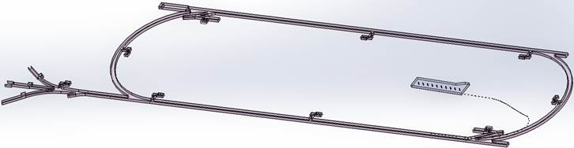
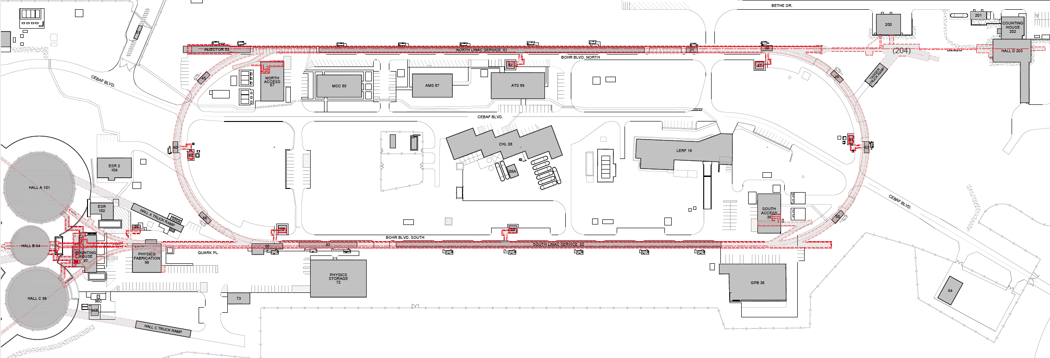

Turning the LERF into a Positron Injector Facility
123 MeV
At the last JLAAC we were exploring e+ production at 10, 100, 1000 MeV…
Today we are focused on producing 123 MeV e⁺ utilizing the Low Energy Research Facility
Inject e⁺ into North Linac to usual 12 GeV (w/ magnets reversed)
Build e⁺ injector at the LERF
Build new LERF to CEBAF tunnel
123 MeV
Build new transport line along South Linac and West Arc

Slide 6
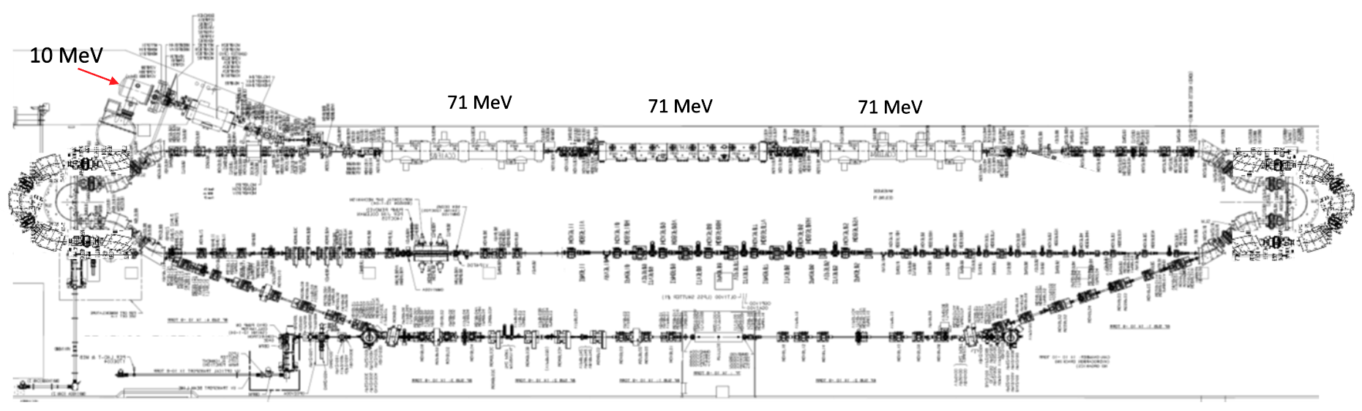
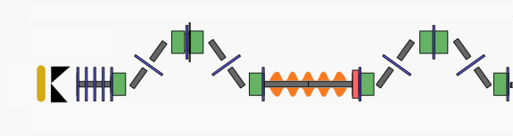
LERF Polarized Positron Injector Concept
Focus is developing a technical report on a polarized e⁺ injector at LERF
  High current polarized electron injector (10 MeV/10 mA)
  High current 1-3 mA LINAC (two C75 CM)
  Positron conversion target (~100 kW)
  Positron bunch collection and momentum selection
  Positron bunch compression and acceleration to 123 MeV
#1 – Compact 10 mA P-Gun, Wien filter, 10 MeV e- injector
#6 – SRF accelerate e+ to 123 MeV
#2 - SRF accelerate to 120 MeV
#5 – Transport e+
#3 – Extract e- to target
#4 - Produce and collect e+ 20 to 60 MeV
#7 – Evaluating 123 MeV spin rotator concept
#8 – Transport e+ at 123 MeV to CEBAF

Slide 7
Present Workforce
Beginning in FY22 positron research was supported at the division level
  ~2 FTE spread across CIS, CASA, OPS departments
  Includes one full-time scientist and one PhD grad student
In FY23 the Ce⁺BAF working group has grown and with broader collaboration
  JLab Physics division supporting target and magnet R&D
  JLab Eng. division supporting evaluation of electrical requirements (magnets reversal, diagnostics)
  SRF discussions for NC capture linac R&D and SRF integration starting
  ORNL contributing to conceptual design of a 123 MeV e⁺ spin rotator
  IJCLab (France) remains an important collaborator, contributing to target development
  HEP proposal submitted in support of e⁺ collaboration (SLAC/KEK/JLAB)
  Xelera Inc. awarded SBIR Phase 1 to evaluate a liquid metal target option
We will focus on three technical areas at this review
  High power solid target development (my talk)
  Start-to-End S2E simulation of polarized e⁺ collection at LERF (PhD student Sami Habet’s talk)
  High polarization photocathode development (Marcy Stutzman’s talk)

Slide 8
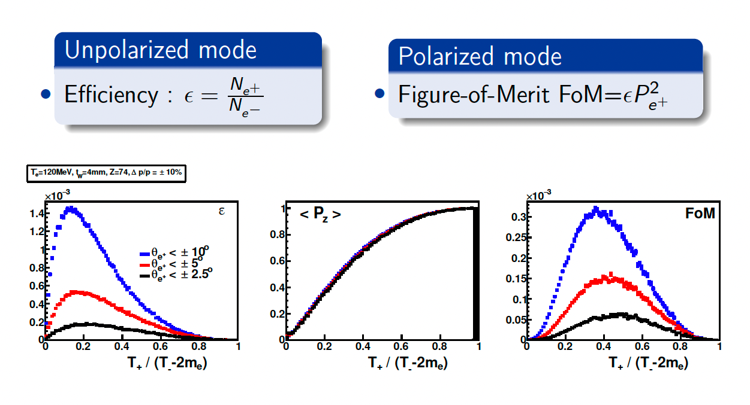
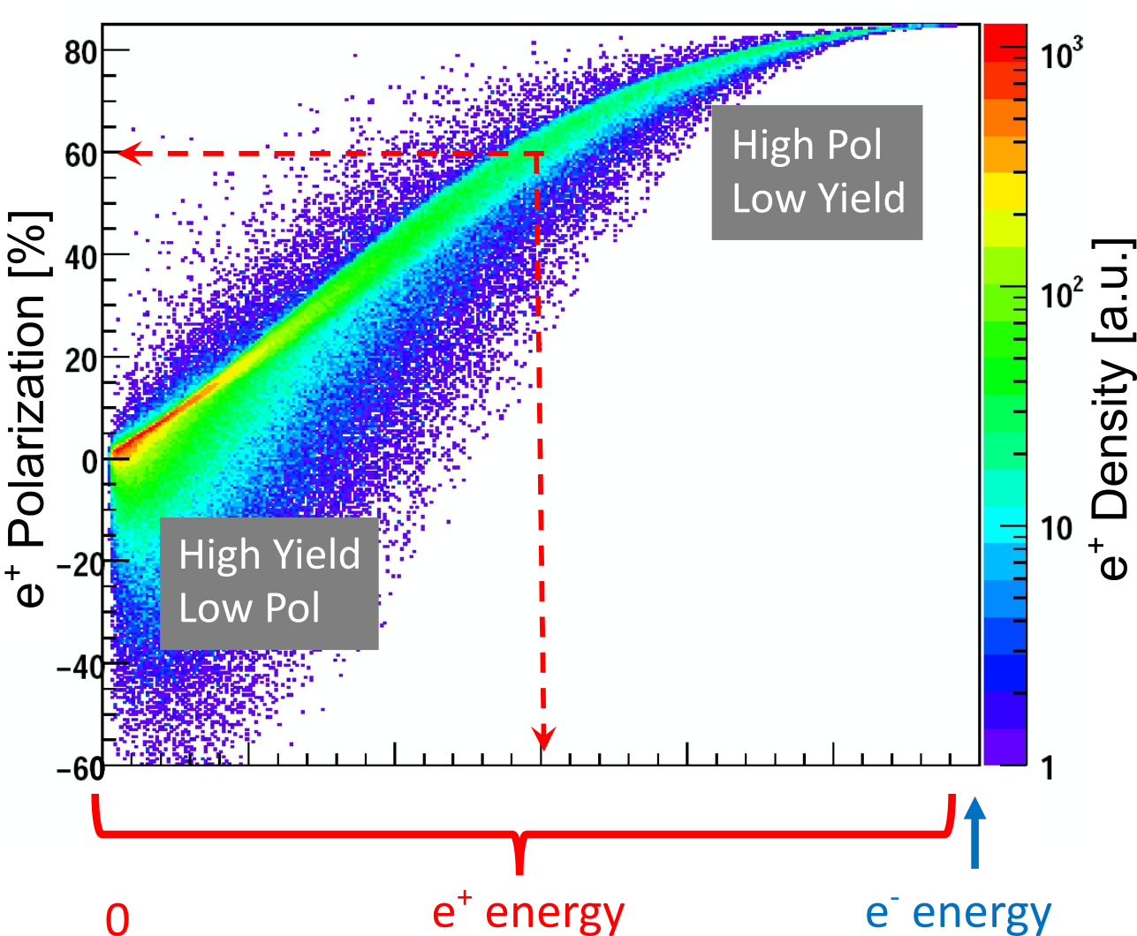
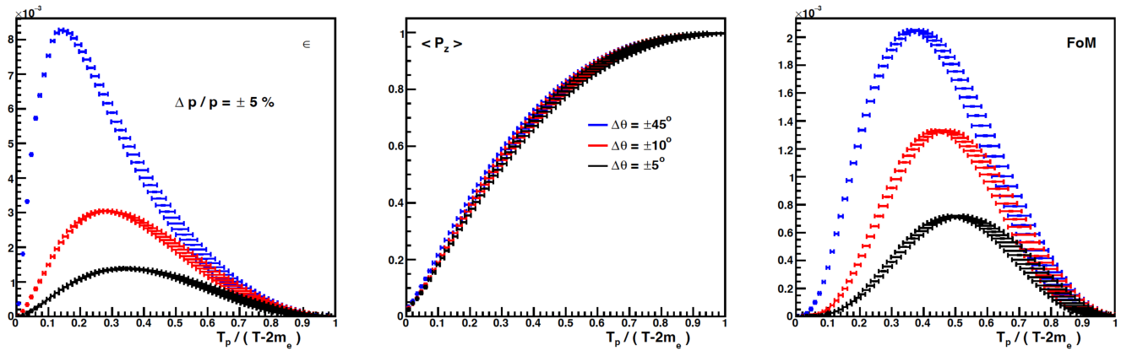
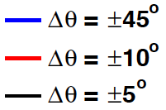
Yield and Polarization at Target vs Energy. Polarized and Unpolarized Modes
e⁺ Polarization vs Energy
4 mm Tungsten Target
120 MeV e‒
Efficiency
FoM
e⁺
e‒
e⁺
e‒
Positron beamline has to be designed
for efficient capture and transport of e⁺ with different energies

Slide 9
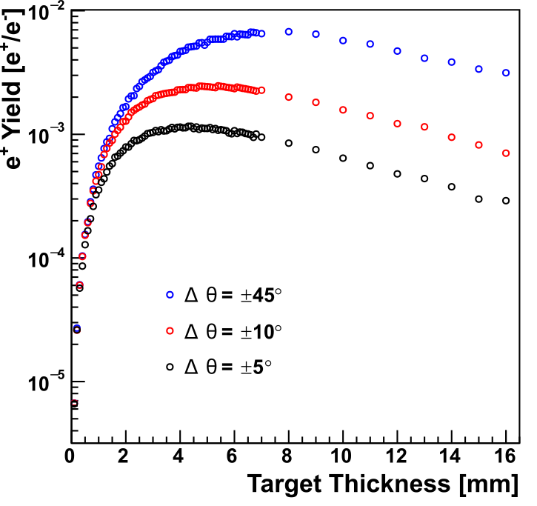
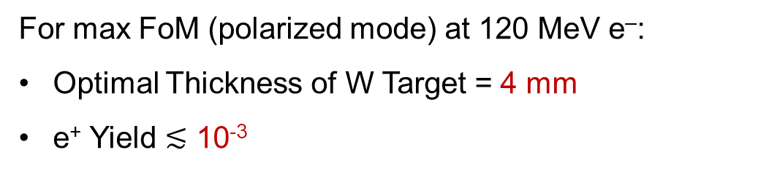
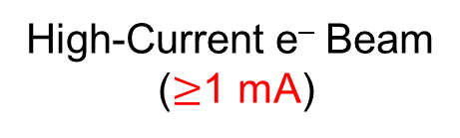
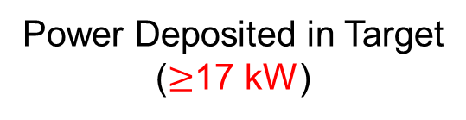
Optimal Target Thickness and e⁺ Yield
Yield vs Target Thickness
For max FoM (polarized mode) at 120 MeV e‒:
Optimal Thickness of W Target = 4 mm
e⁺ Yield $≲$ 10⁻³
Δp_{e+}/p_{e+} = ±0.05
High-Current e‒ Beam
($≥$1 mA)
Power Deposited in Target
($≥$17 kW)
Tungsten

Slide 10
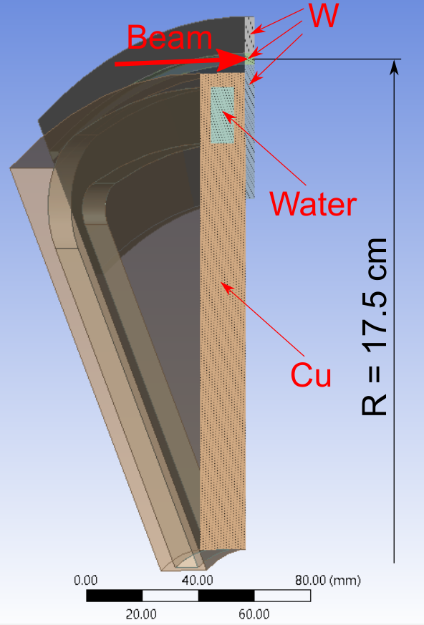
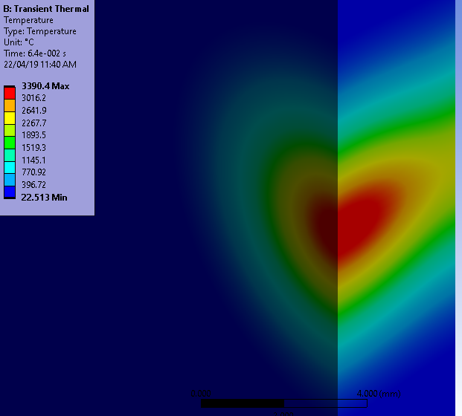

Concept and Challenges of High-Power Target
Target Concept
Target Challenges:
High (average) heat → cool and rotate
Radiation damage → rotate
Material fatigue cause by cycling temperature → study material properties under realistic conditions
1/12 Segment of Rotated Target
Temperature in Stationary Target
1 mA @ 120 MeV cw e‒ beam
σ_{beam} = 1.5 mm
Some parameters of currently considered model of e⁺ target:
Beam passes through the target at R of 17.5 cm
4 m/s target tangential speed at R of 17.5 cm
10x20 mm² cross-section of water channel inside Cu disk
24 l/min rate of water flow
Static target would melt in 64 ms
This project has received funding from the European Union’s Horizon 2020 research and innovation program under grant agreement STRONG-2020-No 824093

Slide 11
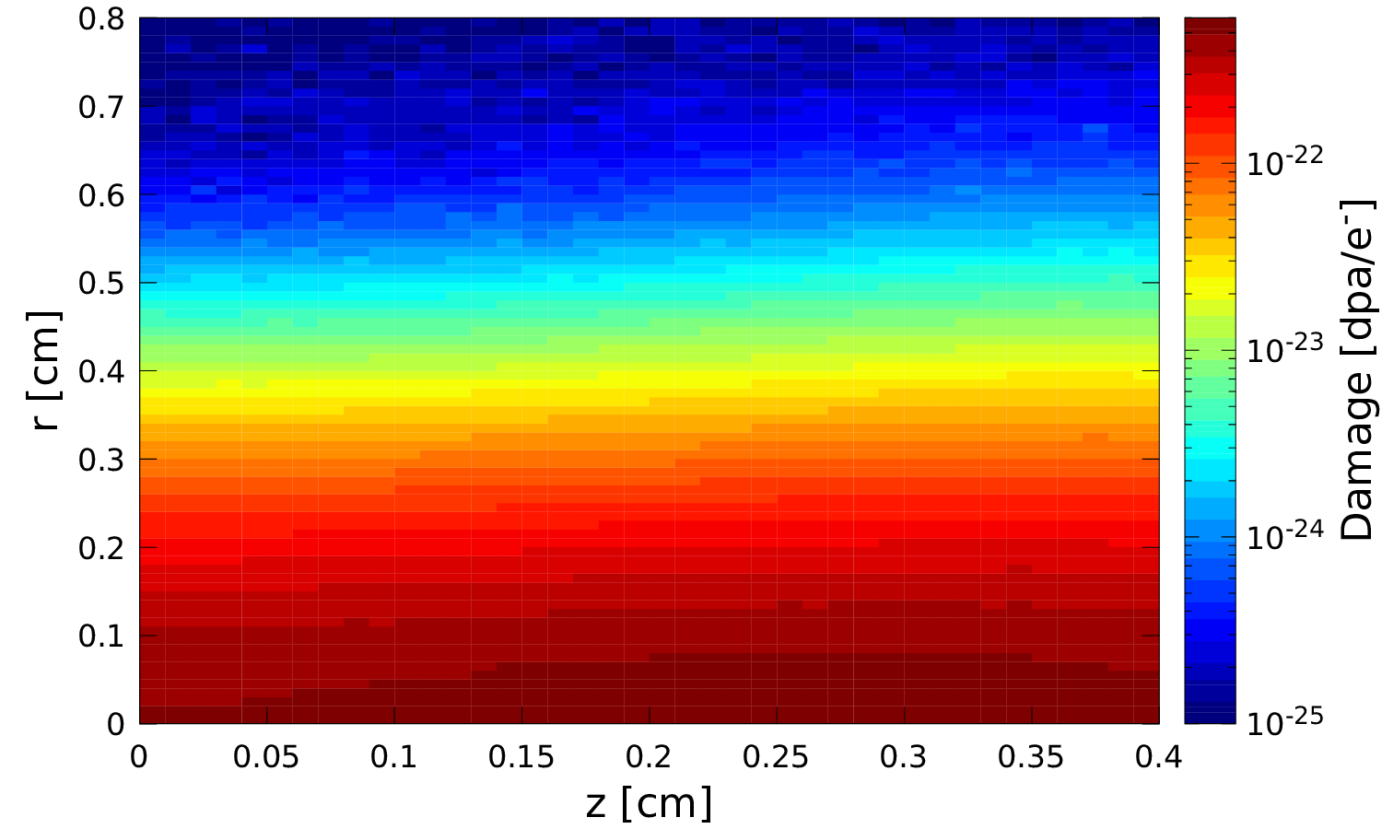
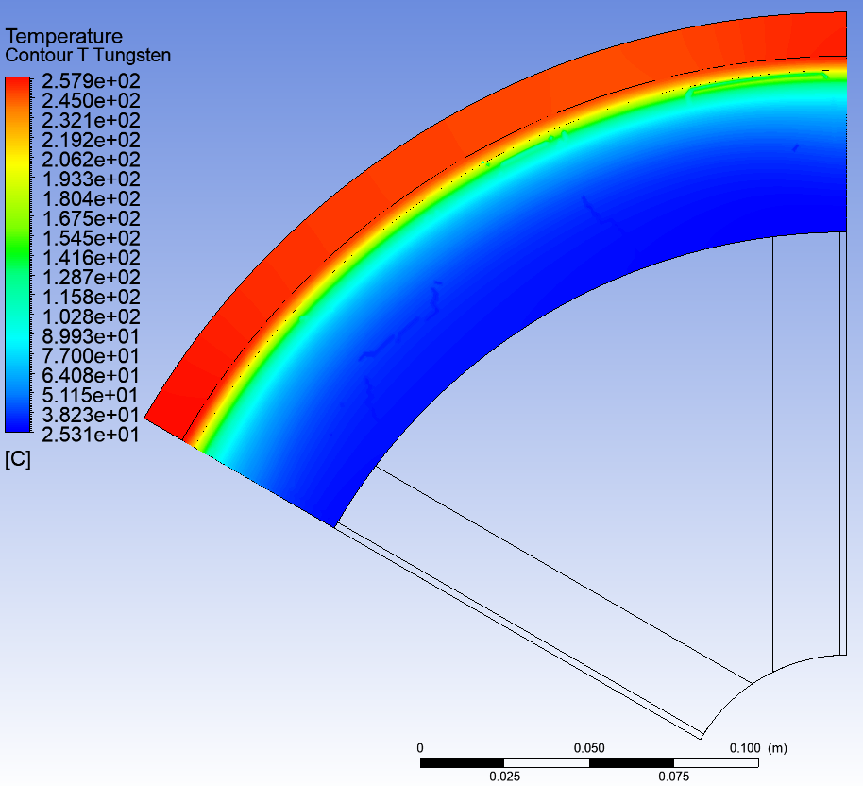
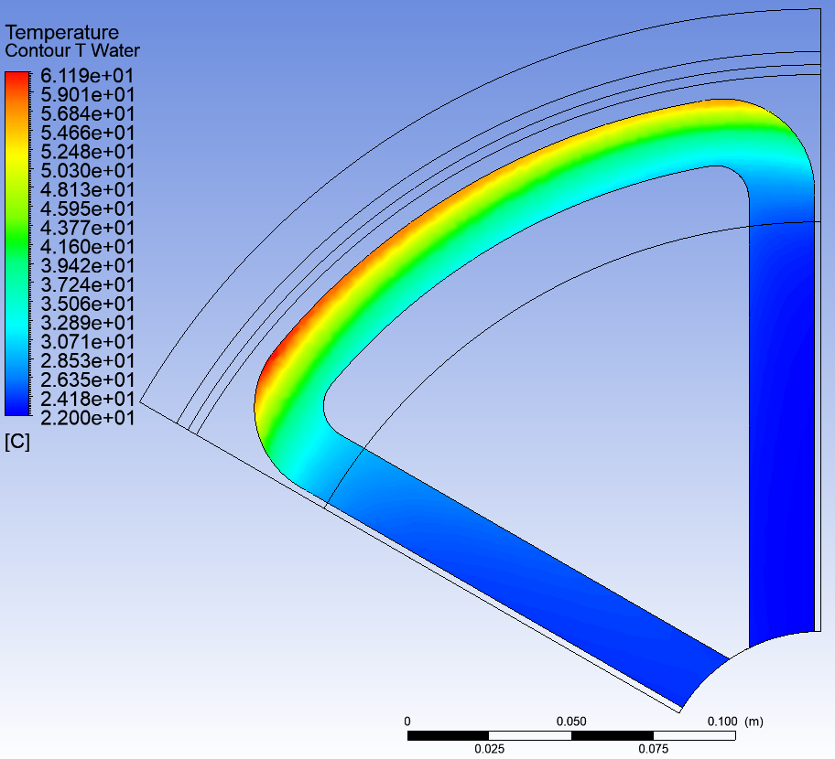
Average Temperature and Radiation Damage in 17 kW Tungsten Target
Radiation Damage
Average Temperature in Tungsten
Temperature of Water
Ø35 cm W Target
1 mA @ 120 MeV e‒
1.5 mm rms spot size σ
T_{max} = 258 °C
T_{max} = 61 °C
Radiation Damage < 0.5 dpa

Slide 12
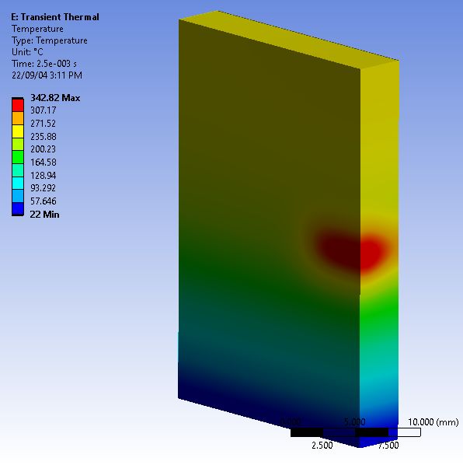
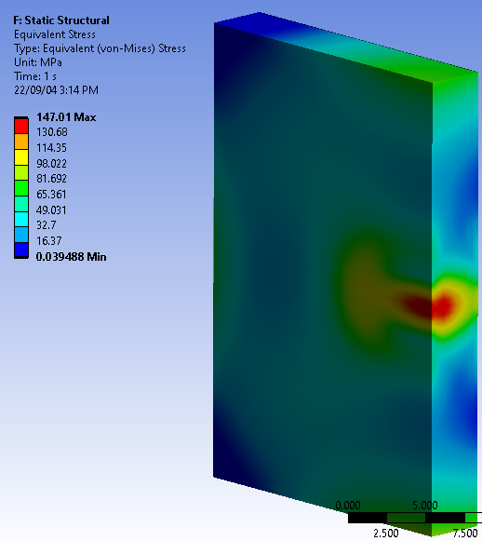
Thermal Cycling in 17 kW Tungsten Spinning Target (Ø35 cm, v_{rot} = 4 m/s)
Thermal Cycle
Temperature and Stress at the End of Heating Phase
Heating Phase
T_{max} ≈ 340°C
σ_{vM max} ≈ 150 MPa
+ 280 MPa due to T_{ave} = 258°C
ΔT_{max} ≈ 120°C
σ_{fatigue} = ? MPa
Duration of Heating ≈
2.5 ms
Check fatigue limits experimentally
Period of Cycles =
275 ms

Slide 13
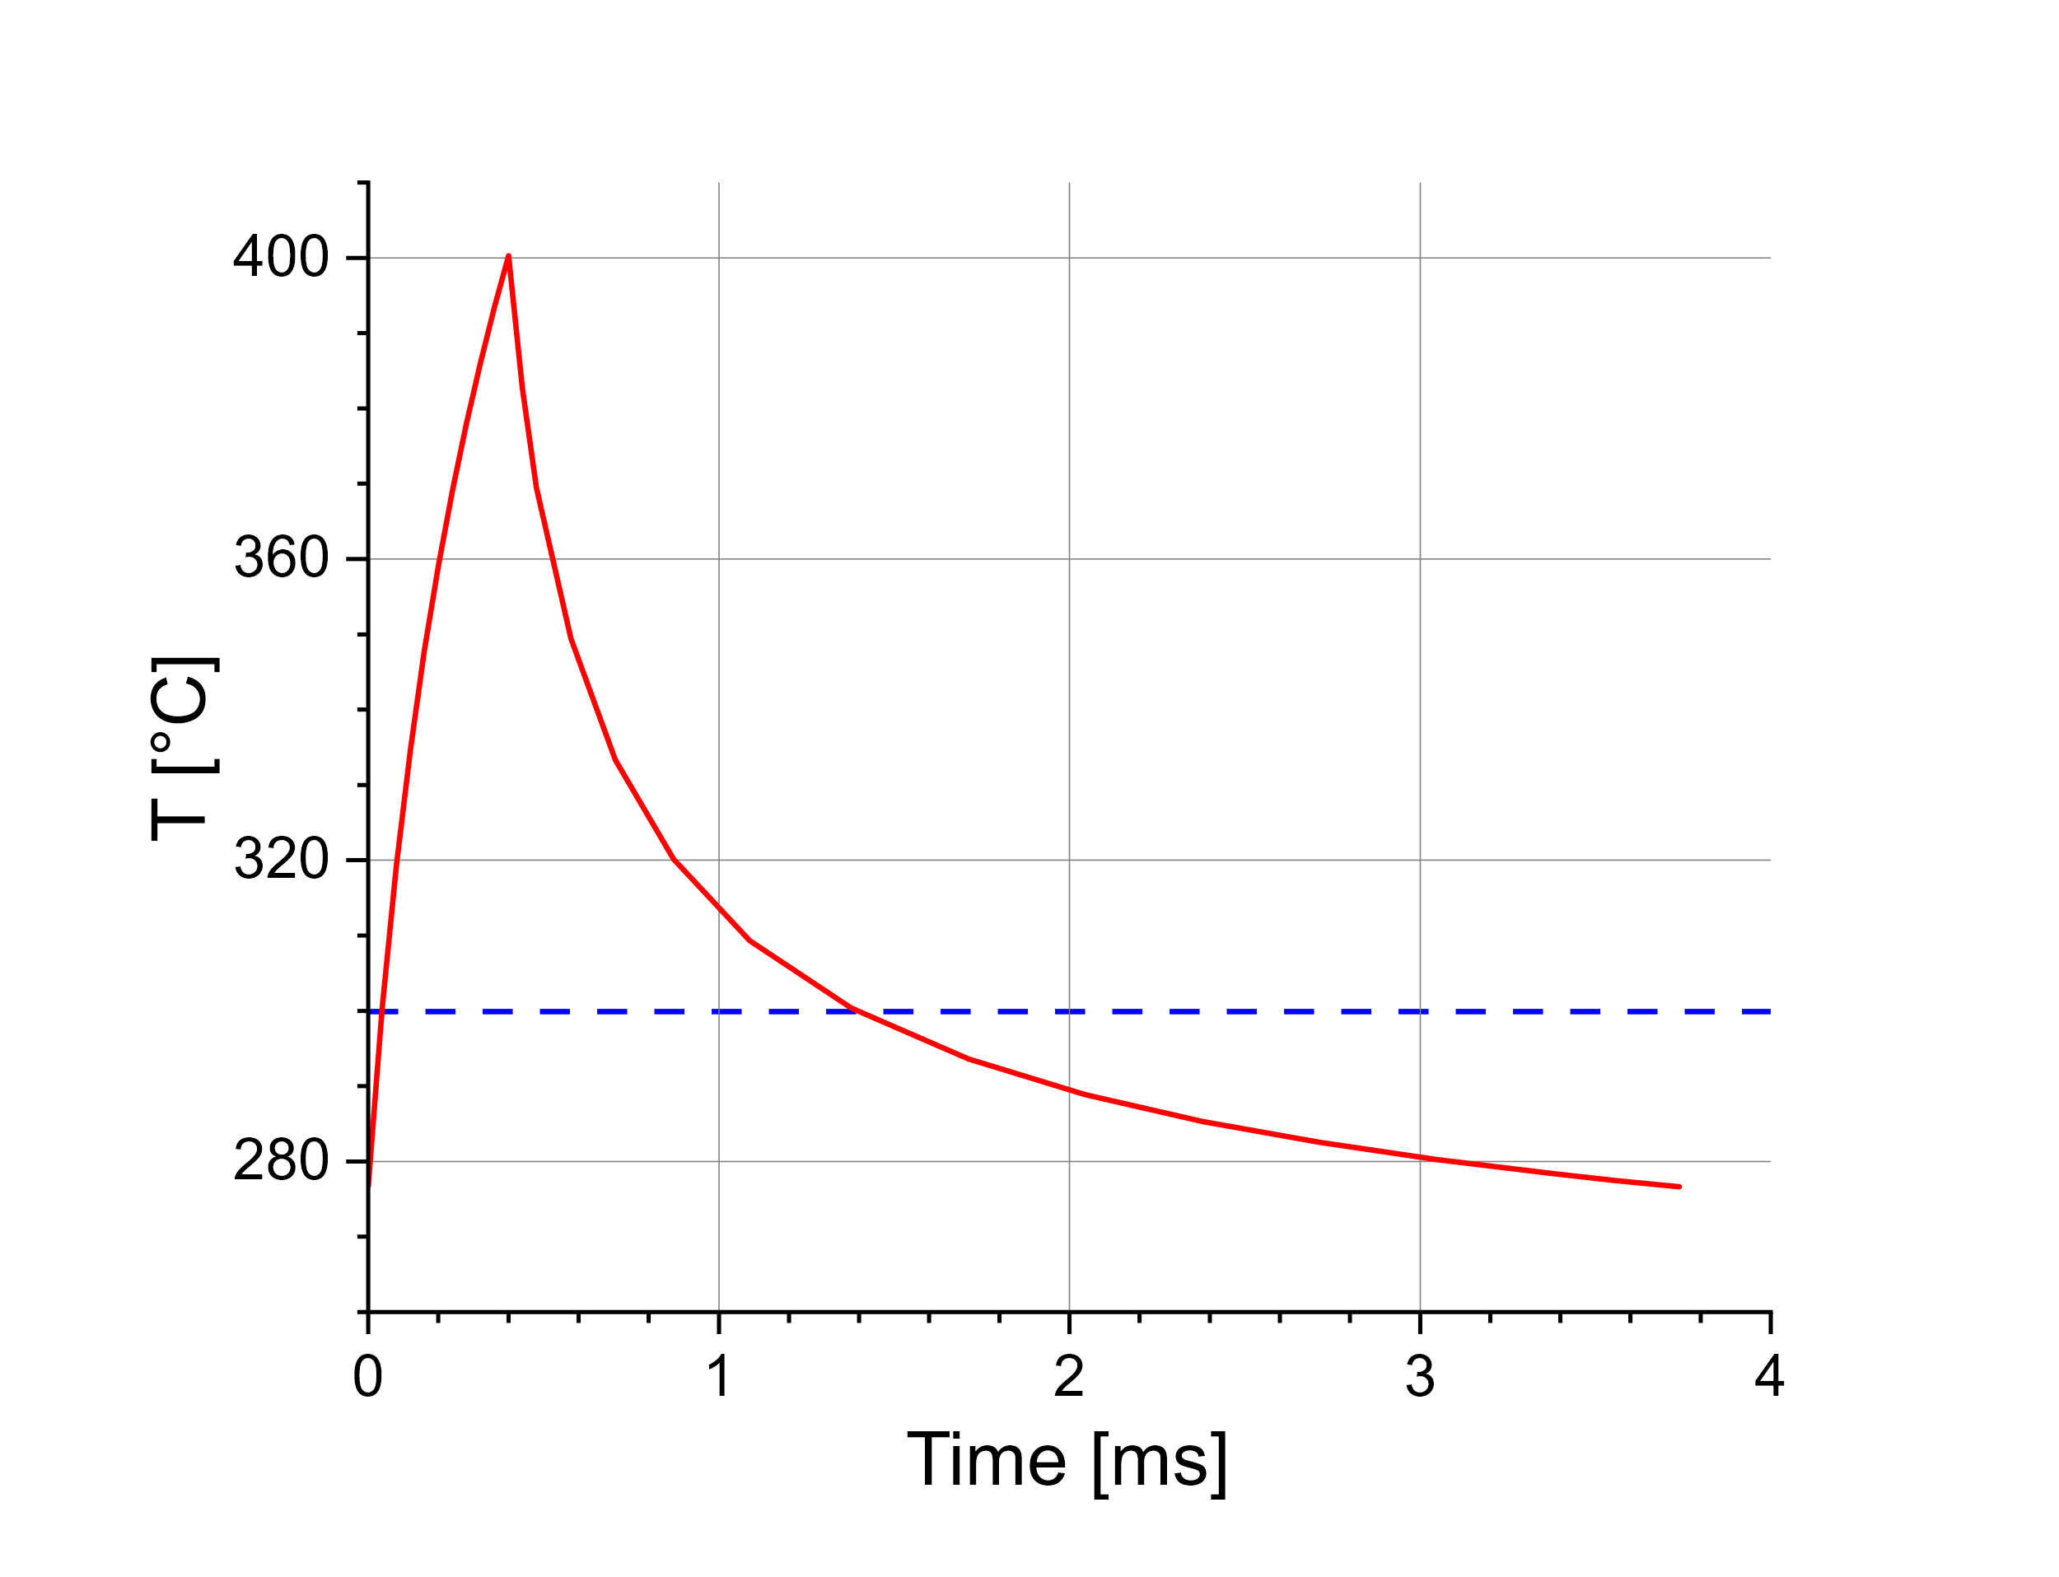
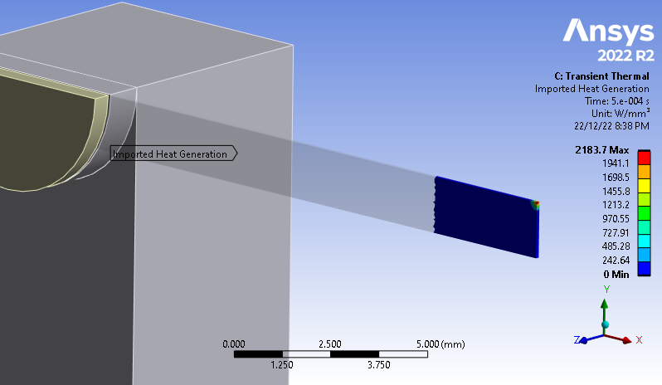

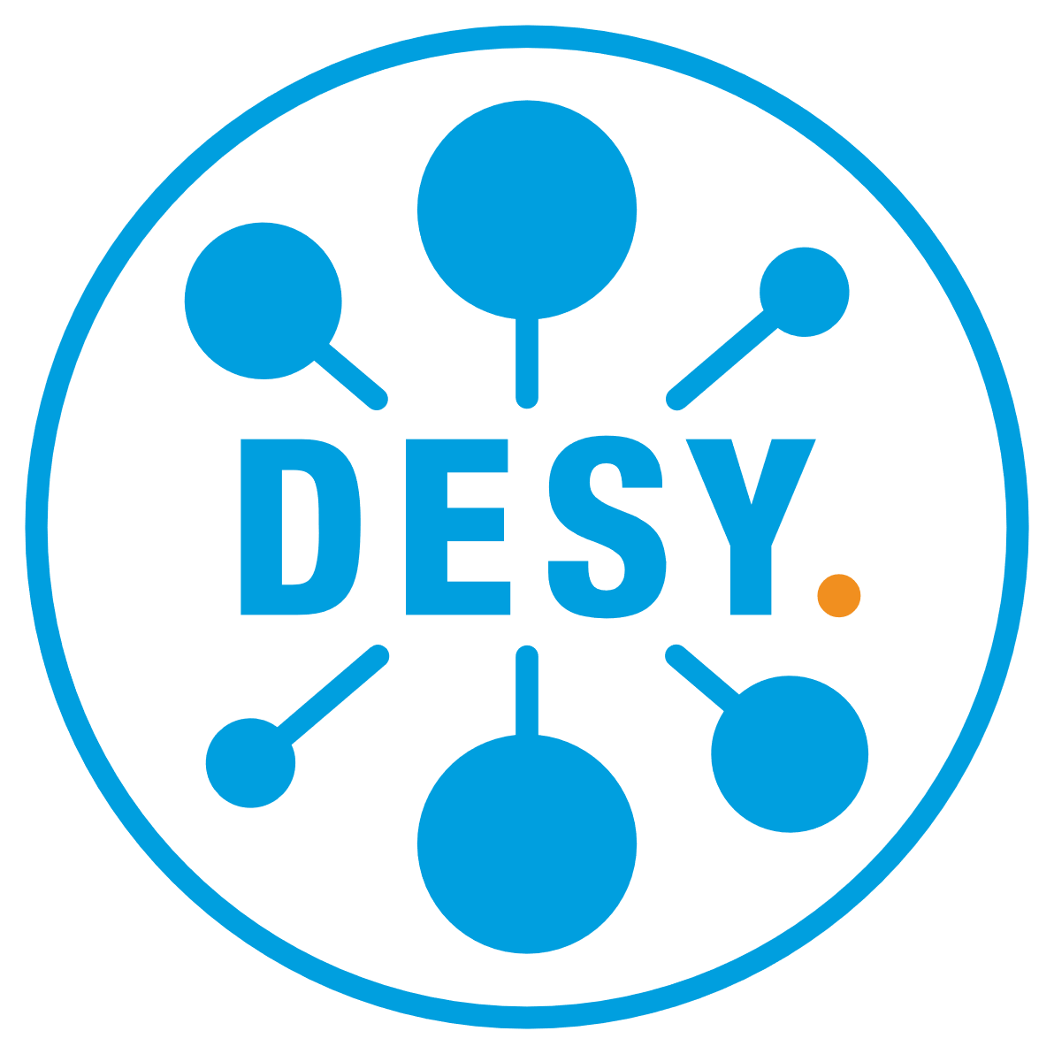





Test of Target Materials with e‒ Beam at Mainz Microtron (MAMI)
Geometry and Cycling Temperature
Test changes/degradation of target properties after 10⁶-10⁷ thermal cycles. Check a fatigue limit at average elevated temperature of about 300°C
Investigate impact of radiation damage on target material properties between 0.1 and 0.5 dpa at expected elevated temperatures
Test different high Z materials: W, Ta, W-alloys, to evaluate candidate target materials
Deposited Power Density in 0.1 mm W Foil
Pulse Length = 0.4 ms
Pulse Period = 3.74 ms
50 μA @ 3.5 MeV e‒ beam, σ = 0.1 mm (rms)
This project has received funding from the European Union’s Horizon 2020 research and innovation program under grant agreement STRONG-2020-No 824093

Slide 14
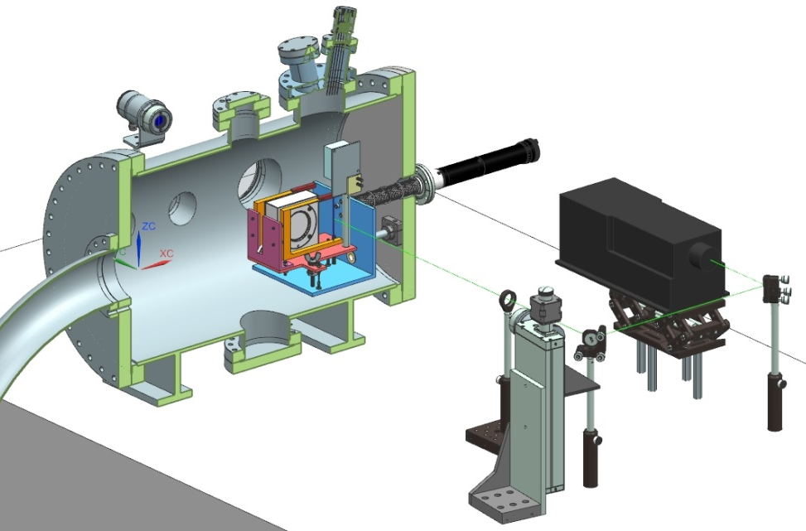
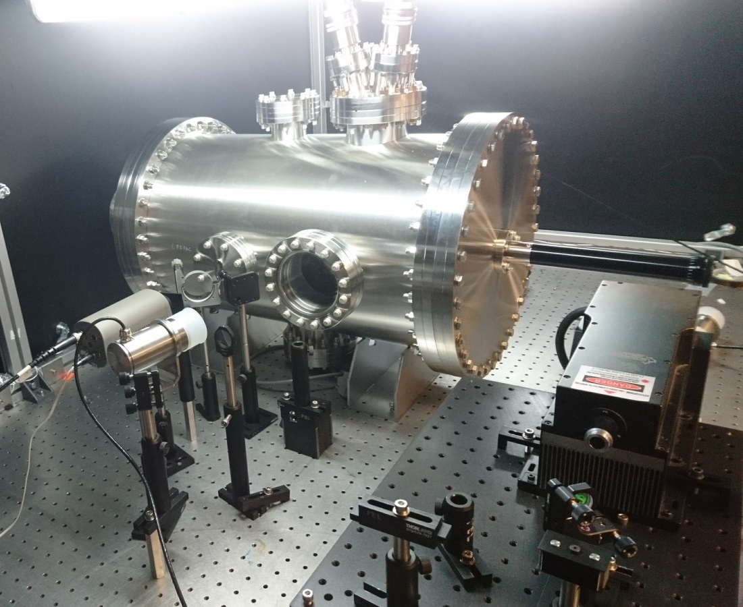
Test of Target Materials and Low Power Target with Laser at LERF Laser Lab 6
CAD assembly
10 W lasers (532 nm) were used for testing 18 µm W foils to their limits and beyond [S. Gopinath, S. Covrig “APEX Target Thermal Assessment”, PMAG0000-0001-A0001, 10/29/2020]
Experimental setup at LERF Laser Lab 6 would allow us to test a high peak heat load (significantly higher than could be achieved with MAMI e‒ beam) and fatigue of target materials in the wide temperature range
Test of thermal contact conductance between high-Z materials and Cu or Al (Ce⁺BAF and ILC targets)
Possibility of testing a lightweight version of e⁺ target (equivalent to the power density of a low-power stationary target, but without water cooling) will be studied
S. Gopinath
Experimental Setup

Slide 15
Summary and Outlook
We are focused on developing 123 MeV e⁺ injector at LERF
By the end of the year we want to complete a technical design report on e⁺ injector
Development and test of e⁺ targets:
  JLab Phase I: Prototype/proof-of-principle of low-power stationary solid water-cooled target (< 4 kW)
  JLab Phase II: High-power rotated solid water-cooled target (17 ‒ 20 kW)
  Xelera Research LLC is exploring (DOE SBIR) liquid metal targets (Ga-In-Sn /
  Pb-Bi)
Target material tests:
  Radiation damage and fatigue of target materials with pulsed 3.5 MeV e⁺ beam at MAMI on Mar 31 – Apr 5, 2023 (W, Ta) and in Fall 2023 (W-alloys)
  Study of irradiated targets with PETRA X-rays at DESY
  Fatigue target tests with a laser at LERF Laser Lab 6 (Summer 2023)

Slide 16
Backup Slides

Slide 17
Fatigue Limit (Plansee and ANSYS Granta Data)
High temperature reduces the yield strength
Material fatigue under cyclic thermal loading can initiate and grow cracks (fracture)
Yield Strength σ_{0.2} vs Temperature
Max Alternating Stress vs Number of Cycles
For 17 kW Tungsten Target
Ø35 cm, 4 m/s rot. speed
Tungsten
(Plansee)
Tungsten at 22°C
(ANSYS Granta)
6.5E+7 cycles/5000h
T_{max} ≈ 340°C
σ_{vM max} ≈ 430 MPa
k (6.5E+7 cycles) = 0.52
σ_{0.2} (340°C) = 1020 MPa
σ_{fatigue} (6.5E+7 cycles; 340°C) ≈ 530 MPa
Fatigue Limit = k (Number of Cycles) * Yield Strength (T), where k = < 1

