Slide 1

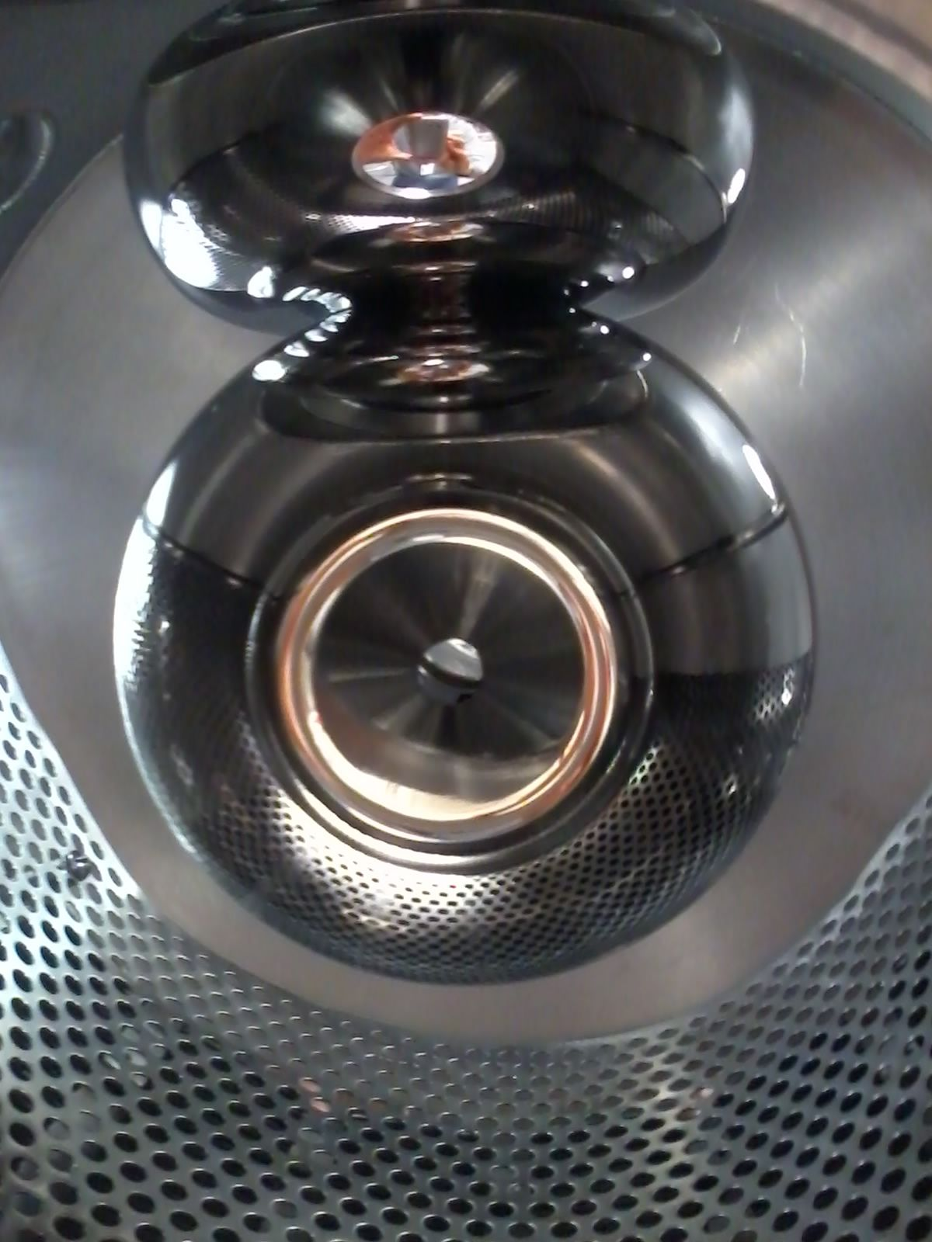
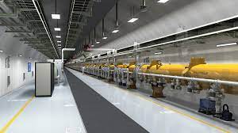
Building the next high voltage dc photogun polarized source for the ILC at JLab
Carlos Hernandez-Garcia
On behalf of the Center for Injectors and Sources group

Slide 2

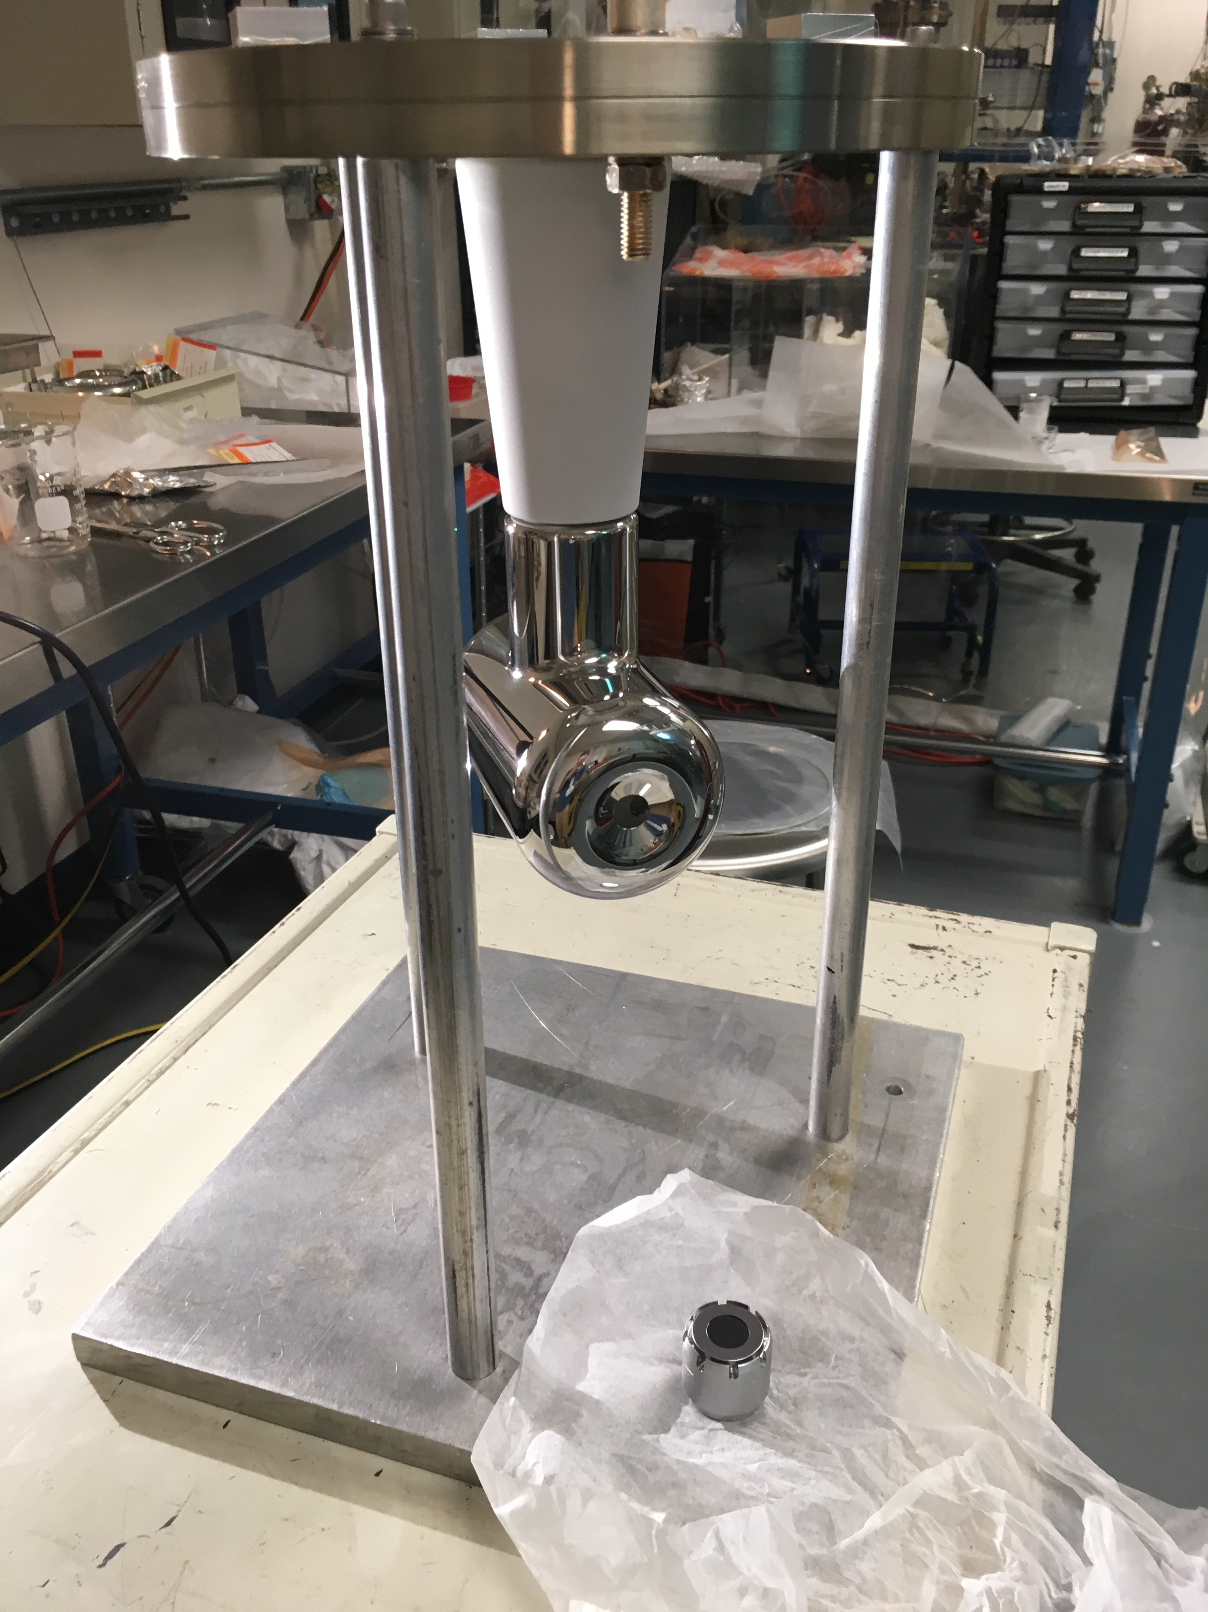
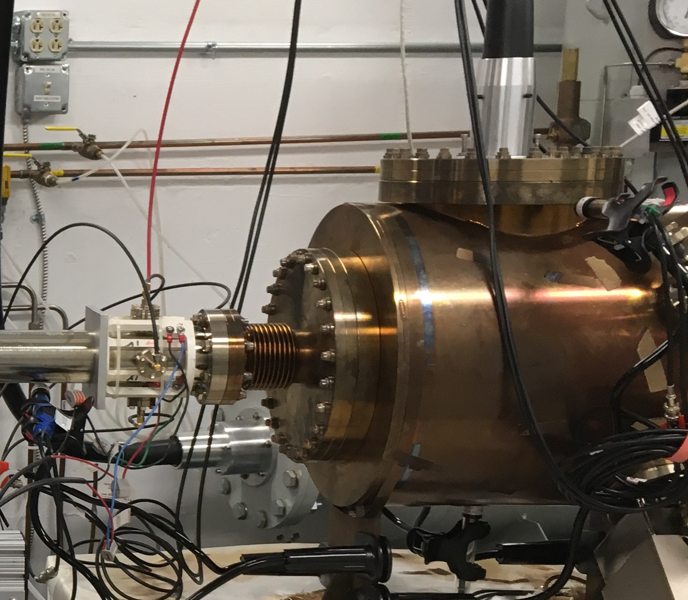
JLab built two 200 kV guns with commercial inverted insulators for ILC in 2010
CEBAF Polarized Photogun
8 in
5 in
Test Stand Polarized Photogun

Slide 3
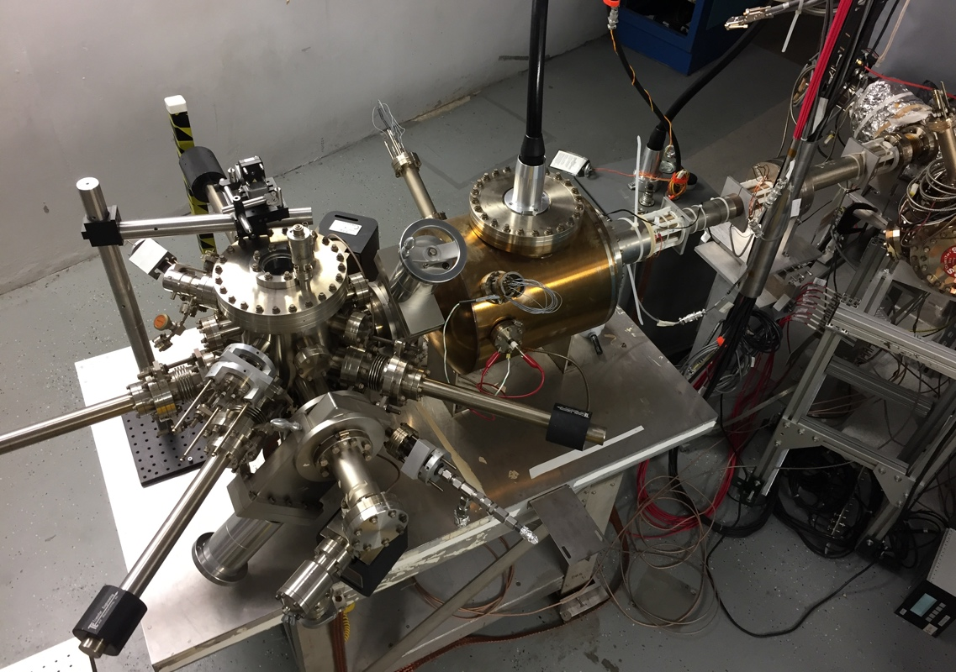
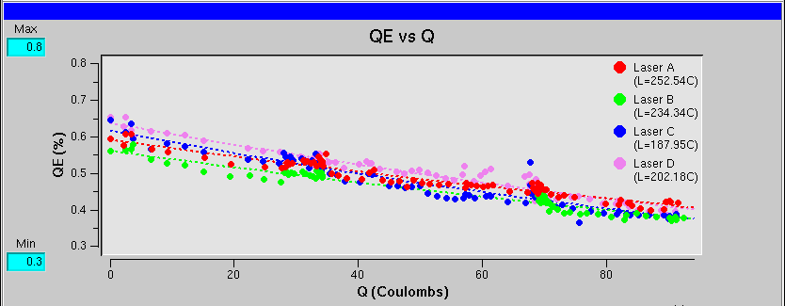
CEBAF Polarized Electron Load Lock Photogun: two decades delivering spin-polarized electron beam for nuclear physics
P. Adderley et al., Phys. Rev. Accel. Beams 13, 010101 (2010)
Gun2 Photocathode (Fall 2016 – Spring 2017)
  Strained Superlattice GaAs/GaAsP #5756-4
  Good Polarization >85% (measured at Mott polarimeter)
  Good QE > 1% after activation => 6 mA/Watt/% @ 780 nm
  Lifetime about 200 C (σ_{4D} ~ 1mm) with intensity < 200 μA
  CW rep. rate >250 MHz => bunch charge < 1 pC
Preparation
Chamber
Activation Laser
HV Chamber
GaAs
Storage
Loading
Chamber

Slide 4
Proposed new polarized beam sources from GaAs call for higher peak current
CW <1 pC
Pulsed > 1 nC
CW > 10-100 pC
Older sources
Newer sources

Slide 5
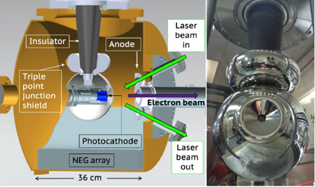
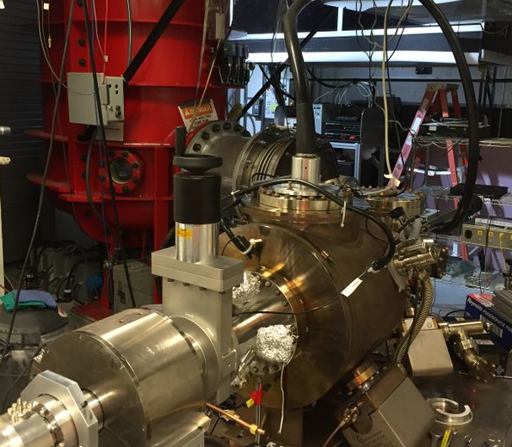
Higher voltage photoguns help EIC, ILC and CLIC to operate to operate with shorter laser pulse length, higher bunch charge and/or smaller laser spot size
(better emittance at higher peak current)
300 kV Magnetized Beam Electron Source (CsKSb)
Factor 2 in charge
Factor ½ in pulse
Factor 0.7 in size
C. Hernandez-Garcia et al., Phys. Rev. Accel. Beams 22, 113401 (2019)
R30 inverted geometry ceramic insulator
Conditioned to 350 kV
Operated > 1000 h at 300 keV
Delivered 4.5 mA CW un-polarized beam from CsKSb photocathodes

Slide 6
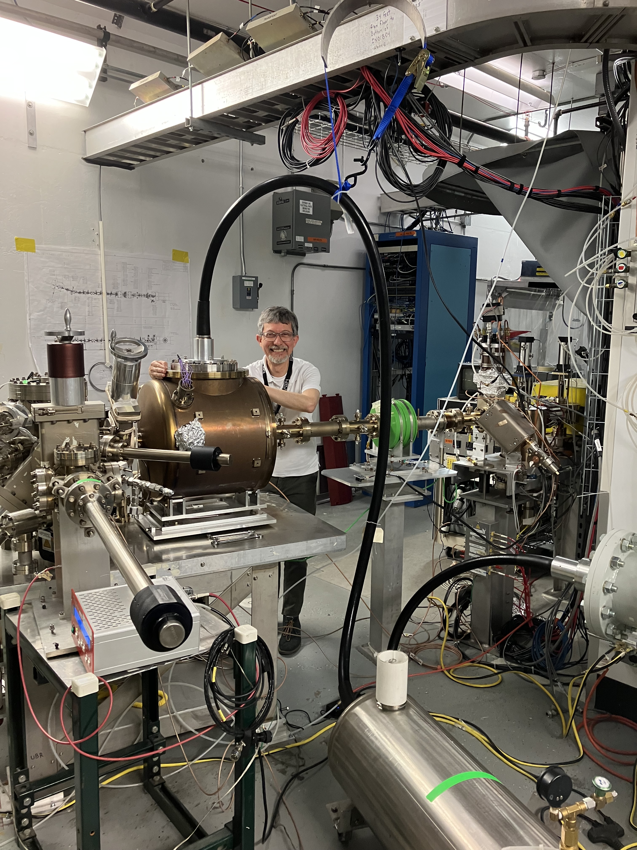
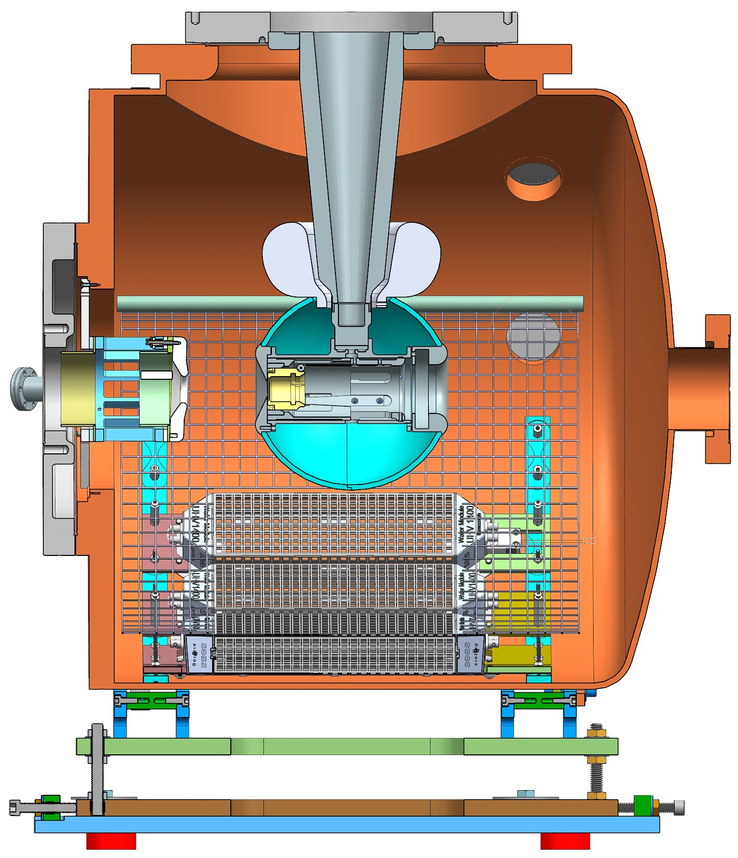
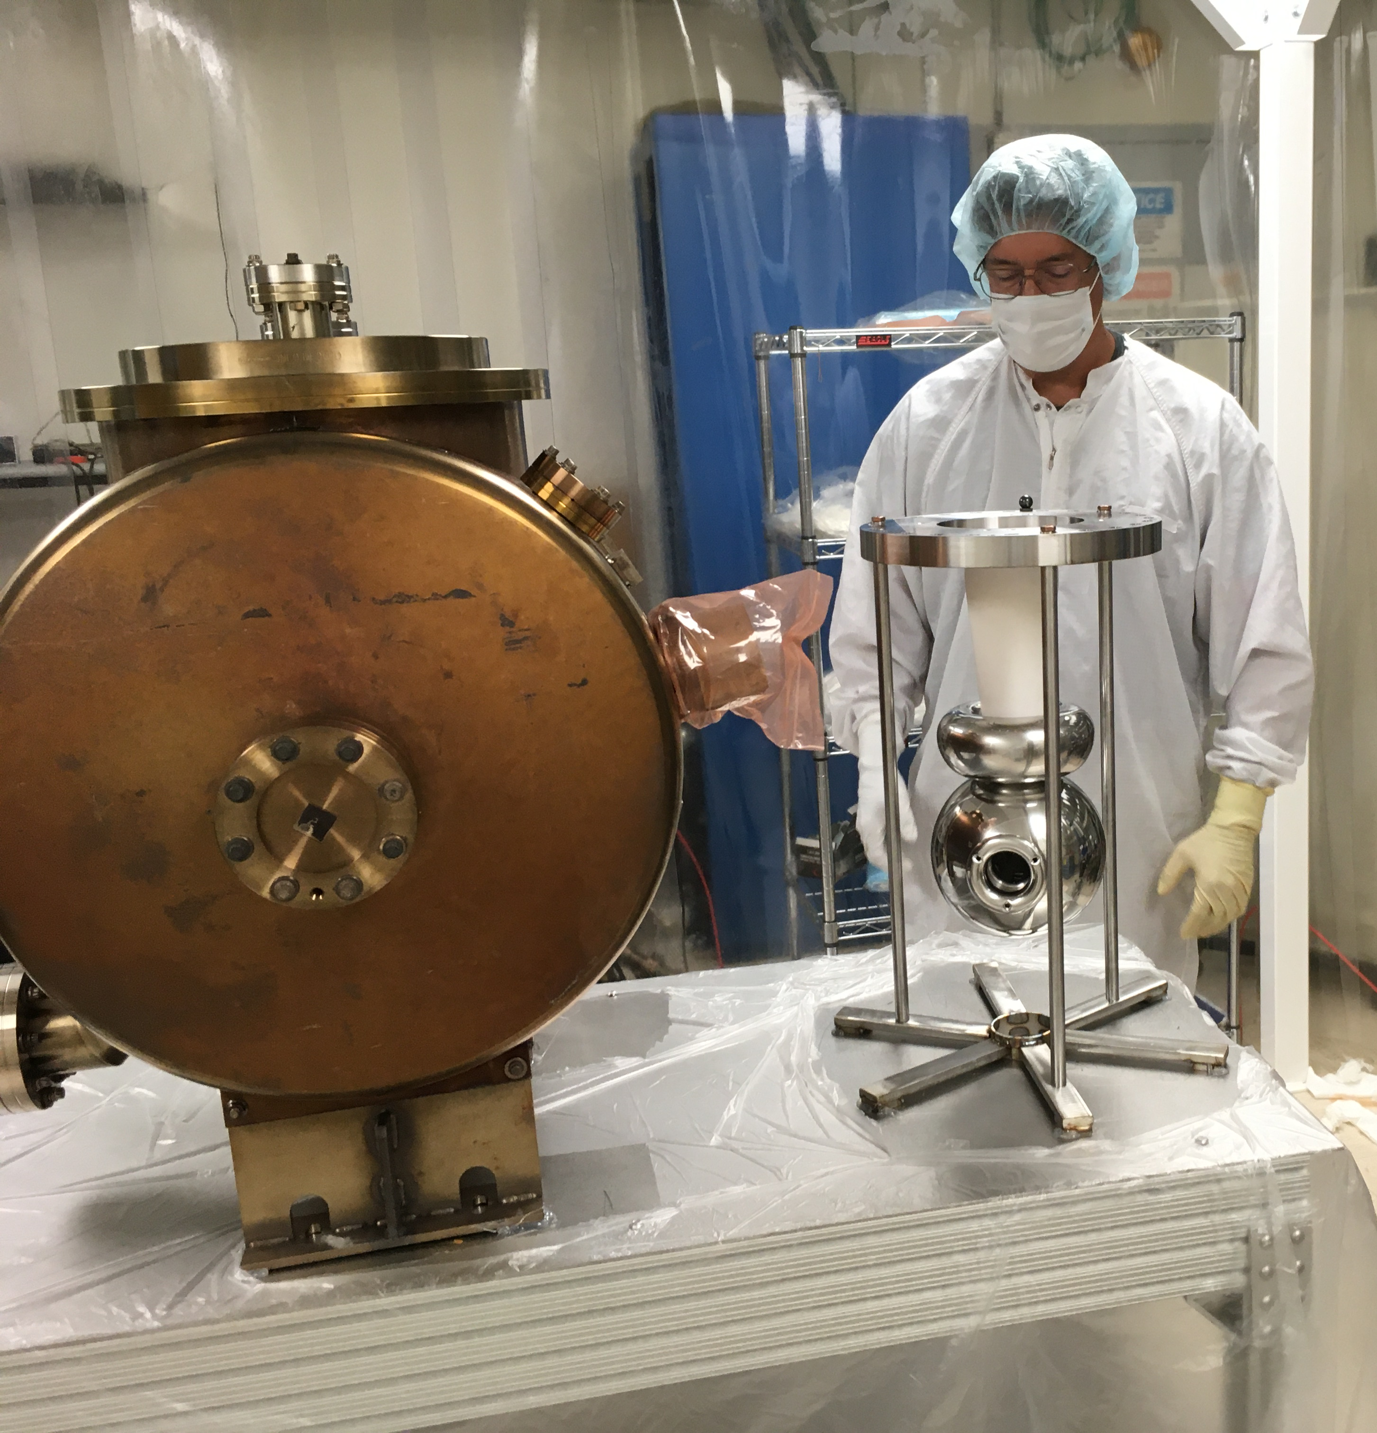
Building a higher voltage Polarized Gun for CEBAF
  Applying the experience and lessons learned from the 300 kV magnetized beam photogun, a 200 kV UHV polarized electron source for operation with GaAs/GaAsP was installed in CEBAF on April 2023 and conditioned to 240 kV
Reliability
Long photocathode lifetime
Operate at >200 kV without field emission
HV biasing uses R30 inverted ceramic insulator capable >300 kV
Dynamic pressure (during beam delivery) ~ 1x10⁻¹² Torr
Biased anode to repel ions
Improved anode tube for better pumpdown behind anode
Higher operating voltage helps reducing ionization cross section

Slide 7
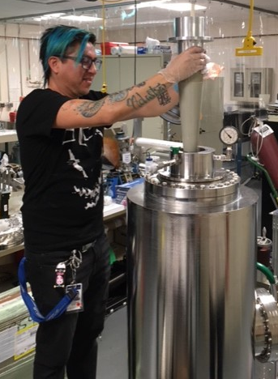
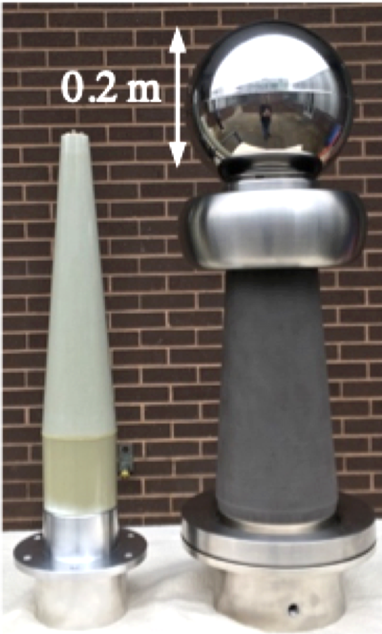
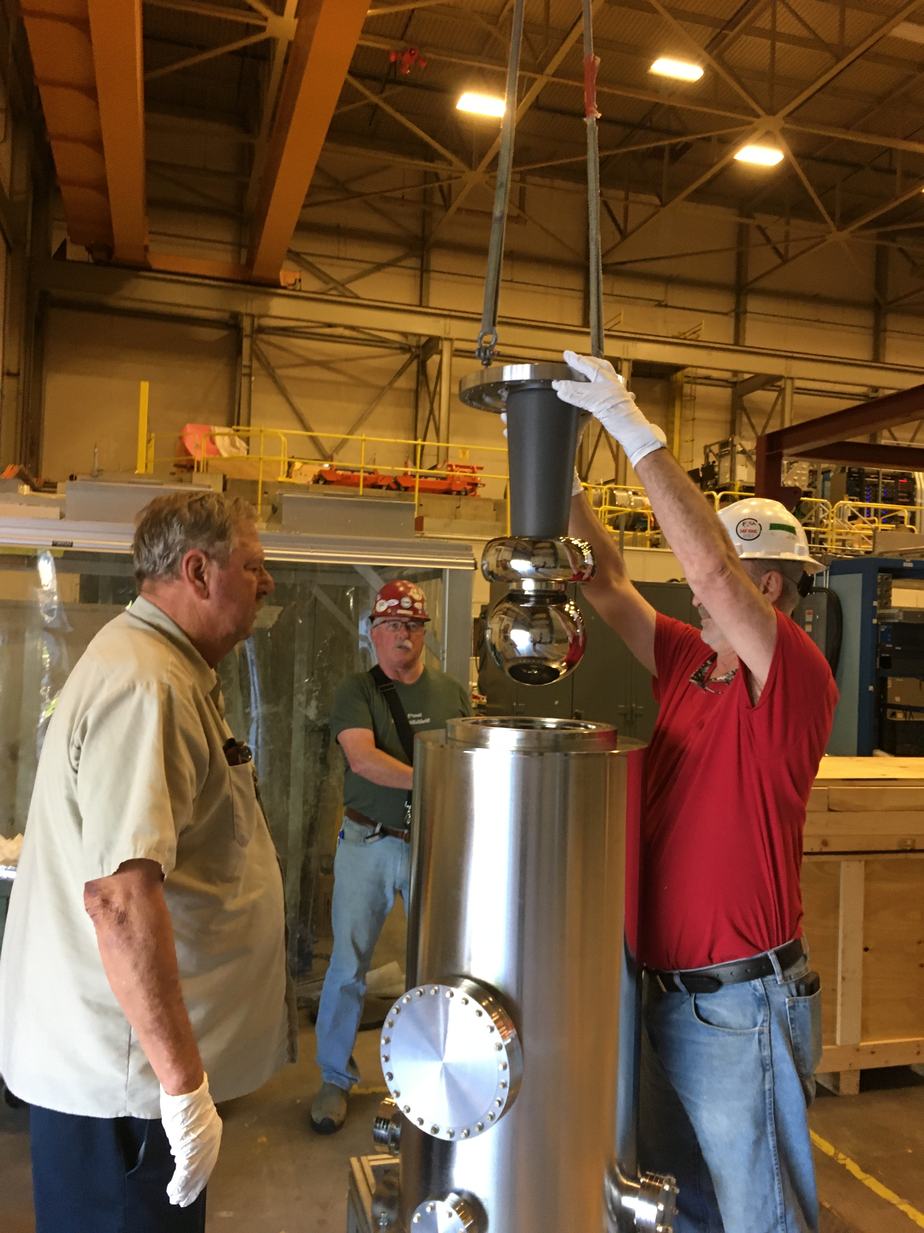
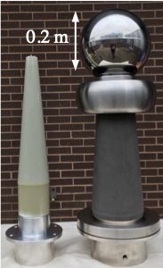
Operating a photogun to 350 kV field emission free requires applying ~450 kV for field emission processing without HV components breakdown. JLab is testing a large insulator with SF₆ intervening layer, and recently applied 500 kV to unmodified epoxy receptacle+cable+ electrode
Picture of the tapered epoxy receptacle (left) next to the 500 kV doped alumina insulator with triple point junction shield and spherical test electrode.
Electrode-insulator assembly being lowered into the test chamber using an overhead crane
Postdoctoral fellow Gabriel Palacios-Serrano installing the modified epoxy receptacle to the SF6 reservoir assembly on top of the testing chamber.
C. Hernandez-Garcia et al., Proceedings of the North America Particle Accelerator Conference, Albuquerque NM, 7-12 August, 2022

Slide 8
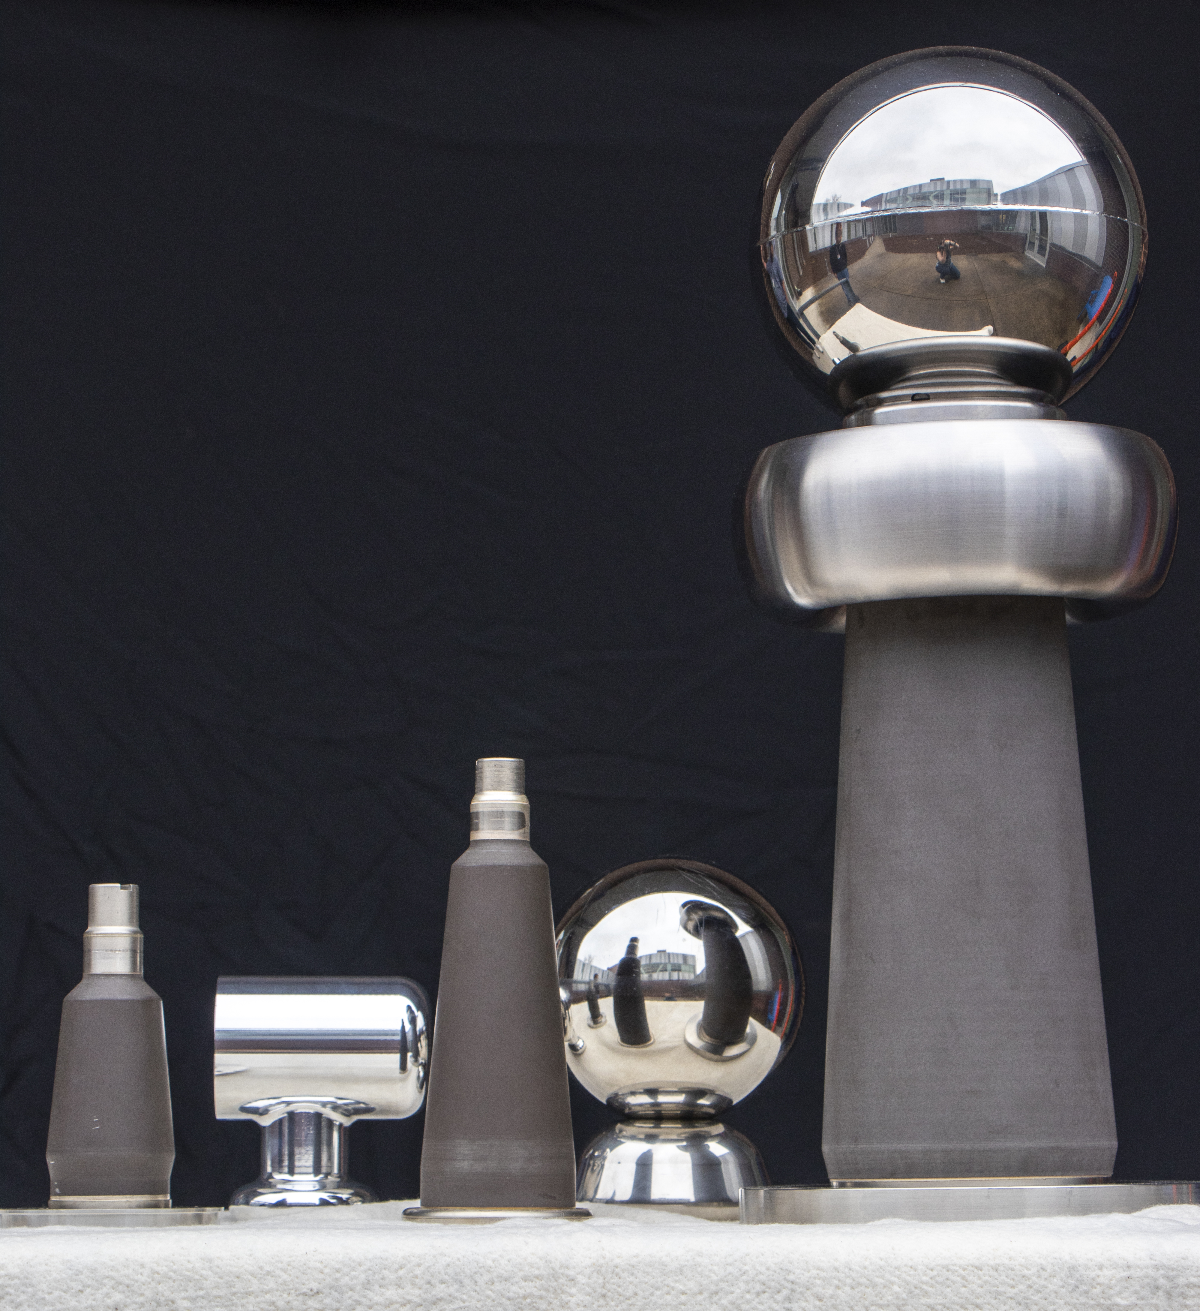
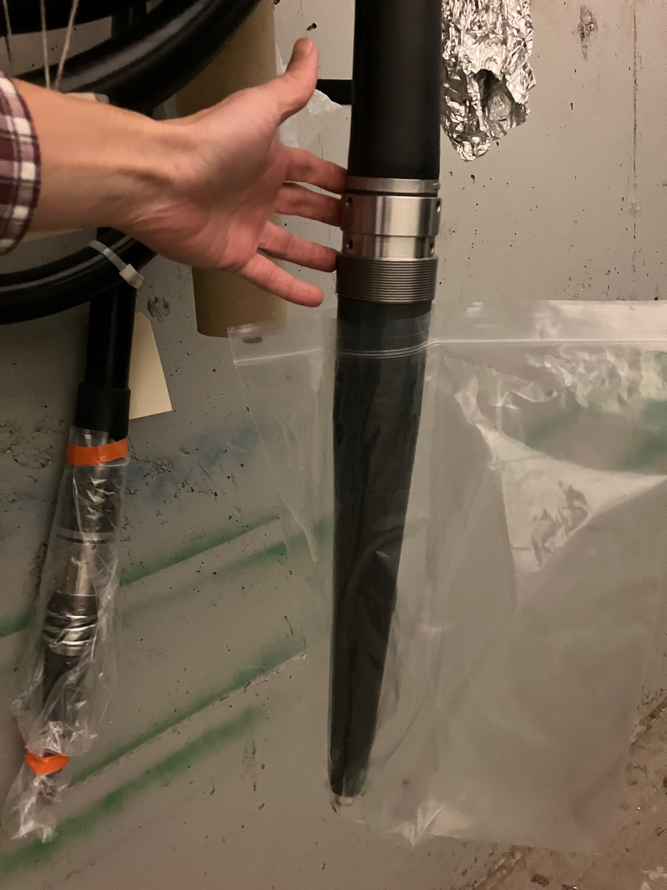
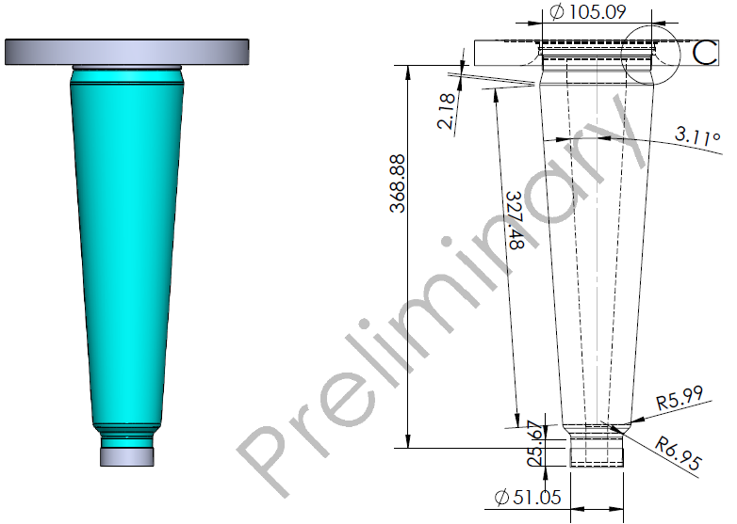
JLab submitted a proposal to HEP to develop and HV test a new 500 kV insulator for a higher voltage gun
Development based on:
Designing a new inverted larger insulator than commercially available designed to fit commercial 500 kV cable
Partnering with industry to manufacture the new insulator
Larger electrode to accommodate larger laser spot size to reduce ion energy density on photocathode
Larger vacuum chamber with newest NEG ZAO wafer 1400 l/s modules from SAES
Biased anode to repel downstream ions
Higher operating voltage to:
  Reduce hydrogen ionization cross section
  Manage space charge for short bunch beams
  Improve beam transmission at mA CW current
  Inject directly into SRF booster w/o RF capture structure
7 in
14 in
A polarized beam source providing
1 mA CW for a week = 600 Coulombs
Lifetime must be longer than this!

