Slide 1
Spin Polarization Sensitivity of Electrons Emitted from Bulk GaAs Photocathodes
Wei Liu
Brookhaven National Laboratory
Matt Poelker, Shukui Zhang, Marcy Stutzman
Jefferson Lab
PSTP 2017, October 19, 2017

Slide 2
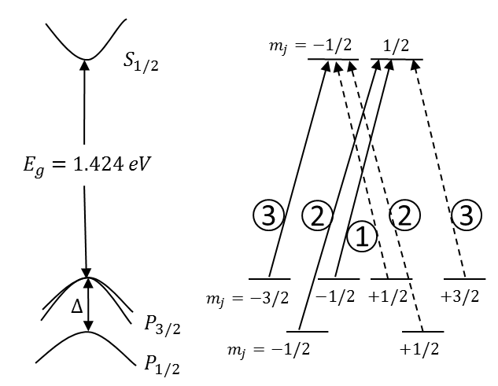
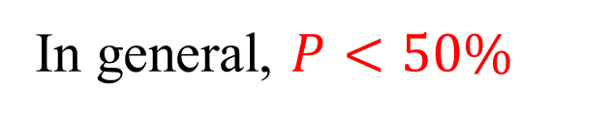
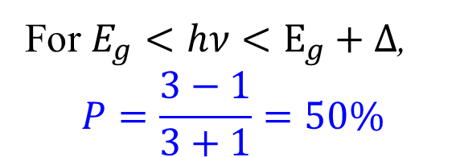
Production of spin-polarized electrons
For $E_{g}<hν<E_{g}+Δ$,
$$P=\frac{3−1}{3+1}=50\%$$
In general, $P<50\%$
The energy bands diagram
The optical transitions
Notes:
The energy bands diagram of unstrained GaAs at the center of Brillouin zone and the optical transitions between sublevels for circularly polarized light, right circularly polarized light (solid lines) and left circularly polarized light (dashed lines), with the relative transition probabilities given by circled numbers

Slide 3
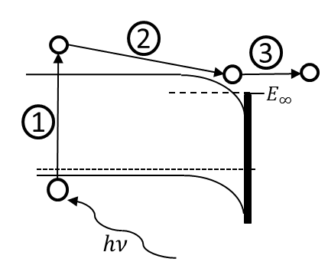
Factors affected the spin polarization
Material quality
Temperature
Dopant density
Thickness
Activation layer
Surface contamination
Laser
Others
Transportation of photoelectrons
Emission of photoelectrons
Absorption of photons
The QE is also affected by these factors
Three-Step Model

Slide 4
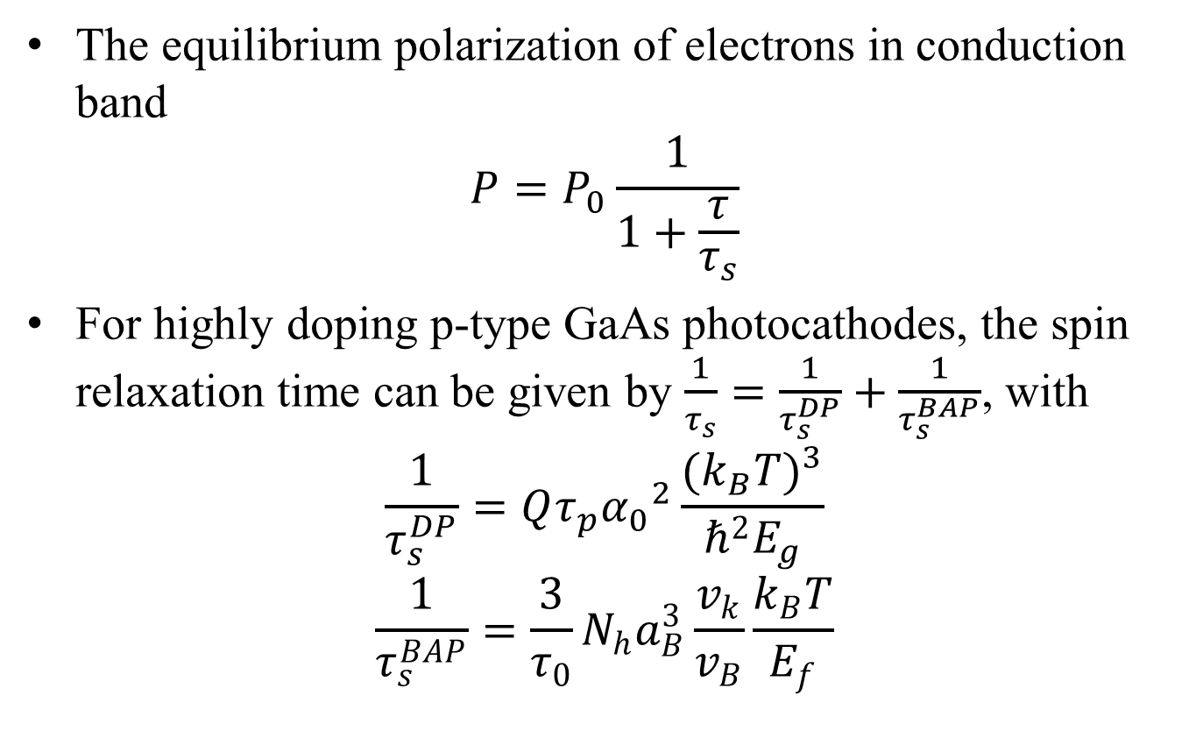
Spin relaxation mechanism
The equilibrium polarization of electrons in conduction band
$$P=P_{0}\frac{1}{1+\frac{τ}{τ_{s}}}$$
For highly doping p-type GaAs photocathodes, the spin relaxation time can be given by $\frac{1}{τ_{s}}=\frac{1}{τ_{s}^{DP}}+\frac{1}{τ_{s}^{BAP}}$, with
$$\frac{1}{τ_{s}^{DP}}=Qτ_{p}{α_{0}}^{2}\frac{{(k_{B}T)}^{3}}{ℏ^{2}E_{g}}$$
$$\frac{1}{τ_{s}^{BAP}}=\frac{3}{τ_{0}}N_{h}a_{B}^{3}\frac{v_{k}}{v_{B}}\frac{k_{B}T}{E_{f}}$$

Slide 5
BAP and DP mechanism
Temperature dependence of the spin relaxation rate

Slide 6
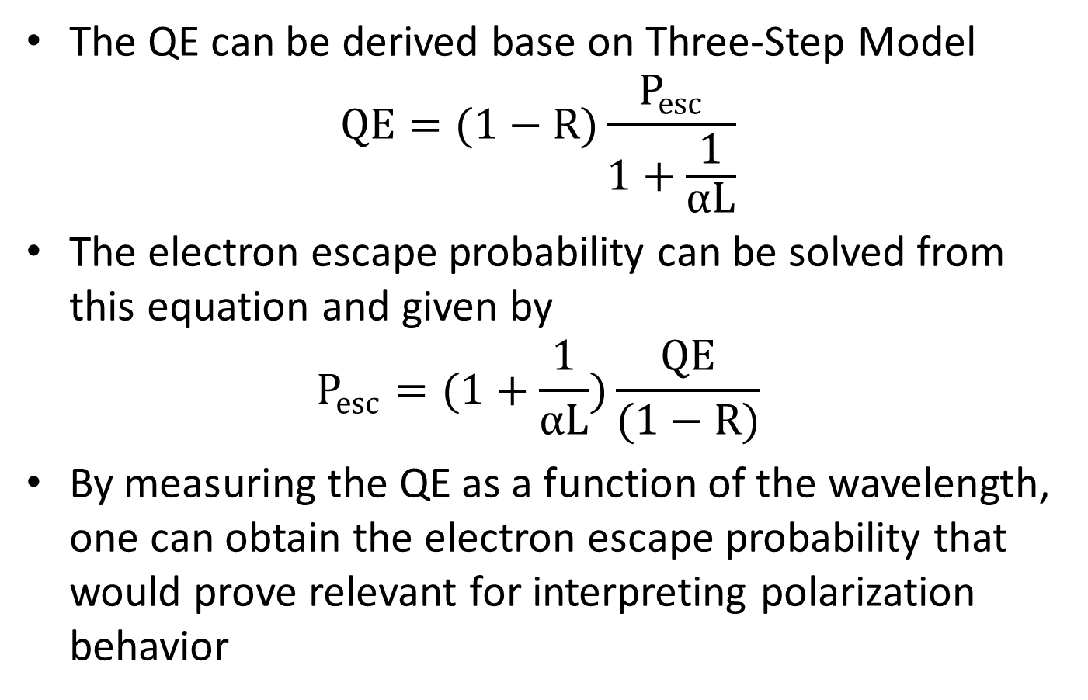
Evaluation of electron escape probability
The QE can be derived base on Three-Step Model
$$QE=(1−R)\frac{P_{esc}}{1+\frac{1}{αL}}$$
The electron escape probability can be solved from this equation and given by
$$P_{esc}=(1+\frac{1}{αL})\frac{QE}{(1−R)}$$
By measuring the QE as a function of the wavelength, one can obtain the electron escape probability that would prove relevant for interpreting polarization behavior

Slide 7
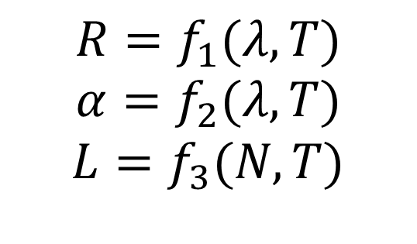



$$N=1×{10}^{19} {cm}^{−3}$$
$$R=f_{1}(λ,T)$$
$$α=f_{2}(λ,T)$$
$$L=f_{3}(N,T)$$
$$λ=650 nm$$
$$λ=650 nm$$

Slide 8
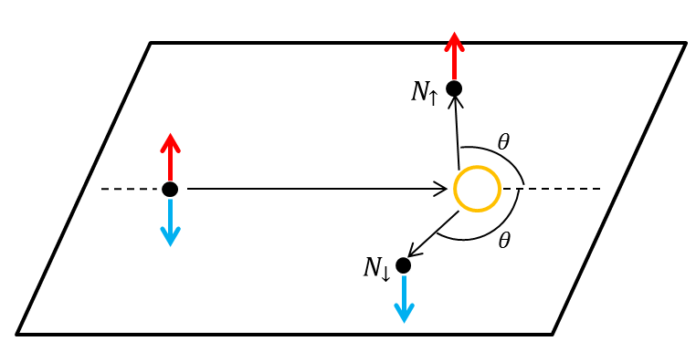
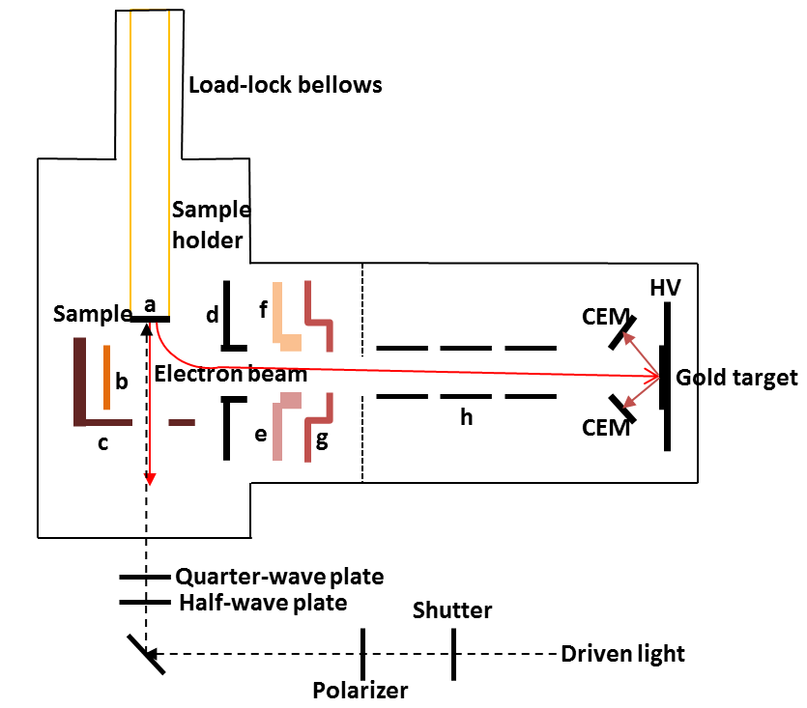
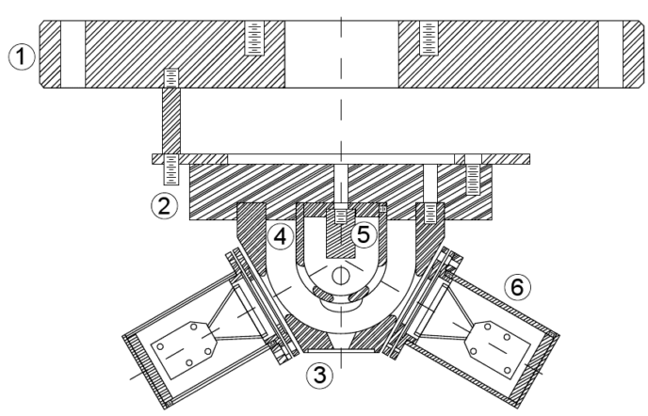
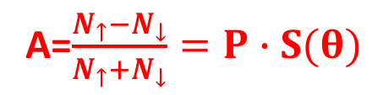
Measurement of electron spin polarization (ESP)
A=$\frac{N_{↑}−N_{↓}}{N_{↑}+N_{↓}}=P∙S(θ)$
Spin-polarized electrons incident to the target and scatter with target nuclei
Target
Schematic of experimental apparatus for measuring ESP of photocathodes
CEM
CEM
The cross section drawing of Mott polarimeter

Slide 9
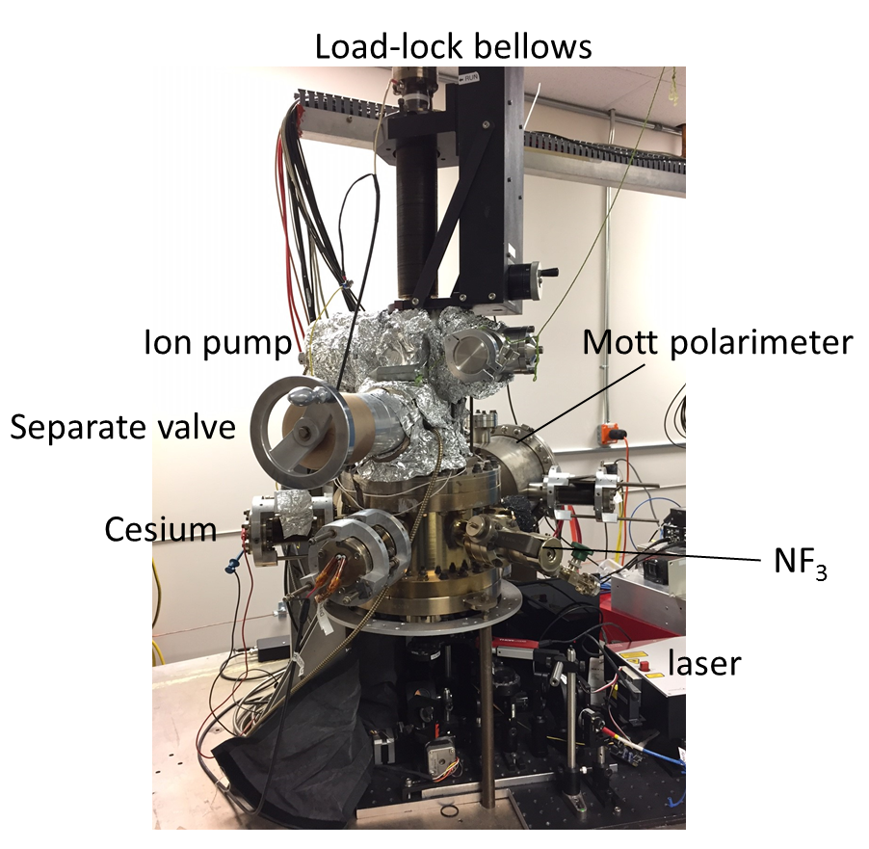
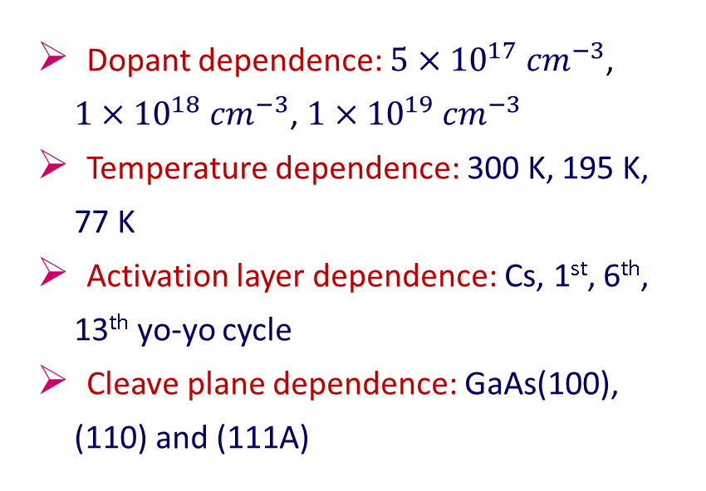
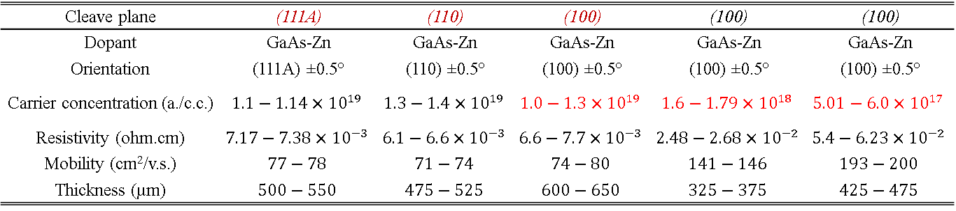
Experiment
Cleave plane | (111A) | (110) | (100) | (100) | (100)
Dopant | GaAs-Zn | GaAs-Zn | GaAs-Zn | GaAs-Zn | GaAs-Zn
Orientation | (111A) ±0.5° | (110) ±0.5° | (100) ±0.5° | (100) ±0.5° | (100) ±0.5°
Carrier concentration (a./c.c.) | $$1.1−1.14×{10}^{19}$$ | $$1.3−1.4×{10}^{19}$$ | $$1.0−1.3×{10}^{19}$$ | $$1.6−1.79×{10}^{18}$$ | $$5.01−6.0×{10}^{17}$$
Resistivity (ohm.cm) | $$7.17−7.38×{10}^{−3}$$ | $$6.1−6.6×{10}^{−3}$$ | $$6.6−7.7×{10}^{−3}$$ | $$2.48−2.68×{10}^{−2}$$ | $$5.4−6.23×{10}^{−2}$$
Mobility (cm²/v.s.) | $$77−78$$ | $$71−74$$ | $$74−80$$ | $$141−146$$ | $$193−200$$
Thickness (µm) | $$500−550$$ | $$475−525$$ | $$600−650$$ | $$325−375$$ | $$425−475$$
Experiment content
Dopant dependence: $5×{10}^{17} {cm}^{−3}$, $1×{10}^{18} {cm}^{−3}$, $1×{10}^{19} {cm}^{−3}$
Temperature dependence: 300 K, 195 K, 77 K
Activation layer dependence: Cs, 1st, 6th, 13th yo-yo cycle
Cleave plane dependence: GaAs(100), (110) and (111A)
mini-Mott chamber

Slide 10
Photocurrent evolution while cooling GaAs
77 K
High dopant
  300K: QE=6.9%
  77K: QE=10%
Low dopant
  300K: QE=1.5%
  77K: QE=0.79%
300 K
77 K
Cathodes cool down from 300 K to 77K

Slide 11
Temperature and dopant dependence
300 K
77 K
ESP@300 K: high dopant: 30%, low dopant: 41%
ESP@77 K: high dopant: 41%, low dopant: 52%

Slide 12
Temperature and dopant dependence
Polarization is inversely proportional to temperature and dopant density
Notes:
Lower dopant concentration, higher ESP; Lower temperature, higher ESP

Slide 13
Activation layer dependence
Thinner thickness of activation layer, lower QE and P_{esc}
Max ESP
only Cs: 36%
1st cycle: 32%
6th and 13th cycles: 30%
Notes:
QE and ESP for bulk GaAs (110) with dopant concentration of $1×{10}^{19} {cm}^{−3}$ as a function of surface activation layer. Cycle number refers to the number of applications of Cs and F

Slide 14
Cleave plane dependence
Cleave plane samples (100) and (110) provided higher QE compared to cleave plane (111A)
There was no ESP sensitivity to crystal orientation (plane)
Notes:
QE and ESP of bulk GaAs with three different cleave planes, Zn dopant concentration 1$×$10¹⁹ cm⁻³, measured at room temperature

Slide 15
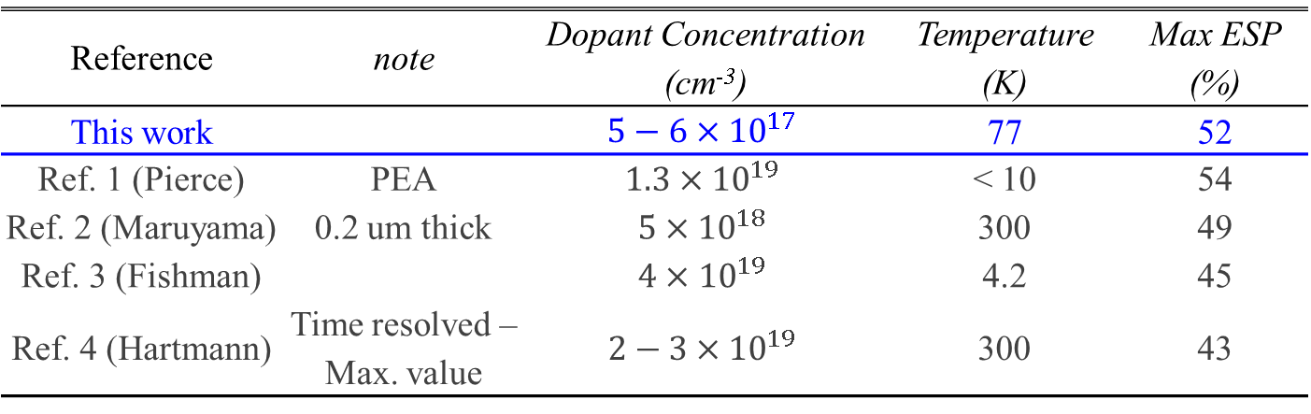
Reported maximum ESP values from GaAs
Reference | note | Dopant Concentration (cm⁻³) | Temperature (K) | Max ESP (%)
This work |  | $$5−6×{10}^{17}$$ | 77 | 52
Ref. 1 (Pierce) | PEA | $$1.3×{10}^{19}$$ | < 10 | 54
Ref. 2 (Maruyama) | 0.2 um thick | $$5×{10}^{18}$$ | 300 | 49
Ref. 3 (Fishman) |  | $$4×{10}^{19}$$ | 4.2 | 45
Ref. 4 (Hartmann) | Time resolved – Max. value | $$2−3×{10}^{19}$$ | 300 | 43
[1] D. T. Pierce and F. Meier, Phys. Rev. B 13, 5484 (1976)
[2] T. Maruyama, R. Prepost, E. L. Garwin, C. K. Sinclair, B. Dunham, and S. Kalem, Appl. Phys. Lett. 55, 1686 (1989)
[3] Guy Fishman, and Georges Lampel, Phys. Rev. B 16, 820 (1977)
[4] P. Hartmann, Aufbau einer gepulsten Quelle polarisierter Elektronen, Dissertation, Shaker Verlag, Aachen, 1998
Notes:
polarization exceeds max theory value, but also point out that Dan Peirce saw polarization > 50%
Sure, this might be caused by systematic error, wrong analyzing power, or interesting physics

Slide 16
Maximum ESP versus P_{esc}
ESP is inversely proportional to P_{esc} (excepted “cleave plane”)
In general, it can be said that ESP can be increased at the expense of QE

Slide 17
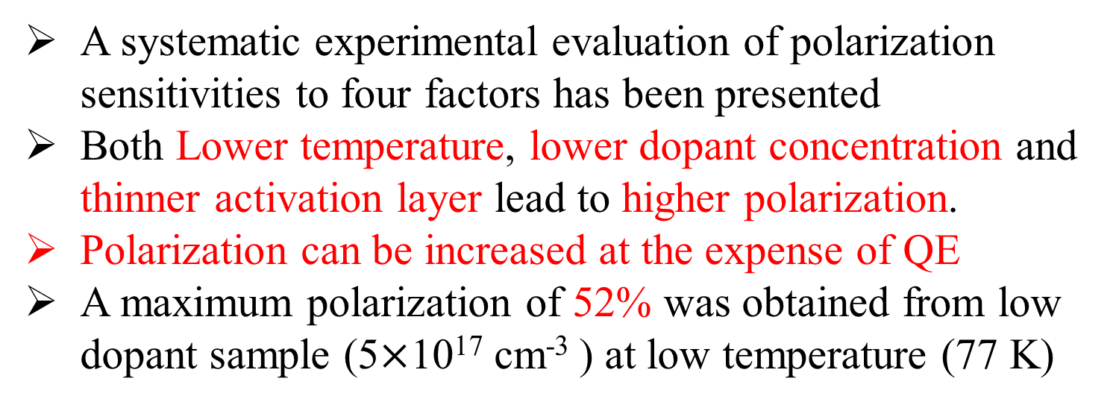
Conclusions
A systematic experimental evaluation of polarization sensitivities to four factors has been presented
Both Lower temperature, lower dopant concentration and thinner activation layer lead to higher polarization.
Polarization can be increased at the expense of QE
A maximum polarization of 52% was obtained from low dopant sample (5$×$10¹⁷ cm⁻³ ) at low temperature (77 K)
This work can be found at: Wei Liu, etc., J. Appl. Phys. 122, 035703 (2017)

Slide 18
Thanks for your attention

