Slide 1
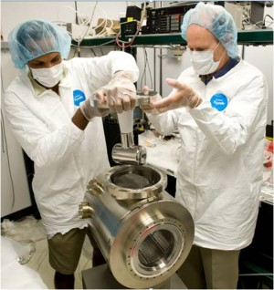
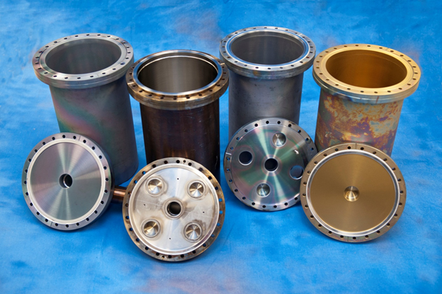
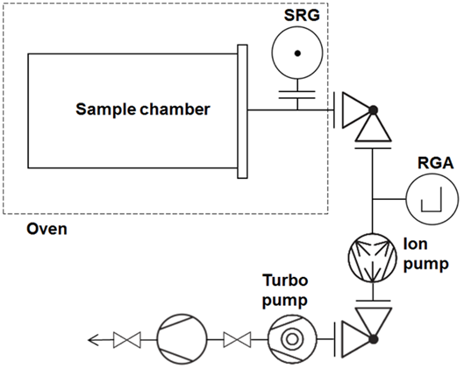
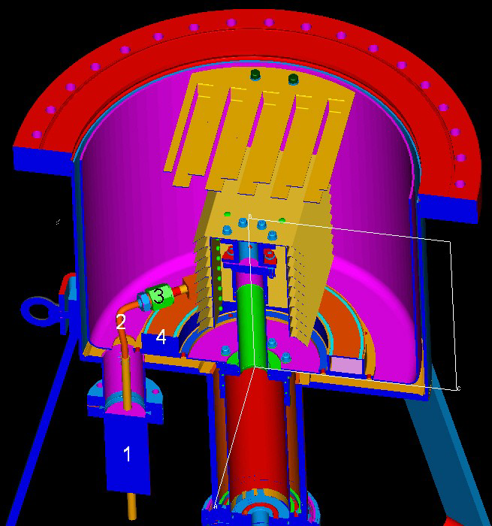
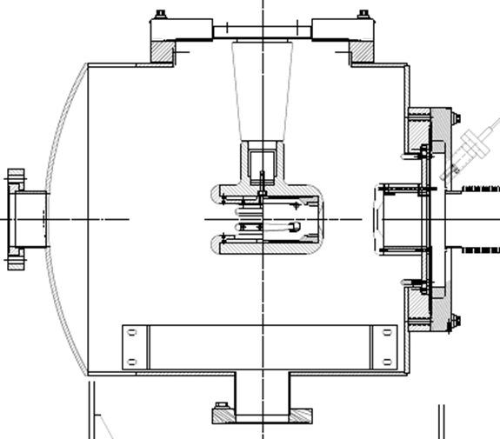
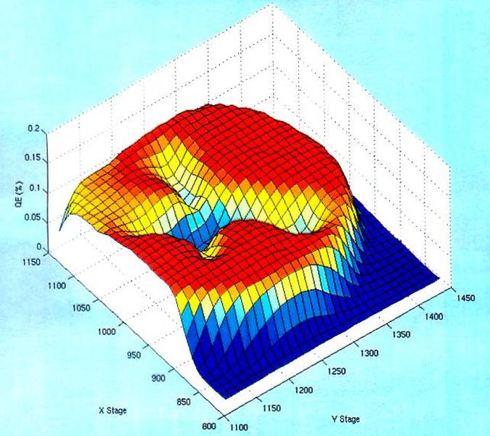
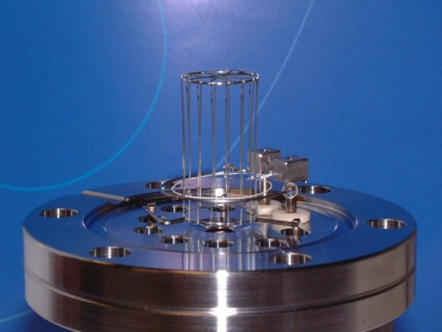
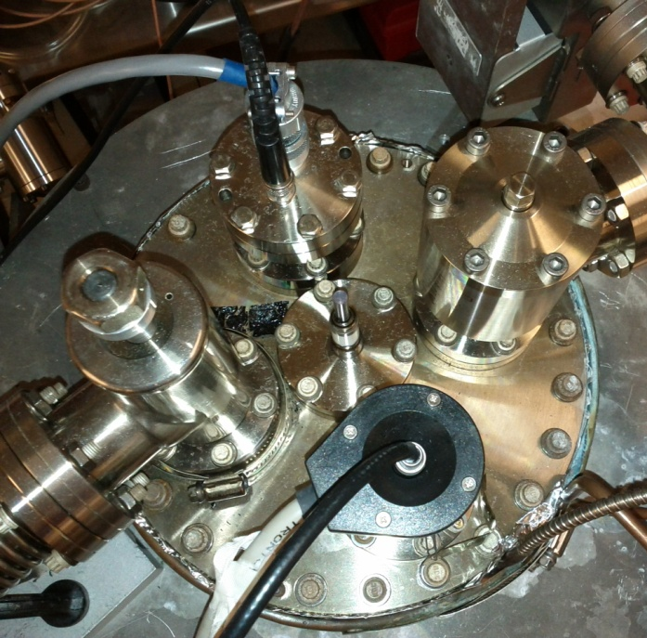
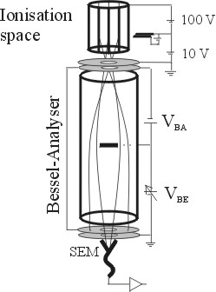
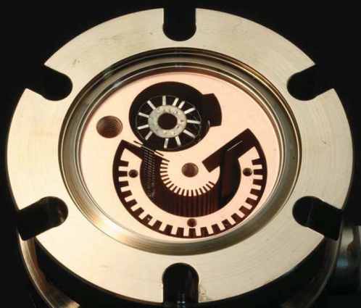
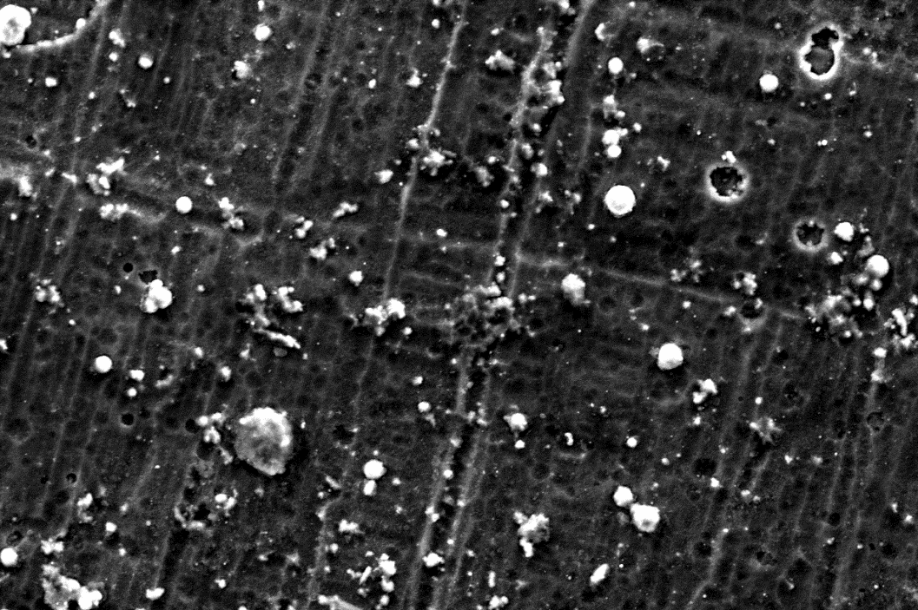



Vacuum Characterization and Improvement for the Jefferson Lab Polarized Electron Source
Marcy L. Stutzman, P.A.Adderley, M.Poelker (Jefferson Lab),
Md.A.Mamun (Old Dominion University)
Motivation
Outgassing Reduction
XHV Pumping
Improved vacuum for increased photocathode lifetime
Identical 304L chambers
Bare steel
TiN coating (9 µm)
a-Si (SilcoGuard-1000®~900 nm)
Outgassing rates
Spinning Rotor Gauge
Accumulation technique
Multiple bakes
Q(T_{room}) after each bake
Typical pumps: non-evaporable getter + Ion pump
Do the ion pumps have low pressure limitation? Could the NEG pumps or infrastructure limit base?
Can adding a commercial “XHV” cryopump improve electron gun base pressure?
Residual gasses ionized, limit operational lifetime
SAES WP NEG modules
Gamma Vacuum SEM style ion pump
Base pressure approaching XHV
XHV ≡ P < 1x10⁻¹⁰ Pa = 1x10⁻¹² mbar = 7.5x10⁻¹³ Torr
Expected pressure calculations
a-Si
a-Si
TiN
 | NEG, Ion pump only | NEG, Ion and Cryopump
Getter pump (l/s) | 2150 | 2150
Ion pump (l/s) | 45 | 45
Cryopump (l/s) | - | 800-1300 (conductance dependent)
Area (cm²) | 8000 (chamber only) | 8000 (chamber) + 3400 (bellows) + 13700 (gate valve)
Outgassing (TorrLs⁻¹cm⁻²) | 1x10⁻¹³ | ≥ 1x10⁻¹³
Expected pressure | 4 x 10⁻¹³ Torr | 3 - 7 x 10⁻¹³ Torr
Measured pressures | 4x10⁻¹² Torr | 1.5x10⁻¹² Torr
bare
Accumulation setup
-130kV
light in
electrons out
For high polarization (near 90%),
Strained superlattice GaAs/GaAsP
Outgassing Progression with successive heat treatments
14 layers
GaAs
Strained
Superlattice
Photocathode
Structure
Ionized residual gas accelerated into photocathode, limits operational lifetime
0.36
GaAsP
Leybold Bakable cryopump
LN₂ chill circuit
  cools cryosorber panels and compressor
  allows bake of cryopump body
Operation
  10K pumping surface
  30K baffles
Presented at AVS 55 by Dieter Mueller, Leybold
GaAs
Outgassing reduction with 400°C bake
First test of a-Si “Silco” coating
TiN coating: remarkably low outgassing
Does it yield similarly remarkable base pressure?
How to improve vacuum?
Less gas in:
Reduce outgassing rate
Better gas removal:
XHV pumping
Measure improvements:
XHV gauge characterization
V. Shutthanandan, …, M.L. Stutzman et al.,Phys.Rev.ST Accel.Beams 15 (2012) 063501.
Published 2014
  Md. A. Mamun, A. A. Elmustafa, M. L. Stutzman, P. A. Adderley and M. Poelker, “Effect of heat treatments and coatings on the outgassing rate of stainless steel chambers”, J. Vac. Sci. Technol. A 32, 021604 (2014)
Moderate improvement when cryopump added
Significant infrastructure required: gate valve, LN₂ plumbing circuit, vibration isolation
Further work to understand discrepancy between predicted and measured pressures
Base Pressures:
Predicted vs. Achieved
400°C heat treatment compares favorably to tested coatings
Low TiN outgassing rate due to Ti pumping, does not improve base pressure
XHV gauges require background measurement and corrections
XHV cryopump improves base pressure
  Adds surface area and complexity
  Ongoing investigation
XHV Gauge
Characterization
Extractor gauge
x-ray limit reduced through geometry
~$4k
Conclusions
3BG
Commercial XHV Ionization gauges require mitigation and measurement of backgrounds
x-ray limit
gauge heating effects
electron stimulated desorption
Axtran gauge
Bessel box energy discrimination
electron multiplier for amplification
~$8k
extractor
Add 1340 L/s NEG /ion pumps
Characterize all gauge limitations
Determine base pressure
Watanabe 3BG (Bent Belt Beam) gauge
230° deflector BeCu housing
~15.5k ($13k sensor + Leybold extractor controller)
$$P=\frac{qA}{S}$$
Bare and Silco agree with calculated base pressure
TiN pressure ~1000x too high
Elemental Ti excellent pump for hydrogen
XPS analysis shows inhomogeneous TiN coating
Backgrounds | X-ray | Heating | ESD
Extractor | ~1x10⁻¹² Torr | ~1x10⁻¹² Torr | degas well
3BG | 0 | ~1x10⁻¹² Torr | degas well
AxTran | 0 | ~1x10⁻¹² Torr | energy discrimination
Gauges used in combination
Gauge performance
Base chamber pressure
  Cryopump
  Outgassing test chambers
Net pump speed of 0.003 L/s in accumulation measurement would explain discrepancy
Acknowledgement: U.S. DOE Contract No. DE-AC05-06OR23177 and with funding from the DOE R&D for Next Generation Nuclear Physics Accelerator Facilities Funding Opportunity Number: DE-FOA-0000339

