Slide 1
Magnetization in the GTS
Fay Hannon

Slide 2
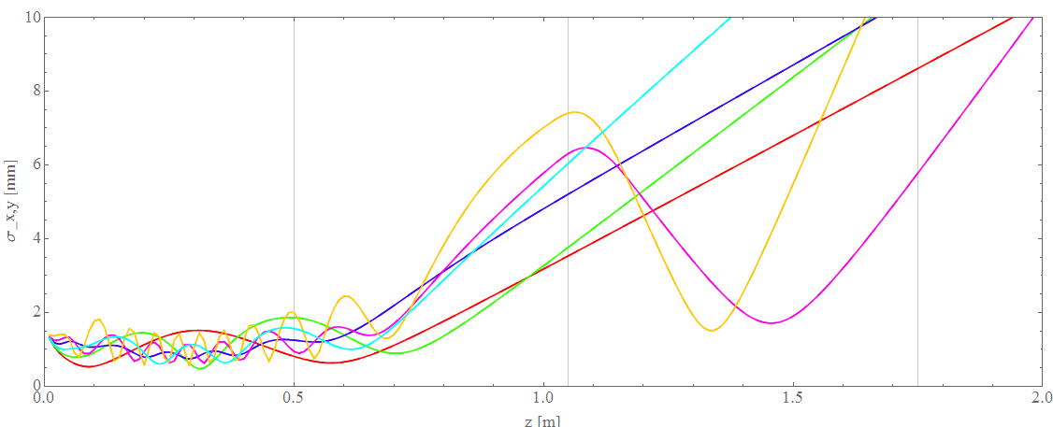
Beam envelope with cathode field
0.075T
0.015T
0.03T
0.05T
0.1T
Slit
Screen

Slide 3
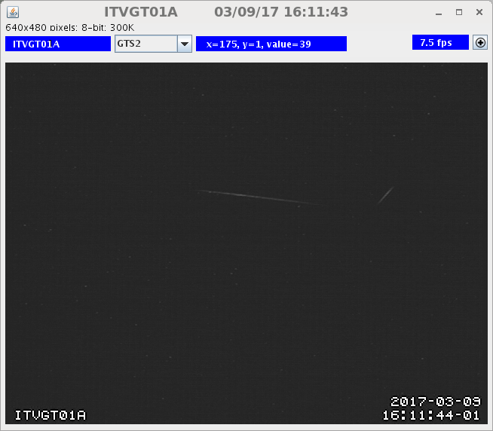
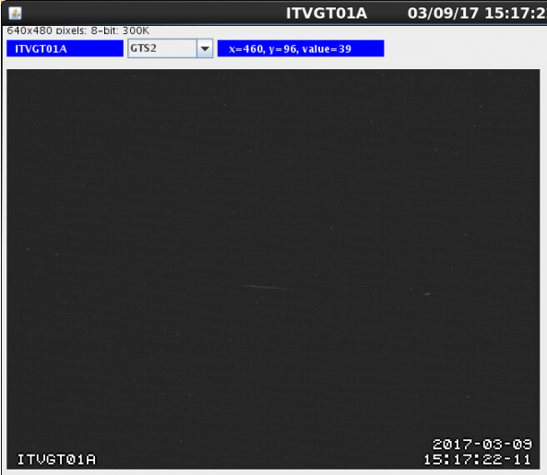
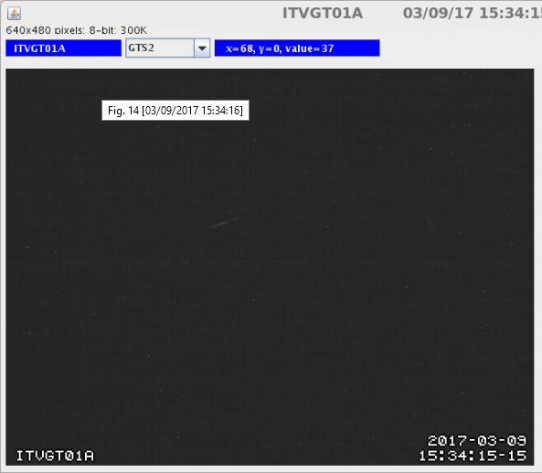
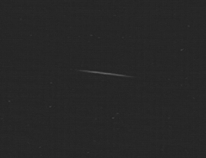
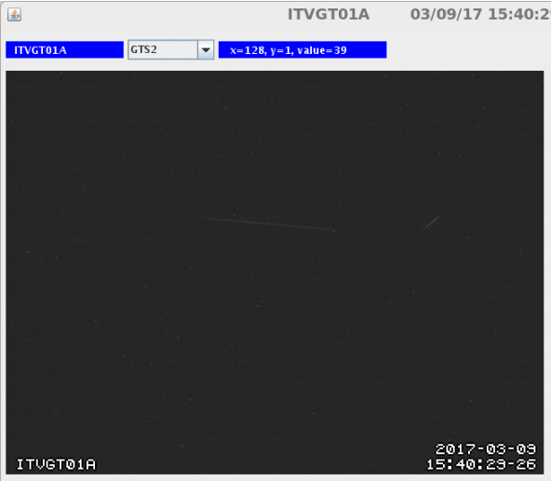


500G
150G
300G
0G
1000G
1300G
750G

Slide 4
150G
300G
500G
1000G
1300G
750G

