Slide 1
Metal-Organic Chemical Vapor Deposition (MOCVD)
August 2024
Adam Masters

Slide 2
Overview
MOCVD System Overview
MOCVD System Components
Let’s Grow a Cathode!
More boring science
Additional Considerations for MOCVD Cathodes

Slide 3
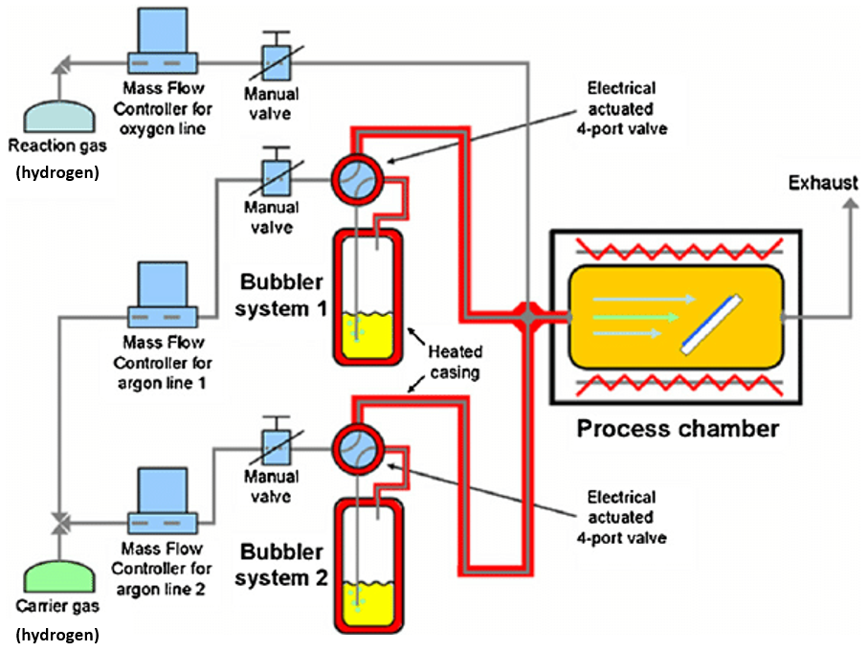
1. MOCVD System Overview
A large number of the components in the system are related to the plumbing for the various gases used during the process
Reaction gases such as arsine are stored in gas cylinders while other reactants such as trimethyl-gallium are stored in precursor bubblers and hydrogen is used as a carrier.
The gases pass through a showerhead and onto the hot substrate surface where reactions occur to form the epitaxial film
All exhaust gas passes through a scrubber to ensure no hazardous chemicals are vented to atmosphere.
(Hydrogen, Arsine, Phosphine)
(Trimethyl-gallium)
S. Abermann, J. Kuzmik and G. Strasser, "MOCVD of HfO2 and ZrO2 high-k gate dielectrics for InAlN/AlN/GaN MOS-HEMTs," Semiconductor Science and Technology, vol. 22, pp. 1-5, 2007.

Slide 4
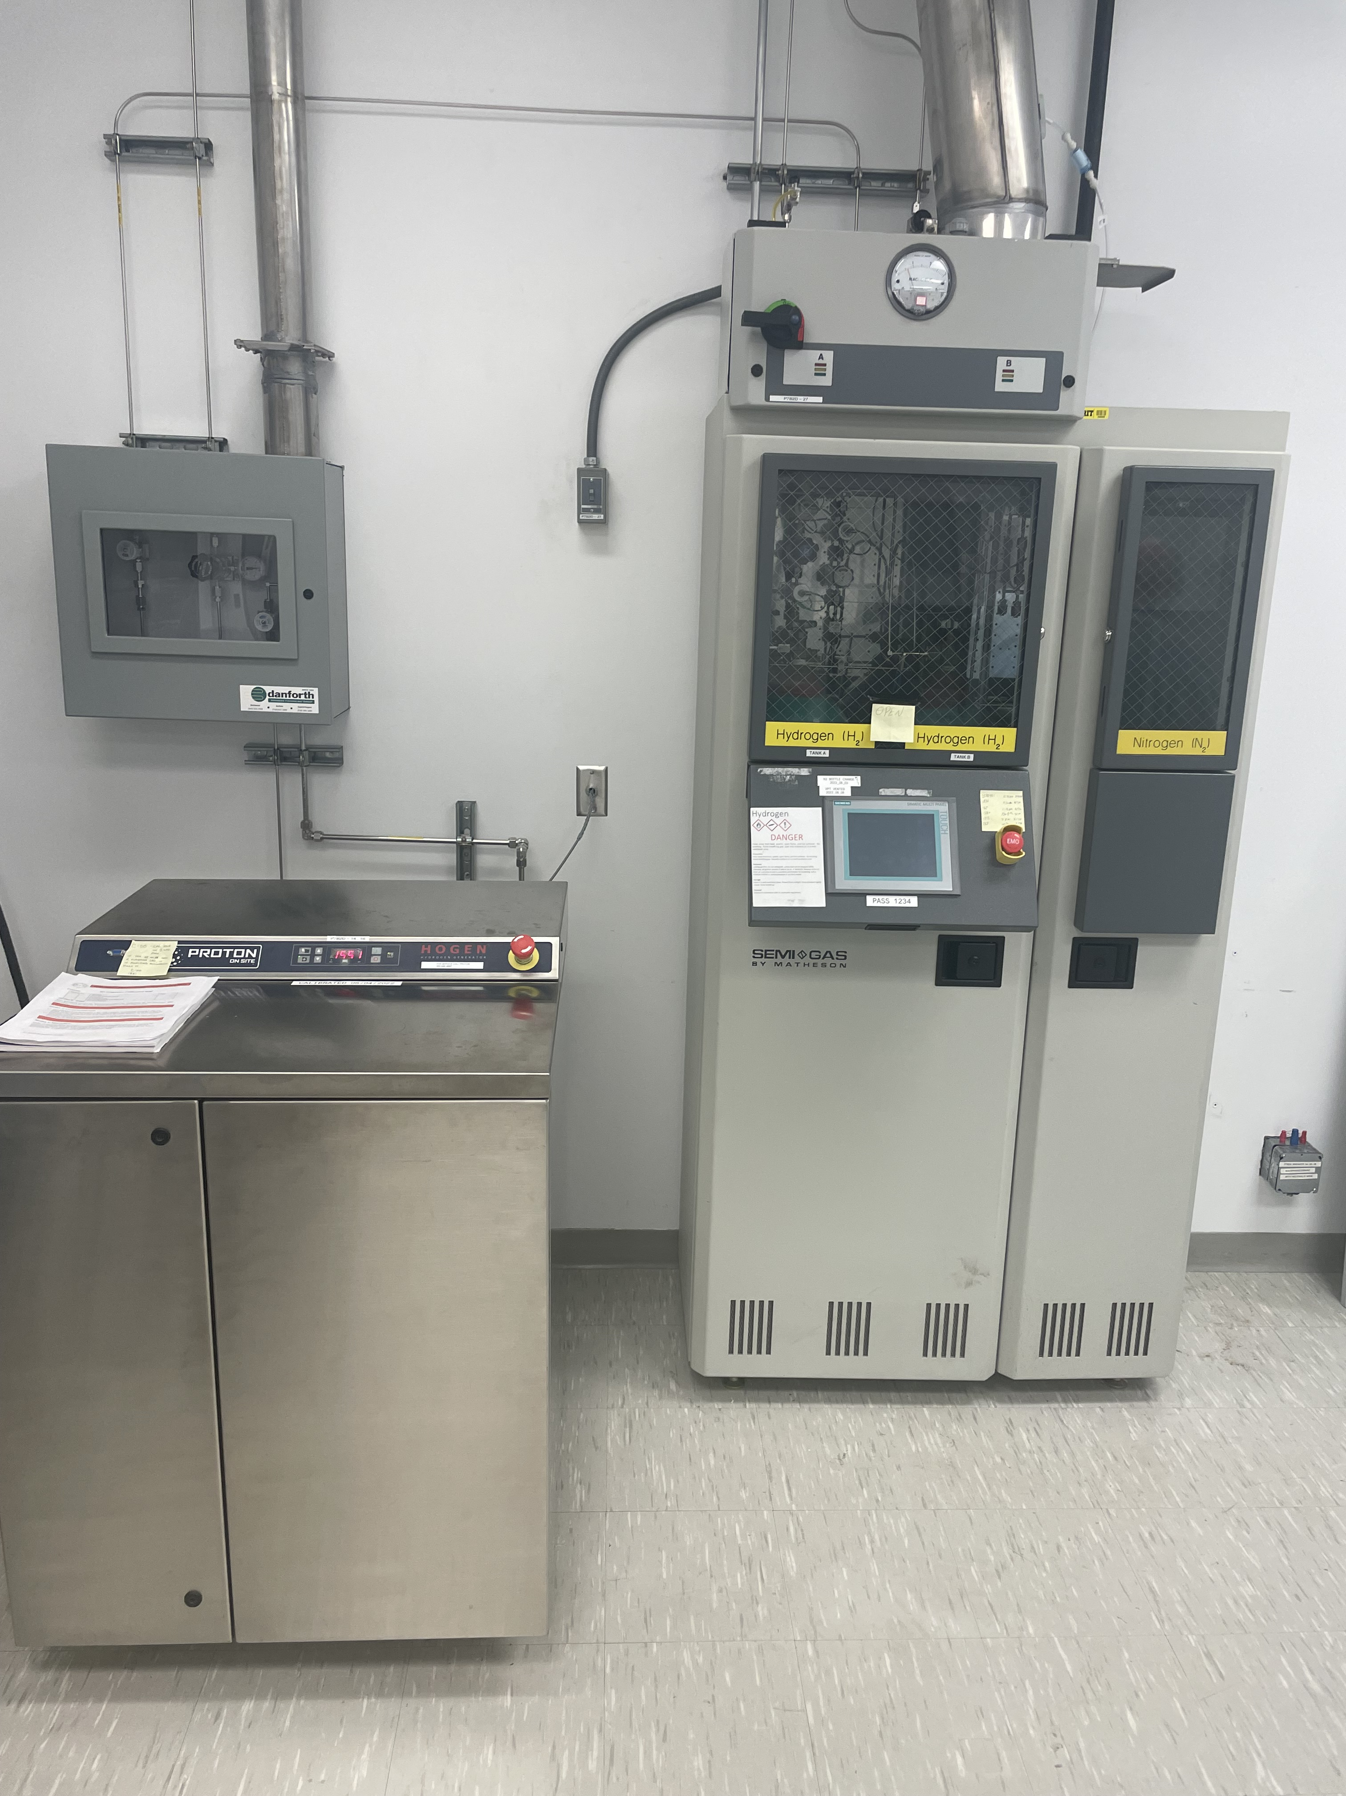
2. MOCVD System Components
Reaction and Carrier Gases
Hydrogen carrier gas can come from hydrogen generator or bottled UHP hydrogen
Reaction gases such as Arsine and Phosphine are bottled UHP gases
Mass flow controllers
Allow precise control of the input gases
G. Stringfellow, Organometallic Vapor-Phase Epitaxy, London, UK: Elsevier, 1999.

Slide 5
2. MOCVD System Components
Precursor Bubblers
Some reactants such as trimethyl-gallium are in liquid form and use bubblers to flow the gas into the reaction chamber
These precursors must be at a controlled temperature, usually in a bath
Veeco, "Piezocon Gas Concentration Sensor," 2023. [Online]. Available: https://www.veeco.com/products/piezocon-gas-concentration-sensor/. [Accessed 08 02 2024].

Slide 6
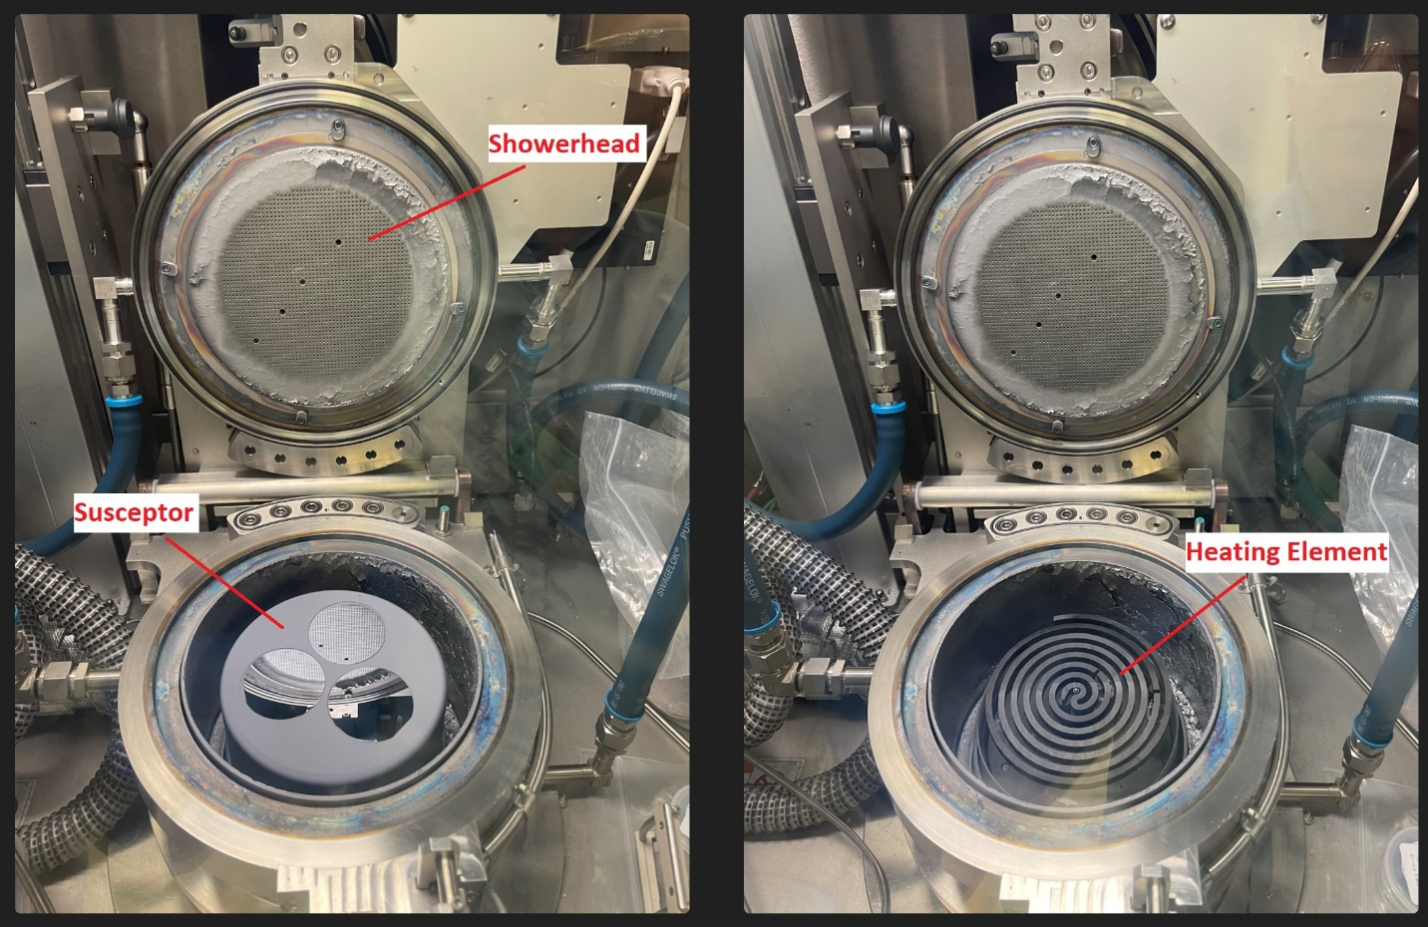
2. MOCVD System Components
Reactor Chamber
A showerhead allows uniform reactant flow over the reaction surface
The graphite susceptor allows the wafers to rotate during the growth process
The heating element provides uniform heating of the substrate
G. Stringfellow, Organometallic Vapor-Phase Epitaxy, London, UK: Elsevier, 1999.

Slide 7
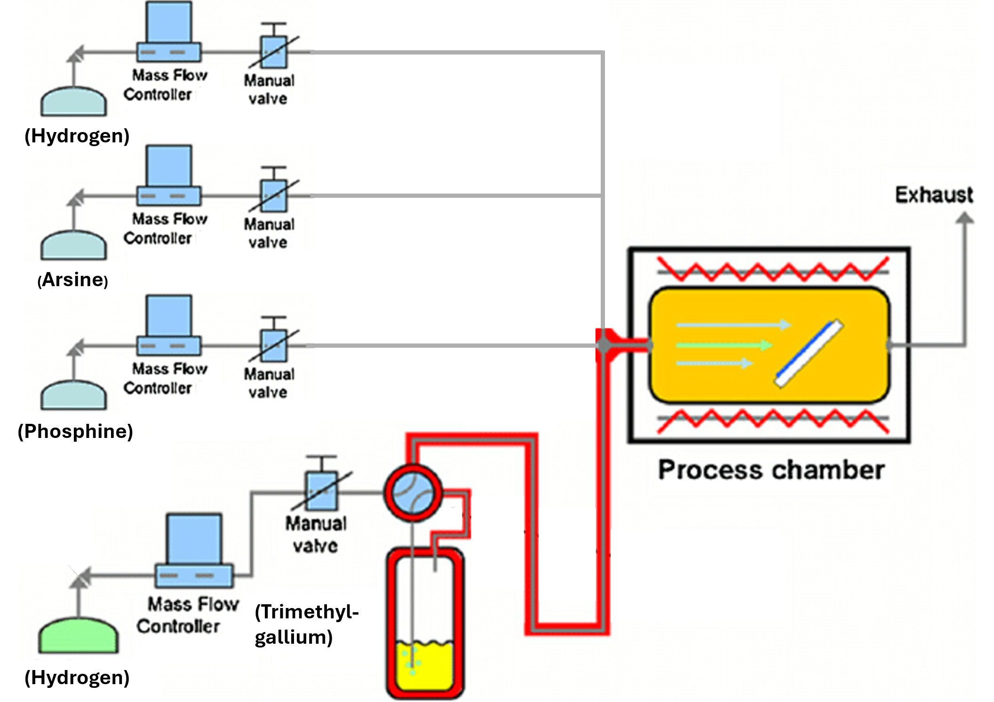
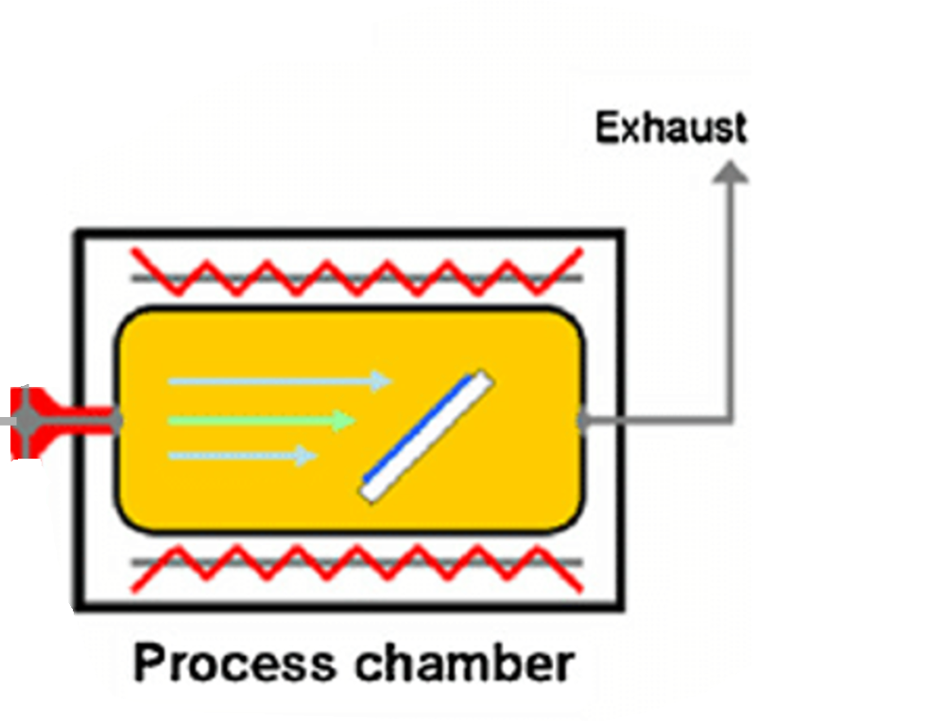
Gas Flow
Growth
Rate
Growth
Composition
10um/hr
GaP
5nm/min
GaAs

Slide 8
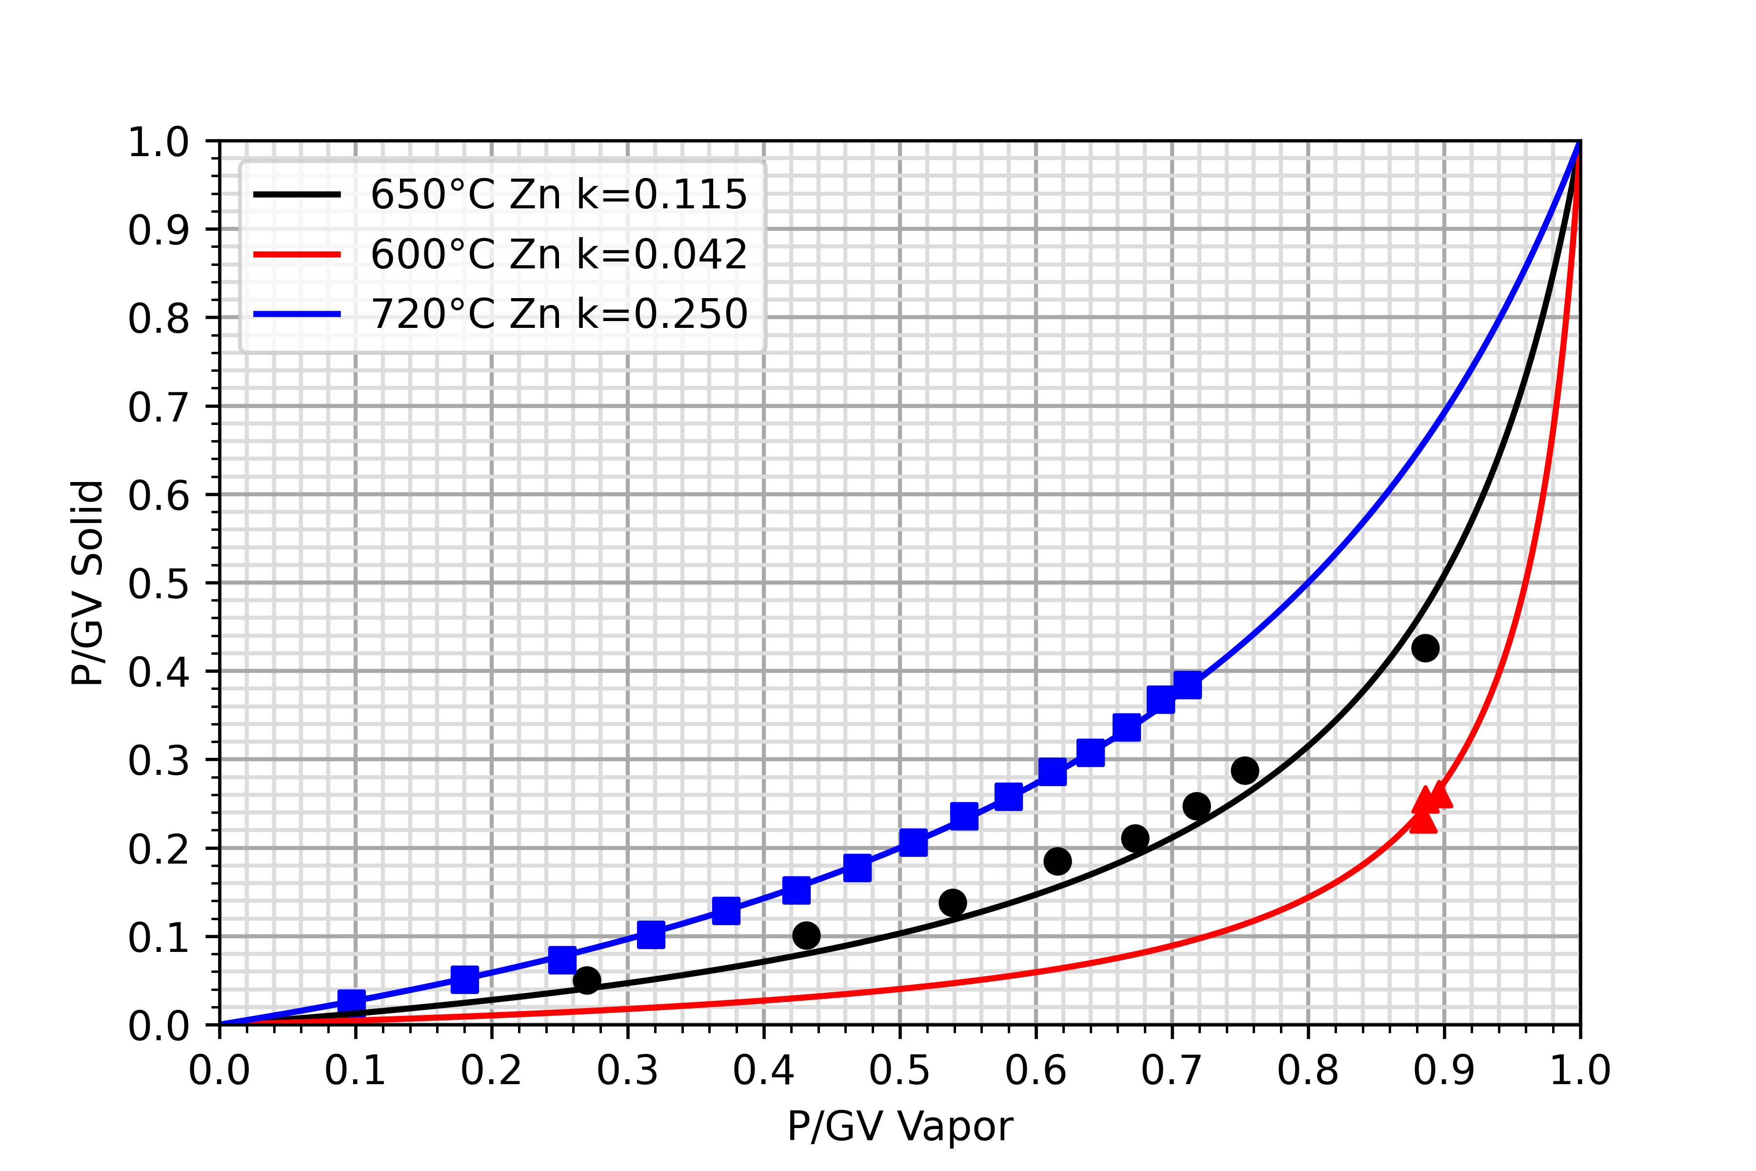
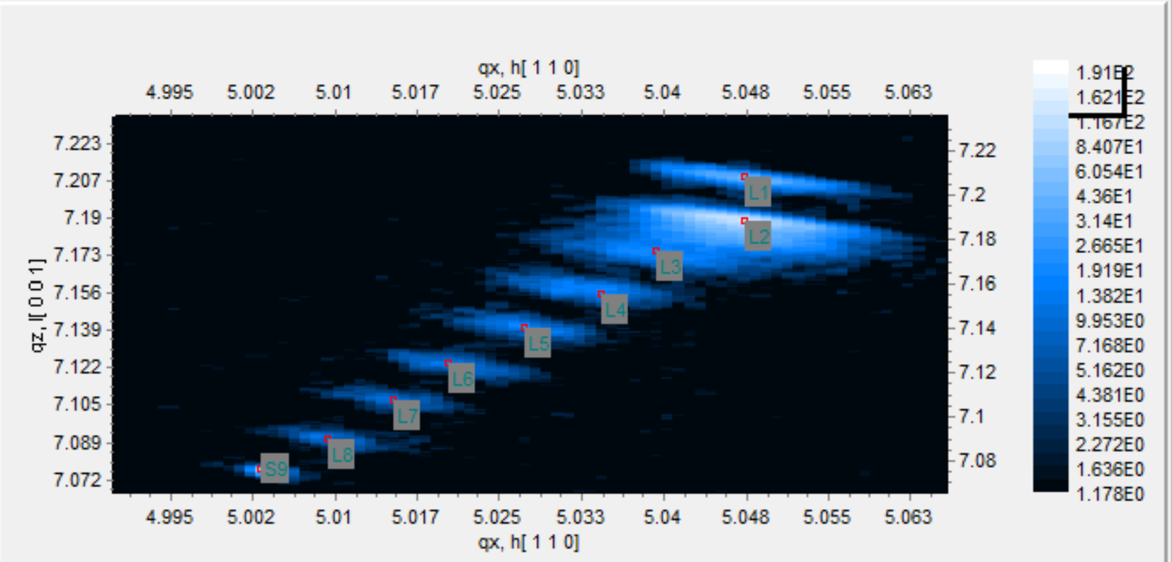
4. Establishing Gas Flow Ratios
Langmuir Curve
For a given growth temperature, the parital pressures of the phosphine and are varied during growth.
After the growth is complete, the composition of the layers can be analyzed using x-ray diffraction

Slide 9
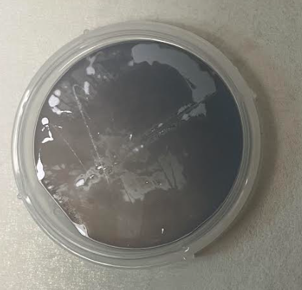
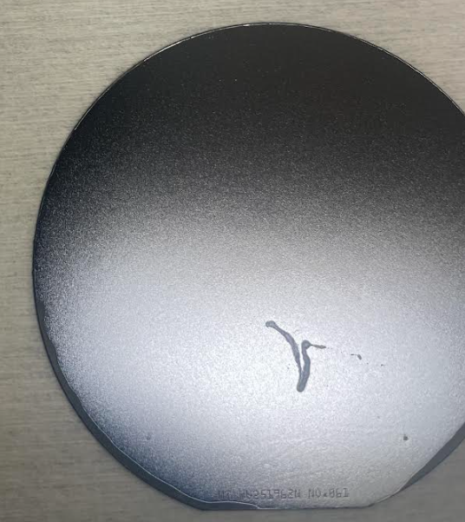
5. Additional Considerations for MOCVD Cathodes
Parasitic backside growth
Excess reactants can find their way to the underside of the wafer and form a parasitic growth.
Must be removed with appropriate backside etch process.
No capping layer
MBE cathodes are capped with amorphous arsenic to protect cathode surface.
Formation of gallium oxide can occur along with atmospheric hydrocarbon contamination.
Must be removed with HCl etching and additional heating prior to activation
Hydrocarbons and oxides
Electrons

