Slide 1
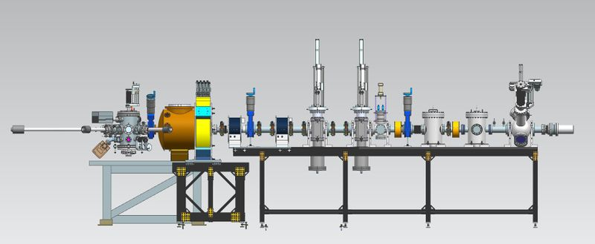
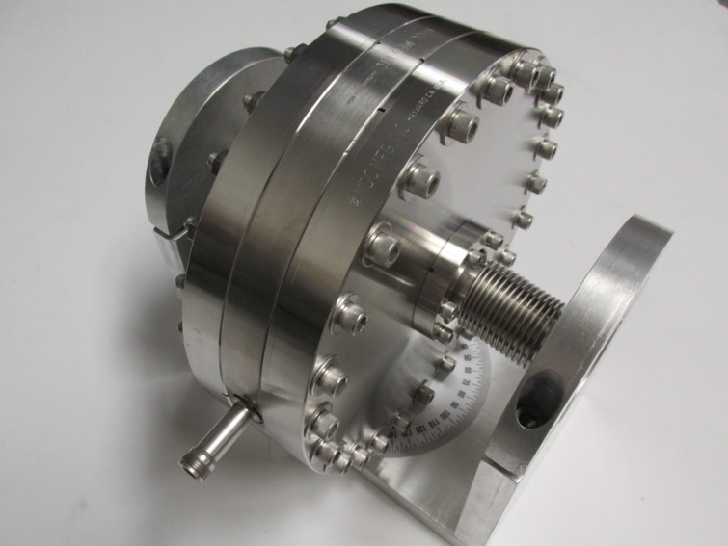
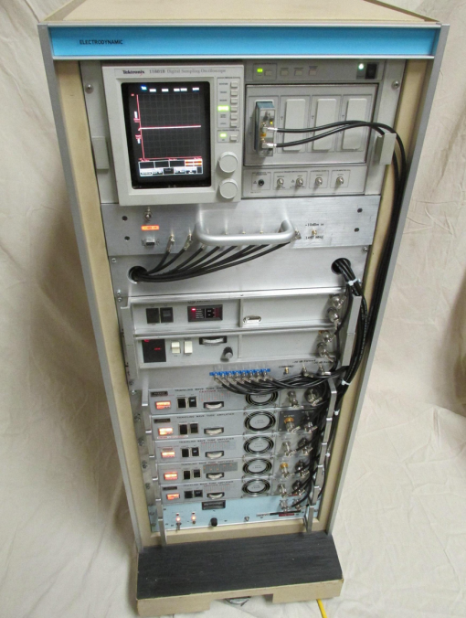
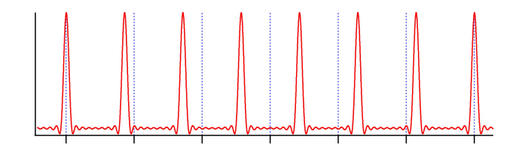
PoP: laser rep rate 1247.5 MHz, kicker driven at 1497 MHz plus harmonics
Install here
Electrodynamic, phase2 sbir
Hope to see kicked beam on viewer, one out of six bunches
Harmonically resonant cavity
8-channel RF source

Slide 2
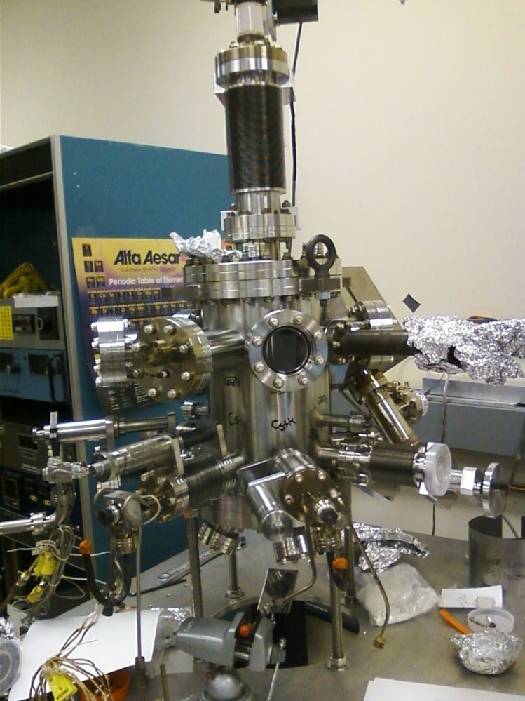
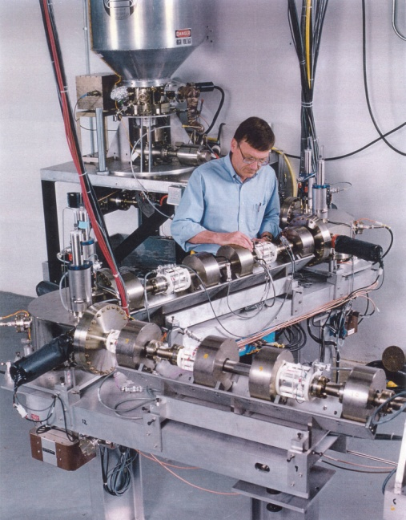
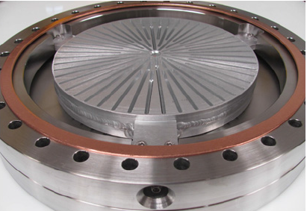
CsK₂Sb deposition Chamber
8-channel RF source

