Slide 1
Brock Cavity Install: first draft
Isolate beamline at VBV1I07 and VBV0I02
Remove all magnets, BPMs (EES help?)
Vent line at VIP0I01
Remove A1 cube and Wien2
Align Brock, new A1 cube, and Wien2 in alignment lab (Survey support)
Return segment to tunnel (need elevator or crane?)
Pumpout, leak check
Bakeout
Reconnect hardware
HCO on disconnected equipment
Beam tests
Brock functionality tests

Slide 2
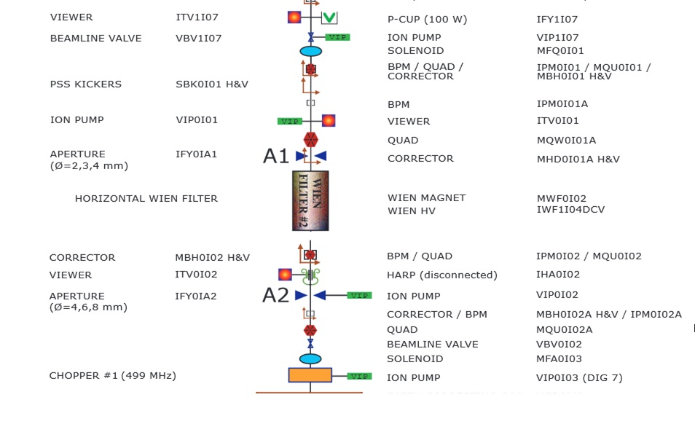

Slide 4
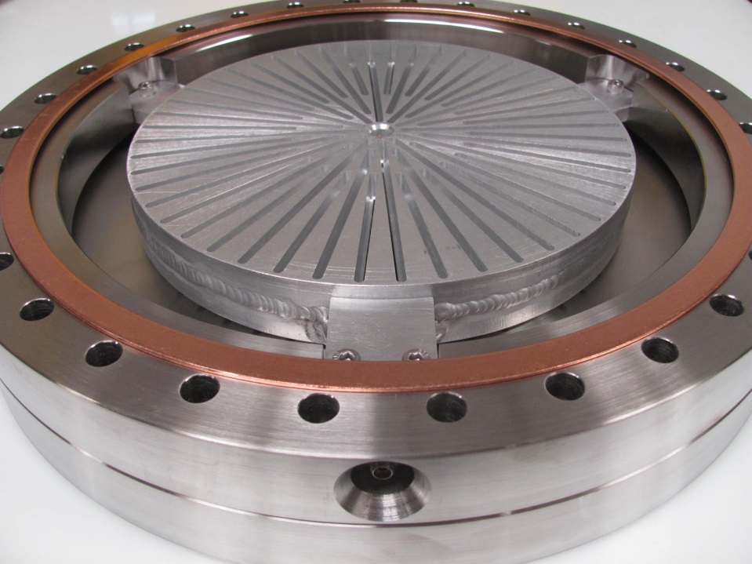
Flanged
A1 cube
Wien2
Wien2
Welded
A1 cube
Brock cavity

