Slide 1
UITF ODH Assessment
UITF Safety Review
May 10, 2016

Slide 2
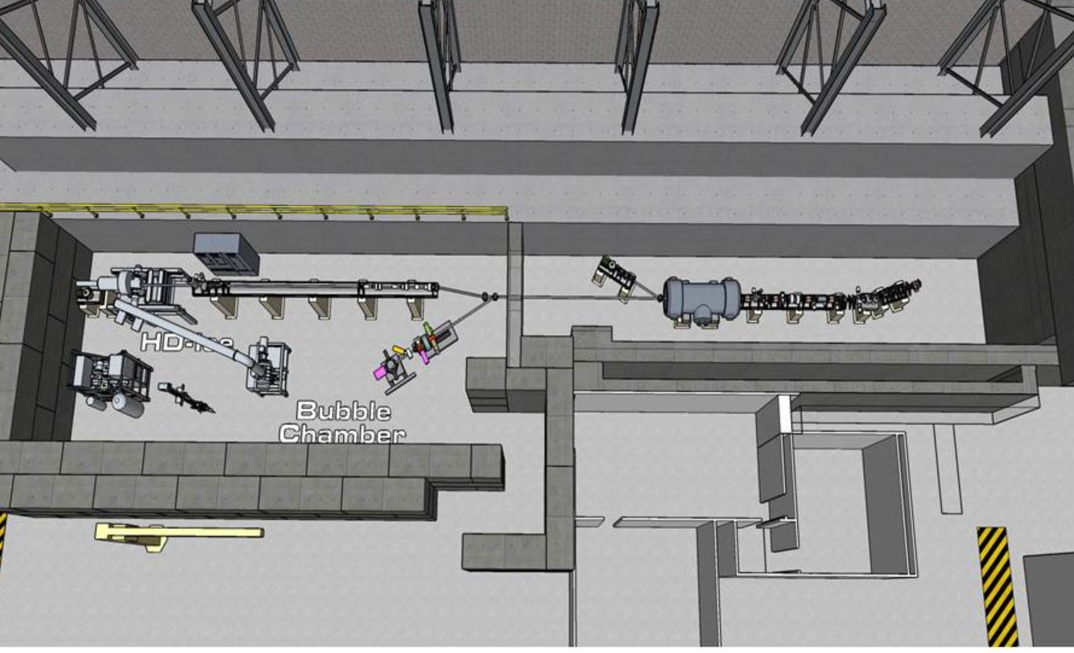
UITF Layout

Slide 3
Sources of ODH Hazards
Source | Gas | Location
Gun Power Supply | SF6 Gas | Cave 1
¼ Cryomodule (400 L) | Liquid Helium | Cave 1
Nitrogen Supply Line | Nitrogen Gas | Cave 1
1000 L Dewar | Liquid Helium | Cave 2
500 L Dewar | Liquid Helium | Cave 2
100 L Dewar | Liquid Nitrogen | Cave 2
In Beam Cryostat (IBC) | Liquid Helium | Cave 2

Slide 4
Table of Vents
Vent size | No. of Vents | Location | Credited for mitigation
0.25 m (10”) diameter | 6 | Cave 1 Ceiling | No
0.76 m (30”) diameter, active 2.1 m³/s & 3.5 m³/s | 2 | Cave 1 East Wall | No
0.3 m x 0.46 m (12” x 18”) | 3 | Cave 1 Ceiling | No
0.15 m diameter (6”) | 3 | Cave 1 West Wall | Used for vent stack
5.6 m² (60 sq. ft) | 1 | Cave 2 | Yes

Slide 5
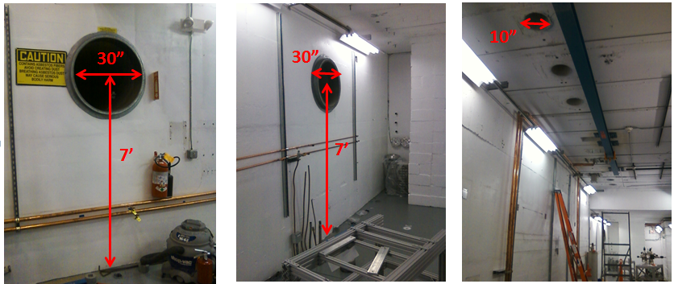
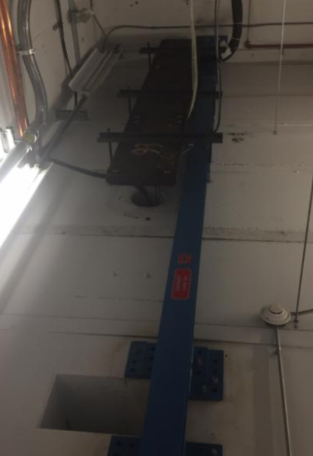
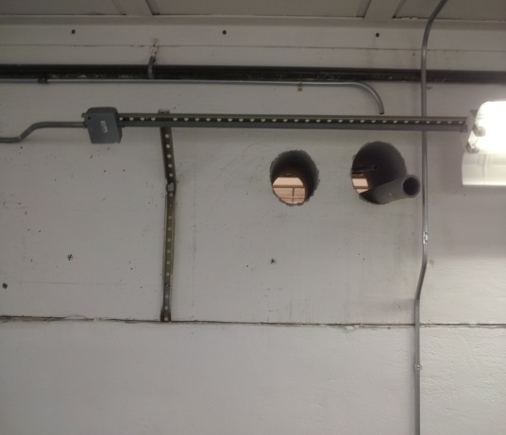
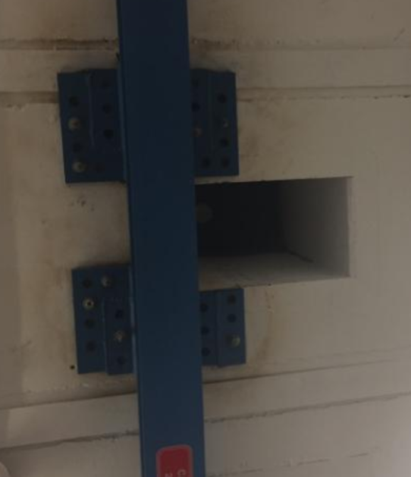
Vents in Cave 1
30” Vents, East Wall (active)
Roof Vents
6” Vents, West Wall

Slide 6
ENTRY/EXIT
The main entry/exit to UITF is through a labyrinth with chain-link fence gate, approximately 1.8m (6’) wide and 2.4m (8’) tall, which also provides an escape path for helium gas and/or a path for makeup air.
The vent tubes, penetrations and chain-link fence gate allow lighter than air mixtures of ODH gases to leave the enclosure to the high bay.

Slide 7
High Bay –Equivalence to Outside
The Test Lab high bay volume roughly 40220 m³ (81.4m L x 40.5m W x 12.2m H) = 1.4 million cubic feet
To justify the claim that the high bay volume is large enough to be considered equivalent to the outdoors, consider 1,900 L of LHe released simultaneously from the quarter cryomodule (400L) and from the HDIce target (500L buffer dewar and a 1000L fill dewar). This amount of LHe would expand to 1481m³ (52,315 ft³of gas) with a resulting O2 concentration of 20.2% in the Test Lab high bay.

Slide 8
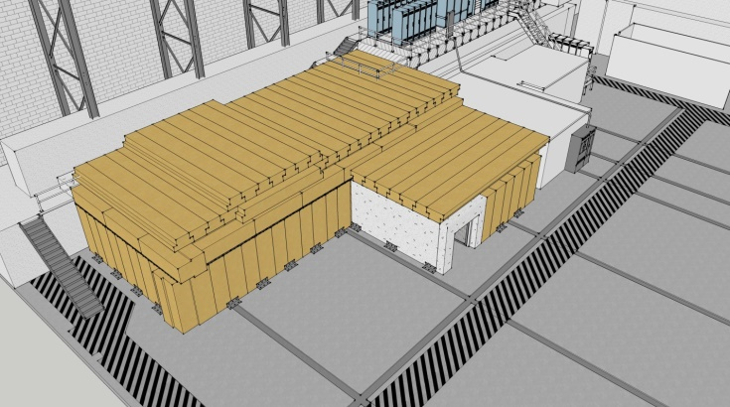
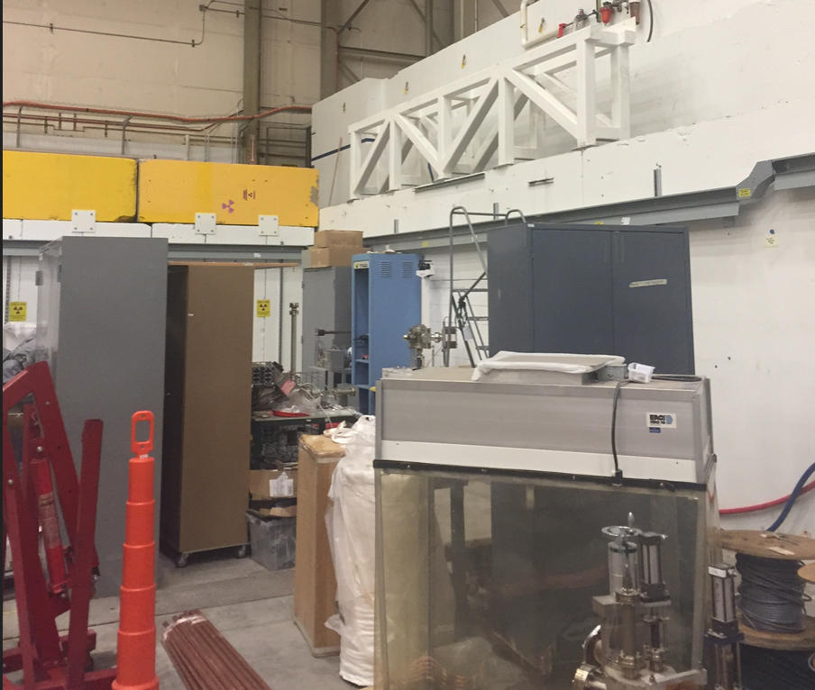
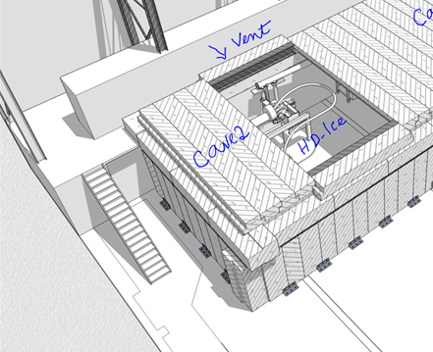
Vent in Cave 2
Elevated roof section over Cave 2
60 sq.ft (5.6 sq.m) vent. Roof tiles rest on the steel structure
Roof tiles of elevated section removed

Slide 9
ODH Assessment
Used two independent methods for ODH analysis with respect to Helium
  Dana Arenius’s numbers for venting helium through a ceiling vent
  For Cave 2, by calculating the release of helium and venting of helium using Bernoulli principle and gas laws
  The conclusions from the two methods agree

Slide 10
Relevant Data
Percentage of Oxygen in ambient air = 21%
Oxygen level below which ODH exists = 19.5%
Ambient temperature = 300K
Cave 1 Volume = 259 m³
Cave 2 Volume = 469m³
Cave 2 ceiling vent area = 5.6 m²
Rate of escape of Helium = 0.25kg/s/m² (from Dana Arenius)
Volume of Helium venting through 1 m² vent= 0.002 m³/s
Volume Helium venting capacity of 5.6 m² vent = 0.0112 m³/s

Slide 11
Cave 2 - Cryogen Container Data
Pressure in liquid Helium dewars = 13.8 KPa
Mass of liquid Helium in 1 m³ dewar = 125 kg
Transfer pipe radius of 1 m³ dewar = 0.0064 m
Mass of liquid Helium in 0.5 m³ dewar = 62.5 kg
Transfer pipe radius of 0.5m³ dewar = 0.0032 m
Expansion factor for 4K He = 750
Expansion factor liquid N₂ = 700
Pressure in liquid Nitrogen dewar = 139 KPa
Mass of liquid Nitrogen in 100 L dewar = 81 kg
Transfer Pipe radius of Nitrogen dewar = 0.0064 m

Slide 12
Equipment Failure in Cave 1 and Passive Vent Rates
Item and Event | Spill Rate kg/sec | Passive Vent Rate kg/sec based on 5.6m² vent area | Ratio (Spill Rate)/(Vent Rate) | If <1 “Ok”, If >/=1 “Issue”
Rupture 4K Supply | 0.02 | 1.50 | 0.013 | Ok
Blocked 4K Return | 0.02 | 1.50 | 0.013 | Ok
Rupture Shield Supply | .015 | 1.50 | 0.010 | Ok
Blocked Shield Return | .015 | 1.50 | 0.010 | Ok
¼ CM Insul Vac Loss | 0.22 | 1.50 | 0.147 | Concern⁺
¼ CM Beam Line Vac Loss | 0.89 | 1.50 | 0.593 | Concern⁺
Rupture 300K Helium Supply | 0.01 | 1.50 | 0.007 | Ok

Slide 13
Concerns
There are two concerns to be addressed.
The venting of the entire helium inventory upon the loss of beam line vacuum in the ¼ cryomodule will take place in approximately 70secs with a large discharge plum.
While the passive venting can handle the volume, the direction of flow from the reliefs (close to head height) and the distance to the 5.6 m² vent is a concern if an actual event were to occur.
To ensure clear egress and clear flow of the spill out of the cave, the primary relief, the secondary parallel plate relief and the burst disk on the new ¼ CM must be diverted to the outside of the cave.

Slide 14
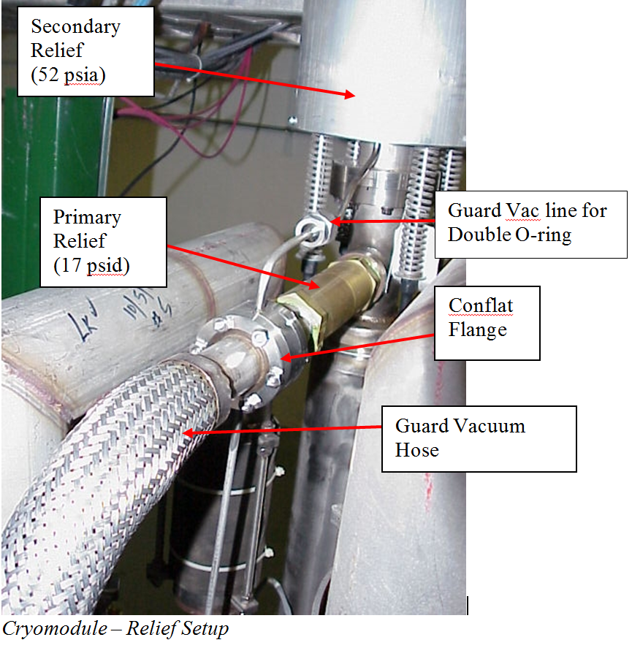
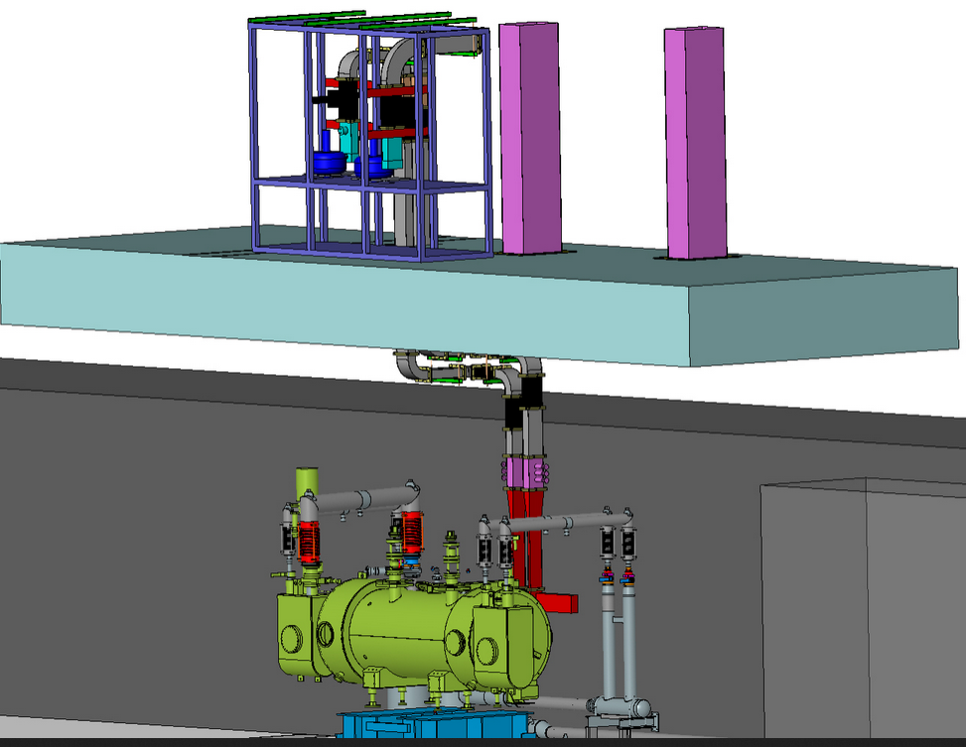
ODH Concern Mitigation – Cave 1
Diverted to high bay using the vents
On west wll
Roof over Cave 1
¼ Cryomodule in Cave 1

Slide 15
Equipment Failure in Cave 2 and Passive Vent Rates
Item and Event | Spill Rate kg/sec | Passive Vent Rate kg/sec based on 5.6m² vent area | Ratio (Spill Rate)/(Vent Rate) | If <1 “Ok”, If >/=1 “Issue”
Rupture HDice 50L IBC | NA | 1.50 | NA | Ok
Rupture transfer line 500L Buffer Dewar | 0.06 | 1.50 | 0.040 | Ok
Rupture transfer line 1000L Dewar | 0.25 | 1.50 | 0.167 | Ok
Rupture 500L Dewar | 63kg | 1.50 | NA | Issue*
Rupture 1000L Dewar | 125kg | 1.50 | NA | Issue*
Rupture HDice boil off return line | 0.0003 | 1.50 | <<1 | Ok
Rupture 100L LN2 Dewar | 81kg | 1.50 | NA | Ok

Slide 16
Things to note
Instantaneous failure of 50L IBC results in a 19.9% O₂ concentration in the cave with a fatality factor of 0.
Instantaneous failure of nitrogen dewar dumping entire contests results in O₂ concentration of 18.8% resulting in a fatality factor of 0.

Slide 17
Issues
Instantaneous failure of dewar dumping entire contents results in O₂ concentration of 8.8% for 500L dewar and inerts the cave for 1000L dewar
The median failure rate for a dewar is 10⁻⁶/hr with a fatality factor of 1 (EH&S manual )
The resulting Probability x Fatality = 10⁻⁶ which is ODH 1. rating for a 500L or larger helium dewar
However, instantaneous dumping of the entire dewar contents would occur only during the movement of such a dewar and not when the dewar is stationary

Slide 18
ODH Assessment
Standard UITF Configuration
UITF will have a chain link entry gate
UITF will have the primary reliefs of the ¼ Cryomodule diverted outside the cave through the vents on west wall
The passive vent areas will be kept free and clear for the passage of helium gas

Slide 19
ODH0 Conditions for UITF
From the floor to an elevation of 9’ whether the roof is fully installed or not
When the elevated section of Cave 2 roof is removed for work on the HDice target

Slide 20
ODH1 Conditions for UITF
From 9’ up to the ceiling
When a 500L helium dewar or larger is being moved into/out of UITF
When the cave roof is fully installed, during u-tube operations to connect or disconnect the ¼ Cryomodule
Signage will indicate the ODH0 and ODH 1 areas. UITF will have ODH monitors and alarms (PSS)

