Slide 1
High Voltage Insulators and Electrodes for 500 kV DC High Voltage Photogun with Inverted Insulator Design
NP FOA FY20
Virtual Office of Nuclear Physics (NP) Principal Investigator (PI) Exchange meeting for Accelerator R&D award recipients
December 07, 2023
PI: Carlos Hernandez-Garcia
Co-PI: Matthew Poelker
Postdoctoral fellow: Gabriel Palacios-Serrano
Center for Injectors and Sources

Slide 2
Why higher voltage?
Gas desorption
Space charge
$$F_{r}\left(r\right)= \frac{eλ_{0}r}{{2πε_{0} a}^{2} γ^{2}}$$
Photocathode
V₀
Aperture
Higher voltage -> higher kinetic energy -> decreased space charge -> less beam dilution -> less loss on apertures -> reduced systematics
Current loss

Slide 3
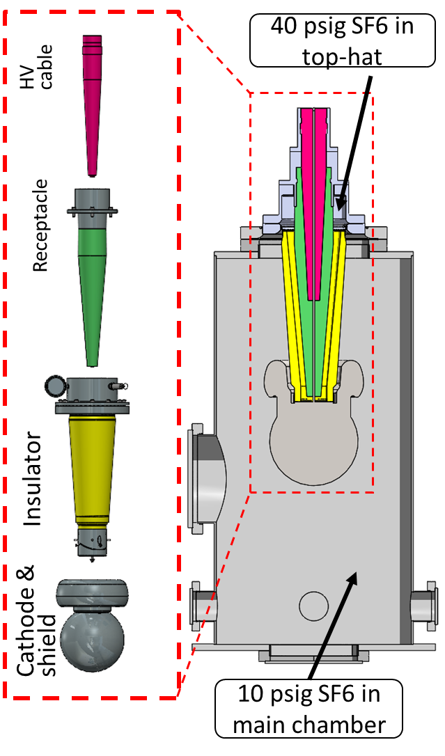
Project description
Main goal:
Demonstrate an inverted insulator + high voltage cable assembly that can be used to reliably apply 500 kV bias voltage to a test electrode
no high voltage breakdown inside or outside the vacuum chamber
the developed system could be implemented in a future photogun capable of delivering spin polarized beam from GaAs photocathodes at 400 kV without measurable field emission.
Status:
High voltage apparatus assembled, installed, and tested at 500 kV.
Milestones
Operation voltage >450 kV for ~113 hrs (4 days and 17 hrs),
Max voltage 500 kV for 7 hrs.
Limiting factor
Contaminated SF₆
Main chamber with SF₆

Slide 4
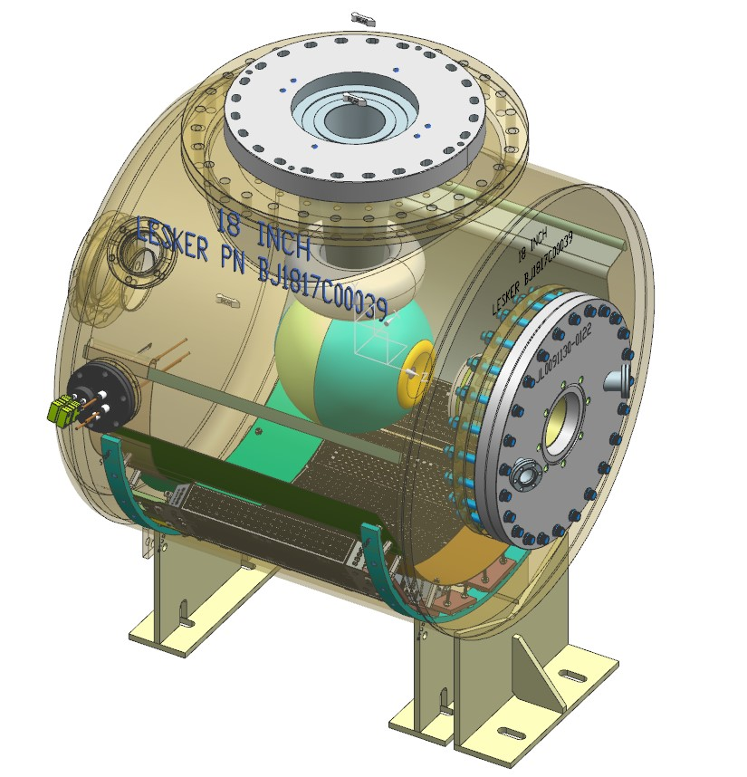
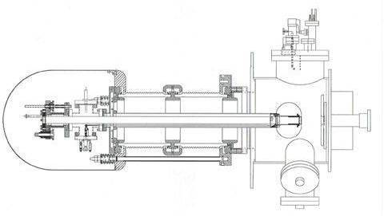
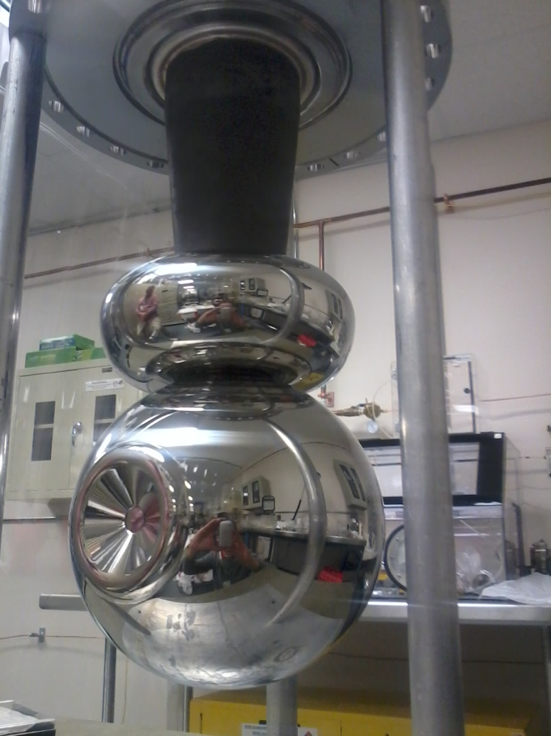
Inverted insulator polarized photogun
“Inverted-insulator” high voltage design: the insulator extends into the vacuum chamber from the top serving as the cathode electrode support structure.
Exceptional vacuum ~10⁻¹² Torr vacuum
Less metal aids in minimizing field emission
Load-lock attaches to the back end.
Compact design.
Uses commercial high voltage cable.
JLab FEL cylindrical insulator photogun
8 in
6 in
JLab inverted insulator photogun

Slide 5
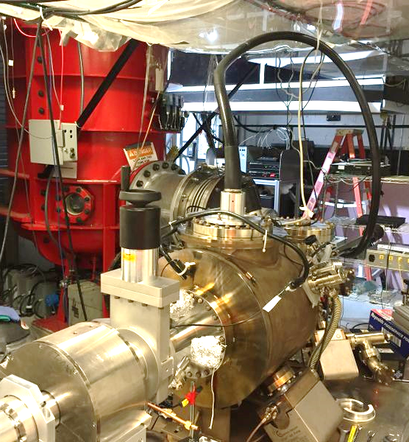
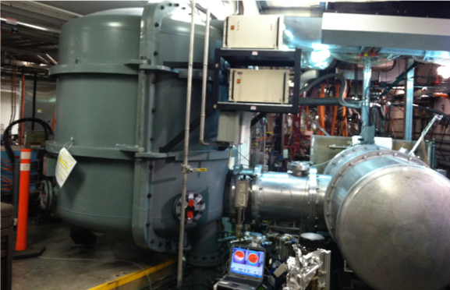
Inverted insulator polarized photogun
The 130 kV spin-polarized inverted-insulator photogun at CEBAF is very compact, provides exceptional vacuum and exhibits NO field emission.
A larger version of this photogun design operates at 300 kV bias voltage
2/3 of SF₆ gets eliminated by using cable
500kV power supply
HV cable
130 ft³
photogun
SF₆

Slide 6
Challenge
An envisioned 400 kV DC photogun design requires reliable 500 kV feedthrough to provide margin for high voltage conditioning
There is no inverted insulator feedthrough capable of 500 kV that fits commercial cable connectors
Commercial cable connectors are rated to ~ 400 kV max in SF₆, and have never been tested > 350 kV connected to inverted insulators in vacuum*
Vendor recommends using Mega-volt cable, but there are no connectors for this type of cable

Slide 7
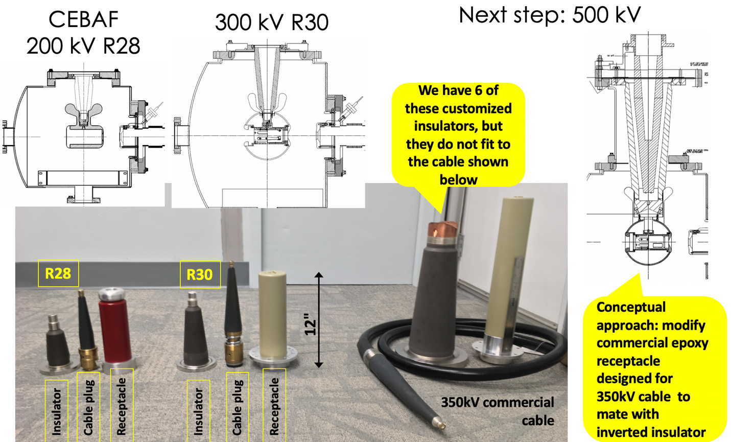
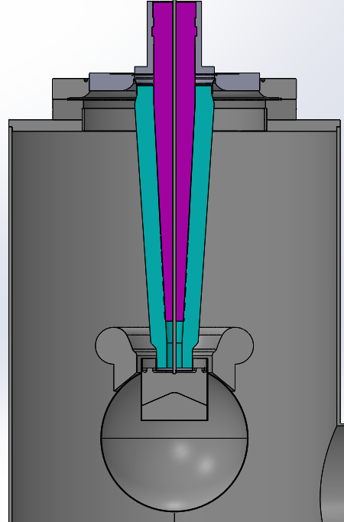
Technical approach
The proposed plan is an evolution from our experience developing and operating high voltage inverted insulator photo-guns connected to power supplies using commercial components.
Conceptual approach: Work with vendor to develop a 500 kV insulator that fits the commercial cable

Slide 8
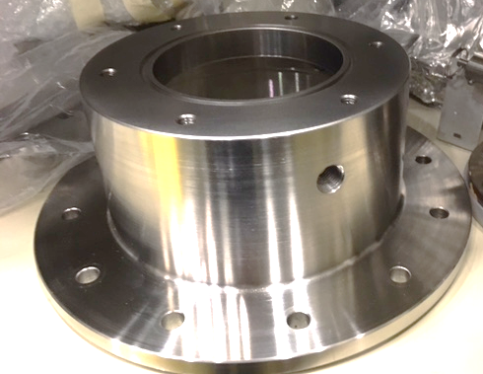
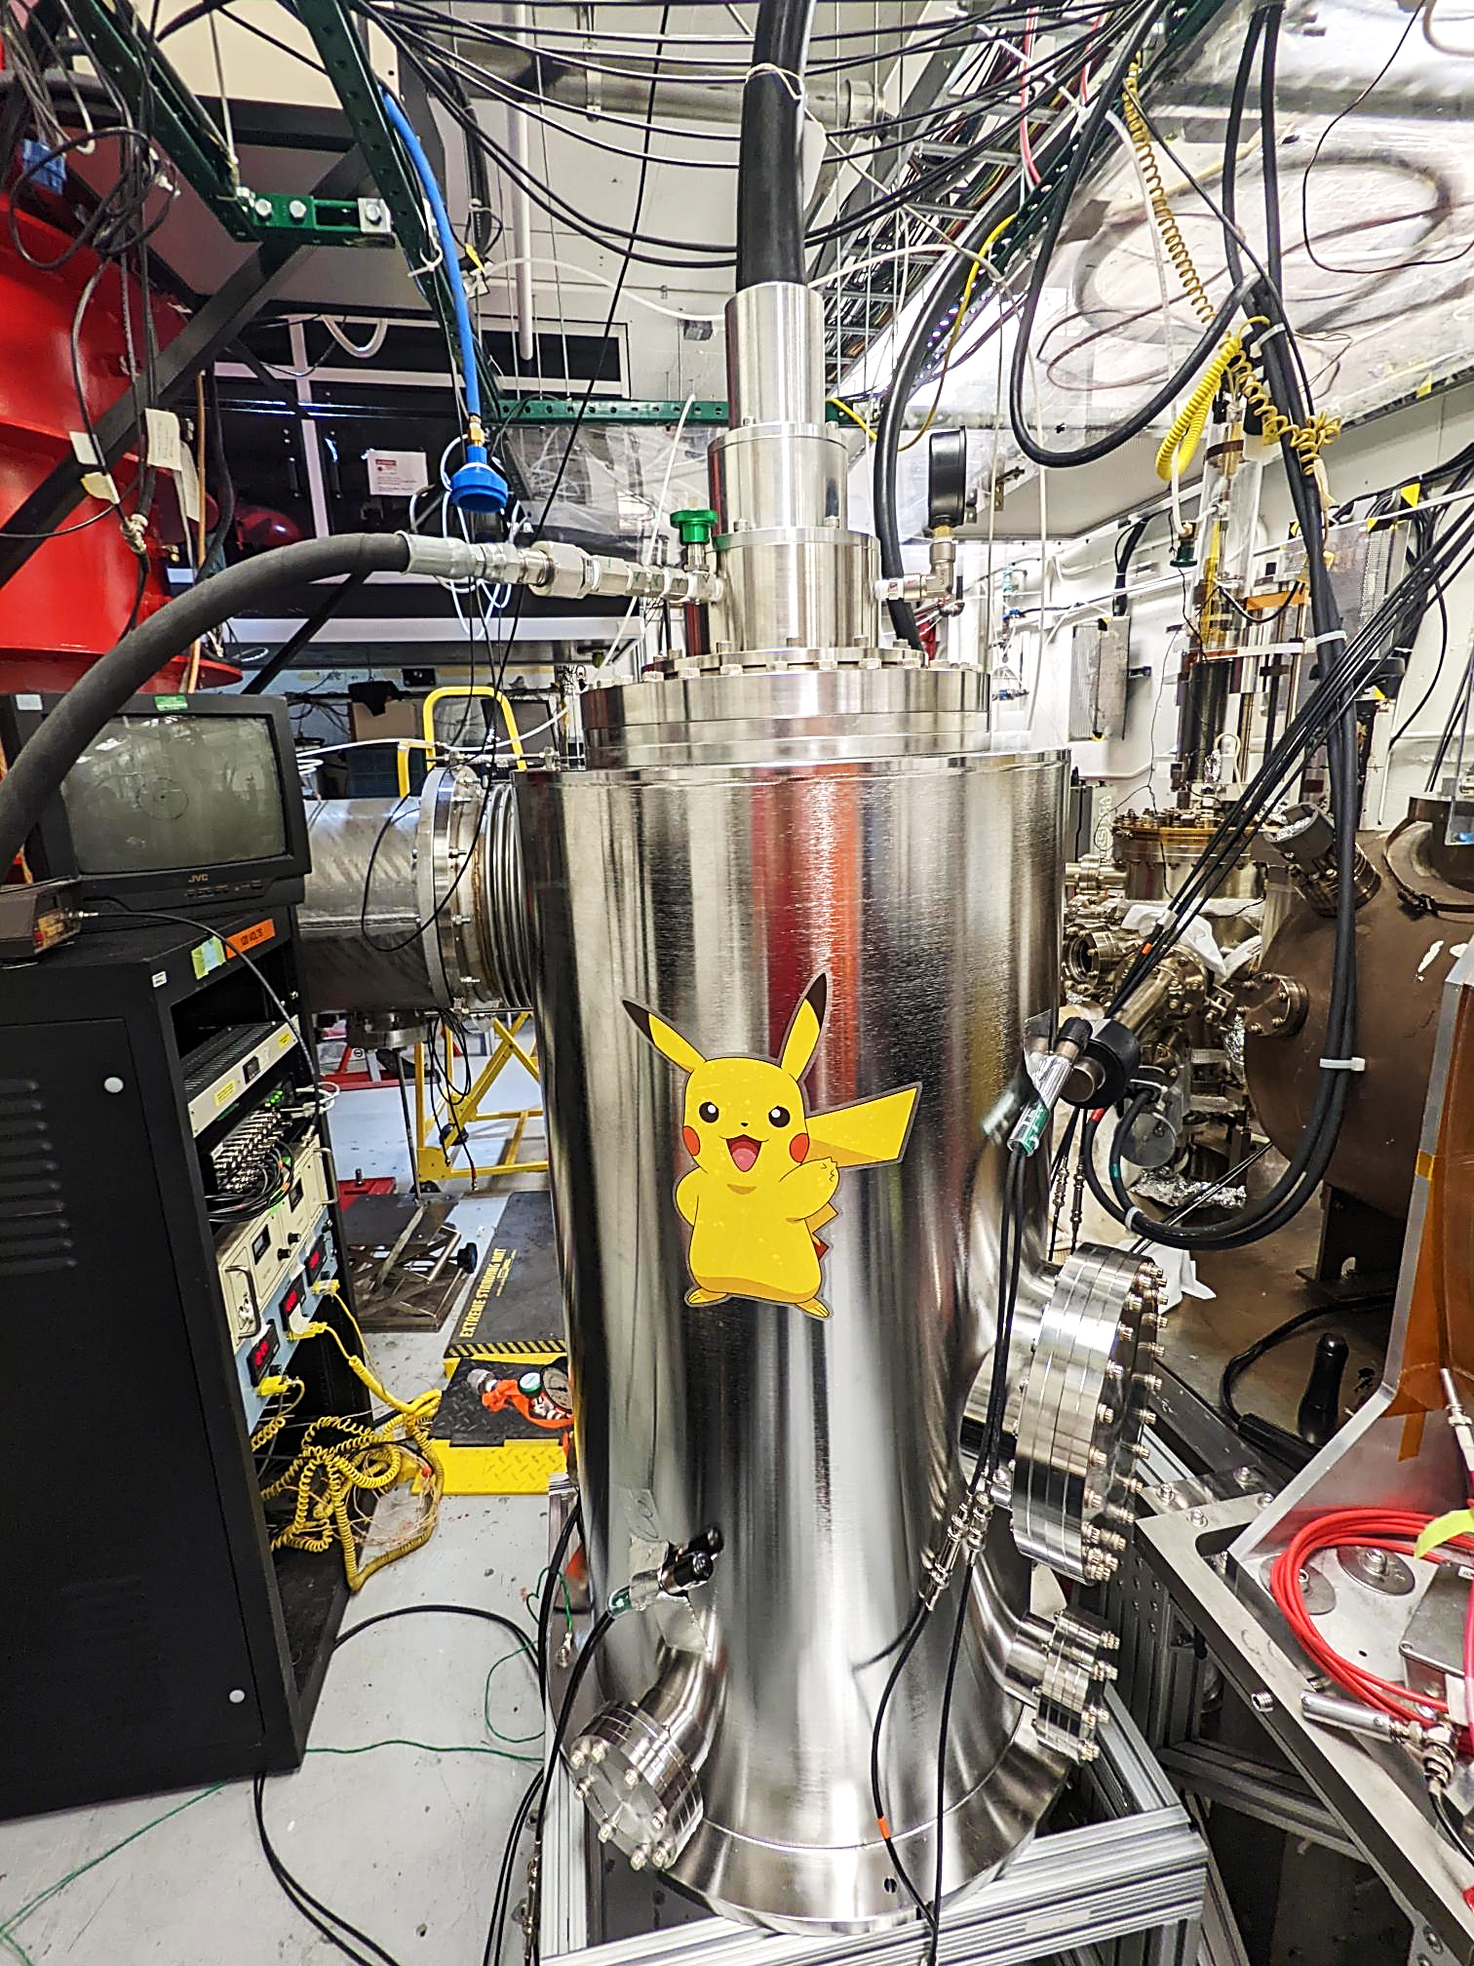
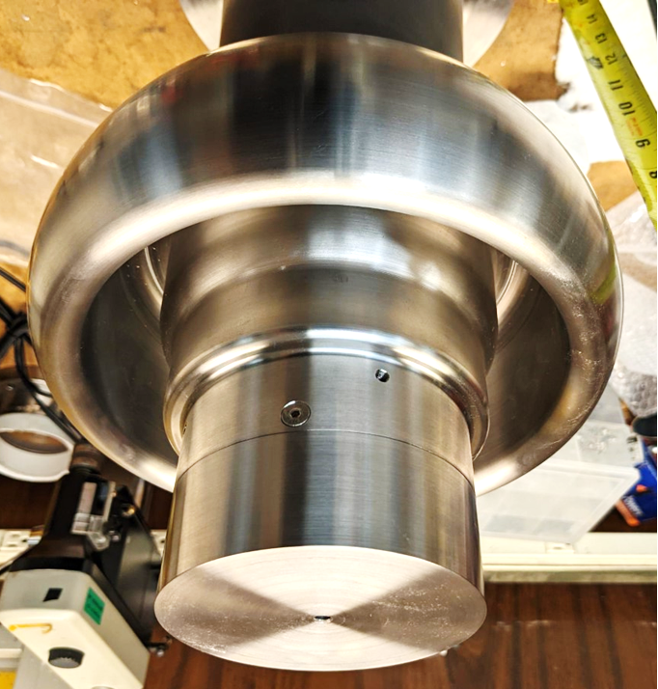
Progress: program
Gabriel Palacios-Serrano was hired as a postdoctoral fellow on 06/16/21
CST EM studio + Solidworks procured on 04/15/21, and license renewed 04/16/22
Electrostatic models completed:
Modified HV receptacle and intervening SF₆ layer
Electrostatic design of electrode + triple point junction shield (to prevent arcing)
Wide HV cable, cylindrical HV cable, no-receptacle
Manufactured: SF₆ reservoir and electrostatic shield, modified epoxy receptacle.
System assembled, and … drum roll!

Slide 9
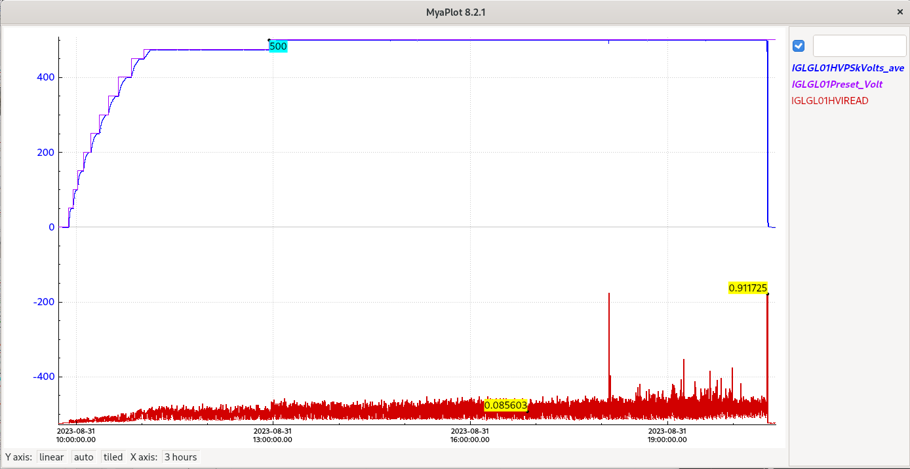
Progress: High voltage test successful!
The test chamber was filled with SF₆ gas to nominal 10 PSIG, the separate feedthrough reservoir containing the volume of the SF₆ intervening layer between the receptacle and the insulator was filled to 40 PSIG.
The graph shows the voltage steps in blue, and the high voltage power supply current (from the internal measuring stack) in red. A couple of current peaks were observed at 500 kV until an over-current trip. The current readings are in mA.
500 kV
500 kV for 7 hrs
450 kV
450 kV for 24 hrs
0.085 mA power supply current
0.055 mA power supply current

Slide 10
Progress: Conferences and papers
Gabriel presented a poster about the project remotely via zoom at the 2021 IEEE Conference on Electrical Insulation and Dielectric Phenomena (CEIDP), 12-15 December.
Gabriel was invited and presented (online) his progress on this project at his alma mater, at the wavelet seminar of the Engineering and Basic Science Division of the Autonomous Metropolitan University – Azcapotzalco, Mexico, March 10, 2022.
Carlos presented our work in the 2022 North American Particle Accelerator Conference in Albuquerque, New Mexico. 7-12 August 2022.

Slide 11
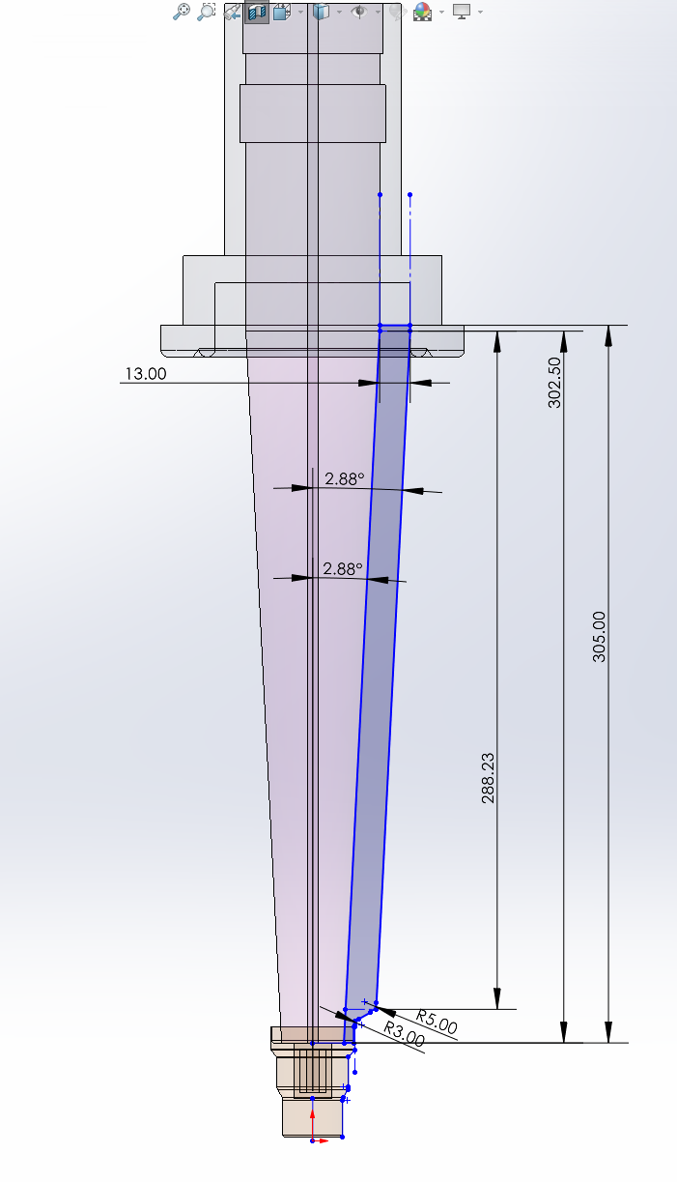
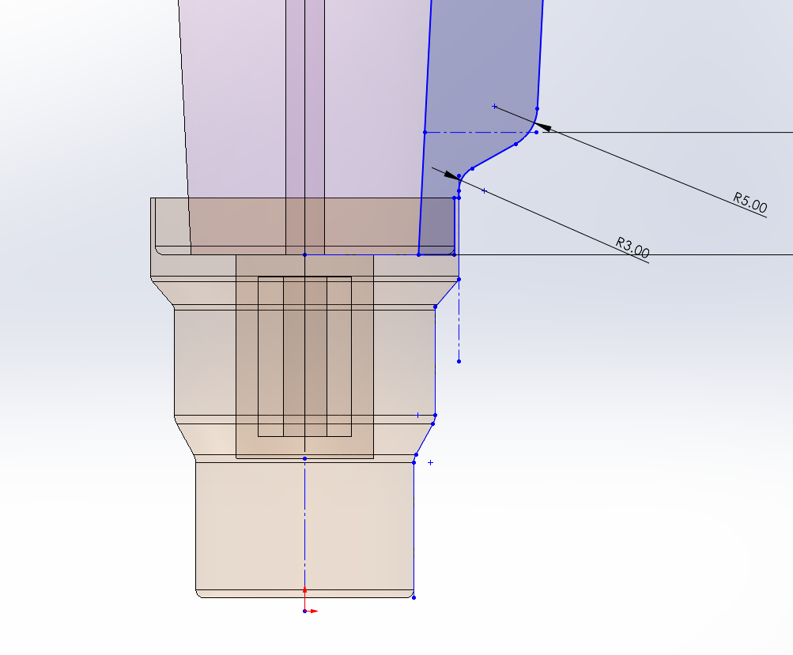
Next steps
We have started conversations with industries to design and evaluate a 500 kV insulator compatible with our available 350kV commercial cable
Testing under vacuum conditions
500 kV insulator prototype

Slide 12
Budget
Summary of total expenditures:
 | Item/Task | Baseline Total Cost | Costed & Committed | Estimate To Complete | Estimated Total Cost
ID #
 |  | (AY$) | (AY$) | (AY$) | (AY$)
000001.04.05.030.001 HVINS | 500kV Inverted Insulator | $538,800 | $530,718 | $8,082 | $538,800
Totals: |  | $538,800 | $530,718 | $8,082 | $538,800
Summary of expenditures by fiscal year (FY):
FOA Funding | FY 2020 | FY 2021 | Total
a) Funds allocated | $269,400 | $269,400 | $538,800
b) Actual costs to date | $269,400 | $261,318 | $530,718
c) Uncosted commitments | $0 | $0 | $0
d) Uncommitted funds (d=a-b-c) | $0 | $8,082 | $8,082

Slide 13
Schedule:
Tasks Year 1 | Q1 | Q2 | Q3 | Q4
1. Hire postdoctoral appointee
2. Purchase and install software packages
3. Electrostatic design: electrodes + long insulator + SF6 intervening layer
4. Engineering design
5. Fabricate components
6. Assemble components
7. Test high voltage assembly in SF6
8. Test high voltage assembly in vacuum
Tasks Year 2 | Q1 | Q2 | Q3 | Q4
9. Electrostatic design: custom high voltage plug for long insulator
10. Work with Dielectric Sciences on custom high voltage plug
11. High voltage test long insulator + custom cable plug in SF6
12. High voltage test long insulator + custom cable plug in vacuum
13. Electrostatic design: 500kV insulator concept + R350 commercial cable
7. Test high voltage assembly in SF6
8. Test high voltage assembly in vacuum

Slide 14
Conclusion
An inverted insulator + high voltage cable assembly was tested to a maximum of 500 kV.
The highest HV ever achieved on alumina insulators connected to commercial cables!
Fin
Carlos Hernandez-Garcia, Matt Poelker, Gabriel Palacios Serrano
chgarcia@jlab.org, poleker@jlab.org, gabrielp@jlab.org

Slide 15
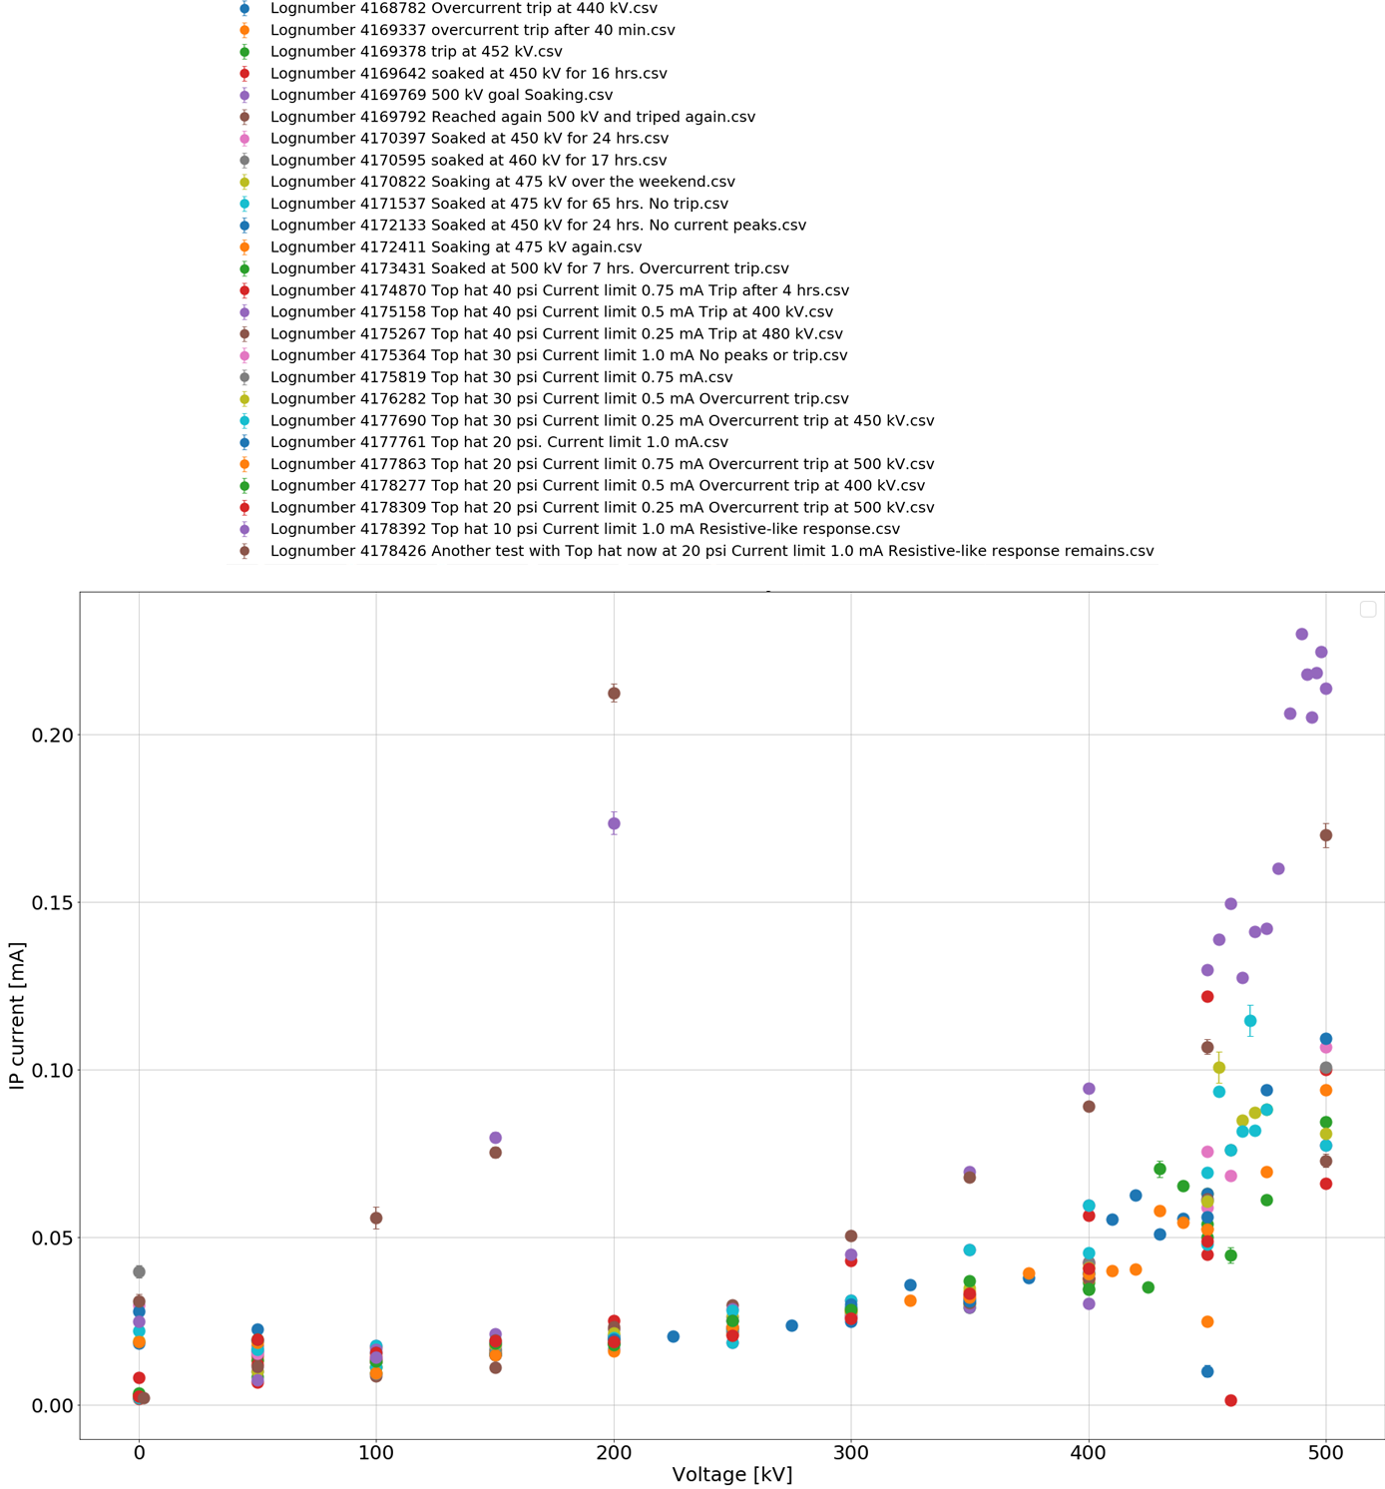
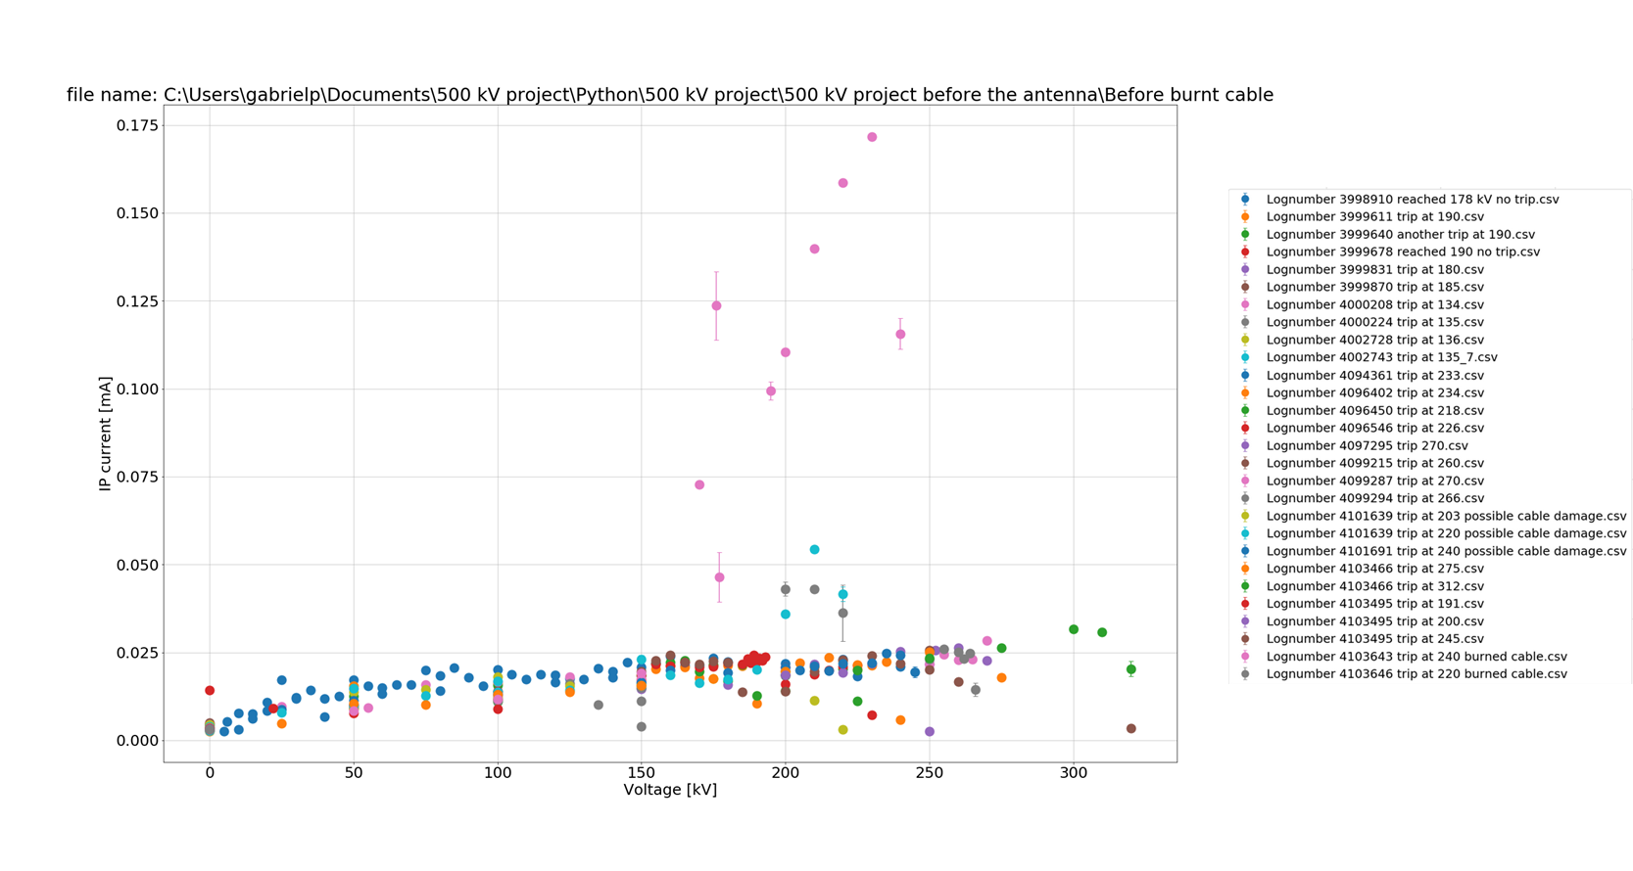
Extra
PS current [mA]
PS current [mA]

Slide 16
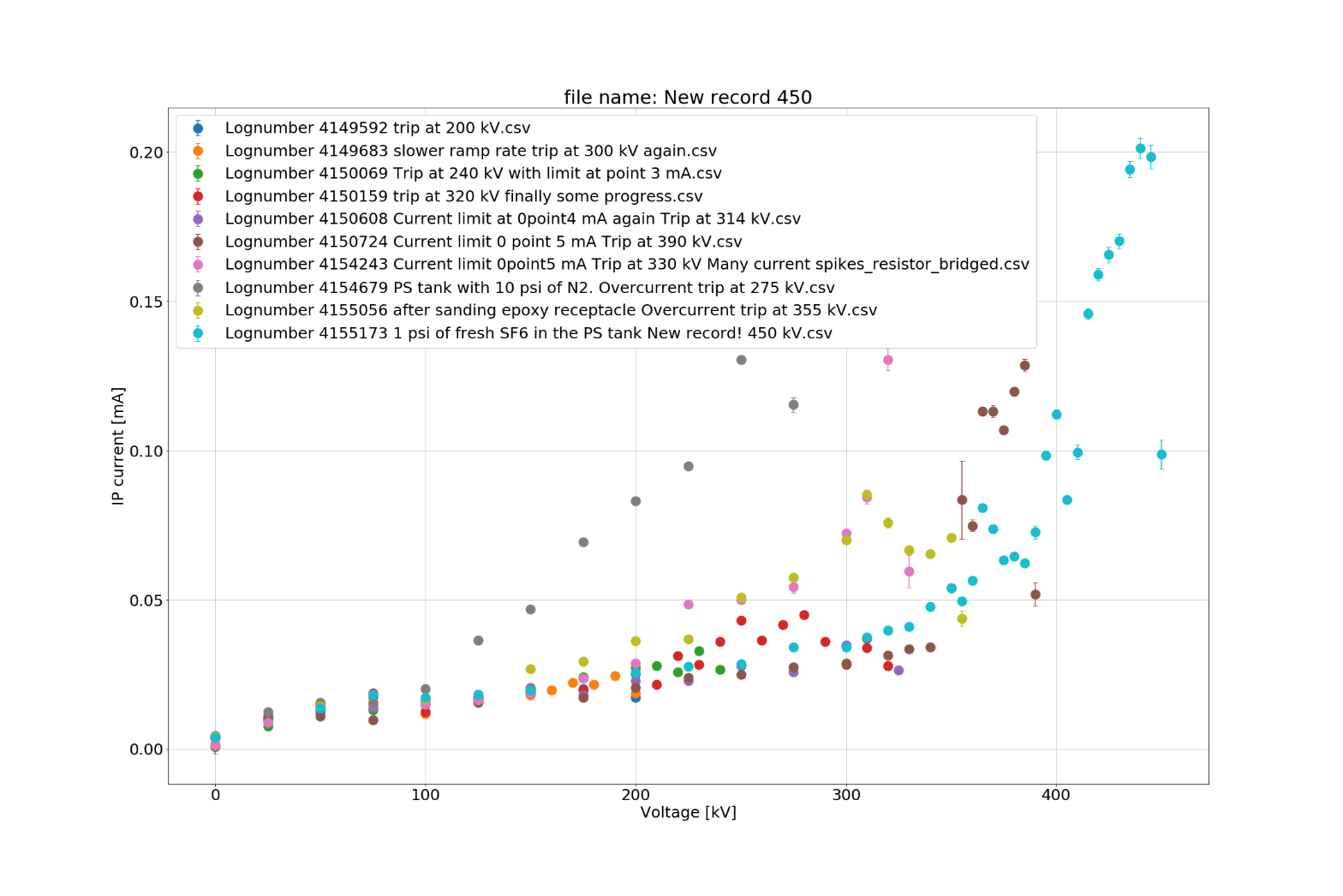
Extra
Found the issue: Not-pure SF6
275 kV, 0.5 mA, Nitrogen
450 kV, 0.75 mA limit, +1 psi of clean SF6
390 kV, 0.5 mA limit
330 kV, 0.5 mA, resistor bridged
240 kV, 0.3 mA limit
355 kV, 0.5 mA, sanded epoxy
320 kV, 0.4 mA limit
200 kV, 0.2 mA limit

