Slide 1
Ionization Routine Tests: Ion Energy and Space Charge
Josh Yoskowitz

Slide 2
Global parameters for all simulations (unless otherwise specified)
Simulation Time: 500ns
Timestep: 0.5ns
Bunch parameters:
Bunch Charge: 0.5pC
Bunch Length: 50ps (uniform dist)
Bunch Radius: 2mm (uniform dist)
Number of bunches: 10
Bunch spacing: 10ns
Start at z=0m, centered at (x,y)=(0m,0m)
Gas Parameters:
Density: 2.60×10¹⁸m⁻³
Range: 0.001m ≤ z ≤1.001m
Scaling factor: 1
Species: H₂
Particles removed when outside:
-0.01m ≤ z ≤ 1.0m
R ≤ 0.04m
Electric Field (T-Cathode)
Cathode: -130kV
Anode: 0V
Over entire simulation range
Color Coding:
Blue = electron (primary, secondary, scattered)
Red = H₂ ion

Slide 3
Tunable parameters
Secondary electrons ON/OFF, Default=ON (If OFF, ion/scattered electron final momenta are calculated as if the secondary electron were present)
Space Charge ON/OFF, Default=OFF
Ion Energies:
Ion gets random amount of remaining energy: T_{ion} = (T_{primary} + T_{gas} – T_{secondary} – I_{i}) × rand
Ion energy is equal to gas energy (no energy change): T_{ion} = T_{gas}

Slide 4
Simulation: Ionization Routine OFF (timestep = 1e-10)

Slide 5
Simulation: Ionization Routine As Is

Slide 6
Simulation: Ionization Routine As Is, Secondary Electrons OFF

Slide 7
Simulation: Ionization Routine with T_{ion} = T_{gas}

Slide 8
Simulation: Ionization Routine with T_{ion} = T_{gas}, Space Charge ON

Slide 9
Screen: Parameters
Location: z = 0.0001m
Color Coding:
Energy (Low = Purple, High = Red), Range: Tϵ[0,130000]eV

Slide 10
Screen: Ionization Routine As Is (all locations at z=0.1mm)
eV

Slide 11
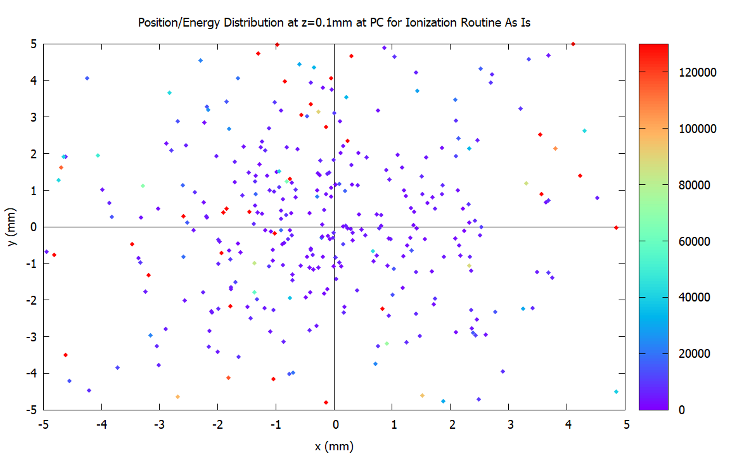
Screen: Ionization Routine As Is (at photocathode (x,y)ϵ[-5mm,5mm], z=0.1mm)
eV

Slide 12
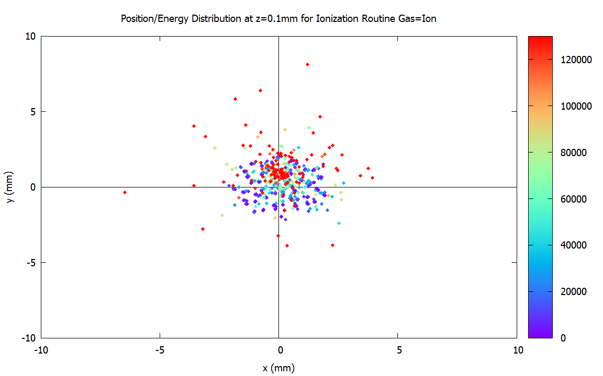
Screen: Ionization Routine Gas Is Ion (all locations at z=0.1mm)
eV

Slide 13
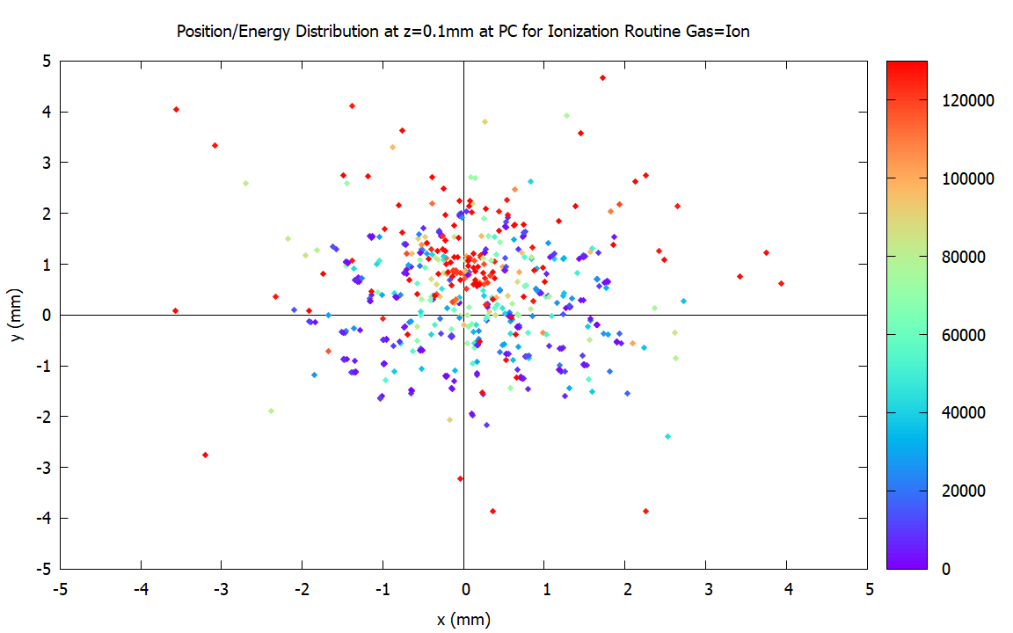
Screen: Ionization Routine Gas Is Ion (at photocathode (x,y)ϵ[-5mm,5mm], z=0.1mm)
eV

Slide 14
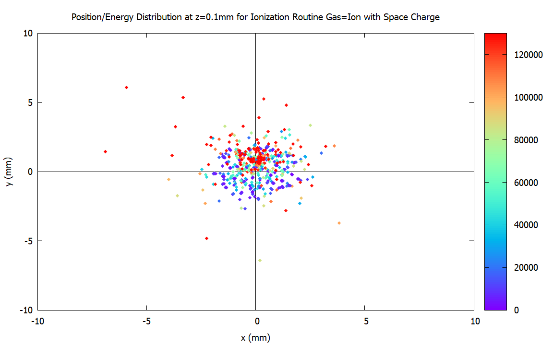
Screen: Ionization Routine Gas Is Ion with Space Charge ON (all locations at z=0.1mm)
eV

Slide 15
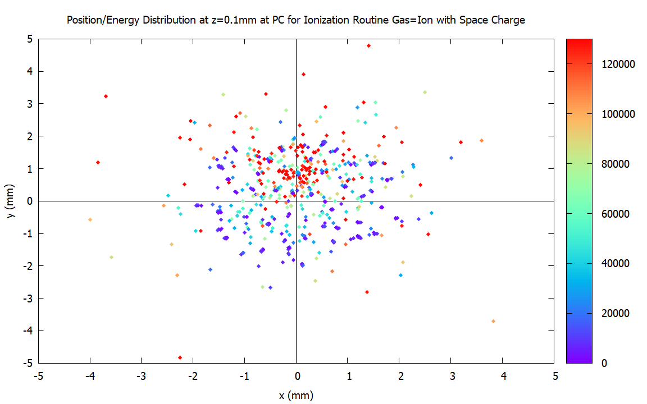
Screen: Ionization Routine Gas Is Ion with Space Charge ON (at photocathode (x,y)ϵ[-5mm,5mm], z=0.1mm)
eV

