Slide 1
GaInSn Liquid Metal e+ Target
3/16/22
Colwyn Gulliford, Val Kostroun, Christopher Mayes, Bruce Dunham,
Ralf Eichhorn, Karl Smolenski, Nick Taylor, Joe Conway

Slide 2
Introduction
This presentation deals with a free surface liquid metal jet positron converter. Liquid metal jets allow for significantly greater electron beam power densities than are possible with solid targets. Higher power densities lead to greater positron production and importantly, allow CW operation. In this work, 10 MeV electrons incident on a GaInSn liquid metal jet are being considered to generate positrons (including polarized positrons).
Liquid metal targets making use of a free surface require very careful design of the nozzle forming the free jet as it is one of the most important components of the system (next to positron collection). The nozzle determines the shape of the free jet, its time behavior and stability. Heat removal and shape of the nozzle determine the liquid metal jet velocity.
S. Gordeev et el. (Intl. J. Comp. Fluid Dyn. 23, No.6 477-493 (2009)) discuss specifically turbulent liquid metal flow in rectangular shaped contraction nozzles for target applications. Although thes pecificc analysis is for a 2 GeV 238U ions incident on a lithium metal jet at 10¹² particles/cycle, the information provided is pertinent to any liquid metal target utilizing a free surface. (At a fast extraction of 50 ns this corresponds to 3.2 GW/pulse. Since the beam spot is
circular with a Gaussian distribution σ = 1-2 mm, the power density is enormous.)

Slide 3
Pertinent Properties of Liquid Metals
Material GaInSn PbBi
Composition 67Ga 20.5In 12.5Sn vol% 44.5Pb 55.5Bi at%
Melting Point -19 to 10.5 ºC 123.5 ºC
Vapor Pressure <E-08 Torr@500 ºC 7.5E-09 Torr@250 ºC
Density 6.44 g/cm³@ 20 ºC 10.44 g/cm³
Radiation Length Xo 1.470 cm 0.606 cm
Thermal Conductivity 16.6 W/m-K 10.89 W/m-K (130 ºC)
Dynamic viscosity 2.4E-3 Pa-s 3.3E-3Pa-s
GaInSn properties obtained from:
Y.Plevachnek et al. “Thermophysical Properties of the Liquid GaInSn Eutectic Alloy”, J Chem. Engr. Data 59, 757 (2014)
N.B. Morley et al. “GaInSn Usage in the Research Laboratory”, Rev. Sci. Instr. 79, 056107 (2008)
T. Bell, “Properties of the Metal Galinstan”, Thought Co., Aug. 7, 2021. thoughtco.com/what-is-Galinstan-2340177
PbBi properties obtained from:
Handbook on Lead-Bismuth Eutectic Alloy and Lead Properties, Materials Compatibility, Thermal-Hydraulics and Technologies, 2015 Edition, Nuclear Energy Agency.
Available from: https://inis.iaea.org/collection/NCLCollectionStore/_Public/46/133/46133907.pdf

Slide 4
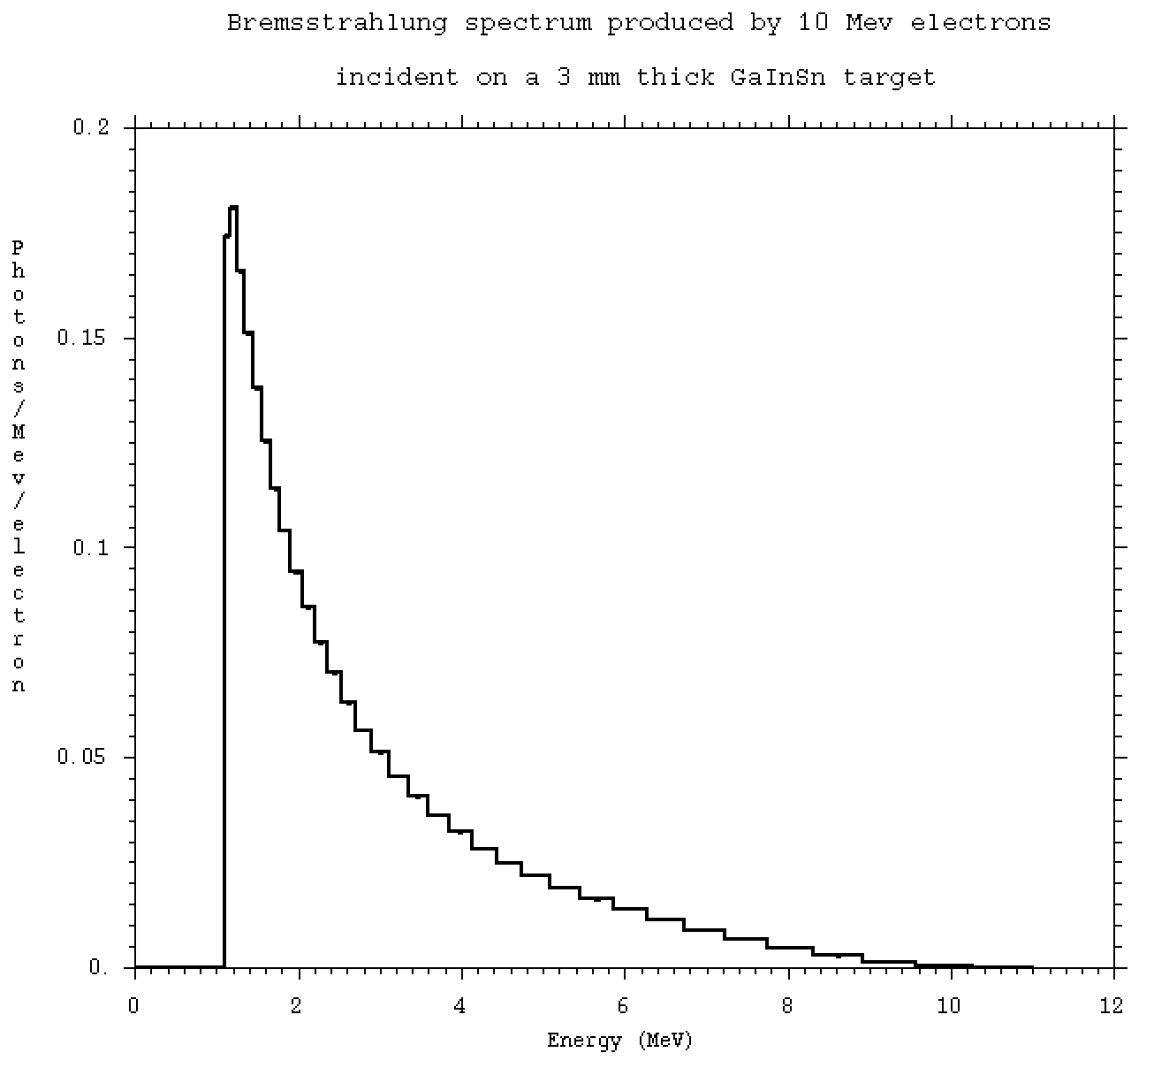
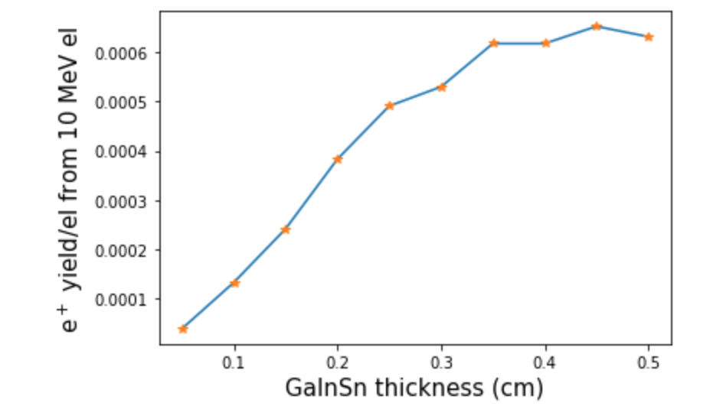
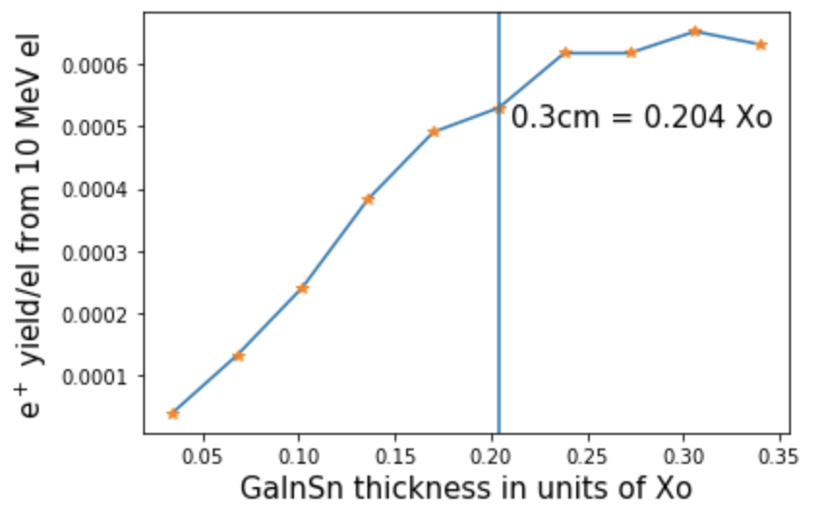
All GaInSn properties presented were calculated with the MCNP6.2 code (Initial MCNP6 Release Overview, T. Goorley, et al., Nuclear Technology, 180, pp 298-315 (Dec 2012)) and “The MCNPTools Package: Installation and Use”, Clell J. (CJ) Solomon Jr.,Cameron R. Bates and Joel Kulesza provided with the code.

Slide 5
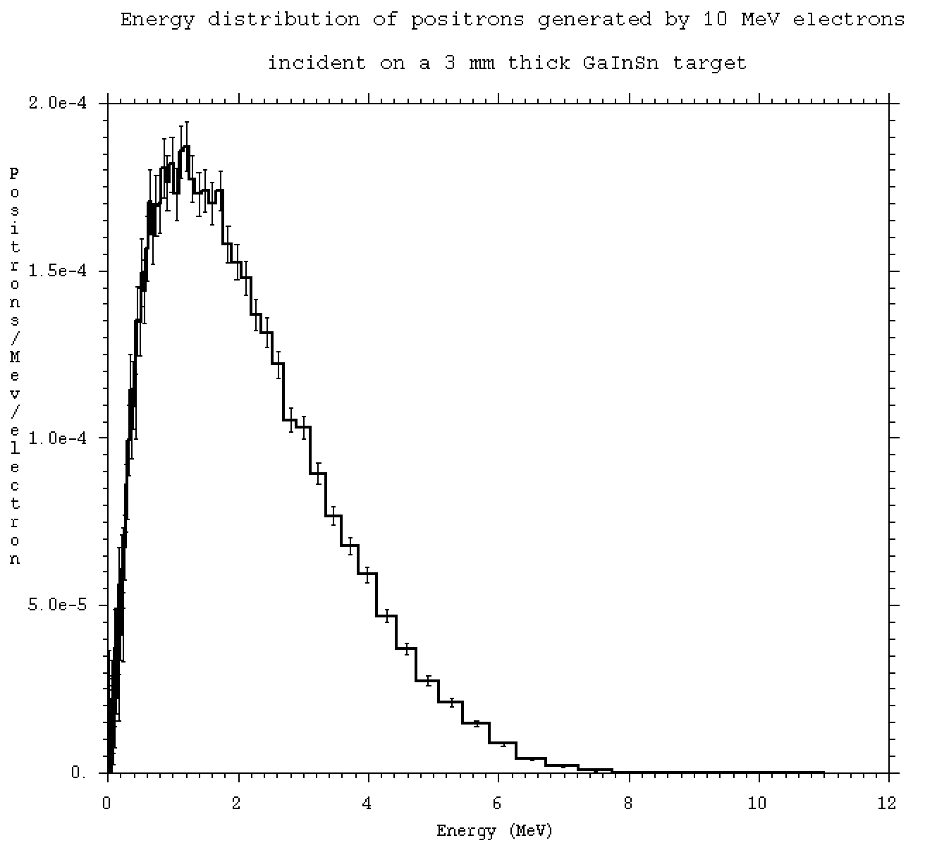
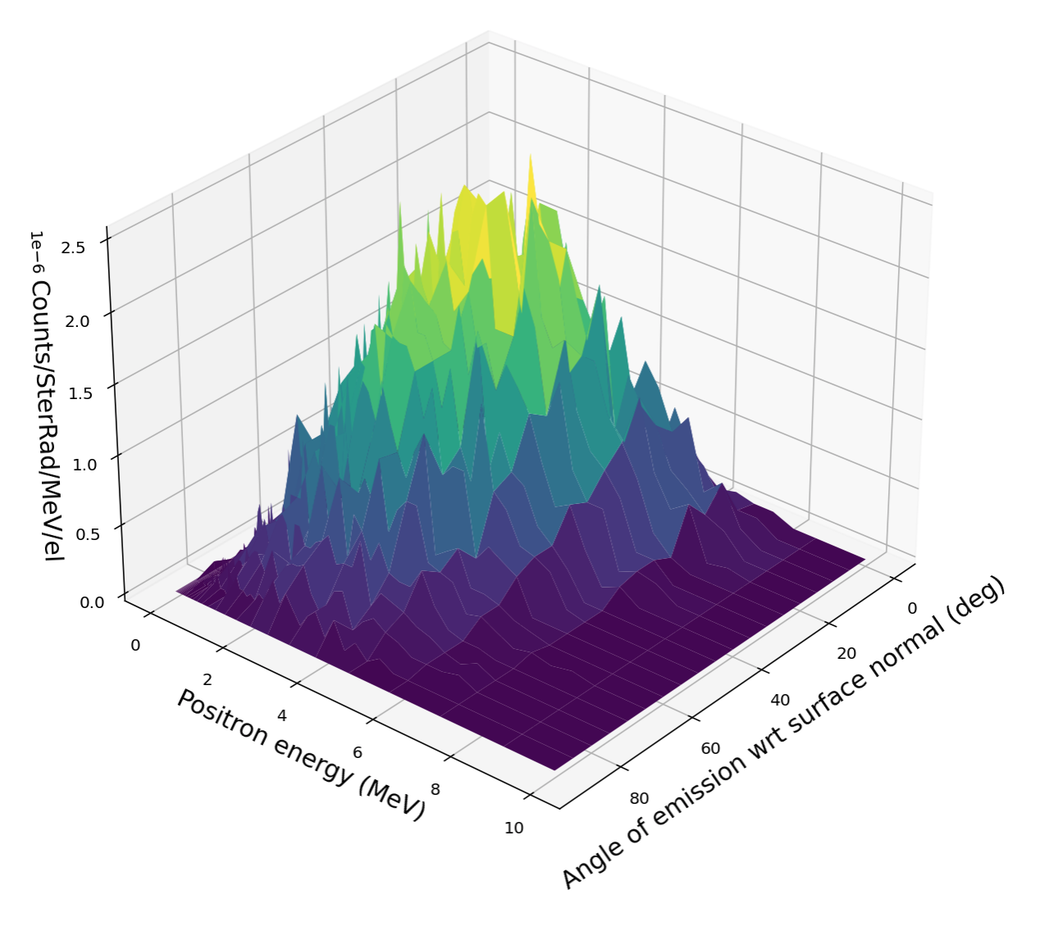
Energy and angular distribution of positrons from a 3 mm thick GaInSn target

Slide 6
Positron production by 10 MeV electrons in various targets of roughly the same radiation thickness thickness
The PEPPo experiment at Jlab was designed to evaluate and demonstrate the PEPPo concept. A few μA, 85% polarized 8.25 Mev/c continuous electron beam generated positrons in a 0.1-1.0 mm tungsten target. (V. Vouitier, Nucl. Theory 33, (2014))
From Yu. S. Tsai, “Pair Production and Bremmstrahlung of Charged Leptons”, Rev. Mod. Phys., 46:4, 815 (1974), one gets the radiation lengths for various elements. Xo for tungsten, (divided by the density of 19.25 g/cm³) is 0.3513 cm. Thus in the Jlab experiment the W thicknesses were 0.02847 – 0.2847 Xo.

Slide 7
The properties of a GaInSn liquid metal nozzle were calculated using OpenFOAM, a free, open source CFD software.(https://openfoam.org) The basic nozzle design was taken from the paper by Gordeev et al. The nozzle contraction ratio given is four. Since the GaInSn positron target thickness at 10 MeV is 0.3 cm, the rest of the nozzle dimensions were scaled accordingly, except for the nozzle width, which was set at 1 cm.
The shape of the nozzle is given by a fifth order polynomial as discussed in the paper by Bell and Mehta (JIAA TR-84. April 1988) y(x’)/H_{i} = 1-(1-H_{e}/H_{i})(6 x’⁵ -15 x’⁴ + 10 x’³)
Where 0 < x’< 1. x’ = x/L, L is the length of the contraction region and H_{i} and H_{e} are half the heights of the nozzle at input and exit respectively. (If the widths of the input, W_{i} and output, W_{e}, are the same, H_{i}/H_{e} is the contraction ratio, otherwise it is H_{i}W_{i}/H_{e}W_{e}.)
The calculation was carried out using the OpenFOAM standard solver simpleFoam a steady-state solver for incompressible, turbulent flow, using the SIMPLE algorithm. As per Gordeev et al, the V2F model results exhibited a reasonably good agreement with measured results and therefore the v2f version in OpenFOAM was used in the present calculations.
Nozzle Design and CFD Simulation

Slide 8
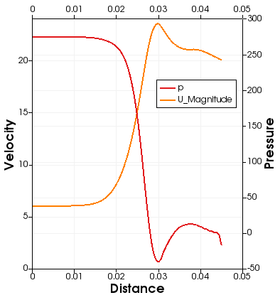
Nozzle Geometry
The GaInSn flow is shown in red and the nozzle walls in blue. So far, the best flow occurred for an input velocity U = 6 m/s.
Since the input area is 1.2 cm², the flow of GaInSn has to be 1.2 cm² times 600 cm/s or 0.72 l/s (11.41 gpm).

Slide 9
Schematic System Layout

Slide 10
Radionuclide production in target
Element Isotope Abundance Sn Radionuclide Sp Radionuclide
ZZAAA (at%) (MeV) with T_{1/2} > 1d (MeV)
Ga 31069 0.60108 10.31 31069 T_{1/2} < 2h 6.10 30068 stable
31071 0.39892 9.30 31070 T_{1/2} < 22m 7.35 30070 stable
In 49113 0.04290 9.38 5.56 48112 stable
49115 0.95710 8.89 6.29 48114 stable
Sn 50112 0.00970 10.72 7.05 49111, 2.805d
50114 0.00660 10.24 50113, 115.09d 7.97 49113 stable
50115 0.00340 7.48 8.43 49114, 49.51d
50116 0.14540 9.50 8.75 49115 stable
50117 0.07680 6.88 50117m, 9.58 MeV, 13.6d 9.05 49116 T_{1/2} < 1h
50118 0.24220 9.26 9.81 49117 T_{1/2} < 2h
50119 0.08590 6.42 8.95 49118 T_{1/2} < 5m
50120 0.32580 9.05 50119m, 9.14 MeV, 293.1d 10.49 49119 T_{1/2} < 18m
50122 0.04630 8.76 50121m, 55y 11.20 49121 T_{1/2} < 4m
50124 0.05790 8.43 50123, 129.2d 11.61 49123 T_{1/2} < 1m
Nuclides produced in (γ,n) and (γ,p) reactions on GaInSn. Neutron and proton separation energies calculate from values given in “Nuclear Wallet Cards”, J.K. Tuli, National Nuclear Data Center, BNL, Upton, NY (July 1995)

Slide 11
Gamma dose rates in (rem/h)/(el/s) in GaInSn and W targets by 10 MeV electrons

Slide 12
Gamma dose near target (LM and W)
In both cases, 3 cm from target, the dose rate is ~4.0E-07 (rem/h)/(el/s). 1 mA corresponds to 6.242E+15
(el/s), so dose rate is 2.5E+09 rem/h. For gammas, rem=rad, so dose rate is 2.5E+09 rad/h.
The GigaRad/h dose rates is a problem for the magnetic field needed to collect the positrons. No known magnet wire insulation can withstand such high dose rates. Need bare conductor coils with many turns and several kA currents.

Slide 13
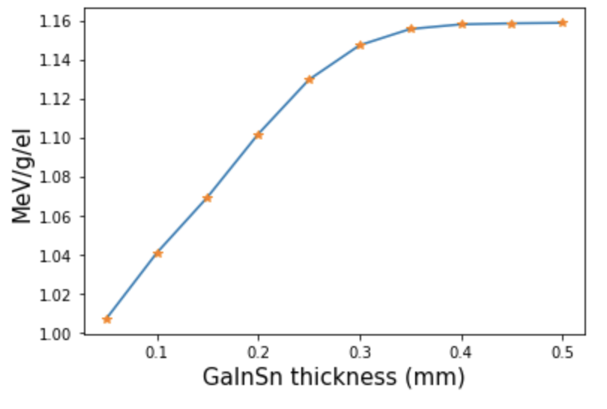
Energy per gram deposited in the GaInSn target by 10 MeV electrons
Energy deposited into a 1.2 cm² area of GaInSn vs. target thickness. At 0.3 cm, the energy deposited is 1.15 MeV/g/el, or 2.67 MeV/el. For a 1 mA beam, this corresponds to 2.67 kW.

Slide 14
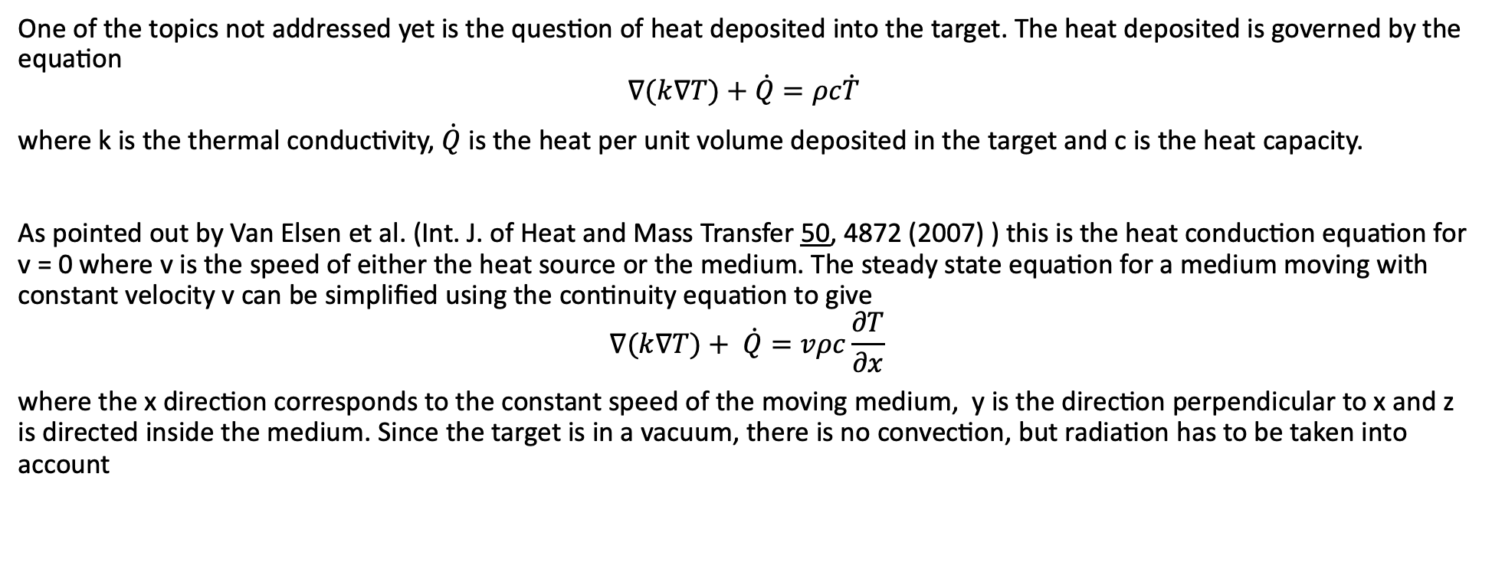
Thermal Analysis to Follow
One of the topics not addressed yet is the question of heat deposited into the target. The heat deposited is governed by the equation
$$∇(k∇T)+\dot{Q}=ρc\dot{T}$$
where k is the thermal conductivity, $\dot{Q}$ is the heat per unit volume deposited in the target and c is the heat capacity.
As pointed out by Van Elsen et al. (Int. J. of Heat and Mass Transfer 50, 4872 (2007) ) this is the heat conduction equation for v = 0 where v is the speed of either the heat source or the medium. The steady state equation for a medium moving with constant velocity v can be simplified using the continuity equation to give
$$∇(k∇T)+ \dot{Q}=vρc\frac{∂T}{∂x}$$
where the x direction corresponds to the constant speed of the moving medium, y is the direction perpendicular to x and z is directed inside the medium. Since the target is in a vacuum, there is no convection, but radiation has to be taken into account

Slide 15
Thank you for your attention

