Slide 1
UITF Wien rebuild with single piece 316L SS electrodes
The first UITF Wien (U-Wien) was built with spare parts from the CEBAF Wiens.
These included electrodes made from several SS pieces, brazed together, resulting in a ‘faceted’ electrode profile
The U-Wien was also upgraded with 40 kV HV feedthroughs, and 20 A magnet coils.
Testbench results showed gas bursts starting at ~ 15 kV applied to either electrode, regardless of polarity. The hypothesis is that observed gas bursts came from voids in the braze.
The rebuild incorporates now electrodes made from a single piece of SS 316L. HV tests yet to be performed.
This documents metrology QA for a pair of polished electrodes by Bubba, first with sand paper, and then in the barrel polisher with corncob, and one electrode as received from manufacturing
Carlos Hernandez-Garcia

Slide 2
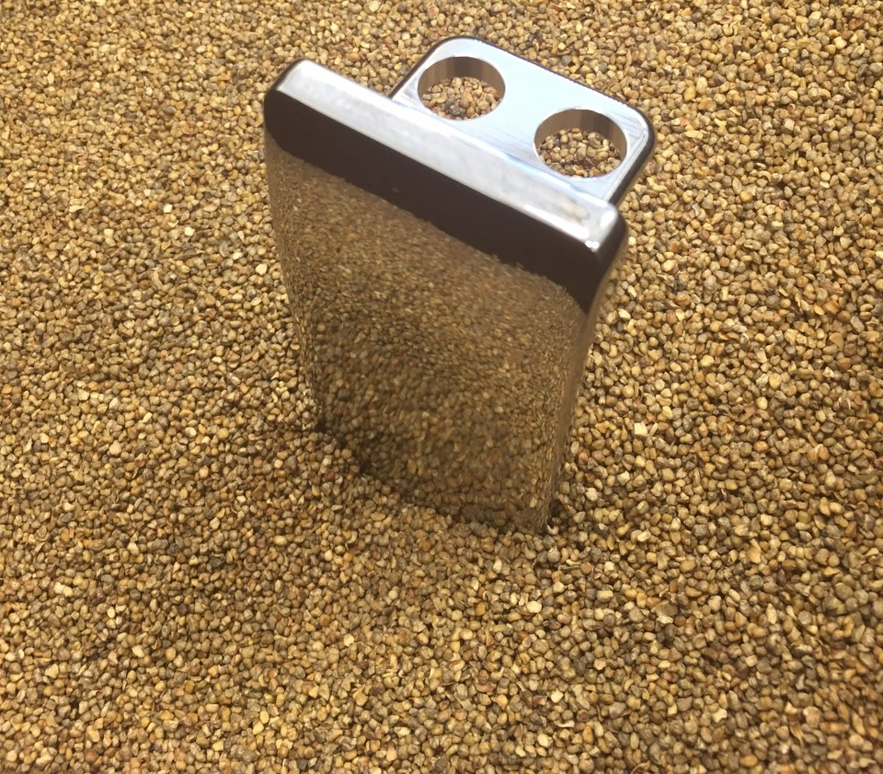
Electrode polishing
A total of 6 electrodes were manufactured by Xometry from single piece 316 L SS.
Each electrode flat surface came with tooling marks
Bubba spent a few days using sand paper and the potter’s wheel to even out and smooth the surface. Then transitioned to finer paper (600 grit) before final polishing in the tumbler with corncob for ~ 3 hours

Slide 3
Two types of electrodes: several SS pieces brazed together and single piece spline
The electrode Rowoski profile follows a spline thanks to the use of a CNC machine in manufacturing.
In contrast, the CEBAF Wien electrodes were made of several sheets brazed together, resulting in a faceted Rowowski profile.

Slide 4
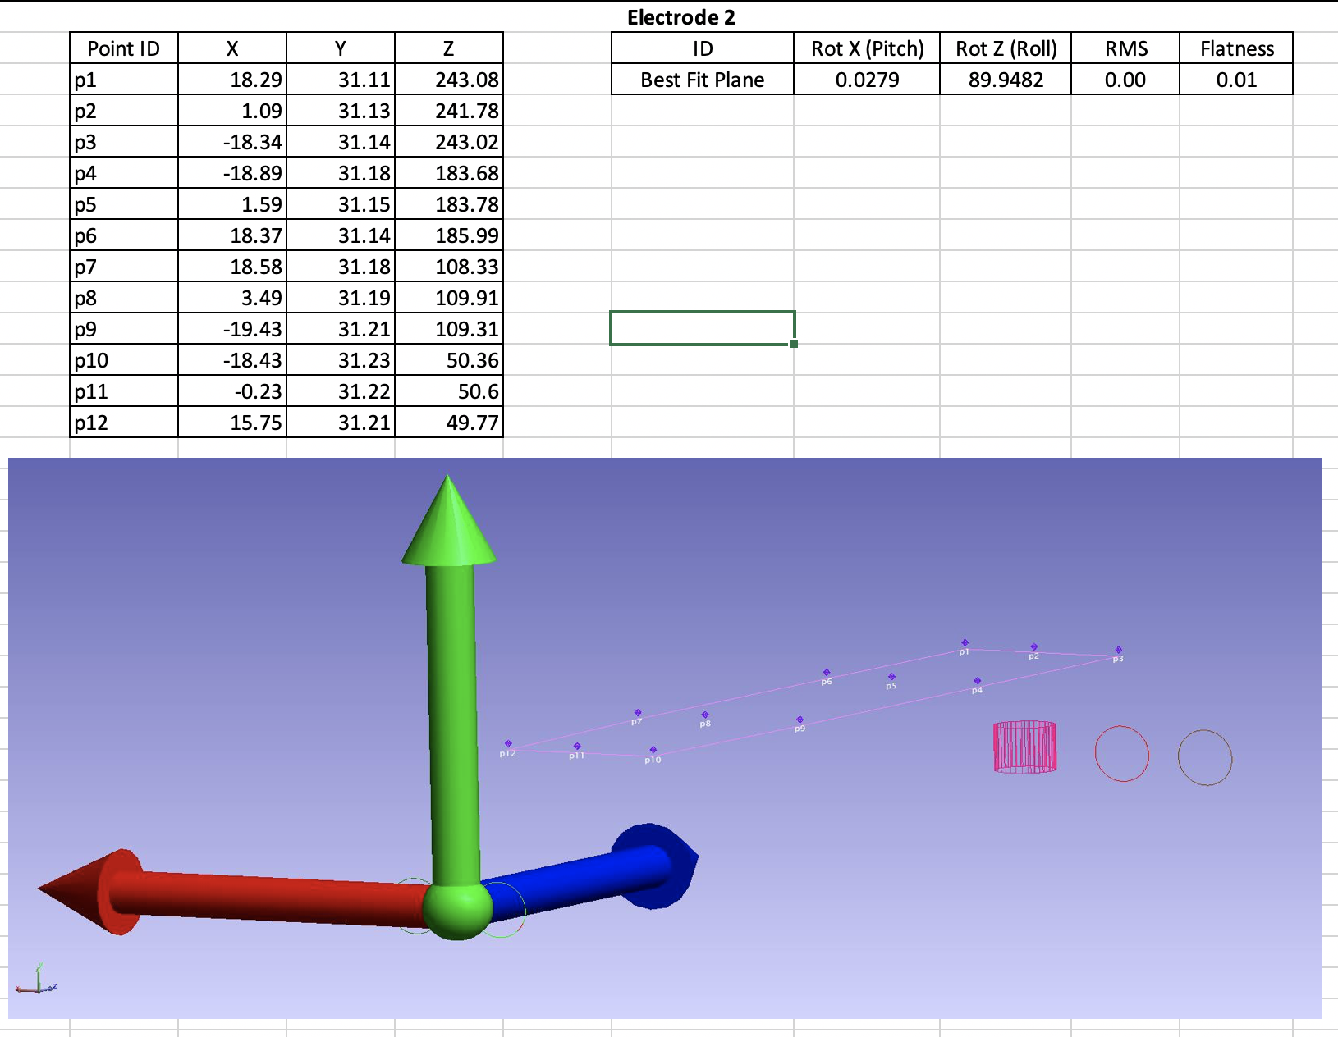
S&A group performed metrology on two of the polished spline, and one unpolished spline
On August 16, 2001 Survey and Alignment performed an inspection of 3 (three) Wien electrodes. The inspection included overall flatness and orientation of the top of the electrodes to the mounting holes. The coordinate system is based on an average line
Y
Z
X

Slide 5
All of the electrodes seem to be sloped in Z and in X wrt mounting tab holes
Y
X
Z

Slide 6
Electrode 2 Polished
Y
X
Z
50 mm
108 mm
186 mm
243 mm

Slide 7
Electrode 4 Polished
Y
X
Z
57 mm
123 mm
195 mm
243 mm

Slide 8
Electrode 3 Un-polished
Y
X
Z
55 mm
117 mm
184 mm
238 mm

