Slide 1

Laser & Injector Upgrade for 4-Hall Operation
Joe Grames
July 17, 2015
Operations Retreat

Slide 2

Outline
RF separation for 4-Hall operation
Injector beam generation
Timeline and plans

Slide 3
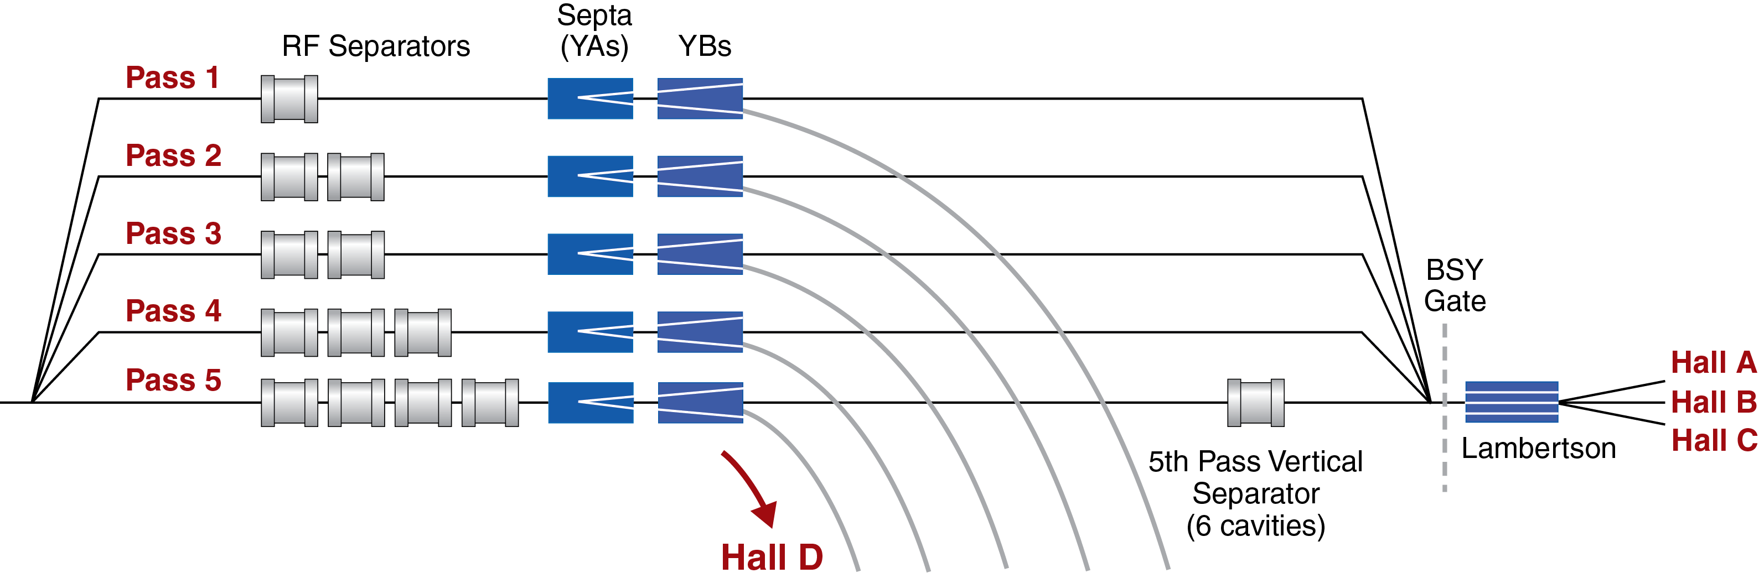
RF Separation for 4-Hall Operation
Horizontal 1st- 4th Pass
499 MHz Separators
(kicks out Halls A, B, C)
Horizontal 5th Pass
750 MHz Separators
(kicks out Hall D)
Vertical 5th Pass
499 MHz Separators
(kicks out Halls A, B, C)

Slide 4
Constraint on LLRF/Laser System
Beam Condition | Hall D | Halls A, B, C
Beam @ 1 - 4 passes | n/a | 499* MHz
Beam @ 5th pass (Hall D OFF) | OFF | 499* MHz
Beam @ 5th pass (Hall D ON) | 249.5 MHz | 249.5 MHz
*Halls A, B, C can operate at 249.5 MHz at any pass too.
Major upgrade tasks
  Add a 4th fiber laser, combine with other 3 on laser table
  Generate bunch trains at both 499 and 249.5 MHz
  Achieve similar and reliable functionality at both rep rates
  Demonstrate “sharing” of 3-beam chopper

Slide 5
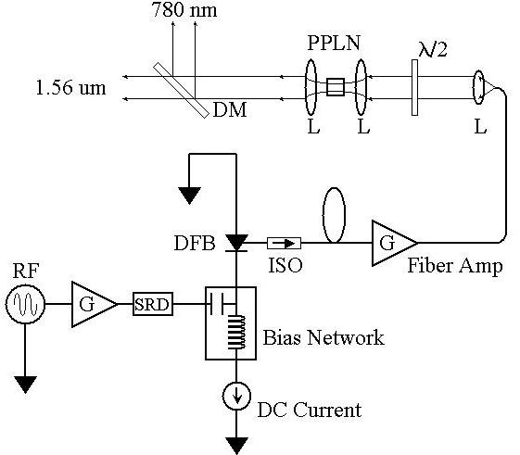
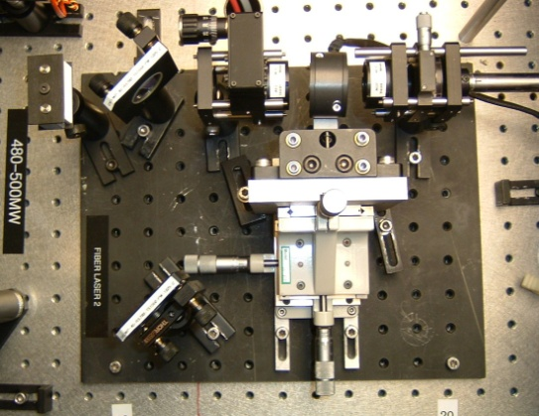
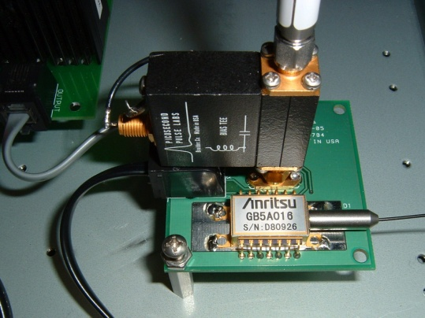
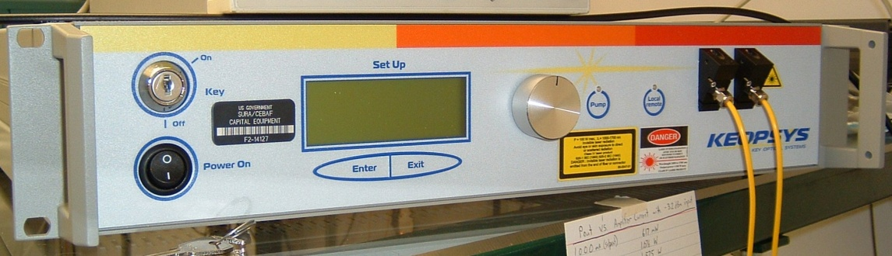
Synchronous Photo-Injection by Fiber Laser
4-Hall operations requires building one more laser…
780 nm
Frequency-doubler
1560 nm to 780 nm
30% Efficiency (2 W)
RF Locked Low-Power (1 mW)
1560 nm Fiber Diode
1560 nm
499 MHz
High Power (6 W) 1560 nm Fiber Amplifier

Slide 6
Beam Repetition Rate
We are considering three approaches to producing 499 and 249.5 MHz (also 31 MHz for Mott).
Analog
Gain
Switching
LLRF = 499, 249.5
Laser = 499, 249.5
Electron = 499, 249.5
Digital
Gain
Switching
LLRF = 998
RF Divider =
499, 249.5
Laser =
499, 249.5
Electron =
499, 249.5
Optical
Pulse
Picking
LLRF = 499
Laser = 499
Fast Shutter =
499 (off), 249.5
Electron =
499, 249.5

Slide 7
Laser Beam Spatial Combination
Laser beams must be spatially combined to illuminate the same location on the photocathode.
Polarization cube – combine (s-, p-) orthogonal polarization with high efficiency e.g. use to combine to high power (high current halls).
Dichroic mirror – combine but with unequal e.g. 10/90 efficiency e.g. use to combine to low power (low current halls).
    For example:
      Combine A+B with dichroic to s- state
      Combine C+D with dichroic to p-state
      Combine (A+B)+(C+D) with polarization cube
Also being studied is combining beams by optical fiber

Slide 8
Laser Table Upgrade
MULTIPLE LASERS ON LASER TABLE…
  PPLN
  TUNE MODE
  IA (PQB)
  SHUTTERS
…ARE COMBINED TO SINGLE OPTICAL PATH
  PSS SHUTTERS
  POLARIZATION POCKELS CELL
  WAVEPLATE REVERSAL (IHWP)
  STEERING LENS

Slide 9
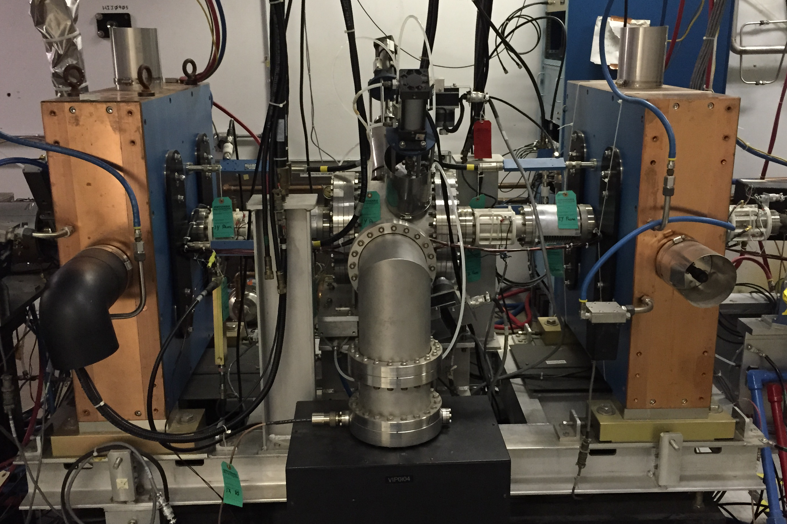
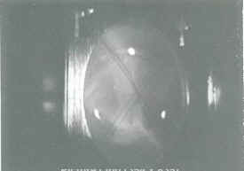
Beam Chopping
The injector chopping system defines three physical apertures which are spanned at 499 MHz
Defines the longitudinal acceptance and aids in achieving low current (Halls B, D).
3-hall operation allows each hall to have a unique aperture; 4-hall operation requires two beams to share an aperture, to be demonstrated
An alternative to sharing is to build a 250 MHz chopping system
499 MHz
B, D
C
A

Slide 10
Bunch Charge
The bunch charge is inversely proportional to repetition rate; halving the rep rate (499 MHz to 249.5 MHz) doubles the bunch charge.
Current | @ 499 MHz | @ 249.5 MHz
85 µA, max for 12 GeV | 0.17 pC/bunch | 0.34 pC/bunch
180 µA, max for 6 GeV | 0.36 pC/bunch | 0.72 pC/bunch
Combined current to Halls A and C will be limited to 85 µA because of 1 MW total power limit.
The bunch charge for 85uA @ 249.5 MHz has already been demonstrated during for QWeak.
Injector Upgrade of gun operation from 130kV to 200kV will improve and extend capability for high bunch operation.

Slide 11
FY15 – Retrospective
Halls A(249.5), B(499), D (249.5) achieved using Digital Gain Switching
High current ~100 uA operation to Hall A @ 249.5 MHz achieved
Operation at 249.5MHz suffered most from…
  180 deg phase shifts (locking 2^{N} division to LLRF)
  Lack of 360 deg phase adjustment at 249.5 MHz made issue above tougher
  Learning curve: new system & procedure to set phase (space charge, Mott, …)
Other issues muddied the outlook…
  Damaged amplifiers at lower rep rates (exceeded peak power)
  Intermittent low frequency noise associated with seed laser digital TEC
  Running in pulsed mode (being familiar with spatial profile from PC)
Ended run with standard Analog Gain Switching
  Required LLRF at both 499 and 249.5 MHz
  Still lacked 360 deg phase shifting

Slide 12
FY16 – This SAD & Upcoming Year
Laser system (Hansknecht)
  Modular analog gain switching chassis (one for each laser, 3 now + 1 later)
  Rack mounted chiller provides thermally controlled micro-climate
  Restore analog seed laser TEC control
  Communication to seed/pre-amp + IPG models (Johnson)
LLRF (Plawski)
  LLRF : 3 channels of 249.5 MHz, 2 channels of 499 MHz
  Low cost solution bridges to final system in FY17
  Phase control at 249.5 MHz cable delay or firmware (Allison)
Post SAD Priority is testing and development
  Stable CEBAF system means efforts stay focused on final system
  Evaluate performance & cost for reduced rep rate options
  Test laser pulse pick-off PLL on bench for improving phase regulation
  Test delivering two 249.5 MHz beams to B/D through 1 chopping aperture
  Build new SCAM module for 4-laser operation (Flood)

Slide 13
FY17 – Ready for 4-hall Operation
Install 4th fiber laser
  Additional chassis in ISB
  Additional laser amplifier in tunnel
  Rework laser table (big job!)
    Plan A – Laser combination by polarization/reflection
    Plan B – Launching through a common fiber
  Implement new 4-laser SCAM module
LLRF/Repetition Rate
  Plan A – multiple channels of 499/249.5 MHz LLRF channel
  Plans B – digital gain switching or pulse picking
  Phase control at 249.5 MHz
    Requires phase lock at 249.5 MHz
    Requires 360 deg phase control at 249.5 MHz
  Implementing laser pick-off 499/249.5 MHz for stabilization improvement
Implement software/controls for managing 4-lasers, 3-chopping apertures, 4-halls

