Slide 1
Magnetized Beam LDRD
Abdullah Mamun
On behalf of JLab Injector Group
JLEIC Collaboration Meeting Spring 2018, March 26-28,, Jefferson Lab

Slide 2
Outline
Magnetized Bunched-Beam Electron Cooling
LDRD Magnetized Electron Source
K_{x}Cs_{y}Sb Photocathode and HV Chambers
Gun Solenoid
Beamline
Generation of Magnetized Electron Beam
Measuring Electron Beam Magnetization
Slit and View-screens
TE₀₁₁ Cavity: new non-invasive method
Measuring Transverse Emittance of Non-magnetized Beam
Measuring Charge Lifetime from High Current Beams
Outlook
Summary

Slide 3
Magnetized Bunched-Beam Electron Cooling
Ion beam cooling in presence of magnetic field is much more efficient than cooling in a drift (no magnetic field):
Electron beam helical motion in strong magnetic field increases electron-ion interaction time, thereby significantly improving cooling efficiency
Electron-ion collisions that occur over many cyclotron oscillations and at distances larger than cyclotron radius are insensitive to electrons transverse velocity
Long cooling solenoid provides desired cooling effect:
Counteracting emittance degradation induced by intra-beam scattering
Maintaining ion beam emittance during collisions and extending luminosity lifetime
Suppressing electron-ion recombination
but putting the electron beam into the cooling solenoid represents a challenge

Slide 4
Magnetized Cooling Schematics
Electron beam suffers an azimuthal kick at entrance of cooling solenoid. But this kick can be cancelled by an earlier kick at exit of photogun. That is the purpose of cathode solenoid
Electrons born in strong uniform B_{z}
Upon exit of Cathode Solenoid
Upon entering Cooling Solenoid
$$〈L〉=γm_{e}〈r^{2}〉\dot{φ}$$
r_{e}= 0.7 mm
B_{cool} = 1 T
$a_{0}$= R_{laser} = 3.14 mm
B_{z} = 0.5 kG
= 36 µm

Slide 5
JLEIC Magnetized Source Requirements
Bunch length | 60 ps (2 cm)
Repetition rate | 43.3 MHz
Bunch charge | 3.2 nC
Peak current | 53.9 A
Average current | 140 mA
Transverse normalized emittance | <19 microns
Cathode spot radius – Flat-top ($a_{0}$) | 3.14 mm
Solenoid field at cathode (B_{z}) | 0.5 kG
Cornell University demonstrated 65 mA and 2 nC, but not at same time, and non-magnetized
Fermilab Magnetized Photoinjector Laboratory:
Pulsed NCRF gun with Cs₂Te photocathode and UV laser (λ=263 nm)
Bunch charge: 0.5 nC and bunch length: 3 ps
0.5% duty factor (average current: 7.5 μA)
Bunch frequency: 3 MHz
Macropulse duration: 1 ms
Number of bunches per macropulse: 3000
Macropulse frequency: 5 Hz

Slide 6
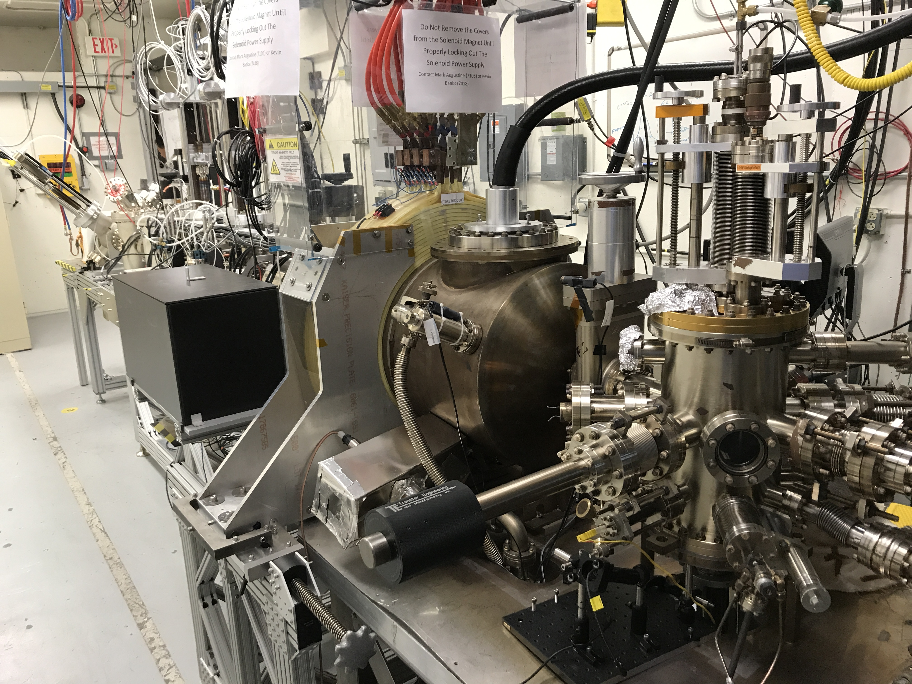
Magnetized Source for e-cooler at 32 mA
A high charge (420 pC) magnetized source is funded by the Jefferson Lab LDRD program that should operate up to 32 mA average current. This project concludes in 2018.
Magnetized beam parameters:
$a_{0}$ = 0.1-1 mm, B_{z} = 0-1.5 kG
Bunch charge: up to 2 nC
Frequency: 1-15 Hz , 100-500 MHz
Bunch length: 50 ps
Average beam currents up to 32 mA
Gun high voltage: 200 – 350 kV

Slide 7
Magnetized Beam LDRD
Three-year project (FY16 – FY18):
Generate magnetized electron beam from dc high voltage photogun and measure its properties
Explore impact of cathode solenoid on photogun operation
Simulations and measurements will provide insights on ways to optimize JLEIC electron cooler and help design appropriate source
JLab will have direct experience magnetizing electron beams at high current

Slide 8
LDRD Magnetized Electron Source
Bialkali Antimonide Photocathode Preparation Chamber, Gun, Solenoid and Beamline are all operational

Slide 9
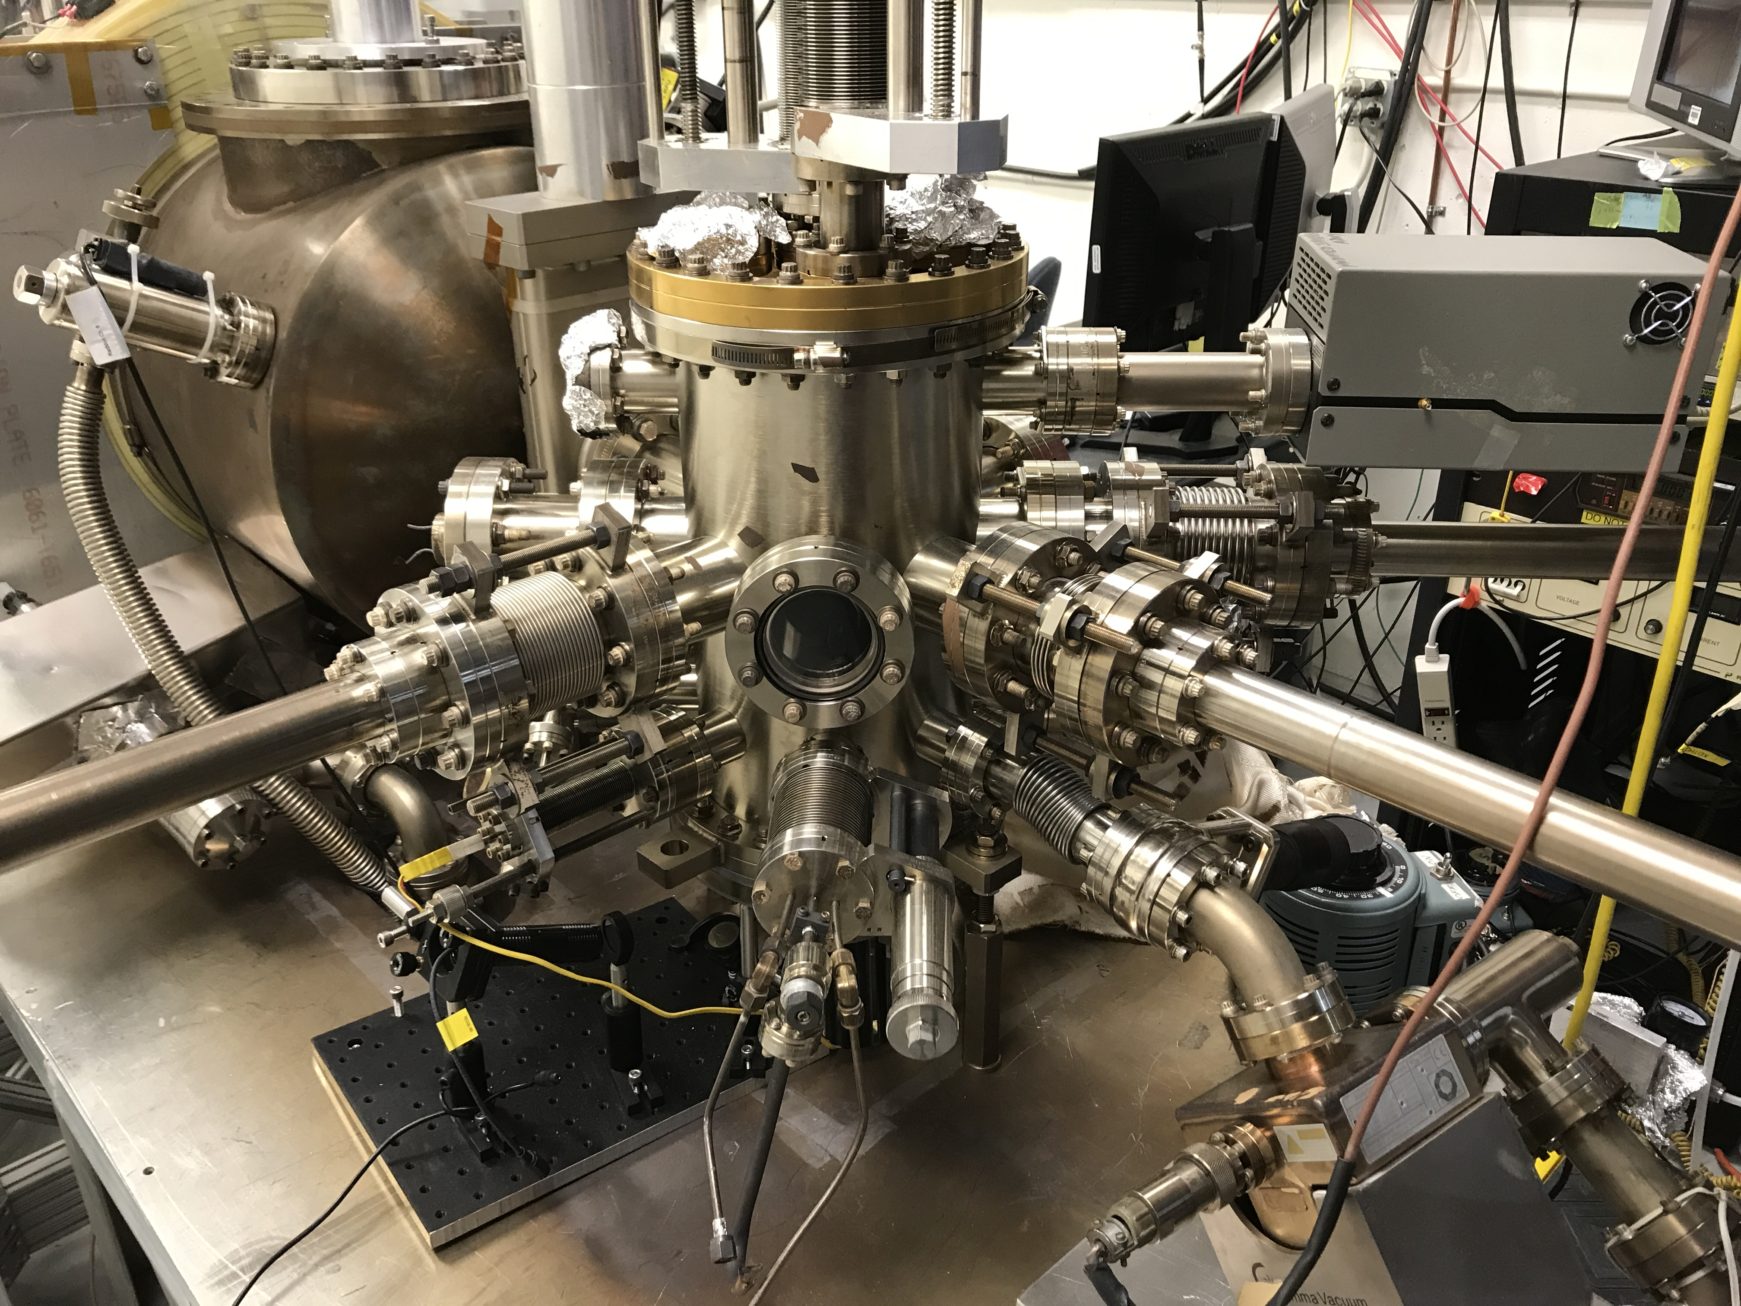
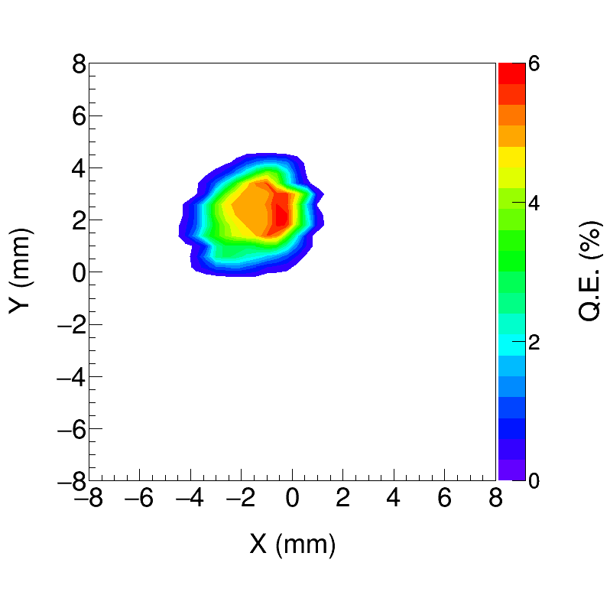
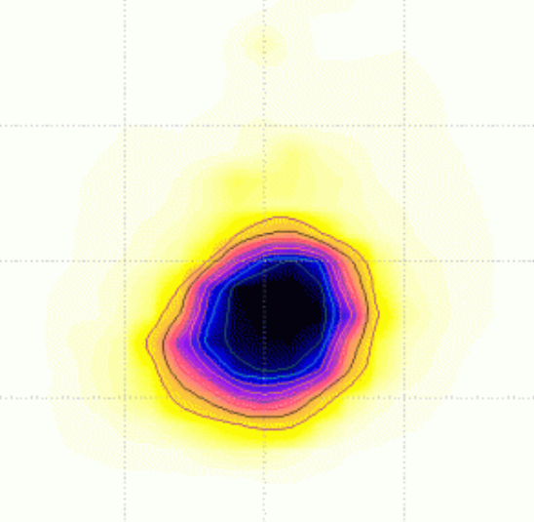
Photocathode Preparation Chamber
K_{x}Cs_{y}Sb grown with a mask – limit photocathode active area (3 and 5 mm dia.) to reduce beam halo, minimize vacuum excursions and high voltage arcing, prolong photogun operating lifetime
Active area can be offset from electrostatic center
3 and 5 mm dia. active area available; entire photocathode can be activated too
Consistently growing photocathodes with 5-7% QE

Slide 10
Photocathode Preparation
Co-deposition of alkalis (K and Cs) on Sb layer using an effusion alkali source to grow bialkali photocathode .
Deposition chamber was initially baked at 200 °C for >180 h.
Vacuum with NEG pumps and an ion pump, Vacuum ~10 nA (~10⁻¹⁰ Pa)
Sb (99.9999%) , K (99.95%), and Cs (99.9+%).
Working distance: 2 cm, -280 V bias, low power (4 mW) laser (532 nm) and wavelength tunable light source.
Substrate temperatures: 120 °C (for Sb), dropping from 120 °C to 80 °C (for alkalis).
Sb heater current supply from 25 A for 10-20 minutes.
Temperature kept stable at effusion source and adjusted to control alkali evaporation rate: hot air inlet tube (381-462 ° C), dispensing tube (232 -294 ° C), and reservoir tube (153 -281 ° C).
Chamber pressure: during bialkali deposition, > 1x10⁻⁶Pa and post-deposition to ~10⁻⁷-10⁻⁸Pa quickly.
H₂O partial pressure < 2x10⁻⁹ Pa.

Slide 11
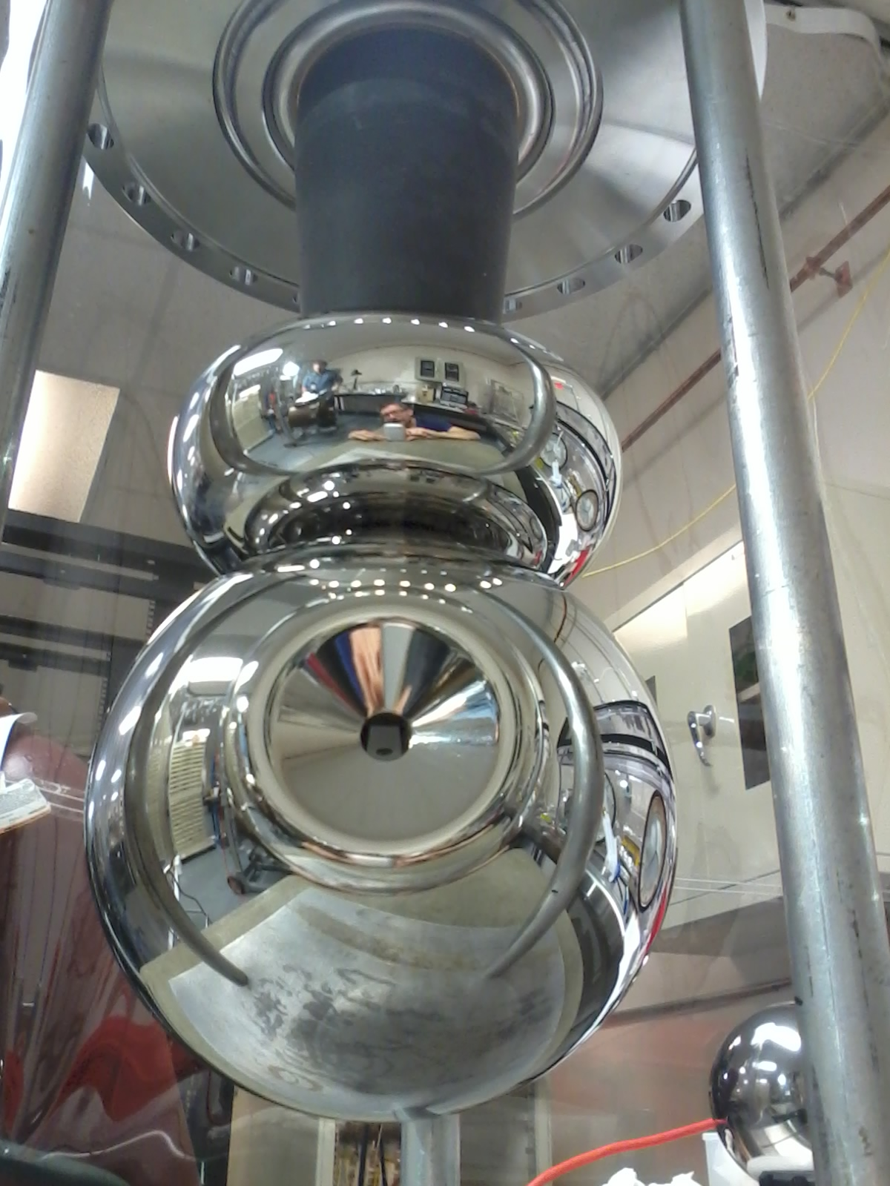
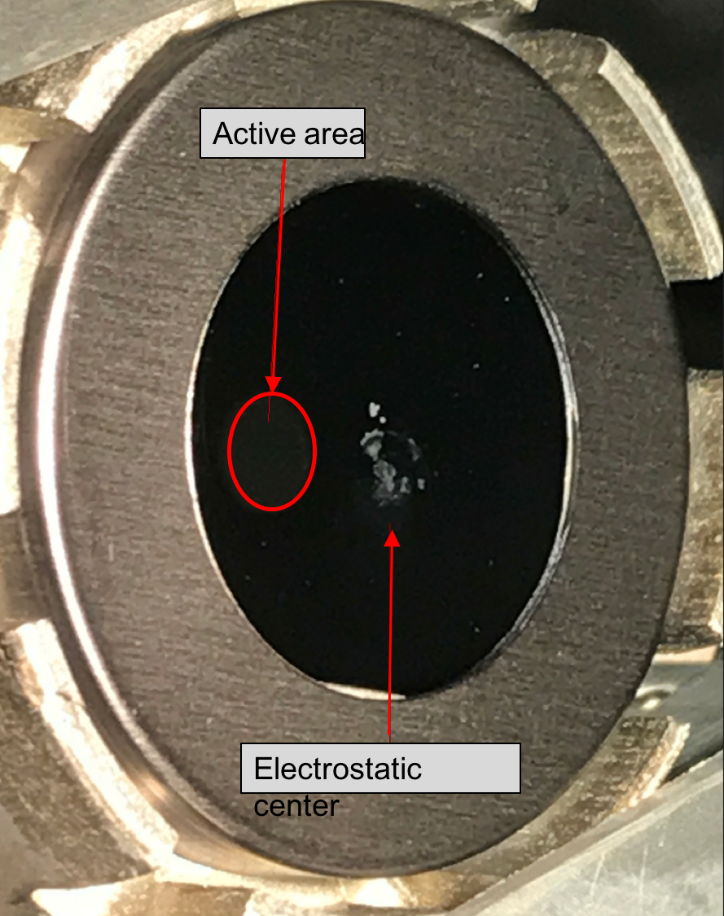
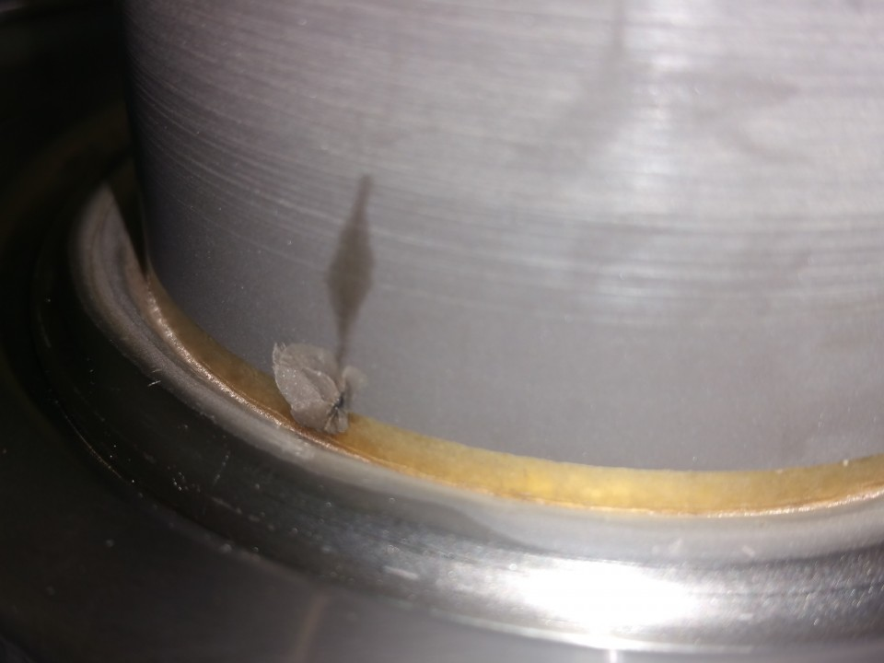
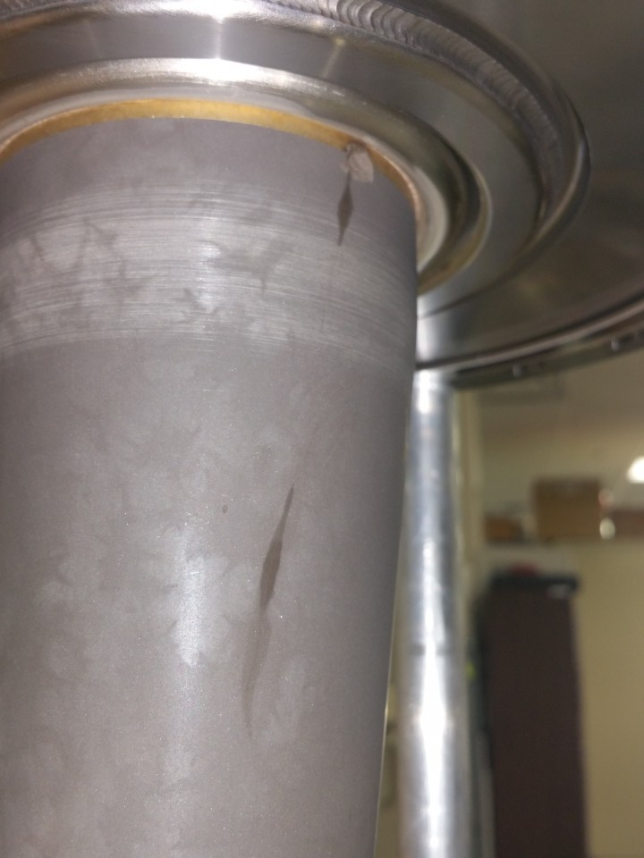
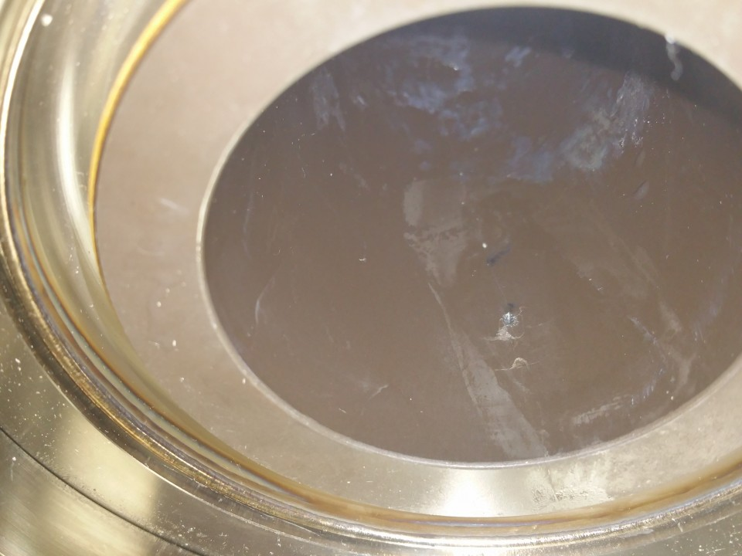
Gun HV Chamber
Upgraded HV Chamber with new doped-alumina inverted insulator and newly designed screening electrode (triple point junction shield) to lower gradient from 12 MV/m to 10 MV/m at 350 kV
Photogun operates at 300 kV with gun solenoid at 400 A
Active area
Two weeks ago we got a setback from ceramic breakdown.
Under process of replacing with a new ceramic, afterward baking and conditioning the gun for making it operational again.

Slide 12
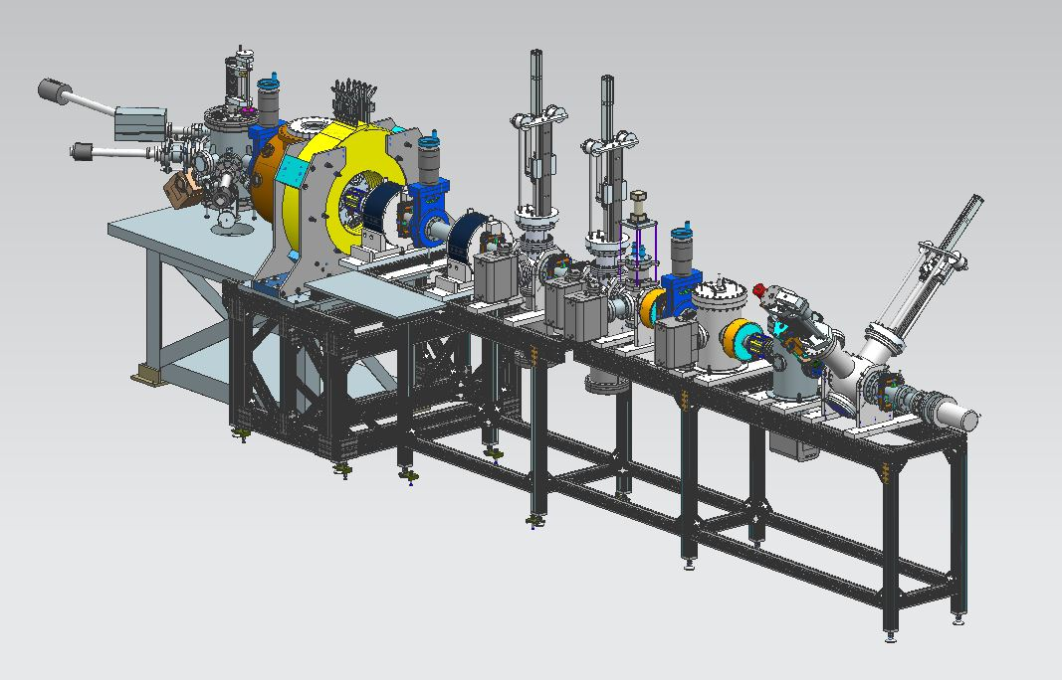
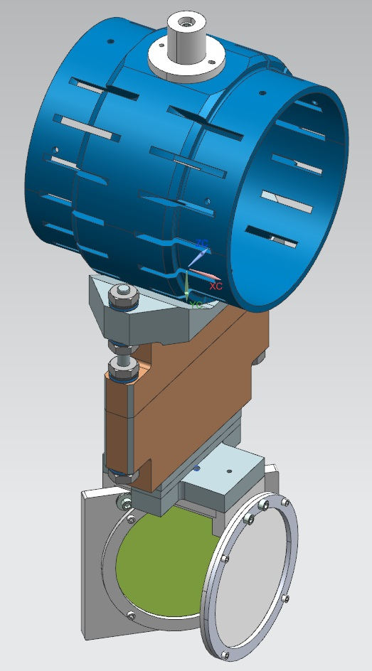
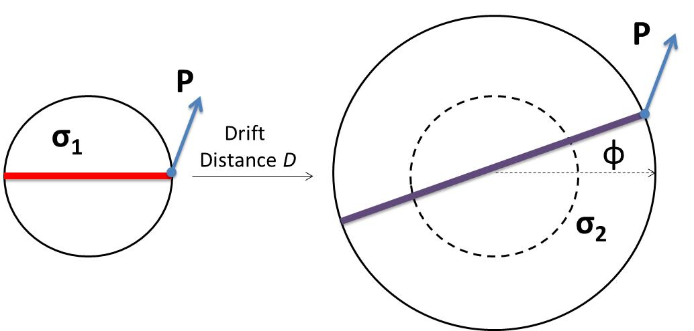
Magnetized Source Schematics
Gun HV Chamber
Beamline
Photocathode
Preparation
Chamber
Harp
Gun Solenoid
Viewer Screen 3
Shield Tube
Beam Dump
Use slit and viewscreens to measure mechanical angular momentum:
Slit
$B_{z}$: solenoid field at photocathode
$a_{0}$: laser rms size
φ: rotation (sheering) angle
Viewer Screen

Slide 13
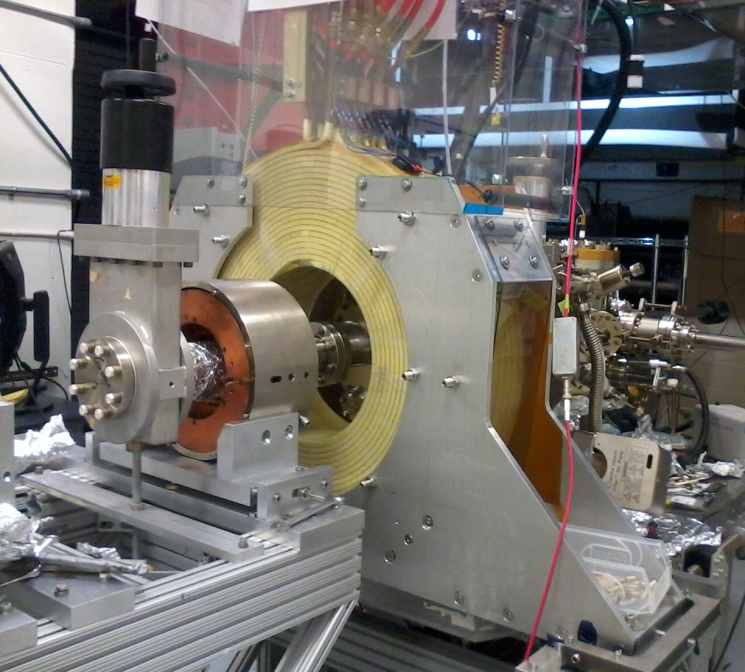
Gun Solenoid
Size | 11.811" ID, 27.559" OD, 6.242" Z
Conductor | L=500 m, A=0.53 cm² 16 layers by 20 turns
Coil Weight | 254 kg (560 lbs)
Resistance | 0.198 Ω
Field at Photocathode | 1.5 kG
Voltage | 79 V
Current | 400 A
Using spare CEBAF Dogleg magnet power supply (500 A, 80 V)
Learned that gun solenoid can influence field emission
First trials with gun at high voltage and solenoid ON resulted in new field emission and vacuum activity
Procedure to energize solenoid without exciting new field emitters

Slide 14
Slit and Viewscreen Measurement
0 G at photocathode
Beamlette observed on downstream viewer
1511 G at photocathode

Slide 15
Beam Size and Rotation Angle
Gun HV=300 kV, Laser spot size = 0.1 mm rms, Illumination position: 5 mm off centric on photocathode
Gun solenoid magnetizes beam but also focuses beam
JLEIC design requirement=500G
Three curves correspond to measurements at three beamline viewers
JLEIC design requirement=500G
Sign convention followed
Rotation angle influenced by Larmor oscillation in gun solenoid

Slide 16
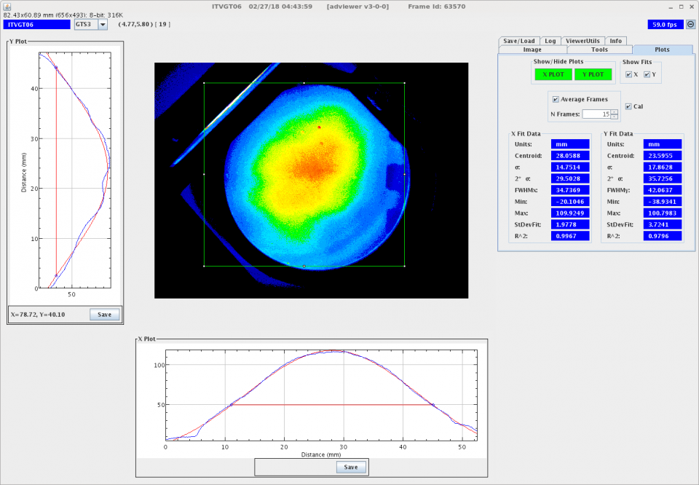
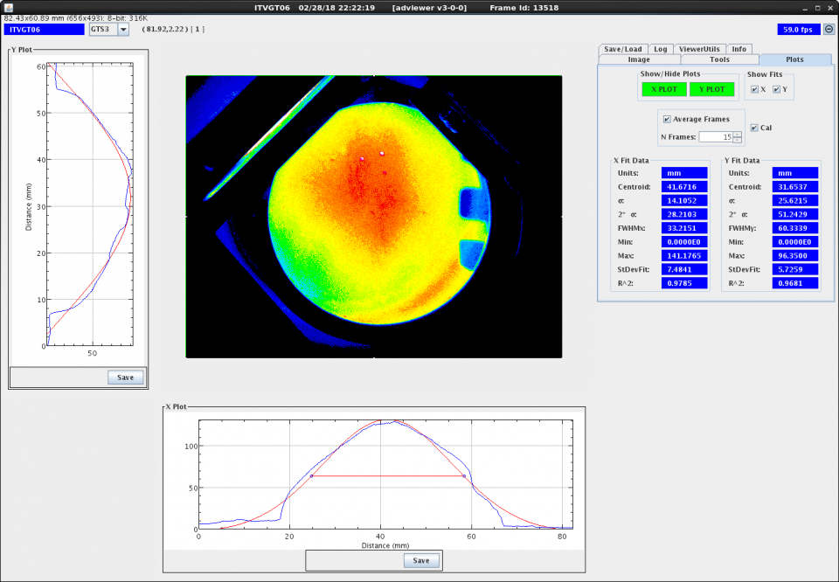
Beam Size and Rotation Angle
Gun HV=300 kV, Laser spot size = 0.3 mm rms, Illumination position: center on photocathode
JLEIC design requirement=500G
B_{z} at cathode: 831 G
JLEIC design requirement=500G
B_{z} at cathode: 1322 G

Slide 17
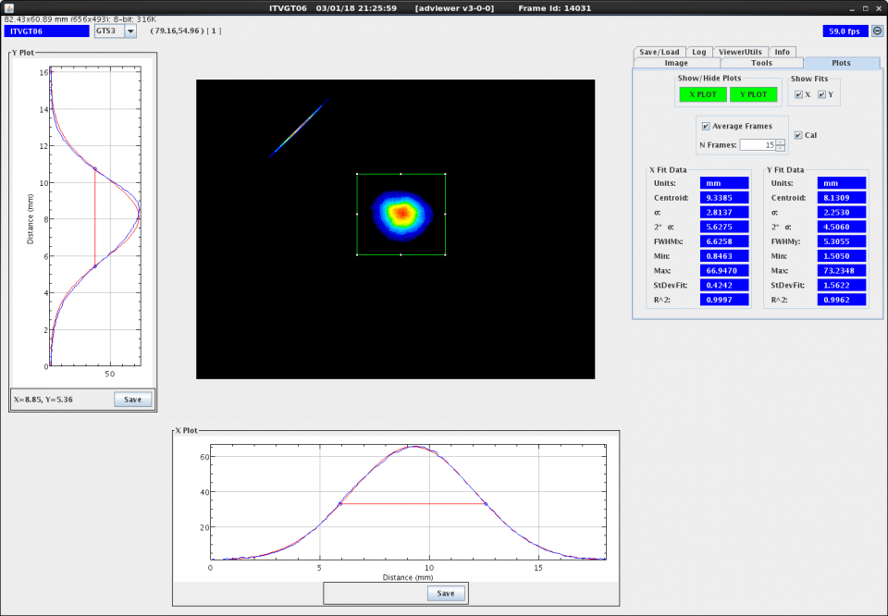
With/out Focusing with Beamline Lenses
Gun HV=300 kV, Laser spot size = 0.3 mm rms, Illumination position: center on photocathode
JLEIC design requirement=500G
B_{z} at cathode: 1322 G
S1-V3
Focusing field used at 2nd lens (MFGGT03)~ 2400 G-cm (2.206 Amps) and at 3rd lens(MFHGT05) ~700 G-cm (0.736 A)
JLEIC design requirement=500G
B_{z} at cathode: 1322 G
S1-V3

Slide 18
On Ceneter vs Off Center Illumination
Gun HV=300 kV
JLEIC design requirement=500G
JLEIC design requirement=500G

Slide 19
Modeling Magnetized Beam
ASTRA simulation of beam size

Slide 20
Simulation vs Experimental
Encouraging progress in modeling our apparatus and beam magnetization
Gun HV=300 kV, Laser spot size = 0.1 mm rms, position: 5 mm off center on photocathode
JLEIC design requirement=500G

Slide 21
Simulation vs Experimental
In progress of optimizing our simulation
Gun HV=300 kV, Laser spot size = 0.3 mm rms, position: on center on photocathode
Viewer3: viewer limited data
JLEIC design requirement=500G

Slide 22
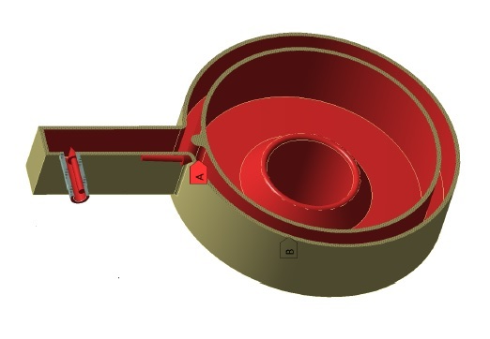
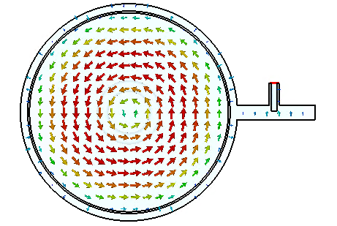
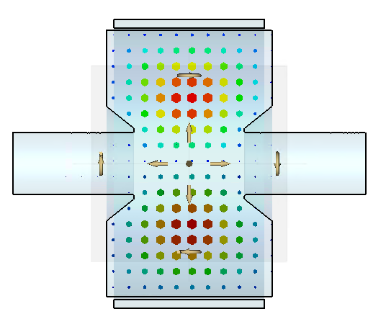
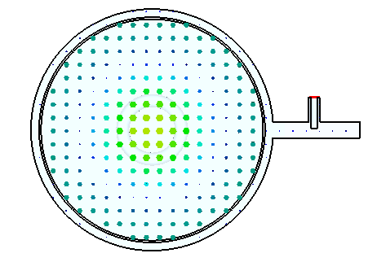
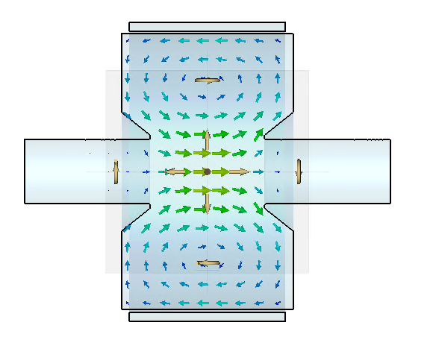
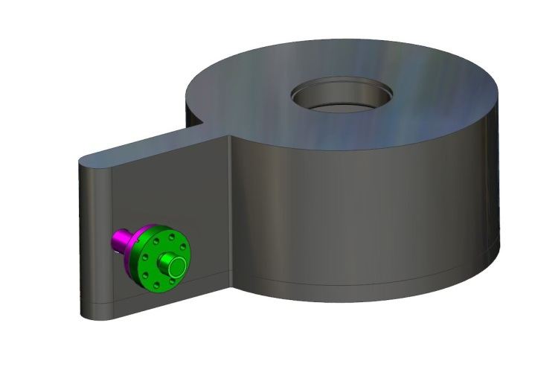
TE₀₁₁ Cavity: Non-invasive Technique
New non-invasive technique to measure electron beam magnetization
Filed inventor disclosure entitled “Non-invasive RF Cavity to Measure Beam Magnetization”
Mechanical design and vacuum pressure analysis are completed
Copper blocks are on-site and fabrication is in process
E-field: only in azimuthal direction
Copper cavity in progress
H-field: only in longitudinal and radial direction
Waveguide-coax out-coupler

Slide 23
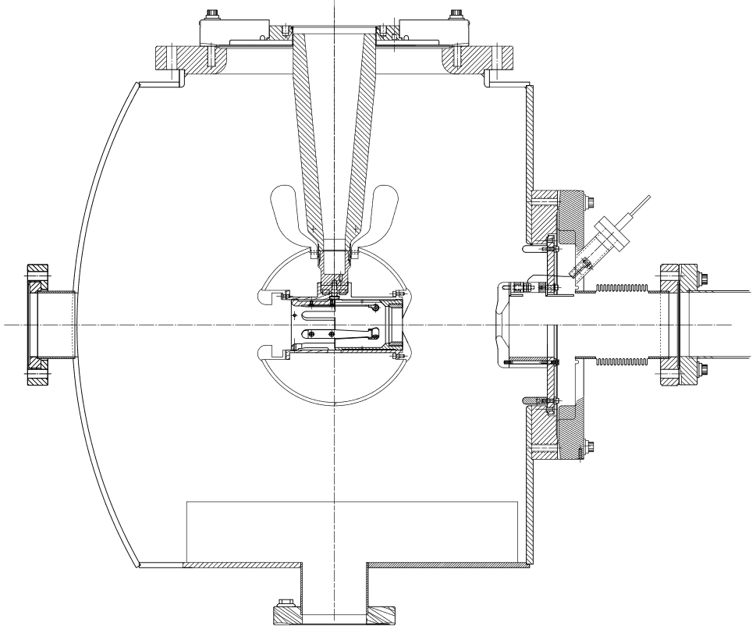
Non-magnetized Beam Emittance
Photocathode dia. = 13 mm
Laser rms = 0.2 mm
Gun HV = 200kV
y
x
Measured beam emittance, typical thermal angle value of 0.6 mm mrad/mm(rms), consistent with published data
Beam current used ~100 nA
Electrostatic field asymmetry in gun chamber significantly influences emittance growth
Beam current used ~100 nA

Slide 24
Space Charge and Emittance Growth
Increasing space charge effect causes in increased beam emittance as beam current increases
Beam current used for other measurements ~ 100 nA
Increasing beam emittance realized at lower gun HV due to increasing space charge effect
Operating gun HV at 200-300 kV

Slide 25
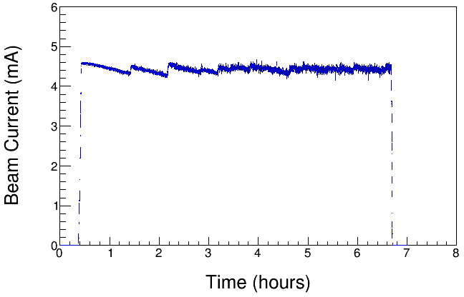
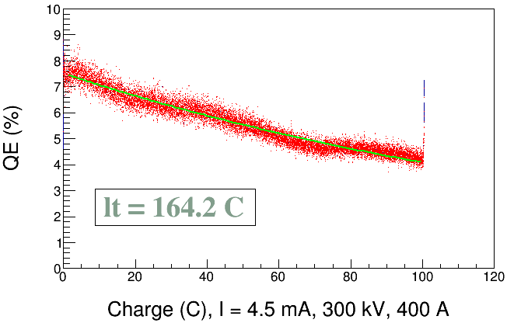
High Current Magnetized Beam
1511 G
1511 G
Delivered 4.5 mA DC magnetized beam for ~7 h.
Investigated charge lifetime from twenty two 1 h long runs of 3 - 4.5 mA beams at 200-300 kV gun HV, and 0-400 A gun solenoid current conditions. No apparent Lifetime dependency on gun HV, magnetization effect, or run sequence.
Only 3 times QE dropped due to arcing and happened only with non-magnetized beam. Strong focusing due to gun solenoid might have helped keeping ions stay away from e-beam.
For same laser spot size (0.38 mm rms)and gun HV, observed better lifetime at lower beam current, or Increased lifetime at lesser laser power
Investigating the efficacy and necessity of installed dc ion-clearing electrodes to stop ions in beamline from reaching gun and causing HV arcs.
To improve lifetime we will investigate metal substrate(Mo) and use different K₂CsSb photocathode recipes with increasing Sb layer thickness.

Slide 26
Outlook
Continue to characterize magnetized beam and cross check measurements with simulation
Measure and simulate space charge effect on magnetized beam
To study space charge effect with nano-coulombs bunch charge (1-2 nC), we will get a new laser 1-15 Hz, 50 ps.
Build and install TE₀₁₁ cavity to measure beam magnetization in collaboration with JLab SRF Institute and Brock Roberts (Electrodynamics LLC)
Demonstrate 32 mA magnetized beam. Need to install a new power supply (225 kV, 32 mA)
We will study charge lifetime for different photocathode recipes and substrates
Next:
- Funded Phase-II SBIR with Xelera, to develop rf-pulsed dc high voltage thermionic gun to be installed at Gun Test Stand (GTS) in FY19 – will use LDRD beamline
- I will be submitting an early career proposal for FY2020 on magnetized injector (if regularized)

Slide 27
Summary
K_{x}Cs_{y}Sb Photocathode Preparation Chamber, Gun, Solenoid and Beamline are all operational; photogun operates reliably at 300 kV
Installed wire scanner and measured emittance
Have successfully magnetized electron beam and measured rotation angle
Demonstrated 4.5 mA magnetized beam and measured lifetime
Installed RF pulsed laser, completed installation of Gain switched diode laser (1064 nm, 50 ps Gaussian pulses, doubling efficiency > 30%, 1.8W output, 1497/4=374.25 MHz)
Then switch to 32 mA 225 kV HV power supply….
Thanks to the people involved in this team work:
P. Adderley, J. Benesch, B. Bullard, J. Grames, J. Guo, F. Hannon, J. Hansknecht, C. Hernandez-Garcia, R. Kazimi, G. Krafft, M. Poelker, R. Suleiman, M. Tiefenback, Y. Wang, S. Wijiethunga, J. Yoskovitz, S. Zhang.
ODU Graduate Students

Slide 28
Backup Slides

Slide 29
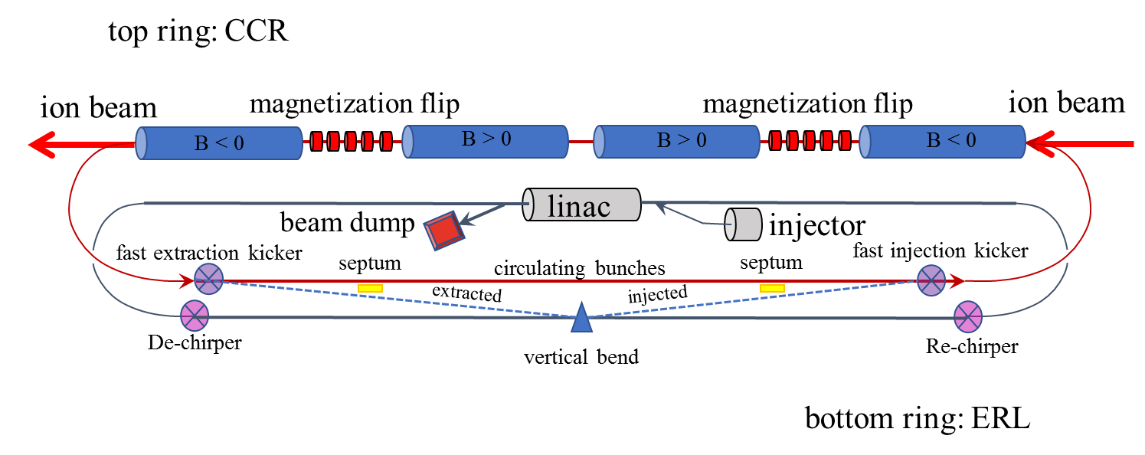
JLEIC High Energy Electron Cooler
High Energy Electron Cooler
Circulator Cooler Ring
ERL Ring

Slide 30
Charge Lifetime of High Current Beam
No apparent Lifetime dependency on gun HV, magnetization effect, or run sequence
Only 3 times QE dropped due to arcing and happened only with non-magnetized beam
Strong focusing due to gun solenoid might have helped keeping ions stay away from e-beam

Slide 31
Charge Lifetime of High Current Beam
Same laser spot size (0.38 mm rms)and gun HV
Better lifetime at lower beam current, or
Increased lifetime at lesser laser power
Good beam alignment is important
With HV off: No QE drop from 22 h illumination at 0.8 W (required for 4.5 mA runs), not even at 2 W for 2 h.
Laser spot size↑ and QE↑, good beam alignment ═ Photocathode Lifetime↑

Slide 32
Slit and Viewer Distance
for=> | S1-V2 | S1-V3 | S2-V3 |  | S1-V2 | S1-V3 | S2-V3
Distance, m: | 0.5 | 2.2965 | 1.7965 |  | 0.5 | 2.25666 | 1.75666
 | Old |  |  |  | New

