Slide 1
International Workshop on Future Linear Colliders (LCWS2023), SLAC, May 15-19, 2023
Andriy Ushakov
Ce+BAF WG Meeting
May 24, 2023

Slide 2
Jared Maxson

Slide 3
Carlos Hernandez-Garcia

Slide 4
Erdong Wang (BNL)

Slide 9
Carmen Tenholt (DESY)

Slide 10
Steffen Doebert (CERN)

Slide 11
Yoshinori Enomoto (KEK)

Slide 12
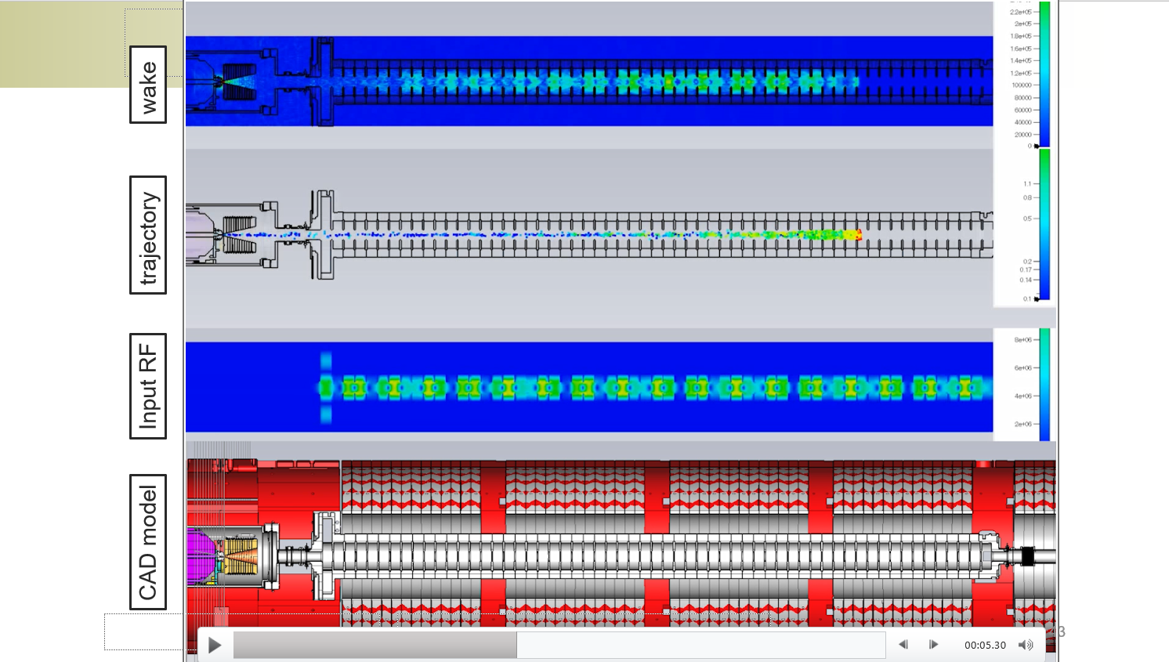
Yoshinori Enomoto (KEK)

Slide 13
Masao KURIKI (Hiroshima University)

Slide 14
Masao KURIKI (Hiroshima University)

Slide 15
Shunpei KUROGUCHI (Hiroshima University)

Slide 16
Masafumi Fukuda (KEK )

Slide 17
Spencer Gessner, SLAC

Slide 18
Max Varverakis (Cal Poly, SLO)

