Slide 1
Simulations of Water Cooled Tungsten Target of Positron Source at Low e⁻ Beam Energy (8 MeV)
Andriy Ushakov
IJCLab, Orsay
June 8, 2022
This project has received funding from the European Union’s Horizon 2020 research and innovation program under grant agreement No 824093

Slide 2
Parameters of Primary Beam and Target of Positron Source
Beam energy: electron beam with energy of 8 MeV
Beam current: 1 mA (and 2 mA)
RMS beam size on target: 1.5 mm
Target material: pure Tungsten
Target thickness: 1 mm
Average power deposited in 1 mm thick W target: 4.4 kW (55% of e⁻ beam power)

Slide 3
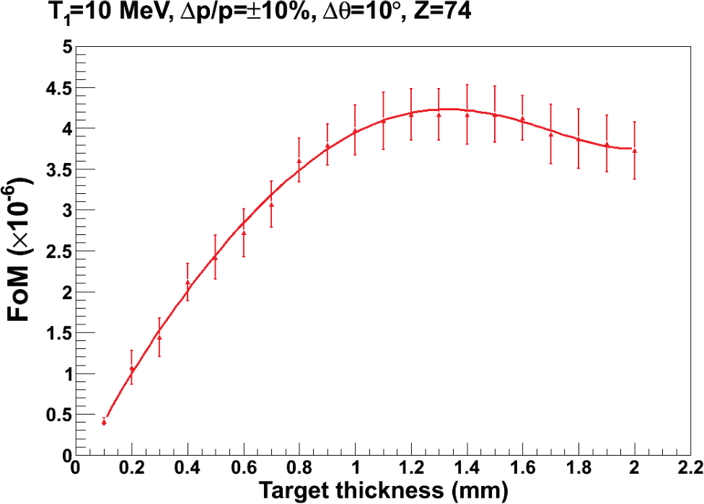
Optimal Target Thickness (Jonathan Dumas, PhD Thesis, 2011)
3

Slide 4
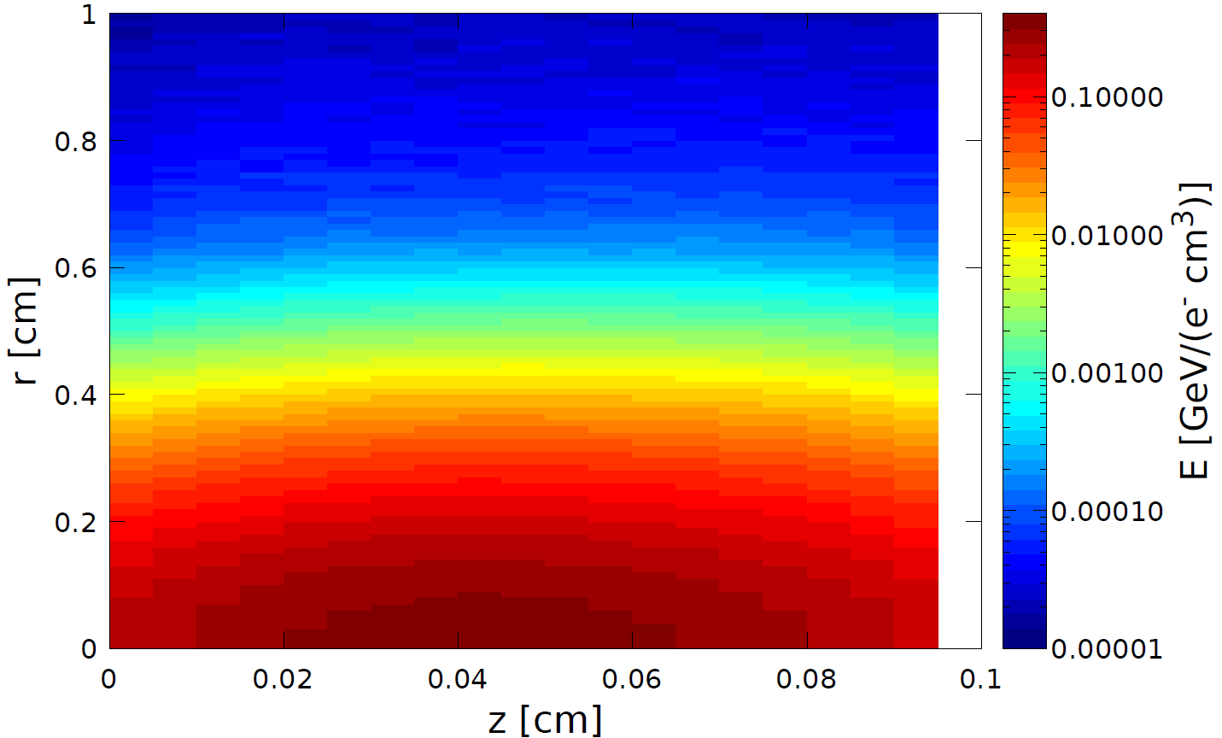
Energy Deposited by 120 MeV e⁻ (left) and 8 MeV e⁻ (right) in Stationary Tungsten Target
120 MeV e⁻, 4 mm Target Thickness
8 MeV e⁻ , 1 mm Target Thickness
PEDD = 0.34 GeV/(e⁻ cm³)
E_{dep} = 0.1425 E_{beam}
1 mA e⁻ beam: P_{dep} = 17 kW
PEDD = 0.36 GeV/(e⁻ cm³)
E_{dep} = 0.5487 E_{beam}
1 mA e⁻ beam: P_{dep} = 4.4 kW
4

Slide 5
Energy Deposited by 120 MeV e⁻ (left) and 8 MeV e⁻ (right) along Beam Axis (r = 0)
120 MeV e⁻
8 MeV e⁻
PEDD = 0.34 GeV/(e⁻ cm³)
PEDD = 0.36 GeV/(e⁻ cm³)
5

Slide 6
W Rim Cooled from One Side by Copper Disk with 10mm x 20mm Cross Section of Water Channel and 2 m/s Flow (ANSYS Fluent) Beam Passing through the Target at Radius of 17.5 cm
W
Water
Beam
R = 17.5 cm
Cu

Slide 7
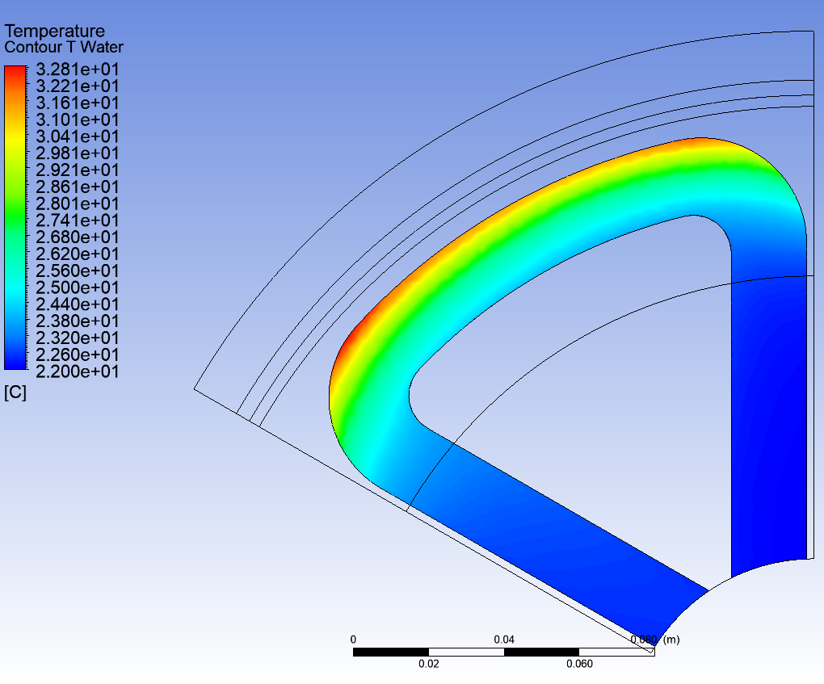
1 mA @ 8 MeV e⁻ Beam: Average Temperature of Tungsten (left) and Temperature of Water (right) for 2 m/s Water Flow
T_{max} = 181 °C
(120 MeV Beam: T_{max} = 260 °C)
T_{max} = 32.8 °C
(120 MeV Beam: T_{max} = 61 °C)
7

Slide 8
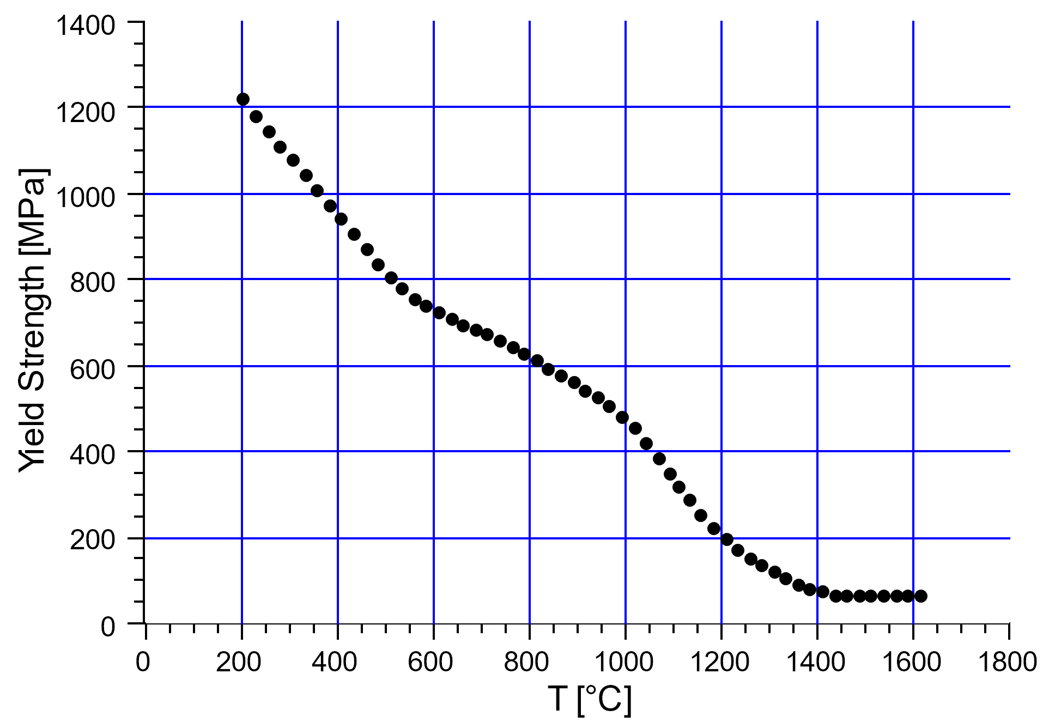
Average Thermal Stress (left) and Yield Strength of Tungsten vs Temperature (right)
Tungsten produced by Plansee
Max σ_{von-Mises} = 214 MPa
(120 MeV Beam: σ_{von-Mises} = 282 MPa)
Yield Strength (200°C) ≈ 1220 MPa
8

Slide 9
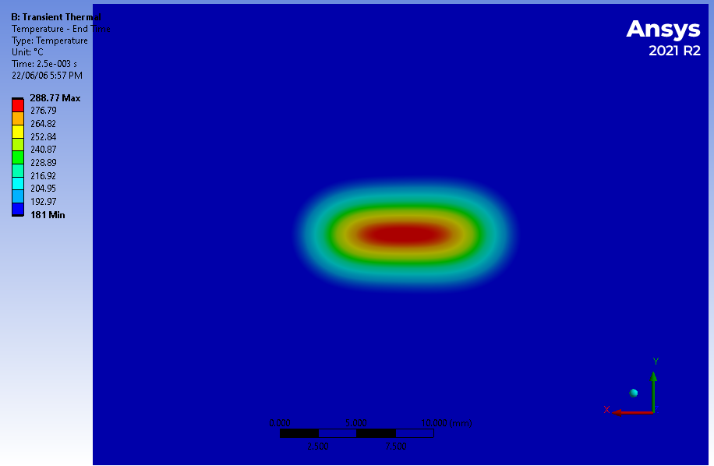
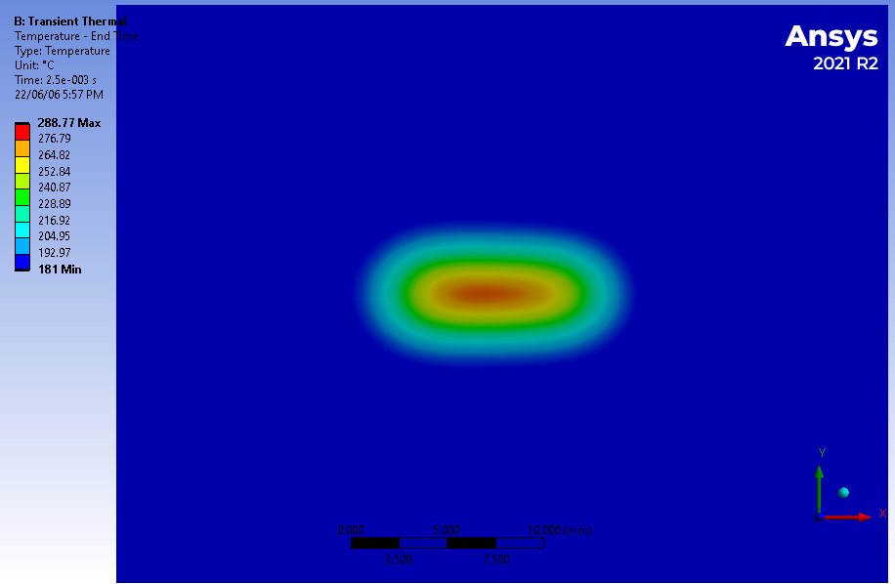
Temperature of Tungsten moving with 4 m/s
Snapshot of T at front side after 2.5 ms
Snapshot of T at back side after 2.5 ms
ΔT_{max} ≈ 108 °C
(120 MeV Beam: ΔT_{max} = 120 °C)

Slide 10
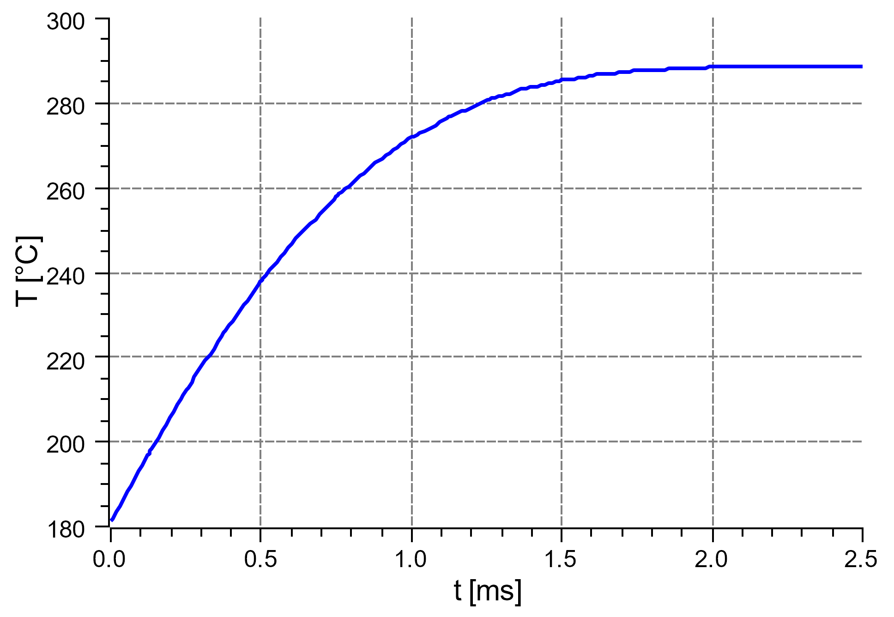
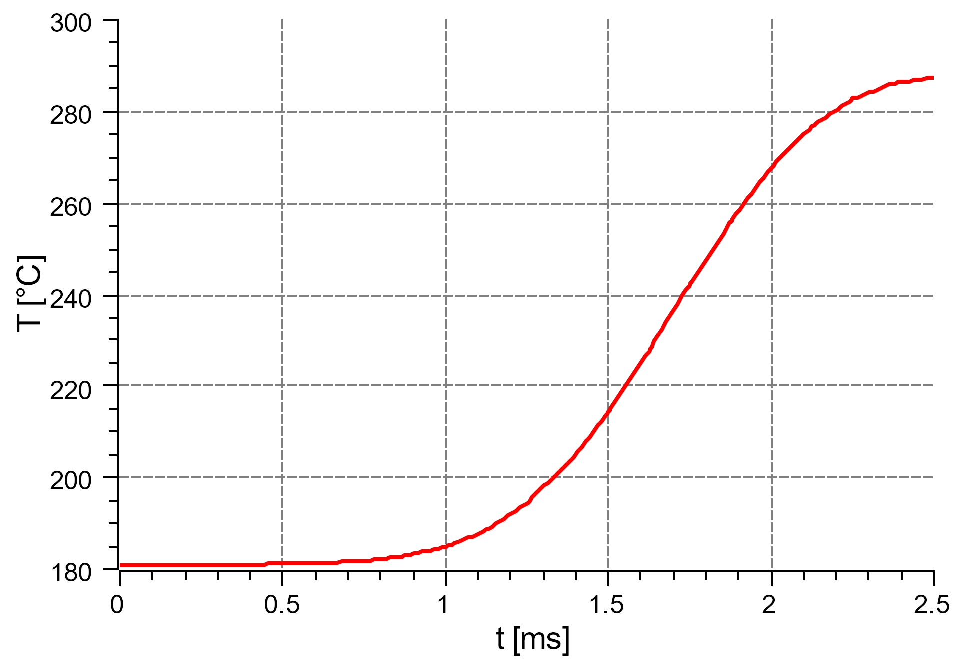
Temperature vs Time at Selected Point on Target moving with 4 m/s
“Global” max Temperature vs time
Temperature at selected point (probe) vs time
at R = 17.5 cm
T_{max} ≈ 289 °C

Slide 11
Thermal Stress after 2.5 ms for Beam Moving with 4 m/s
Max σ_{vM} ≈ 108 MPa

Slide 12
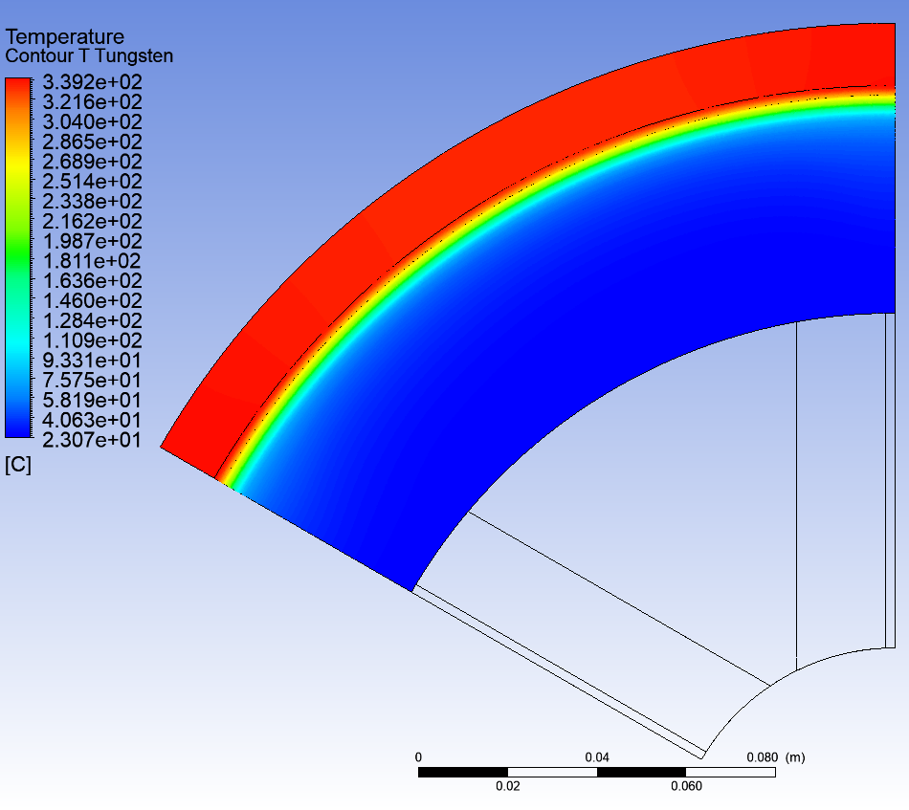
Average Temperature of Tungsten at 1 mA (left) and 2 mA (right) for 2 m/s Water Flow
T_{max} = 181 °C
T_{max} = 339 °C
12

Slide 13
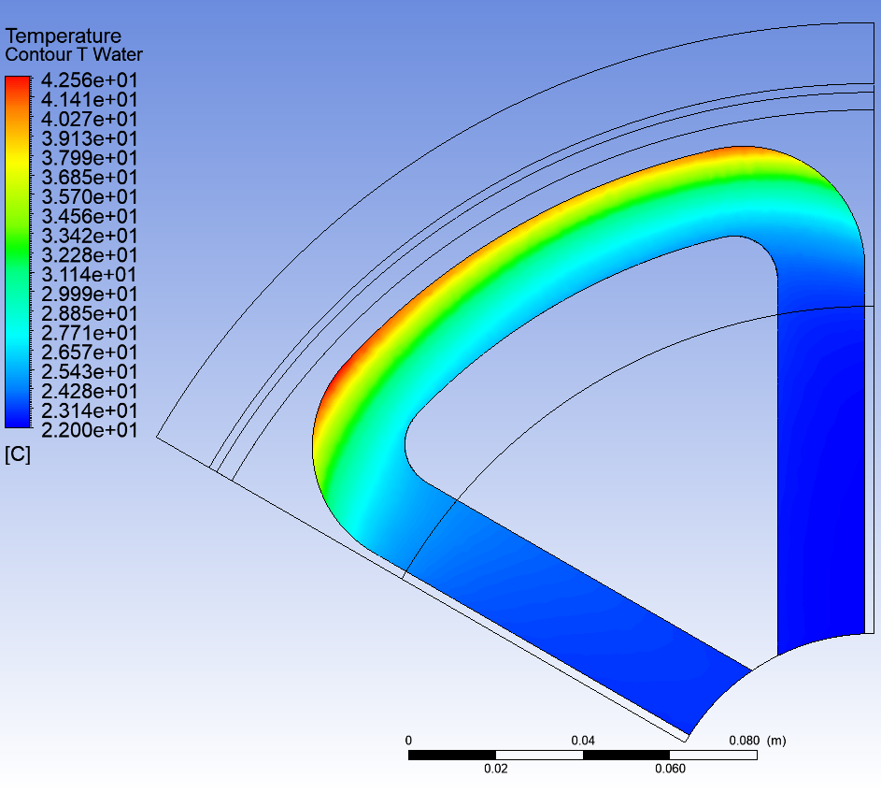
Average Temperature of Water at 1 mA (left) and at 2 mA (right)
T_{max} = 32.8 °C
T_{max} = 42.6 °C
13

Slide 14
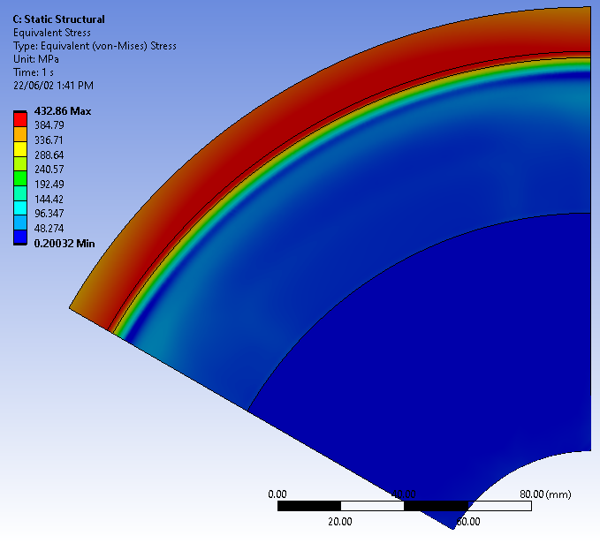
Average Thermal Stress at 1 mA (left) and 2 mA (right)
Max σ_{von-Mises} = 214 MPa
Max σ_{von-Mises} = 432 MPa
14

Slide 15
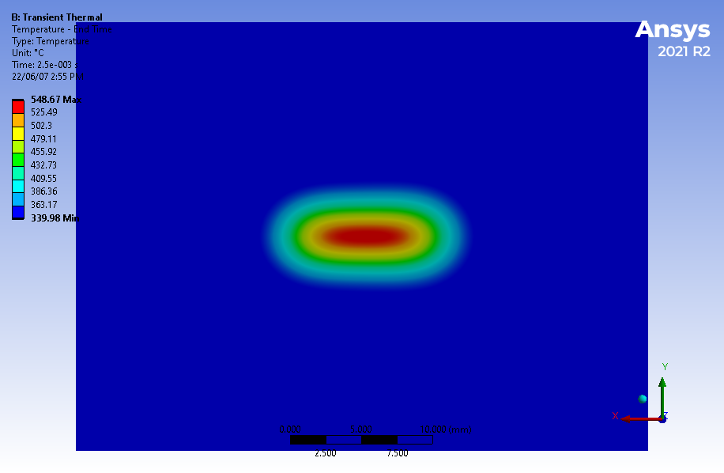
Temperature of Tungsten moving with 4 m/s at 1 mA (left) and 2 mA (right)
Snapshot of T at front side after 2.5 ms at 1 mA
Snapshot of T at front side after 2.5 ms at 2 mA
T_{max} ≈ 289 °C
T_{max} ≈ 549 °C

Slide 16
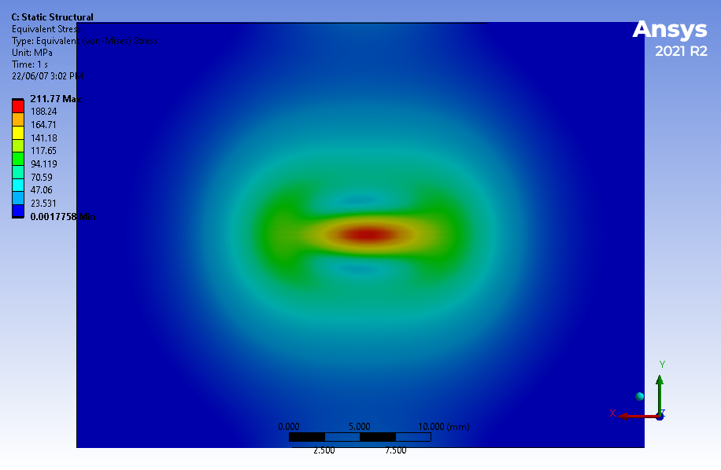
Thermal Stress of Tungsten moving with 4 m/s at 1 mA (left) and 2 mA (right)
Snapshot of stress at front side after 2.5 ms at 1 mA
Snapshot of stress at front side after 2.5 ms at 2 mA
Max σ_{vM} ≈ 108 MPa
Max σ_{vM} ≈ 212 MPa

Slide 17
Summary
Same concept of positron target can be used for the positron source at 120 MeV and 8 MeV
For target thickness of 1 mm at 1 mA and 8 MeV e⁻ beam and 2 m/s water flow:
Average deposited power is 4.4 kW
Average T_{max} of Tungsten = 181 °C
Average thermal stress of Tungsten = 214 MPa
Peak T of target moving with 4 m/s = 289 °C
Peak thermal stress of target moving with 4 m/s = 108 MPa
For target thickness of 1 mm at 2 mA and 8 MeV e⁻ beam and 2 m/s water flow:
Average deposited power is 8.8 kW
Average T_{max} of Tungsten = 339 °C
Average thermal stress of Tungsten = 432 MPa
Peak T of target moving with 4 m/s = 549 °C
Peak thermal stress of target moving with 4 m/s = 212 MPa

Slide 18
Backup Slides

Slide 19
Fatigue Strength of Tungsten. S-N Curve for Pure Tungsten at 22 °C (ANSYS Granta)

Slide 20
Temperature of stationary tungsten target after 64 ms irradiation by 1 mA @ 8 MeV electrons

