Slide 1
6/20/17 and 6/27/17 QE Scans and A1C1 Runs
Josh Yoskowitz

Slide 2
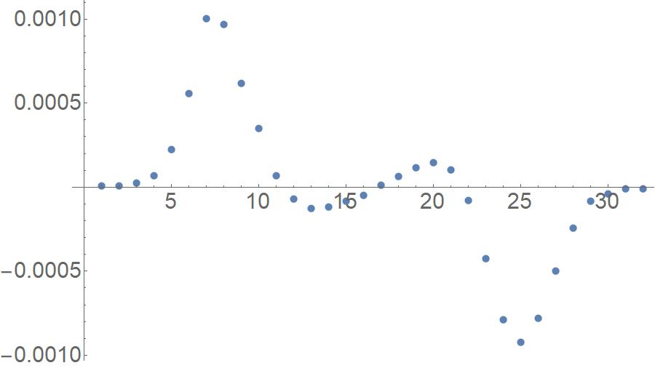
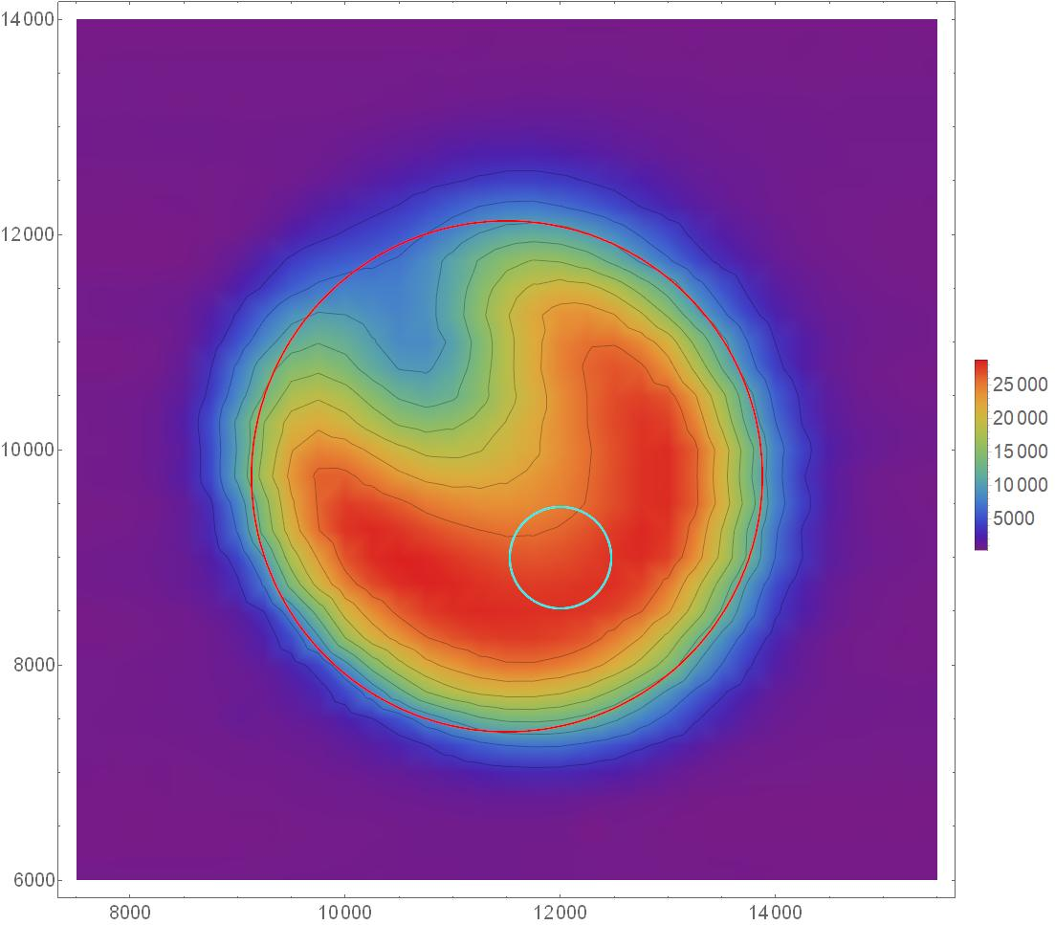
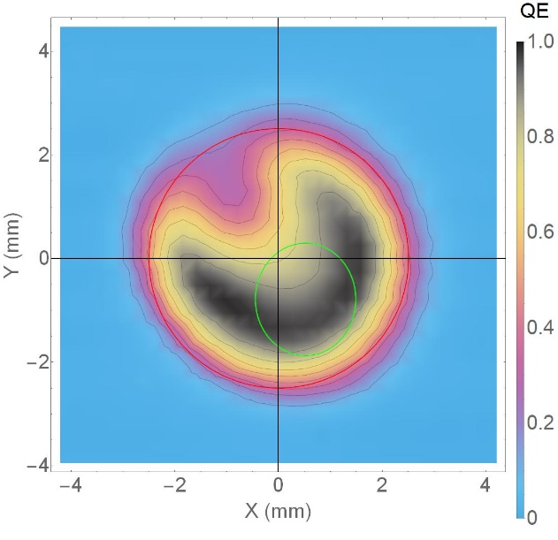
Calibration of QE Scan Data
Steps to calibrate data:
Convert ADC values to QE values using beam current, laser power, laser wavelength, etc.
Plot QE scan data by row.
For each row that crosses the active area (i.e. has significant, non-zero QE values): While approaching from the left and right sides of the plot, find the positions that correspond to the highest slope (i.e. highest absolute value of the derivative).
Find the difference in x-values between these two points – this corresponds to the distance across the active area at this row.
Plot all distances and then pick the largest distance – this corresponds to the diameter of the active area.
Set this distance (in steps) equal to 5mm – the diameter (FWHM) of the active area -- then use this to calibrate the data from steps to mm. This row is also the center of the active area, thus the QE scan can also be centered about the active area.
Using the steps to mm conversion factor, the laser spot (cyan circle) can be plotted.
Slope
Column #
Y (steps)
QE
X (steps)
QE

Slide 3
6/20/2017 at QE Scan
Date/Time: 6/20/17 at 9:09 AM
Photocathode Active Area (Red Circle): 5mm Diameter
4σ Laser Spot Size: 3.3mm²
4σ Diameters: σ_{x} = 1.928 mm, σ_{y} = 2.162 mm
Laser Configuration C1, Lens OUT
Laser Spot: (12000, 9000)=(0.53mm, -0.79mm)
Note that the laser spot was originally at (11500,9000), but was shifted due to unsuccessful setup
Activation A1
Log Entry: https://logbooks.jlab.org/entry/3476599
Comments:
QE scan just after activation A1, but before beam run (6/21/17-6/27/17)

Slide 4
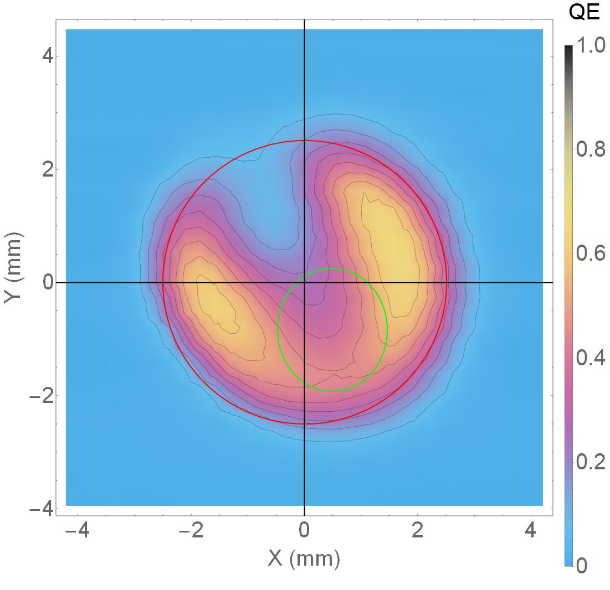
6/27/2017 QE Scan
Date/Time: 6/27/17 at 8:33 AM
Photocathode Active Area (Red Circle): 5mm Diameter
4σ Laser Spot Size: 3.3mm²
4σ Diameters: σ_{x} = 1.909 mm, σ_{y} = 2.219 mm
Laser Configuration C1, Lens OUT
Laser Spot: (12000, 9000)=(0.53mm, -0.79mm)
Activation A1
Log Entry: https://logbooks.jlab.org/entry/3477314 Comments:
QE scan just after beam run.
QE degradation over entire beam area.
Overall QE has apparently decreased by ~0.2%.
Highest degradation northwest of laser spot.

Slide 5
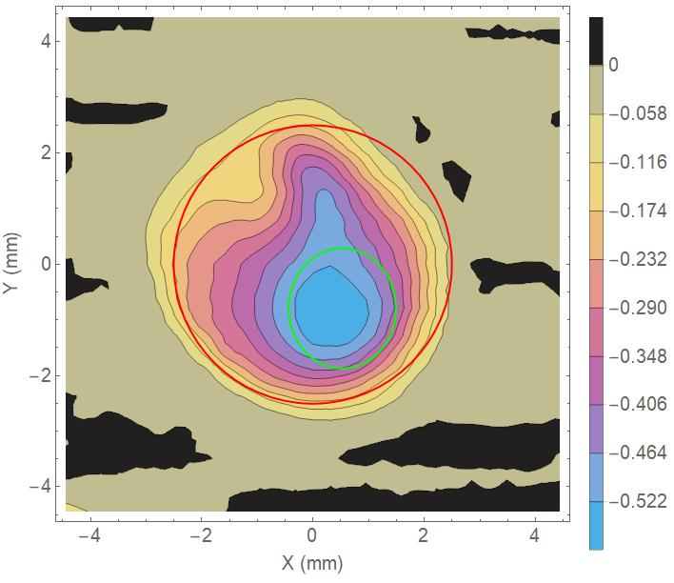
6/27 – 6/20 QE Difference Scan
ΔQE
Total run time: 2374 minutes
Total time between scans: 10044 minutes
Total Charge Extracted: 118.071 C
Average Lifetime: 188.348 C

Slide 6
A1C1 Runs Summary (from LifeSize Spreadsheet)
Date | Run/QE Scan | Laser X (steps) | Laser Y (steps) | Current (mA) | Activation | Laser Config | Lens | Spotsize (mm²) | Duration (min.) | Charge Extracted (C) | Average Lifetime (C)
06/20/17 | QE Scan |  |  |  |  | C1 | OUT | 3.3
06/21/17 | Run 1 Start | 12000 | 9000 | 0.5 | A1 | C1 | OUT | 3.3
06/22/17 | Run 1 End | 12000 | 9000 | 0.5 | A1 | C1 | OUT | 3.3 | 660 | 19.789 | 116.817
06/22/17 | Run 2 Start | 12000 | 9000 | 1.0 | A1 | C1 | IN | 9.9
06/22/17 | Run 2 End | 12000 | 9000 | 1.0 | A1 | C1 | IN | 9.9 | 356 | 21.357 | 379.439
06/22/17 | Run 3 Start | 12000 | 9000 | 0.5 | A1 | C1 | IN | 9.9
06/23/17 | Run 3 End | 12000 | 9000 | 0.5 | A1 | C1 | IN | 9.9 | 607 | 18.1963 | 113.545
06/23/17 | Run 4 Start | 12000 | 9000 | 1.5 | A1 | C1 | IN | 9.9
06/23/17 | Run 4 End | 12000 | 9000 | 1.5 | A1 | C1 | IN | 9.9 | 254 | 22.8639 | 283.561
06/23/17 | Run 5 Start | 12000 | 9000 | 1.5 | A1 | C1 | OUT | 3.3
06/23/17 | Run 5 End | 12000 | 9000 | 1.5 | A1 | C1 | OUT | 3.3 | 204 | 18.2863 | 102.835
06/23/17 | Run 6 Start | 12000 | 9000 | 1.0 | A1 | C1 | OUT | 3.3
06/23/17 | Run 6 End | 12000 | 9000 | 1.0 | A1 | C1 | OUT | 3.3 | 293 | 17.5785 | 133.89
06/27/17 | QE Scan |  |  |  |  | C1 | OUT | 3.3

Slide 7
6/20 and 6/27 QE Scan Summary
Date | Time | Laser Spot (steps) | Laser Spot (mm) | Min QE (%) | Max QE (%) | Average QE (%) | Std Dev (%)
06/20/17 | 9:09 AM | (12000, 9000) | (0.53, -0.79) | 0.0021 | 0.99 | 0.21 | 0.31
06/27/17 | 8:33 AM | (12000, 9000) | (0.53, -0.79) | 0 | 0.67 | 0.12 | 0.18
Calculation | Value
Gaussian-weighted integral (GWI) within laser spot for 06/20/17 QE Scan | 0.3591
Gaussian-weighted integral (GWI) within laser spot for 06/27/17 QE Scan | 0.1575
Total charge extracted Q (C) | 118.071
Average lifetime of all runs τ (C) | 188.348
Gaussian-Weighted Integral (GWI):
Gaussian-Weighted Integral: $GWI=\iint_{S}{G\left(x,y\right)f\left(x,y\right)dxdy}$
2D Gaussian Function: $G\left(x,y\right)=\frac{1}{2πσ_{x}σ_{y}}\exp\left[−\left(\frac{{\left(x−x_{o}\right)}^{2}}{2σ_{x}^{2}}+\frac{{\left(y−x_{o}\right)}^{2}}{2σ_{y}^{2}}\right)\right]$
$f(x,y)$ denotes the QE scan interpolation function (from Mathematica)
S is the (elliptical) area of the laser spot at $\left(x_{0},y_{0}\right)$ with radii
Exp(-Q/τ) | 0.5343
GWI Quotient (2nd/1st) | 0.4384
% Difference | 17.94

