Slide 1
Alkali-antimonide photocathodes using co-deposition and an effusion source
Md Abdullah A. Mamun
Carlos Hernandez-Garcia
Matthew Poelker
P3 Workshop : Photocathode Physics for Photoinjectors, November 3-5, 2014
Lawrence Berkeley National Laboratory, Berkeley, California, USA

Slide 2
Provided an important measure of weak mixing angle and validation of the Standard Model

Slide 3
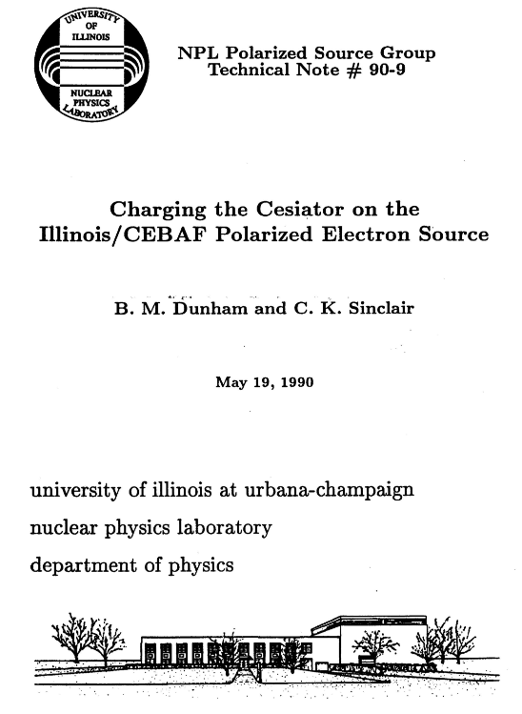
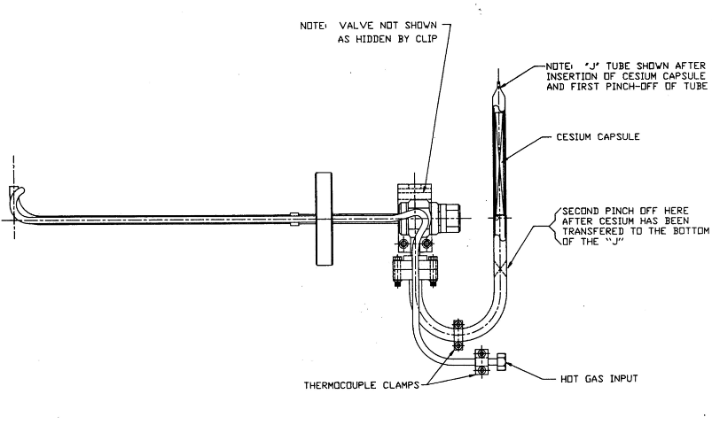
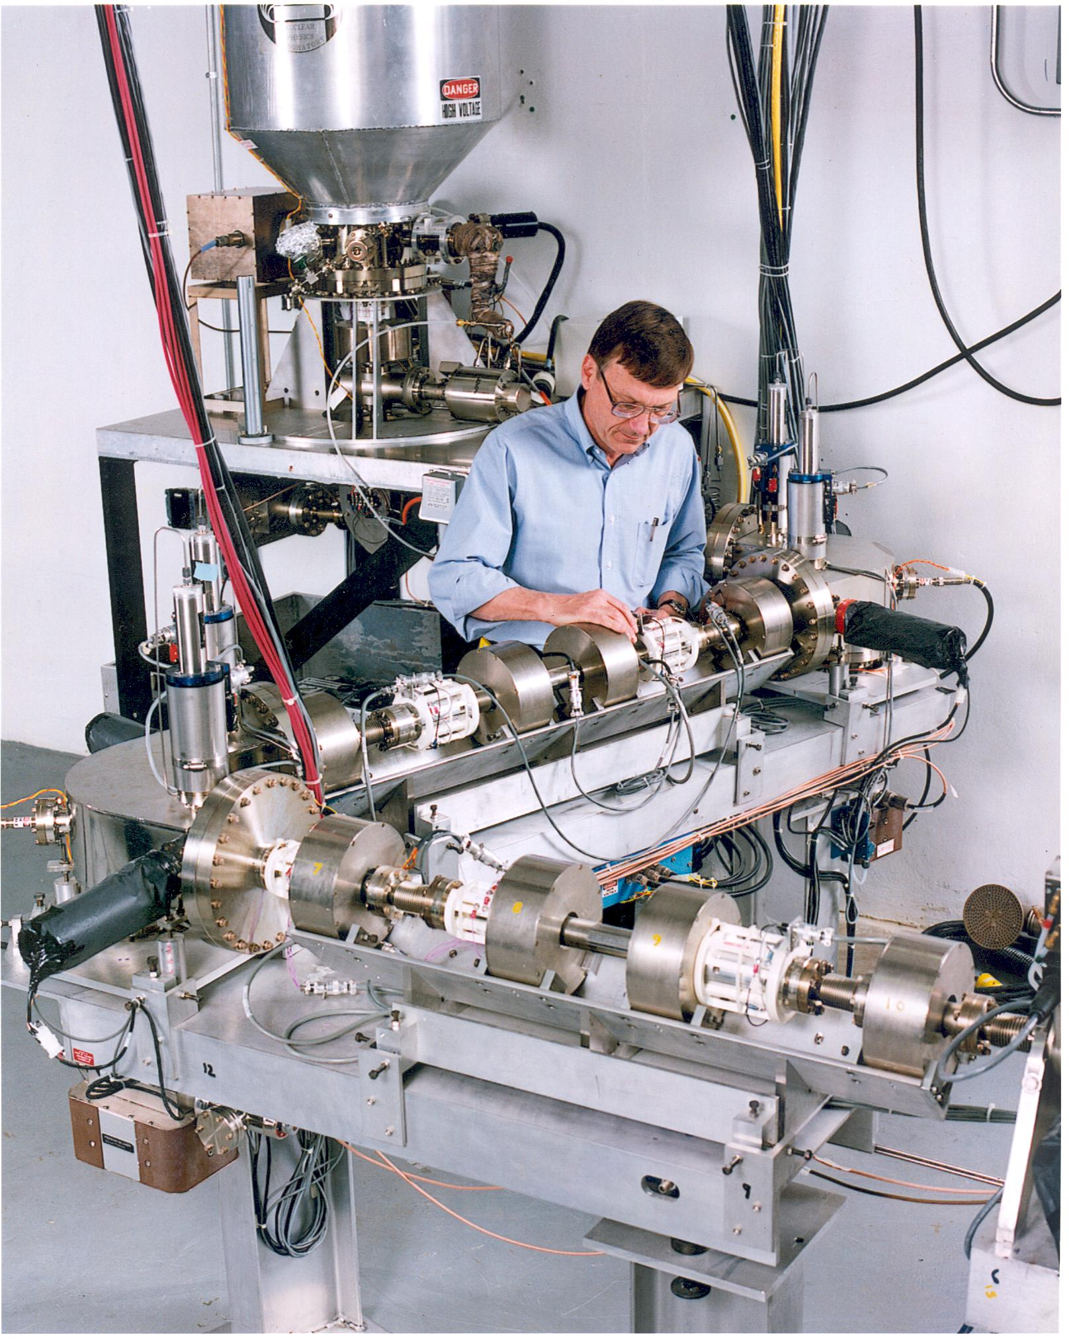
http://www.jlab.org/accel/inj_group/docs/NPL-TN/90-9.pdf
Too much cesium, some deposited on cathode electrode….

Slide 4
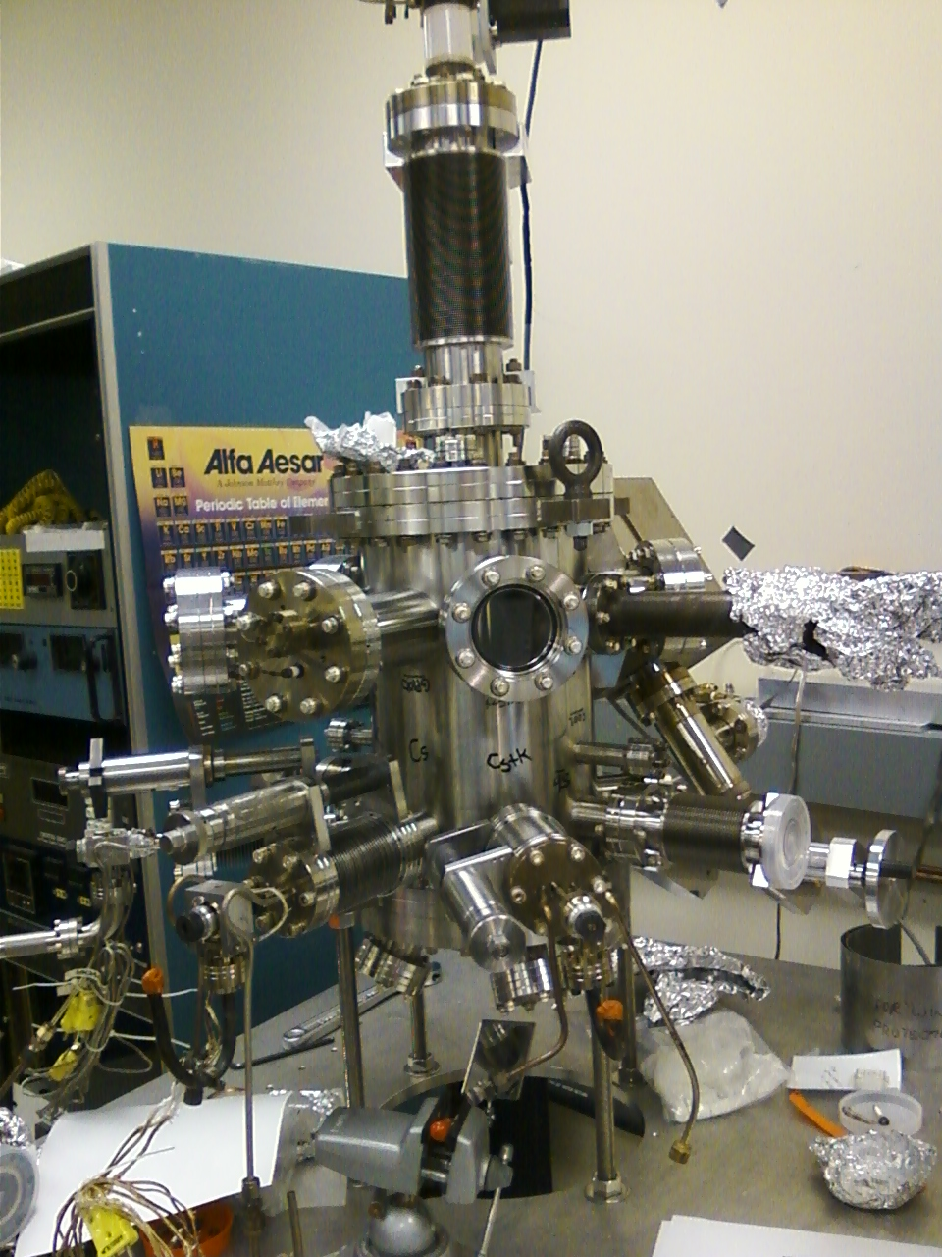
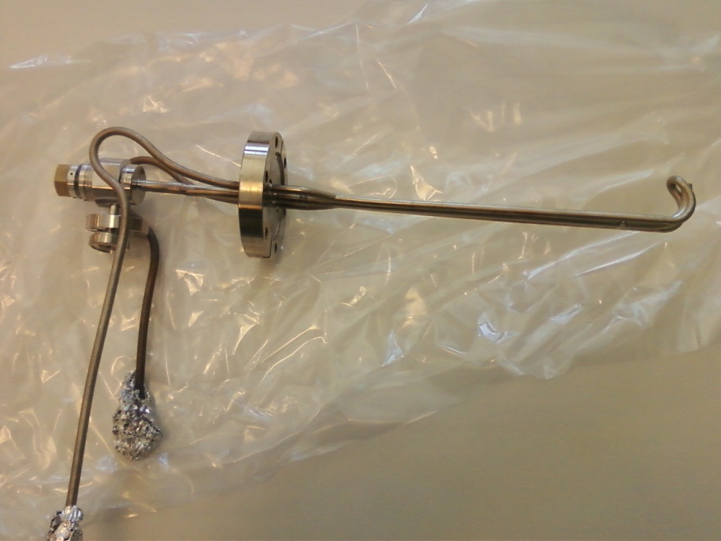

Slide 5
Motivation
JLab’s introduction to alkali-antimonide photocathode fabrication…
Can an inexpensive effusion source be used to make good alkali-antimonide photocathodes?
How does the thickness/amount of Sb dictate the ultimate QE and low voltage lifetime of K_{x}Cs_{y}Sb?
To understand the substrate sensitive growth of Sb
How does a baked or unbaked system effect on bialkali photocathode and its performance.
To understand the role of Sb for the bi-alkali photocathodes

Slide 6
K-Cs Co-deposition using Effusion Source
Substrate temp: Falling from 120 °C to ° 80 C
Duration of evaporation varied depending on QE to optimize
Monitored QE using a 532 nm green laser with cathode biased at V_{b}=284 V
K ampoules (1 gram in argon) from Espimetals, and Cs ampoules (1 gram in argon) from Strehm Chemicals
Evaporation of bi-alkali was controlled by adjusting heater power and gas flow through the effusion source, in the following ranges:
Inlet tube: 381-462 °C
Dispensing tube: 232-294 °C
Reservoir tube: 153-281 °C
Partial pressure of alkali vapors was monitored using residual gas analyzer (RGA) during deposition, not the usual quartz crystal thickness monitor.
Such as, for 387 °C at inlet tube, 259 °C at dispensing tube , and 184 °C at reservoir:
Cs PP on RGA: 1.35(±0.1)×10⁻¹⁰ Torr
K PP on RGA: 3.15(±0.5)×10⁻¹¹ Torr
The duration of deposition, to optimize QE, was also recorded for each case.

Slide 7
Role of Sb for Bialkali Photocathode
Baked system: Sb PP of 5.5×10⁻¹¹ Torr, T_{sub}= 200 °C, 32.7 A from power supply
30 min Sb deposition
100 min Sb deposition
Same amount of bialkali, No QE on GaAs ?
During deposition QE optimized on Ta area
Adequate bialkali for Sb on Ta=right stoichiometry
Excess bi-alkali for GaAs region with thinner Sb
Same amount of bialkali, No QE on Ta ?
During deposition QE optimized on GaAs area
Adequate bialkali for Sb on GaAs=> right stoichiometry
Inadequate bi-alkali for Ta region with thicker Sb
Photoemission is sensitive to stoichiometry, Optimum Stoichiometry is essential for good QE
Sb thickness variation ⬄ variation in amount of bialkali to result the same right stoichiometry
Co-deposition of bi-alkali allows optimization of stoichiometry for any thickness of Sb
and
This is easily achieved using the effusion type evaporation source

Slide 8
Sb growth: Ta vs. GaAs Substrate(Baked System)
Sb PP of 5.5×10⁻¹¹ Torr , 100 min at T_{sub}= 200 °C, 32.7 A from power supply
Sb on Ta
Sb on GaAs
Sb on GaAs
Sb on GaAs
Max. grain height ~ 100 nm
Sb PP of 1×10⁻¹⁰ Torr , 120 min at T_{sub}= 200 °C, 33.6 A from power supply
Sb on Ta
Sb on GaAs
Sb on GaAs
Sb on GaAs
FE-SEM images
Max. grain height ~ 600 nm
Initially Sb grows more favorably on Ta compared to GaAs.
Once the Sb layer is established on GaAs, the Sb structure on both GaAs and Ta substrate observed to be in similar scale.
Indicates:
Sticking coefficient of Sb on Ta is better than that on GaAs.
Time of formation of initial monolayers of Sb on GaAs takes longer than on Ta.
The subsequent growth of Sb on Sb monolayers occurs at similar pace on both Ta and GaAs.

Slide 9
Sb growth: Baked vs. Unbaked System
Sb PP of 5.5×10⁻¹¹ Torr , 100 min at T_{sub}= 200 °C, 32.7 A from power supply
Leak-free baked system
Sb on Ta
Sb on GaAs
Sb on GaAs
Sb on GaAs
Max. grain height ~ 100 nm
Post-leak unbaked system
Sb on Ta
Sb on GaAs
Sb on GaAs
Sb on GaAs
Max. grain height ~ 300 nm
Sb growth was enhanced on GaAs in the unbaked system compared to baked system
Sb growth was equally favored on both Ta and GaAs substrates in the unbaked system.
Indicates :
Sticking coefficient of Sb on GaAs is enhanced in the unbaked system and become similar to that on Ta.
Monolayers of Sb on both GaAs and Ta grew at the same pace.
Sb films on Ta and GaAs are expected to be of similar thickness in the unbaked system.

Slide 10
QE: Baked vs. Unbaked System
Sb PP of 5.5×10⁻¹¹ Torr, T_{sub}= 200 °C, 32.7 A from power supply, 532 nm laser
30 min Sb deposition
100 min Sb deposition
Baked System: QE observed only on one substrate ⬄ Dissimilar Sb growth on GaAs and Ta
Unbaked System: QE observed on both substrates ⬄ Similar Sb growth on both substrates

Slide 11
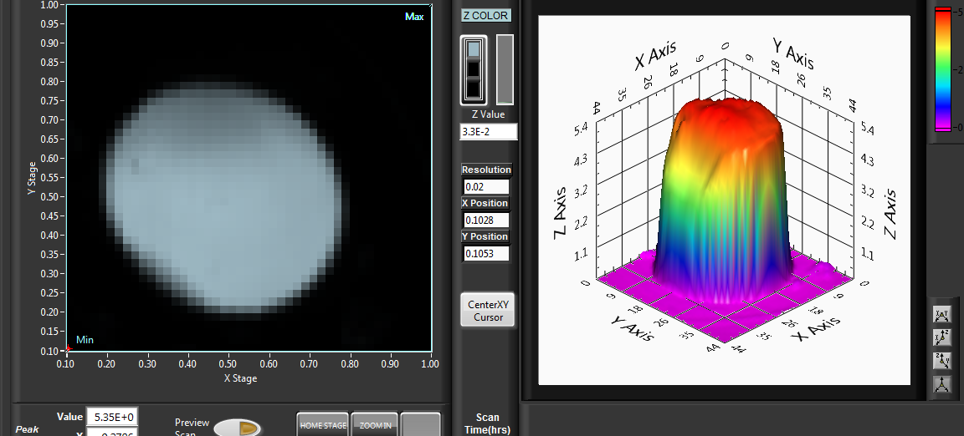
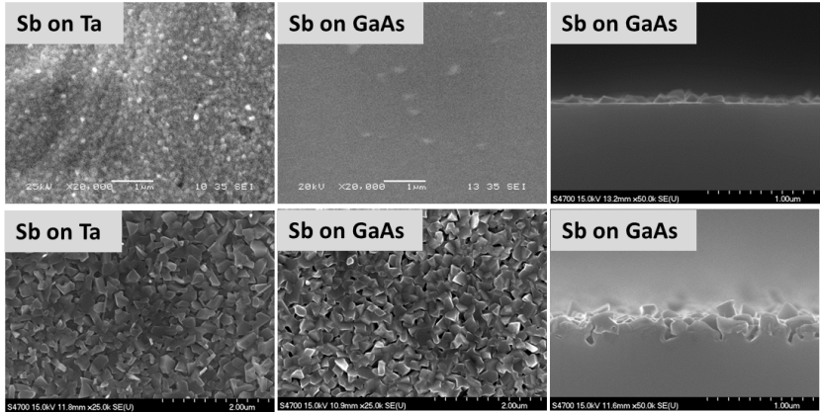
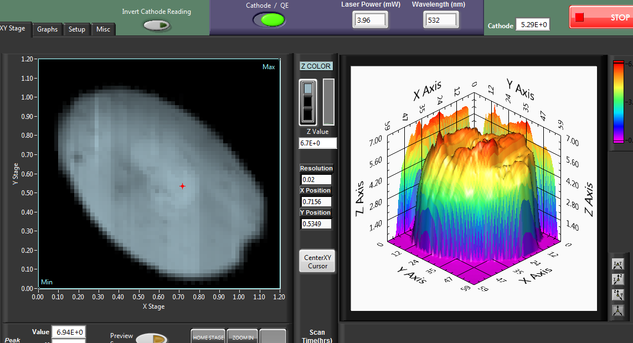
QE: Baked vs. Unbaked System
Sb PP of 5.5×10⁻¹¹ Torr , 100 min at T_{sub}= 200 °C applying 32.7 A current, 532 nm laser
During co-deposition QE was optimized w.r.t GaAs area
Baked system
5.3% QE on GaAs area
No QE on Ta area!
GaAs Ta
Leak-free baked system
Unbaked system
Post-leak unbaked system
~7% QE on GaAs and Ta area
GaAs Ta
In the baked system, No QE on Ta ?
Same amount of K-Cs => Adequate for thinner Sb on GaAs => But, Inadequate for thicker Sb on Ta

Slide 12
Sb Qty. vs. Bialkali Qty.
An indirect approach
$$Norm A=\frac{tAi .PPAi}{tAo.PPAo}$$
$t$ = time of deposition
$PP$ = Partial Pressure
$i$ = trial index
$o$ = benchmark trial’s index
[UBS] Sb/Ta, QE (%) : 8 8 10 10 10
[UBS] Sb/GaAs, QE (%) : 5.5 6 8 8 10
[BS] Sb/Ta, QE (%) : 3 0 0 ---- 0
[BS] Sb/GaAs, QE (%) : 0.5 5 8.5 ---- 0
[UBS]Sb/GaAs, t_{Sb}, nm : >15 >35 300 >350 >600
[BS] Sb/GaAs, t_{Sb}, nm : 15-25 35-50 100 >320 ~600
Excess K-Cs
Inadequate K-Cs
Amorphous
Granular
Evaporated amount of both the Cs and K are dependent on Sb amount evaporated.
Increasing Sb Thickness => Increasing porosity & Surface roughness=> Larger surface area=> Higher capacity to absorb bi-alkali

Slide 13
Role of Sb for Bialkali Photocathode
DC voltage: 284 V, λ= 532 nm, 3.96 mW
Excess K-Cs
Inadequate K-Cs
[UBS]Sb/GaAs, t_{Sb}, nm : >15 >35 300 >350 >600
[BS] Sb/GaAs, t_{Sb}, nm : 15-25 35-50 100 >320 ~600
Amorphous
Granular
Sb serves as a sponge

Slide 14
Role of Sb for Bialkali Photocathode
Thicker Sb => Porous crystalline granular film => Rougher topography
Thinner Sb => Denser amorphous film => Smoother surface.
Porous Sb film => More alkali absorption capacity => Require longer duration of alkali deposition => Delay in showing photo-current during deposition => Longer low voltage lifetime.
Denser amorphous Sb film => Lower alkali absorption rate in Sb => Quickly reaches right alkali amount on the surface => Readily show photo-current during deposition => Shorter low voltage lifetime.
Sb is acting as a reservoir to hold the bialkali materials

Slide 15
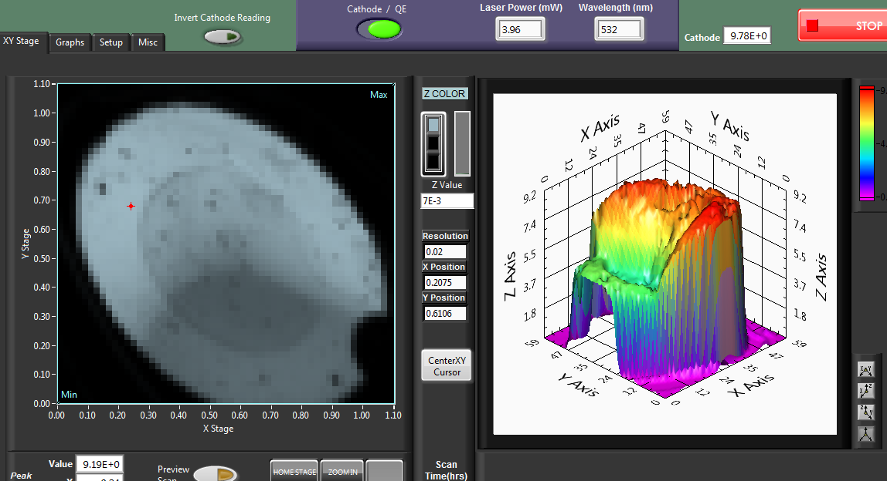
Spectral Response
Sb PP of 5.5×10⁻¹¹ Torr , 120 min at T_{sub}= 200 °C, 32.7 A from power supply (unbaked system)
With λ = 532 nm laser and V_{b}=284 V
The best QE spot on:
Ta: ~10%
GaAs: ~8%
GaAs Ta
With λ = 425 nm laser and V_{b}=284 V
The best QE spot on:
Ta: ~ 24.2%
GaAs: ~ 22%
GaAs Ta

Slide 16
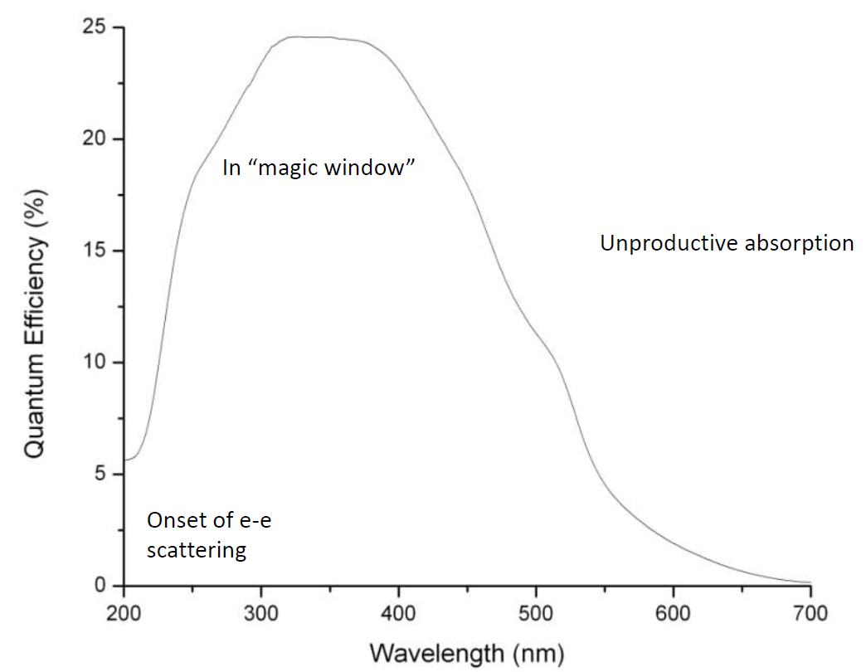
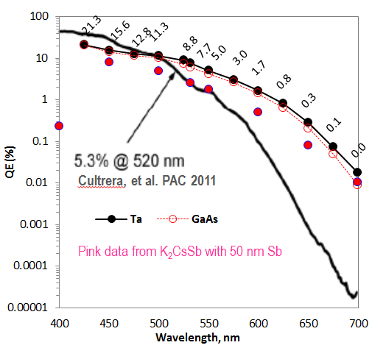
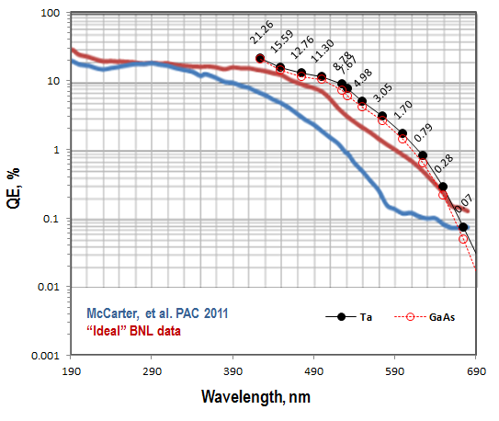
Spectral Response
Sb PP of 5.5×10⁻¹¹ Torr , 120 min at T_{sub}= 200 °C, 32.7 A from power supply (unbaked system)
The best QE spot on Ta = 24.2% and on GaAsa~22% at λ=425 nm, V_{b}=284 V
Ref: CHESS seminar 2013 Smedley
If we did this measurement earlier when QE was ~10% at 532 nm compared to 9% when this data is taken after 7days of deposition, we could have seen >21.3% (~27 %) QE at 425 nm

Slide 17
Advantage of Effusion Source
Relatively compact
Convenient for bi-alkali co-deposition
Co-deposition enables achieving optimized stoichiometry for even thicker(>500 nm) Sb
Preserves the alkali supply when the rest of the vacuum system is vented
Allows alkali replacement without venting the rest of the deposition chamber
Very high alkali storage capacity
Relatively inexpensive and easy to operate

Slide 18
Backup slides

Slide 19
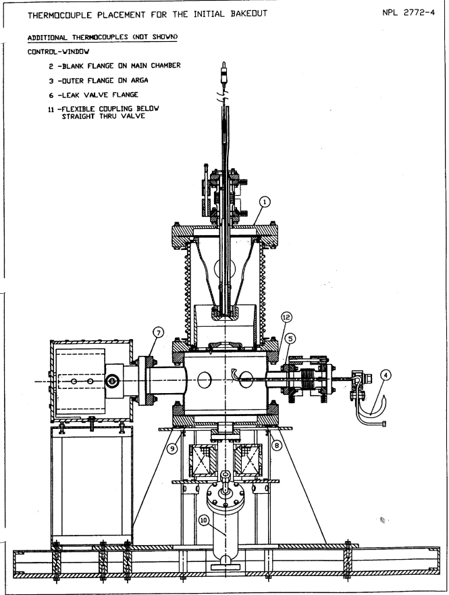
University of Illinois, ~ 1990
CEBAF, ~ 1996

Slide 20
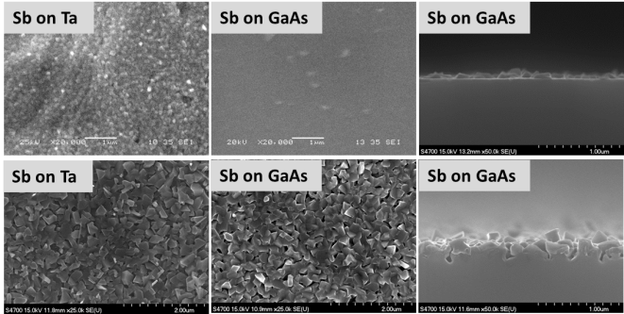
List of Trials
Current Supply to Sb furnace | Time of Sb deposition | Baked/unbaked system (BS/UBS)
32.7(±0.3) A | 30 min | Baked & Unbaked
32.7(±0.3) A | 70 min | Baked & Unbaked
32.7(±0.3) A | 100 min | Baked & Unbaked
31.0(±0.3) A | 120 min | Unbaked
33.7(±0.3) A | 120 min | Baked & Unbaked
MGH ~ 100 nm
MGH ~ 300 nm
MGH ~ 600 nm

Slide 21
Sb Growth on Ta
Sb source: Sb pellet from Alfa Aesar
1×10⁻¹¹ Torr Sb PP, 60 min
5.5 × 10⁻¹¹ Torr Sb PP, 100 min
1 × 10⁻¹⁰ Torr Sb PP, 120 min
Ta Substrate
Substrate Temperature, T_{sub}= 200 °C
With the increase in Sb deposition rate or duration
The Sb crystals get bigger
The Sb film gets increasingly porous
Topography becomes rougher.

Slide 22
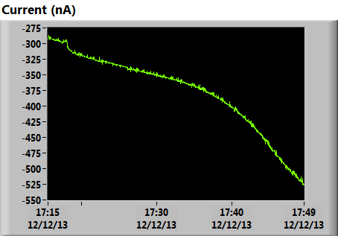
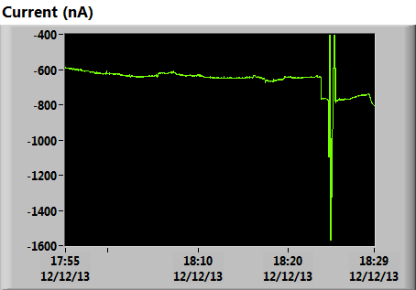
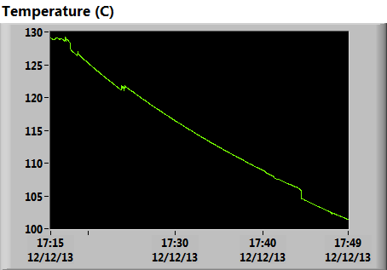
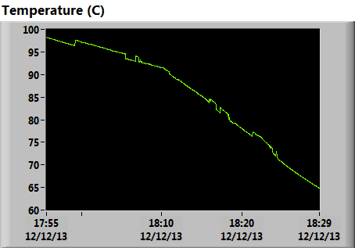
K-Cs co-deposition on ~50 nm Sb
Deposition control parameters
Cs PP on RGA: 1.35(±0.1)E-10 Torr
K PP on RGA: 3.15(±0.5)E-11 Torr
Substrate temp: Falling from 120 C to 80 C
Deposition time: 75 min

Slide 23
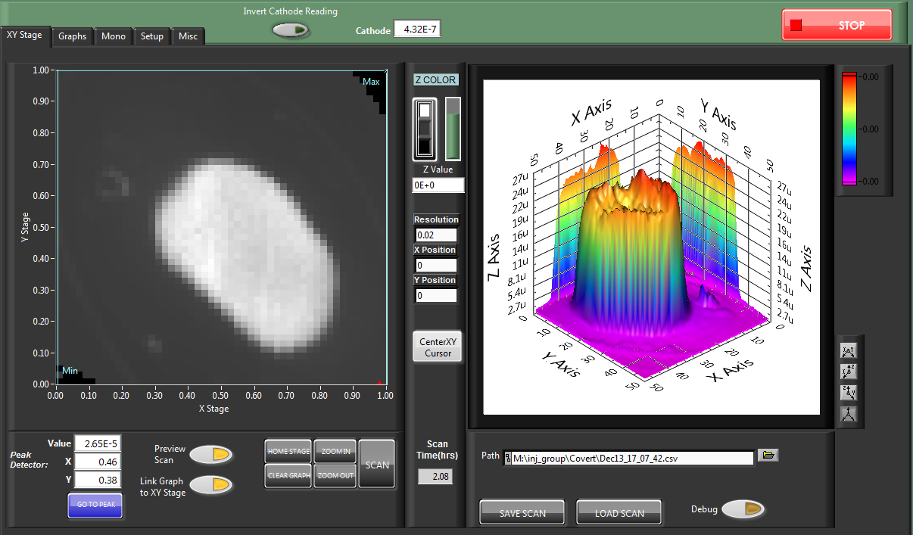
Photocurrent from Cs_{x}K_{y}Sb with ~50 nm Sb
7.3 % QE_{max} at 532 nm on GaAs, No QE from Ta

Slide 24
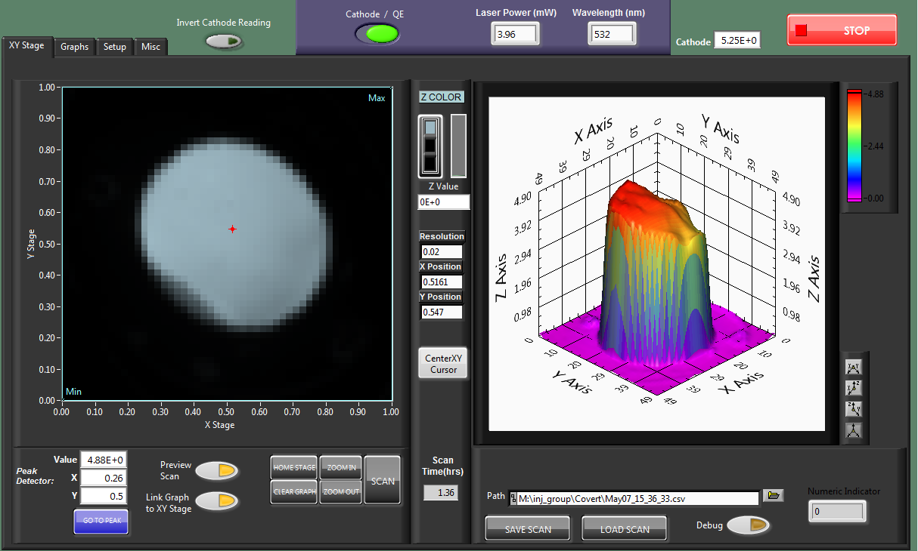
Cs_{x}K_{y}Sb with ~35 nm Sb on GaAs (leakfree baked system)
Monitored ~5 % QE_{max} at 532 nm on GaAs, No QE from Ta

Slide 25
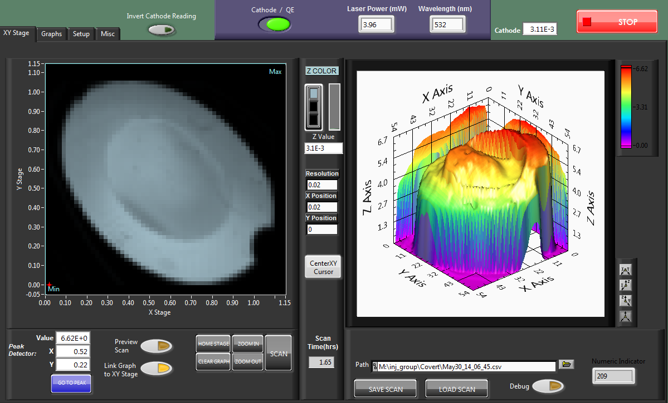
Cs_{x}K_{y}Sb with 35 nm Sb on GaAs (post leak unbaked system)
Monitored ~6 % QE_{max} at 532 nm on GaAs, ~ 8% on Ta

Slide 26
Sb(~100 nm) on GaAs: Ta vs. GaAs
Sb on Ta
Sb on GaAs
Initially Ta favors growth of Sb film on it, indicating that the relative Sb film thickness differs more as the films get thinner.

Slide 27
Sb(~600 nm) on GaAs: Ta vs. GaAs
Sb on Ta
As Sb grow thicker, the Sb structure on both GaAs and Ta substrate observed to be in similar scale.
Which indicates that the relative Sb film thickness difference minimizes as the films get thicker.
Sb on GaAs

