Slide 1
Bubble Demo Radiator

Slide 2
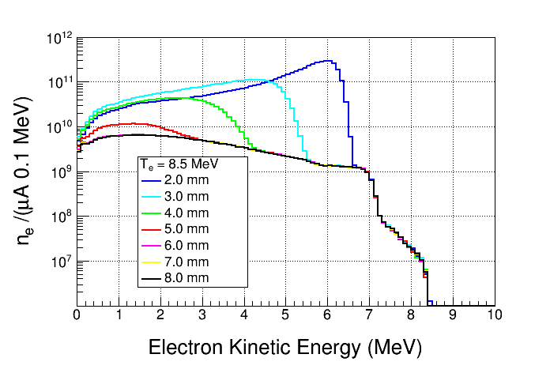
Electrons Exiting Radiator

Slide 3
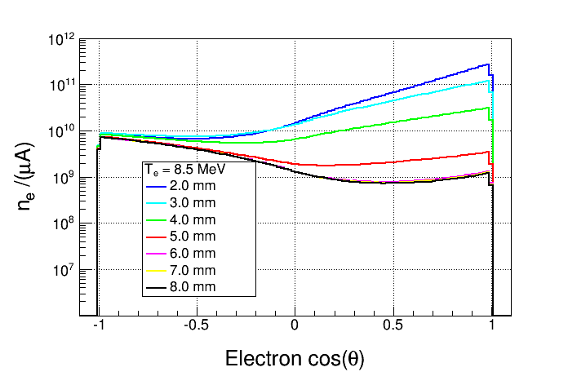
Electrons Exiting Radiator

Slide 4
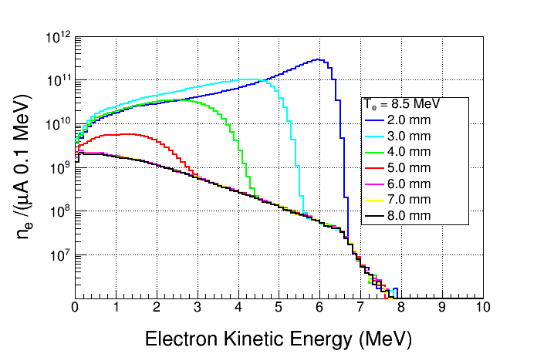
Electrons Exiting Radiator, cos(θ)>0

Slide 5
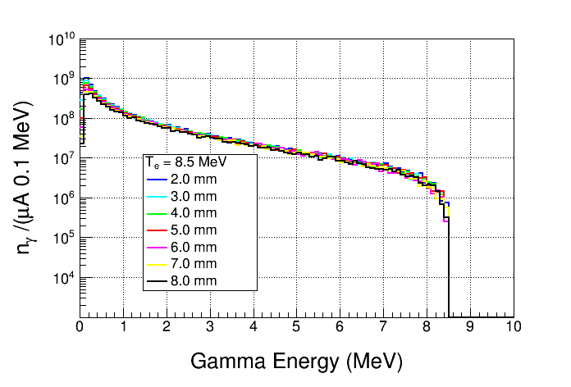
Gammas Entering Chamber

Slide 6
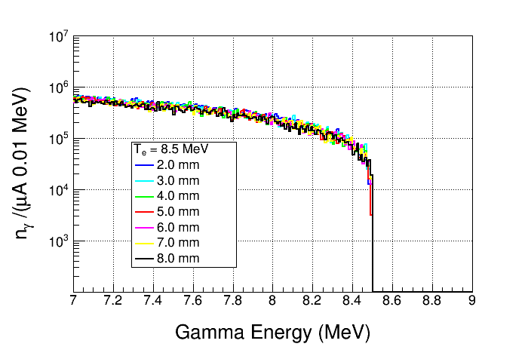
Gammas Entering Chamber

Slide 7
6 mm
2 mm

