Slide 1
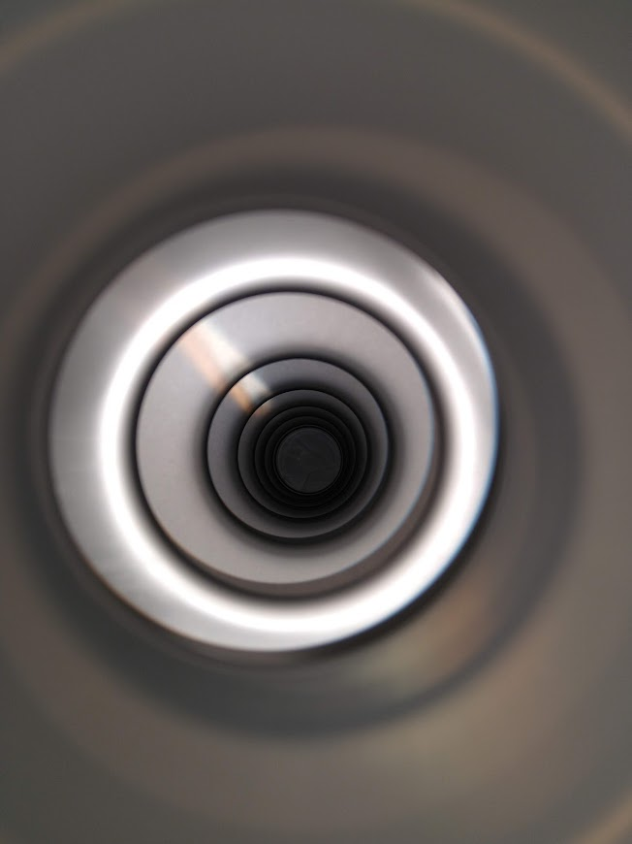
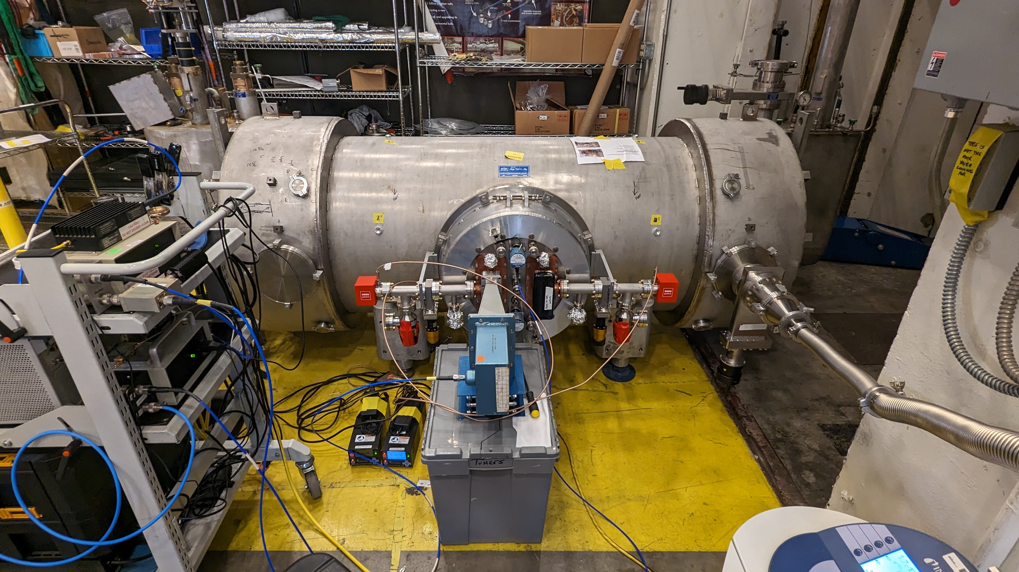
First Nb₃Sn coated CEBAF style quarter cryomodule
Nb₃Sn Quarter Cryomodule
U. Pudasaini, G. Ciovati, C. Reece, J. Fisher, M. Drury, M. McCougan, M. Weaks, R. Rimmer, T. Reilly, R. Geng and SRF Technical Staff.
G. Eremeev, S. Posen, B. Tennis

Slide 2
References
G. Eremeev et al., "First results from two Nb₃Sn cavities assembled in a CEBAF quarter cryomodule", in Proc. LINAC2024, Chicago, IL, USA, Aug. 2024, pp. 604-607. doi:10.18429/JACoW-LINAC2024-THAA004
U. Pudasaini, "Nb₃Sn SRF cavities: from R&D to real accelerator – overview of recent developments", IPAC'24, Nashville, TN, May 2024
JLab Technote JLAB-TN-24-05
U. Pudasaini et al. “First cryomodule with Nb₃Sn cavities for beam acceleration test at Jefferson Lab”
JLab Technote JLAB-TN-24-05
R. Geng and U. Pudasaini “Nb3Sn Quarter Cryomodule (Gray Enid I) First Beam Test: Objective, Key Metrics, and Interface Parameters”

Slide 3
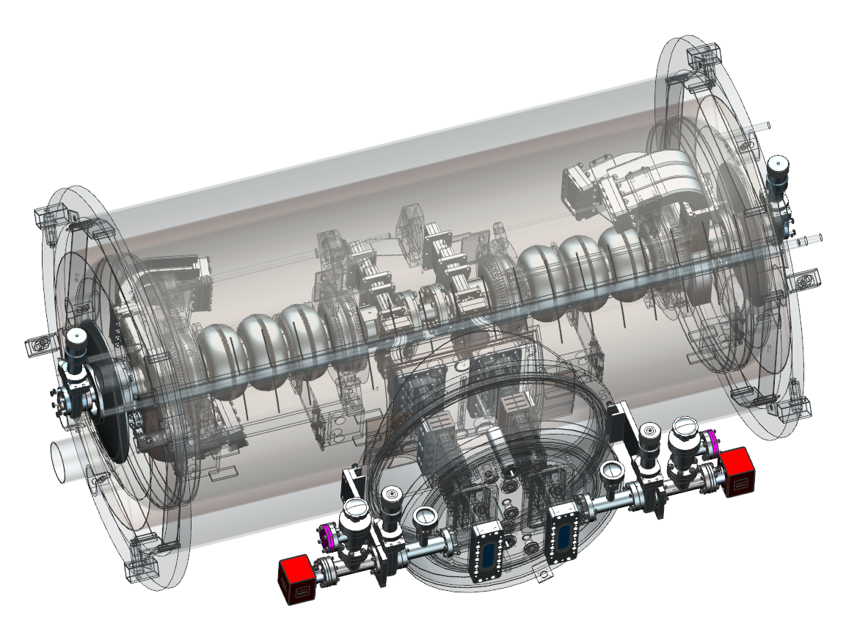
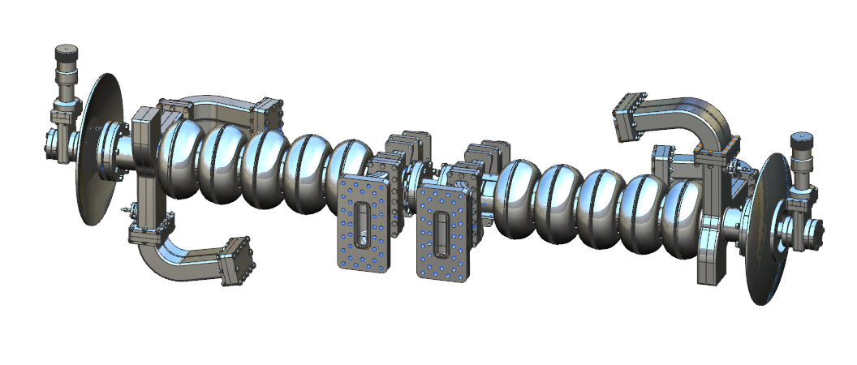
Introduction
Goal: develop a quarter cryomodule with Nb₃Sn-coated cavities with an average gradient of 10 MV/m per cavity.
Based on:
1.5 GHz CEBAF C75 (low-loss) 5-cell cavities
In the framework of G. Eremeev’s DOE NP Early Career Award :
“Formation of Superconducting Nb₃Sn Phase for Superconducting Radio Frequency (SRF) Cavities ”

Slide 4
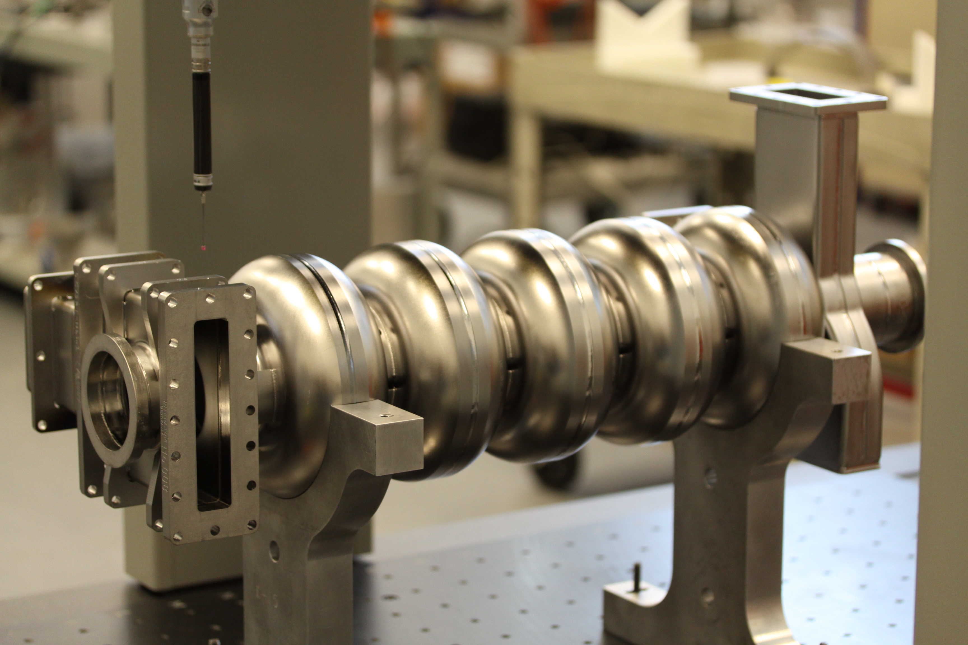
Qualification of Nb₃Sn-coated C75 5-cell cavities at Jlab (1st Attempt)
Two five-cell Nb₃Sn-coated cavities qualified in 2019 with E_{max} of 12 and 14 MV/m
Degraded to below 5 and 7 MV/m during the vertical pair test
  Mechanical stress due to vertical pair assembly & hanging
Both cavities required reprocessing and re-coating
G. Eremeev, U. Pudasaini, Tesla Collaboration Meeting 2022, Aomori Japan

Slide 5
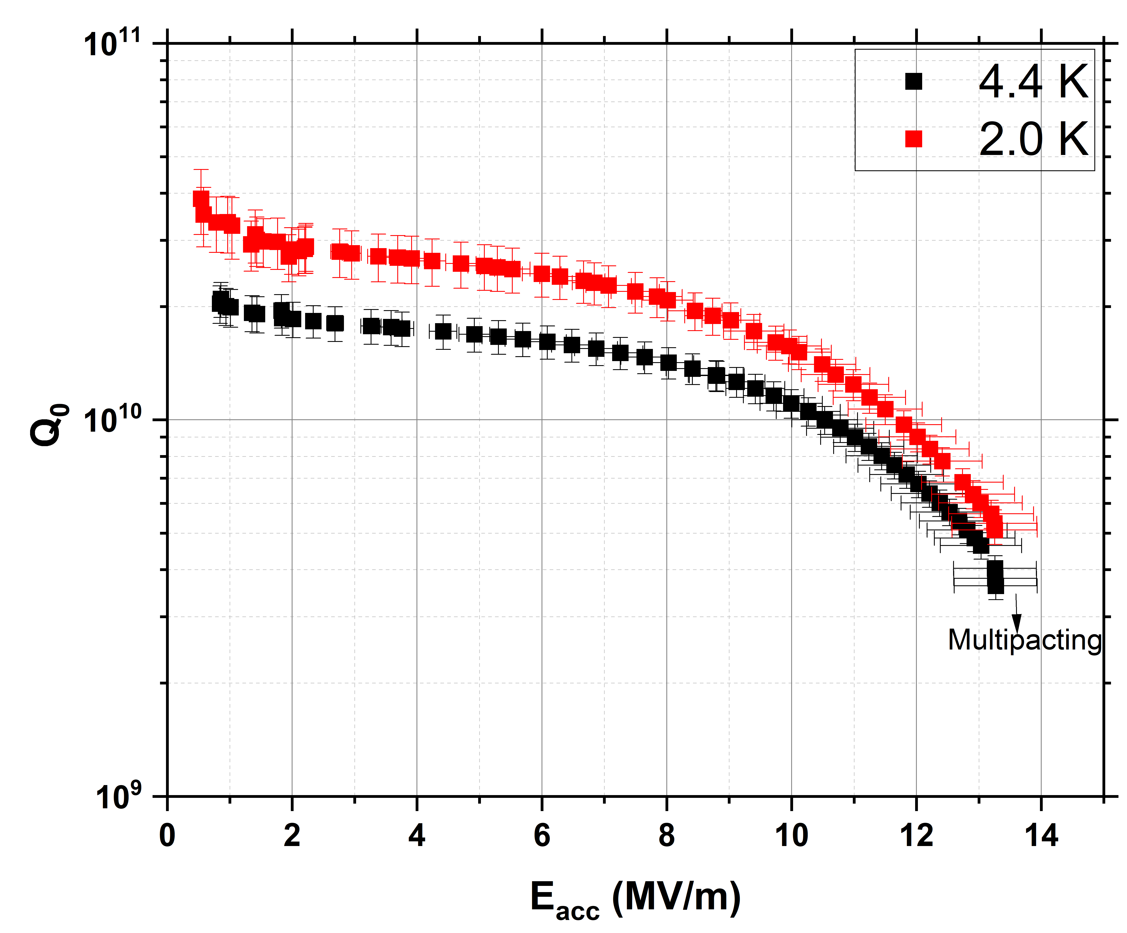
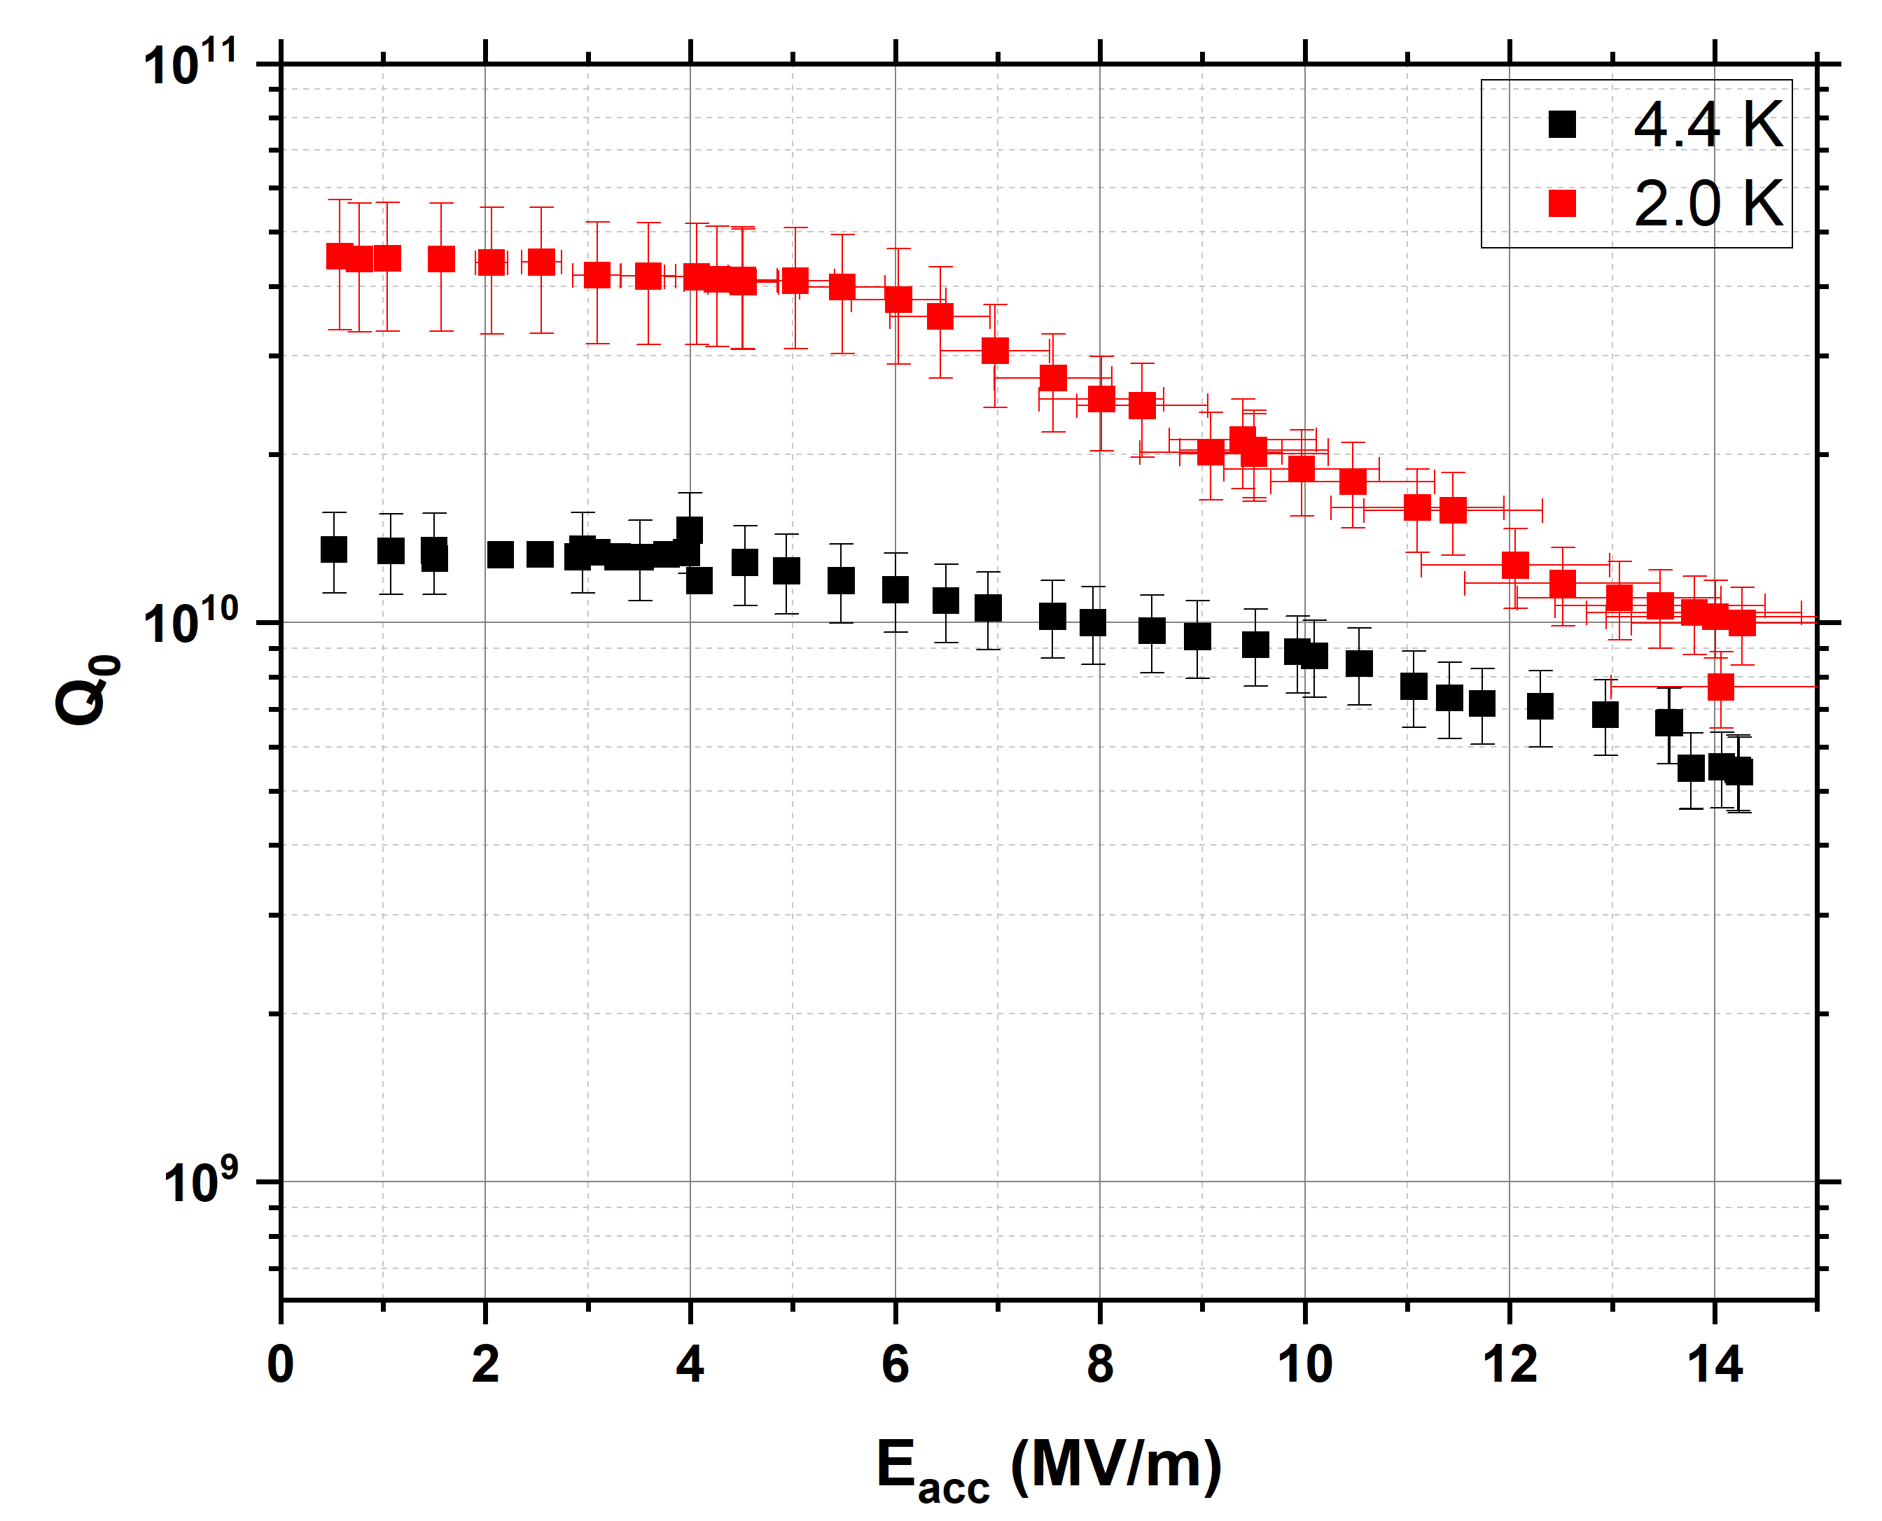
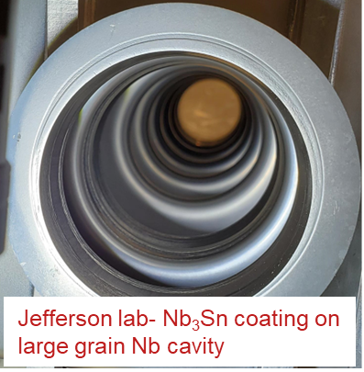
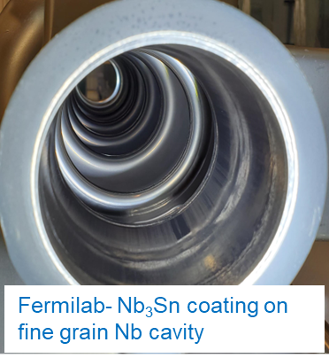

Re-Qualification of Nb₃Sn-coated Cavities
One cavity coated at JLab and another at Fermilab
Both cavities reached >13 MV/m with Q ~ 10¹⁰ at 10 MV/m
5C75-RI-04
5C75-RI-NbSn01
Cavity pair assembled, but subjected to disassembly due to a leak in a RF window

Slide 6
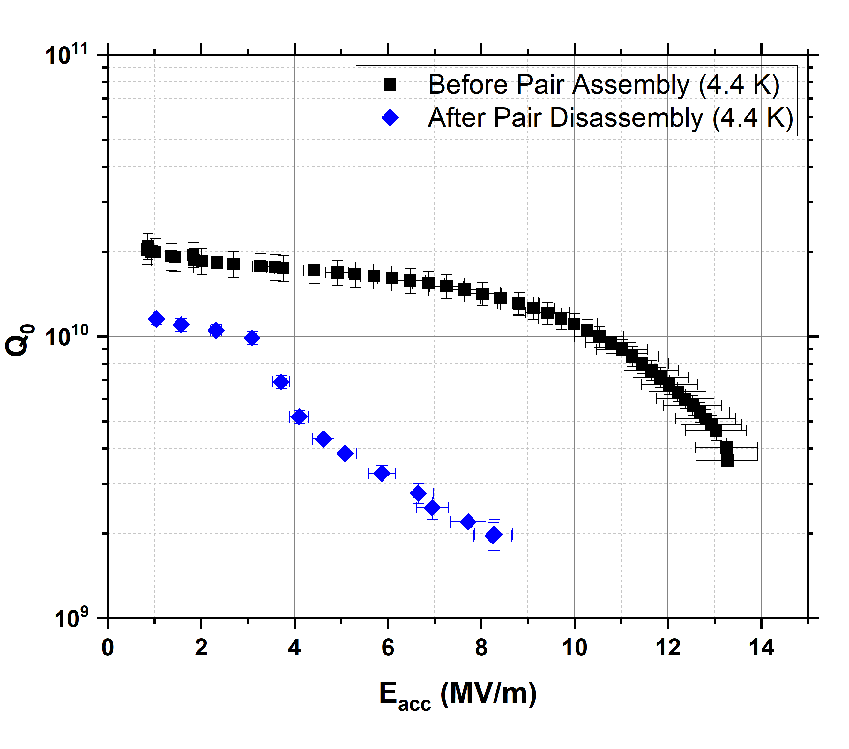
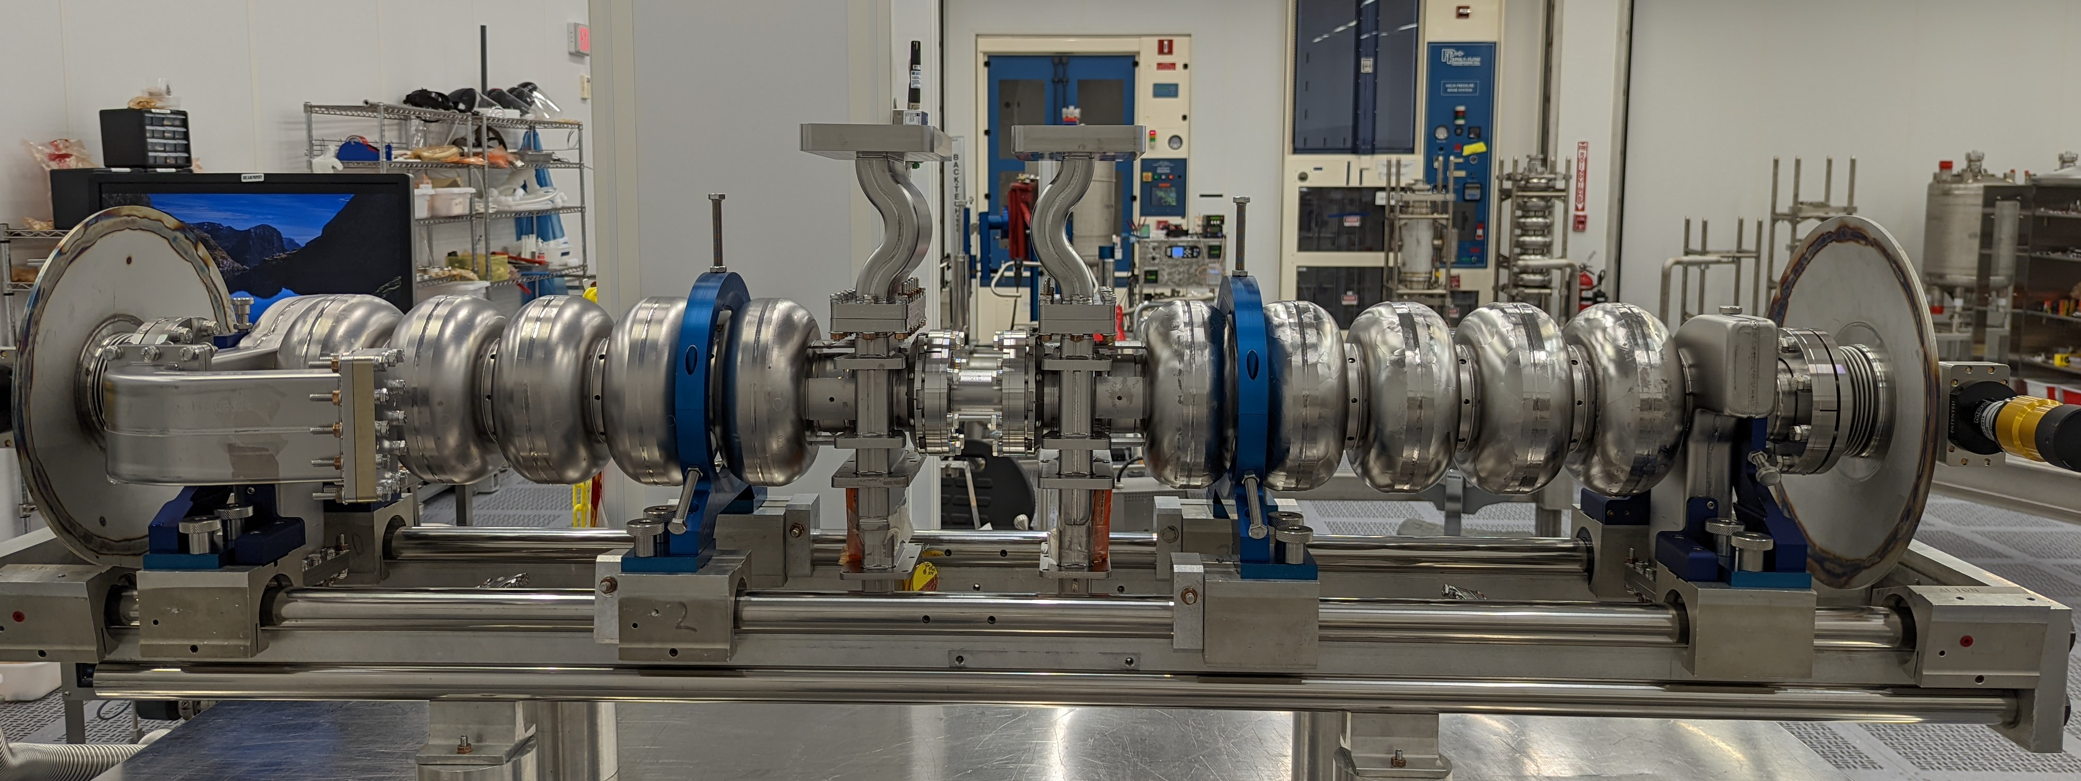

Re-Qualification of Nb₃Sn-coated Cavities
Cavities were re-tested independently – degraded one cavity
Pair successfully assembled again
Skipped vertical test of the pair to avoid mechanical degradation
5C75-RI-04

Slide 7
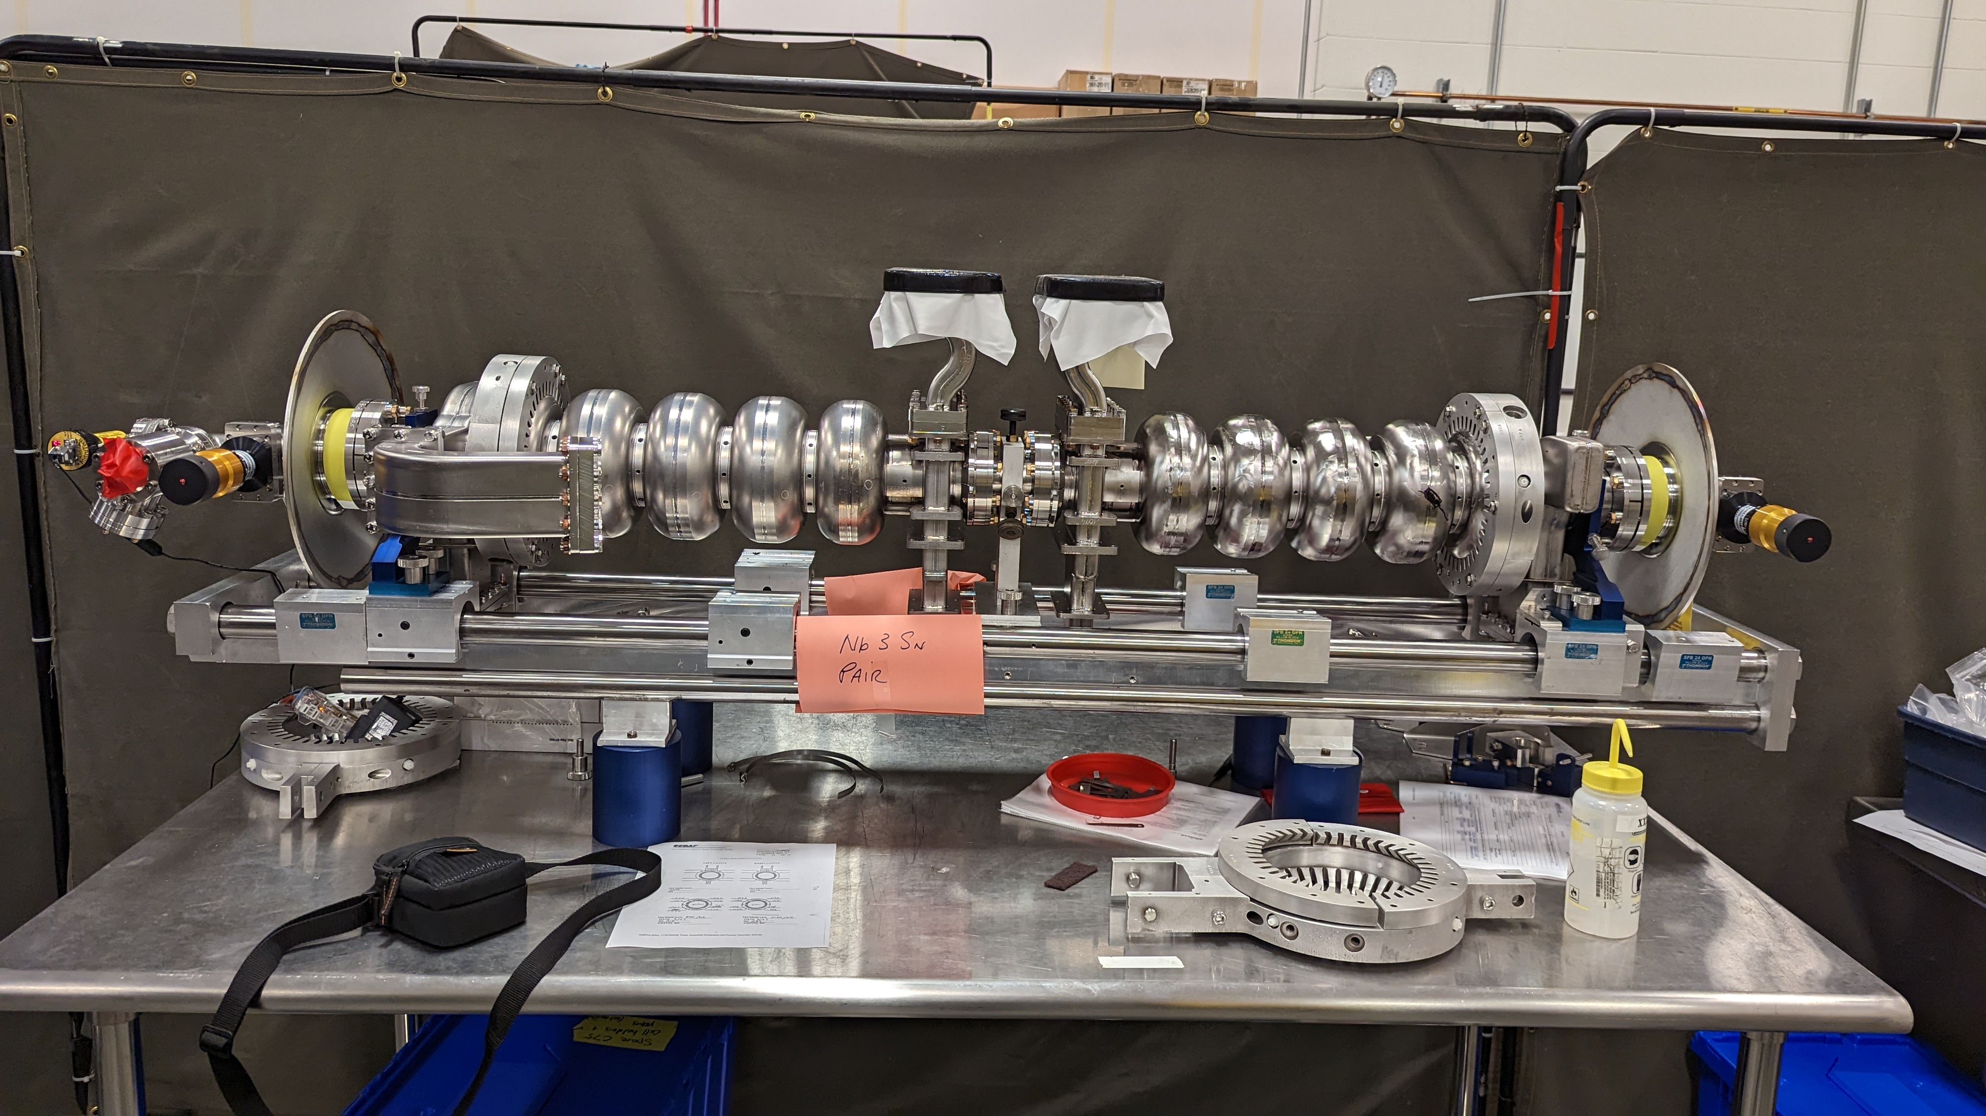
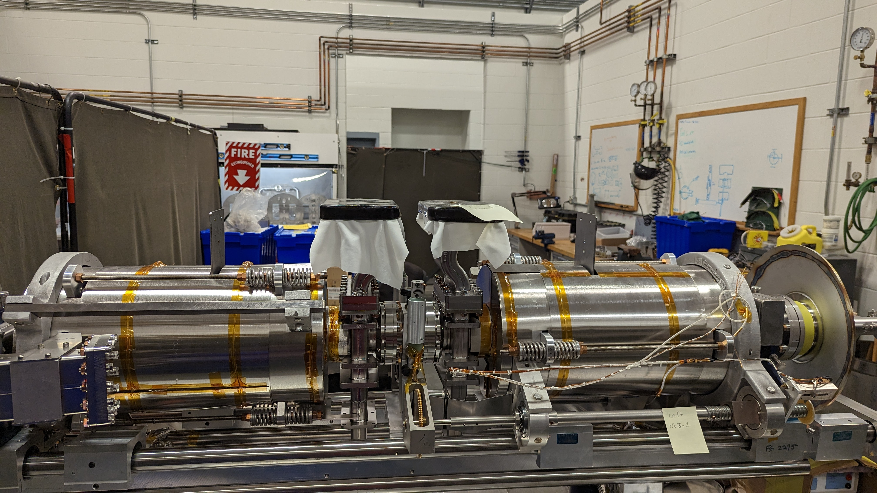
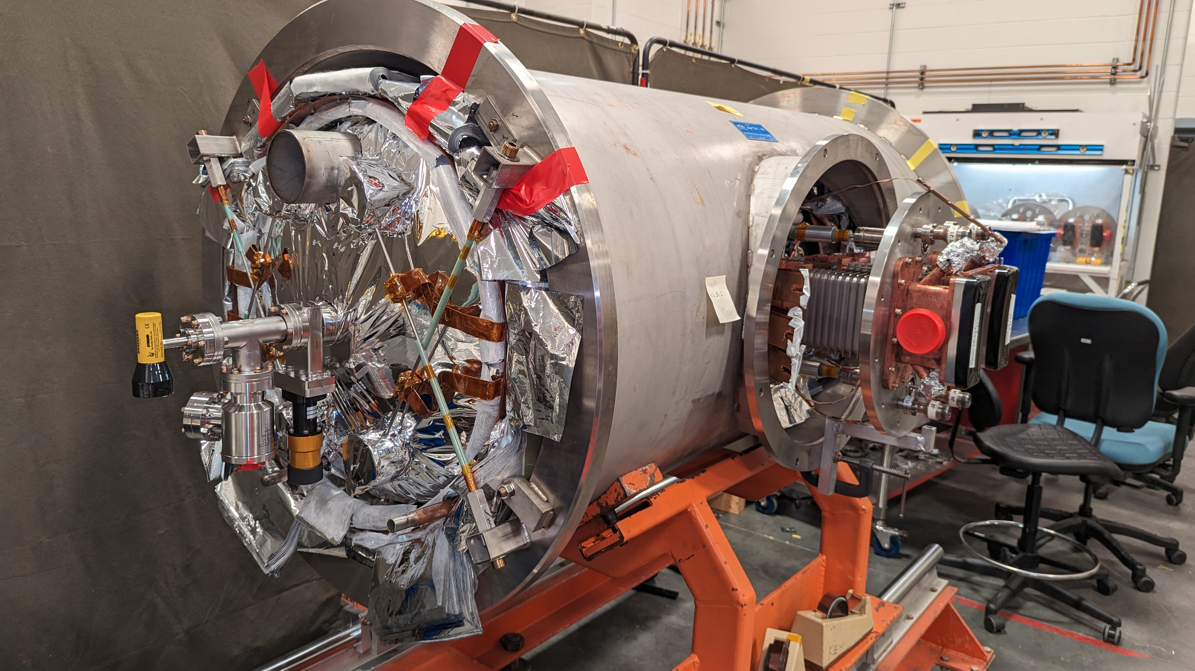
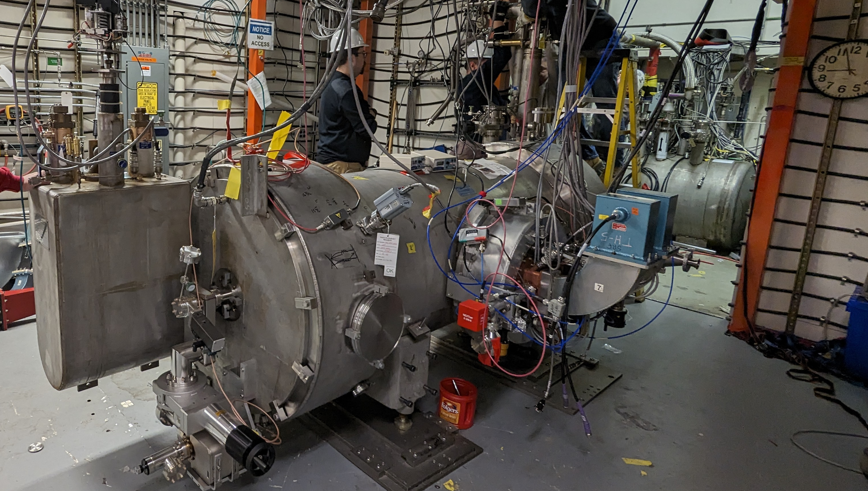
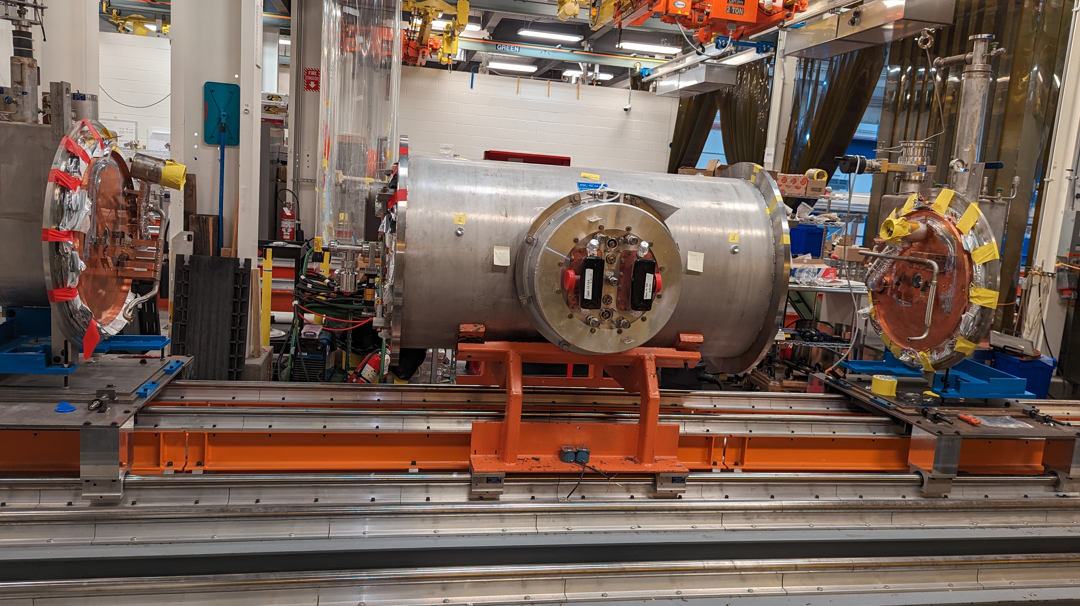
Cryomodule Assembly
Several assembly steps required modifications to avoid mechanical strain on the cavities.
April 2023
May 2023
July 2023
April 2024
November 2023
August 2023
Slow cooldown with temperature gradient was aimed to ~ 0.3 K across the cryomodule.

Slide 8
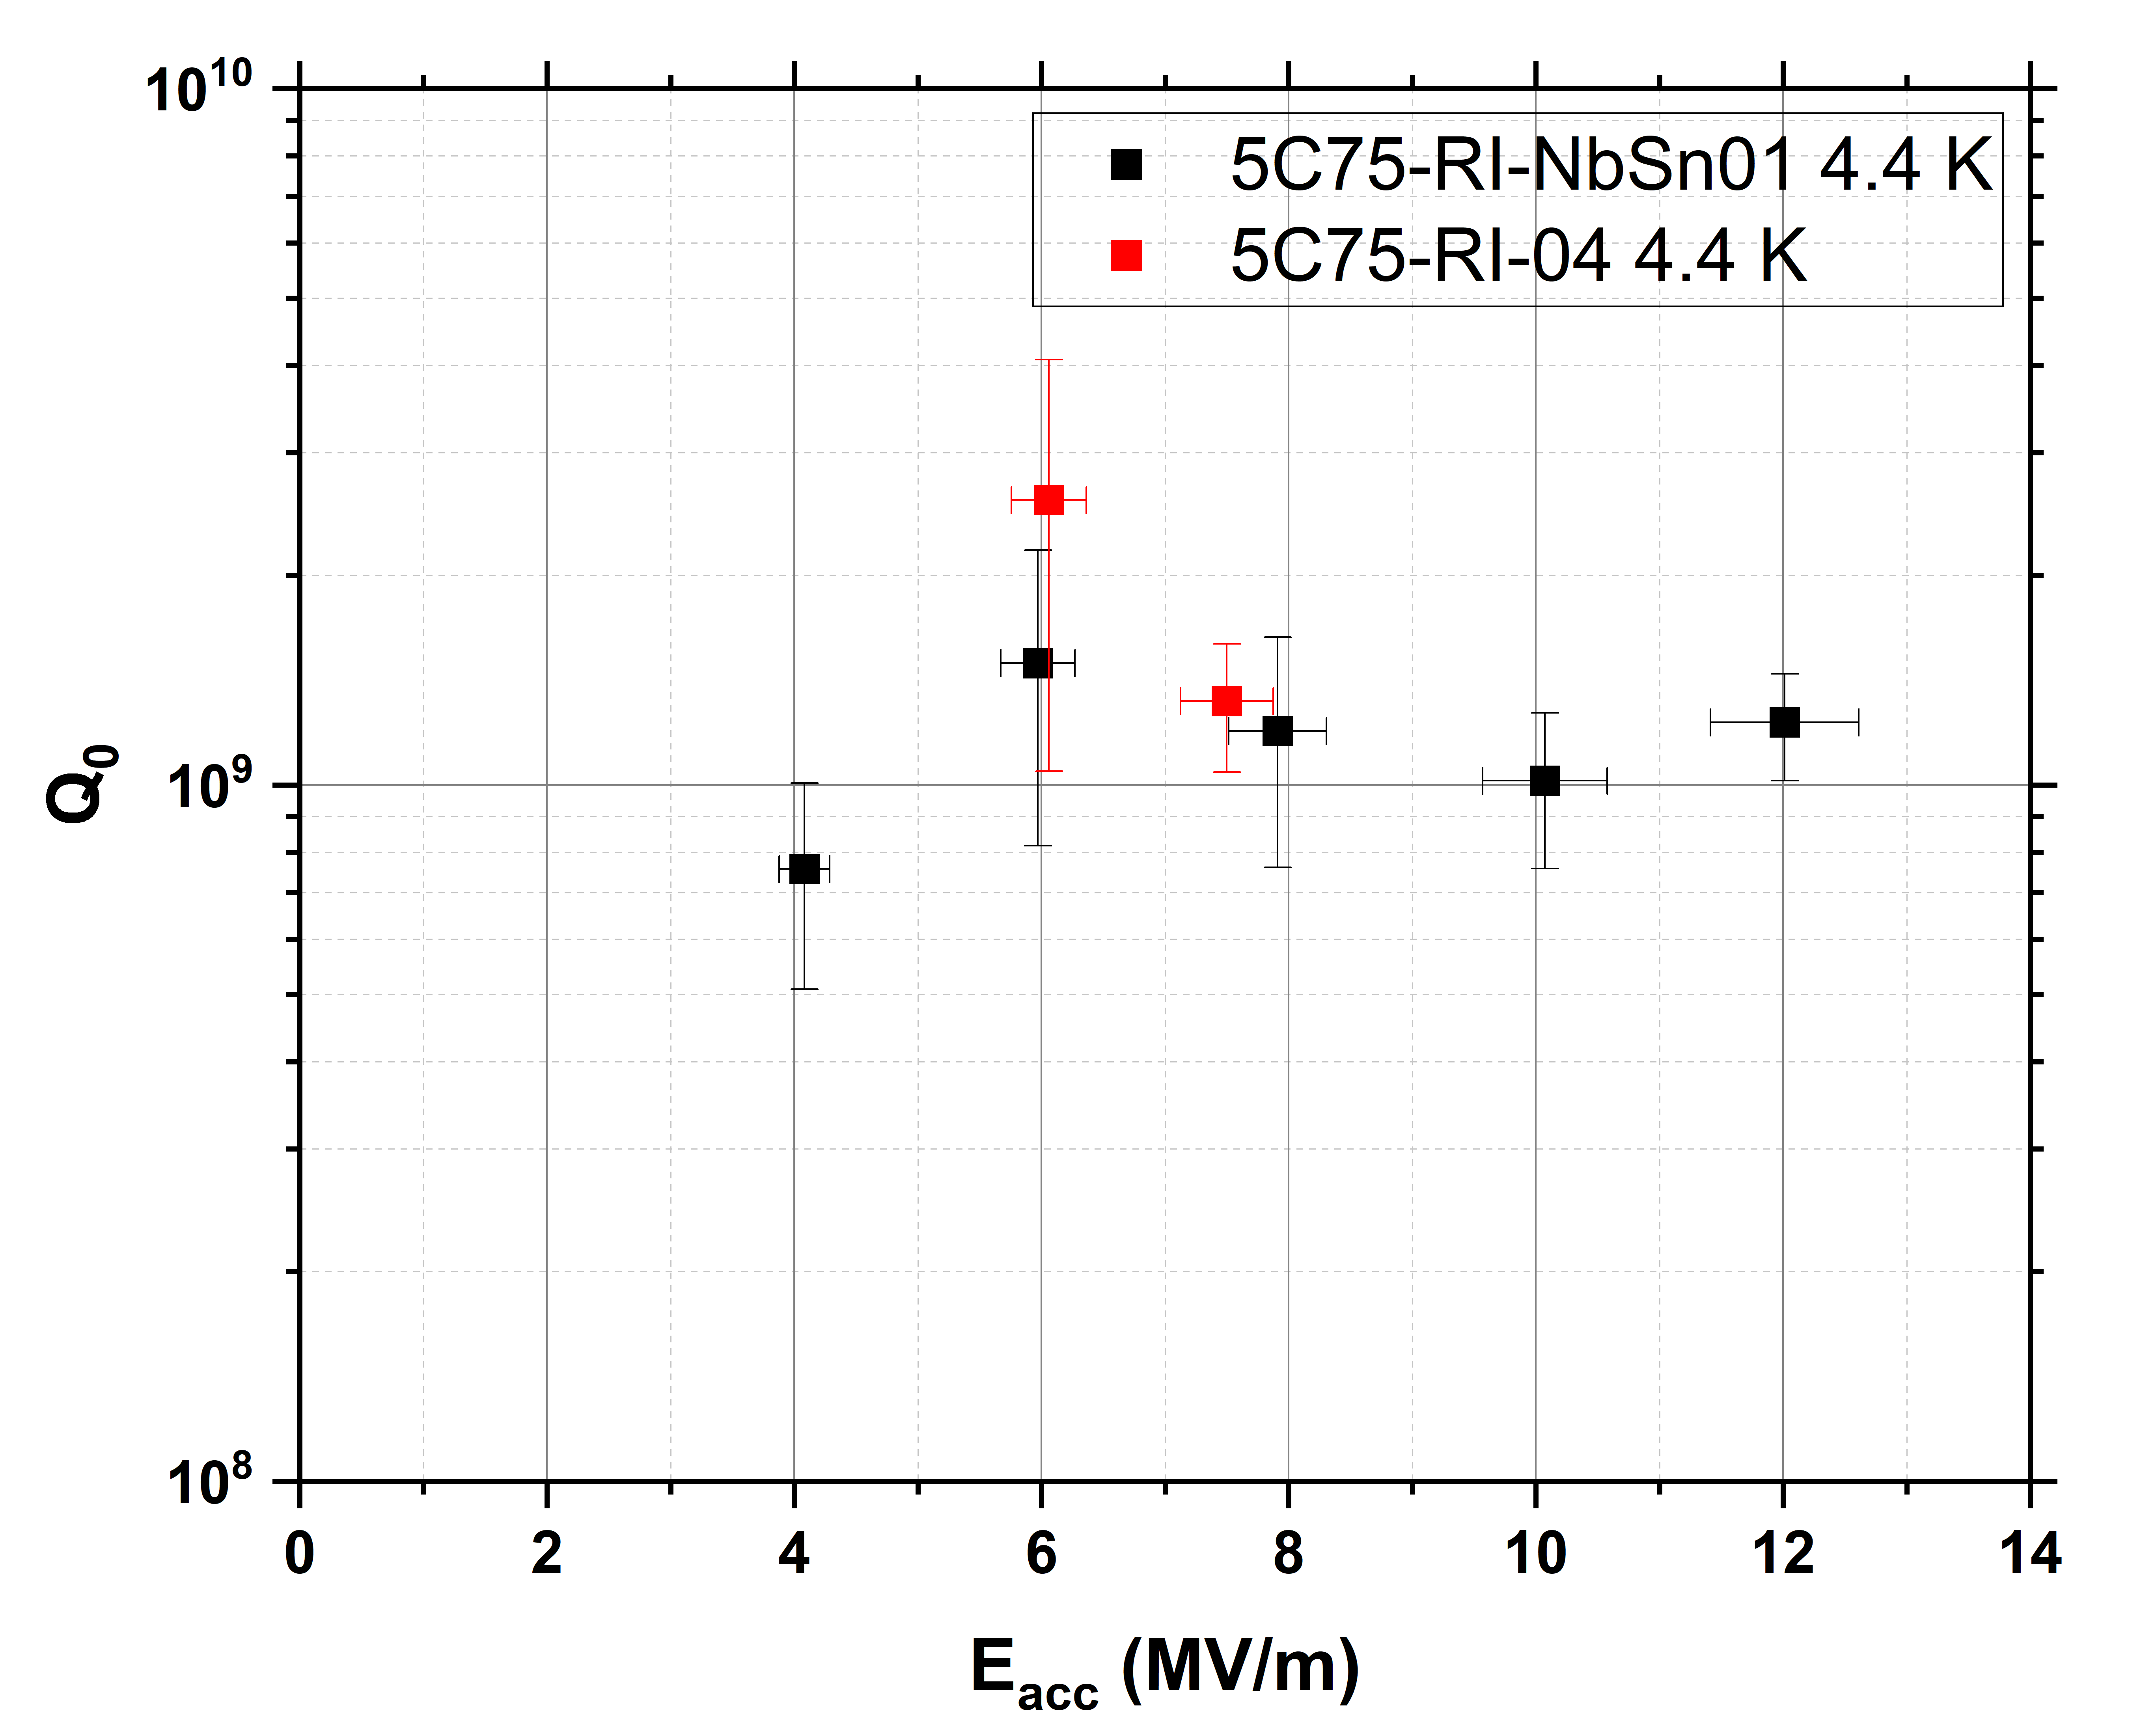
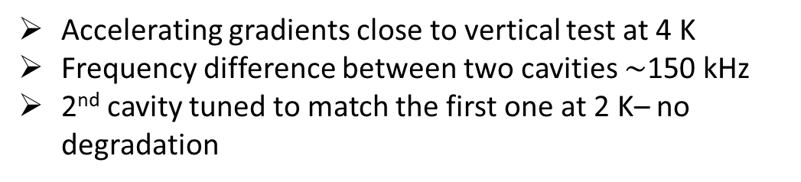
QCM Preliminary Acceptance Test Results
Accelerating gradients close to vertical test at 4 K
Frequency difference between two cavities $\sim$150 kHz
2nd cavity tuned to match the first one at 2 K– no degradation
Cavity | E_{max} at 4.4 K (MV/m) | E_{op} at 4.4 K (MV/m) | E_{max} at 2.1 K (MV/m) | E_{op} at 2.1 K (MV/m)
5C75-RI-NbSn01 (cavity #7) | 13.3 | 12.6 | 13.2 | 12.4
5C75-RI-04 (cavity #8) | 7.9 | 7.5 | 8.7 | 8.5
dLL/dt method
First demonstration of >10 MeV Nb₃Sn cryomodule
No degradation in the field but reduced quality factor compared to VTA test: cooldown and measurement technique effects?

Slide 9
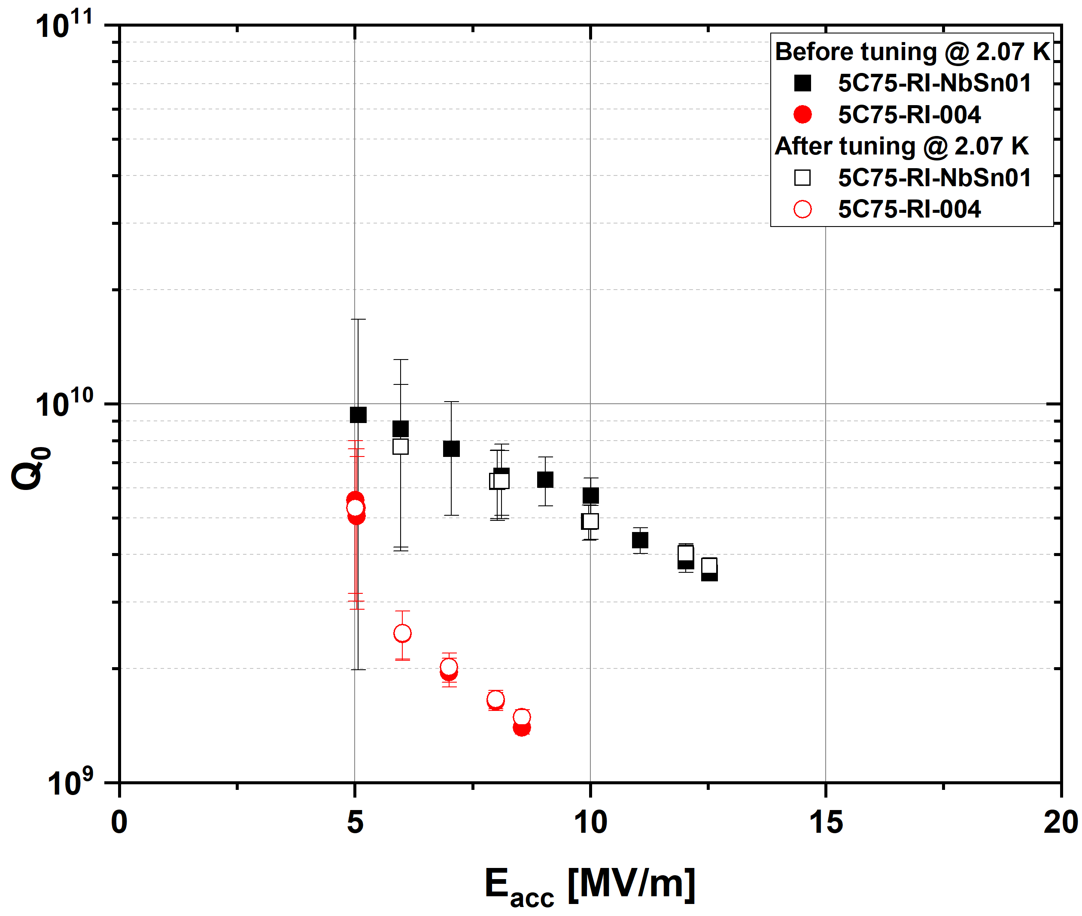
Cryomodule performance at 2 K
Rate of rise of the helium pressure method
Cavity | Frequency at 4.4 K (MHz) | Frequency at 2.07 K (MHz) | Post Tuning Frequency at 2.07K (MHz)
5C75-RI-NbSn01 (cavity #7) | 1496.55 | 1496.59
5C75-RI-04 (cavity #8) | 1496.41 | 1496.44 | 1496.61
5C75-RI-004 cavity tuned by ~ 180 KHz at 2 K to match the frequency of 5C75-RI-NbSn01 induced no degradation.
G. Eremeev., U. Pudasaini, A. Reilly, B. Tennis, G. Ciovati, J. Fischer, M. Drury et al. "First results from two Nb₃Sn cavities assembled in a CEBAF quarter Cryomodule." In Proc. 32nd Linear Accelerator Conference (LINAC’24)

Slide 10
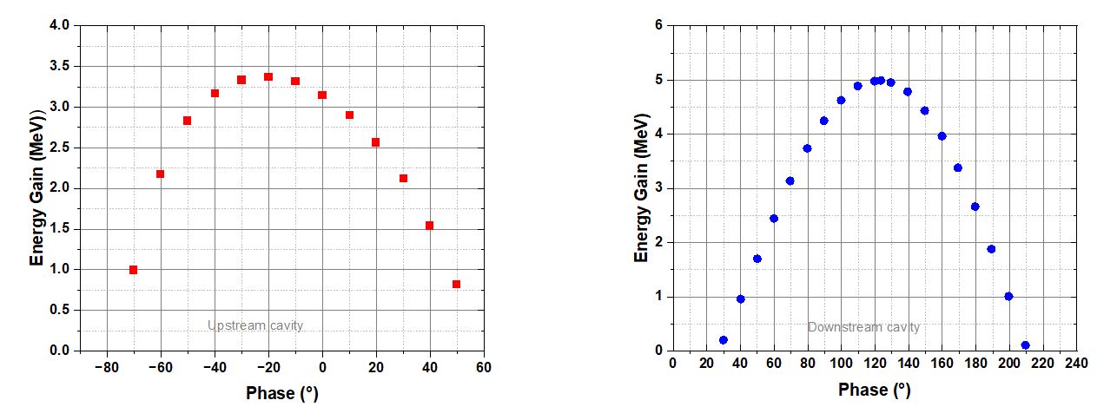
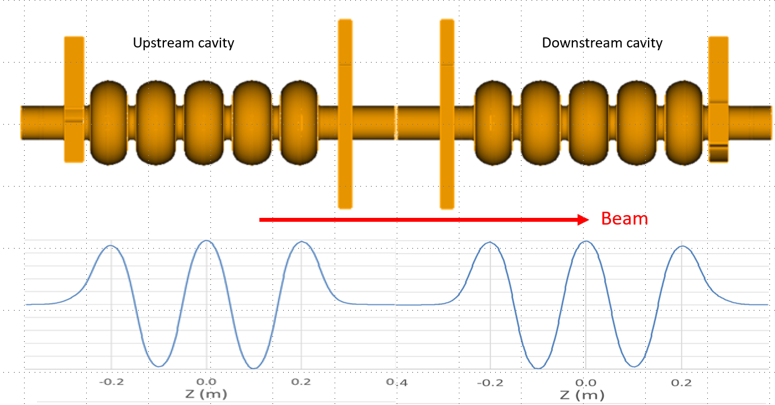
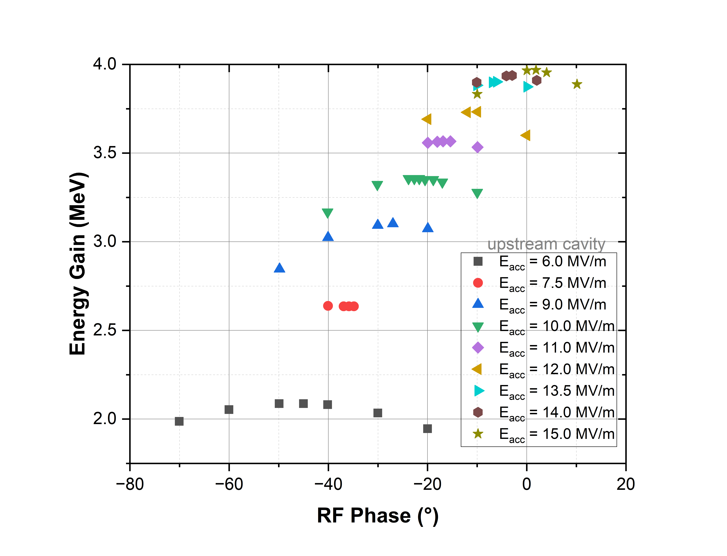
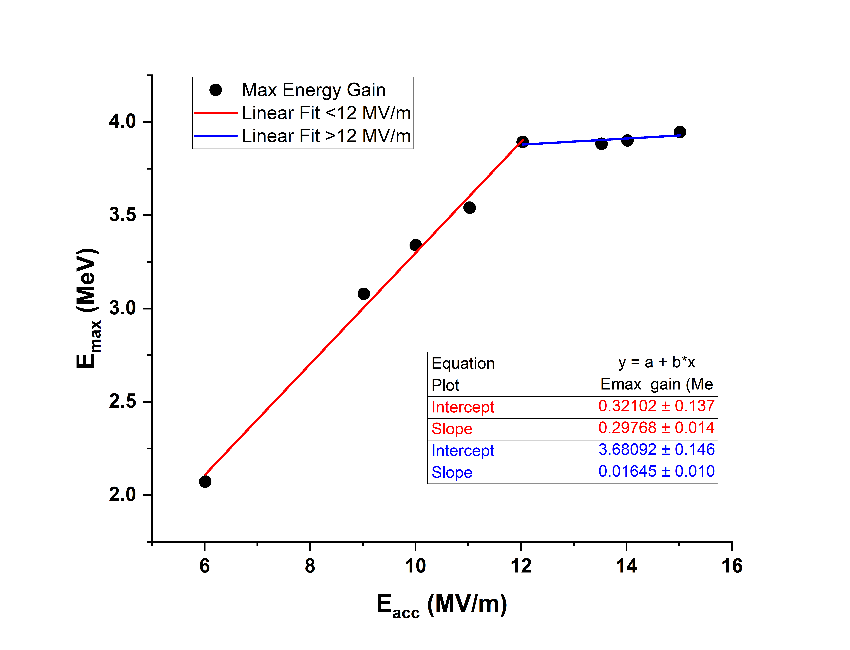
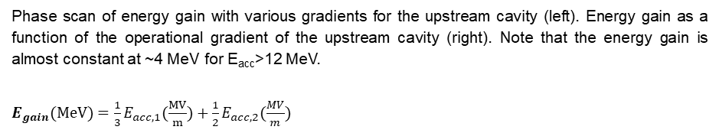
Expected energy gain and beam acceleration at 4.4 K
A simple model consisting of two cavities was used to simulate the beam acceleration with ACE3P (an RF structure EM simulation code), GPT, and PARMELA (an electrodynamics simulations package) to estimate the energy gain [27-29]. Omega3P module of ACE3P was used to calculate the RF field and output the field map for PARMEL
The energy gains vs. the phase (Φ) for the upstream cavity (left) and downstream cavity (right) for an accelerating gradient of 10.13 MV/m.
Phase scan of energy gain with various gradients for the upstream cavity (left). Energy gain as a function of the operational gradient of the upstream cavity (right). Note that the energy gain is almost constant at ~4 MeV for E_{acc}>12 MeV.
$E_{gain}(MeV)=\frac{1}{3}E_{acc,1}(\frac{MV}{m})+\frac{1}{2}E_{acc,2}(\frac{MV}{m})$
Electric field map for each cavity.

Slide 11
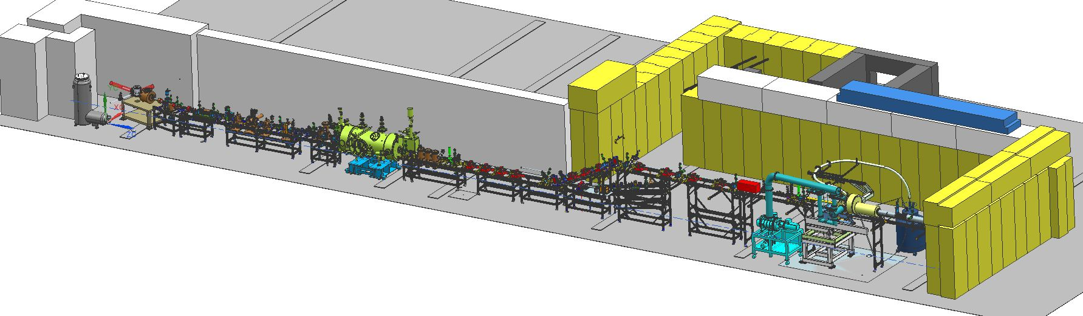
What’s next?
Upgraded Injector Facility at Jefferson Lab
Currently in the UITF for the installation
Beam test planned in Jan 2025.
                Stay Tuned.

Slide 12
Summary & Outlook
First-ever ≥10 MV/m gradient achieved in Nb₃Sn cryomodule with multi-cell cavities
Cryomodule progressing for the beam test in the UITF
Successful exercise highlighting the potential of Nb₃Sn, but further efforts needed for reliable deployment of Nb₃Sn based cavities in cryomodules

