Slide 1
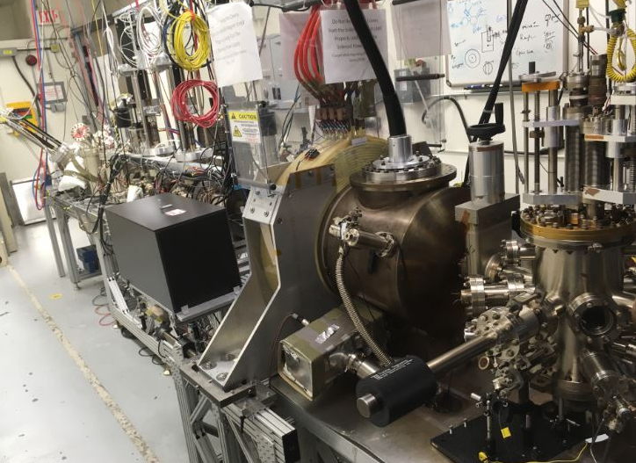
Magnetized Electron Source
This work is supported by the Department of Energy, Laboratory Directed Research and Development (LDRD) funding, under contract DE-AC05-06OR23177
Riad Suleiman
2018 Accelerator R&D PI Exchange Meeting
November 13-14, 2018

Slide 2
Outline
LDRD Goals, Budget, Deliverables and Schedule
Magnetized Bunched-Beam Electron Cooling at Jefferson Lab Electron Ion Collider (JLEIC)
LDRD Magnetized Electron Source:
  K₂CsSb Photocathode and HV Chamber
  Cathode Solenoid
  Beamline
Characterization of Magnetized Beam:
  Beam Size and Shearing Angle
  Drift Emittance
  High Bunch Charge
  High Average Current and Charge Lifetime
Future Plans
Summary

Slide 3
Jefferson Lab LDRD Goals
Project, “Generation and Characterization of Magnetized Bunched Electron Beam from DC Photogun for JLEIC Cooler”, was funded by Jefferson Lab LDRD program. This was three-year project concluded on September 30, 2018.
LDRD Goals:
  Generate magnetized electron beam from dc high voltage photogun and measure its properties
  Exploring impact of cathode solenoid on photogun operation
  Simulations and measurements will provide insights on ways to optimize JLEIC electron cooler and help design appropriate source
  Jefferson Lab will have direct experience on magnetizing electron beams at high currents
Jones report

Slide 4
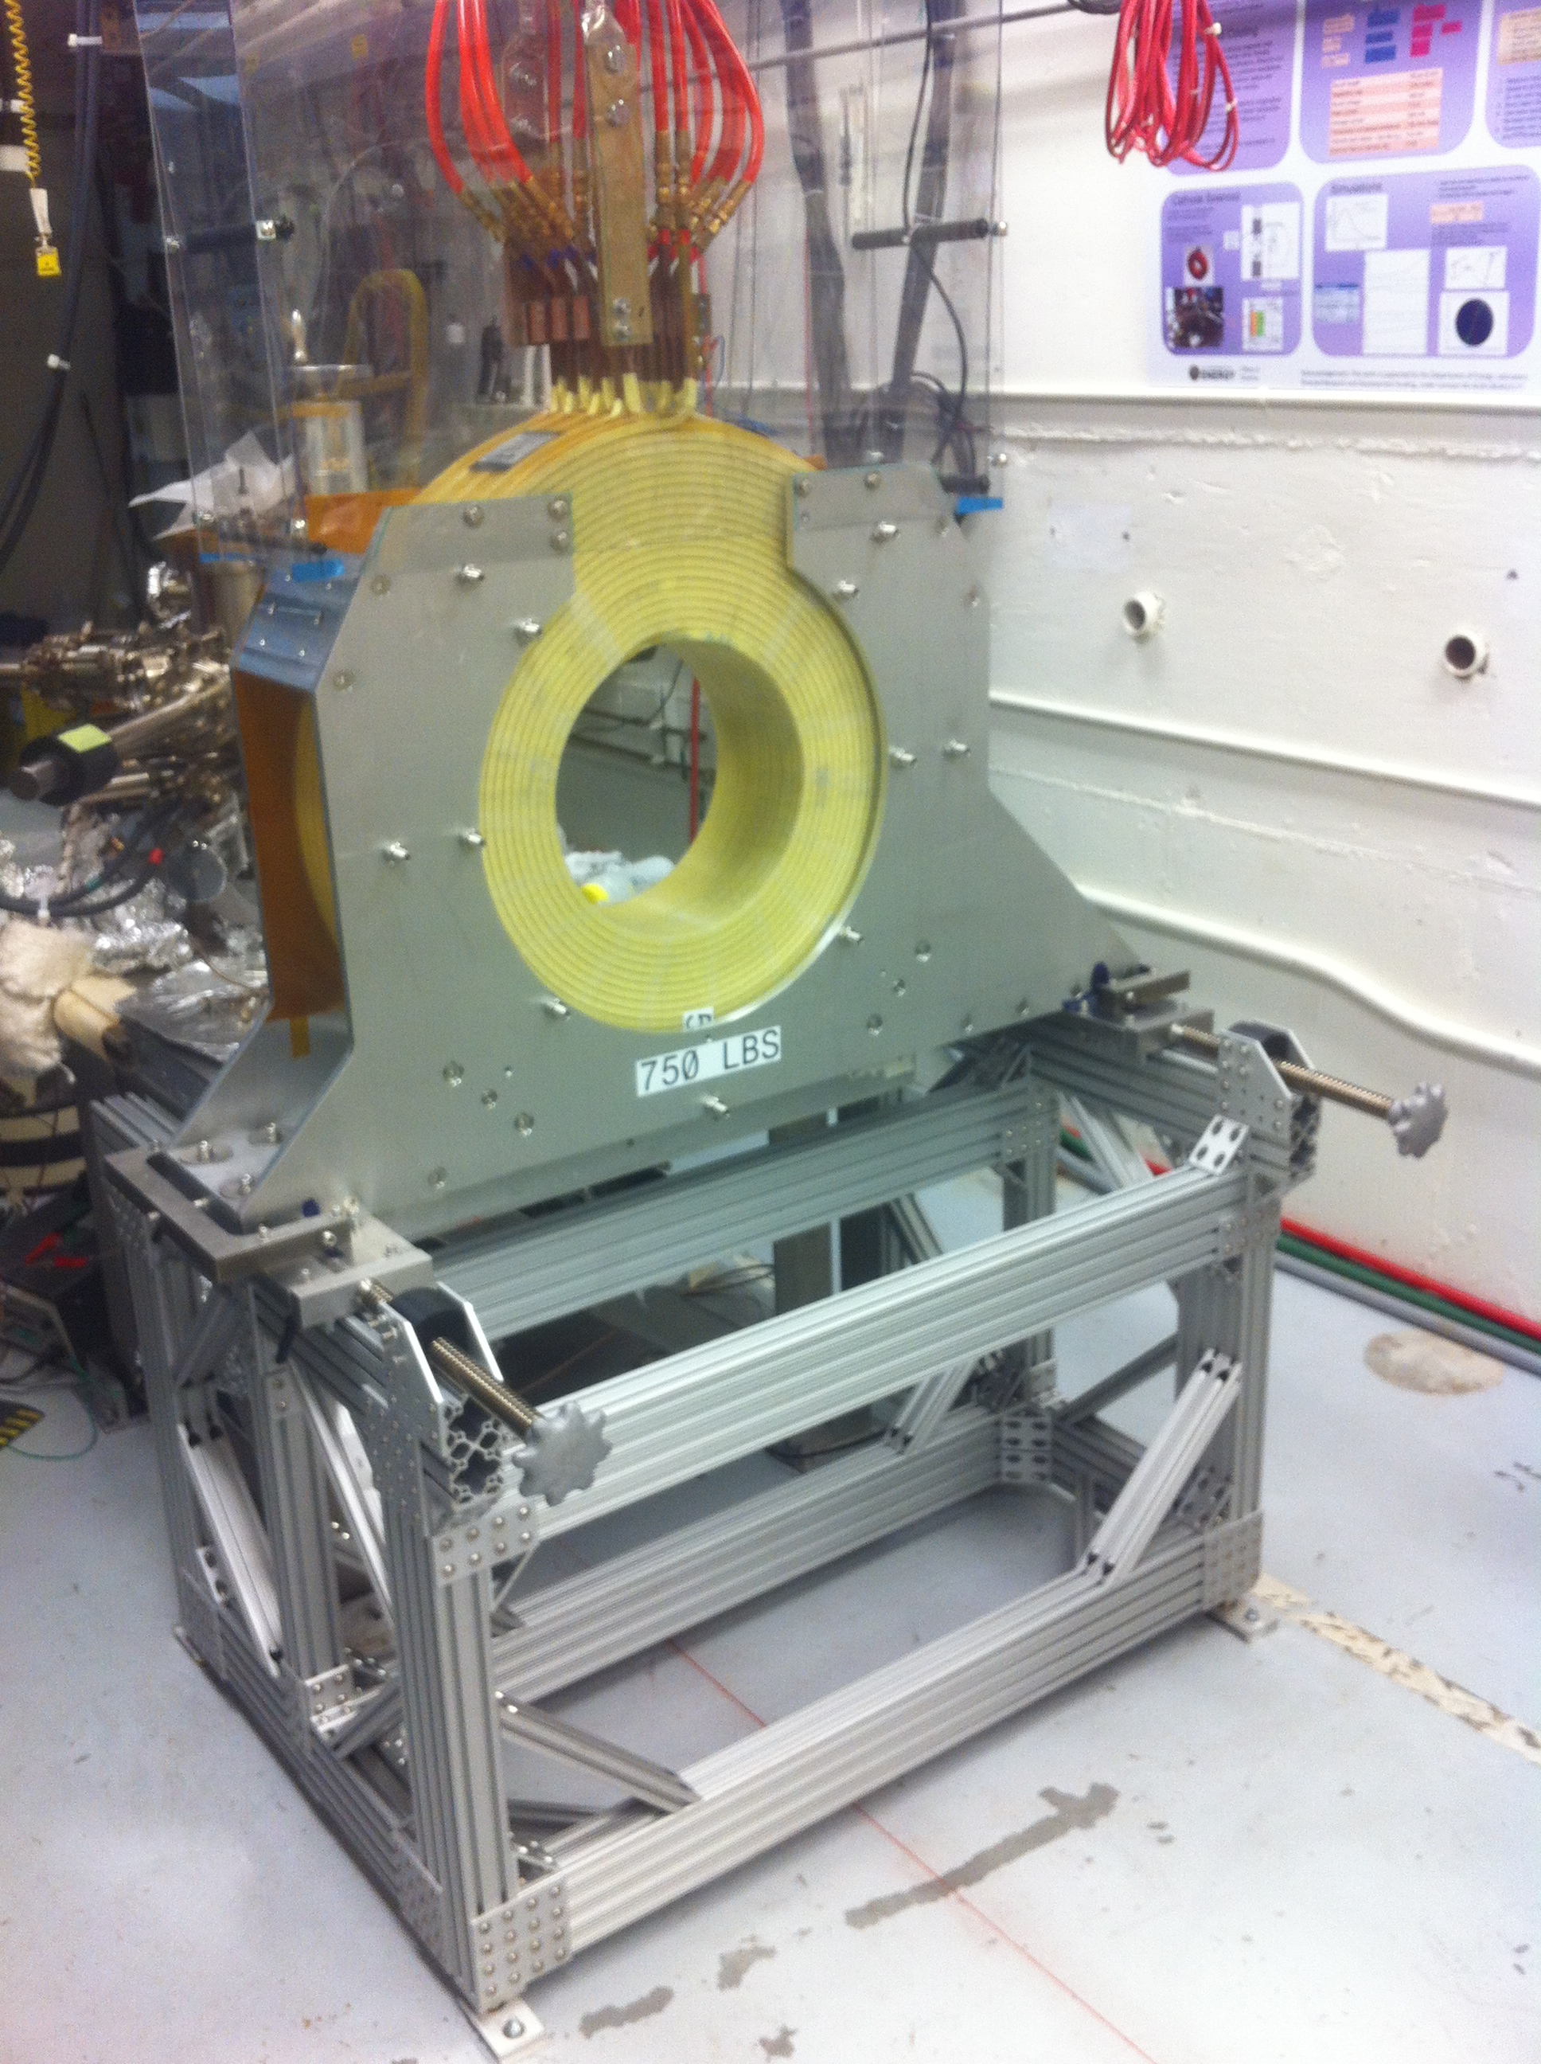
Budget
FY16 | $339,211
FY17 | $264,979
FY18 | $211,449
Total | $815,639
Materials and Supplies:
  Cathode solenoid magnet
  Beamline hardware: steering magnets and slits
  Laser components
Labor:
  Cathode solenoid design, mapping and installation
  Mechanical designer
  Beam simulations with A Space Charge Tracking Algorithm (ASTRA) and General Particle Tracer (GPT)
  Postdoc (FY17 and FY18)

Slide 5
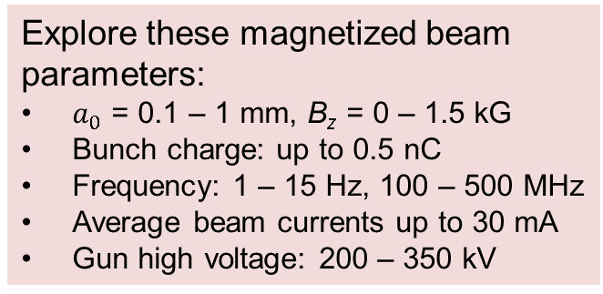
Deliverables and Schedule
FY16:
  HV condition gun to 350 kV and build K₂CsSb preparation chamber
  Design beamline. Design and procure slits
  Design and procure cathode solenoid magnet
  Measure lifetime at 1 mA and 300 kV (non-magnetized)
  Install cathode solenoid magnet
FY17:
  Generate magnetized beam
  Measure mechanical angular momentum vs magnetic field and laser size at photocathode
  Benchmark simulation against measurements
  Measure lifetime at 5 mA and 300 kV
  Study beam halo and beam loss vs magnetic field at photocathode
FY18:
  Design TE₀₁₁ cavity to measure beam magnetization (non-invasive)
  Change to HV Supply of 30 mA and 225 kV
  Measure photocathode lifetime at 30 mA
  Generate high bunch charge magnetized beam
  Commission TE₀₁₁ cavity with beam
Explore these magnetized beam parameters:
$a_{0}$ = 0.1 – 1 mm, B_{z} = 0 – 1.5 kG
Bunch charge: up to 0.5 nC
Frequency: 1 – 15 Hz, 100 – 500 MHz
Average beam currents up to 30 mA
Gun high voltage: 200 – 350 kV

Slide 6

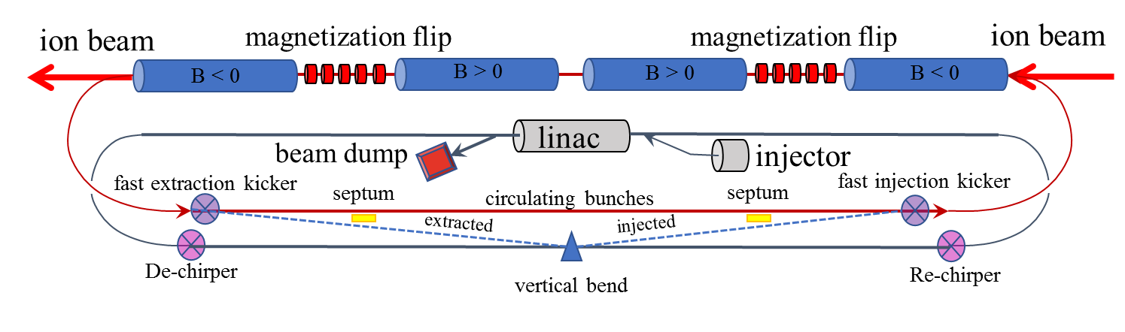
JLEIC High Energy Electron Cooler
High Energy Electron Cooler
Circulator Cooler Ring
ERL Ring

Slide 7
Magnetized Bunched-Beam Electron Cooling
Ion beam cooling in presence of magnetic field is much more efficient than cooling in a drift (no magnetic field):
  Electron beam helical motion in strong magnetic field increases electron-ion interaction time, thereby significantly improving cooling efficiency
  Electron-ion collisions that occur over many cyclotron oscillations and at distances larger than cyclotron radius are insensitive to electrons transverse velocity
Long cooling solenoid provides desired cooling effect:
  Counteracting emittance degradation induced by intra-beam scattering
  Maintaining ion beam emittance during collisions and extending luminosity lifetime
  Suppressing electron-ion recombination
  Putting electron beam into cooling solenoid represents a challenge

Slide 8
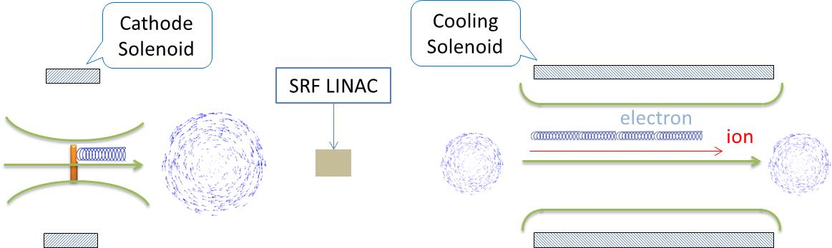
Magnetized Cooling Schematics
Electron beam suffers an azimuthal kick at entrance of cooling solenoid. But this kick can be cancelled by an earlier kick at exit of photogun. That is the purpose of cathode solenoid.
v
v
B_{z}
v
B_{z}
B_{r}
B_{r}
v
Electrons born in strong uniform B_{z}
Upon exit of Cathode Solenoid
Upon entering Cooling Solenoid

Slide 9
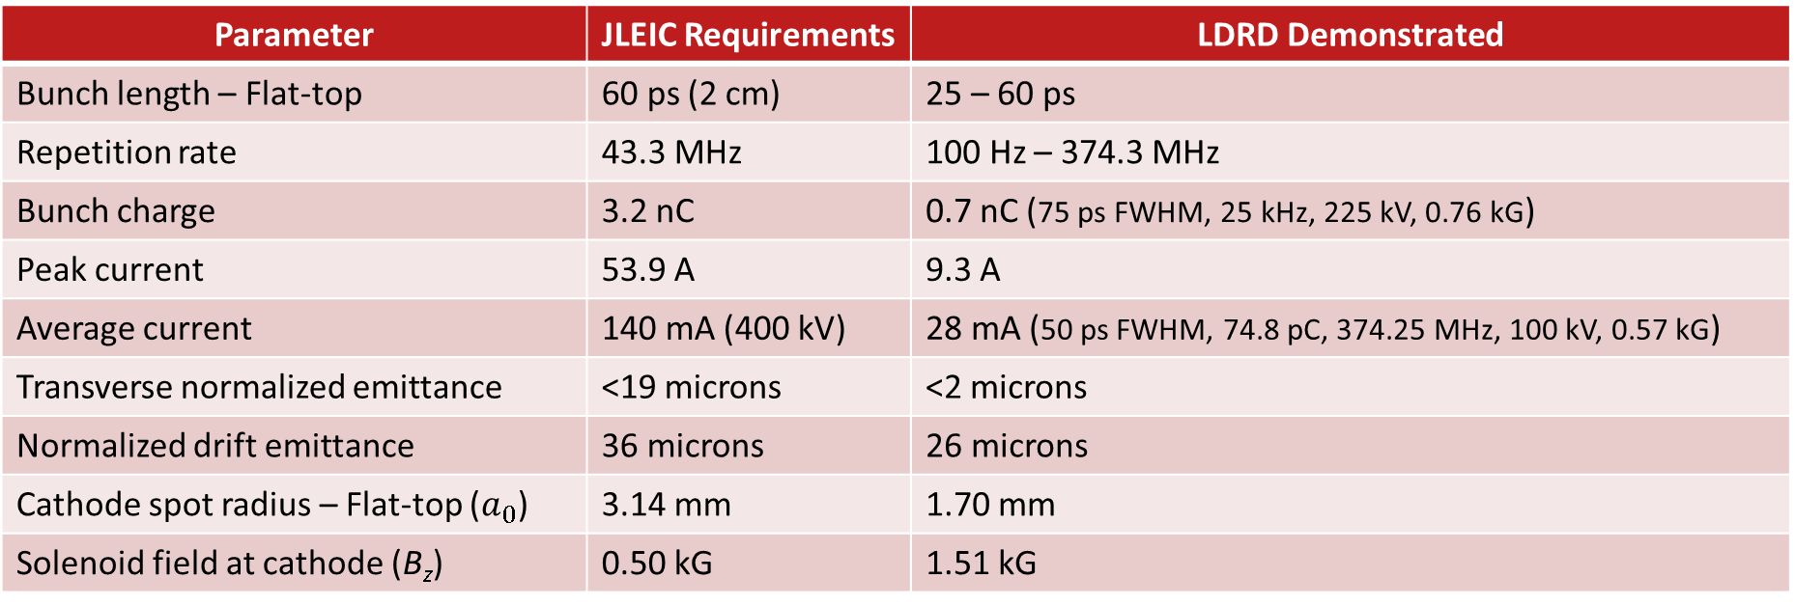
JLEIC Magnetized Source Requirements
Parameter | JLEIC Requirements | LDRD Demonstrated
Bunch length – Flat-top | 60 ps (2 cm) | 25 – 60 ps
Repetition rate | 43.3 MHz | 100 Hz – 374.3 MHz
Bunch charge | 3.2 nC | 0.7 nC (75 ps FWHM, 25 kHz, 225 kV, 0.76 kG)
Peak current | 53.9 A | 9.3 A
Average current | 140 mA (400 kV) | 28 mA (50 ps FWHM, 74.8 pC, 374.25 MHz, 100 kV, 0.57 kG)
Transverse normalized emittance | <19 microns | <2 microns
Normalized drift emittance | 36 microns | 26 microns
Cathode spot radius – Flat-top ($a_{0}$) | 3.14 mm | 1.70 mm
Solenoid field at cathode (B_{z}) | 0.50 kG | 1.51 kG
Beam current was limited by laser power and power of high voltage
supply (30 mA/225 kV supply with 3 kW limit)

Slide 10
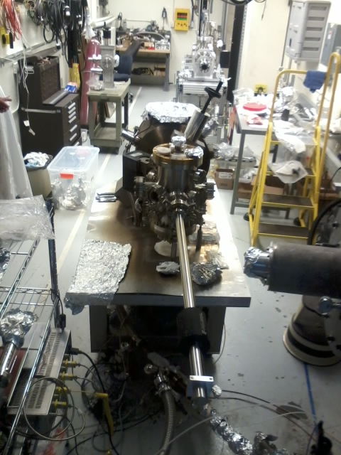
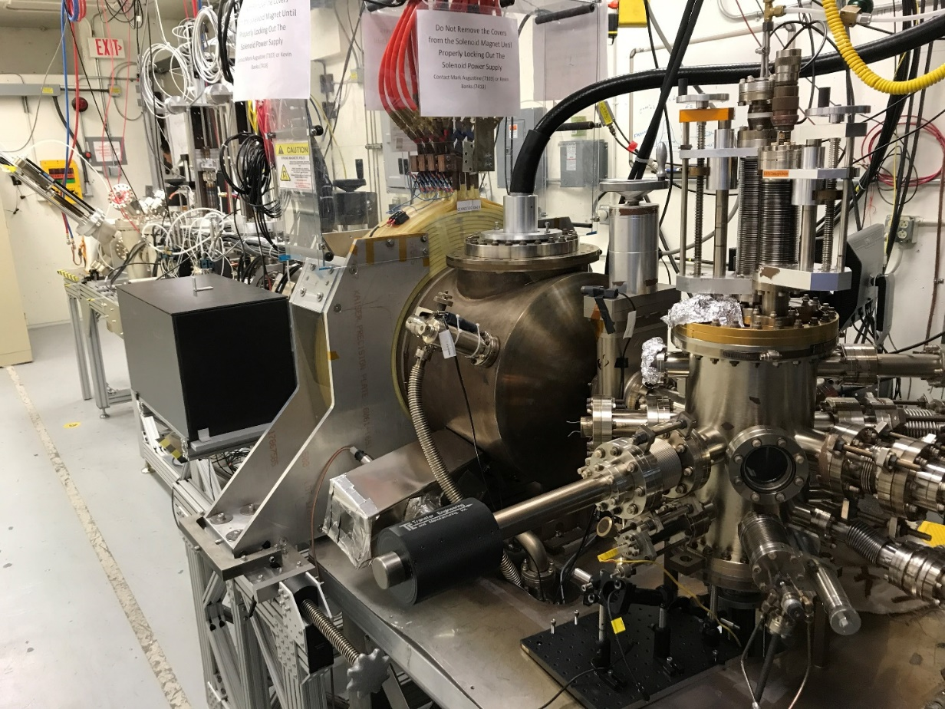
Gun Test Stand with 300 kV Inverted Gun and K₂CsSb Photocathode
Salvaged un-used beamline from old project
Designed and procured cathode solenoid that can provide magnetic field up to 1.5 kG at photocathode
Used CEBAF spare Dogleg magnet power supply (400 A, 80 V)
Cathode solenoid can trigger field emission but we have learned how to prevent this
Photogun operated at 300 kV with gun solenoid at 400 A
Gun Test Stand in October 2015
Magnetic Field at 400 A
Beamline
Focusing
Solenoid 1
Beamline
Focusing
Solenoid 2
Gun Test Stand in September 2018
Electrostatic Field at 300 kV

Slide 11
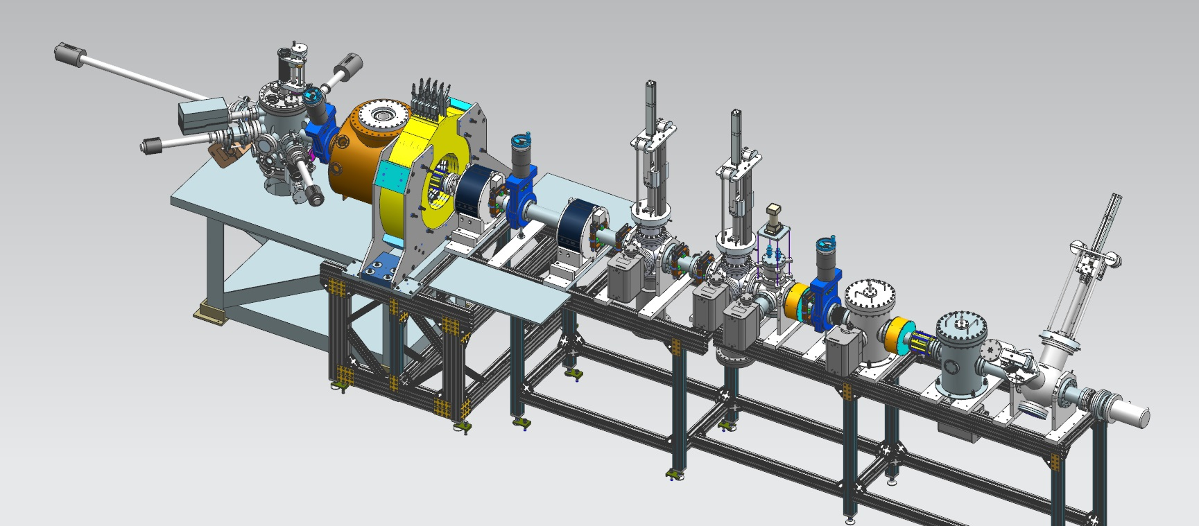
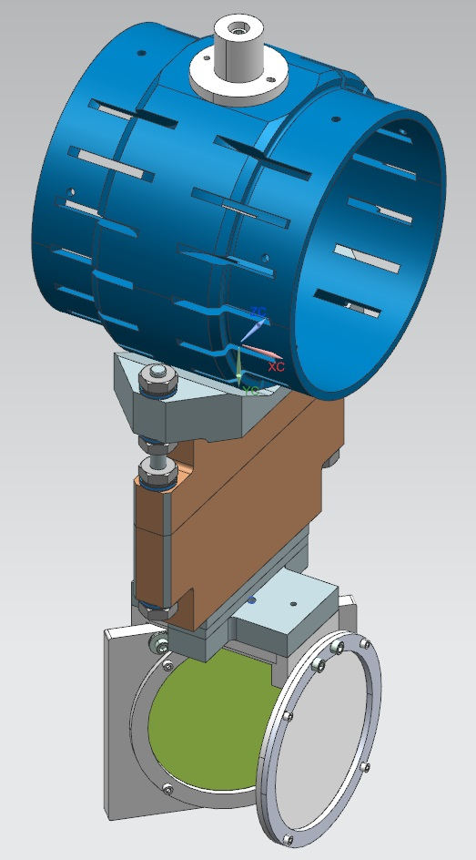

Magnetized Source Schematics
Gun HV Chamber
Photocathode
Preparation
Chamber
Beamline
Viewer 3 Screen
Cathode Solenoid
Beam Dump
Shield Tube
Use slit and viewscreens to characterize magnetization:
Slit
$σ_{i}$: beam size on i ^{-th} viewer
θ: shearing angle
Viewer Screen

Slide 12
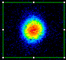
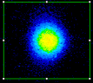


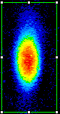
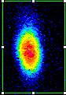

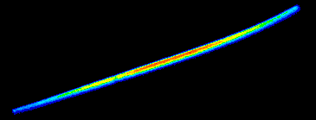
Beam Size and Shearing Angle
Beam and beamlet observed on successive viewers
Beam size and Shearing Angle: Experiment vs Simulation
Magnetic field at photocathode = 0 G
300 kV, laser rms = 0.3 mm
V1
V2
S1-V2
S1-V3
Magnetic field at photocathode = 1514 G
V1
V2
S1-V2
Modelled apparatus using ASTRA & GPT
Focusing by cathode solenoid magnetic field causes mismatch oscillations resulting in repeated focusing inside cathode solenoid field which affects beam size at exit of solenoid field and resulted in varying beam expansion in field free region
S1-V3

Slide 13
Drift Emittance
Beam size too large to transport cleanly
Used beamline solenoid and viewer screen to measure drift emittance for different laser sizes at 200 kV
GPT simulation and experimental results show good agreement

Slide 14
High Bunch Charge
225 kV, 757 G, 50 kHz , 75 ps (FWHM)
Irregular pattern due to beam-loss
Encountered space-charge-limited regime within 0.3 nC for different magnetized conditions
Need longer laser pulses, higher gun voltage and better beamline optics to get nC bunches

Slide 15
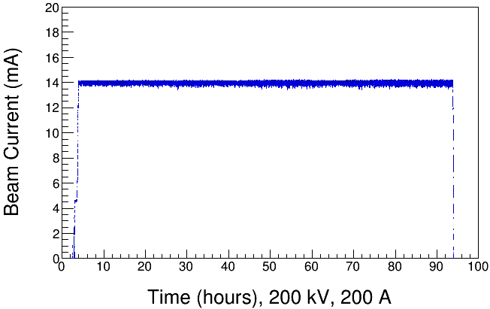
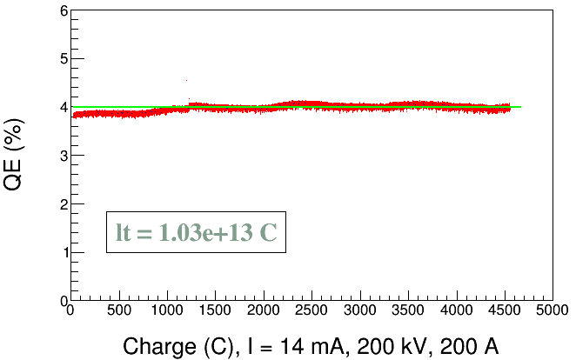
High Average Current: 14 mA
Magnetic field = 757 G
Laser rms = 0.9 mm, 303 MHz, 60 ps (FWHM)
Gun HV = 200 kV, Gun Solenoid = 200 A, Anode at + 1 kV
K₂CsSb photocathode on molybdenum
Bunch charge = 46 pC
No quantum efficiency (QE) reduction over 90 hour run
Positive anode bias (+1 kV) effectively prevented ions in beamline from reaching gun and stopped micro-arcs and sudden QE loss (problem we struggled with)

Slide 16
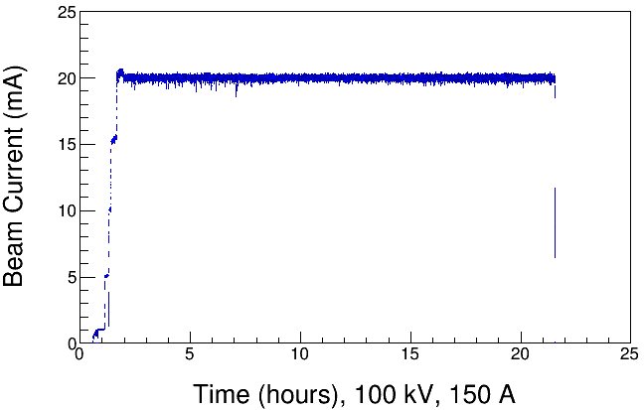
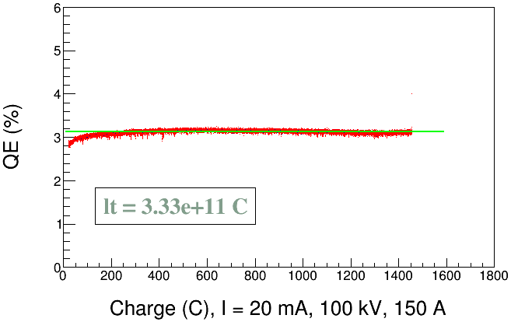
High Average Current: 20 mA
Magnetic field = 568 G
Laser rms = 0.9 mm, 303 MHz, 60 ps (FWHM)
Gun HV = 100 kV, Gun Solenoid = 150 A, Anode at + 1 kV
K₂CsSb photocathode on molybdenum
Bunch charge = 66 pC
14 mA, 725 G, 90 h run
Laser rms =0.9 mm, 303 MHz, 60 ps
Gun Sol=200 A, HV=200 kV
No QE loss over 20 hours

Slide 17
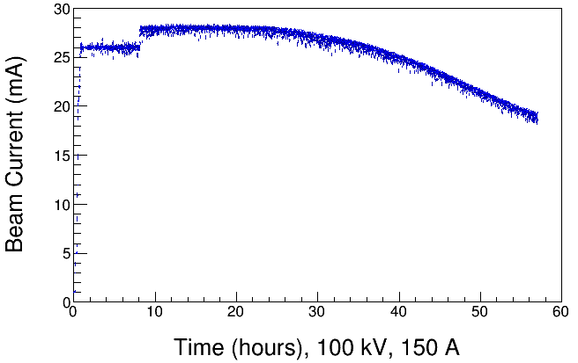
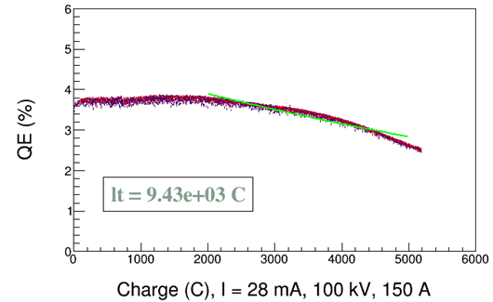
High Average Current: 28 mA
Radiation Control Group approval obtained
Magnetic field = 568 G
Laser rms = 1.4 mm, 374.25 MHz, 50 ps (FWHM)
Gun HV = 100 kV, Gun Solenoid = 150 A, Anode at + 1 kV
K₂CsSb photocathode on molybdenum
Bunch Charge = 92 pC
Limited lifetime might be a result of heating and associated bandgap shift, or enhanced ion bombardment
Will increase anode bias voltage beyond 1kV

Slide 18
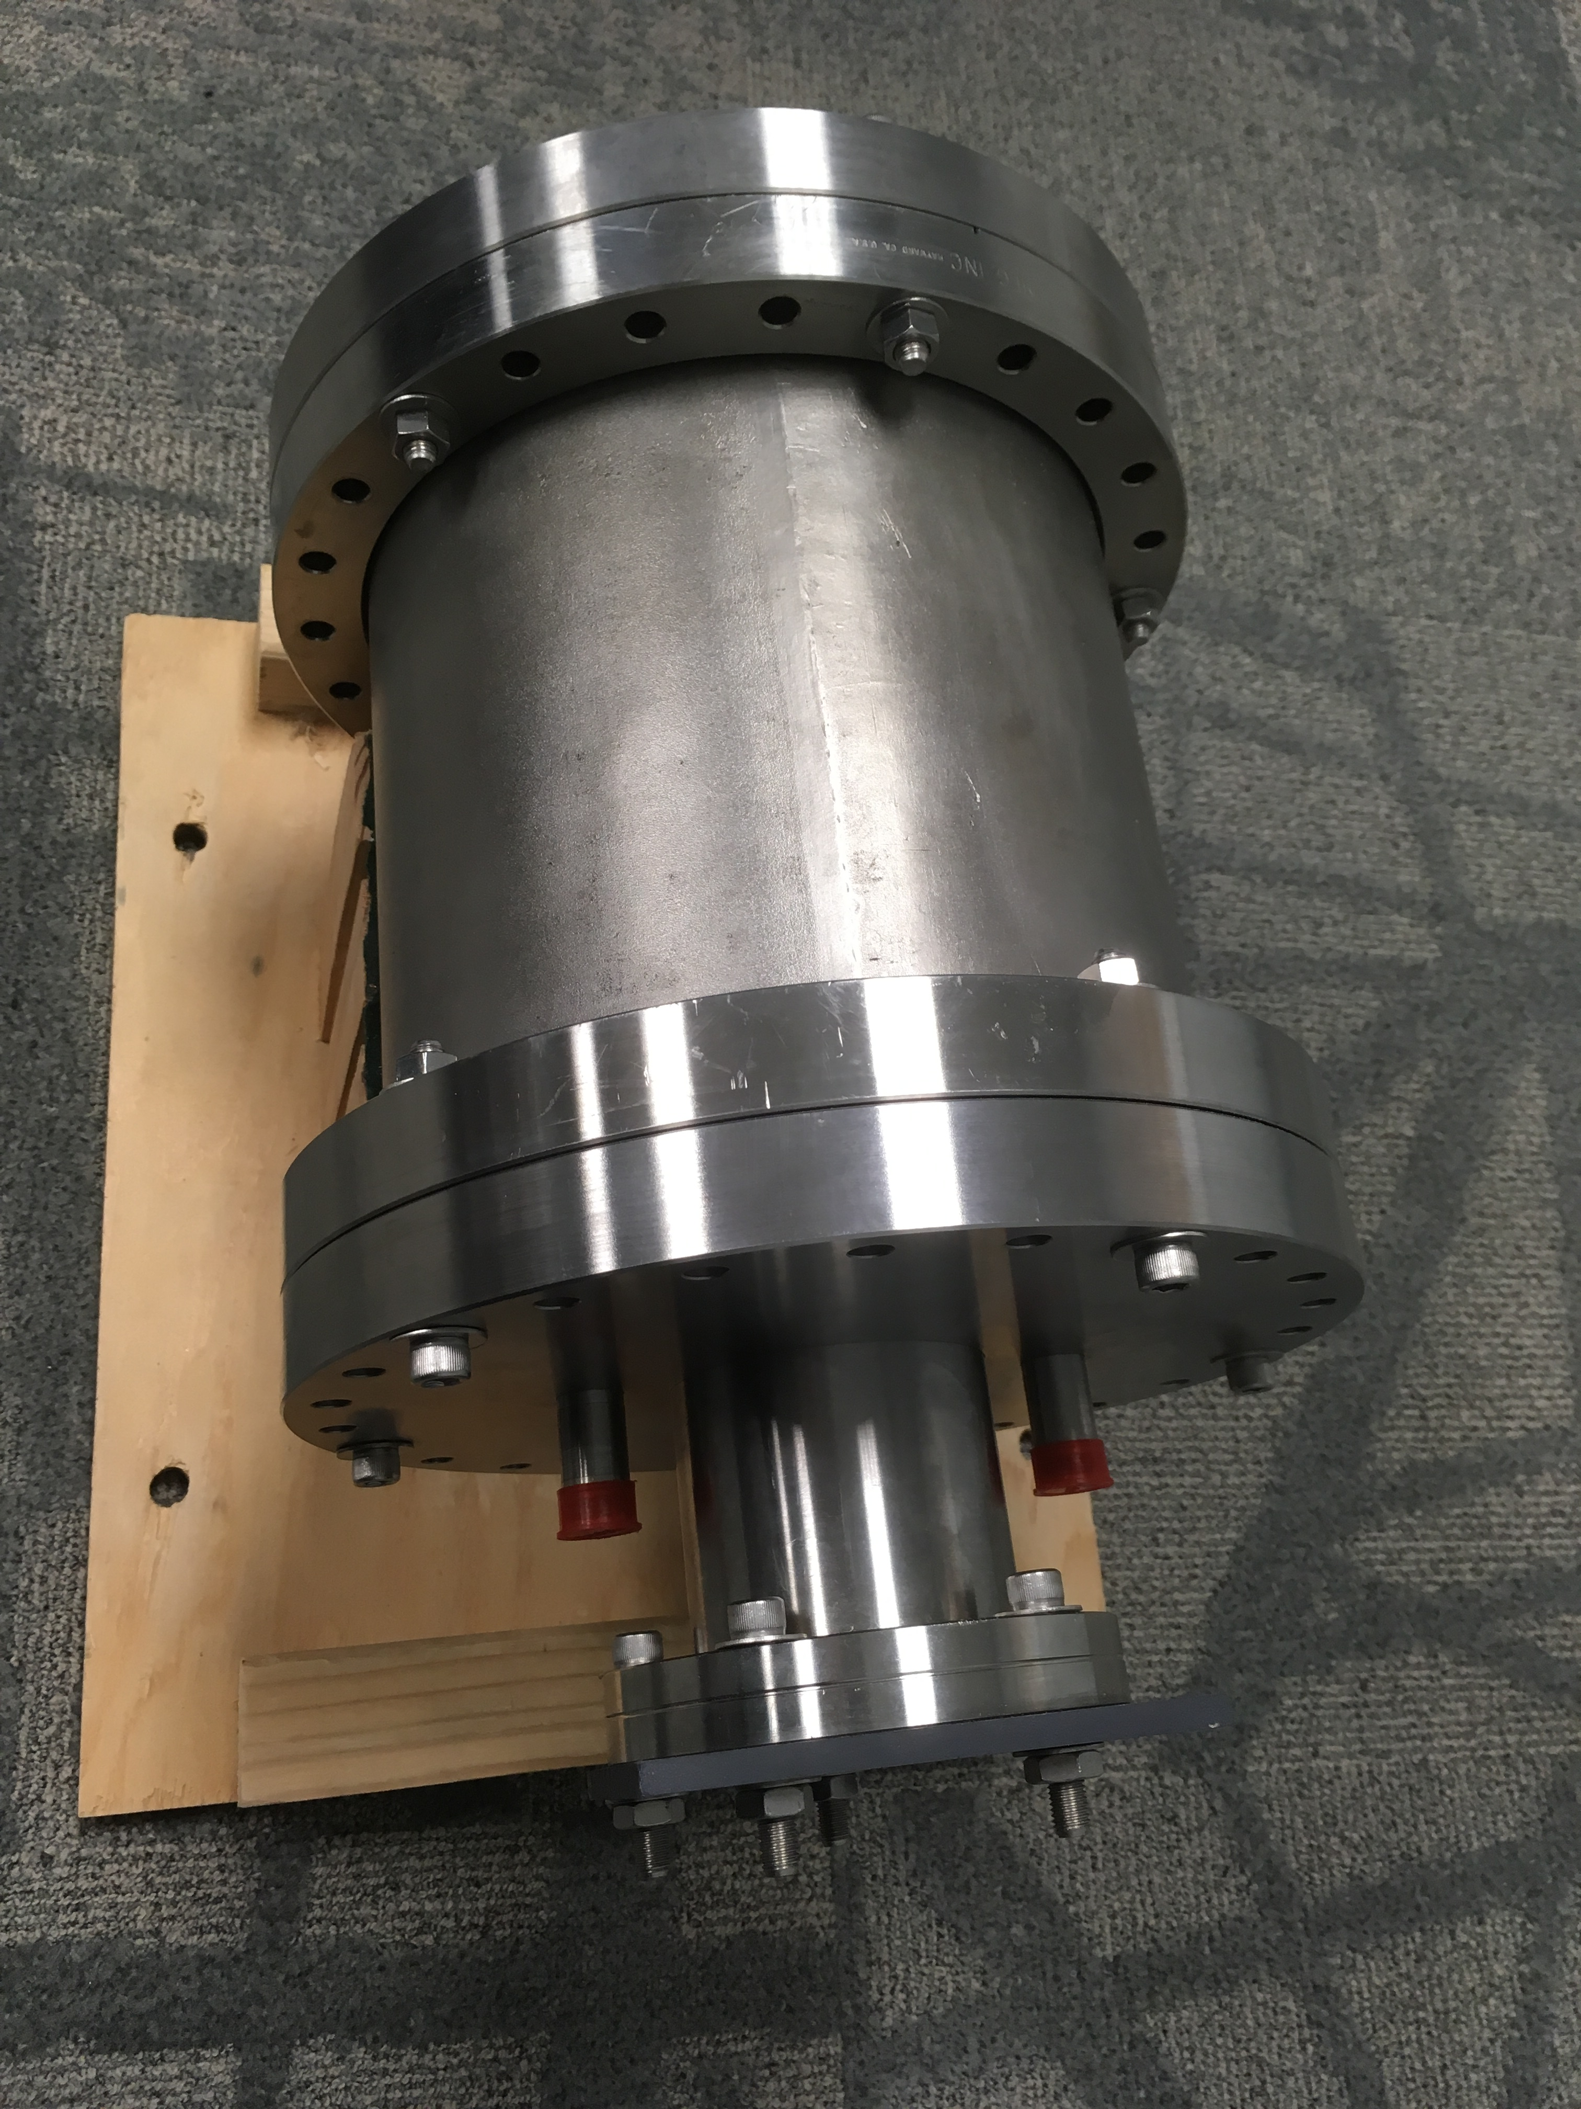
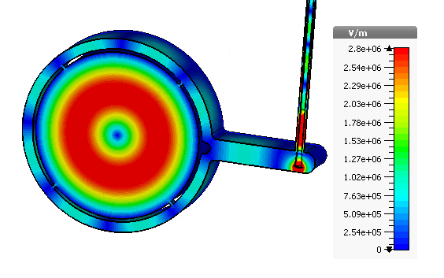
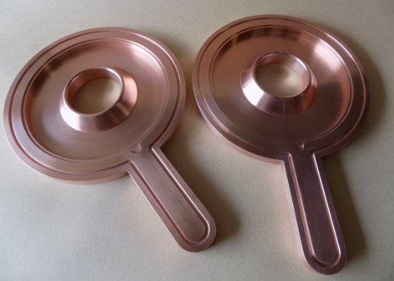
Future Plans
Swap photogun for RF-pulsed thermionic gun built by Xelera Research LLC to demonstrate magnetized beam at 65 mA and 125 kV (will use LDRD cathode solenoid and beamline but with new HV supply): an SBIR Phase II funded project (DE-SC0015186)
Install two non-invasive magnetometer cavities – LDRD cavity and “Brock” cavity from Electrodynamic to measure beam magnetization: another SBIR Phase II funded project (DE-SC0017120)
Collaborate with Xelera, Electrodynamic, Brookhaven National Lab and others on more follow-up projects

Slide 19
Summary
K₂CsSb photocathode preparation chamber, gun, cathode solenoid and beamline - all operational
Photogun operated reliably up to 300 kV for >1000 h
Have successfully generated and characterized magnetized electron beams
Demonstrated high bunch charge up to 0.7 nC
Delivered 28 mA magnetized beam (568 G at photocathode) with RF structure (gain-switched drive laser, 374.25 MHz, 50 ps FWHM) at 100 kV using 30 mA/225 kV HV supply
with 3 kW limit
Successfully fabricated bialkali antimonide photocathode with QE ~ 9% on molybdenum substrate that provided long charge lifetime
Positive bias on anode helps to prevent sudden QE loss from ion-induced micro-arcing events
Envisioned new non-invasive device to measure beam magnetization (TE₀₁₁ cavity). Cavity was designed and now under construction.
Thanks to those involved in this team work:
P. Adderley, J. Benesch, B. Bullard, J. Delayen , J. Grames, J. Guo, F. Hannon, J. Hansknecht, C. Hernandez-Garcia, R. Kazimi, G. Krafft, M. A. Mamun, M. Poelker, M. Tiefenback, Y. Wang, S. Wijiethunga, S. Zhang.
Postdoc
Old Dominion University Ph.D. Students

