Slide 1
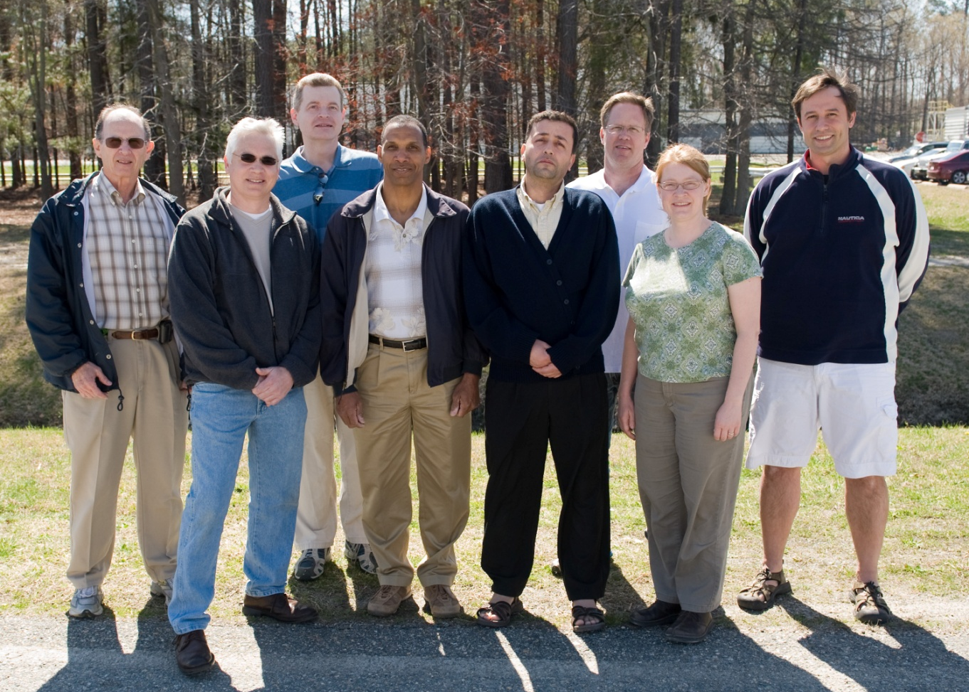
High Current Polarized Electron Source
Considerations for building a reliable photogun that provides mA beam current at 80% polarization
JLab interest:
Parity Violation Experiments
Photogun for EIC
Polarized Positrons
P. Adderley, J. Clark, S. Covert, E. Forman, J. Grames, J. Hansknecht,
M. Poelker, M.Stutzman, R. Suleiman, K. Surles-Law,
Graduate students: M. BastaniNejad, M. Mamun
LHeC-Daresbury Workshop, Jan. 22 – 23, 2013

Slide 2
Source Parameter Comparison
Parameter | CEBAF | SLC | JLab/FEL | Cornell ERL | LHeC | eRHIC | CLIC | ILC
Polarization | Yes | Yes | No | No | Yes | Yes | Yes | Yes
Number electrons/microbunch | 2.5 x 10⁶ | 1 x 10¹¹ | 8.3 x 10⁸ | 4.8 x 10⁸ | 1 x 10⁹ | 2.2 x 10¹⁰ | 6 x 10⁹ | 3 x 10¹⁰
Number of microbunches | CW | 2 | CW | CW | CW | CW | 312 | 3000
Width of microbunch | 50 ps | 2 ns | 35 ps | 2 ps | ~ 100 ps | ~ 100 ps | ~ 100 ps | ~ 1 ns
Time between microbunches | 2 ns | 61.6 ns | 13 ns | 0.77 ns | 25 ns | 71.4 ns | 0.5002 ns | 337 ns
Microbunch rep rate | 499 MHz | 16 MHz | 75 MHz | 1300 MHz | 40MHz | 14MHz | 1999 MHz | 3 MHz
Width of macropulse | - | 64 ns | - | - | - | - | 156 ns | 1 ms
Macropulse repetition rate | - | 120 Hz | - | - | - | - | 50 Hz | 5 Hz
Charge per micropulse | 0.4 pC | 16 nC | 133 pC | 77 pC | 160 pC | 3.6 nC | 0.96 nC | 4.8 nC
Charge per macropulse | - | 32 nC | - | - | - | - | 300 nC | 14420 nC
Average current from gun | 200 uA | 2 uA | 10 mA | 100 mA | 6.5 mA | 50 mA | 15 uA | 72 uA
Average current in macropulse | - | 0.064 A | - | - | - | - | 1.9 A | 0.0144 A
Duty Factor | 2.5 x 10⁻² | 2.8 x 10⁻⁷ | 2.6 x 10⁻³ | 2.6 x 10⁻³ | 4 x 10⁻³ | 1.4 x 10⁻³ | 0.2 | 3x10⁻³
Peak current of micropulse | 8 mA | 8 A | 3.8 A | 38.5 A | 1.6 A | 35.7 A | 9.6 A | 4.8 A
Current density* | 4 A/cm² | 10 A/cm² | 19 A/cm² | 500 A/cm² | 8 A/cm² | 182 A/cm² | 12 A/cm² | 6 A/cm²
Laser Spot Size* | 0.05 cm | 1 cm | 0.5 cm | 0.3 cm | 0.5 cm | 0.5 cm | 1 cm | 1 cm
* Loose estimates
Existing
Proposed
Specific challenges depend on beam requirements

Slide 3
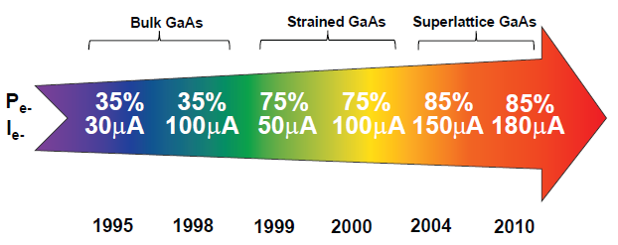
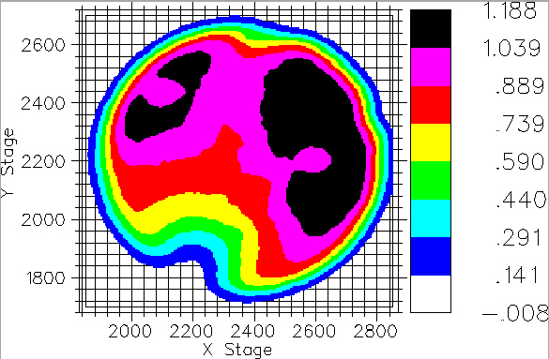

Jlab - ILC High Current Polarized Electron Source
High Initial QE
Parameter | Value
Laser Rep Rate | 1500 MHz
Laser Pulselength | 50 ps
Laser Wavelength | 780 nm
Laser Spot Size | 350 µm FWHM
High-Pol Photocathode | SSL GaAs/GaAsP
Gun Voltage | 200 kV DC
CW Beam Current | 4 mA
Run Duration | 1.4 hr
Extracted Charge | 20 C
1/e Charge Lifetime | 85 C
Bunch charge | 2.7 pC
Peak current | 53 mA
Current density | 55 A/cm²
R. Suleiman et al., PAC’11, New York (NJ, USA), March 28 – April 1, 2011

Slide 4
How Long Can We Run at 6.5 mA?
6.5 mA operation, 23 C/hr, 560 C/day.
Photocathode with 1% initial QE, 2W at 780nm and gun with 80C charge lifetime (i.e., what we had during 4mA test)
Need initial laser power ~ 1 W to produce 6.5mA
Should be able to operate at 6.5mA for 2 hours before running out of laser power. Time to move to fresh photocathode spot (10 minutes), swap photocathode (1 hour), heat/reactivate photocathode (8 hours)
Imagine a 10W laser and 200C charge lifetime, should be able to operate at 6.5mA for ~ 20hr before “doing something”! 1000C charge lifetime means 4 days of operation, etc.…

Slide 5

Ion Back-bombardment

Slide 6
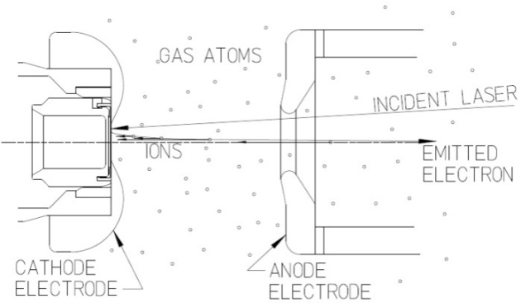
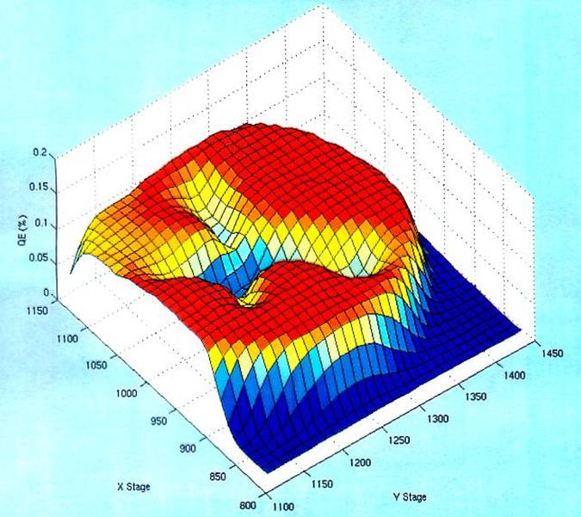
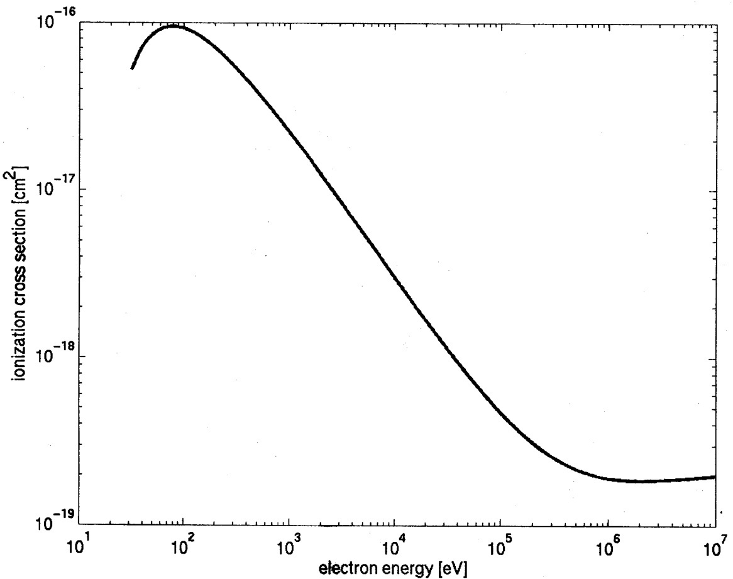
Imperfect Vacuum = Finite Lifetime
Ion bombardment –characteristic “trench” from laser spot to electrostatic center of photocathode
QE can be restored but takes about 8 hours
Active area = 5mm
Laser spot = 0.5mm dia.
Ionization cross section for H₂
Most ions created at low energy
100kV

Slide 7
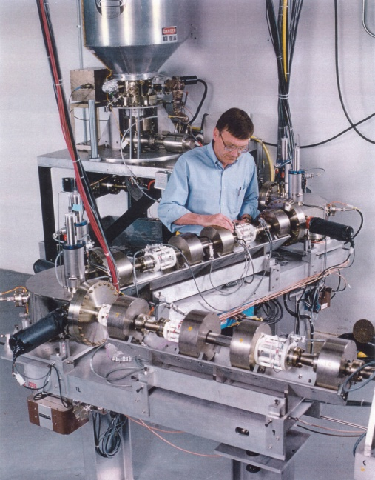
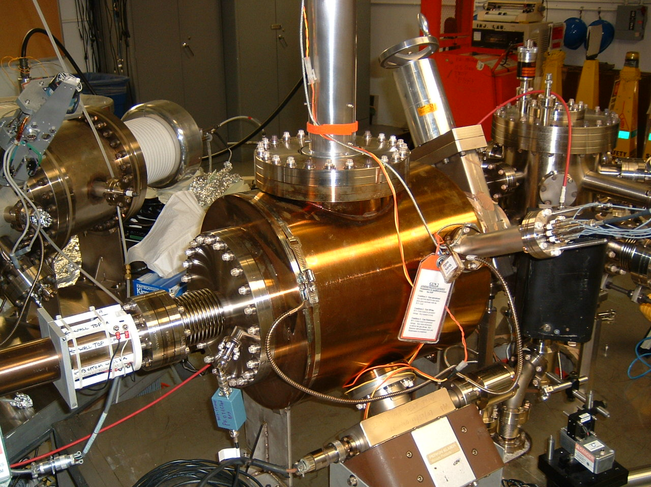
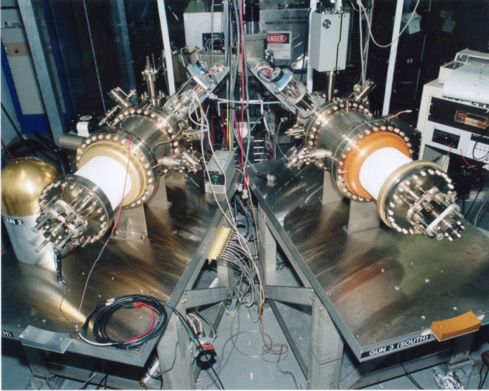
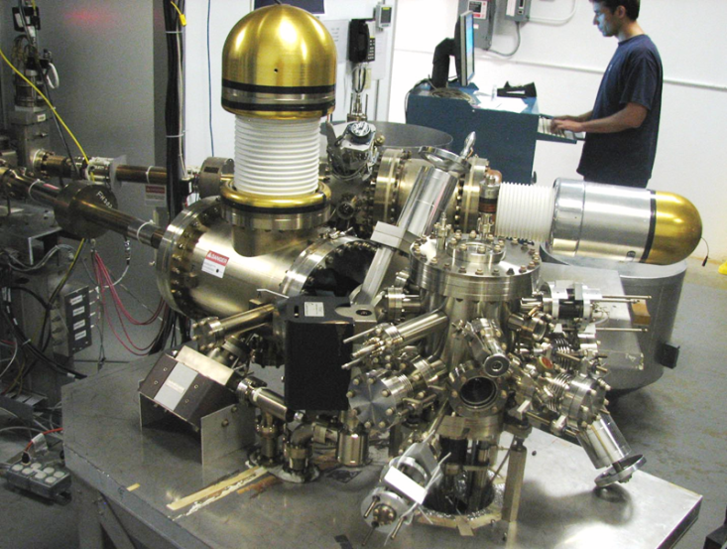
Always Tweaking the Design
1
4
Endless (?) quest for perfection
2
3

Slide 8
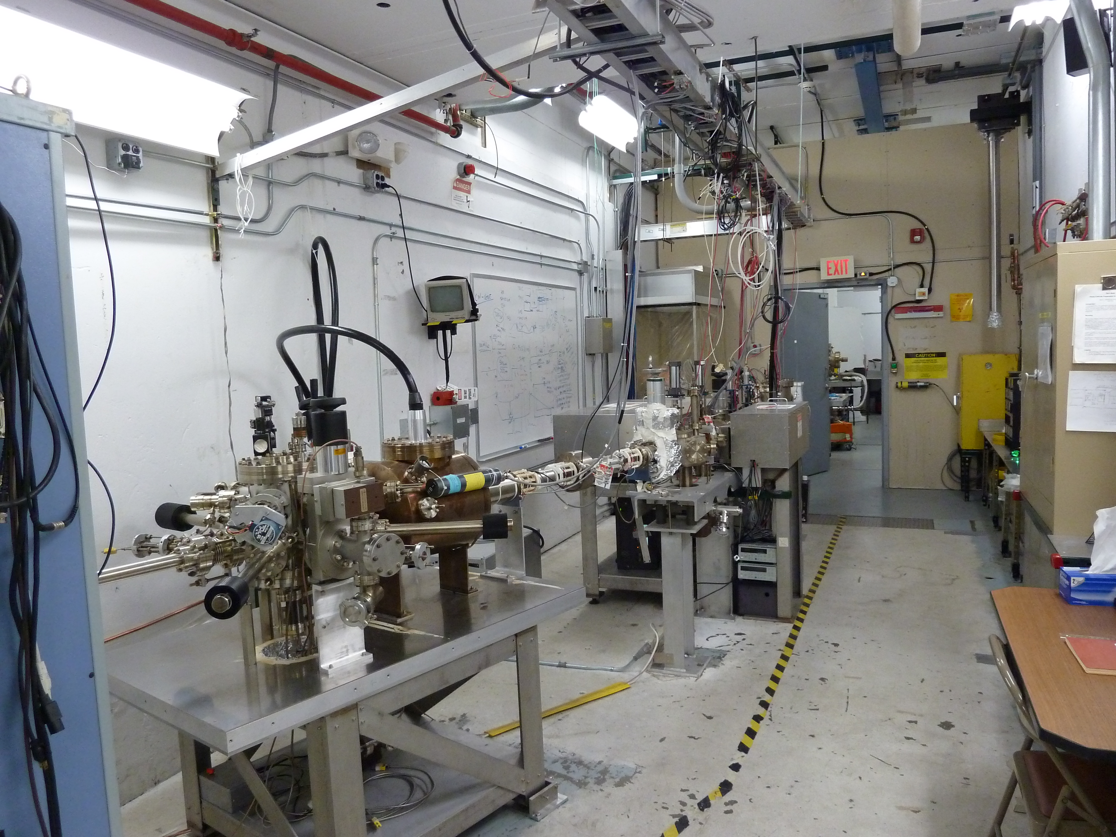

Slide 9
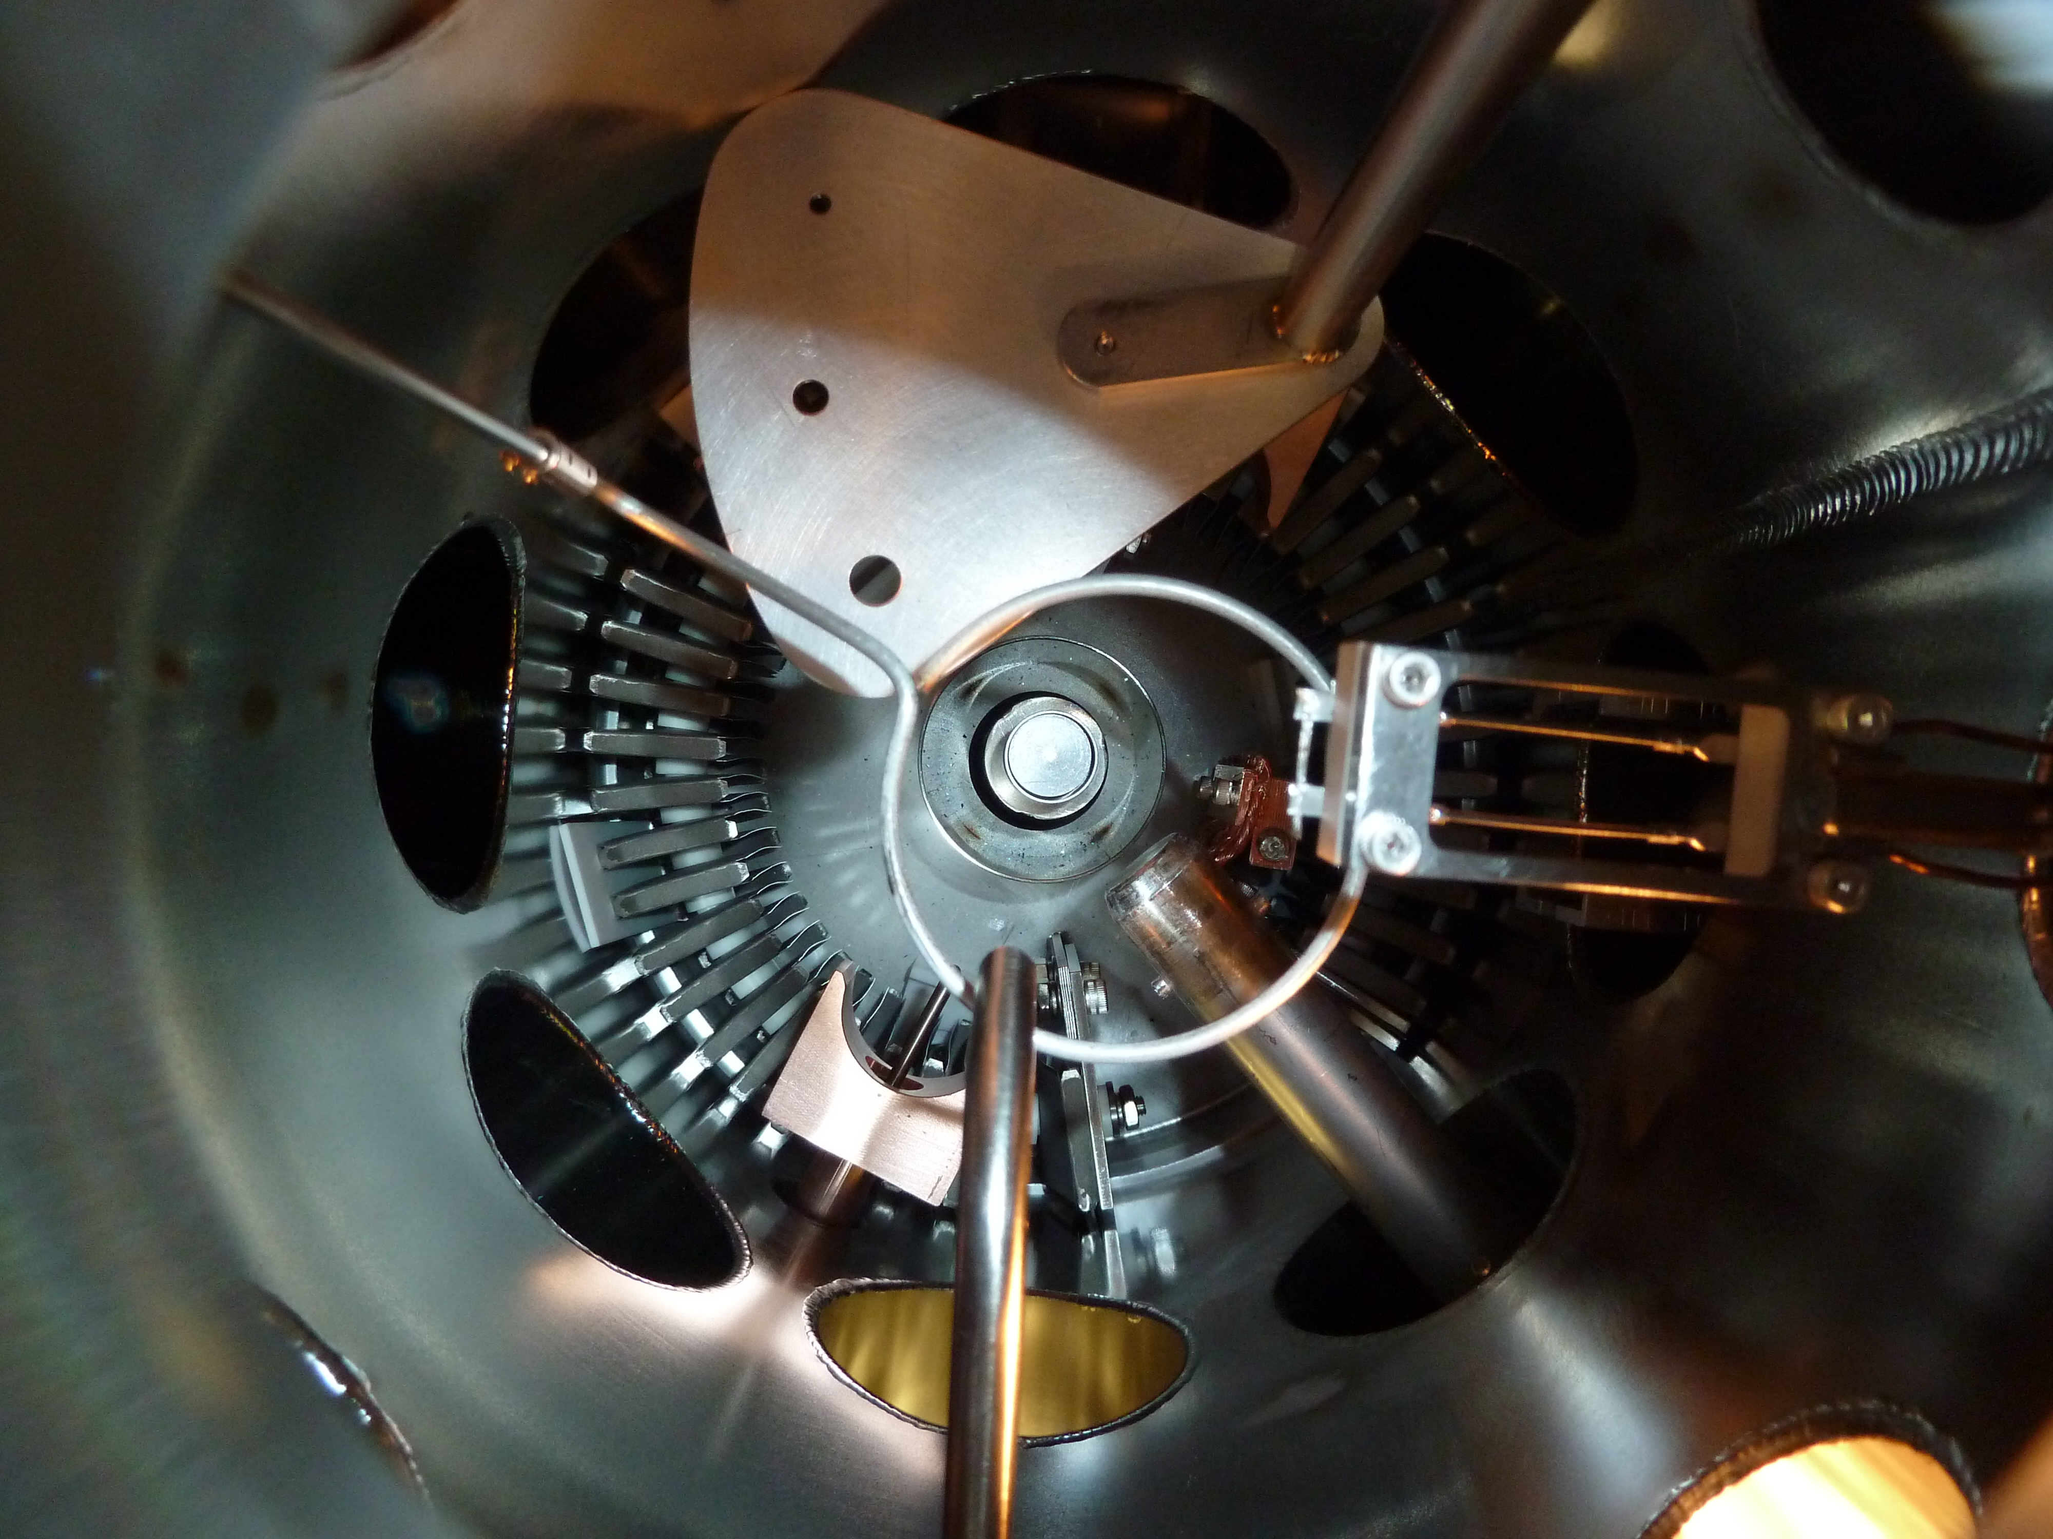
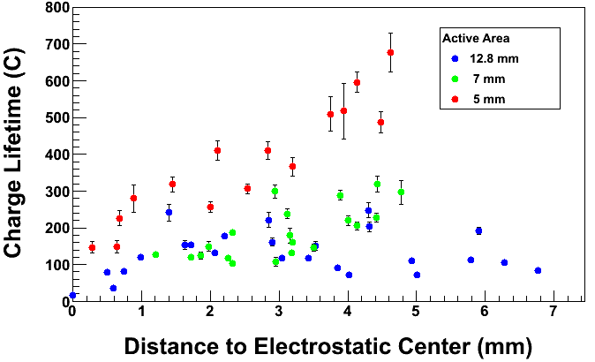
Lifetime vs. Laser Position and Active Area
Mask
Lesson: extremely important to manage ALL of the extracted beam
Beam from outside 5 mm active area hits beam-pipe walls, degrades vacuum, reduce lifetime
Bias Ring
+200 V
Cs
Heater
Long Manipulator
NF₃
Leak Valve

Slide 10
Improve Lifetime with Large Laser Spot?
(Best Solution – Improve Vacuum, but not easy)
Bigger laser spot, same # electrons, same # ions
Ionized residual gas
strikes photocathode
Ion damage distributed
over larger area

Slide 11
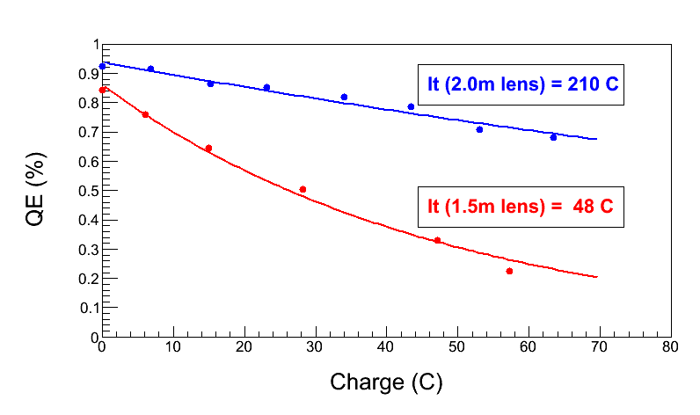
Enhanced lifetime for Qweak
“Charge and fluence lifetime measurements of a DC high voltage GaAs photogun at high average current.,” J. Grames, R. Suleiman, et al., Phys. Rev. ST Accel. Beams 14, 043501 (2011)

Slide 12
Benefits of Higher Gun Voltage
Reduce space-charge-induced emittance growth, maintain small transverse beam profile and short bunch-length. In other words, make a “stiff” beam right from the gun
Address current density limitation due to Child’s Law (Space Charge Limit)
Reduce problems associated with Surface Charge Limit (i.e., QE reduction at high laser power)
Prolong Charge Lifetime (?)
Biggest Obstacle: Field Emission and HV Breakdown… which lead to bad vacuum and photocathode death

Slide 13
Emittance and Brightness
Normalized Emittance from GaAs:
q | Bunch Charge (= 0.4 pC, 200 μA and 499 MHz)
E_{s} | Electric Field at GaAs surface
T_{eff} | Effective Temperature of GaAs (= 300 – 400 K, 780 nm)
k_{B}T_{eff} | Thermal Energy (= 34 meV)
Gun HV (kV) | E_{s} (MV/m) | ε_{n} (μm)
100 | 2.0 | 0.011
140 | 2.8 | 0.009
200 | 4.0 | 0.008
Normalized Brightness:
Brightness is proportional to Gun HV

Slide 14
Benchmarking PARMELA Simulation Results Against Beam-Based Measurements at CEBAF/Jefferson Lab – work of Ashwini Jayaprakash, JLab
Measurements at CEBAF/JLab
PARMELA Simulation Results
Similar Trends
Message: Beam quality, including transmission, improves at higher gun voltage

Slide 15

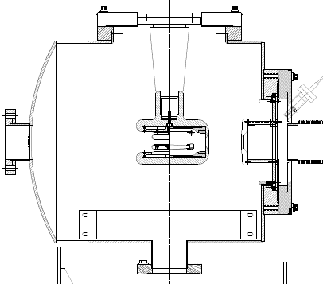
The CEBAF - ILC 200kV Inverted Gun
New design
Higher voltage = better beam quality.
The inverted design might be the best way to reach voltages > 350kV

Slide 16
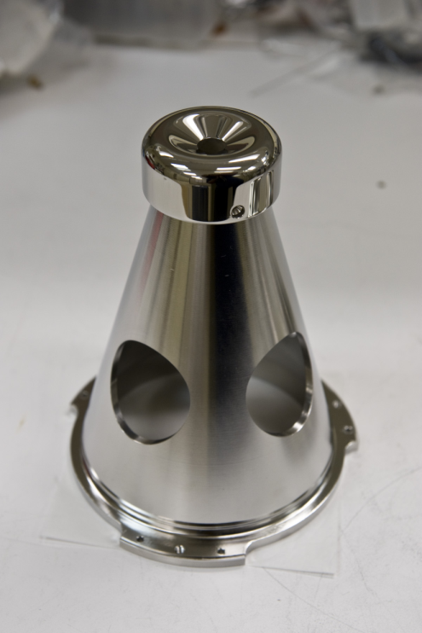
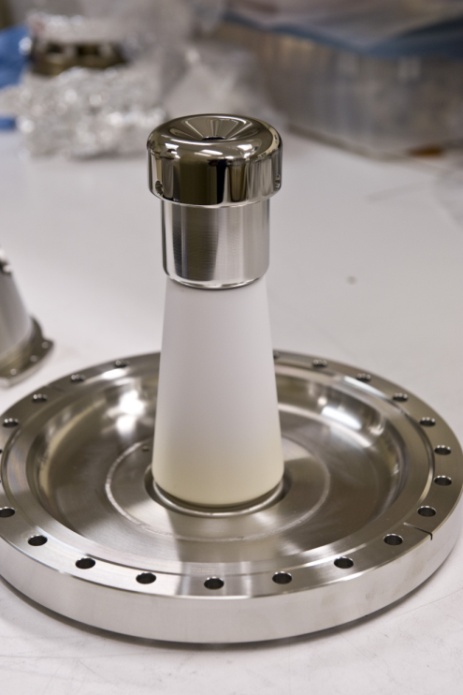
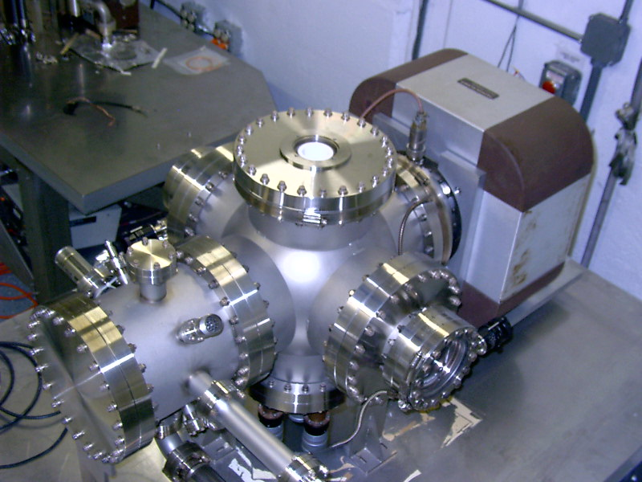
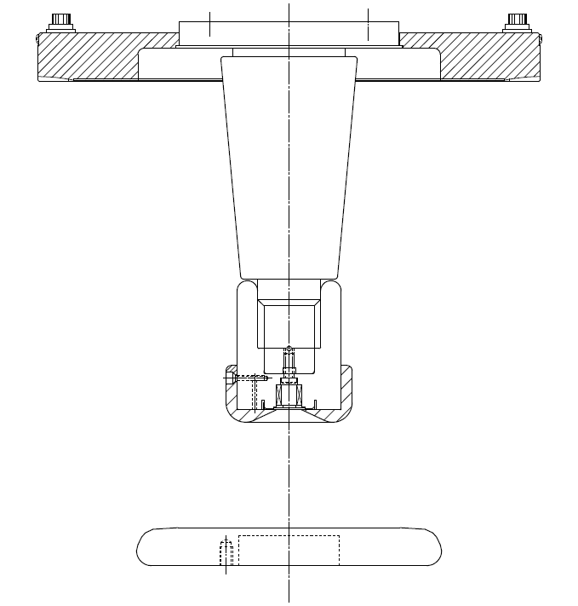
Niobium
Capable of operation at higher voltage and gradient?
Buffer chemical polish (BCP) much easier than diamond-paste-polish
Conventional geometry: cathode electrode mounted on metal support structure
Replace conventional ceramic insulator with “Inverted” insulator: no SF6 and no HV breakdown outside chamber

Slide 17
Field Emission from Niobium
Work of M. BastaniNejad
Phys. Rev. ST Accel. Beams, 15, 083502 (2012)
DPP stainless steel
Fine grain niobium
Large grain niobium
Single crystal niobium
Conventional High Voltage processing: solid data points
After Krypton Processing: open data points

Slide 18
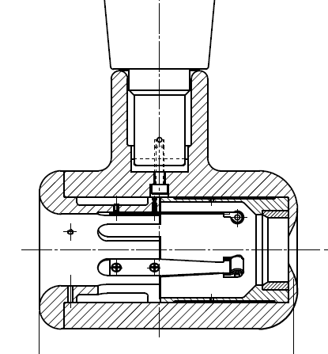
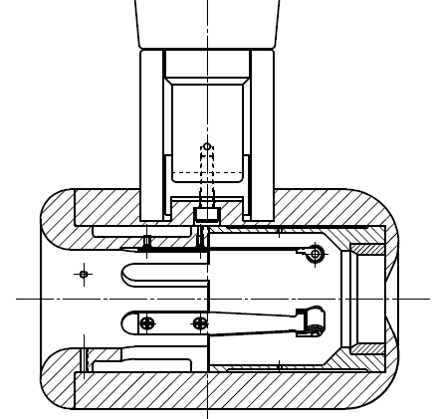
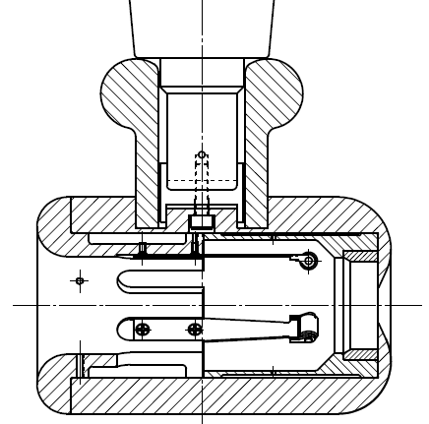
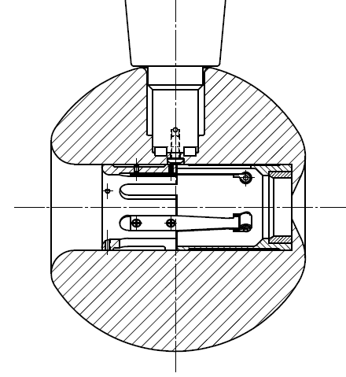
Plan B
Insulator sleeve
Plan A
No Improvement
Plan D
Plan C
In hand, but untested

Slide 19
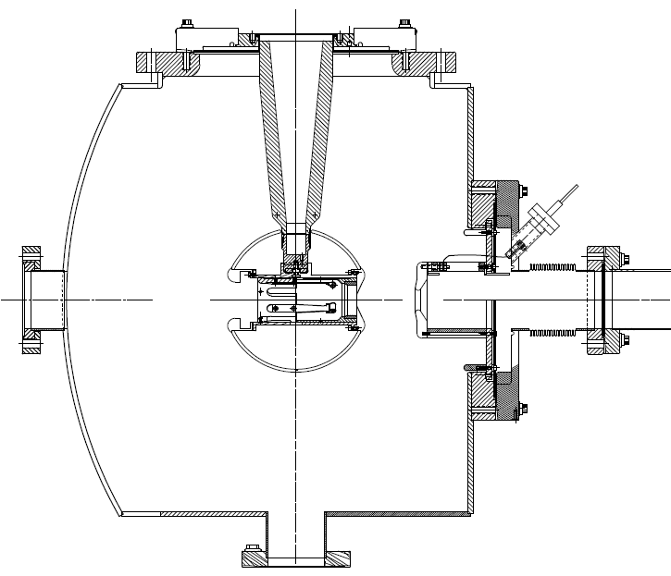
350kV Inverted Gun
200kV Inverted Gun
Longer insulator
Spherical electrode
Thin NEG sheet to move ground plane further away

Slide 20
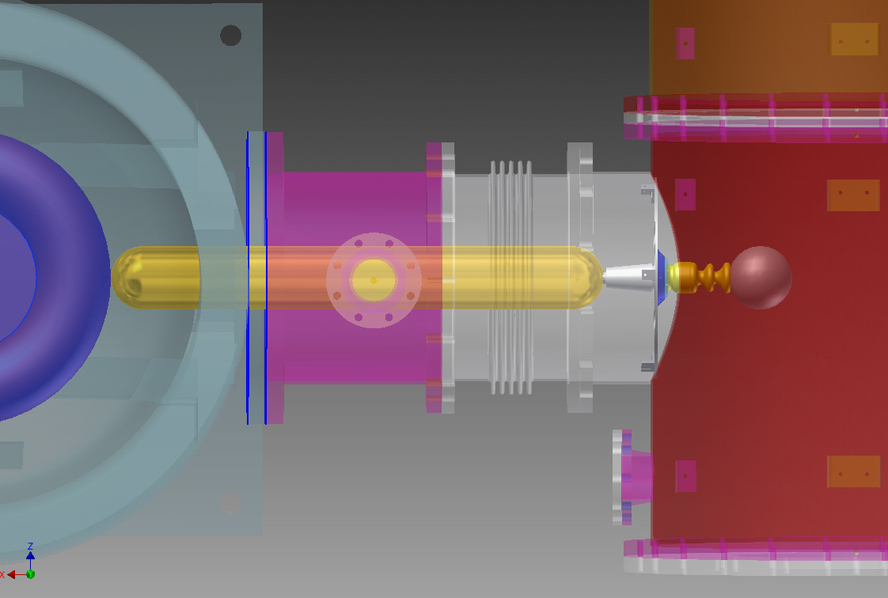
HV Issues: inside and outside the gun
600 kV supply at FEL gun test stand, with SF6 tank
Inverted insulator
4.5” long CEBAF insulator
reached 470kV before arcing to ground
Learn to apply high voltage without breakdown, dielectric plug inside insulator,
Then address the field emission problems inside the gun

Slide 21
Space Charge Limit
Old Slide
Child’s Law
V (kV) | j₀ (A/cm²)
100 | 7
140 | 14
200 | 23
350 | 53
People expect to operate beyond these current densities
Assume 3cm cathode/anode gap

Slide 22
More Realistic Space Charge Limit
Child’s Law (1D):
Child’s Law (2D) (PRL 87, 278301) :
Short Pulse (PRL 98, 164802):
V | Gun voltage
d | Cathode/anode gap (3 cm)
r | Laser spot size (1 cm = 2r)
t_{b} | microbunch length (100 ps)
_{τ} | Gap transit time (0.48 ns @ 100 kV)
Machines like ILC - with long microbunch - won’t reap “short pulse” benefit

Slide 23
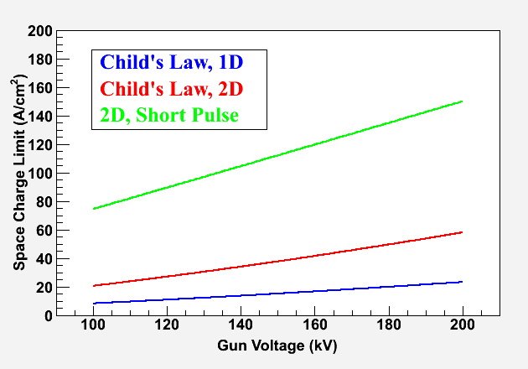
Space Charge Limit – Not an Issue
1D SCL does not apply (i.e. we don’t have infinite charge plane)
Real world conditions, with finite beam size 2D and short pulses, push Child’s Law Current Limit higher…..

Slide 24
Surface Charge Limit
NEA of GaAs depends on Gun HV. QE increases with external Electric Field at GaAs surface, E_{s},
Where χ (~200 meV) is the zero-field NEA value (Physics Letters A 282, 309) and potential barrier lowering due to Electric Field is
χ
Where ε_{s} (= 13.1) is GaAs relative permittivity.
E_{gap}
δU(E_{s})
Gun HV (kV) | E_{s} (MV/m) | δU(E_{s}) (meV)
100 | 2.0 | 50
140 | 2.8 | 59
200 | 4.0 | 70

Slide 25
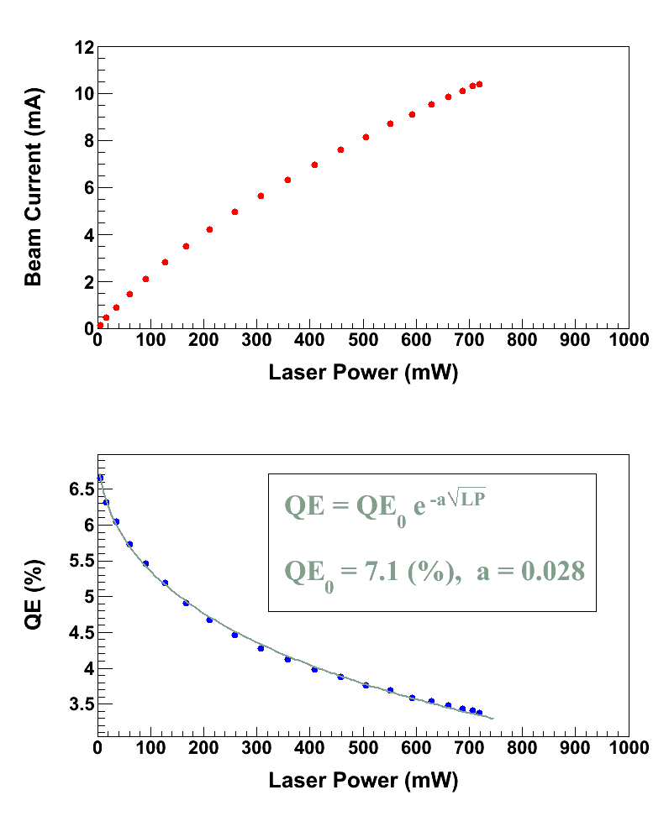
Surface Charge Limit, also known as Surface Photovoltage Effect, reduces NEA of GaAs: Photoelectrons trapped near GaAs surface produce opposing field that reduces NEA resulting in QE reduction at high laser power (LP),
U(LP)
χ
E_{gap}
Where U(LP) is up-shifting of potential barrier due to photovoltage.
δU(E_{s})
For heavily Zn doped GaAs surface, U(LP) → 0
Higher Gun HV suppresses photovoltage

Slide 26
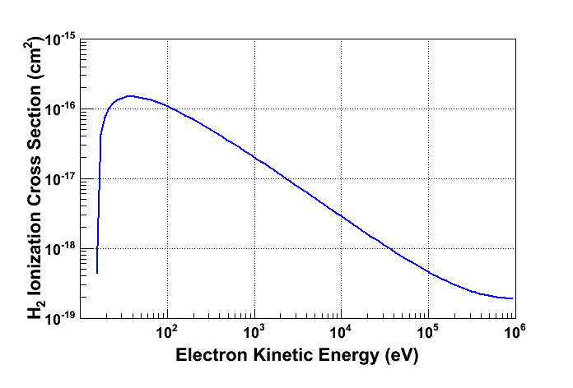
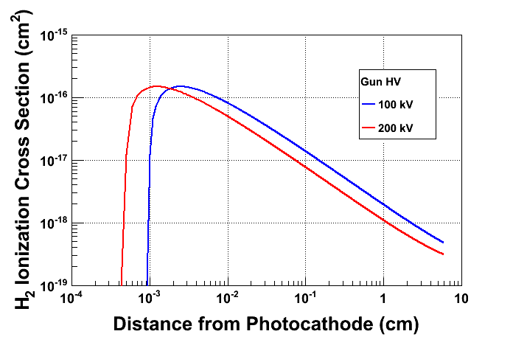
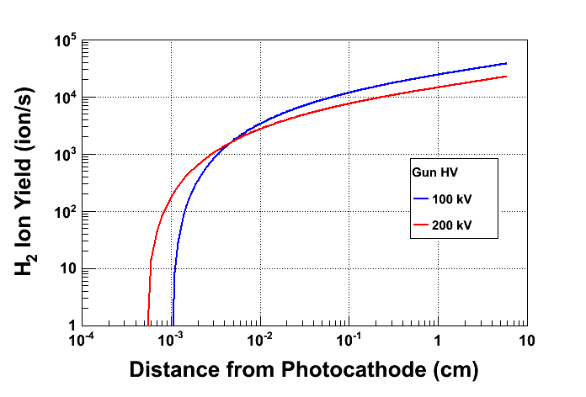
Prolong Photocathode Charge Lifetime
Most ions created at low energy
Most ions created close to GaAs surface
Beam Current: 2.0 mA
Vacuum: 8.0 × 10⁻¹² Torr

Slide 27
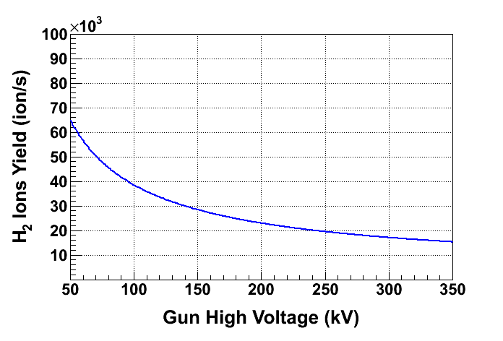
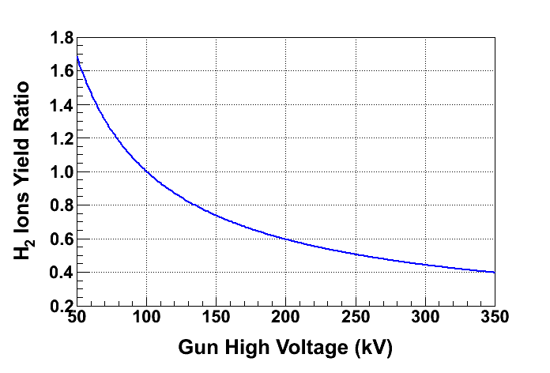
Ion energy
Low energy ion column for 100 kV gun
Low energy ion column for 200 kV gun
Awaits experimental verification
At 200 kV, only 60% of ions are created compared to 100 kV, longer lifetime

Slide 28
LHeC Polarized Source Concerns
Require long photogun lifetime at 6.5mA
  Excellent Vacuum
  Cathode/anode design for 100% transport
  Learn the tricks to “get around” ion bombardment
Emittance, bunch charge and peak current requirements lead to significant space charge forces which necessitate gun voltage ~ 350kV
  Field emission
Child’s Law Space Charge Limit? Probably No
Surface charge limit? Probably Yes
High laser power …. photocathode cooling
Photocathode R&D: look for higher QE (~10%), something more rugged than superlattice GaAs

Slide 29
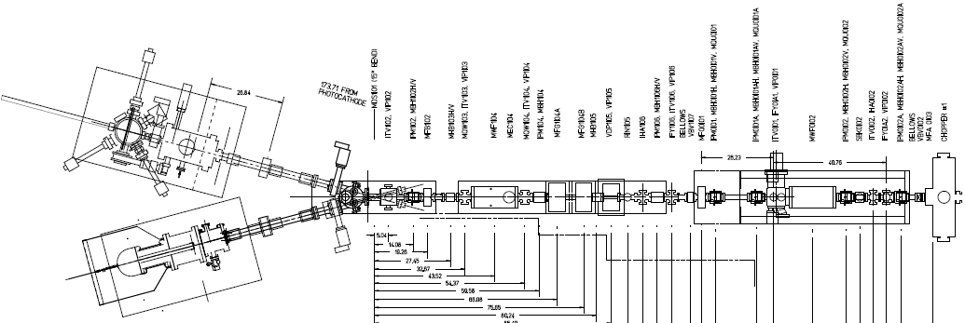
Electron Spin Reversal for PV
From Gun
“Spin Reversal”
Vertical Wien = 90 deg
Two Solenoids = ±90 deg
“Longitudinal Polarization”
Horizontal Wien = {-90…+90}
LEFT
RIGHT
Two-Wien Spin Flipper:
Used to orient spin direction at target and to cancel some helicity-correlated beam systematic errors

Slide 30
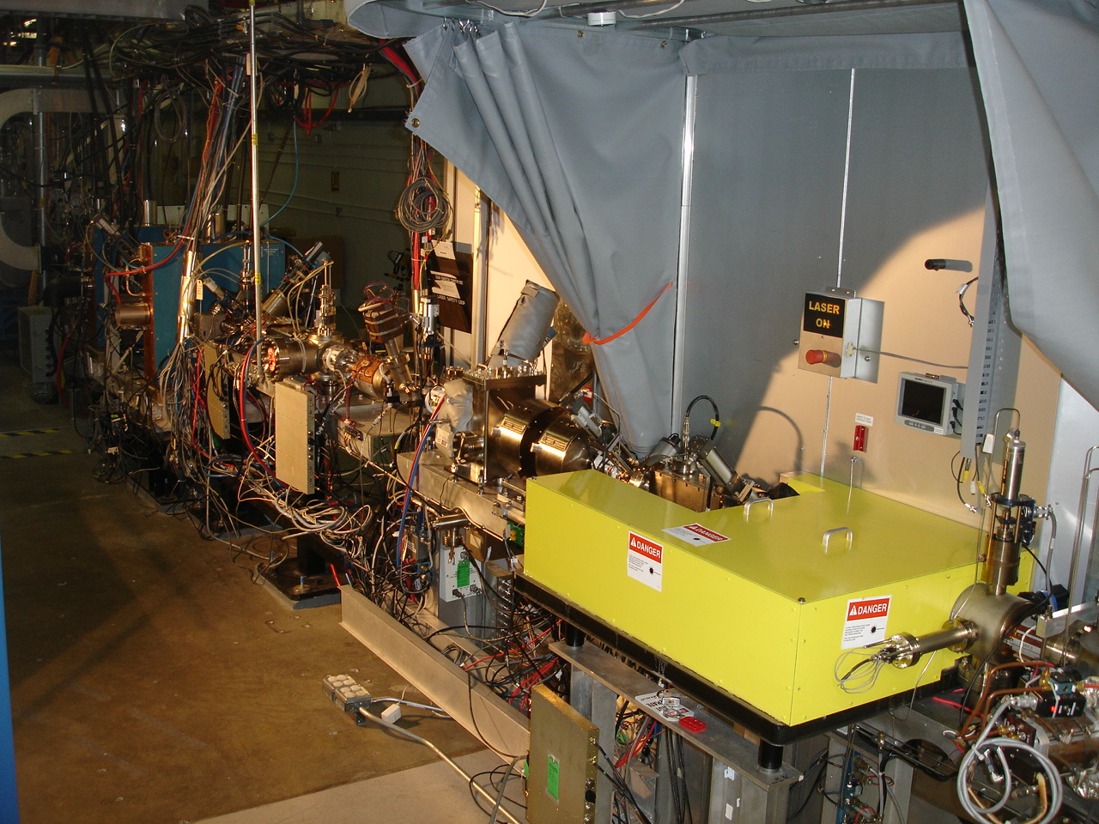
4π Electron Spin Manipulation
Horizontal Wien Filter
Two Solenoids
Vertical Wien Filter

Slide 31
Polarized Positrons

Slide 32
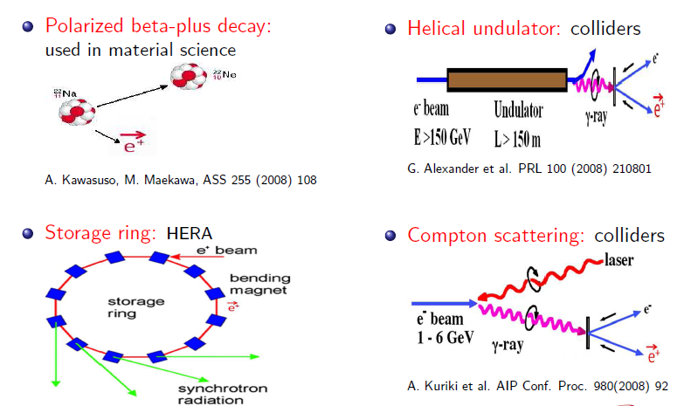
Polarized Positrons

Slide 33
The PEPPo experiment @ JLab
Experiment Layout
PEPPo is proposed to run at the injector, taking advantage of the existing experimental capabilities that uniquely define with precision the CEBAF polarized electron beam at creation.
Energy measurement
(10⁻²)
Intensity controls
Polarization measurement
(1.5%)
PEPPo
Variable energy
2-7.5 MeV
Polarization controls
Newport News, August 22-26, 2011
9/17

Slide 34
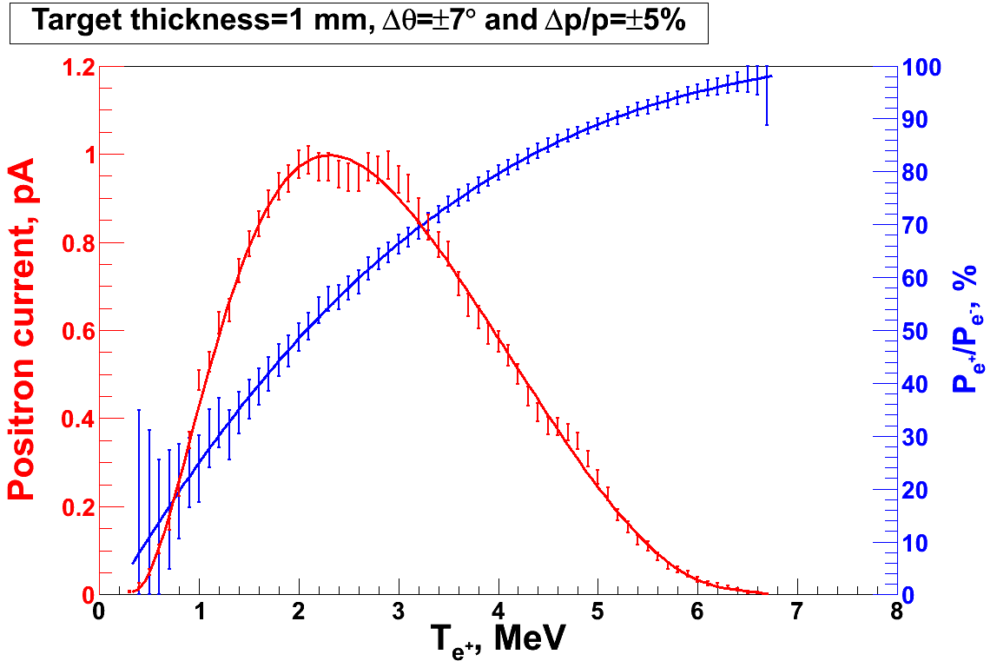
PEPPo Concept @ JLab
P_{e-}
S₁
I_{e} = 1 µA
T₁ = 1 mm
e⁻
D
T₁
PEPPo
Longitudinal e⁻ (P_{e-}) produce elliptical γ whose circular (P_{γ}) component is proportional to P_{e-}.
P_{γ} transfers to e⁺ into longitudinal (P_{e+}) and transverse (P_{t}) polarization components. On the average P_{t}=0.
S₂
P_{t}
D
e⁺
T₂
Calorimeter
PEPPo is proposing to measure the polarization transfer from longitudinal electrons to longitudinal positrons in the 3-7 MeV/c momentum range.

Slide 35
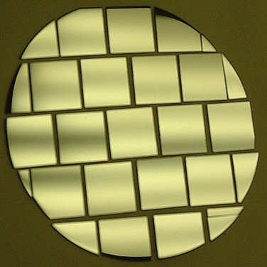
Suitable High Current Polarized Electron Source
R. Suleiman et al., PAC’11, New York (NJ, USA), March 28 – April 1, 2011
Parameter | Value
Laser Rep Rate | 1500 MHz
Laser Pulselength | 50 ps
Laser Wavelength | 780 nm
Laser Spot Size | 350 µm FWHM
High-Pol Photocathode | SSL GaAs/GaAsP
Gun Voltage | 200kV DC
CW Beam Current | 4 mA
Run Duration | 1.4 hr
Extracted Charge | 20 C
1/e Charge Lifetime | 85 C

Slide 36

Installation Complete November, 2011

Slide 37
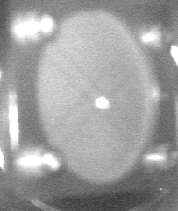
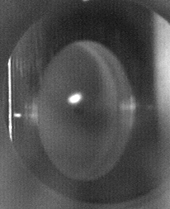
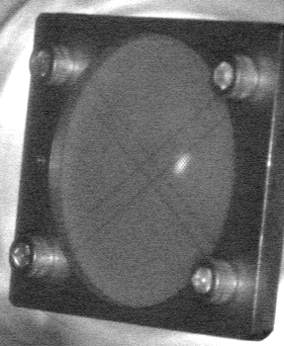
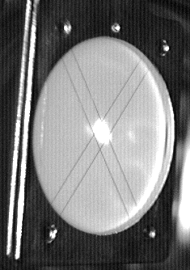
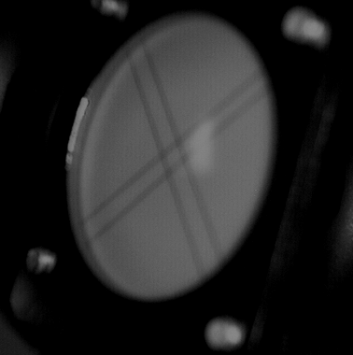
Beam line Tune-up & Check out
Spectrometer
Midpoint
Target
Ladder
Spectrometer
Exit
Vacuum
Exit
Electron
Extraction

Slide 38
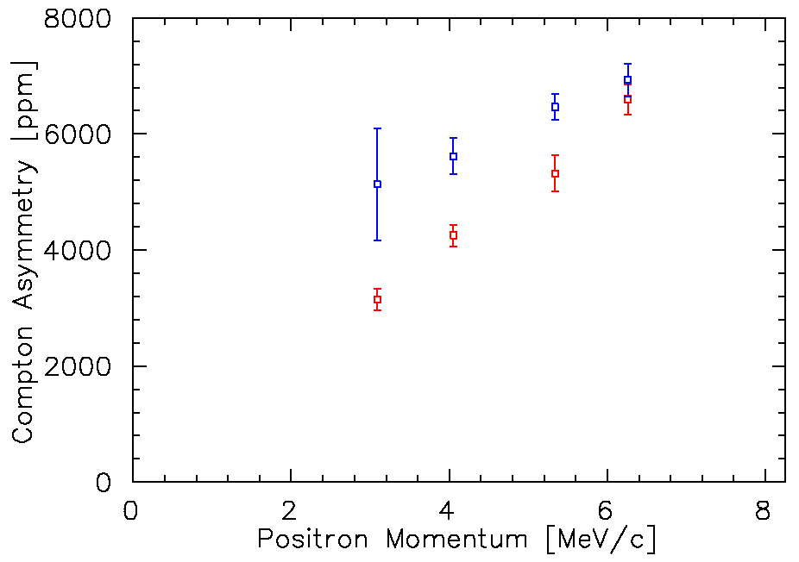
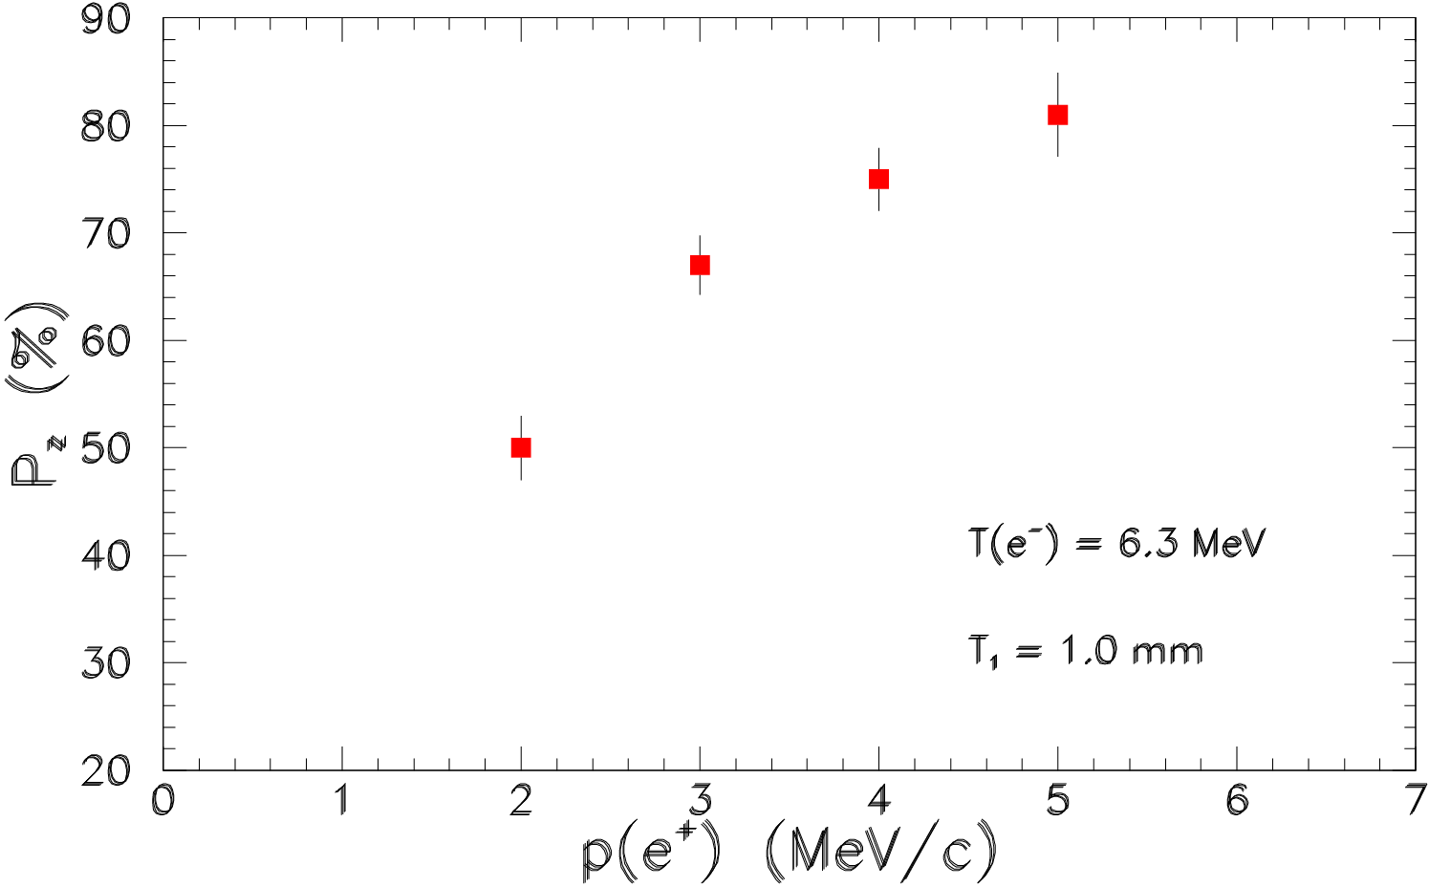
Preliminary Results of Positron Raw Asymmetry
PEPPo Data
Data Set 1
Preliminary pass over e+ collection momenta
Data Set 2
Improved shielding of polarized background
Improved stability of spectrometer PS
Improved coincidence timing signal
Data Set 2
PEPPo Preliminary
Data Set 1
e- beam energy = 8.25 MeV/c
e- beam polarization = 85%
Conversion Target = 1 mm W
Simulation
Operated experiment with somewhat higher electron beam momentum to improve yield
e- beam energy = 6.3 MeV/c
e- beam polarization = 85%
Conversion Target = 1 mm W

Slide 39
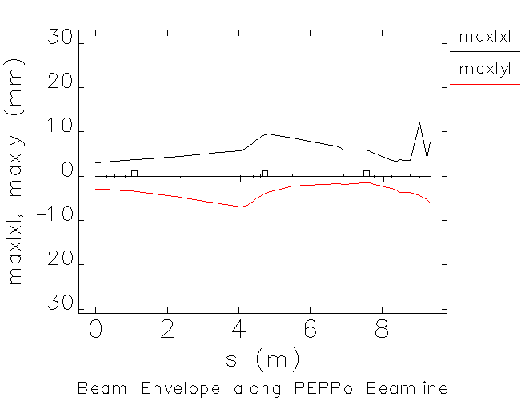
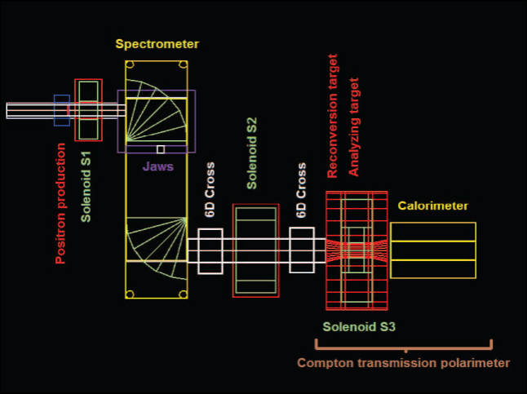
The PEPPo experiment @ JLab
Viewers
Beam position monitors
Solenoid
ELEGANT beam optics
Viewers
Collimator
Polarized Analyzing Target
Solenoid
Corrector magnets
Dipoles
Quadrupoles
G4PEPPo experiment model
Faraday Cup
Production Target
T₁
6σ e⁻ Beam Envelope along PEPPo Line
Annihilation detector
Positron Selection Device
Viewer
Corrector magnets
Reconversion Target
T₂
Beam Profiler
Compton Transmission Polarimeter
Newport News, August 22-26, 2011
10/17

Slide 40
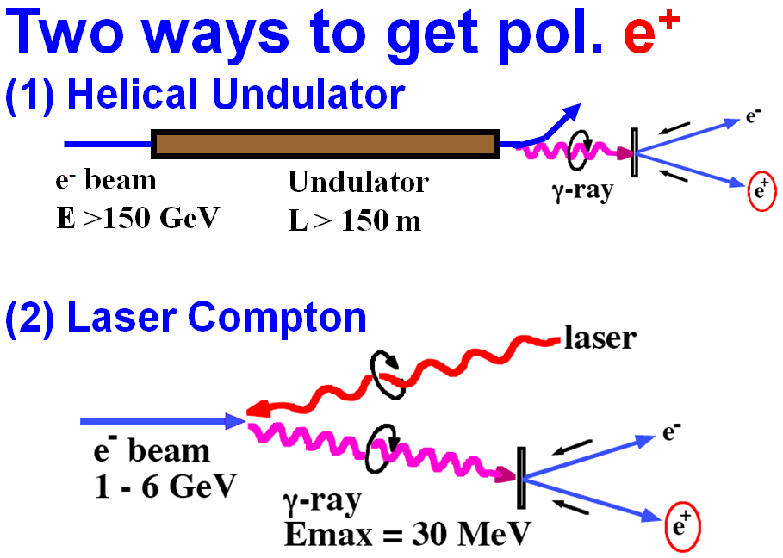
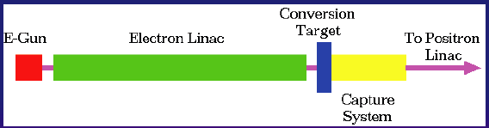
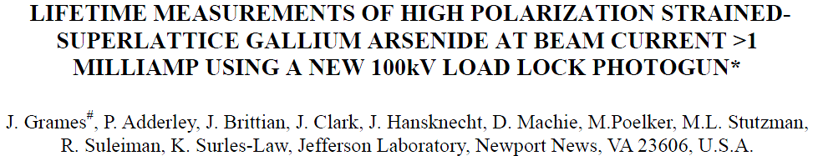
PhD Thesis: Polarized Positrons for JLab, Jonathan DUMAS
Advisors: Eric Voutier, LPSC and Joe Grames, JLab
ILC Polarized e+ Schemes/Demos
(synchrotron/Compton polarized photon)
Conventional un-polarized e+ Scheme
(bremsstrahlung photon)
E = 50 GeV L = 1m E-166 Experiment
OR
High Polarization, High Current e- Gun
(polarized bremsstrahlung photon)
T. Omori, Spin 2006
Source Property | E-166 Experiment PRL 100, 210801 (2008) | J. Dumas et al. Proc. Spin 2008
Electron beam energy | 50 GeV - Undulator | 10 MeV - Conversion
Electron beam polarization | Unpolarized | 85%
Photo Production | Synchrotron | Bremsstrahlung
Converter Target | Tungsten Foil | Tungsten Foil
Positron Polarization | 80% (measured) | 40% (Simulation)
Positron Yield scales with Beam Power
Replace GeV-pulsed with MeV-CW
Reduce radiation budget
Remain below photo-neutron threshold
Bunch/Capture to SRF linac
Compact source vs. Damping Ring
Unique capabilities
First CW source with helicity reversal

Slide 41
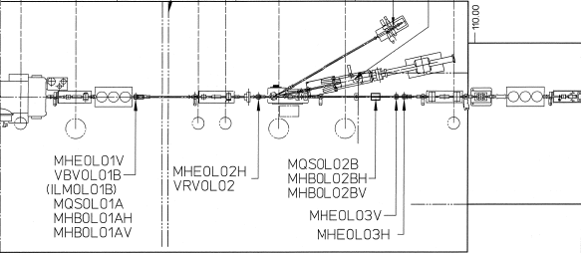




Proof of Principle Experiment: extendible to higher energy (& yield)
Precision Electron
Mott Polarimeter (~1%)
CEBAF Electron Source
High-P (~85%), High-QE (~3mA/500 mW)
e- bunch: 3mA @ 1497MHz demonstrated
Thesis: duty factor => low power, high peak
MeV-Accelerator
Cryounit tested to ~8 MeV
G0 setup ⬄ 1.9mA @ 1497 MHz
Precision Electron
Spectrometer (~3%)
Conversion Target
(Tilted/Normal Tungsten Foils)
G4 Beamline
simulation
e⁻ after target
not shown
e⁻
γ
e⁺
Spec.
Dipole#1
Brem
Pair
e⁻
γ
e⁻
e⁺
ΔΘ = ±20
ΔE = ±250 keV, ΔΦ = 2π
Geant4
simulation
Collimators
Sweep
Dipole
ΔΘ = ±10
γ
Geant4
simulation
ΔΘ = ±5
Spec.
Dipole#2
Analyzer magnet
e⁺ Spectrometer
(or e⁻ & no spin rotation)
γ converter
Transmission Polarimeter (MIT loan)

Slide 42


Use E-166 Apparatus at CEBAF?

Slide 43


Polarized Bremsstrahlung & Pair Creation
E.G. Bessonov, A.A. Mikhailichenko, EPAC (1996) A.P. Potylitsin, NIM A398 (1997) 395
e⁻ → γ → e⁺
E.A. Kuraev, Y.M. Bystritskiy, M. Shatnev, E.Tomasi-Gustafsson, PRC 81 (2010) 055208
Bremsstrahlung
Pair Creation

Slide 44

CEBAF Energy Compatibilities
CEBAF Pre-Injector
CEBAF 6 GeV Injector
CEBAF 12 GeV Injector
Conversion efficiencies are low, but 100nA – 10μA sufficient for user requirements
Corresponding milliamp electron beams are challenging, yet possible (more later).

Slide 45

Polarized Photoinjector
Polarized Electron Source
(130 kV)
Synchronous Photoinjection
SRF Acceleration
(<65 MeV)
B
5 MeV Mott
Polarimeter
Synchrotron
Light Monitor
C
A
Chopper
Cryounit
Cryomodules
Apertures
Buncher
Capture
Gun#2
Bunchlength
Injection Chicane
V-Wien Filter
H-Wien Filter
FC#1
Cavity
FC#2
PreBuncher
Spin Solenoids
Gun#3
100/500 keV Mott
Polarimeter
45 MeV Dump/
Spectrometer
Electron Spin Manipulation
Bunching & Acceleration
500 keV
SRF Acceleration
(<10 MeV)
Injection
Chicane

Slide 46
PEPPo Lobbying (2009-2011)
It followed PAC35’s enthusiastic endorsement of LOI-10-010 which noted that
“Any accelerator facility, like JLab, using polarized electrons for its physics program would like an intense beam of polarized positrons. This Letter marks a proof of principle experiment that should become a full proposal.”
The PEPPo experiment (PR12-11-105) proposes to measure the polarization transfer from longitudinally polarized electrons to longitudinally polarized positrons as a proof-of-principle for a new technique for polarized positron source.
In August 2011 PAC38 recommended to run PEPPo with an “A” rating

Slide 47
Backup Slides

Slide 48
Parity Violation Experiments at CEBAF
Experiment | Energy (GeV) | I (µA) | Target | A_{pv} (ppb) | Maximum Charge Asym (ppb) | Maximum Position Diff (nm) | Maximum Angle Diff (nrad) | Maximum Size Diff (δσ/σ)
HAPPEx-II (Achieved) | 3.0 | 55 | ¹H (20 cm) | 1400 | 400 | 1 | 0.2 | Was not specified
HAPPEx-III (Achieved) | 3.484 | 100 | ¹H (25 cm) | 16900 | 200±100 | 3±3 | 0.5±0.1 | 10⁻³
PREx | 1.063 | 70 | ²⁰⁸Pb (0.5 mm) | 500 | 100±10 | 2±1 | 0.3±0.1 | 10⁻⁴
QWeak | 1.162 | 180 | ¹H (35 cm) | 234 | 100±10 | 2±1 | 30±3 | 10⁻⁴
Møller | 11.0 | 75 | ¹H (150 cm) | 35.6 | 10±10 | 0.5±0.5 | 0.05±0.05 | 10⁻⁴
PV experiments motivate polarized e-source R&D

Slide 49
Attenuator
IA
Rotatable GaAs
Photocathode
Gain-switched Diode Laser and Fiber Amplifier
LP HWP LP
PC WP LP
Shutter
Helicity Fiber
Helicity Generator
HV Supply
(0 – 90 V)
15° Dipole
nHelicity
Fiber
Vacuum
Window
Delayed
Helicity Fiber
T-Settle
Fiber
Hall
RHWP
Charge Feedback (IA)
V-Wien Filter
Target
Parity
DAQ
Spin Solenoids
BCM
Charge Feedback (PITA)
H-Wien Filter
BPMs
Position
Feedback
Pockels
Cell
HV Supply
(0 – 4 kV)
CEBAF
5 MeV
Helicity Magnets
PZT
Mirror
IHWP
Electron
Beam

Slide 50

Injector Test Cave
SUITCASE

Slide 51

Measure Lifetime vs. Laser Position and
Active Area
Activate with different Masks: 5 mm, 7 mm, and No Mask (12.8 mm)
Measure Lifetime from different spots on Bulk GaAs with 532 nm green laser
Mask
Bias Ring
+200 V
Cs
Heater
Long Manipulator
NF₃
Leak Valve

Slide 52


Synchronous Photoinjection
A B C A B C….
Beam Current
111ps
1497 MHz
Extracting DC beam, very wasteful, most of the beam dumped at chopper. Need ~ 2mA from gun to provide 100uA to one hall. Gun lifetime not good enough…..yet.
RF Chopper
Sets Bunchlength

Slide 53



Ti-Sapphire Lasers at CEBAF
Needed more laser power for high current experiments
Diode lasers out, ti-sapphire laser in
Re-align Ti-Sapphire lasers each week
Homemade harmonic modelocked Ti-Sapphire laser. Seeded with light from gain switched diode. No active cavity length feedback. It was a bit noisy….
Commercial laser with 499MHz rep rate from Time Bandwidth Products

Slide 54




Fiber-Based Drive Laser
Gain-switched seed
780nm
Frequency-doubler
1560nm
ErYb-doped fiber amplifier

Slide 55
How about 250mA?
250mA operation, 900 C/hr, 21600 C/day.
Photocathode with 1% initial QE, Need initial laser power = 40W to produce 250mA
If gun provides 1000C charge lifetime and you have 100W laser, you can operate at 250mA for ~1 hour before you run out of laser power. Time to move to fresh photocathode spot (10 minutes), swap photocathode (1 hour), heat and reactivate photocathode (8 hours)
For 100W laser and 10,000C charge lifetime, you can operate at 250mA for 10 hours before “doing something”

