Slide 1
Bubble Chamber – Beam Requirements
January 5, 2018

Slide 2
Bubble Chamber Experiment
Plan to be installed on March 26, 2018
April run plan:
2 weeks of beam (2 shifts per day)
Active liquid is C₃F₈
Beam energy: 4.5 – 5.5 MeV
Beam current: 1 nA – 100 µA
Prefer to run with RF at 2K but willing to try 4K
Keep chamber installed at 5D line
Plan to run again in August: 2 weeks of beam

Slide 3
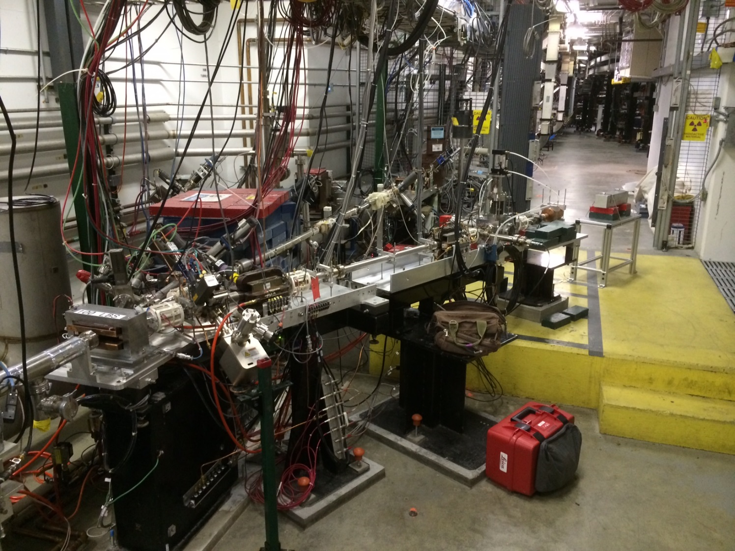
Bubble
Chamber
location
5 MeV
Dipole
5D Spectrometer
Notes:
Interior Page Design 2

Slide 4
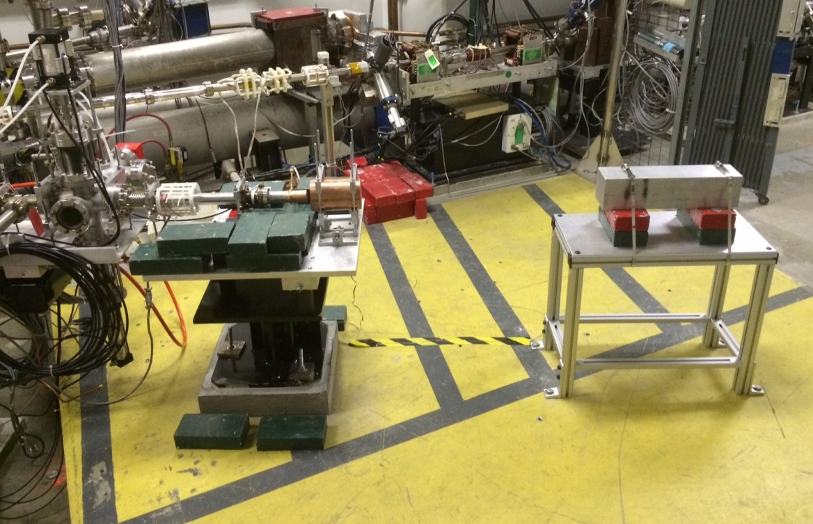
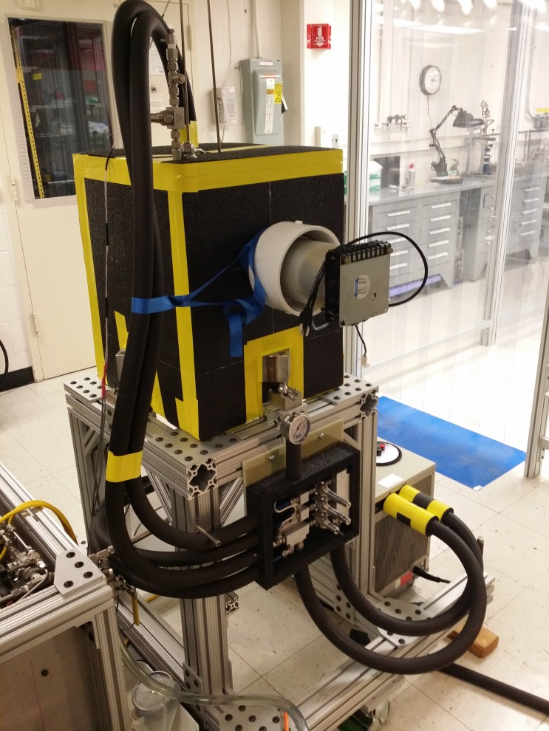
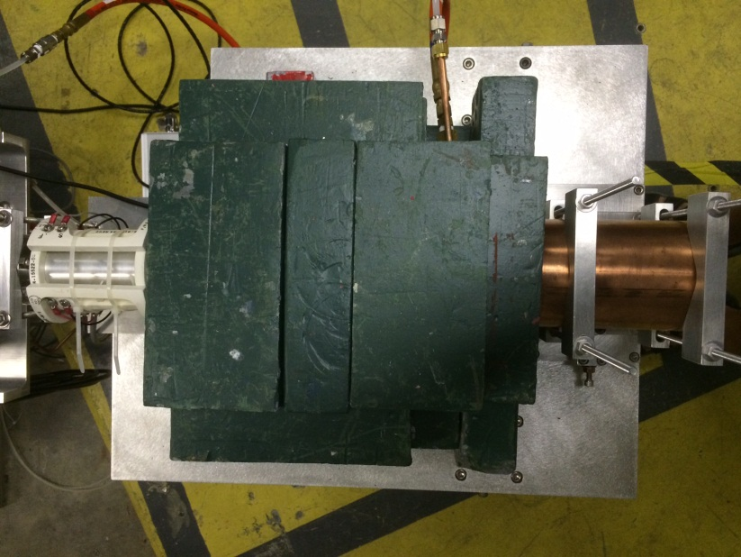

Slide 5
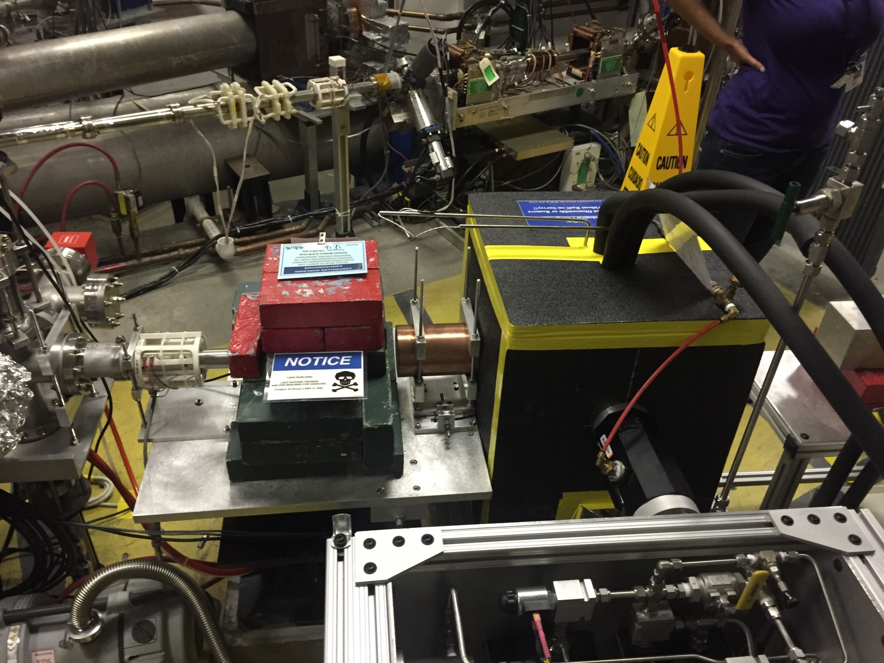

Slide 6
Schematics
Power deposited in radiator (100 µA and 8.5 MeV) :
6 mm: Energy loss = 8.5 MeV, P = 850 W
Pure Copper and Aluminum (high neutron threshold):
⁶³C(γ,n) threshold = 10.86 MeV
²⁷Al(γ,n) threshold = 13.06 MeV
0.001 – 100 µA
Cu
Radiator/Dump
6 mm
Al Beam Pipe
Cu Photon
Collimator
Ceramic
Insulator
Al Photon Dump
40 cm long
Bubble Chamber
Superheated
Notes:
Interior Page Design 2

Slide 7
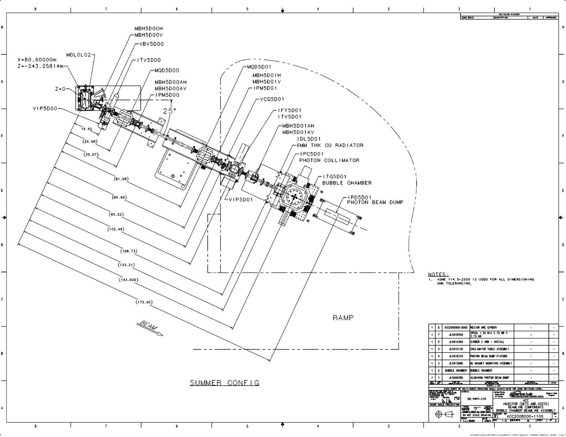
Beam Requirements
Electron Beam Requirements at Radiator
Beam Kinetic Energy, (MeV) | 4.5–5.5
Beam Current (µA) | 0.001–100
Absolute Beam Energy Uncertainty | <0.1%
Relative Beam Energy Uncertainty (0.1 MeV steps) | <0.02%
Energy Resolution (Spread), σ_{T} /T | <0.06%
Beam Size, σ_{x,y} (mm) | 1
Polarization | None
Notes:
Interior Page Design 2

Slide 8
Beam Energy Measurement
5 MeV
Dipole
Beam Position Monitor (BPM)
Electron Beam
Momentum
Notes:
Interior Page Design 2

Slide 9
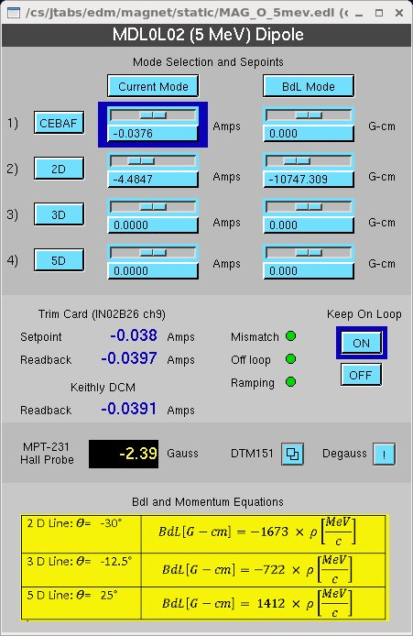

Slide 10
Parameter | Term | Before | Goal
Dipole – field map | δB/B | 0.20% | 0.02%
Dipole – power supply | δI/I | 0.20% | 0.02%
Position – surveys | δθ/θ | 0.01% | 0.01%
Position – BPM calibration | δθ/θ | 0.05% | 0.05%
Stray magnetic field | δθ/θ | 0.05% | 0.05%
Total | δP/P | 0.30% | <0.10%
For Bubble Chamber experiment:
Installed new higher field dipole with better uniformity
Installed new Hall probe: 0.01% accuracy, resolution to 2 ppm, and a temperature stability of 10 ppm/°C
Better shielding of Earth’s and other stray magnetic fields
Implemented 5 MeV dipole precision DCCT current readback
Relative beam energy uncertainty <0.02% is required
Notes:
Interior Page Design 2

Slide 11
Beam Position Measurement
Keep beam centered on collimator
Measure beam position on radiator – use x-ray fluorescent screen
Survey 5D line (radiator and collimator)

Slide 12
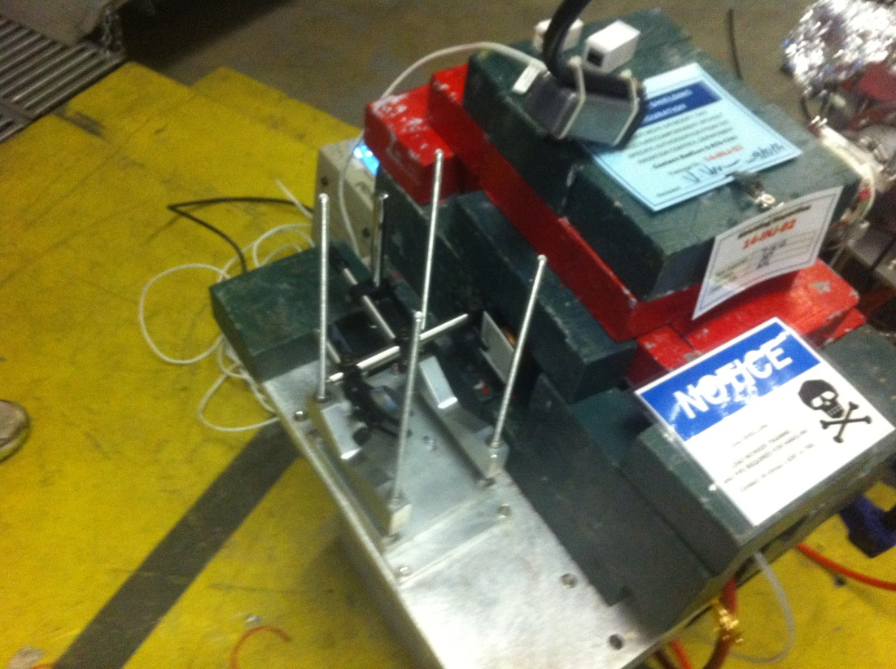
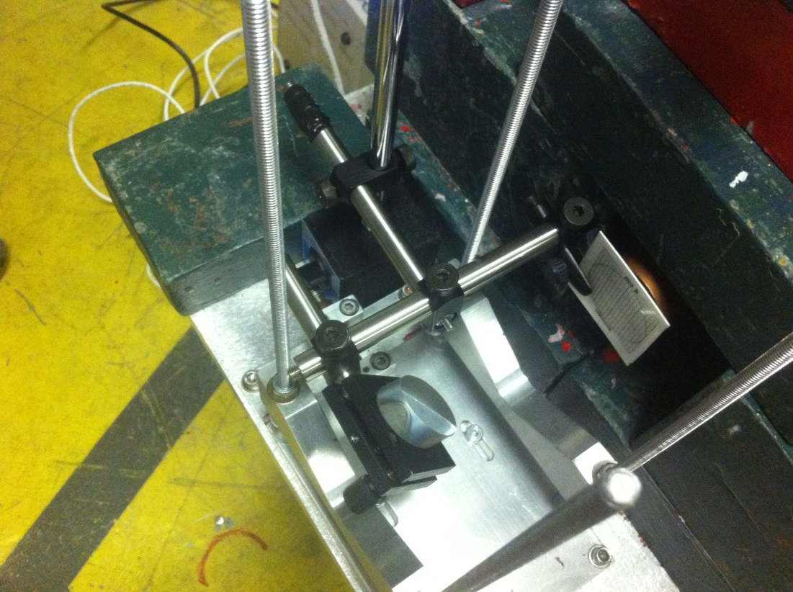
x-ray fluorescent screen was installed in front of radiator on Nov 2, 2015
This screen has a special coating that illuminates under x-rays and emits a green light

Slide 13
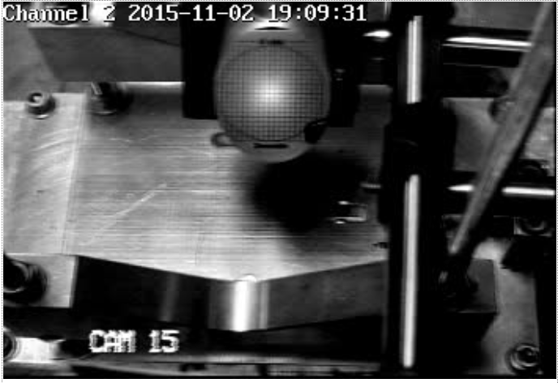
0.5 μA centered on x-ray screen
Need to develop procedure to center beam on radiator using 5D line BPMs and viewers for different beam energies while accounting for earth’s magnetic field

Slide 14
Beam Current Measurement
Approved to run 10 μA CW and total energy of 10 MeV – needs approval to run at 100 μA
Calibrate BCM and measure nA beam currents
Re-isolate radiator to measure beam current
Stop beam when chamber is unstable while quenching a bubble

