Slide 1
New Simulations for Ion-Production and Back-Bombardment in GaAs Photo-guns
Motivation
Ion Production
Ion Tracking using GPT
QE Degradation of the CEBAF Photocathode
Conclusions/Future Work
Questions?
Josh Yoskowitz, Joe Grames, John Hansknecht, Carlos Hernandez-Garcia, Geoffrey Krafft, Gabriel Palacios-Seranno, Matthew Poelker, Sebastian Van Der Geer, Riad Suleiman, Sajini Wijethunga

Slide 2
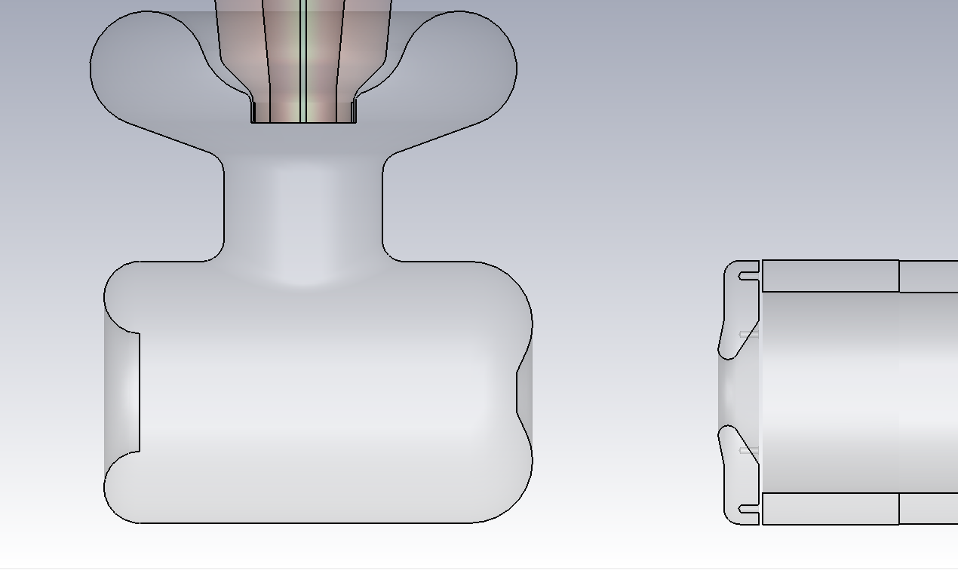
Motivation: Ion Back-Bombardment leads to QE Reduction
Anode
Cathode
Ions
Ions
e-beam
Residual gas in the photo-gun or adjacent beam line may be ionized by the electron beam
These ions may strike the photocathode, generate secondary electrons or x-rays, and desorb gas from surfaces; all leading to a reduction of the photocathode quantum efficiency (QE).
A positively biased anode should improve photocathode lifetime by limiting ion back-bombardment of the GaAs photocathode.

Slide 3
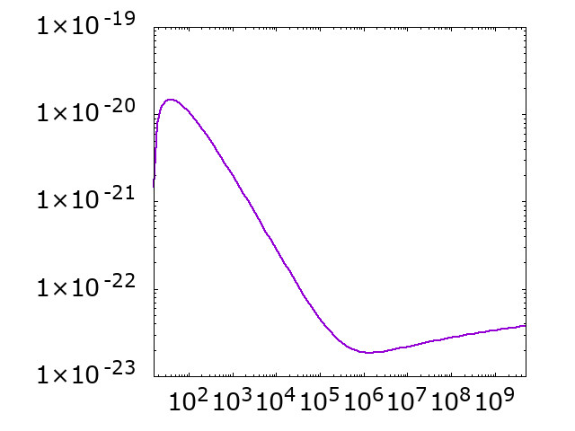
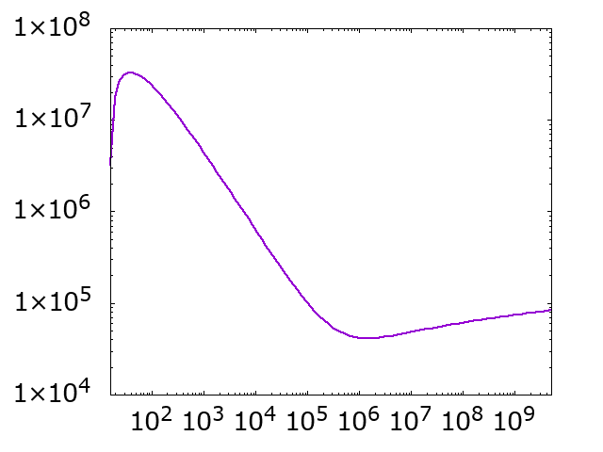
Theory: Ionization Cross Section & Rate
Ion Production Rate Per Unit Length
Ionization Cross Section For H₂⁺
$$\frac{dN}{dt}\left(\frac{1}{l}\right)=ρσ\frac{I_{e}}{e}$$
$ρ$ = Gas density (m⁻³)
$σ$= Ionization cross section (m²)
$l$ = Distance traveled by electron (m)
$I_{e}$ = Electron current (A)
$e$ = Elementary charge (C)
$$σ_{H_{2}^{+}({\text{m}}^{2})}$$
Example Calculations
Energy $(\text{eV})$
Assuming $ρ_{H_{2}}=3.52×{10}^{10} {\text{m}}^{−3} ({10}^{−12} \text{torr})$ and $I_{e}=100 \text{μ}A$…
H₂⁺ Production Rate Per Unit Length
Name | Value
$$σ_{H_{2}^{+}} (100 \text{eV})$$ | $$1.08×{10}^{−20} {\text{m}}^{2}$$
$$σ_{H_{2}^{+}}(100 \text{keV})$$ | $$4.56×{10}^{−23} {\text{m}}^{2}$$
$$\frac{dN_{H_{2}^{+}}}{dt}\left(\frac{1}{l}\right)(100 \text{eV})$$ | $$\sim 2.4×{10}^{7} \frac{H_{2}^{+}}{\text{s}\text{⋅}\text{m}}$$
$$\frac{dN_{H_{2}^{+}}}{dt}\left(\frac{1}{l}\right)(100 \text{keV})$$ | $$\sim {\text{10}}^{5} \frac{H_{2}^{+}}{\text{s}\text{⋅}\text{m}}$$
$\frac{dN_{H_{2}^{+}}}{dt}\left(\frac{1}{l}\right) \left(\frac{H_{2}^{+}}{\text{s}\text{⋅}\text{m}}\right)$
Energy $(\text{eV})$

Slide 4
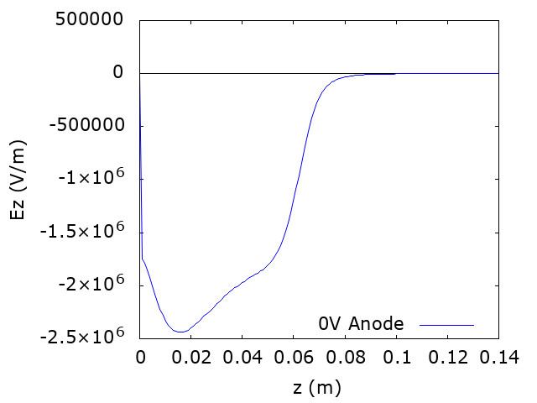
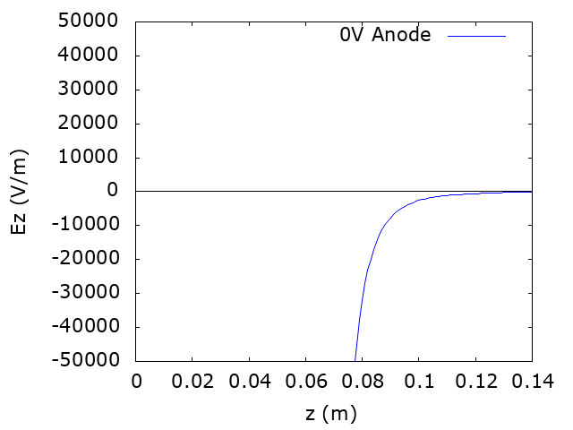
GPT Ion Tracking CEBAF Gun (-130 kV Cathode, 0 kV Anode)
Side View of CEBAF Photo-gun
Ez vs z On Axis
Photocathode
Anode
Photocathode
Anode
Photocathode
Anode
CST Model
CST Model
Ions
Ions
e-beam
Photocathode
Anode
Drift Space

Slide 5
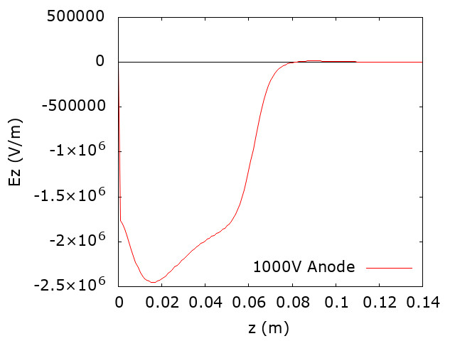
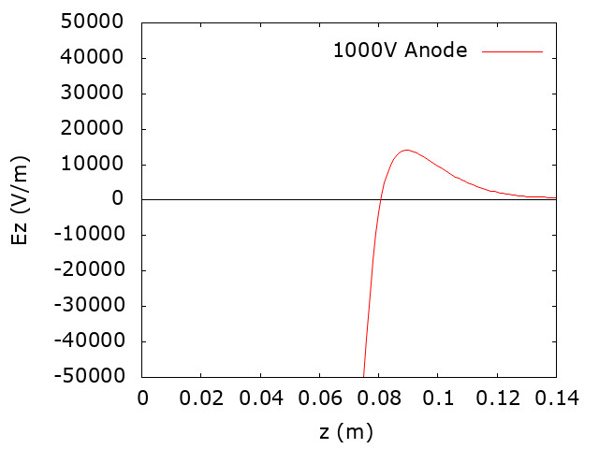
GPT Ion Tracking CEBAF Gun (-130 kV Cathode, 1 kV Anode)
Side View of CEBAF Photo-gun
Ez vs z On Axis
Photocathode
Anode
Photocathode
Anode
Photocathode
Anode
CST Model
CST Model
Ions
Ions
e-beam
Photocathode
Anode
Drift Space

Slide 6
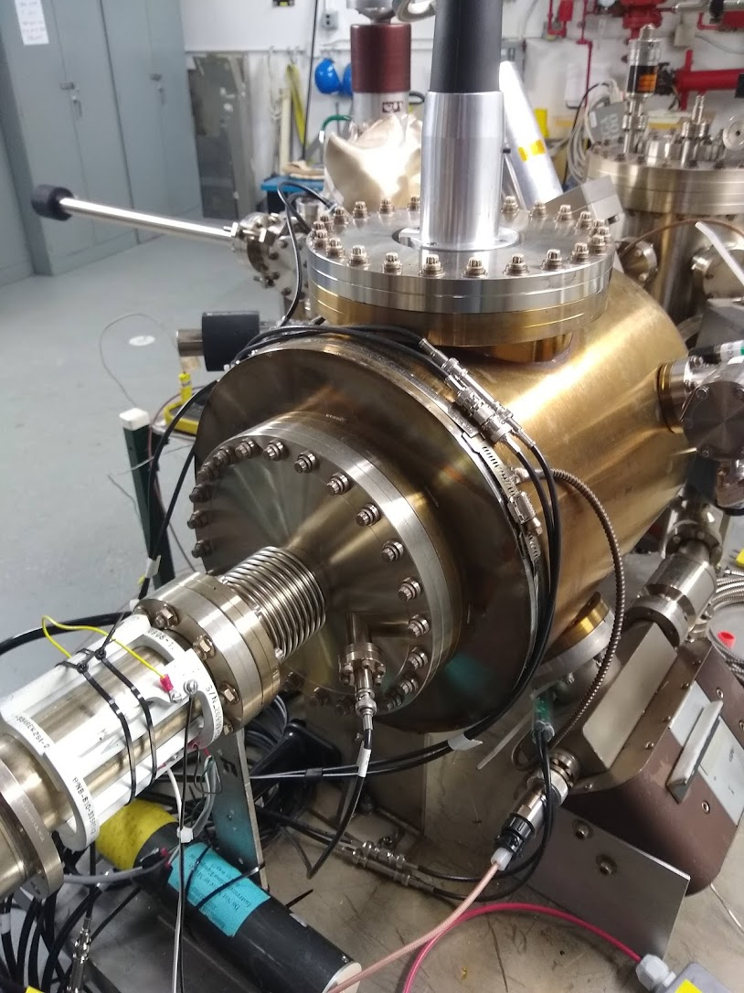
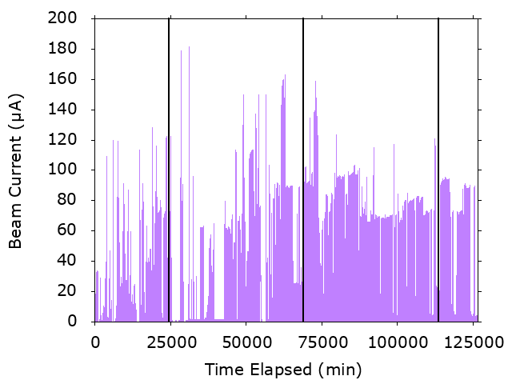
Biased Anode Experiments during CEBAF Summer Run
Ran Halls A, B & C (3 lasers) from June 15 – Sep 9.
Lasers positioned about 1 mm off axis (GaAs active area 5 mm dia.)
Measured the quantum efficiency at laser position each morning, using each of the lasers.
Alternated the anode potential between 0 V and +1 kV every 2-3 weeks (every 50-60 C).
HV Cable
Gun Chamber
Anode Bias Feedthrough
E-Beam Direction
6/15
7/1
8/1
9/1
9/9

Slide 7
QE vs Charge for the CEBAF Photocathode
1
2
3
4
Photocathode lifetime improved on average by ~1.5x with anode biased.
Effect is most pronounced during periods 1-3 (most of the run).
Region | Anode Bias (V) | Laser A Lifetime (C) | Laser B Lifetime (C) | Laser C Lifetime (C)
1 | 0 | 181 ± 8 | 161 ± 9 | 169 ± 7
2 | 961 | 424 ± 53 | 392 ± 23 | 346 ± 16
3 | 0 | 288 ± 39 | 304 ± 14 | 297 ± 5
4 | 961 | 303 ± 18 | 302 ± 9 | 314 ± 11
Laser A: $\frac{{\text{τ}}_{ \text{1} \text{kV}\text{, }\text{avg}}}{{\text{τ}}_{\text{0} \text{V}\text{, }\text{avg}}}≈1.55±0.18$
Laser B: $\frac{{\text{τ}}_{\text{1} \text{kV}\text{, }\text{avg}}}{{\text{τ}}_{\text{0} \text{V}\text{, }\text{avg}}}≈1.49±0.07$
Laser C: $\frac{{\text{τ}}_{\text{1 }\text{kV}\text{, }\text{avg}}}{{\text{τ}}_{\text{0} \text{V}\text{, }\text{avg}}}≈1.42±0.05$

Slide 8
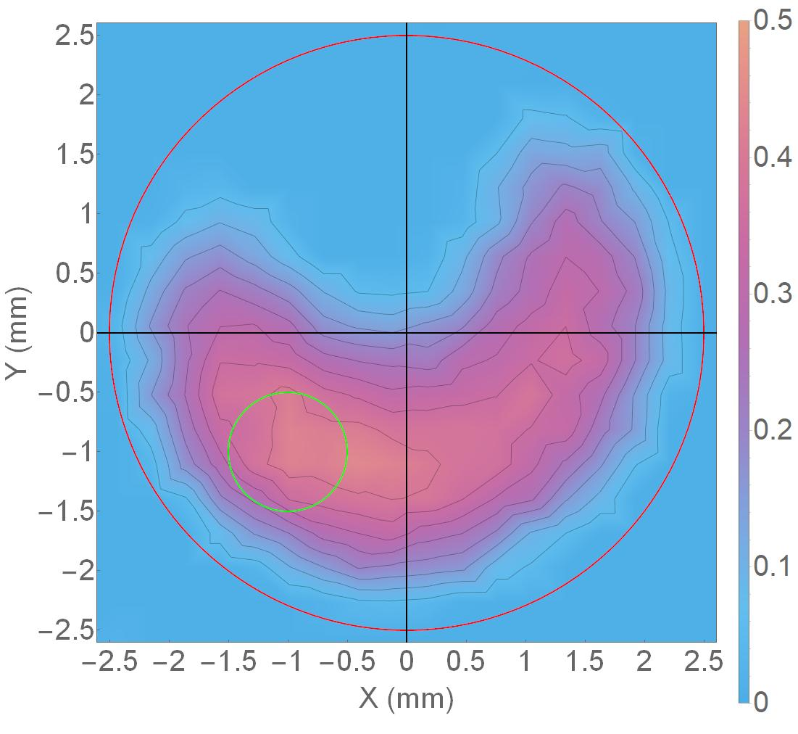
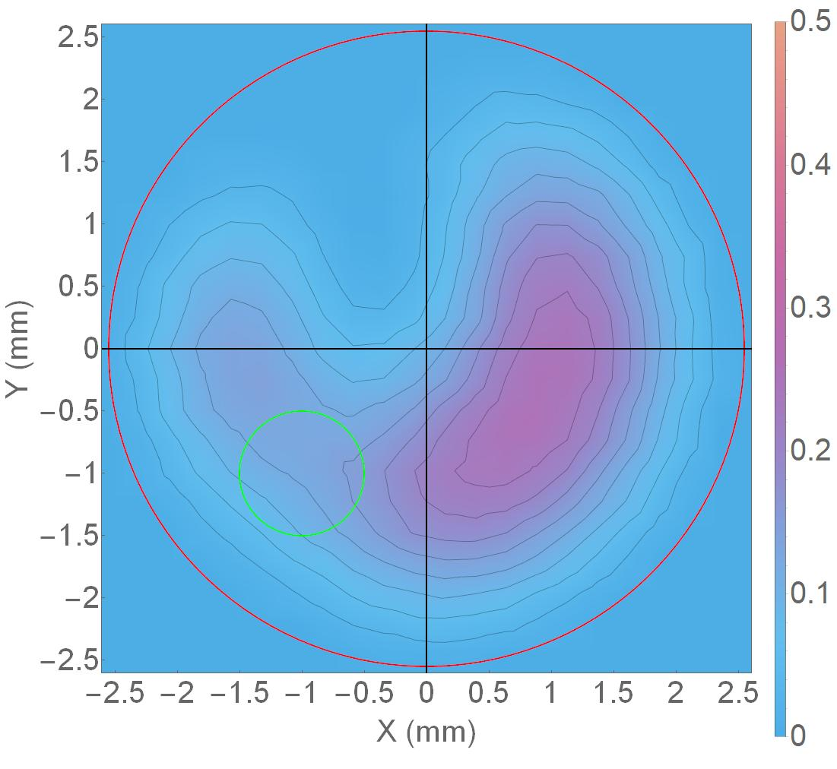
QE Degradation of the CEBAF Photocathode
QE Scan Before Run (5/24/19)
QE Scan After Run (9/9/19)
Red Circle = Photocathode Active Area => NEG region 5 mm diameter at (0 mm, 0 mm)
Green Circle = Laser Spot => FWHM 1 mm positioned at (-1 mm, -1 mm)

Slide 9
GPT Ion Simulations for CEBAF -130 kV Cathode
130 kV Cathode, 0 V Anode
Initial Conditions
Parameter | Value
Macro-particle # | 10⁵
Cathode Position | Z = 0 m
Anode Position | Z = 0.06 m
Ion Species | H₂⁺
Ion Initial KE | 38 meV
130 kV Cathode, 1 kV Anode

Slide 10
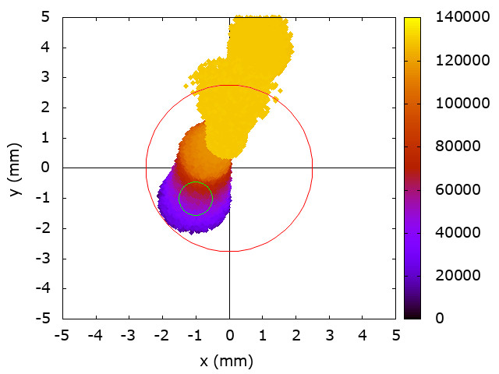
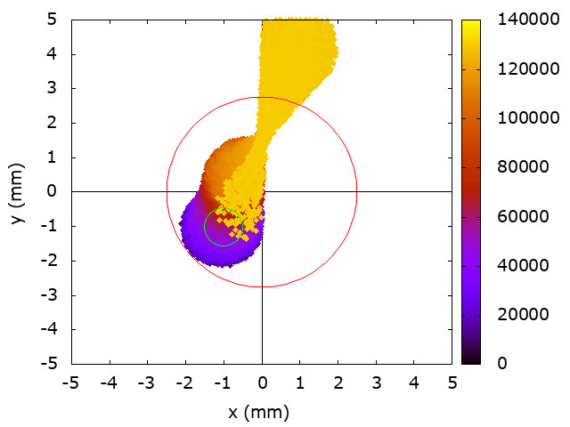
Ion Position-Energy Distribution at the Photocathode
130 kV Cathode, 0 V Anode
eV
Ions created near the cathode are least focused and have lowest kinetic energy
Ions created near the anode (upstream) are most focused due to the cathode geometry and have highest kinetic energy
Ions created near the anode (downstream) are repelled for a biased anode or behave similarly to the grounded anode
130 kV Cathode, 1 kV Anode
eV

Slide 11
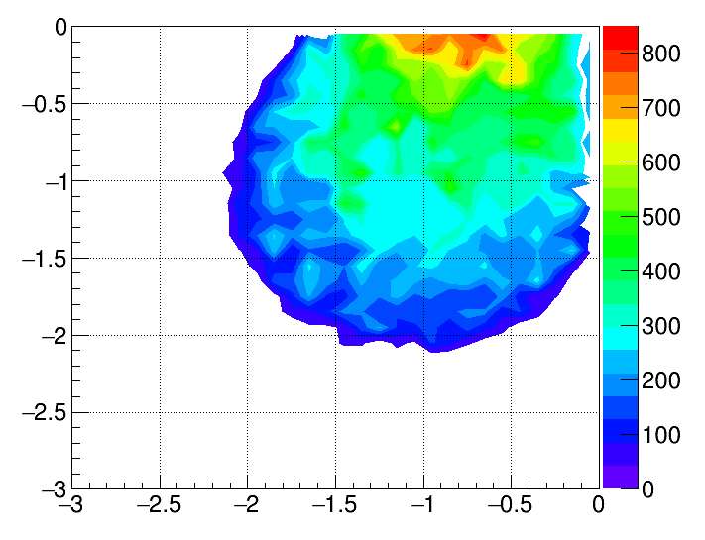
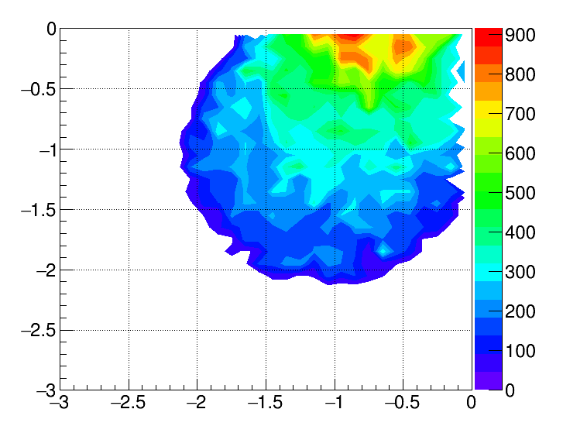
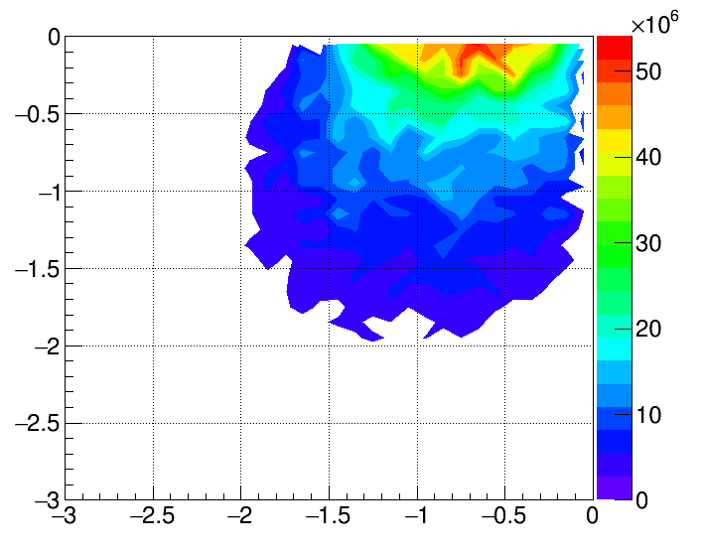
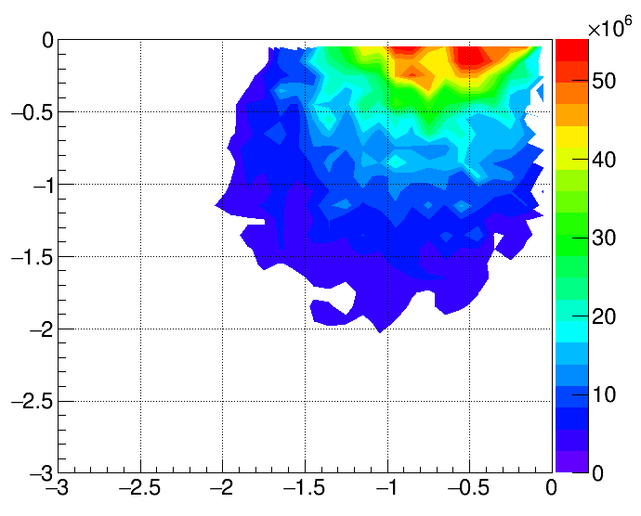
Ion Position-Number Distribution at the Laser Spot
130kV Cathode, 0V Anode
130kV Cathode, 1000V Anode
y (mm)
y (mm)
$${\text{N}}_{\text{ions}}$$
$${\text{N}}_{\text{ions}}$$
x (mm)
x (mm)
y (mm)
$${\text{N}}_{\text{ions}}×{\text{E}}_{\text{ions}}$$
y (mm)
$${\text{N}}_{\text{ions}}×{\text{E}}_{\text{ions}}$$
x (mm)
x (mm)

Slide 12
Biased Anode vs. Grounded Anode Comparison
Description | Ratio | Value
Total ions at the photocathode | $$\frac{{∑\text{N}}_{\text{ion}\text{, 0 }\text{V}}}{{∑\text{N}}_{\text{ion}\text{, 1 }\text{kV}}}$$ | 1.59
Total ions at the photocathode, weighted by incident energy | $$\frac{∑{\text{N}}_{\text{ion}}{\text{E}}_{\text{ion}\text{, 0 }\text{V}}}{∑{\text{N}}_{\text{ion}}{\text{E}}_{\text{ion}\text{, 1 }\text{kV}}}$$ | 1.97
Total ions within the laser spot | $$\frac{{∑\text{N}}_{\text{ion}\text{, 0 }\text{V}}}{{∑\text{N}}_{\text{ion}\text{, 1 }\text{kV}}}$$ | 0.994
Total ions within the laser spot, weighted by incident energy | $$\frac{∑{\text{N}}_{\text{ion}}{\text{E}}_{\text{ion}\text{, 0 }\text{V}}}{∑{\text{N}}_{\text{ion}}{\text{E}}_{\text{ion}\text{, 1 }\text{kV}}}$$ | 0.934
Laser A average charge lifetime | $\frac{{\text{τ}}_{\text{1 }\text{kV}\text{, }\text{avg}}}{{\text{τ}}_{\text{0 }\text{V}\text{, }\text{avg}}}$ | $$1.55±0.18$$
Laser B average charge lifetime | $\frac{{\text{τ}}_{\text{1 }\text{kV}\text{, }\text{avg}}}{{\text{τ}}_{\text{0 }\text{V}\text{, }\text{avg}}}$ | $$1.49±0.07$$
Laser C average charge lifetime | $\frac{{\text{τ}}_{\text{1 }\text{kV}\text{, }\text{avg}}}{{\text{τ}}_{\text{0 }\text{V}\text{, }\text{avg}}}$ | $$1.42±0.05$$

Slide 13
Conclusions
Higher photocathode lifetimes are observed when the anode is biased.
The charge lifetime increase for the biased anode compared to the grounded anode is similar to the decrease in the number of ions incident on the photocathode (not necessarily on the laser spot).
No significant difference in the number of ions incident on the laser spot for the biased and unbiased cases.

Slide 14
Ongoing work: GPT Ionization Custom Element
Future Work
Working on GPT custom element that allows for the real-time production of ions and secondary electrons based on the ion production rate formula

Slide 15
Questions?
Josh Yoskowitz
yoskowij@jlab.org
This material is based upon work supported by the U.S. Department of Energy, Office of Science, Office of Nuclear Physics under contract DE-AC05-06OR23177.

