Slide 1
CEBAF Injector Overview
Reza Kazimi

Slide 2
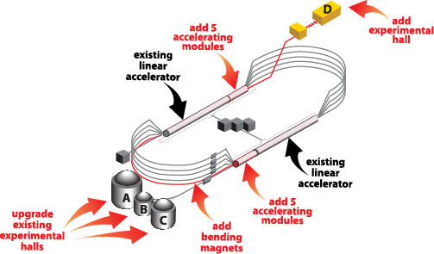
12 GeV CEBAF
Injector
11.25% of
Linac Energy

Slide 3
Beam quality and Injector
In CEBAF many of critical beam parameters are set in the injector and some remain unchanged through the accelerator. Therefore, the injector plays a significant role in setting the final beam qualities such as bunch structure, energy spread, current stability, etc.

Slide 4
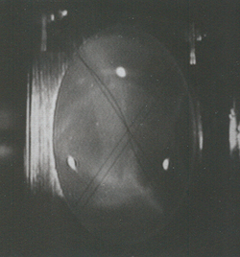
Brief description of the CEBAF Injector
Polarized Electron Source
(130 kV)
Synchronous Injection
SRF Acceleration
(<125 MeV)
B
5 MeV Mott
Polarimeter
Synchrotron
Light Monitor
C
A
Chopper
Cryounit
Cryomodules
Apertures
Buncher
Capture
Gun#2
Bunchlength
Injection Chicane
V-Wien Filter
H-Wien Filter
FC#1
Cavity
FC#2
PreBuncher
Spin Solenoids
Gun#3
100/500 keV Mott
Polarimeter
45 MeV Dump/
Spectrometer
Electron Spin Manipulation
Bunching & Acceleration
500 keV
SRF Acceleration
(<10 MeV)
Injection
Chicane

Slide 5
Breaking down the problem
Beam Creation
Bunch Structure
Spin Angle
Space Charge Control
Acceleration
5 MeV Dump
Synchrotron Light Monitor
Chopper
Cryounit
Cryomodules
Apertures
Buncher
Capture
Gun#2
Bunchlength
Injection Chicane
PCup
FC#1
Cavity
FC#2
Prebuncher
Gun#3
V-Wien Filter
H-Wien Filter
500 keV Dump
4D Dump/Spectrometer
Bunching Process

Slide 6
Beam Bunch and Pulse Structure
Four Lasers, creating four beams at 500 MHz or 250 MHz.
Viewer limited mode, 4 μs/60Hz pulses (very low power for viewers)
Tune mode, 250 μs/60Hz pulses for low power tune up (long enough to see BPM signals)
CW mode, infinite pulse
User defined pulse structure

Slide 7
Beam Dumps
1D dump, ~ 500 keV, Spectrometer for beam setup, Beam parking place for safety system.
2D dump, ~ 5 MeV, Spectrometer for beam setup
3D dump, ~ 5 MeV, Mott measurement
5D dump, ~ 5 MeV, experimental line
4D dump, ~ 17 MeV to 125 MeV (Final injector energy) Spectrometer for beam setup, Potential experimental line

Slide 8
PEPPo, Polarized Electrons for Polarized Positrons
5 MeV Dump, 2D
Chopper
Superconducting
Booster
Apertures
Cryo-modules
Buncher
Capture
Gun#2
Injection Chicane
Faraday Cup
Prebuncher
Faraday Cup
V-Wien Filter
H-Wien Filter
Gun#3
500 keV Dump
5D, PEPPO line
Spectrometer/Beam Dump

Slide 9
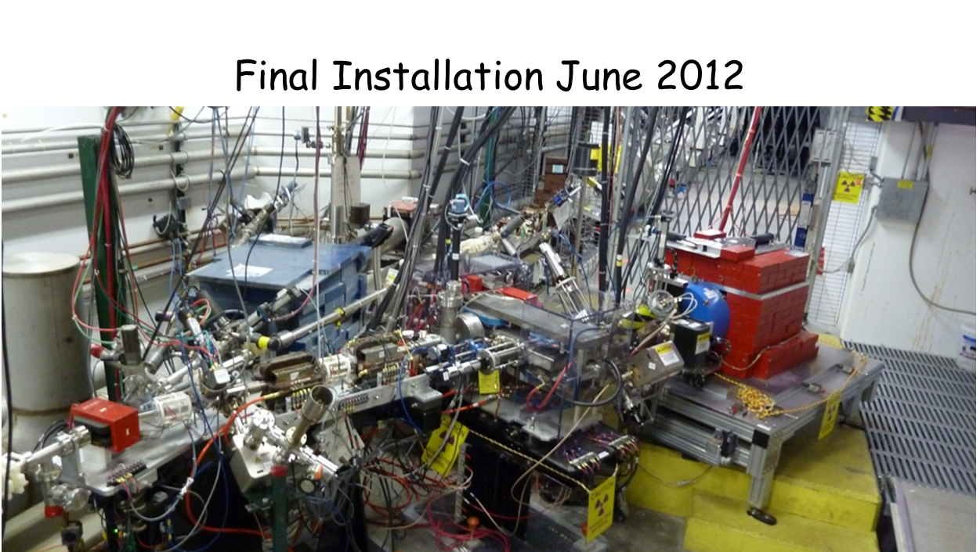
Polarized Electrons for Polarized Positrons
PEPPo measured the polarization transfer from 8.2 MeV/c longitudinal electrons to longitudinal positrons in the 3.1-6.2 MeV/c momentum range.
Pair
Creation
Target
Collection
Magnets
(Princeton/SLAC)
Compton
Polarimeter
(DESY)

Slide 10
PEPPo at CEBAF injector
1. We held a workshop in 2009 to get people involved
2. Then we submitted LOI to PAC, and recommended we submit full proposal following year
3. We submitted to PAC asking for 6 weeks, they rated experiment A, so...
4. Experiment scheduling committee recommended 6 weeks before 12 GeV upgrade
5. We pretty much followed the same readiness/reviews process of hall experiments
6. Arne was doing Beam Studies campaigns at that time, definitely benefitted being ready
7. Ran for ~6 weeks May-June 2012

Slide 11
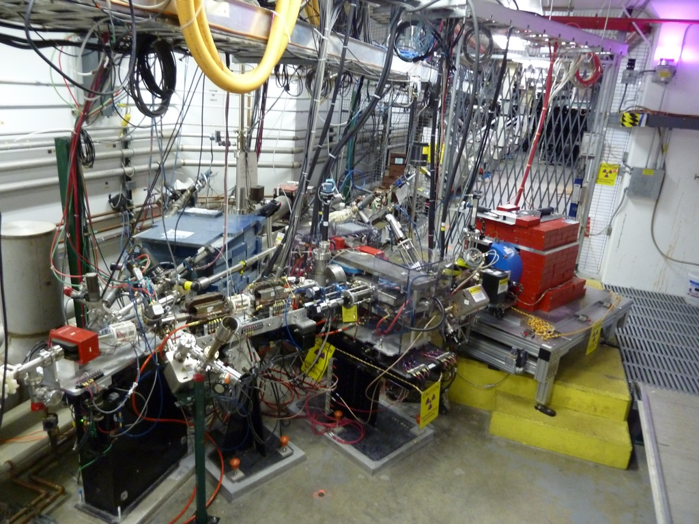
PEPPo (E12-11-105) @ CEBAF Injector
Mott
Polarimeter
Lead
Shielding
Compton
Polarimeter
(DESY/Cornell)
Positron
Production
Target
Polarized
Electron Beam
(3-10 MeV)
Positron
Spectrometer
(Princeton/SLAC)
Positron Annihilation Counters

Slide 12
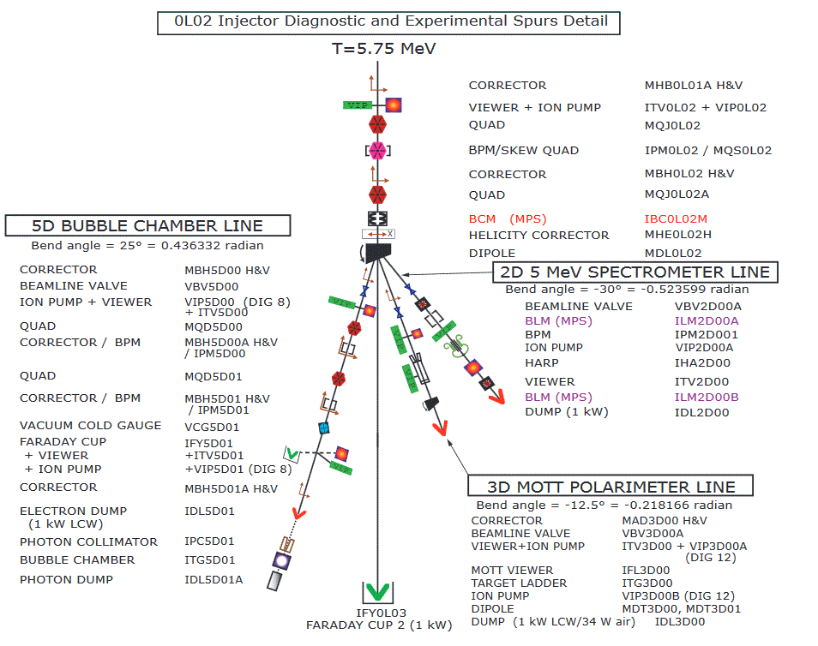
2D, 3D, 5D Lines

Slide 13
Bubble Chamber
This experiment will be staged in the exact place of the completed PEPPo experiment and will re-use the same beamline. The experiment will measure the ¹⁶O(γ,α)¹²C reaction with bremsstrahlung photons at 7 different electron beam kinetic energies ranging from 7.9 MeV to 8.5 MeV.

Slide 14
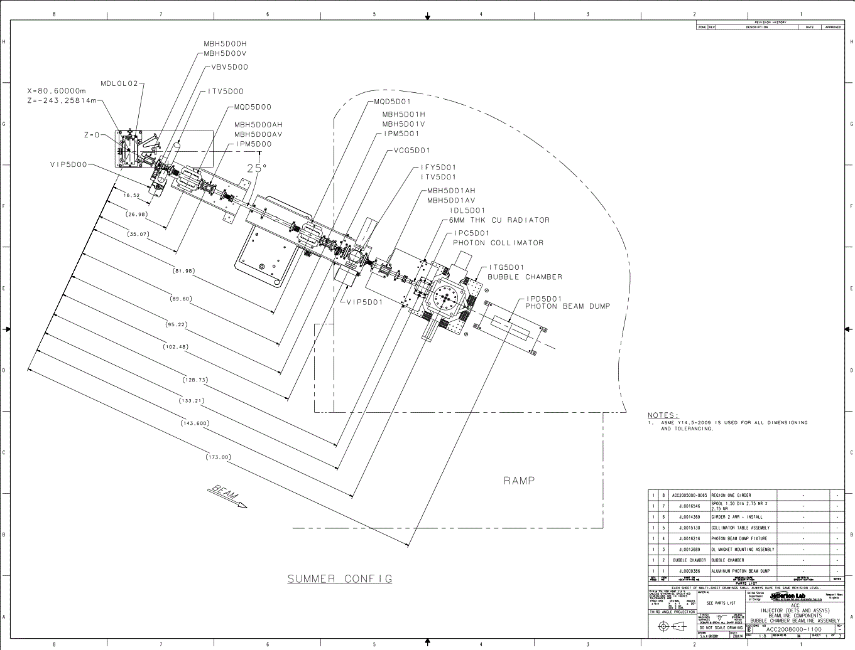
Bubble 5D Line

Slide 15
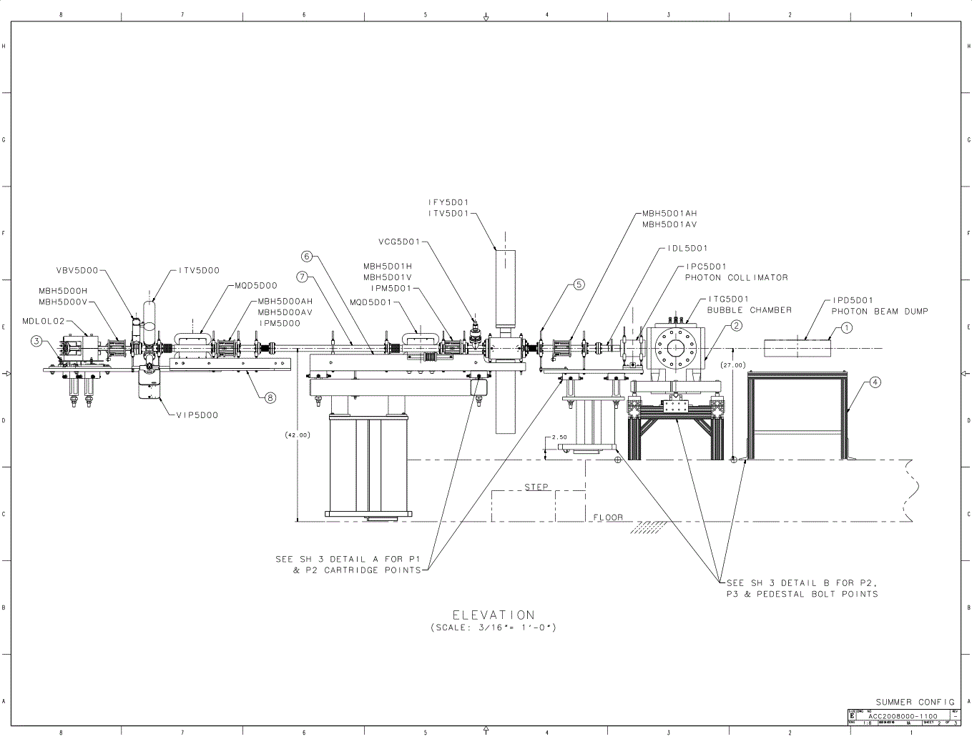
Bubble 5D Line

Slide 16
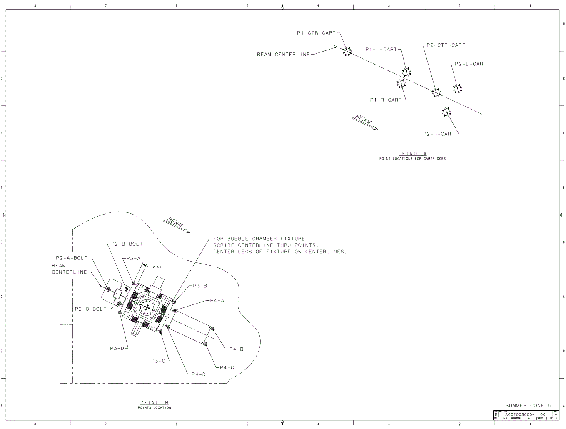
Bubble 5D Line

Slide 17
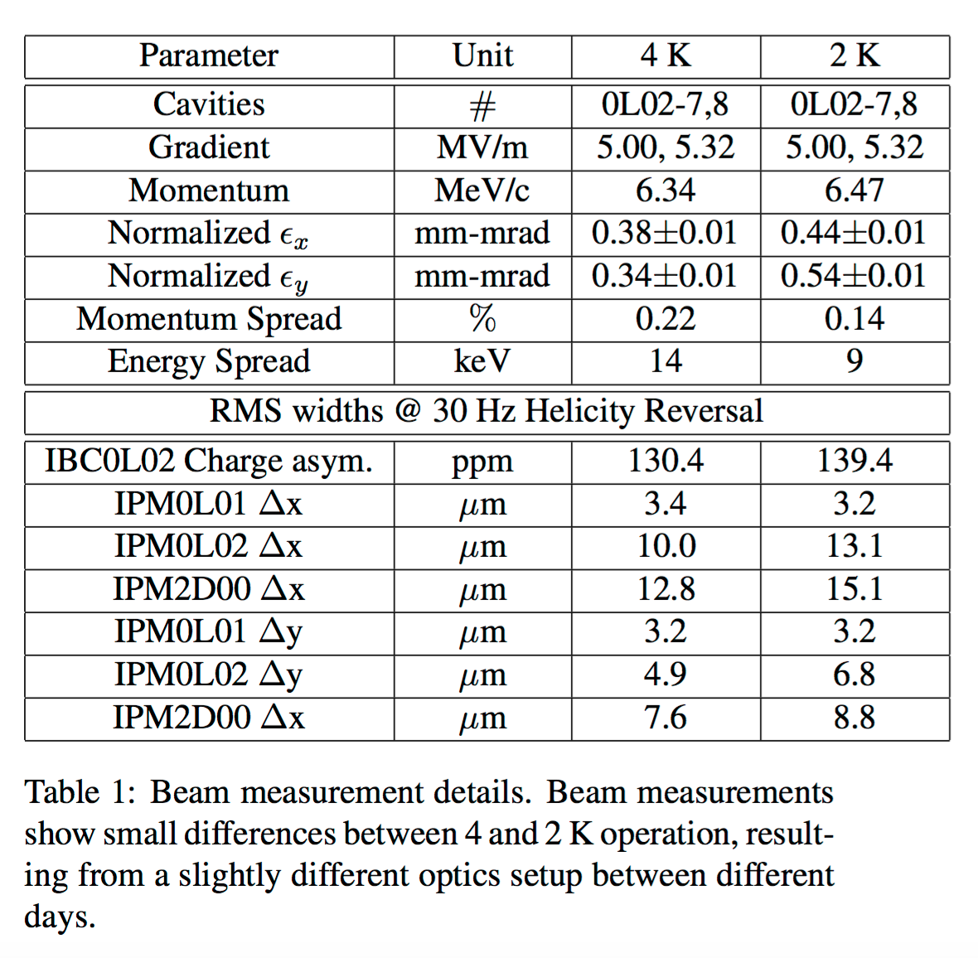
6.3 MeV Setup w/ SRF 0L02 @ 4K (beam to FC#2)
We have operated the injector cryounit (0L02) w/ SRF at 4K a few times over the past 2-3 years.
Our SRF setup steps have been essentially the same:
Maintain JT flow greater than 70%
Maintain LL greater than 90%
Tune cavities (resonance different at 4K vs. 2K)
Last year we compared standard injector setup of 6.3 MeV beam (beam to FC#2) with SRF @ 4K vs. 2K, and found similar beam quality.
The momentum spread was determined to be somewhat larger at 4K, but still relatively small.
28th Linear Accelerator Conference, LINAC 16, East Lansing, Michigan, 25-30 September 2016

Slide 18
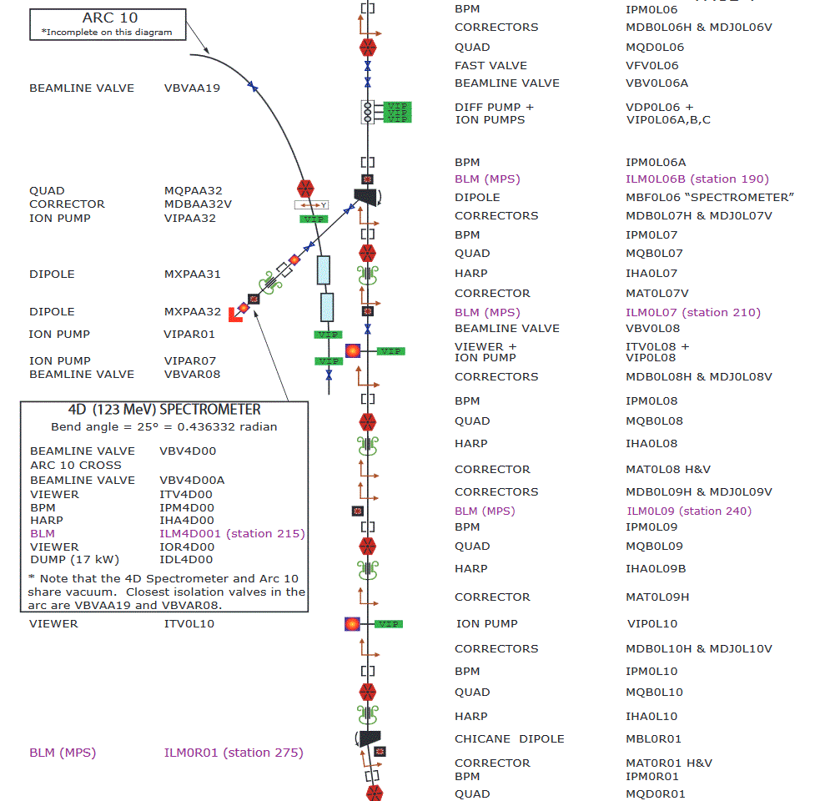
4D Spectrometer line 0.1% precision momentum measurement Typical Beam parameters: dE/E<1e-3 dE>50keV rms Bunch L.< 0.5ps

Slide 19
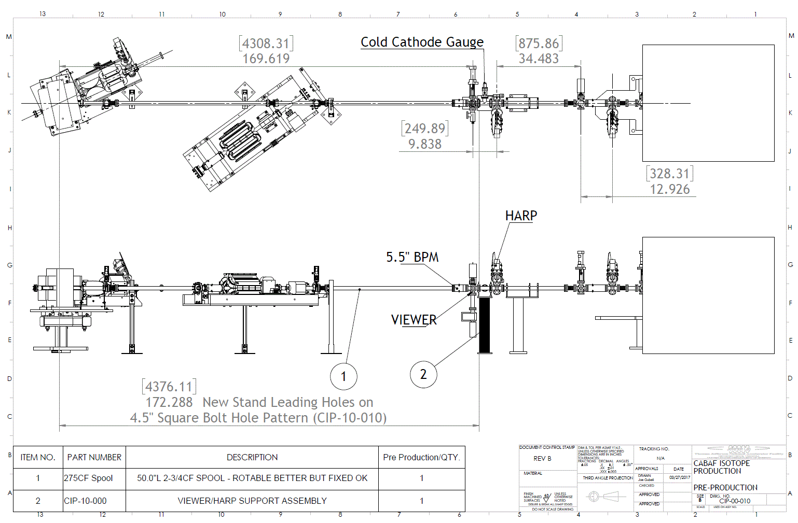
Isotope Production 4D line

Slide 20
4D Isotope Production Quick Reference

Slide 21
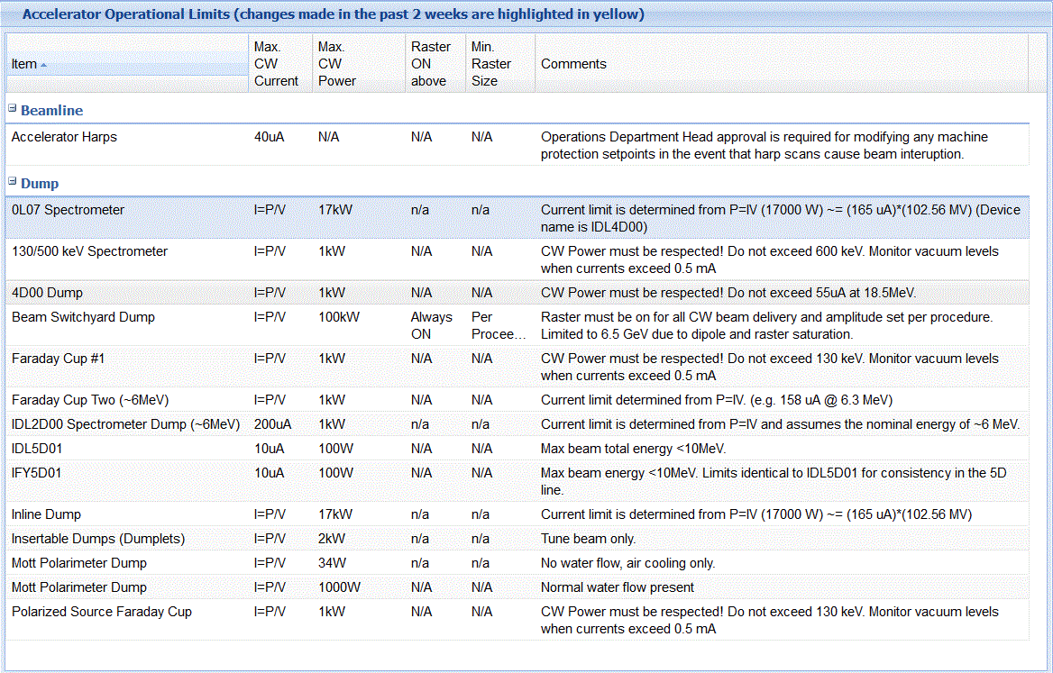
Current and Power Limits
4D Line

Slide 25
Acknowledgments
Thanks to Matt Poelker, Riad Suleiman, Joe Grames, Joseph Gubeli and others for injector experiments’ slides

Slide 26
End of Presentation
Thank You!

