Slide 1
MHD Steering Magnet: Conceptual Magnetic Design and Results (V01)
S-L. Lalitha
July 28, 2020

Slide 2
Contents
Design Requirements
Assumptions
Magnetic Design
Coil geometry, physical dimensions
Conductor choice
Magnetic Analysis Results
Summary

Slide 3
Magnet Performance Requirements
The steering magnets (MHD) mounted onto the A1 and A2 cube should be identical in design and performance.
The new coil assembly should fit within the space available on the A1/A2 cube assembly.
The maximum integrated field along the longitudinal axis for the vertical/ horizontal dipole coil assembly : 5.5×10⁻⁵ T.m
Magnetic field homogeneity requirements- TBD (No specification available. It will be optimized through magnetic design analysis and quantified using multipole field analysis).

Slide 4
Assumptions made for the Magnetic Design Calculations
Steering magnet uses air-core copper coils.
The components used in the coil winding should be able to withstand a maximum of 200 °C.
The fringe field of the neighboring coil assemblies have no impact on the magnet performance.

Slide 5
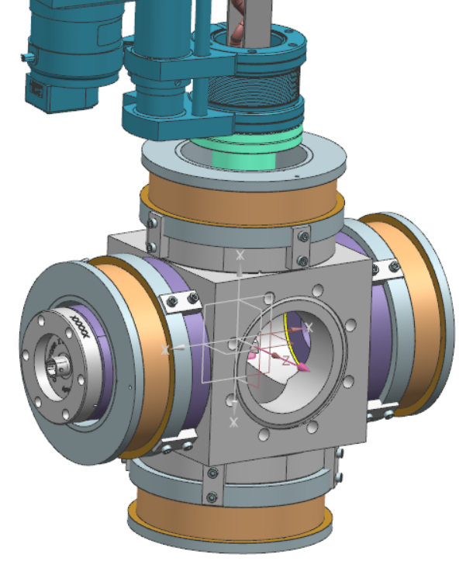
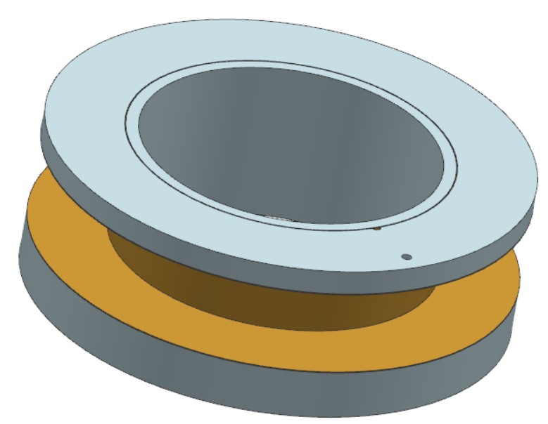
Design Considerations
MHD steering magnet on A1 cube
MHD steering magnet consists of four identical pancake coils
Forms two independent dipole coil assemblies for steering the beam in vertical or horizontal direction.
The vertical coil assembly (upper + lower coils) and the horizontal coil assembly (right + left coils) can be energized separately.
Stainless steel support structure (base plate, top plate and mandrel) for coils.
Kapton for electrical insulation between the coil and bobbin
0.254 mm thick kapton film wrapped around the bobbin core.
0.254 mm thick kapton spacers (pre-cut) placed between the flat surface of the coil and bobbin end plates.
Coil (Upper)
upper
Coil (Left)
right
78 mm
left
60 mm
Lead wire (in)
Right
Coil support structure
Coil (Right)
Lead wire (out)
Left
Dia-38.1 mm
60 mm
Coil (Lower)
Kapton insulation
Lower

Slide 6
Design Considerations : Copper Conductor (Magnet Wire)
The coil design is optimized for the use of 14 AWG insulated round copper conductor (potential supplier- MWS Wire Industries, CA)
Magnet wire parameters (Max. dimensions) | Unit | Value
Shape |  | Round wire
Copper grade |  | C101 or C102
Bare conductor size (equivalent AWG) |  | 14
Bare wire diameter | mm | 1.643
Radial thickness of the insulation | mm | 0.044
Diameter of the insulated wire (Kapton heavy film insulation) | mm | 1.732

Slide 7
Coil Bobbin Dimensions
Bobbin is made of stainless steel
Bobbin for MHD pancake coils (based on the dimensions of the new coil) | Unit | Value
Inner diameter of the mandrel | mm | 76
Radial thickness of the mandrel | mm | 3.175
Outer diameter of the mandrel | mm | 82.35
Radial thickness of the Kapton insulation on the mandrel | mm | 0.254
Outer diameter of the base plate/top plate for the bobbin | mm | 118.252
Bobbin base plate height | mm | 12.7
Bobbin top plate height | mm | 6.35
118.252 mm
76 mm
6.35 mm
12.7 mm

Slide 8
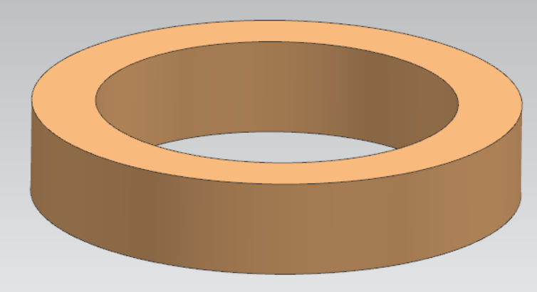
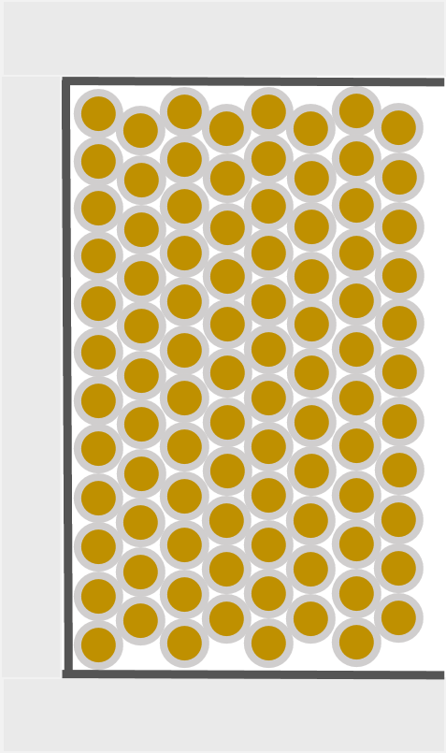
Coil Dimensions
Note: uses single piece length of conductor; winding tight against the thick flange of the bobbin; filler can be used, as needed, against the thin flange of the bobbin)
wet wound coils ( Epoxy: AREMCO 526 N)
MHD pancake coil parameters (estimated using the max. dimensions of the conductor) | Unit | Value
Distance between the opposite coils in the MHD steering magnet | mm | 174.752
Radial thickness of the epoxy surrounding the wire (assumed) | mm | 0.051
Inner diameter of the coil * | mm | 83.366
Radial thickness of the winding | mm | 12.951
Height of the winding | mm | 22.007
Outer diameter of the coil | mm | 109.268
Total turn counts in the coil winding |  | 92
Number of layers (L) of winding |  | 8
Number of turns per layer (Hexagonal close pack winding); (2 layers of 0.1 mm thick E-glass wrap under tension and painted with epoxy on the outer surface of the coil) |  | 12 (L1, 3, 5, 7), 11 (L 2, 4, 6, 8)
Estimated length of conductor per coil (+1m for each lead wire) | m | 29.84
Req. length of conductor per magnet (four coils+ lead wires) | m | ∼120
109.268 mm
83.366 mm
22.007 mm
22.007 mm
12.951 mm
* Based on the dimensions of the bobbin that can be accommodated on the A1 cube assembly

Slide 9
Magnetic Performance Parameters- Dipole Coil Assembly
The EM design fulfills the sufficient operating margin
Parameter | Unit | Value
Operating current | A | 2.535 | 3.18
Current density in the copper conductor | A/mm² | 1.12 | 1.5
Magnetic field strength at the center of the magnet | mT | 0.514 | 0.644
Max. field strength in the coil | mT | 6.45 | 8.09
Integrated field strength along the longitudinal axis (Z-axis) of the dipole assembly (Vertical/ Horizontal) (required: 5.5×10⁻⁵ T.m) | T.m | 5.51×10⁻⁵ | 6.91×10⁻⁵
Effective magnetic length of the dipole assembly (Vertical / horizontal) | m | 0.107 | 0.107
Integrated dipole field homogeneity within GFR (2 mm radius) (only the 6-pole higher order harmonics is present) | % | 99.91 | 99.91
Cumulative strength of Lorentz force | mN | 0.9 | 1.41
Magnetic stored energy of the dipole assembly | mJ | 6.32 | 9.95
Inductance of each coil | mH | 0.97 | 0.97
Resistance of each coil at 20°C | Ω | 0.24 | 0.24
With margin for integrated field

Slide 10
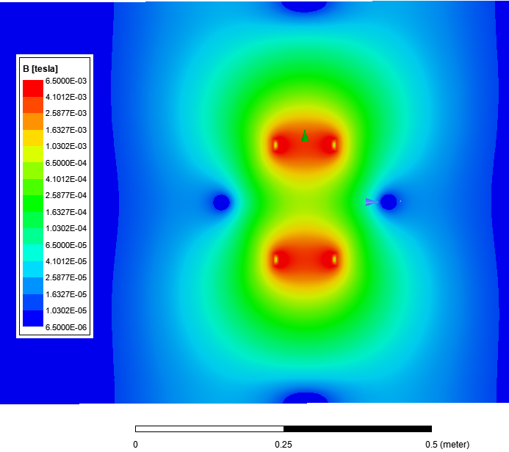
Magnetic Field Distribution in the Vertical Dipole Coil Assemblies
YZ plane
2.535 A
Y
Upper coil
Z
Lower coil
2.535 A
2.385 A

Slide 11
Summary
The new coil design meets the performance requirements.
3A and 10 A power supply (trim card) can be used. The max. operating current should be limited to 4.1 A.
Use a clamp shell around the coils when the magnet together with other beamline components undergo 200 °C heat treatment (Recommendation).
Structural analysis is performed to support the coil support structure design.
Note: Technical note describing the magnet design and engineering, and the performance characteristics will be prepared later.

