Slide 1
GTS GUN
Yan
8/11/15

Slide 2
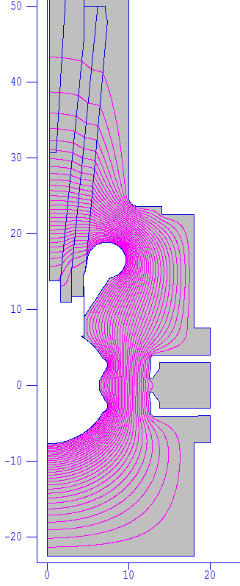
Gun Chamber Geometry
Rubber Plug
Insulator
Receptacle
Shed
Cathode
Gun Chamber

Slide 3
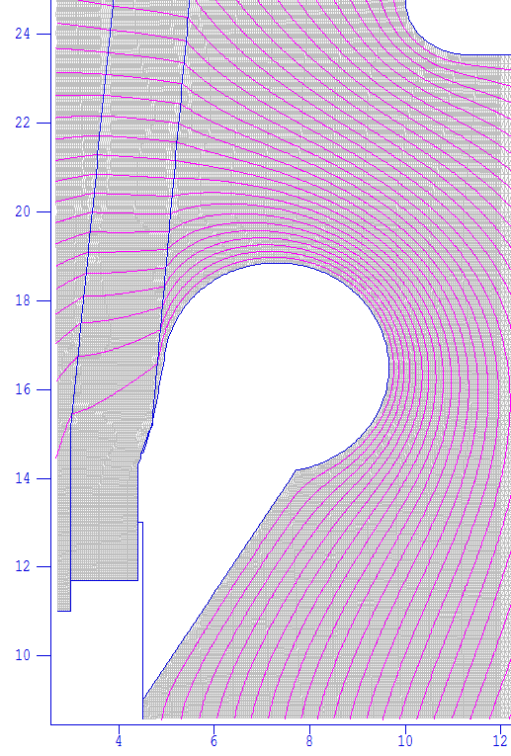
E field in Gun Chamber
r = 2.35, R = 9.65
E = 1.18 MV/m
r
R

Slide 4
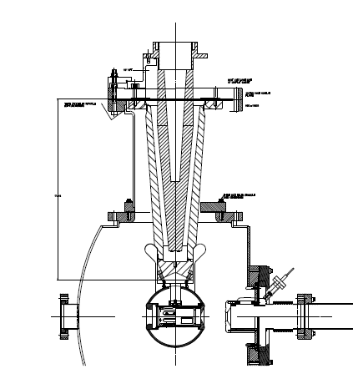
Danny’s Shed

Slide 5
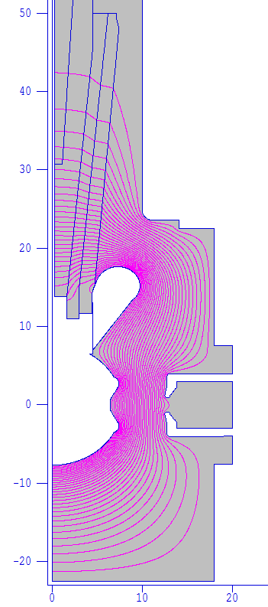
Danny’s Shed
E = ~ 2.2 MV/m

