Slide 1
Bubble Chamber Planning Meeting
24 July 2013

Slide 2
Agenda
Schedule
Design of beamline, radiator and dump
Bubble Chamber work at Argonne
Simulation and Background
Absolute beam energy
Safety

Slide 3
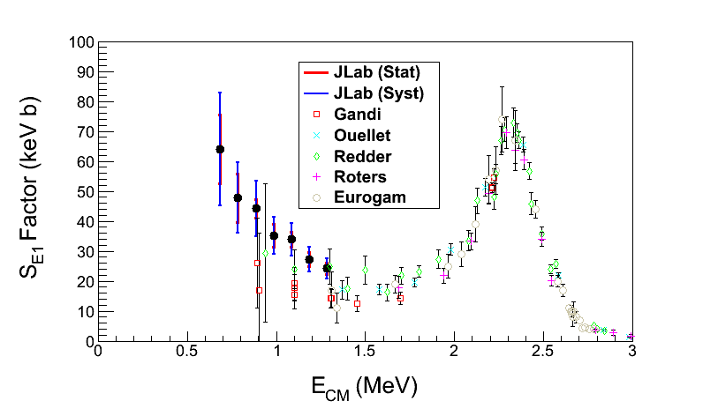
¹²C(α, γ)¹⁶O S-Factor
Statistical Error: dominated by background subtraction from ¹⁸O(γ,α)¹⁴C (depletion = 5,000)
Systematic Error: dominated by absolute beam energy (= 0.2%)
S_{E1}(300 keV) = 74±21 keV b

Slide 4
Schedule
12GeV CEBAF Commissioning:
Bubble Chamber Activities:
  Install beamline, radiator and dump
  Commission beamline, radiator and dump
  Install Bubble Chamber
  Commission Bubble Chamber
  Physics run
 | Start | End
Period I | 2013-11-04 | 2013-12-20
SAD I | 2014-01-02 | 2014-02-05
Period II | 2014-02-05 | 2014-05-07
SAD II | 2014-05-07 | 2014-09-22
Period III | 2014-09-22 | 2014-12-19
SAD III | 2015-01-02 | 2015-02-13
Period IV | 2015-02-13 | 2015-06-12

Slide 5
Design of beamline, Radiator & Dump
Need to design new beamline to replace PEPPo beamline and increase the distance between the two BPMs
Radiator: 0.02 mm and 0.1 mm Copper
Electron Dump: 2kW dump (10 MeV, 200 µA)
Photon Dump

Slide 6
Electron Beam
3.0 – 8.5 MeV (K.E.)
0.01 – 100 µA
Sweep Magnet
Al Photon Dump
10 cm long
20 cm diameter
Cu Vacuum Window 10 mil
Cu Radiator
0.02 mm
Cu Photon
Collimator
50 cm
50 cm
Cu Inner
Pipe
Al Beam Pipe
Bubble Chamber
Superheated N₂O
3 cm long
15°C, 60 atm
Cu Electron Dump

Slide 7
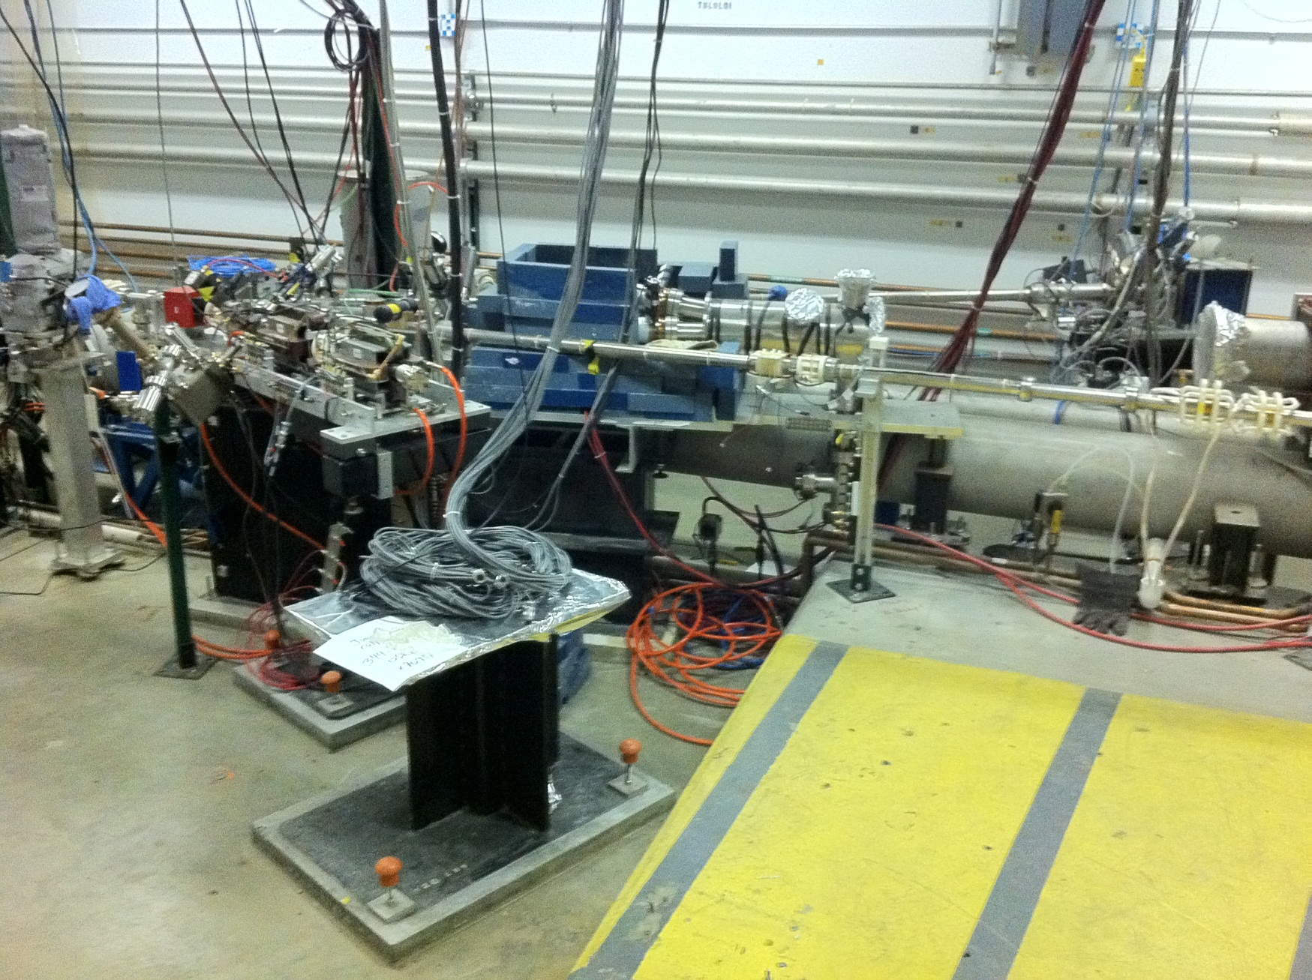
BCM
5 MeV
Spectrometer
5 MeV
Dipole
27’’
PEPPo/Bubble
Chamber
Beamline
Bubble
Chamber
location

Slide 8
Simulation
Two programs:
  GEANT4
  FLUKA
Both use models that calculate wrong cross sections. Both do not allow for user’s cross sections. Suggestion:
  Use GEANT4 and FLUKA to produce the photon spectrum impinging on the super heated liquid.
  Fold the above photon spectrum with our cross sections in stand-alone codes.
Both GEANT4 and FLUKA are good in neutron tracking. Still need to check the neutron cross sections.

Slide 9
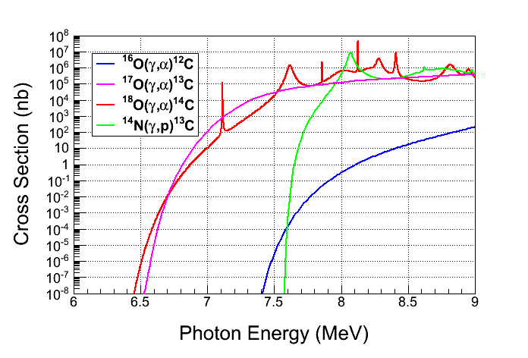
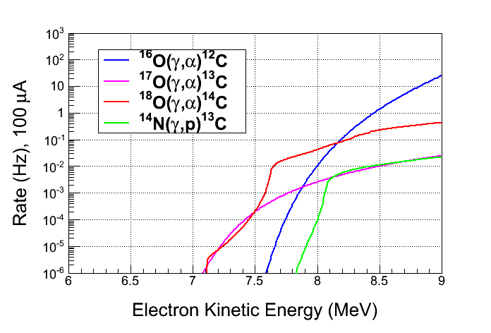
Background
Must measure:
  ¹⁷O(γ,α)¹³C , enrichment=10%
  ¹⁸O(γ,α)¹⁴C , enrichment=10%
Rates:
  ¹⁷O(γ,α)¹³C, depletion=5,000
  ¹⁸O(γ,α)¹⁴C, depletion=5,000
  ¹⁴N(γ,p)¹³C, detection eff.= 10⁻⁸
  Natural Abundance:
    ¹⁷O: 0.038%
    ¹⁸O: 0.205%
Still need to study ¹⁷O(γ,n)¹⁶O, …

Slide 10
Safety
High pressure system
Super heated liquid: N₂O or CO₂
Buffer liquid: Mercury

Slide 11
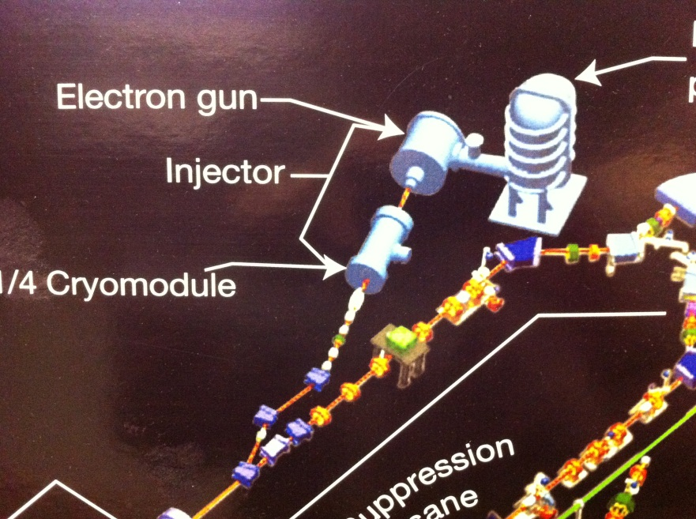
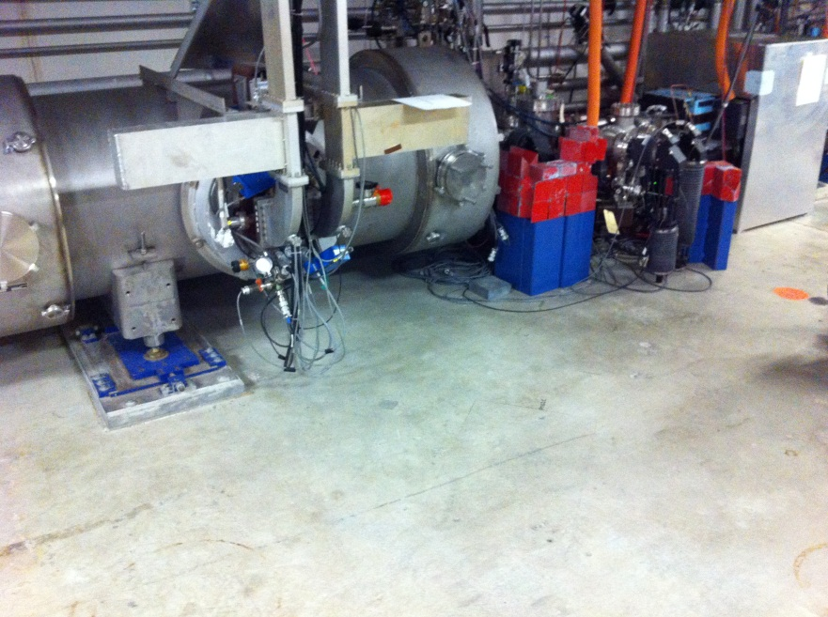
Running in FEL?
Absolute Beam Energy: FEL can measure the energy with a precision of 0.4%. However, it could be very hard to improve (?)
Required Systems:
  Personnel Safety System (PSS)
  Liquid helium and RF
  Gun Laser
  Staff

Slide 12
Planning Meeting
Do we want to meet every two weeks?
Wednesday 3:00 – 5:00 pm?

