Slide 1
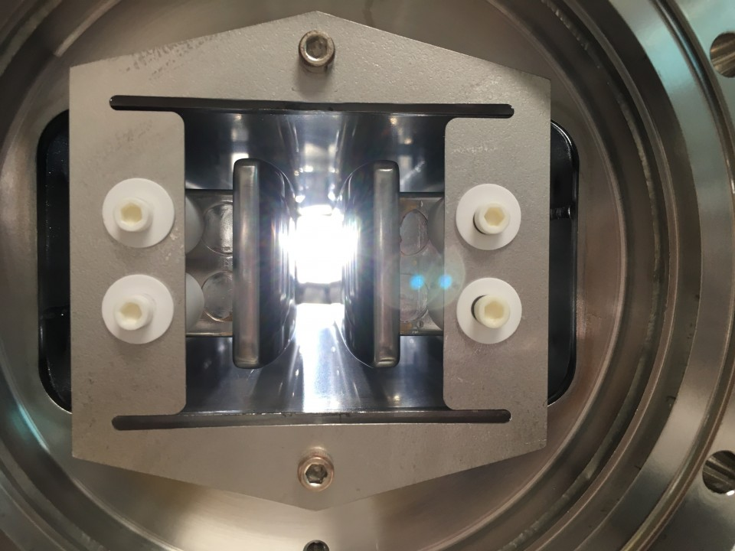
CEBAF New Wien Control
How to set Wien Voltage and Magnetic Field
Use accelerator convention:
Positive current makes positive B-field
Positive B-field bends up (V Wien) or right (H Wien)
Positive B-field makes positive Wien angle rotation up (V Wien) or right (H Wien)
Riad Suleiman

Slide 2





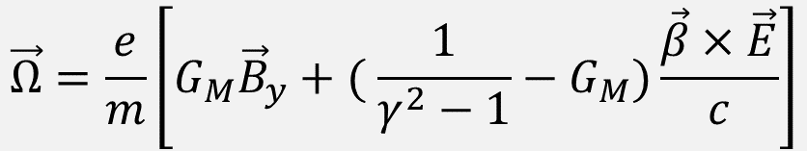


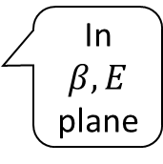



BMT Spin Equation
In a Wien Filter with electric and magnetic fields transverse to electron beam velocity, spin precession relative to momentum in lab frame is given by following form of generalized Thomas-BMT equation:
$$\vec{Ω}=\frac{e}{m}\left[G_{M}{\vec{B}}_{y}+( {\frac{1}{γ^{2}−1}−G}_{M})\frac{\vec{β}×\vec{E}}{c}\right]$$
Vertical Wien
Up
$$\vec{Ω}={\vec{Ω}}_{B}+{\vec{Ω}}_{E}$$
$$\vec{E}$$
Left
Spin Precession Angle:
Time-of-Flight of electron beam in Wien determined by E-Field:
$$θ=\vec{Ω} T$$
$$F_{B}$$
$$\vec{S}$$
$$\vec{B}(+I)$$
$$\vec{β}$$
$$F_{E}$$
$${\vec{Ω}}_{B}+{\vec{Ω}}_{E}$$
In $β,E$ plane
Right
$$T=L_{E}/(βc)$$
Down

Slide 3

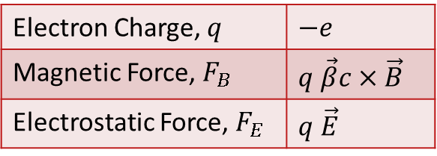

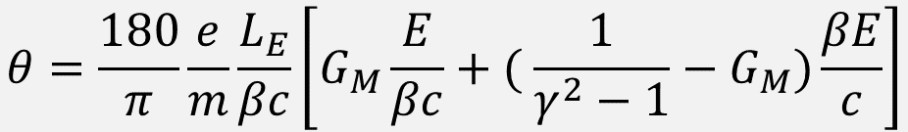
Electromagnetic Forces
Electron Charge, $q$ | $$−e$$
Magnetic Force, $F_{B}$ | $$q \vec{β}c×\vec{B}$$
Electrostatic Force, $F_{E}$ | $$q \vec{E}$$
$$B=E/(βc)$$
$$V=Eg/2$$
c = 299792458.0 Speed of Light (m/s)
e = 1.602176e-19 Electron Charge (C)
mc² = 510998.950 Electron Mass (eV)
G_{M} = 0.00115965218091 Electron Anomalous Magnetic Moment
e/m = 1.758820088e+11 Electron Cyclotron Frequency/Field (rad/(s T))
L_{E} = 3.120e-01 Electric Field Effective Length (m)
L_{B} = 3.107e-01 Vertical Magnetic Field Effective Length (m)
g = 1.5e-02 Wien Gap (m)
E Electric Field Strength (V/m or N/C)
B Magnetic Field (T or N⋅s/(C m))
V Plate Voltage on Beam Down
$$θ=\frac{180}{π}\frac{e}{m}\frac{L_{E}}{βc}\left[G_{M}\frac{E}{βc}+( {\frac{1}{γ^{2}−1}−G}_{M})\frac{βE}{c}\right]$$

Slide 4
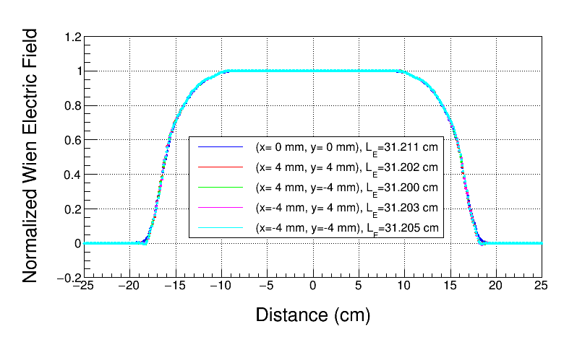
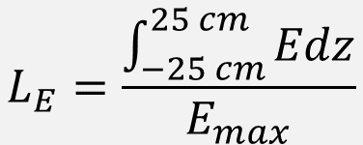
Electric Field Effective Length
$$L_{E}=\frac{\int_{−25 cm}^{25 cm}{Edz}}{E_{max}}$$
CST model based on actual CEBAF drawings (faceted)

Slide 5
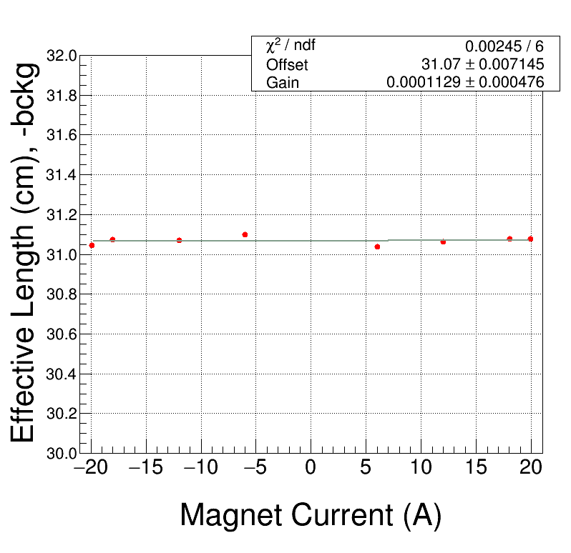
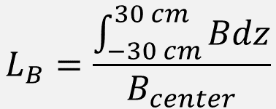
Vertical Magnetic Field Effective Length
$$L_{B}=\frac{\int_{−30 cm}^{30 cm}{Bdz}}{B_{center}}$$

Slide 6
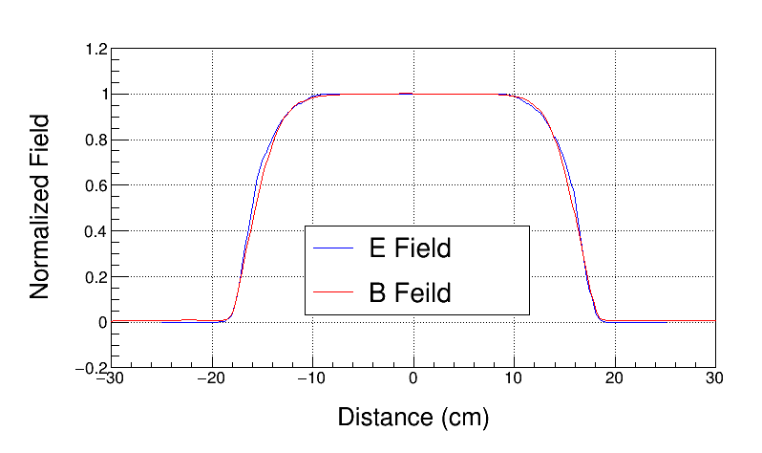
Electric and Magnetic Fields

Slide 7


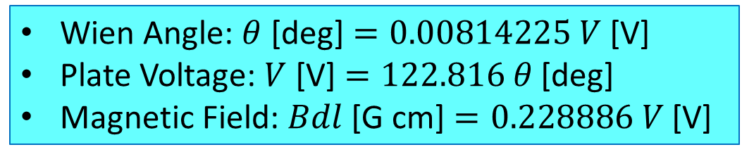
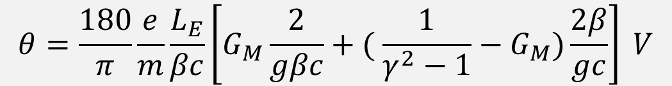
Wien Equations (Gun HV = 130 kV)
$$B=E/(βc)$$
$$V=Eg/2$$
$$θ=\frac{180}{π}\frac{e}{m}\frac{L_{E}}{βc}\left[G_{M}\frac{2}{gβc}+( {\frac{1}{γ^{2}−1}−G}_{M})\frac{2β}{gc}\right] V$$
Wien Angle: $θ$ [deg] $=0.00814225 V$ [V]
Plate Voltage: $V$ [V] $=122.816 θ$ [deg]
Magnetic Field: $Bdl$ [G cm] $=0.228886 V$ [V]

Slide 8
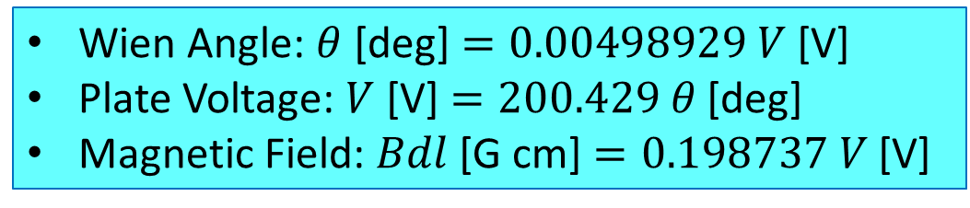
Wien Equations (Gun HV = 200 kV)
$$B=E/(βc)$$
$$V=Eg/2$$
$$θ=\frac{180}{π}\frac{e}{m}\frac{L_{E}}{βc}\left[G_{M}\frac{2}{gβc}+( {\frac{1}{γ^{2}−1}−G}_{M})\frac{2β}{gc}\right] V$$
Wien Angle: $θ$ [deg] $=0.00498929 V$ [V]
Plate Voltage: $V$ [V] $=200.429 θ$ [deg]
Magnetic Field: $Bdl$ [G cm] $=0.198737 V$ [V]

Slide 9
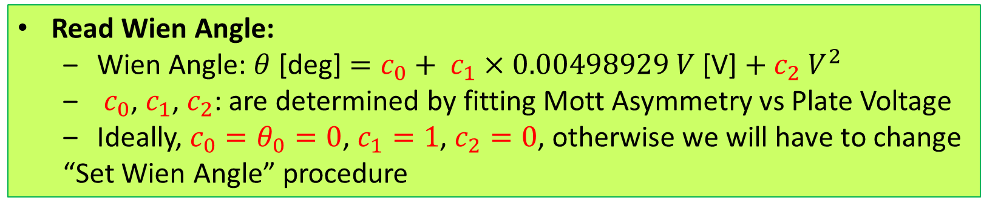
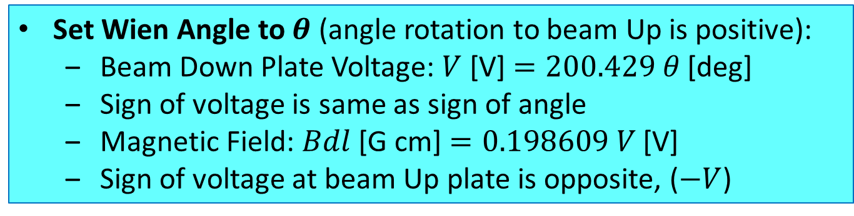
Vertical Wien Angle: Set and Readback (given here at 200 kV, as an example)
Set Wien Angle to $θ$ (angle rotation to beam Up is positive):
  Beam Down Plate Voltage: $V$ [V] $=200.429 θ$ [deg]
  Sign of voltage is same as sign of angle
  Magnetic Field: $Bdl$ [G cm] $=0.198609 V$ [V]
  Sign of voltage at beam Up plate is opposite, ($−V$)
Read Wien Angle:
  Wien Angle: $θ$ [deg] $=c_{0}+ c_{1}×0.00498929 V$ [V] $+ c_{2} V^{2}$
  $c_{0}$, $c_{1}$, $c_{2}$: are determined by fitting Mott Asymmetry vs Plate Voltage
  Ideally, $c_{0}=θ_{0}=0$, $c_{1}=1$, $c_{2}=0$, otherwise we will have to change
  “Set Wien Angle” procedure

Slide 10






Horizontal Wien
Gun HV 130 kV:
Wien Angle: $θ$ [deg] $=0.00814225 V$ [V]
Plate Voltage: $V$ [V] $=122.816 θ$ [deg]
Magnetic Field: $Bdl$ [G cm] $=0.228886 V$ [V]
Gun HV 200 kV:
Wien Angle: $θ$ [deg] $=0.00498929 V$ [V]
Plate Voltage: $V$ [V] $=200.429 θ$ [deg]
Magnetic Field: $Bdl$ [G cm] $=0.198737 V$ [V]
Horizontal Wien
Left
$$F_{E}$$
$$F_{B}$$
$$\vec{β}$$
$$\vec{E}$$
$${\vec{Ω}}_{B}+{\vec{Ω}}_{E}$$
In $β,E$ plane
$$\vec{S}$$
Right
$$\vec{B}(+I)$$
Down

Slide 11
Horizontal Magnetic Field Effective Length

Slide 12
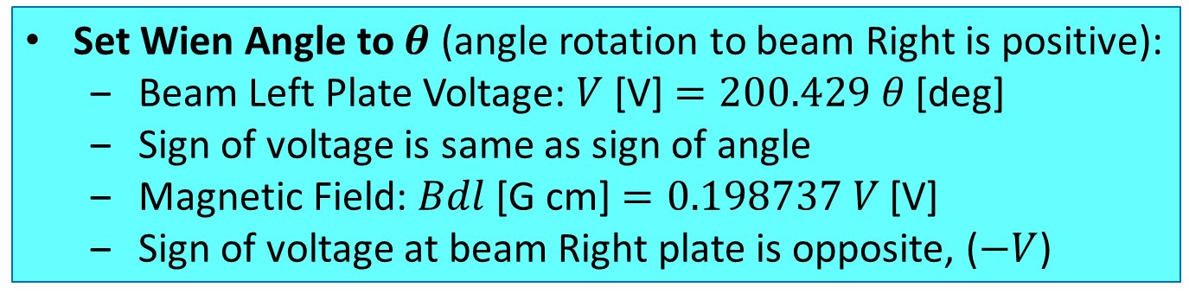
Horizontal Wien Angle: Set and Readback (given here at 200 kV, as an example)
Set Wien Angle to $θ$ (angle rotation to beam Right is positive):
  Beam Left Plate Voltage: $V$ [V] $=200.429 θ$ [deg]
  Sign of voltage is same as sign of angle
  Magnetic Field: $Bdl$ [G cm] $=0.198737 V$ [V]
  Sign of voltage at beam Right plate is opposite, ($−V$)
Read Wien Angle:
  Wien Angle: $θ$ [deg] $=c_{0}+ c_{1}×0.00498929 V$ [V] $+ c_{2} V^{2}$
  $c_{0}$, $c_{1}$, $c_{2}$: are determined by fitting Mott Asymmetry vs Plate Voltage
  Ideally, $c_{0}=θ_{0}=0$, $c_{1}=1$, $c_{2}=0$, otherwise we will have to change
  “Set Wien Angle” procedure

Slide 13
Vertical Wien Settings
Wien Angle (degree) | Down Plate Voltage (V) | Up Plate Voltage (V) | Magnetic Field (G cm)
90.0 | 11053.5 | -11053.5 | 25230.0
45.0 | 5526.7 | -5526.7 | 1265.0
0.0 | 0.0 | 0.0 | 0.0
-45.0 | -5526.7 | 5526.7 | -1265.0
-90.0 | -11053.5 | 11053.5 | -25230.0
130 keV
Wien Angle (degree) | Down Plate Voltage (V) | Up Plate Voltage (V) | Magnetic Field (G cm)
90.0 | 18038.6 | -18038.6 | 3584.9
45.0 | 9019.3 | -9019.3 | 1792.5
0.0 | 0.0 | 0.0 | 0.0
-45.0 | -9019.3 | 9019.3 | -1792.5
-90.0 | -18038.6 | 18038.6 | -3584.9
200 keV

Slide 14







Vertical Wien Schematics
Positive Angle (Up)
Negative Angle (Down)
Up Plate (-HV)
Up Plate (+HV)
$$\vec{E}$$
Left
Left
$$F_{B}$$
$$\vec{S}$$
$$F_{E}$$
$$\vec{B}(−I)$$
$$\vec{Ω}$$
$$\vec{β}$$
$$\vec{β}$$
$$\vec{B}(+I)$$
$$\vec{Ω}$$
$$F_{E}$$
$$F_{B}$$
Right
$$\vec{S}$$
Right
$$\vec{E}$$
Down Plate (+HV)
Down Plate (-HV)

Slide 15
Horizontal Wien Settings
Wien Angle (degree) | Left Plate Voltage (V) | Right Plate Voltage (V) | Magnetic Field (G cm)
90.0 | 11053.5 | -11053.5 | 25230.0
45.0 | 5526.7 | -5526.7 | 1265.0
0.0 | 0.0 | 0.0 | 0.0
-45.0 | -5526.7 | 5526.7 | -1265.0
-90.0 | -11053.5 | 11053.5 | -25230.0
130 keV
Wien Angle (degree) | Left Plate Voltage (V) | Right Plate Voltage (V) | Magnetic Field (G cm)
90.0 | 18038.6 | -18038.6 | 3584.9
45.0 | 9019.3 | -9019.3 | 1792.5
0.0 | 0.0 | 0.0 | 0.0
-45.0 | -9019.3 | 9019.3 | -1792.5
-90.0 | -18038.6 | 18038.6 | -3584.9
200 keV

Slide 16









Horizontal Wien Schematics
Positive Angle (Right)
Negative Angle (Left)
UP
UP
$$\vec{B}(−I)$$
Left Plate (+HV)
$$\vec{E}$$
Left Plate (-HV)
$$F_{E}$$
$$F_{B}$$
$$\vec{S}$$
$$\vec{β}$$
$$\vec{Ω}$$
$$\vec{β}$$
$$F_{B}$$
$$\vec{Ω}$$
$$F_{E}$$
$$\vec{E}$$
$$\vec{S}$$
Right Plate (-HV)
Right Plate (+HV)
$$\vec{B}(+I)$$
Down
Down

