Slide 1
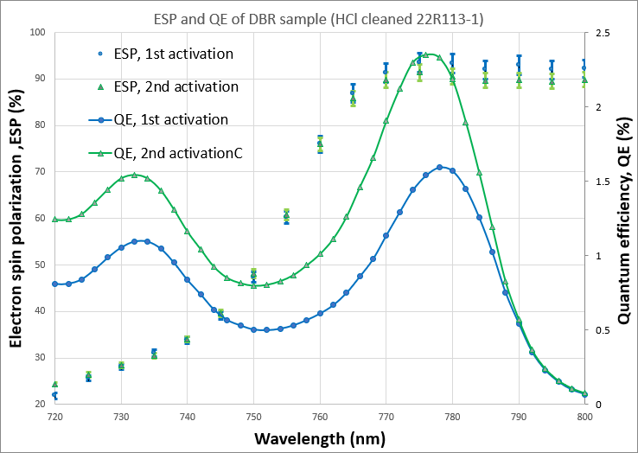
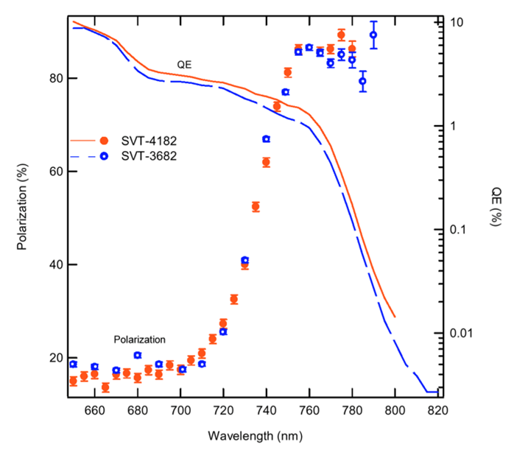
Photocathodes with 90% polarization and QE greater than 1% for DOE NP
Annual NP Accelerator R&D virtual PI Exchange meeting - November 29, 2022
Matt Poelker and M. Stutzman, Jefferson Lab
Sylvain Marsillac, ODU
Erdong Wang, BNL

Slide 2
MBE, GSMBE, CBE and MOCVD (aka MOVPE)
MBE
Gas Source Molecular Beam Epitaxy
elemental As, P, Ga
Pressure ~10⁻⁸ mbar
Growth rates
~ 1 µm/hr
Very precise control
GSMBE
Gas Source Molecular Beam Epitaxy
AsH₃, PH₃, elemental Gallium
CBE
Chemical Beam Epitaxy
AsH₃, PH₃, triethyl gallium (TEGa) or elemental Gallium
Pressure <10⁻⁴ mbar
Growth rates 0.5-1 µm/hr
MOCVD
Metal organic chemical vapor deposition (metal organic vapor phase epitaxy)
AsH₃, PH₃, trimethylgallium (TMGa)
Pressures >100 mbar during growth
Growth Rates 10 µm/hr
Some claim difficult to get sharp interfaces
Molecular
beams
Gas sources
Molecular
and gas sources
Notes:
The difference between the different wafer growth mechanisms vary in the sources they use for the growth. Traditionally, Molecular beam epitaxy uses solid sources for the elements, requires base pressures in the 10^-10 Torr range, and offers precise growth with sharp interfaces. Drawbacks include the vacuum requirements and the need to rotate samples during growth to ensure equal species distribution.
Gas source MBE, and chemical beam epitaxy replace some or all of the solid sources with gas sources such as arsine or phosphine, reducing the requirements for sample rotation or allowing larger wafer growth.
MOCVD is done at much higher pressures with the wafer in a viscous flow of the gas, with drawbacks that much more of the flammable, toxic precursor gasses are required and that sharp transitions are more difficult to control

Slide 3
Background
SPIRE/Bandwidth Semiconductor used MOCVD to grow single-strained-layer GaAs/GaAsP photocathodes (good)
SVT used MBE to grow strained-superlattice GaAs/GaAsP photocathodes (better)
In this work - JLab, ODU and BNL - focus on MOCVD
  Strained Superlattice photocathodes
  Strained Superlattice photocathodes with DBR
We were granted 3 months no-cost extension, project officially ends 12/31/2022

Slide 4
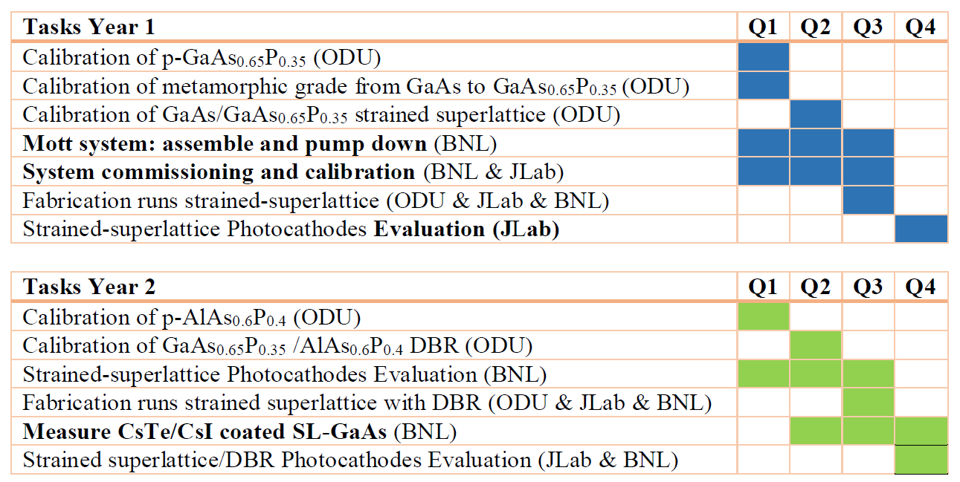


Project Goals

Slide 5
Project Conclusion
Stated clearly:
We successfully fabricated both kinds of photocathodes, SSL and SSL with DBR, via MOCVD. Exceptional work by ODU
We achieved our central goal: Polarization > 90% and QE > 1%
Between JLab and BNL, we have nearly 200k$ worth of photocathode material, our photocathode stores now replenished! Enough material for polarimeter cross checks, to support CEBAF and EIC physics programs, and to support polarized source R&D
BNL has a fully functional microMott polarimeter, and this device was essential for project success
JLab’s microMott polarimeter is very close to being operational again
The cross calibration of the two microMott polarimeters will happen
Having both source groups – JLab and BNL – participating in this project has been wonderful, a big selling point (IMHO)

Slide 6
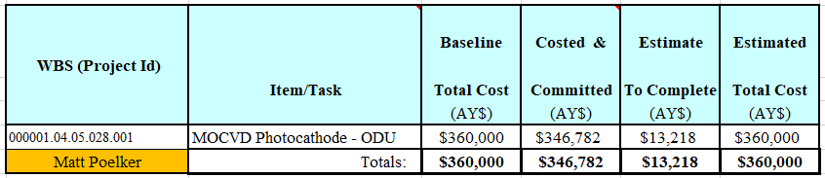
Budget
JLab FY20 + FY21 loaded budget = 360k$
Support for ODU
Procurements: sample evaluation, Mott apparatus upkeep
Some labor for Matt and Marcy

Slide 7
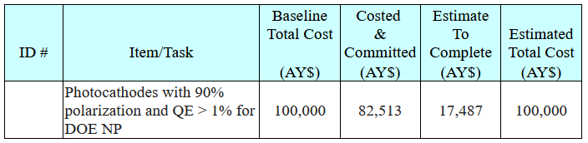
Budget
BNL FY20 + FY21 loaded budget = 100k$
Sample evaluation
Mott apparatus upkeep

Slide 8
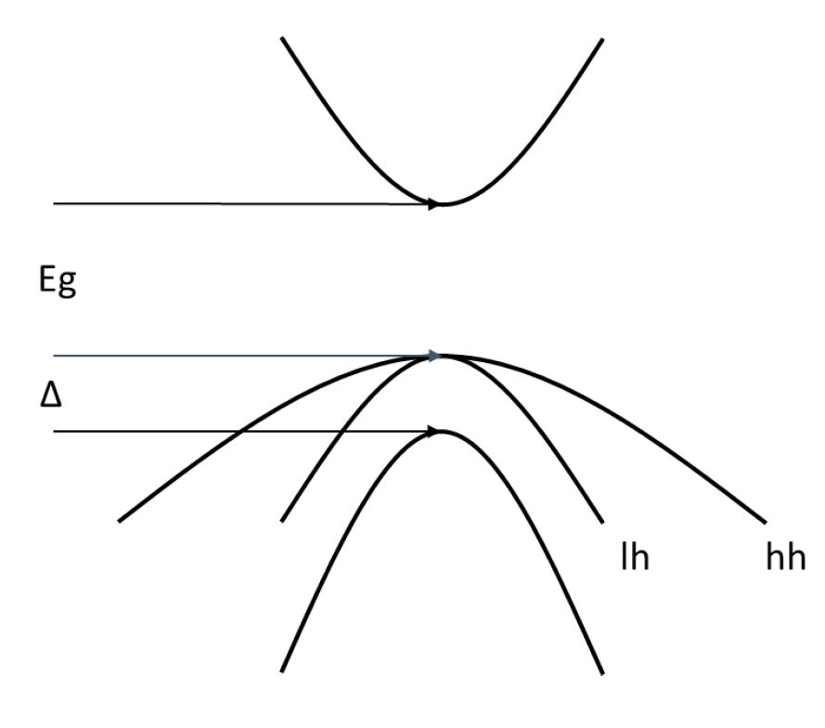
Making polarized electron beams with GaAs
Bulk GaAs – no strain
m _{j} = -1/2
+1/2
σ⁺
σ ⁻
3
3
1
1
m _{j} = -3/2
-1/2
+1/2
+3/2
m _{j} = -1/2
+1/2
Maximum Polarization 50%

Slide 9
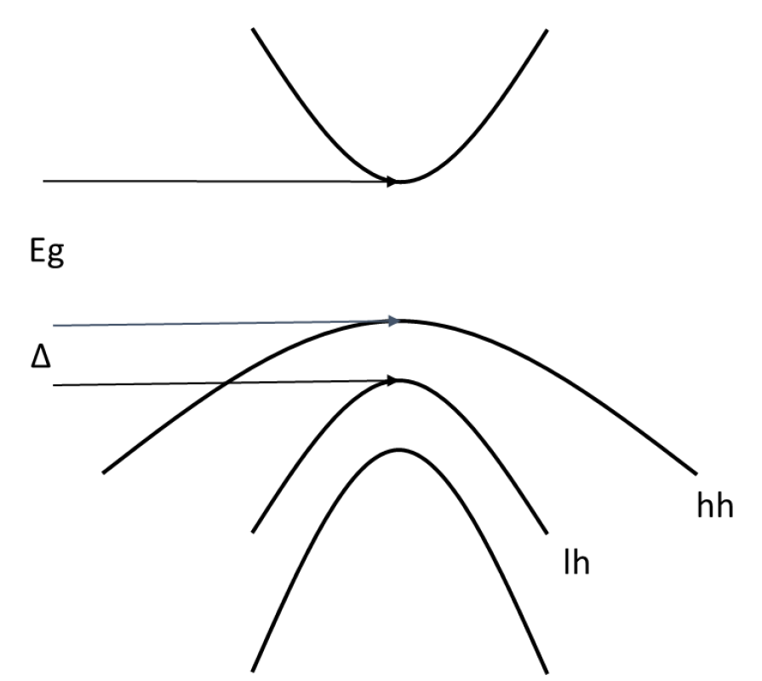
Making polarized electron beams with GaAs
Strained GaAs
m _{j} = -1/2
+1/2
σ⁺
σ ⁻
3
3
m _{j} = -3/2
+3/2
-1/2
+1/2
m _{j} = -1/2
+1/2
Maximum Polarization 100%

Slide 10
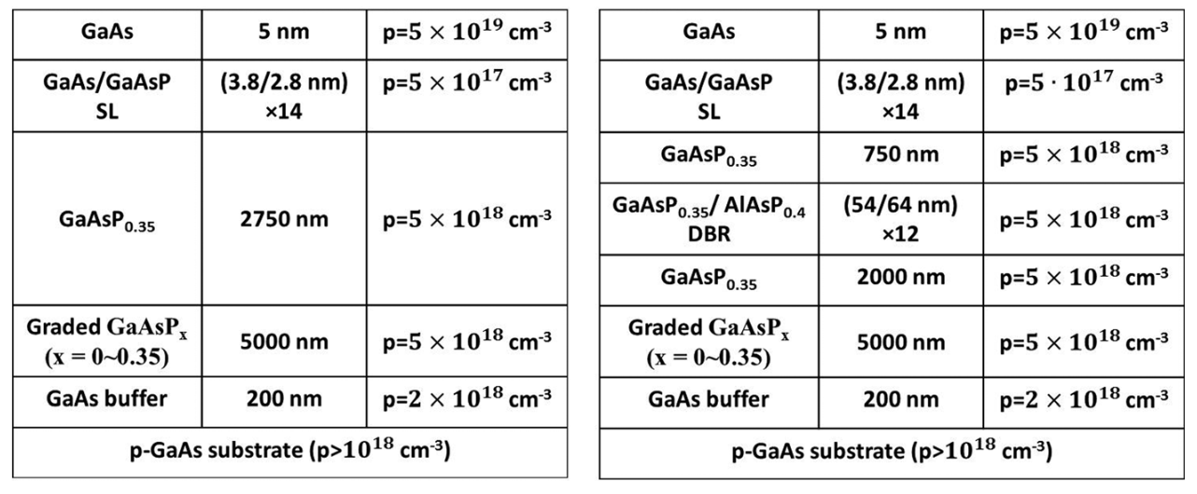
Device Structure
Strained Superlattice
Strained Superlattice with Distributed Bragg Reflector
the superlattice - where the polarized electrons come from, many thin layer pairs

Slide 11
Device Structure
Strained Superlattice
Strained Superlattice with Distributed Bragg Reflector
Highly doped surface layer to reduce surface charge limit (good for EIC)

Slide 12
Device Structure
Strained Superlattice
Strained Superlattice with Distributed Bragg Reflector
Metamorphic grading: starting with GaAs, ending with GaAs_{0.65}P_{0.35}
to create a relaxed layer upon which thick buffer layer is grown

Slide 13
Device Structure
Strained Superlattice
Strained Superlattice with Distributed Bragg Reflector
Another complicated superlattice which forms the distributed Bragg reflector (DBR)
Etalon formed between DBR and top surface: stores light, more light absorbed, higher QE

Slide 14
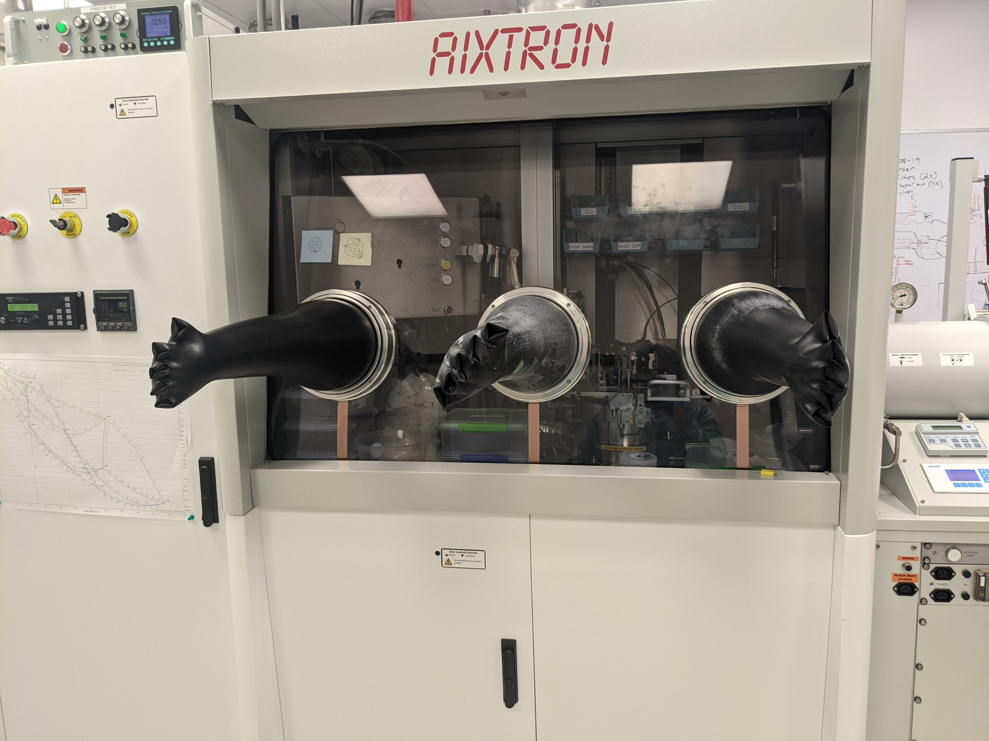
MOCVD growth parameters
Key Precursors
  Trimethyl Gallium (Ga(CH₃)₃)
  Arsine (AsH₃) and Phosphine (PH₃)
  Diethyl Zinc (Zn(CH₃CH₃)₂)
  Carbon Tetrachloride (CCl₄)
  Lower diffusivity of carbon in GaAsP should improve lifetime of device surface
Substrate: 2” GaAs wafers with either 0 or 2º offcut in the 110 direction
Growth rate range: 3-8 μm/hr
Temperature: 650-750ºC
MOCVD system at Rochester Institute of Technology

Slide 15
Issues that needed to be resolved
Sample temperature and growth rate for best metamorphic grading
Phosphorus concentration for optimum strain and polarization
Defect mitigation
Cleave plane orientation, offcut or no offcut

Slide 16
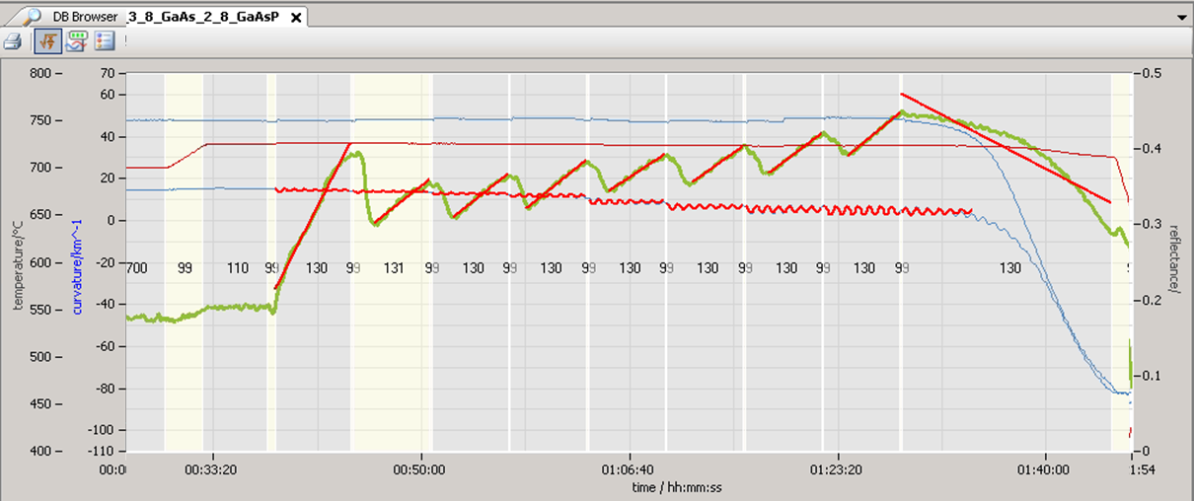
Tools Used
Telemetry: in-situ measurement
  Pyrometry
  Curvature
  Reflectivity
Temperature
Reflectivity
Curvature

Slide 17
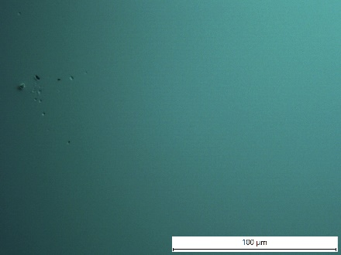
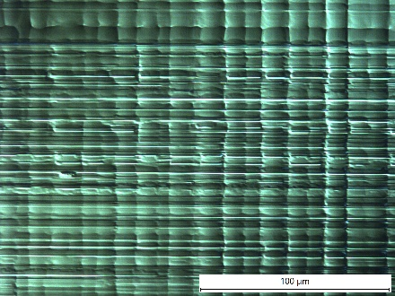
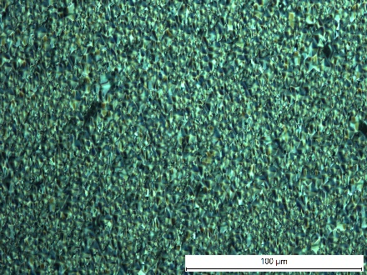
Tools Used
Nomarski Microscopy : ex-situ measurement
  Differential interference contrast (DIC) microscopy
  Surface topography
GaAs_{0.95}P_{0.05}
minimal strain so minimal surface features
Textured photocathode, good, there’s uniform strain
poorly relaxed growth

Slide 18
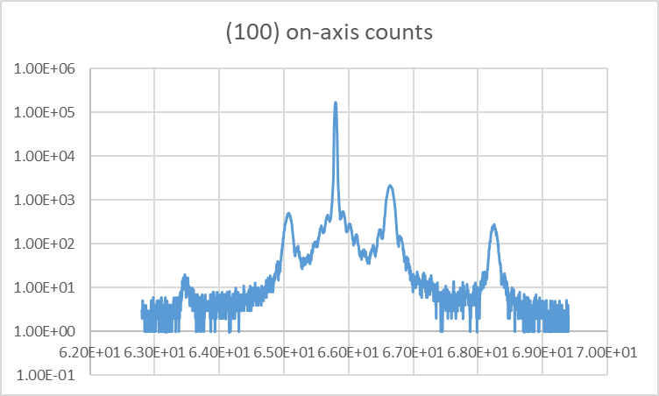
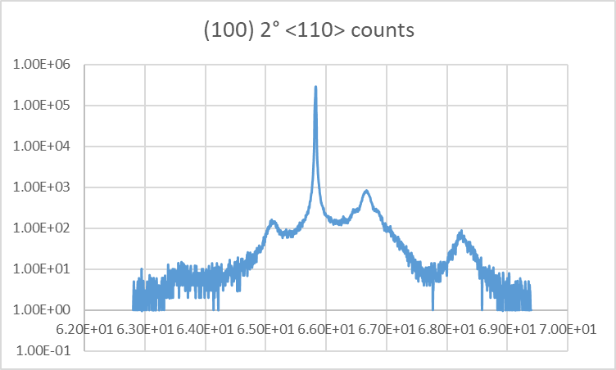
Tools Used
X-ray Diffraction : ex-situ measurement
  Used to measure material strain and composition
  destructive and constructive interference that occurs when X-rays impinge on sample
GaAs/GaAs_{0.65}P_{0.35} superlattice samples grown on different substrates:
(100) substrate, on-axis
(100) substrate, 2 degree offcut in the (110) direction

Slide 19
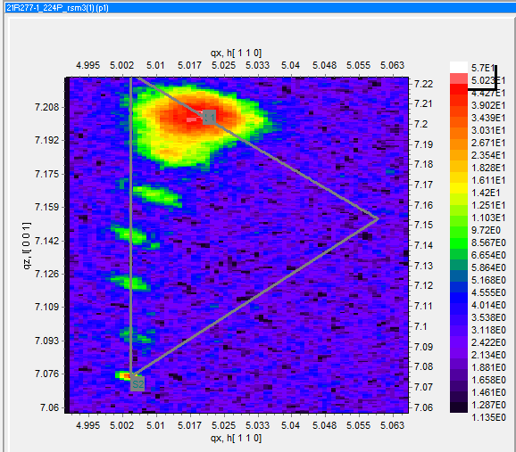
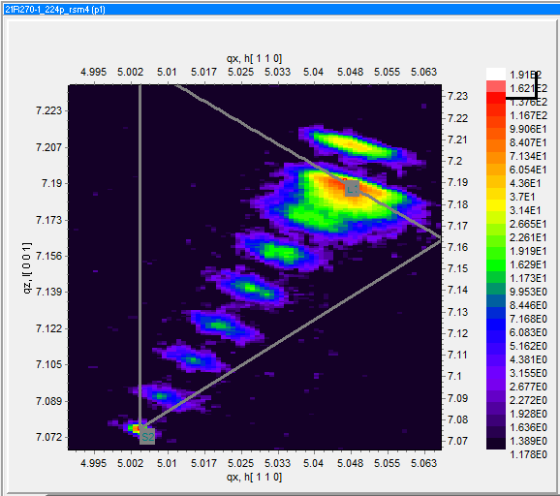
Tools Used
X-ray Diffraction : ex-situ measurement
  Reciprocal phase space mapping
  Shows relaxation of deposited films, key to determining quality of the deposited metamorphic grading
3μm/hr 730ºC Growth Temp
10μm/hr 730ºC Growth Temp
Close to vertical line: more strain
Close to diagonal line: less strain

Slide 20
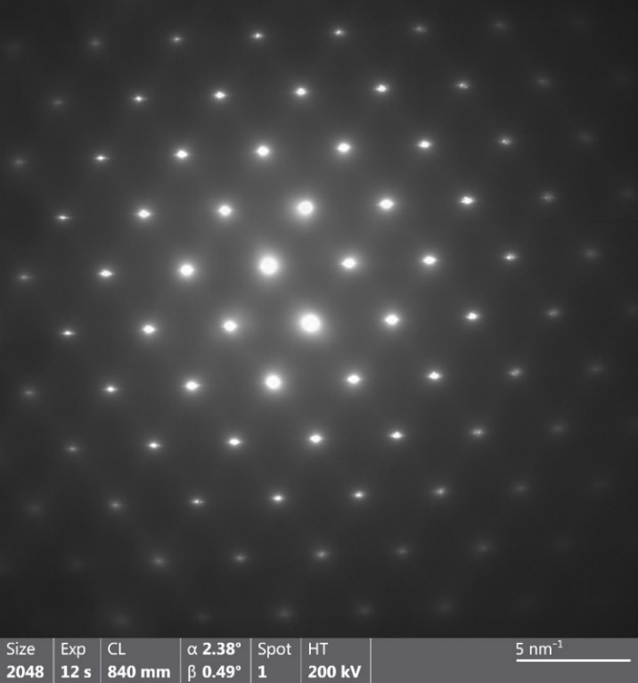
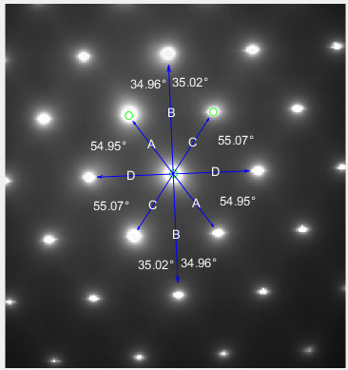
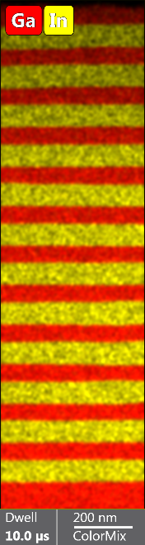
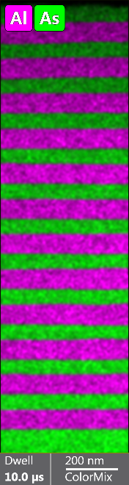
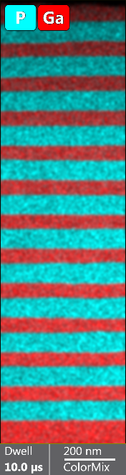
Tools Used
Transmission Electron Microscopy : ex-situ measurement
  TEM micrographs (Images)
  Selected Area Electron Diffraction (SAED)
  Energy Dispersive X-Ray Spectroscopy (EDS)

Slide 21
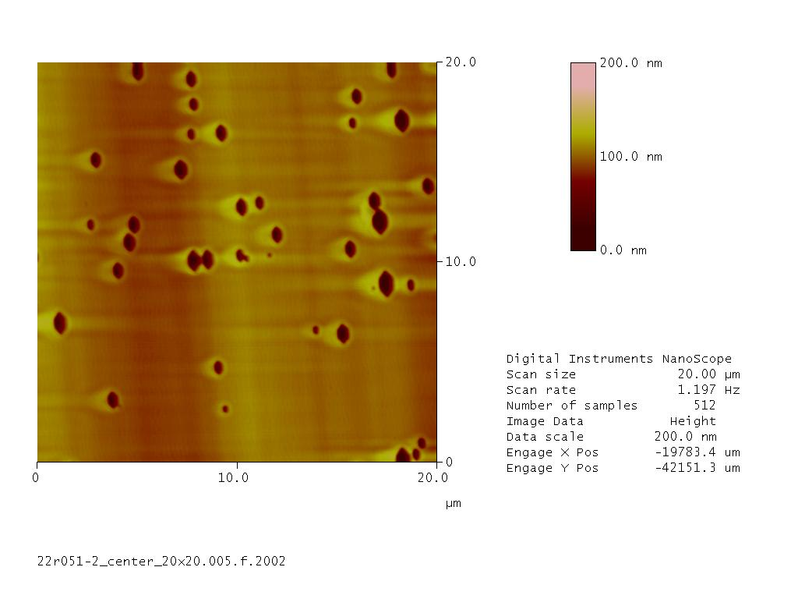
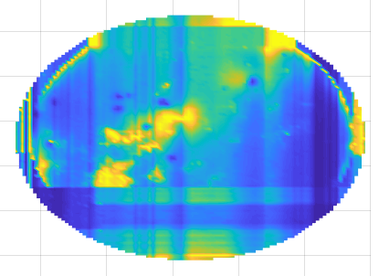
Tools Used
Ellipsometry (optical method, layer thickness)
Photoluminescence (PL) mapping (uniformity)
Hall Effect (measure dopant concentration)
Atomic Force Microscopy (surface defects)

Slide 22
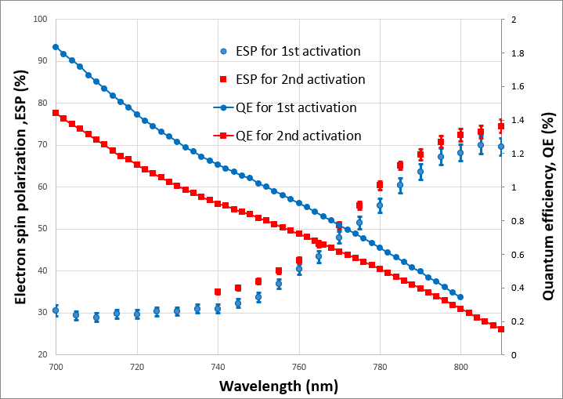
Old Dominion University, Ben Belfore’s first set of photocathodes, SSL
Pol ~ 70%
QE ~ 0.3%
λ_{peak} ~ 820 nm
BNL microMott, measurements by Wei Liu

Slide 23
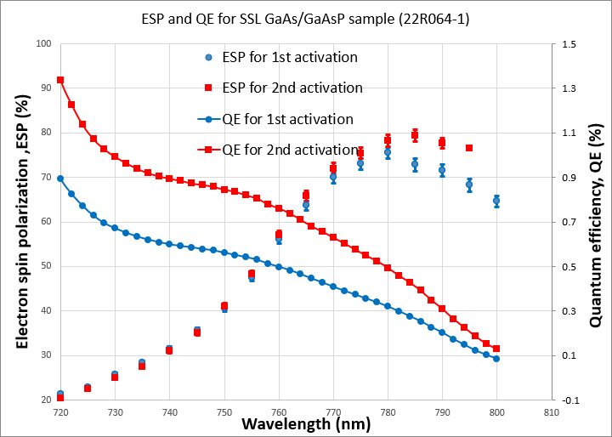
ODU Ben’s second set of photocathodes, SSL
Pol ~ 80%
QE ~ 0.4%
λ_{peak} ~ 785 nm
BNL microMott, measurements by Wei Liu

Slide 24
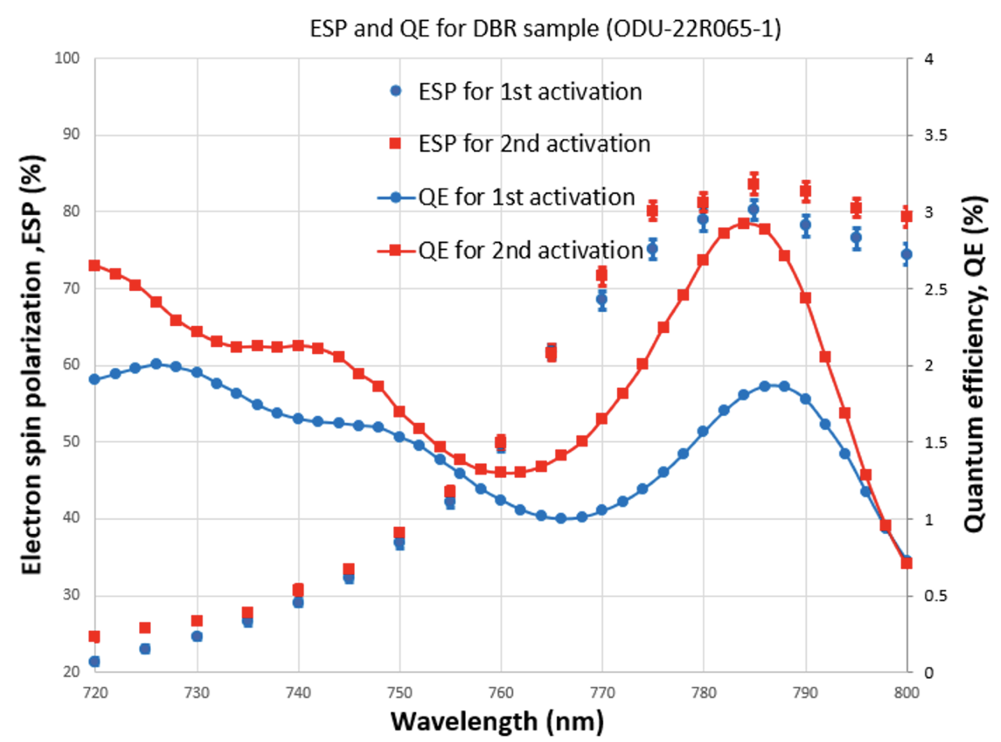
ODU Ben’s third set of photocathodes, SSL with DBR
Pol ~ 83%
QE ~ 3%
λ_{peak} ~ 785 nm
BNL microMott, measurements by Wei Liu

Slide 25
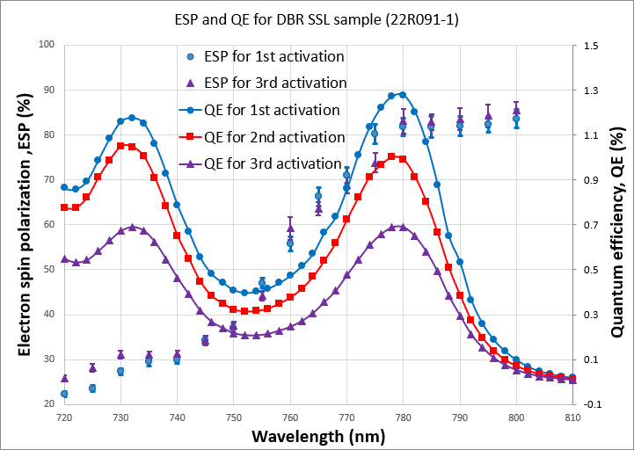
ODU Ben’s fourth set of photocathodes, SSL with DBR
Pol ~ 83%
QE ~ 1.3%
λ_{peak} ~ 775 nm
BNL microMott, measurements by Wei Liu

Slide 26
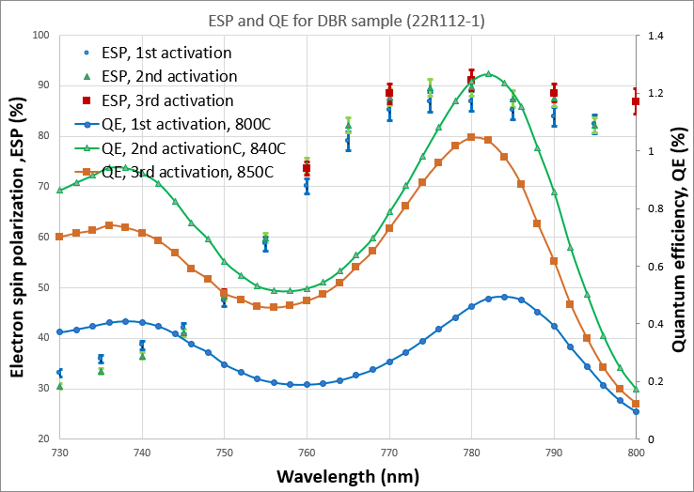
Old Dominion University, Adam Masters’ first set of photocathodes, SSL with DBR
Pol ~ 90%
QE ~ 1%
λ_{peak} ~ 785 nm
BNL microMott, measurements by Wei Liu

Slide 27
ODU Adam’s first set of photocathodes, SSL with DBR
Higher QE following HCl rinse hints at surface contamination
Pol ~ 92%
QE ~ 2.3%
λ_{peak} ~ 785 nm
BNL microMott, measurements by Wei Liu

Slide 28
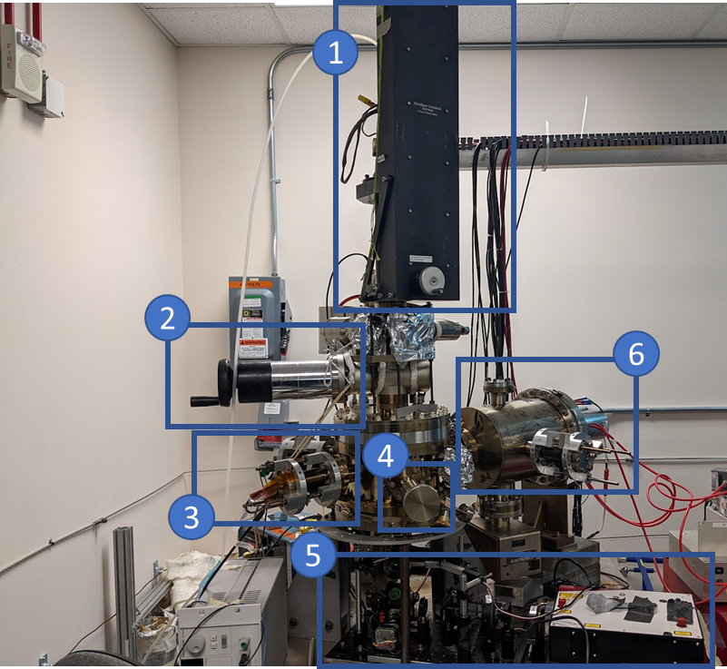
‘microMott’, ‘retarding field’, low voltage polarimeters
BNL
JLab

Slide 29
Conclusion
Multiple devices grown - superlattice and superlattice samples with distributed Bragg reflector
Successful interaction with “service providers”: North Carolina State University and Rochester Institute of Technology
Problems solved in timely manner: successful doping and compositional calibration of all layers, viable and reliable growth recipes identified
MOCVD is definitively a reliable method for fabricating high polarization photocathodes with good QE
Future Work: arsenic cap layer, hydrogen cleaning, higher QE (higher polarization too, why not?)

Slide 30
Project Conclusion
Stated clearly:
We successfully fabricated both kinds of photocathodes, SSL and SSL with DBR, via MOCVD. Exceptional work by ODU
We achieved our central goal: Polarization > 90% and QE > 1%
Between JLab and BNL, we have nearly 200k$ worth of photocathode material, our photocathode stores now replenished! Enough material for polarimeter cross checks, to support CEBAF and EIC physics programs, and to support polarized source R&D
BNL has a fully functional microMott polarimeter, and this device was essential for project success
JLab’s microMott polarimeter is very close to being operational again
The cross calibration of the two microMott polarimeters will happen
Having both source groups – JLab and BNL – participating in this project has been wonderful, a big selling point (IMHO)

Slide 31
Back up slides

Slide 32
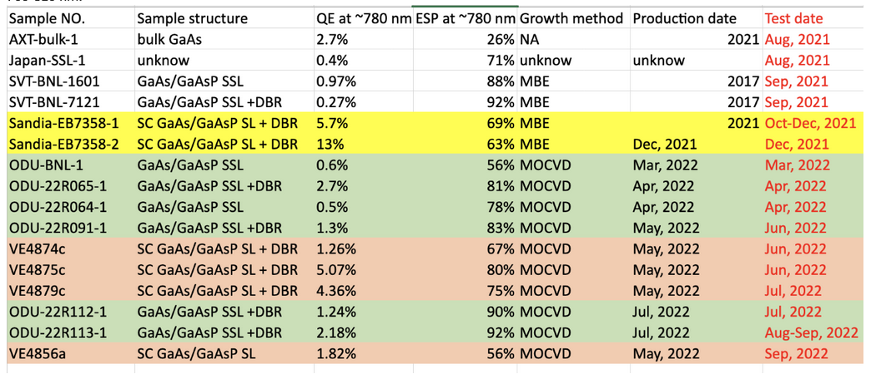
Measurements made at BNL

Slide 33
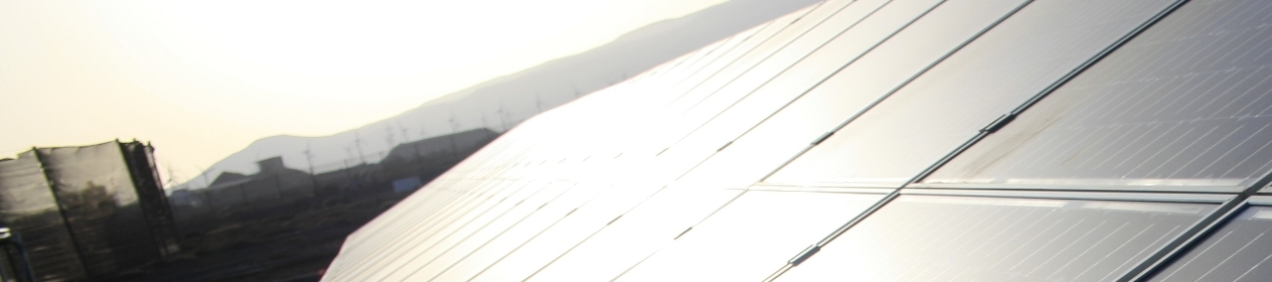
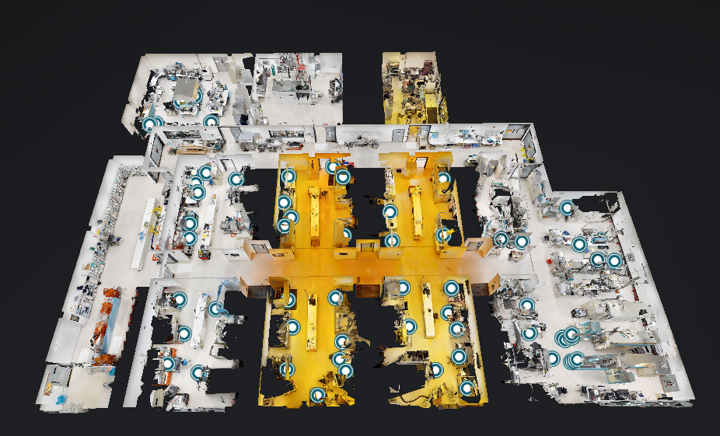
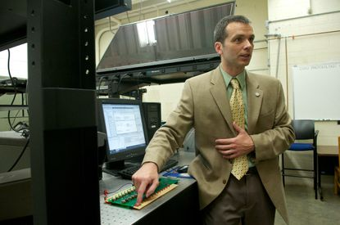
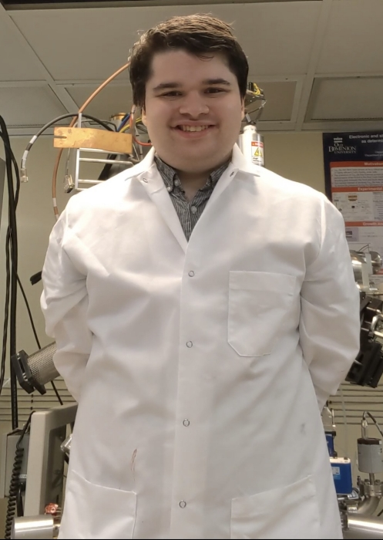
MOCVD: Photocathode progress
Virginia Center for Photovoltaics
The Rochester Institute
of Technology
III-V EPICenter
Dr. Sylvain Marsillac,
Old Dominion University
Ben Belfore
ODU Graduate
Student

Slide 34
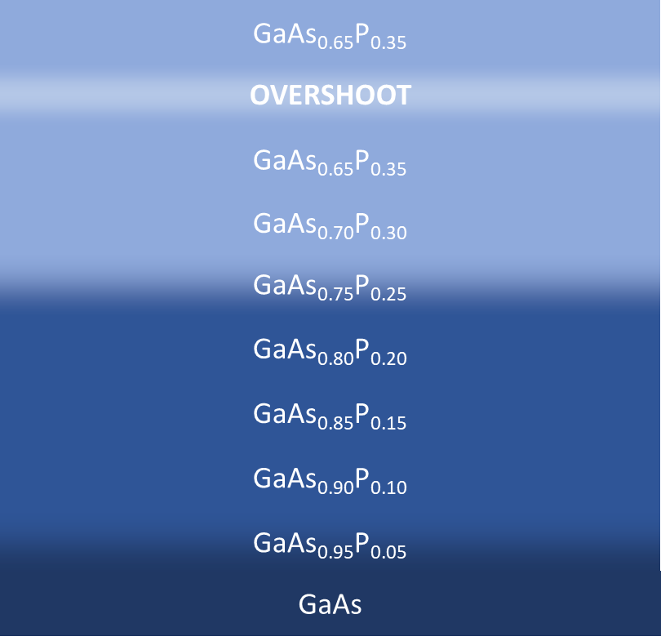
Results: Metamorphic Grading
High-quality strain relaxation of underlying layers is key to getting intended GaAs strain in the emitting region
Necessary because of growing on lattice mismatched substrate
RSM used to characterize extent of relaxation in metamorphic layers
Key parameters changed:
  Growth Rate
  Growth Temperature
  Arsine/Phosphine Ratio

Slide 35
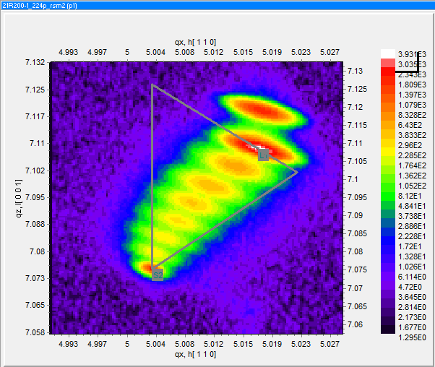
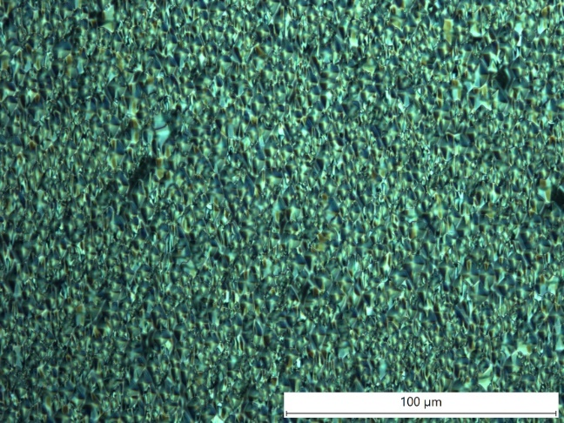
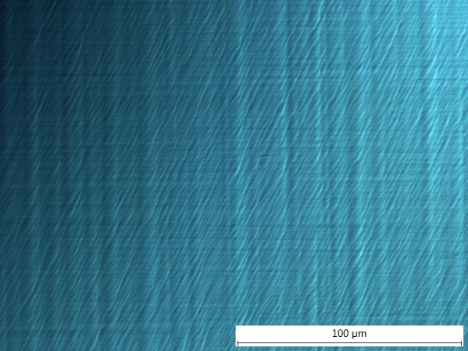
Results: Metamorphic Grading
Slower Growth Rate resulted in highest strained films (left)
High Temperature with smaller composition change between steps is more promising (right)
3μm/hr 730ºC Growth Temp
10μm/hr 650ºC lower phosphorous grade

Slide 36
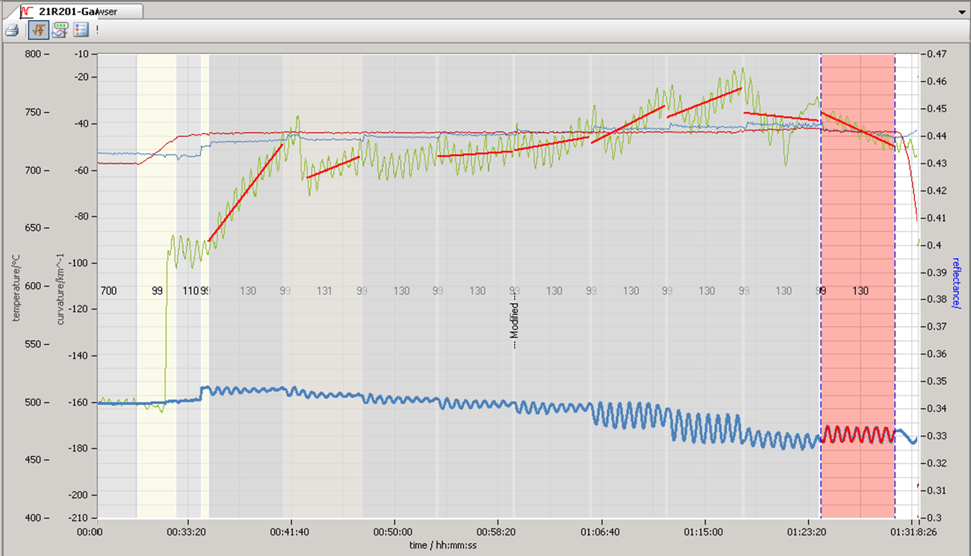
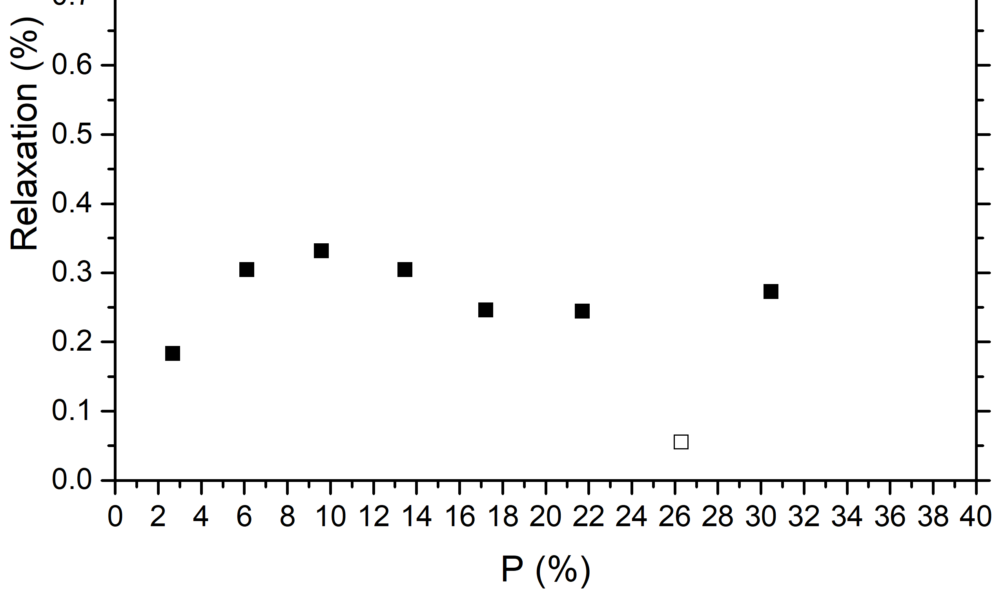
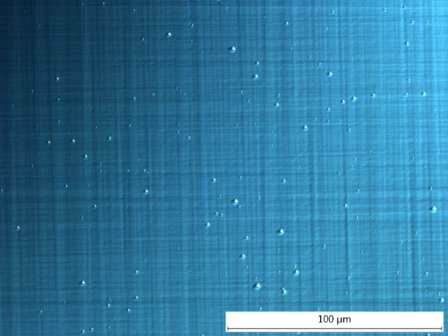
Results: MOCVD
GaAs
GaAs(0.74)P(0.26)
Graded GaAs to GaAsPx layer growth:
Strain in GaAsPx varies with substrate temperature
Higher temperatures yielded improved surface with moderate relaxation throughout
Optimizing temperatures,
graded layer profile
730°C growth temperature
100 um

Slide 37
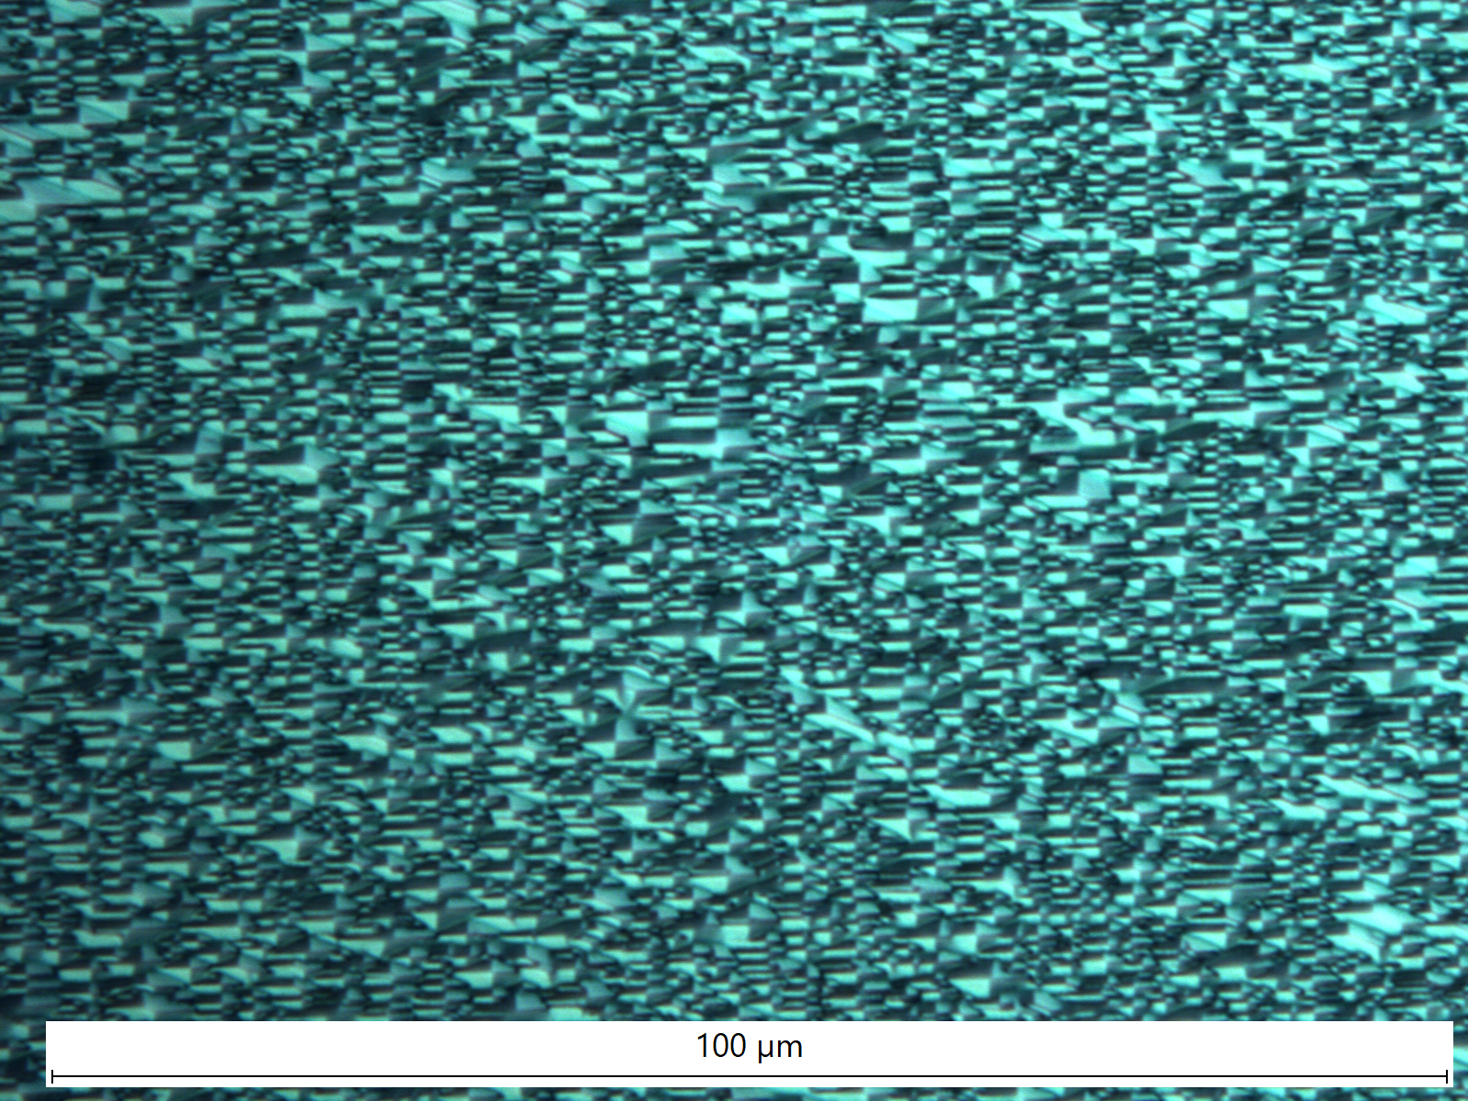
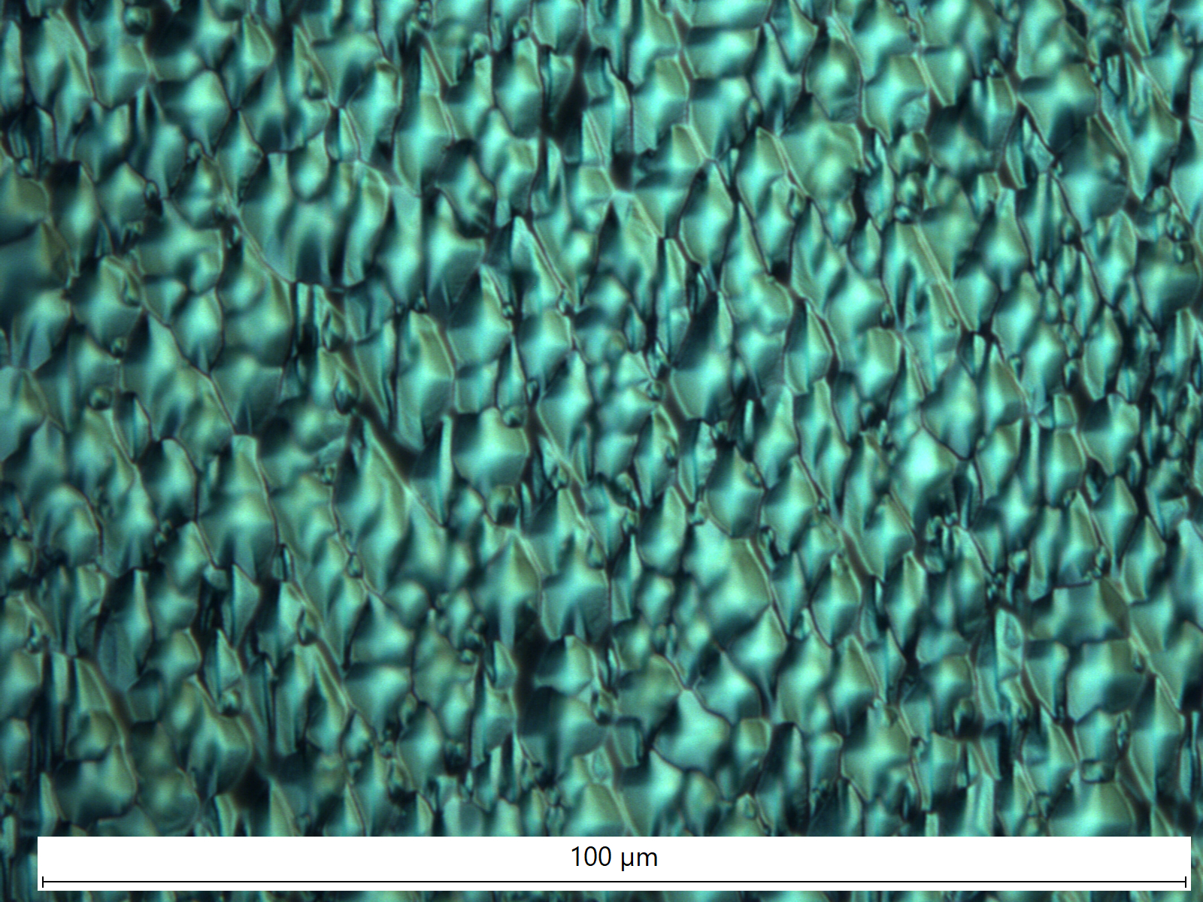
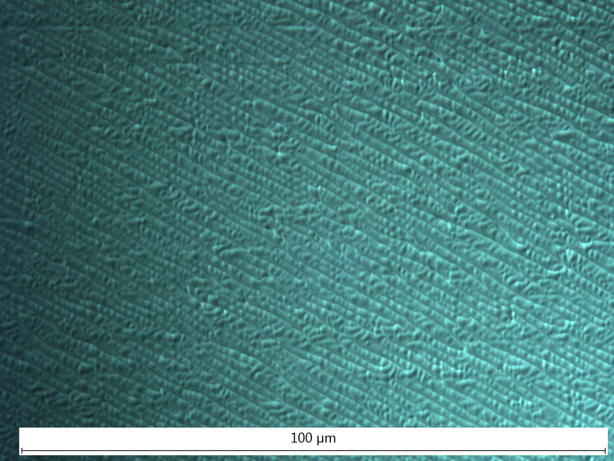
Results: Device Continued
Surface quality initially poor but subsequent runs improved surface quality
Refining runs to improve relaxation
Surface completely matted, RSM not performed
10μm/hr 650ºC Growth Temp
3μm/hr 730ºC Growth Temp
10μm/hr 730ºC Growth Temp
PL Map taken on this sample

Slide 38
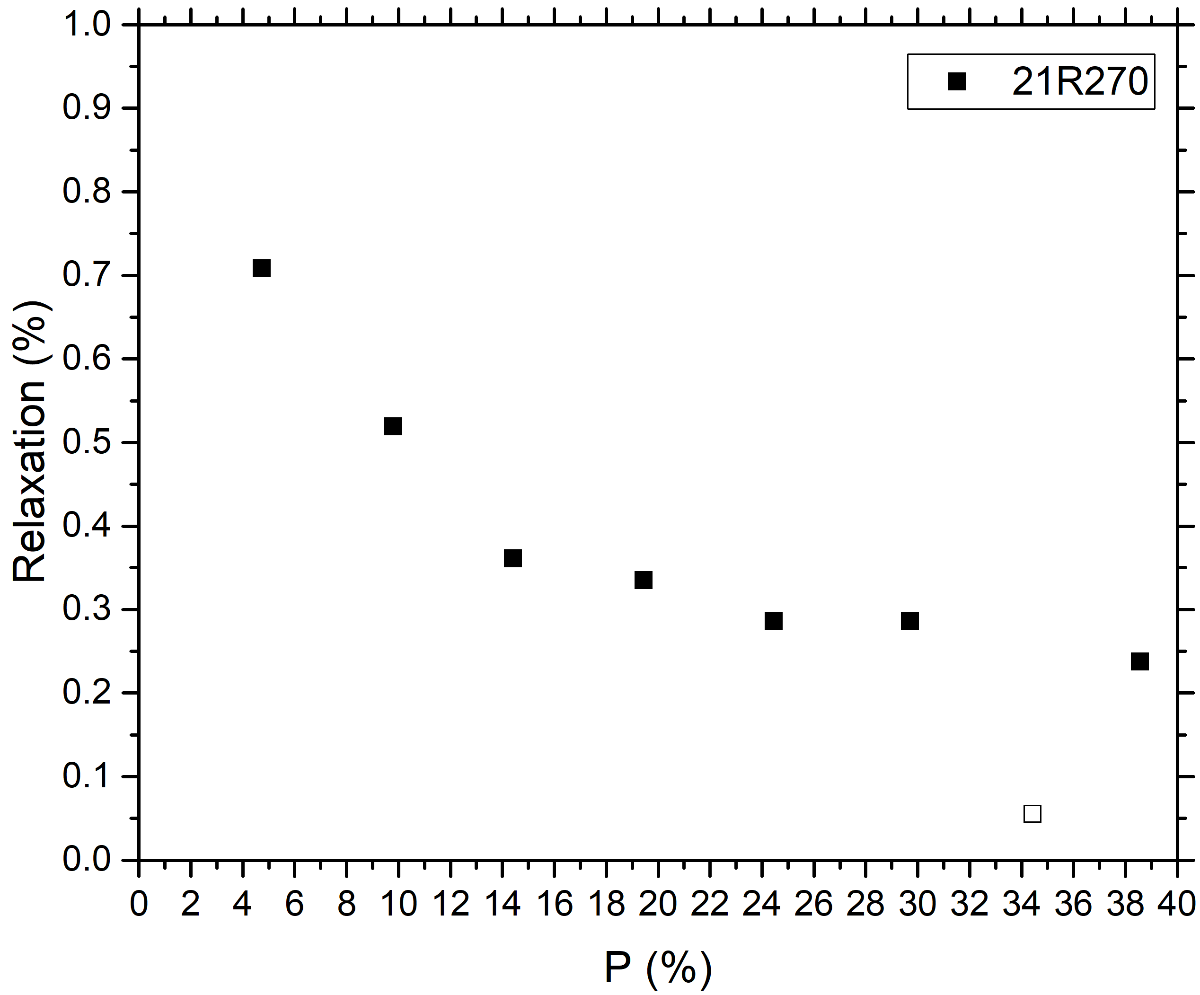
MOCVD monitoring: graded layer optimization
(100) 2° <110>
Higher temperature and higher ΔP steps begins well, levels out to 30% relaxation, and surface degrades during thick 35% buffer
Average ΔP = 4.95%
Ends at ~34.4 % P
~10 µm/hr graded layer growth rate
V/III: 20-25
730°C growth temperature

Slide 39
Making polarized electron beams with GaAs
Bulk GaAs – no strain
Strained GaAs
m _{j} = -1/2
+1/2
m _{j} = -1/2
+1/2
σ⁺
σ ⁻
σ⁺
σ ⁻
3
3
3
3
1
1
m _{j} = -3/2
-1/2
+1/2
+3/2
m _{j} = -3/2
+3/2
-1/2
+1/2
m _{j} = -1/2
+1/2
m _{j} = -1/2
+1/2
Maximum Polarization 50%
Maximum Polarization 100%

