Slide 1
300 kV gun GPT simulations sphere with long anode GTS beam parameters, Spacecharge ON
Gabriel Palacios
gabrielp@jlab.org 08/28/18

Slide 2
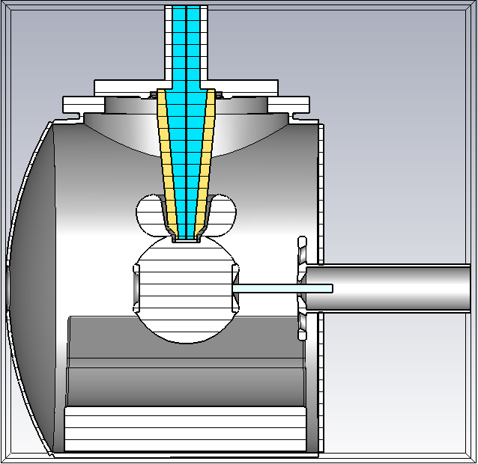
Outline
Is it the cathode-anode gap fields?
Is it the photocathode fields?
Maybe an elliptical beam?
Is GPT doing something weird?
Maybe the bunch charge?

Slide 3
Solidworks: GTS with long anode
Gun is operated at 200kV for Yan’s results
Long anode
9 cm cathode-anode gap
Space charge on
1000 particles
Qbunch 20 fC
Laser RMS spotsize xyrms=0.351E-3 m
Trms=21.27 ps
Mean transverse energy 0.143E-3

Slide 4
Is it the cathode-anode gap fields?
Asymmetry in the “y” direction, acceleration in “z” direction.

Slide 5
Preliminary results: Fields maps
These are @300 kV, but we scaled them to 200 when reading in GPT

Slide 6
Preliminary results: Fields maps
These are @300 kV, but we scaled them to 200 when reading in GPT

Slide 7
Preliminary results: Fields maps
These are @300 kV, but we scaled them to 200 when reading in GPT

Slide 8
Is it the photocathode fields?
Homogeneous on the photocathode surface, dominated by Pierce geometry as expected. Asymmetry becomes noticeable when we move away from the surface.

Slide 9
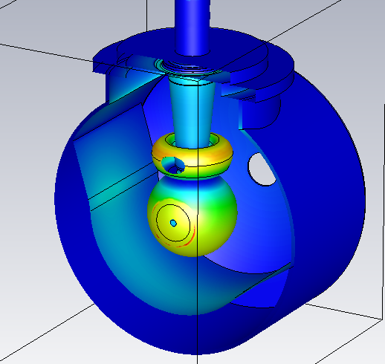
Preliminary results: |E| field on photocathode
Cross section @photocathode surface, front view zoom
Cross section @photocathode surface, isometric view
Cross section @photocathode surface, front view

Slide 10
Preliminary results: |E| field on photocathode
Lateral cross section

Slide 11
Preliminary results: |E| field on photocathode
Along x axis

Slide 12
Preliminary results: |E| field on photocathode
Along y axis

Slide 13
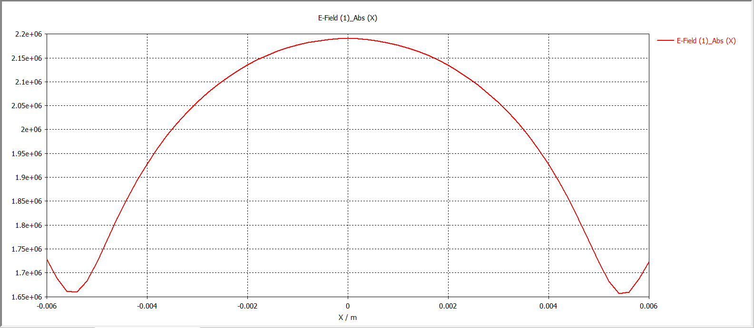
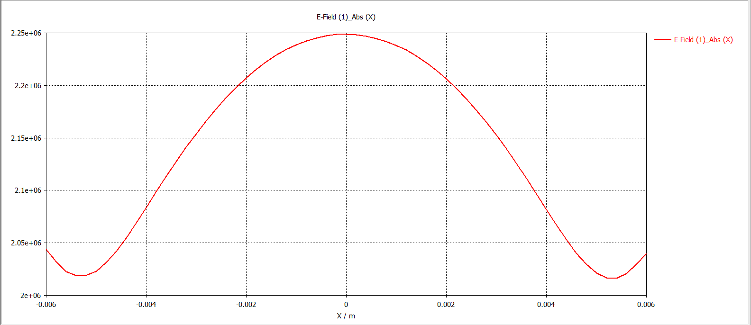
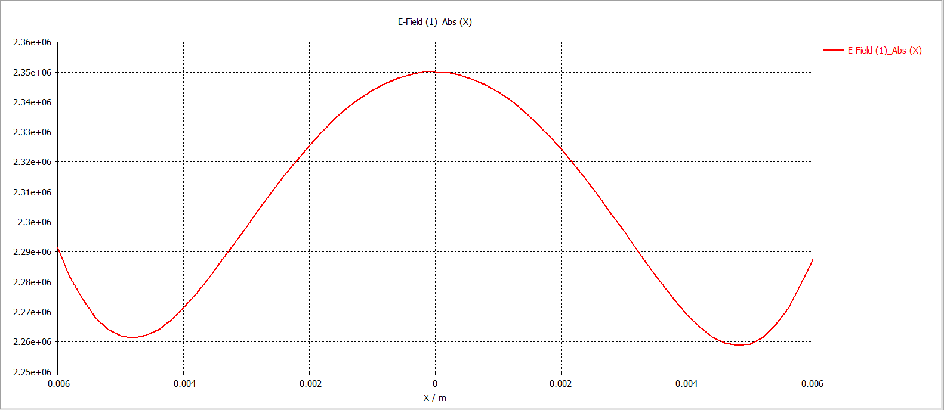
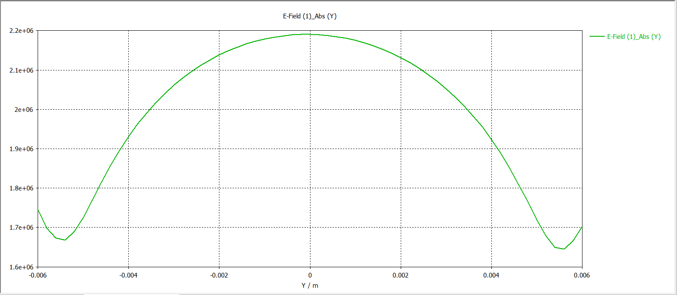
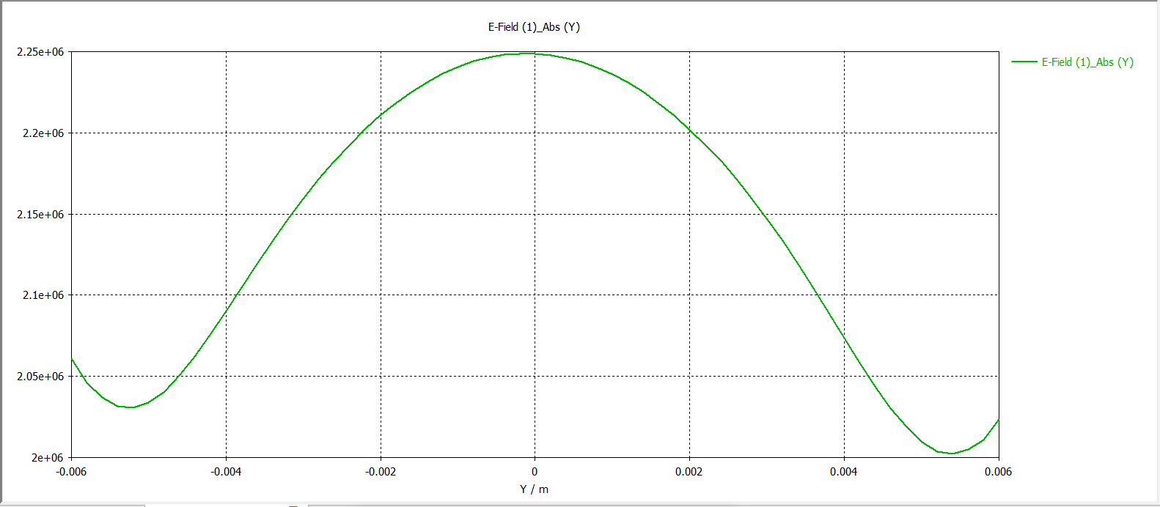
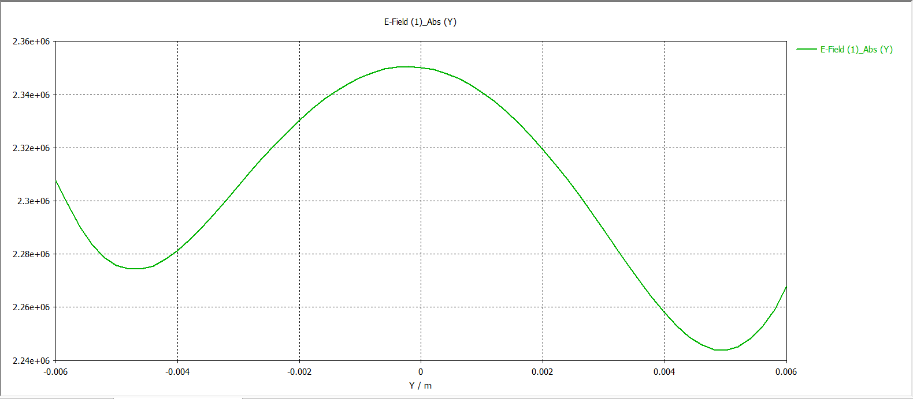
Preliminary results: |E| field
As we move away from the photocathode surface along z-axis.
Z=0.064m
Z=0.065m
Z=0.066m
Red plots are fields along x-axis, green plots are fields along y-axis

Slide 14
Maybe an elliptical beam?
Carlos’ hypothesis. Three metrics for beam distribution: Elliptical beam, uniform, Gaussian

Slide 15
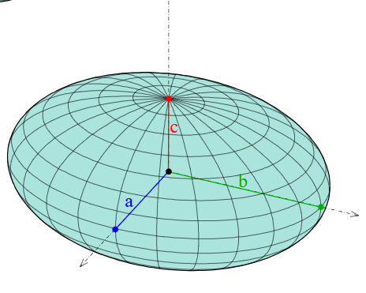
Preliminary results: Normalized emittance
HERE THE ELLIPTICAL BEAM
Click here for excel plots
z
Beam
direction
y
x

Slide 16
Preliminary results: STDX & STDY VS Z
HERE THE ELLIPTICAL BEAM IS UNIFORM
Click here for excel plots
z
Beam
direction
y
x

Slide 17
Preliminary results: Normalized emittance
HERE THE ELLIPTICAL BEAM HEIGHT IS SCALED BY A FACTOR OF 0.75
Click here for excel plots
z
Beam
direction
y
x

Slide 18
Preliminary results: STDX & STDY VS Z
HERE THE ELLIPTICAL BEAM HEIGHT IS SCALED BY A FACTOR OF 0.75
Click here for excel plots
z
Beam
direction
y
x

Slide 19
Preliminary results: Normalized emittance
HERE THE ELLIPTICAL BEAM HEIGHT IS SCALED BY A FACTOR OF 0.5
Click here for excel plots
z
Beam
direction
y
x

Slide 20
Preliminary results: STDX & STDY VS Z
HERE THE ELLIPTICAL BEAM HEIGHT IS SCALED BY A FACTOR OF 0.5
Click here for excel plots
z
Beam
direction
y
x

Slide 21
Is GPT doing something weird?
Flipping the electric field maps shows that GPT is not doing anything in “x” that does not do in “y”

Slide 22
Mirrored Field maps

Slide 23
Preliminary results: Normalized emittance

Slide 24
Maybe the bunch charge?
Just throwing it out there

Slide 25
Preliminary results: Normalized emittance
Bunch charge @ 40 fC
Click here for excel plots

Slide 26
Preliminary results: STDX & STDY VS Z
Bunch charge @ 40 fC
Click here for excel plots

Slide 27
Preliminary results: Normalized emittance
Bunch charge @ 100 fC
Click here for excel plots

Slide 28
Preliminary results: STDX & STDY VS Z
Bunch charge @ 100 fC
Click here for excel plots

Slide 29
Preliminary results
Three metrics: gaussian, Elliptical, uniform

Slide 30
Normalized emittance

Slide 31
Normalized emittance

Slide 32
Normalized emittance

Slide 33
Preliminary results
metrics: gaussian, Elliptical, elliptical scaled

Slide 34
Normalized emittance

Slide 35
Normalized emittance

Slide 36
Normalized emittance

Slide 37
Preliminary results
Metrics: Gaussian at different bunch charges

Slide 38
Normalized emittance

Slide 39
Normalized emittance

Slide 40
Normalized emittance

Slide 41
Preliminary results
All metrics

Slide 42
Normalized emittance: all

Slide 43
Normalized emittance: all

Slide 44
Normalized emittance: all

Slide 45
Preliminary results
Three metrics: gaussian, Elliptical, uniform

Slide 46
Emittance stdx

Slide 47
Emittance stdy

Slide 48
Emittance

Slide 49
Preliminary results
metrics: gaussian, Elliptical, elliptical scaled

Slide 50
Emittance stdx

Slide 51
Emittance stdy

Slide 52
Emittance

Slide 53
Preliminary results
Metrics: Gaussian at different bunch charges

Slide 54
Emittance stdx

Slide 55
Emittance stdy

Slide 56
Emittance

Slide 57
Preliminary results
All metrics

Slide 58
Emittance stdx

Slide 59
Emittance stdy

Slide 60
Emittance

Slide 61
Fin.

