Slide 1
Bunch length and energy dispersion
c. valerio

Slide 2
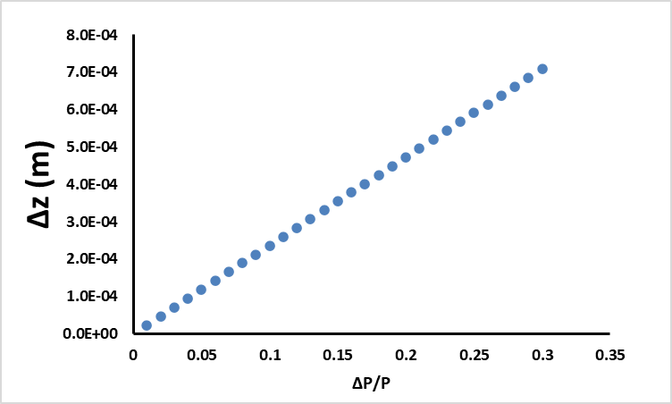
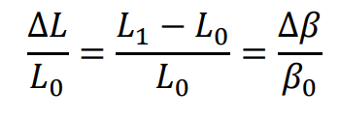
Bunch length on drift and magnet matrix approximation
Dispersion for KEo=10 MeV
Drift 1 m
0.4 degrees at 500 MHz

Slide 3
Transversal momentum effect
Input beam
Uniform distribution with +- 2 mm.
Bunch length=0
The ratio between the longitudinal and transversal momentum dominates the bunch length.

Slide 4
Bunch length evolution

Slide 5
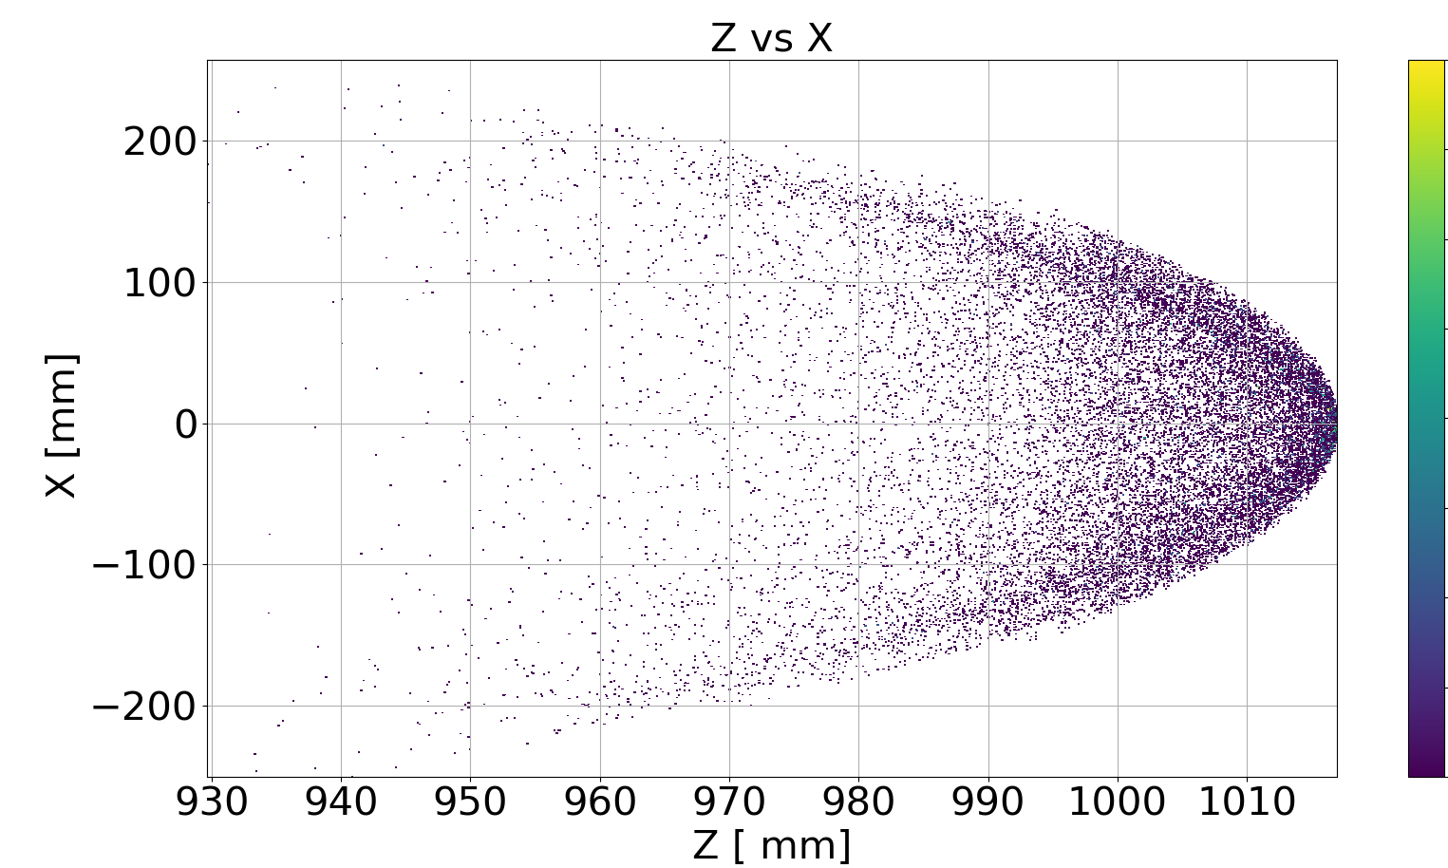
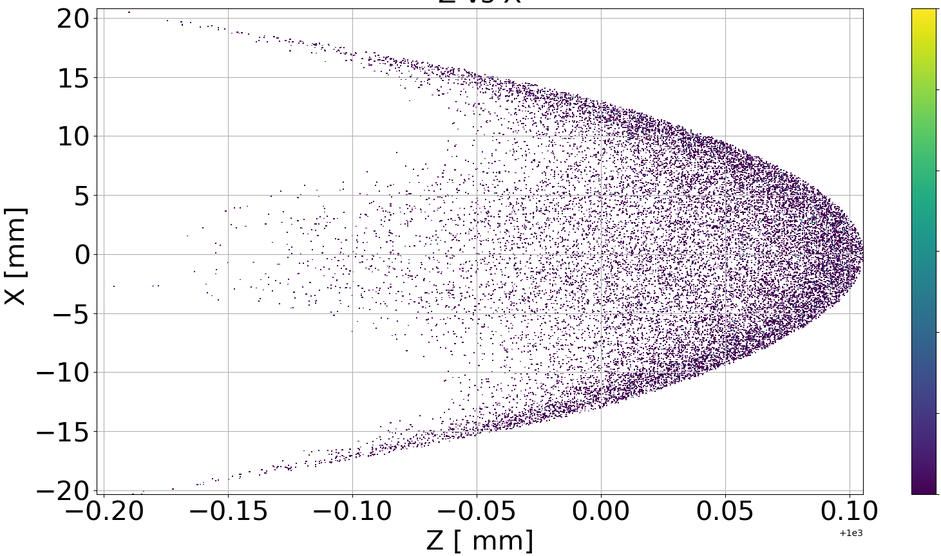
Beam size 80 MeV
PT=0 MeV
PT=20 MeV

Slide 6
Magnetic field

Slide 7
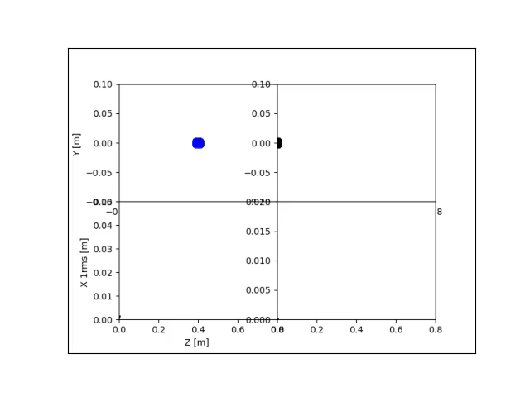
Gdf processing
Work in progress

