Slide 1
UITF: T-cathode and Small shield
Experimental data @200 [kV]
07/22/2019
Gabriel Palacios

Slide 2
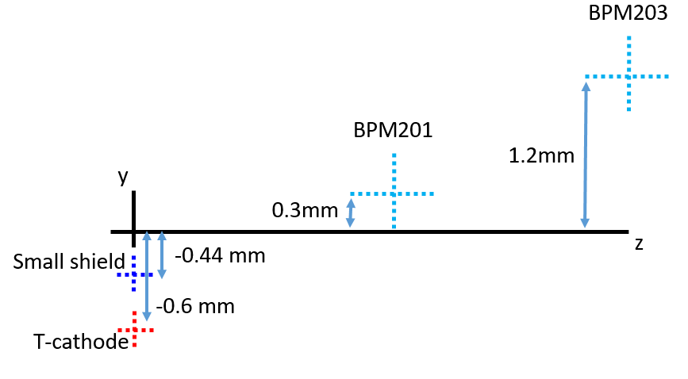
S&A offsets table
S&A offsets along vertical axis
BFS coordinates for both
 | X [mm] | Y [mm]
T-cathode (PC face) | 9.056* | -0.6
Small shield (PC face) | 9.13 ± 0.074 | -0.44
BPM201 | 12.6 | 0.3
BPM203 | 3.6 | 1.2
*calculated

Slide 3
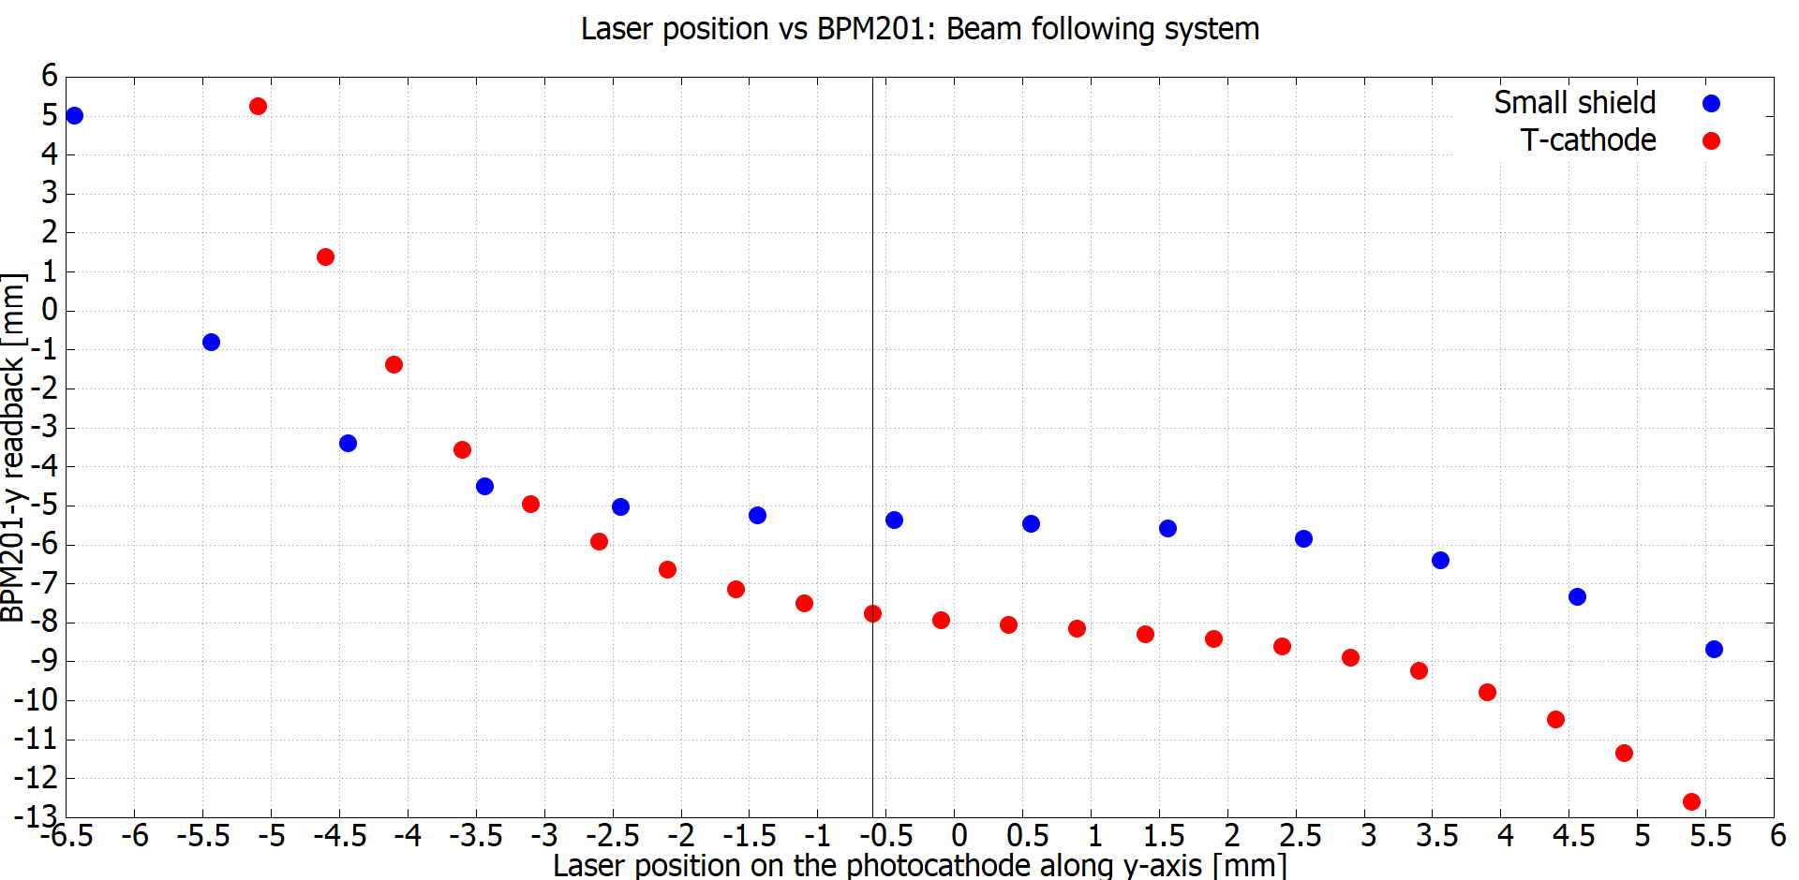
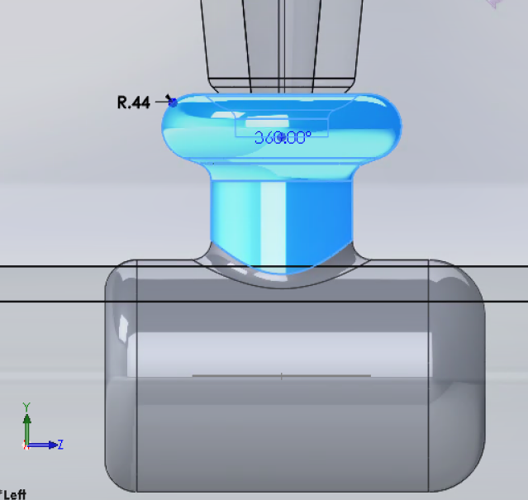
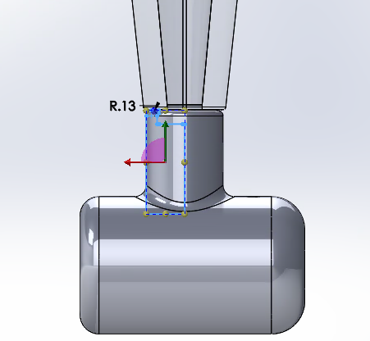
Vertically: Small shield seems to deflect beam less than T-cathode
Vertical deflection for both electrodes in the BFS
2 [mm]
0.9 [mm]
2.4 [mm]
2.7 [mm]
BPM201 linear response
BPM203 linear response

Slide 4
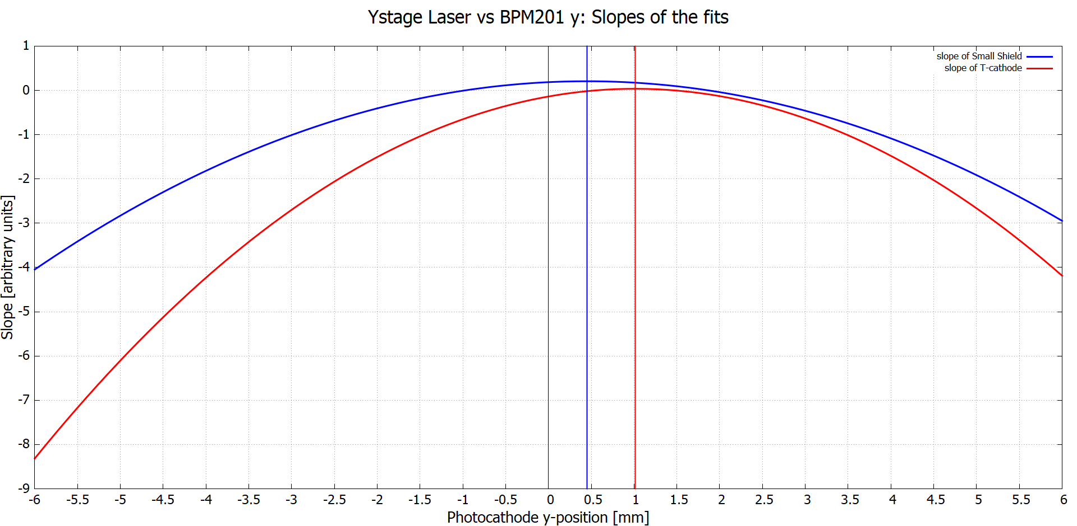
Arrows are zero-crossings

Slide 5
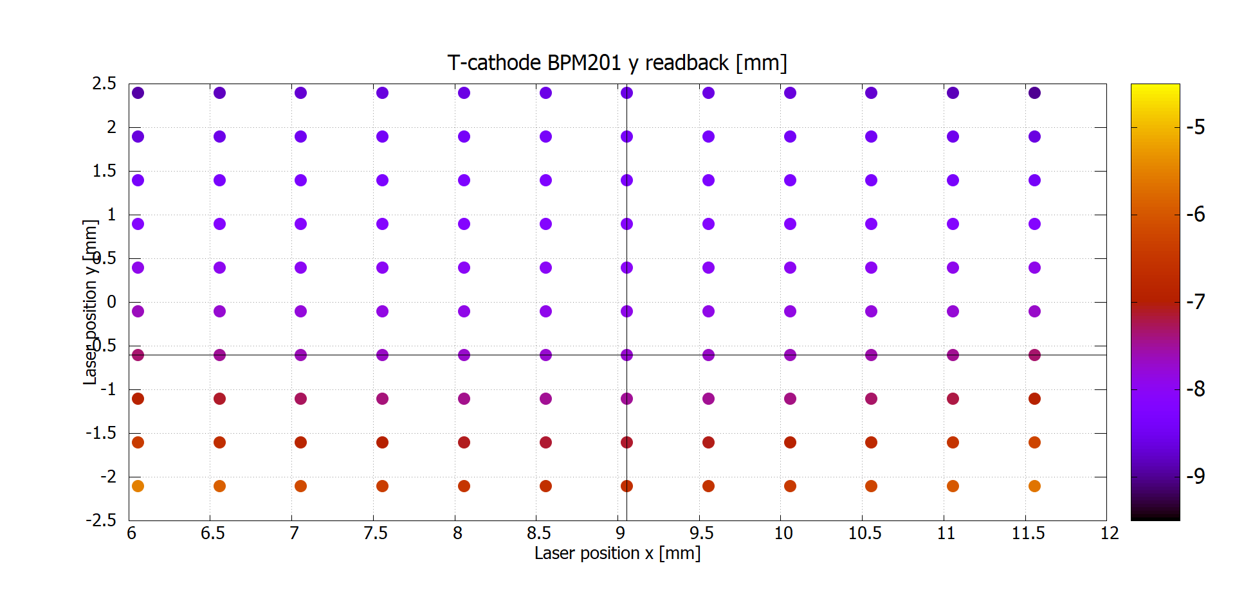
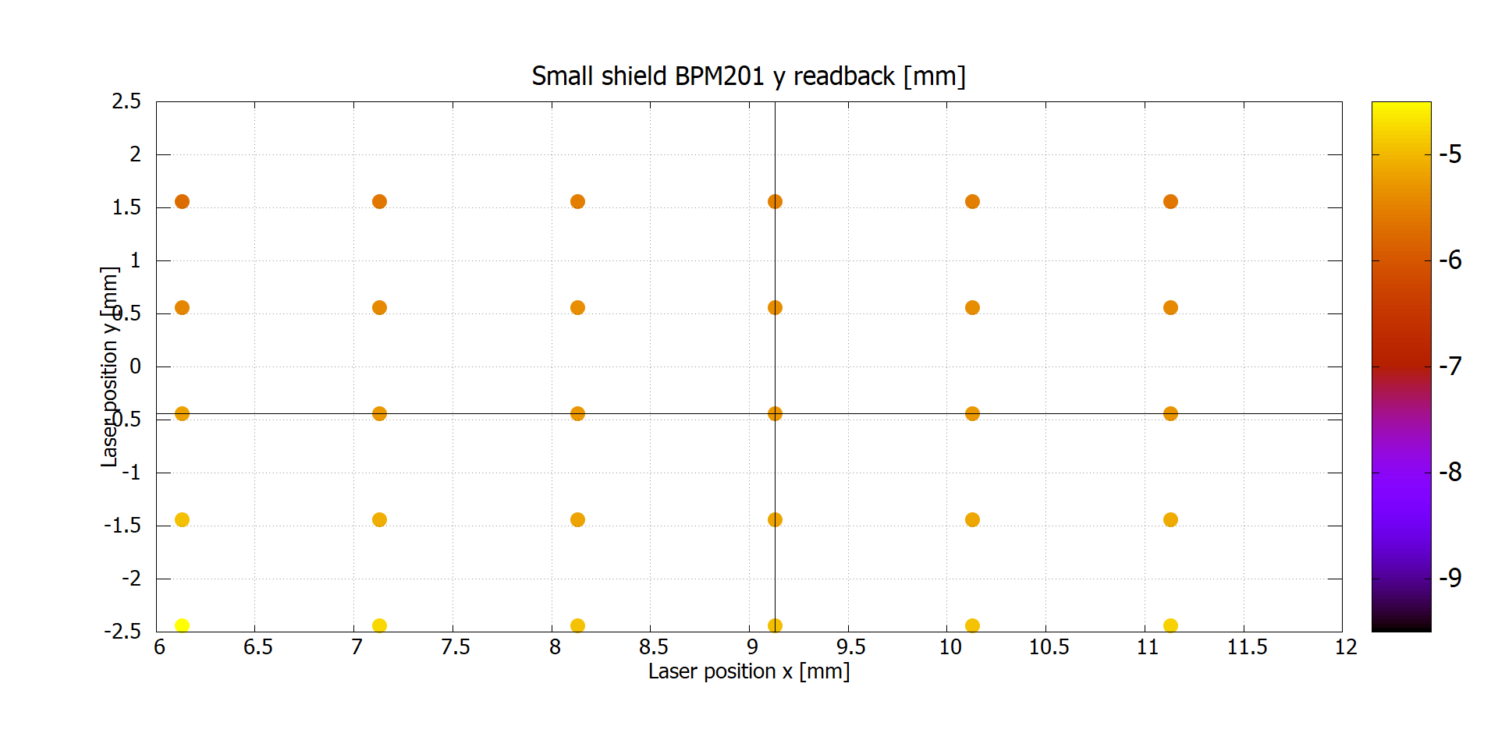
Color indicates vertical deflection with respect to BFS
Photocathode center in BFS: x=9.056 [mm], y= -0.6 [mm]
BPM201 vertical read-back [mm]
Photocathode
Mapping region
5 [mm]
6 [mm]
Photocathode center in BFS: x=9.13 [mm], y= -0.44 [mm]
BPM201 vertical read-back [mm]

Slide 6
Color indicates vertical deflection with respect to BFS
T-cathode
BPM201 vertical read-back [mm]

Slide 7
Color indicates vertical deflection with respect to BFS
Small shield
BPM201 vertical read-back [mm]

Slide 8
Recall: Field maps
Substraction?

Slide 9
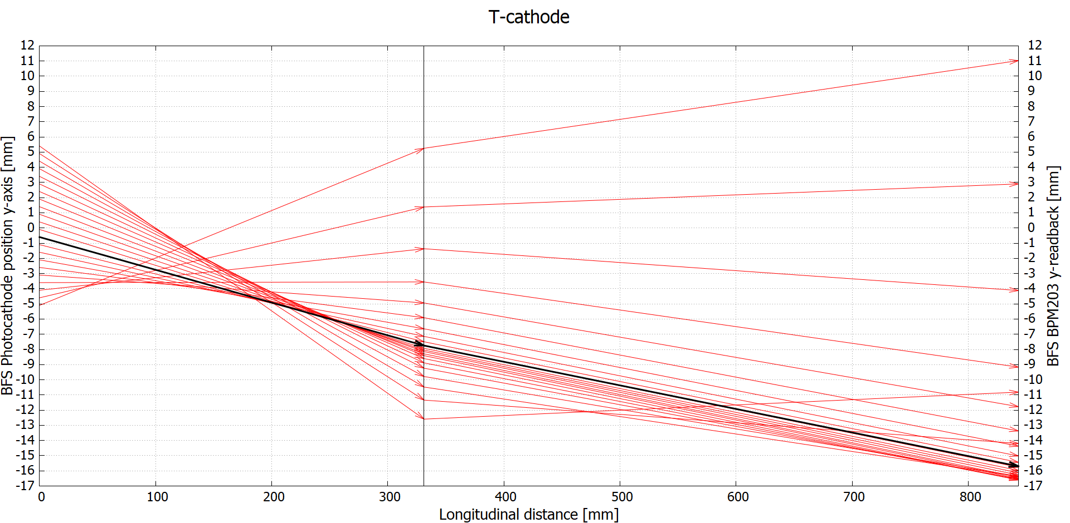
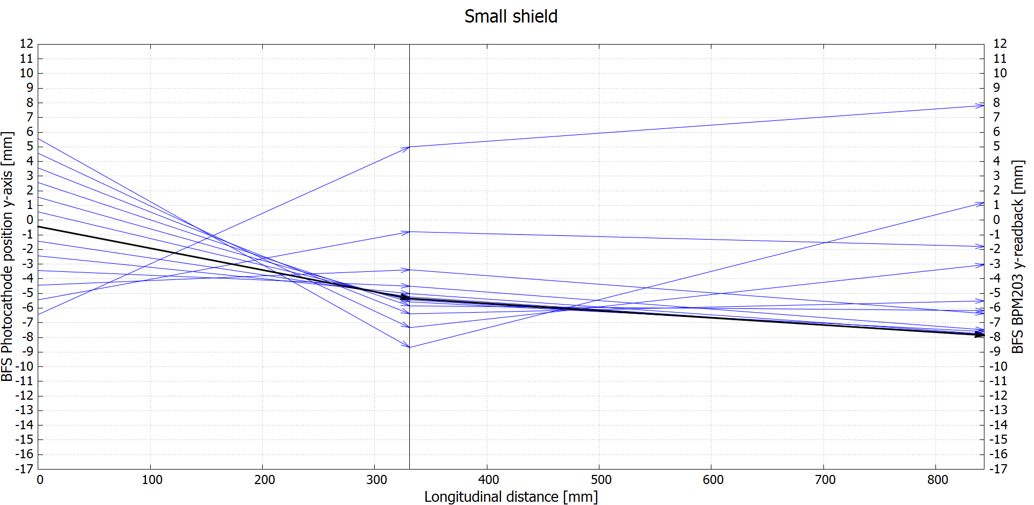
BPM201
These plots show vectors that connect a point on the photocathode at z=0 [mm], to its corresponding read-back at the BPM201 at z= 331.2 [mm], to the corresponding read-back at the BPM203 at z=843.2 [mm].
The dashed boxes are the linear response regions for the corresponding BPM.
BPM201

Slide 10
BPM201
Linear response region

Slide 11
BPM201
Linear response region

Slide 12
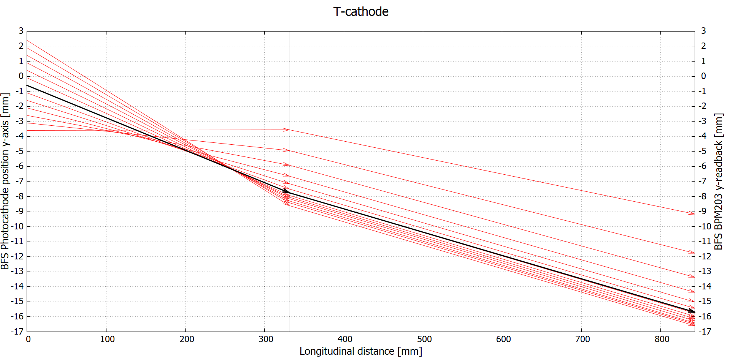
Active area only
BPM201
Most of BPM201 read-backs are outside the linear response region, except the marked ones.
All of BPM203 read-backs are outside the linear response region.

Slide 13
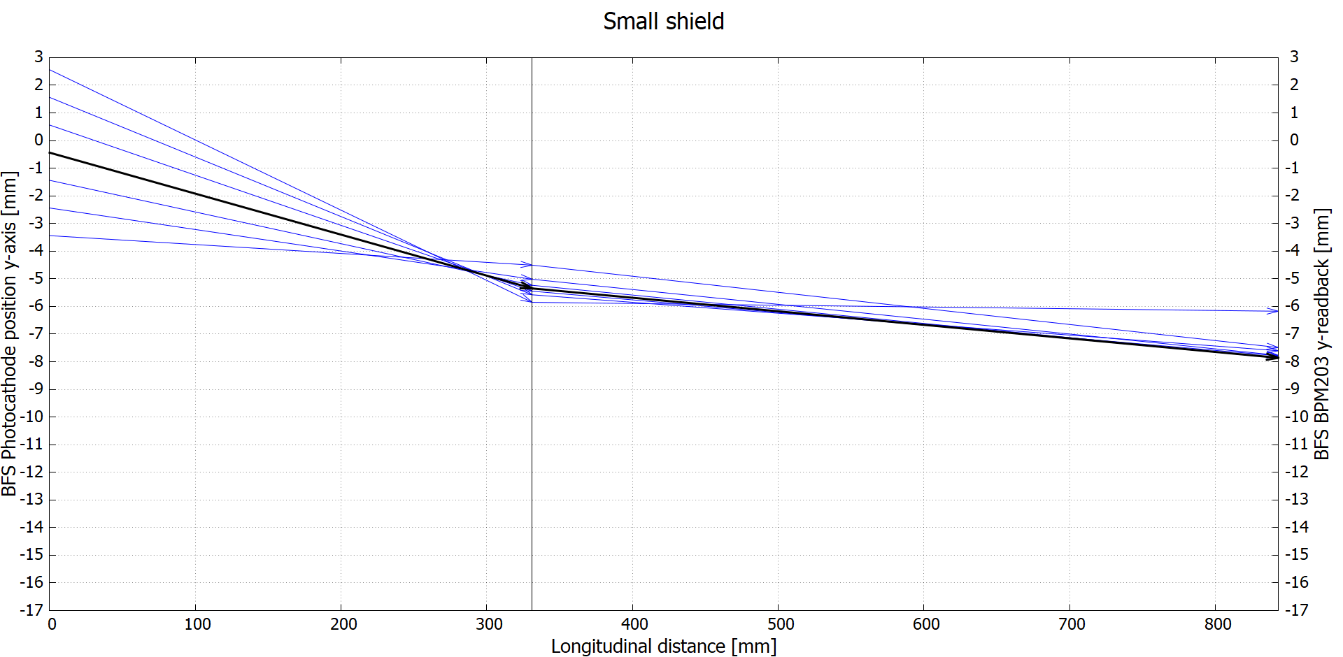
Active area only
BPM201
All of BPM201 read-backs are inside the linear response region.
All of BPM203 read-backs are outside the linear response region.

Slide 14
BPM201
Active area only
BPM201

Slide 15
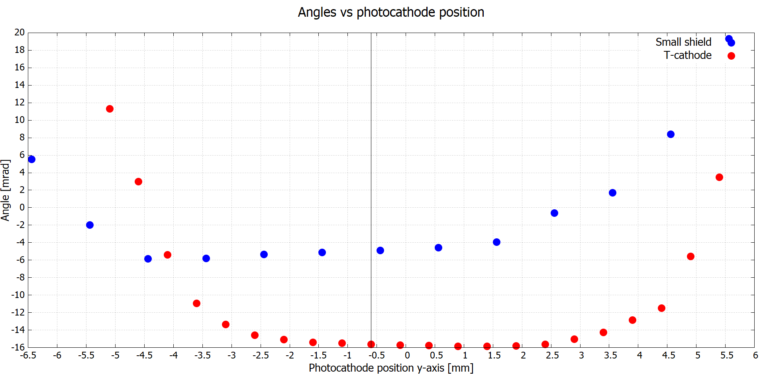

Slide 16
Centered in solenoid lens
How much correction do we need (MBHK101H&V) to center the beam in the first solenoid lens, as we change the position of the beam along the x-axis and y-axis on the photocathode

Slide 17
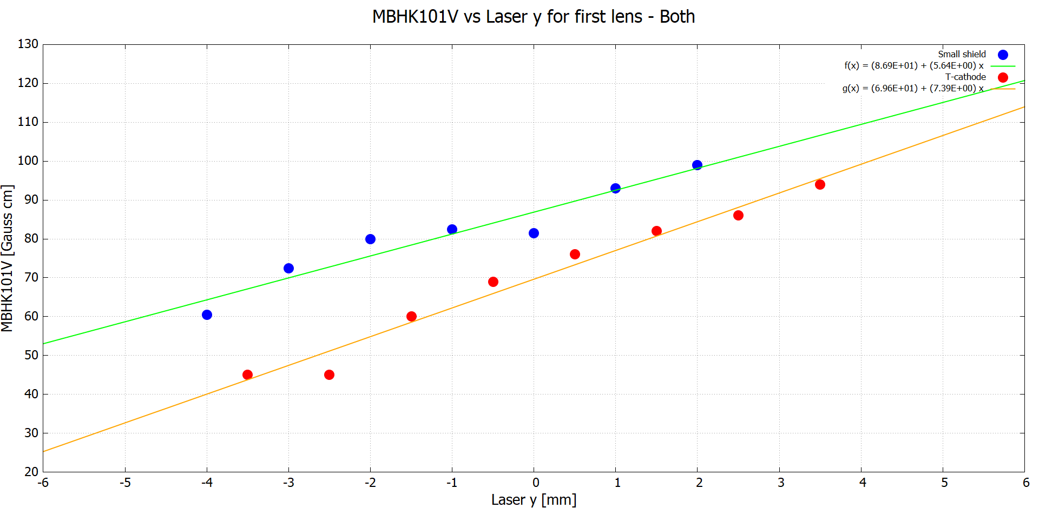
The correct way was: review S&A, for each cathode, then aim laser to respective center, then center in solenoid. Either way this method is cumbersome.
13 [Gauss cm] difference between: 69 and 82
12.6 [Gauss cm] difference between: 98.9 and 86.3
27 [Gauss cm] difference between: 72.6 and 45.0
Notice that for the T-cathode data was not taken at the center, x=-1.5 [mm]

Slide 18
Fin

Slide 19
Extras

Slide 20
Details of experimental data
UITF gun
T-cathode and Small shield both @200 [kV]
Bulk GaAs activated with with Cs and NF₃
Data taken with BPM 201 (on top of corrector 101H&V)
Data taken with first solenoid lens

Slide 21
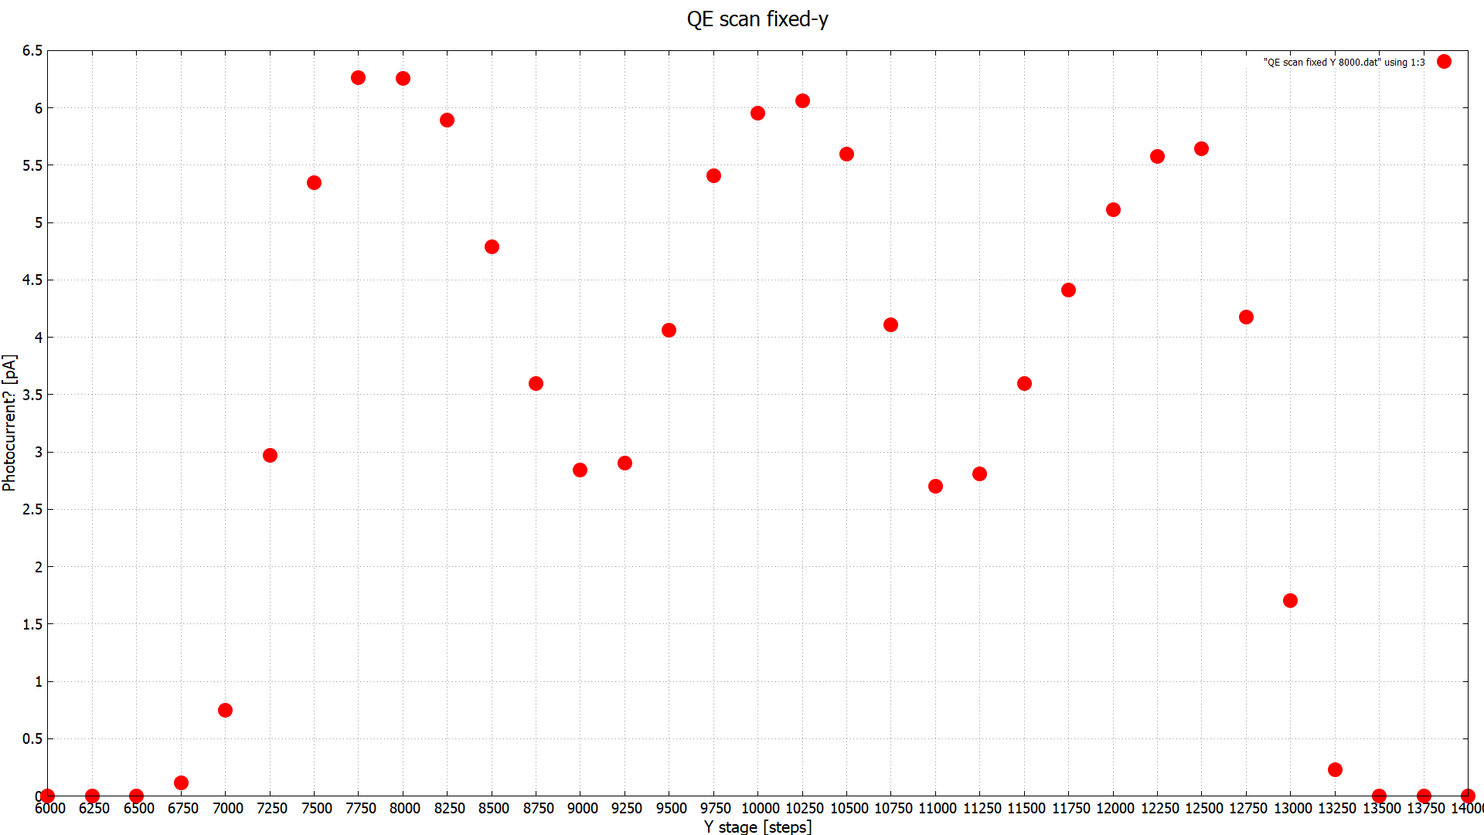
12 [mm] radius photocathode.
6000 [steps] in x-axis
6000 [steps] in y-axis
Then $\frac{12 [mm]}{6000 [steps]}=0.002\frac{[mm]}{[steps]}$
I know this can be done with the scan data,
Bare with me

Slide 22
Correction to T-cathode x-coordinate due to the laser re-adjustment: D=64.262 mm * tan(1.1464 deg)
=1.286 mm
x_SS=x_T + D
= 7.77 mm + 1.286 mm
=9.056 mm
Then:
error=9.13 mm - 9.056 mm
= 0.074 mm
D
α

Slide 23
Corrected positions according to S&A
Corrected to 7.77 by S&A

Slide 24
Corrected positions according to S&A
BPM201
Photocathode
12.6 mm
BPM203
x
7.77 mm
3.6 mm
z

Slide 25
Corrected positions according to S&A
BPM203
BPM201
1.2mm
y
0.3mm
z
0.6 mm
Photocathode

Slide 26
Corrected positions according to S&A
9.056 mm calculated, 9.13 reported
Used as alpha for the T-cathode x-coordinate calculation

Slide 27
Corrected positions according to S&A
BPM201
Photocathode
12.6 mm
BPM203
x
9.13 ± 0.074 mm
3.6 mm
z

Slide 28
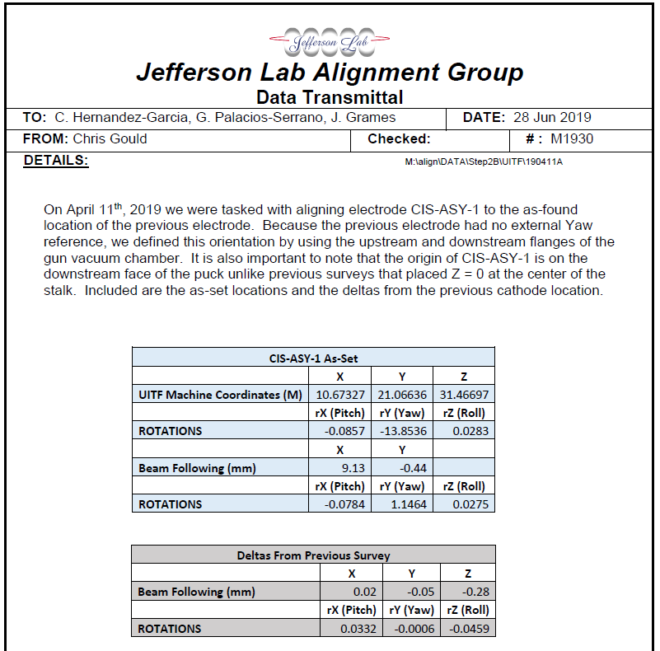
Corrected positions according to S&A
BPM203
BPM201
1.2mm
y
0.3mm
z
-0.44 mm
Photocathode

Slide 29
Corrected positions according to S&A
BPM203
BPM201
1.2mm
y
0.3mm
-0.44 mm
z
Small shield
-0.6 mm
T-cathode

Slide 30
Recall simulations
Just a recap of the simulations

Slide 31
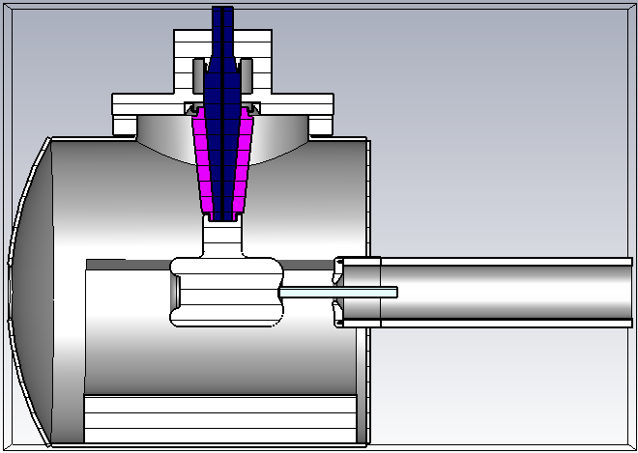
Models: T-cathode

Slide 32
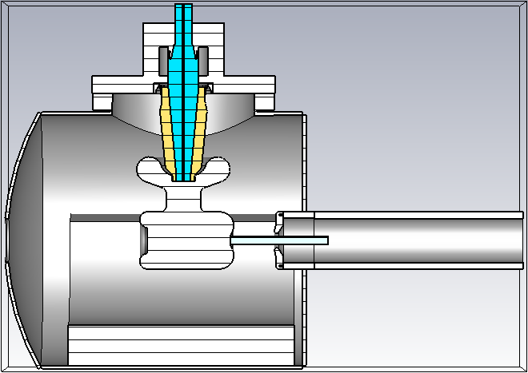
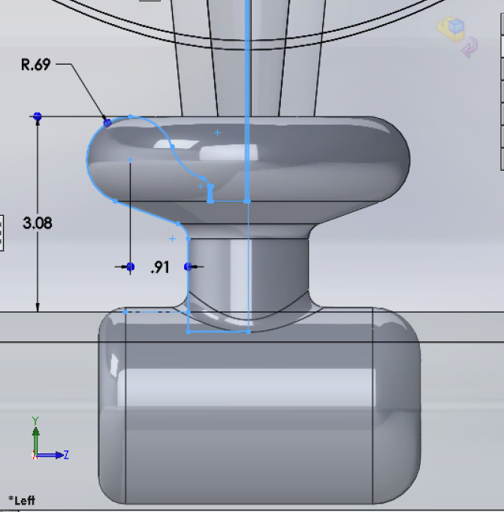
Models: Mushroom

Slide 33
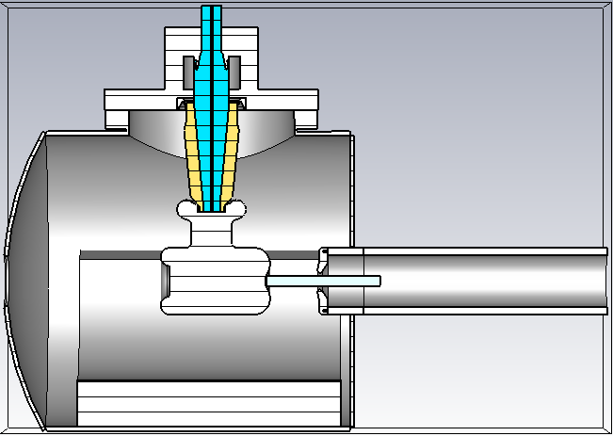
Models: Small mushroom

Slide 34
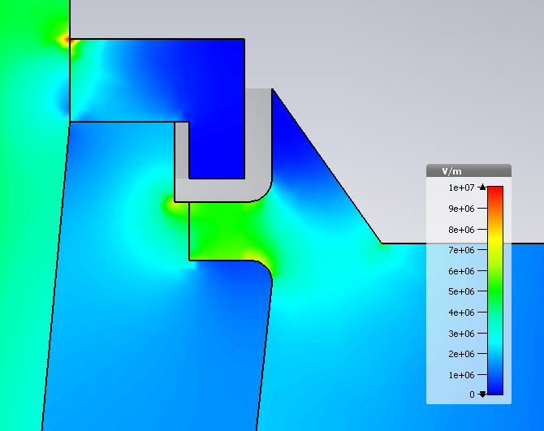
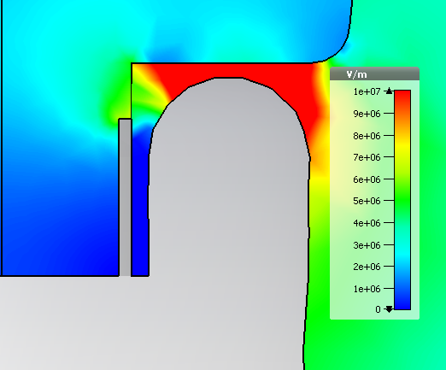
CST results: Electric field norm– No shield
Triple points:
Upper flange:5MV/m
29MV/m at cusp
Triple points:
Cathode: 3.6MV/m
6.5MV/m
7.9MV/m
4.87 MV/m

Slide 35
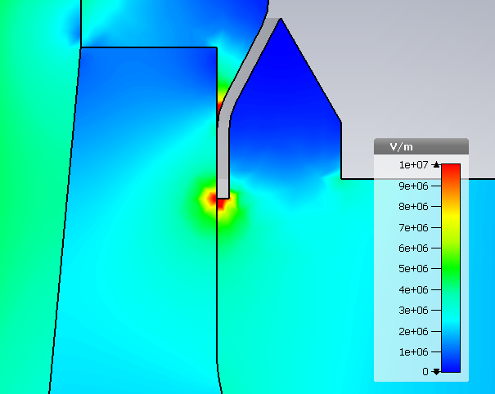
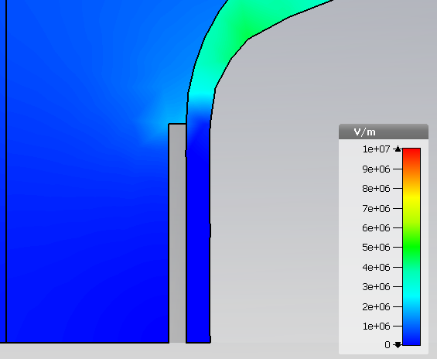
CST results: Electric field norm– original shield
Triple points:
Upper flange:10MV/m
7.2MV/m
5.6MV/m
Triple points:
Cathode: 0.6MV/m
7.9MV/m
4.85 MV/m

Slide 36
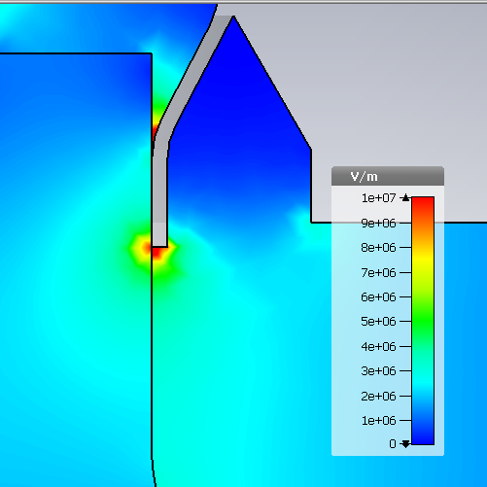
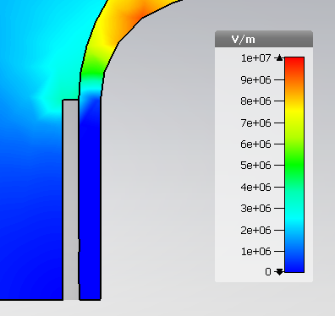
CST results: Electric field norm– Shield 8
Triple points:
Upper flange:11MV/m
7.9MV/m
6.5MV/m
Triple points:
Cathode: 1.2MV/m
8.08MV/m
4.86 MV/m

Slide 37
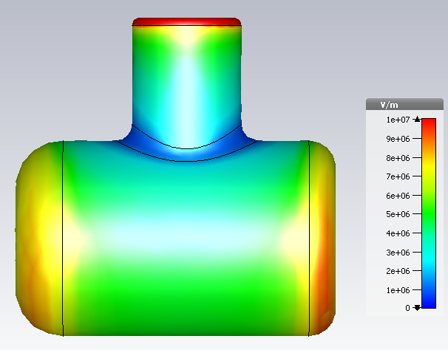
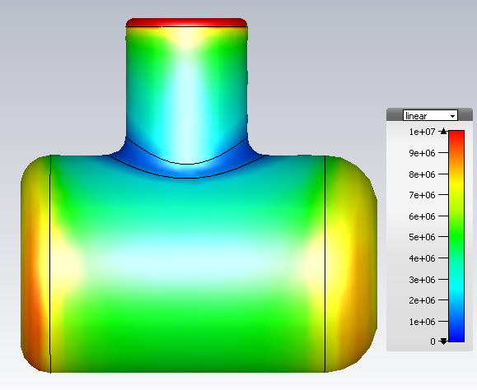
CST results: Electric field norm– T-shape

Slide 38
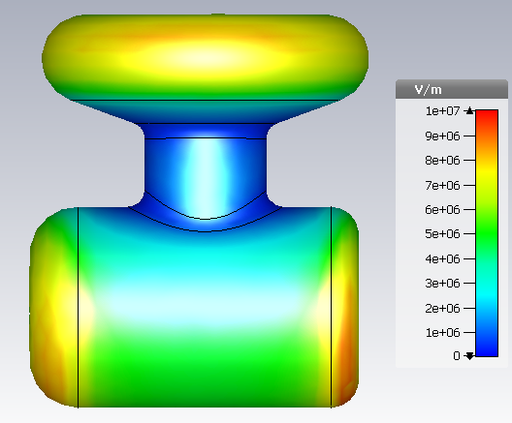
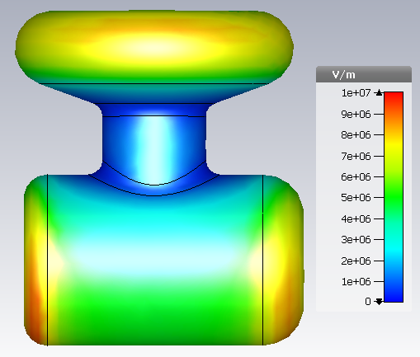
CST results: Electric field norm– Mushroom

Slide 39
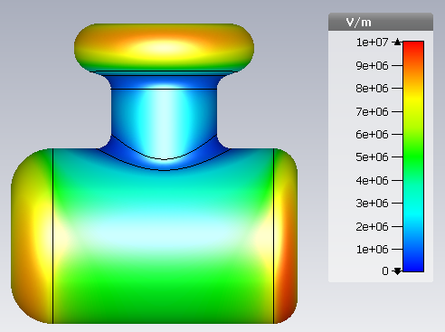
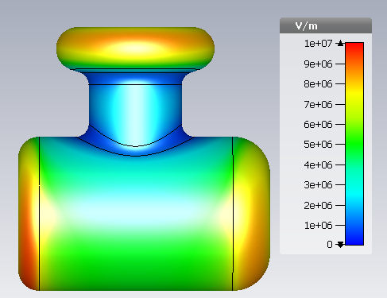
CST results: Electric field norm– Shield 8

Slide 40
CST results: Transverse electric field – T-shape
The different colors show how the transverse electric field changes as a function of height on the photocathode in the interval -6mm<y<6mm along a horizontal line in the cathode-anode gap
0.252 gap between 0.21 and -0.042
Note: offset in z due to CST model photocathode not in 0,0 coordinates

Slide 41
CST results: Transverse electric field – Small mushroom
The different colors show how the transverse electric field changes as a function of height on the photocathode in the interval -6mm<y<6mm along a horizontal line in the cathode-anode gap
0.257 gap between 0.22 and -0.037
Note: offset in z due to CST model photocathode not in 0,0 coordinates

Slide 42
CST results: Transverse electric field at C-a gap axis
All the data sets correspond to the center line in the cathode-anode gap. Different colors represent different shields.
0.176
~52.8% difference between 0.176 and 0.083
0.108
0.083
~23.14% difference between 0.108 and 0.083

