Slide 1
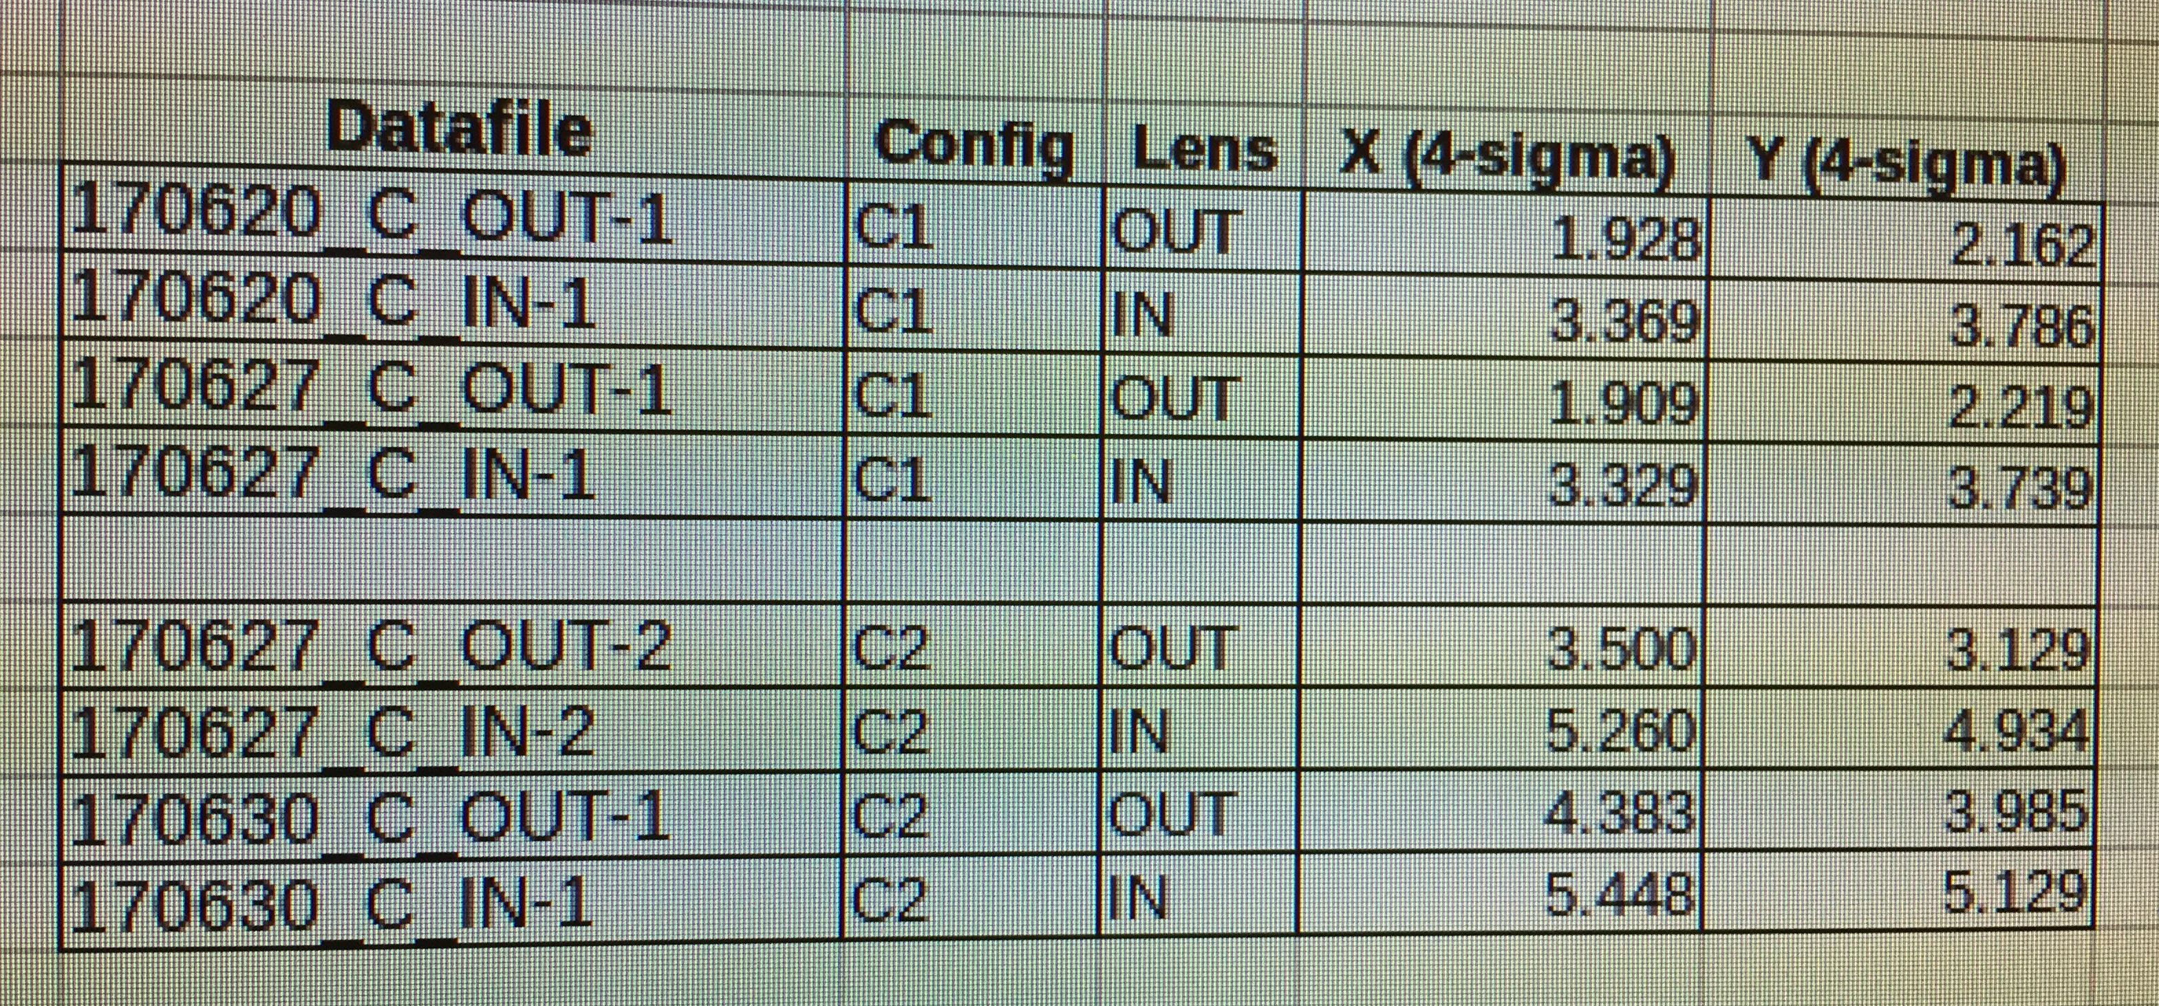
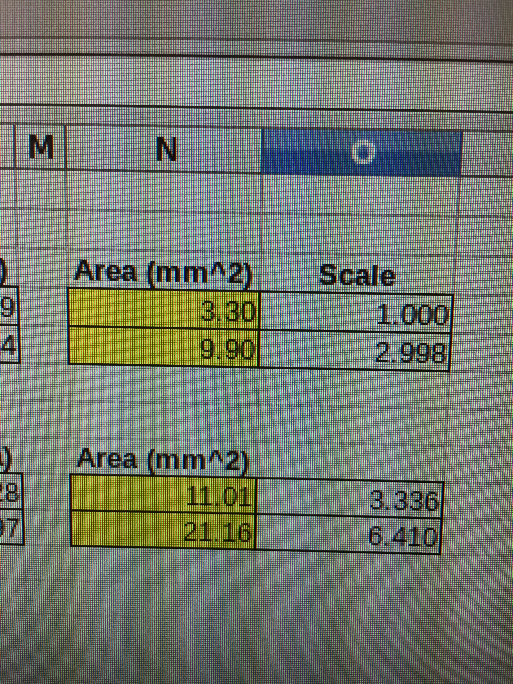
Testing photocathode lifetime and limitations for milli-Ampere operations at CEBAF
May Data – not included yet
June Data – shown today
Photocathode – SLSP-5756-4 (heated/activated twice during June study)
Domain of current – 0.5, 1.0, 1.5, 2.0 mA all at 499 MHz using Hall C laser (the beast!)
Laser spot sizes used – two configurations (C1 and C2), each with two sizes (additional in-line lens OUT and IN)
πσ_{x}σ_{y}

Slide 2
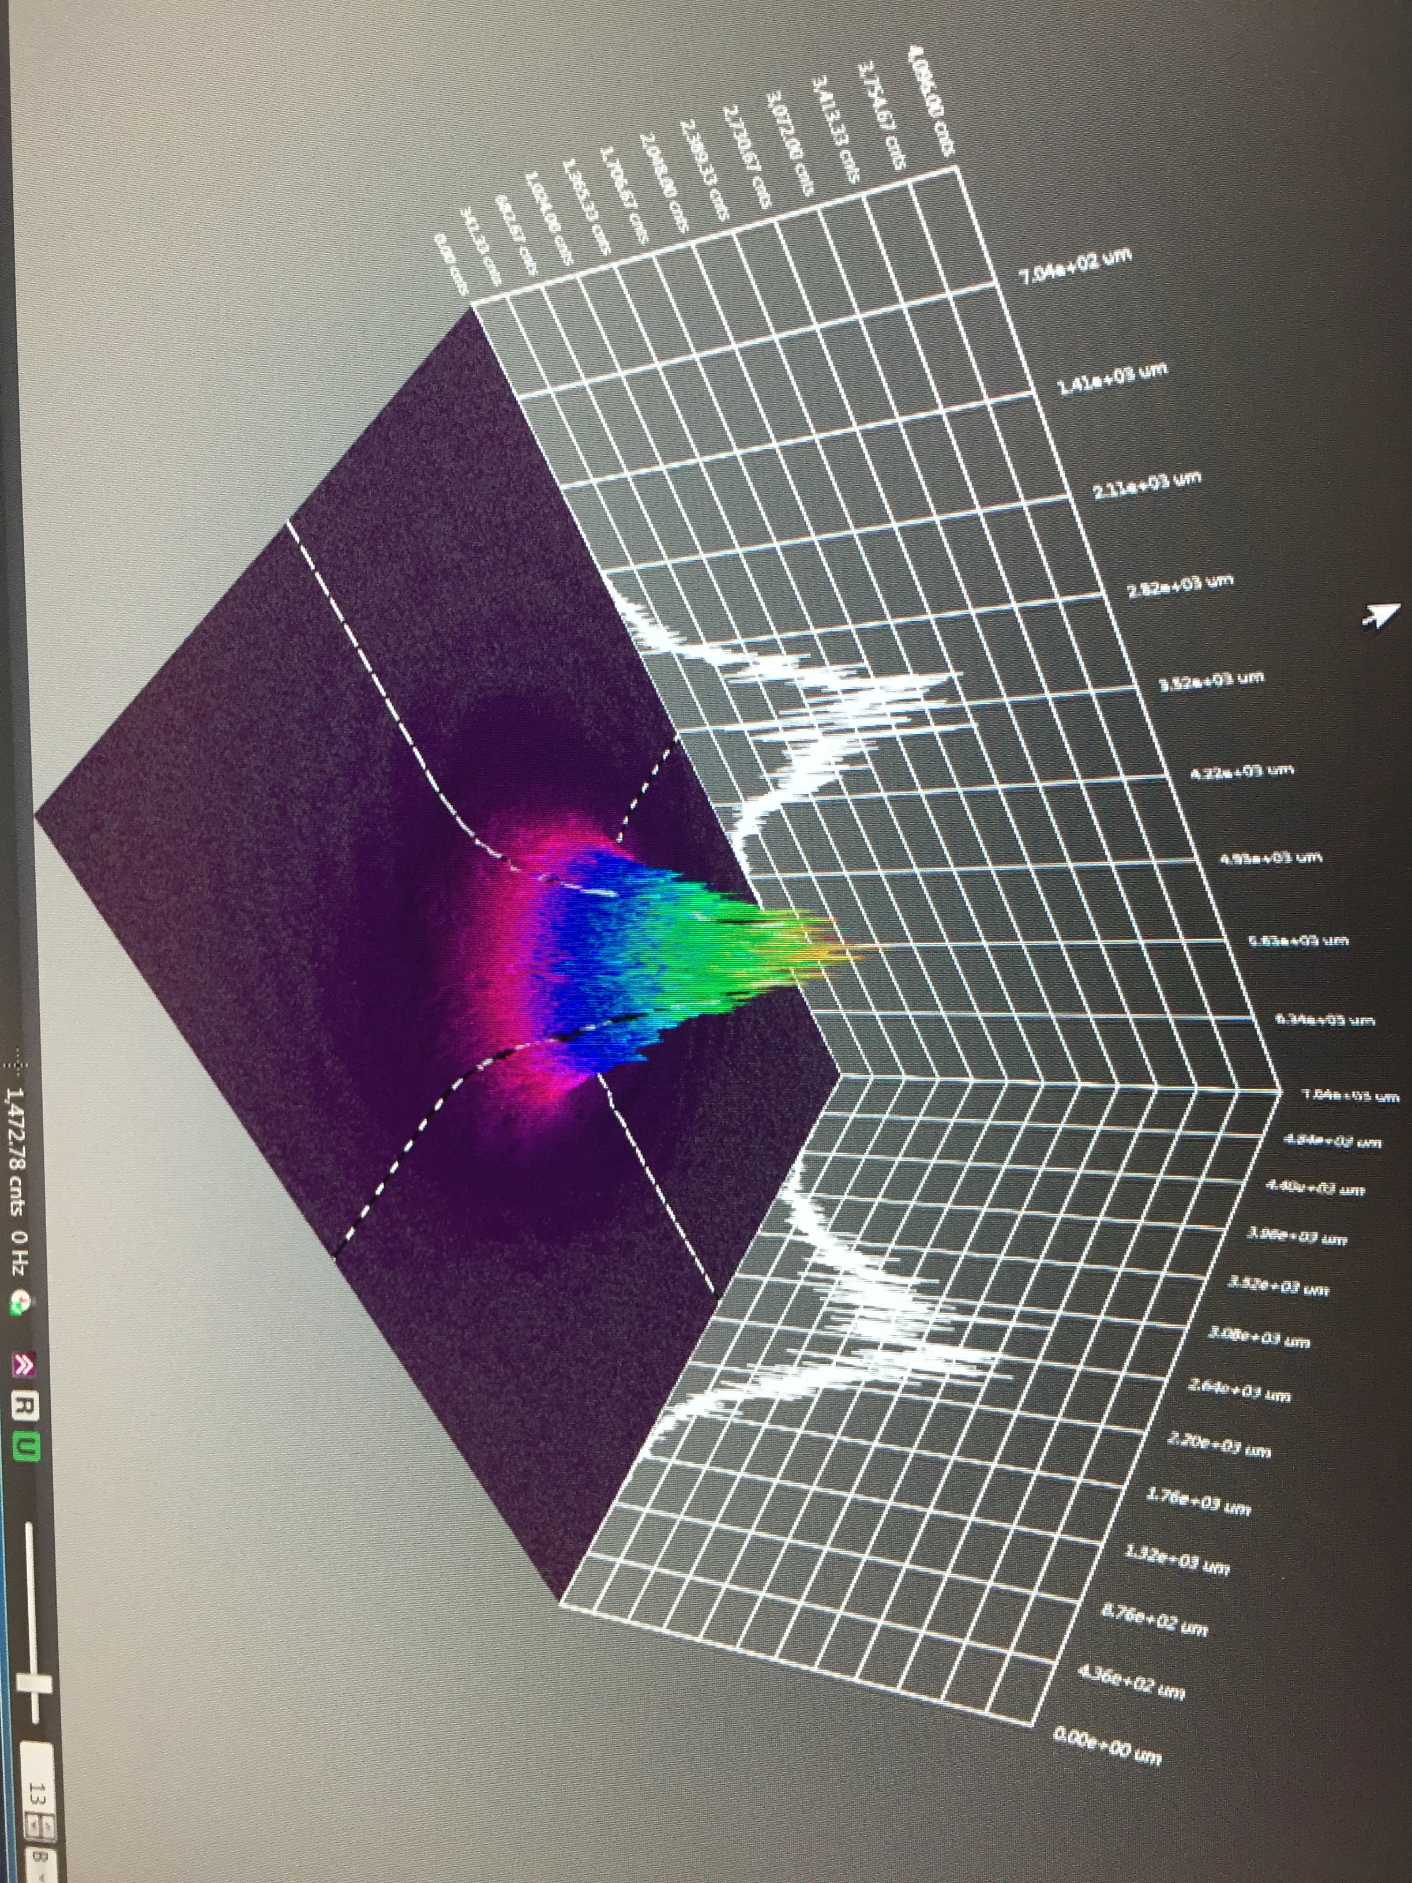

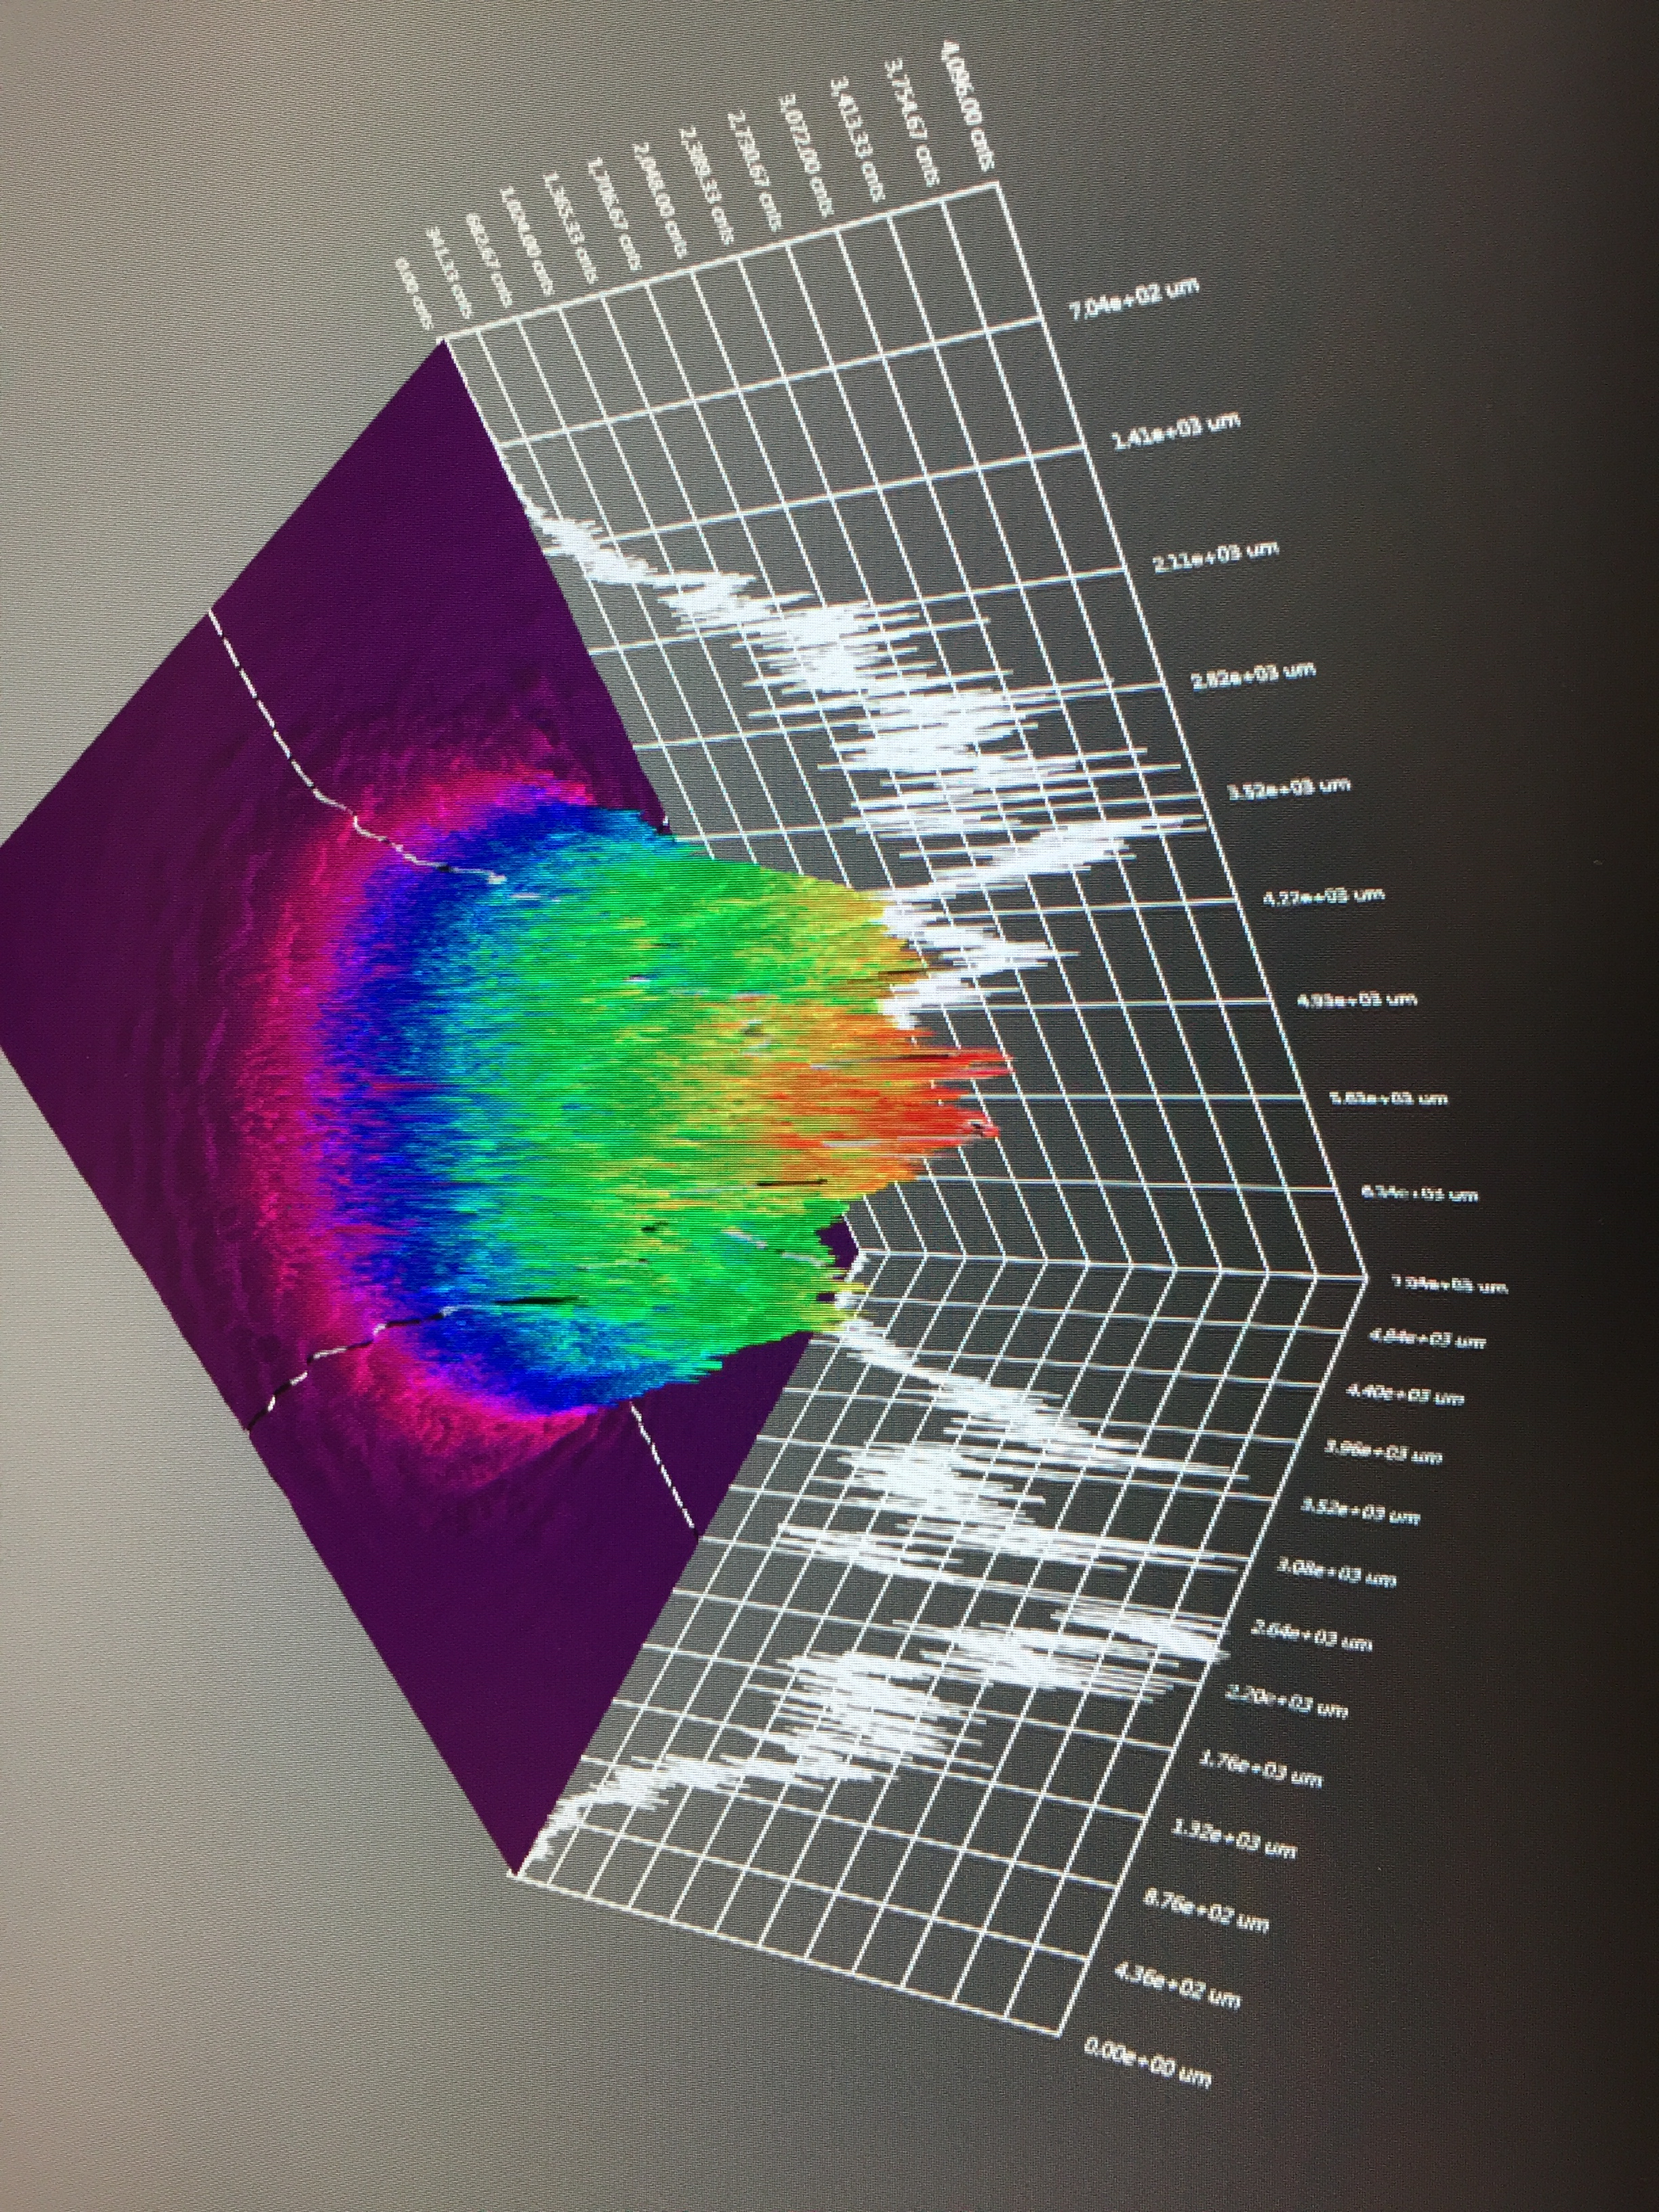
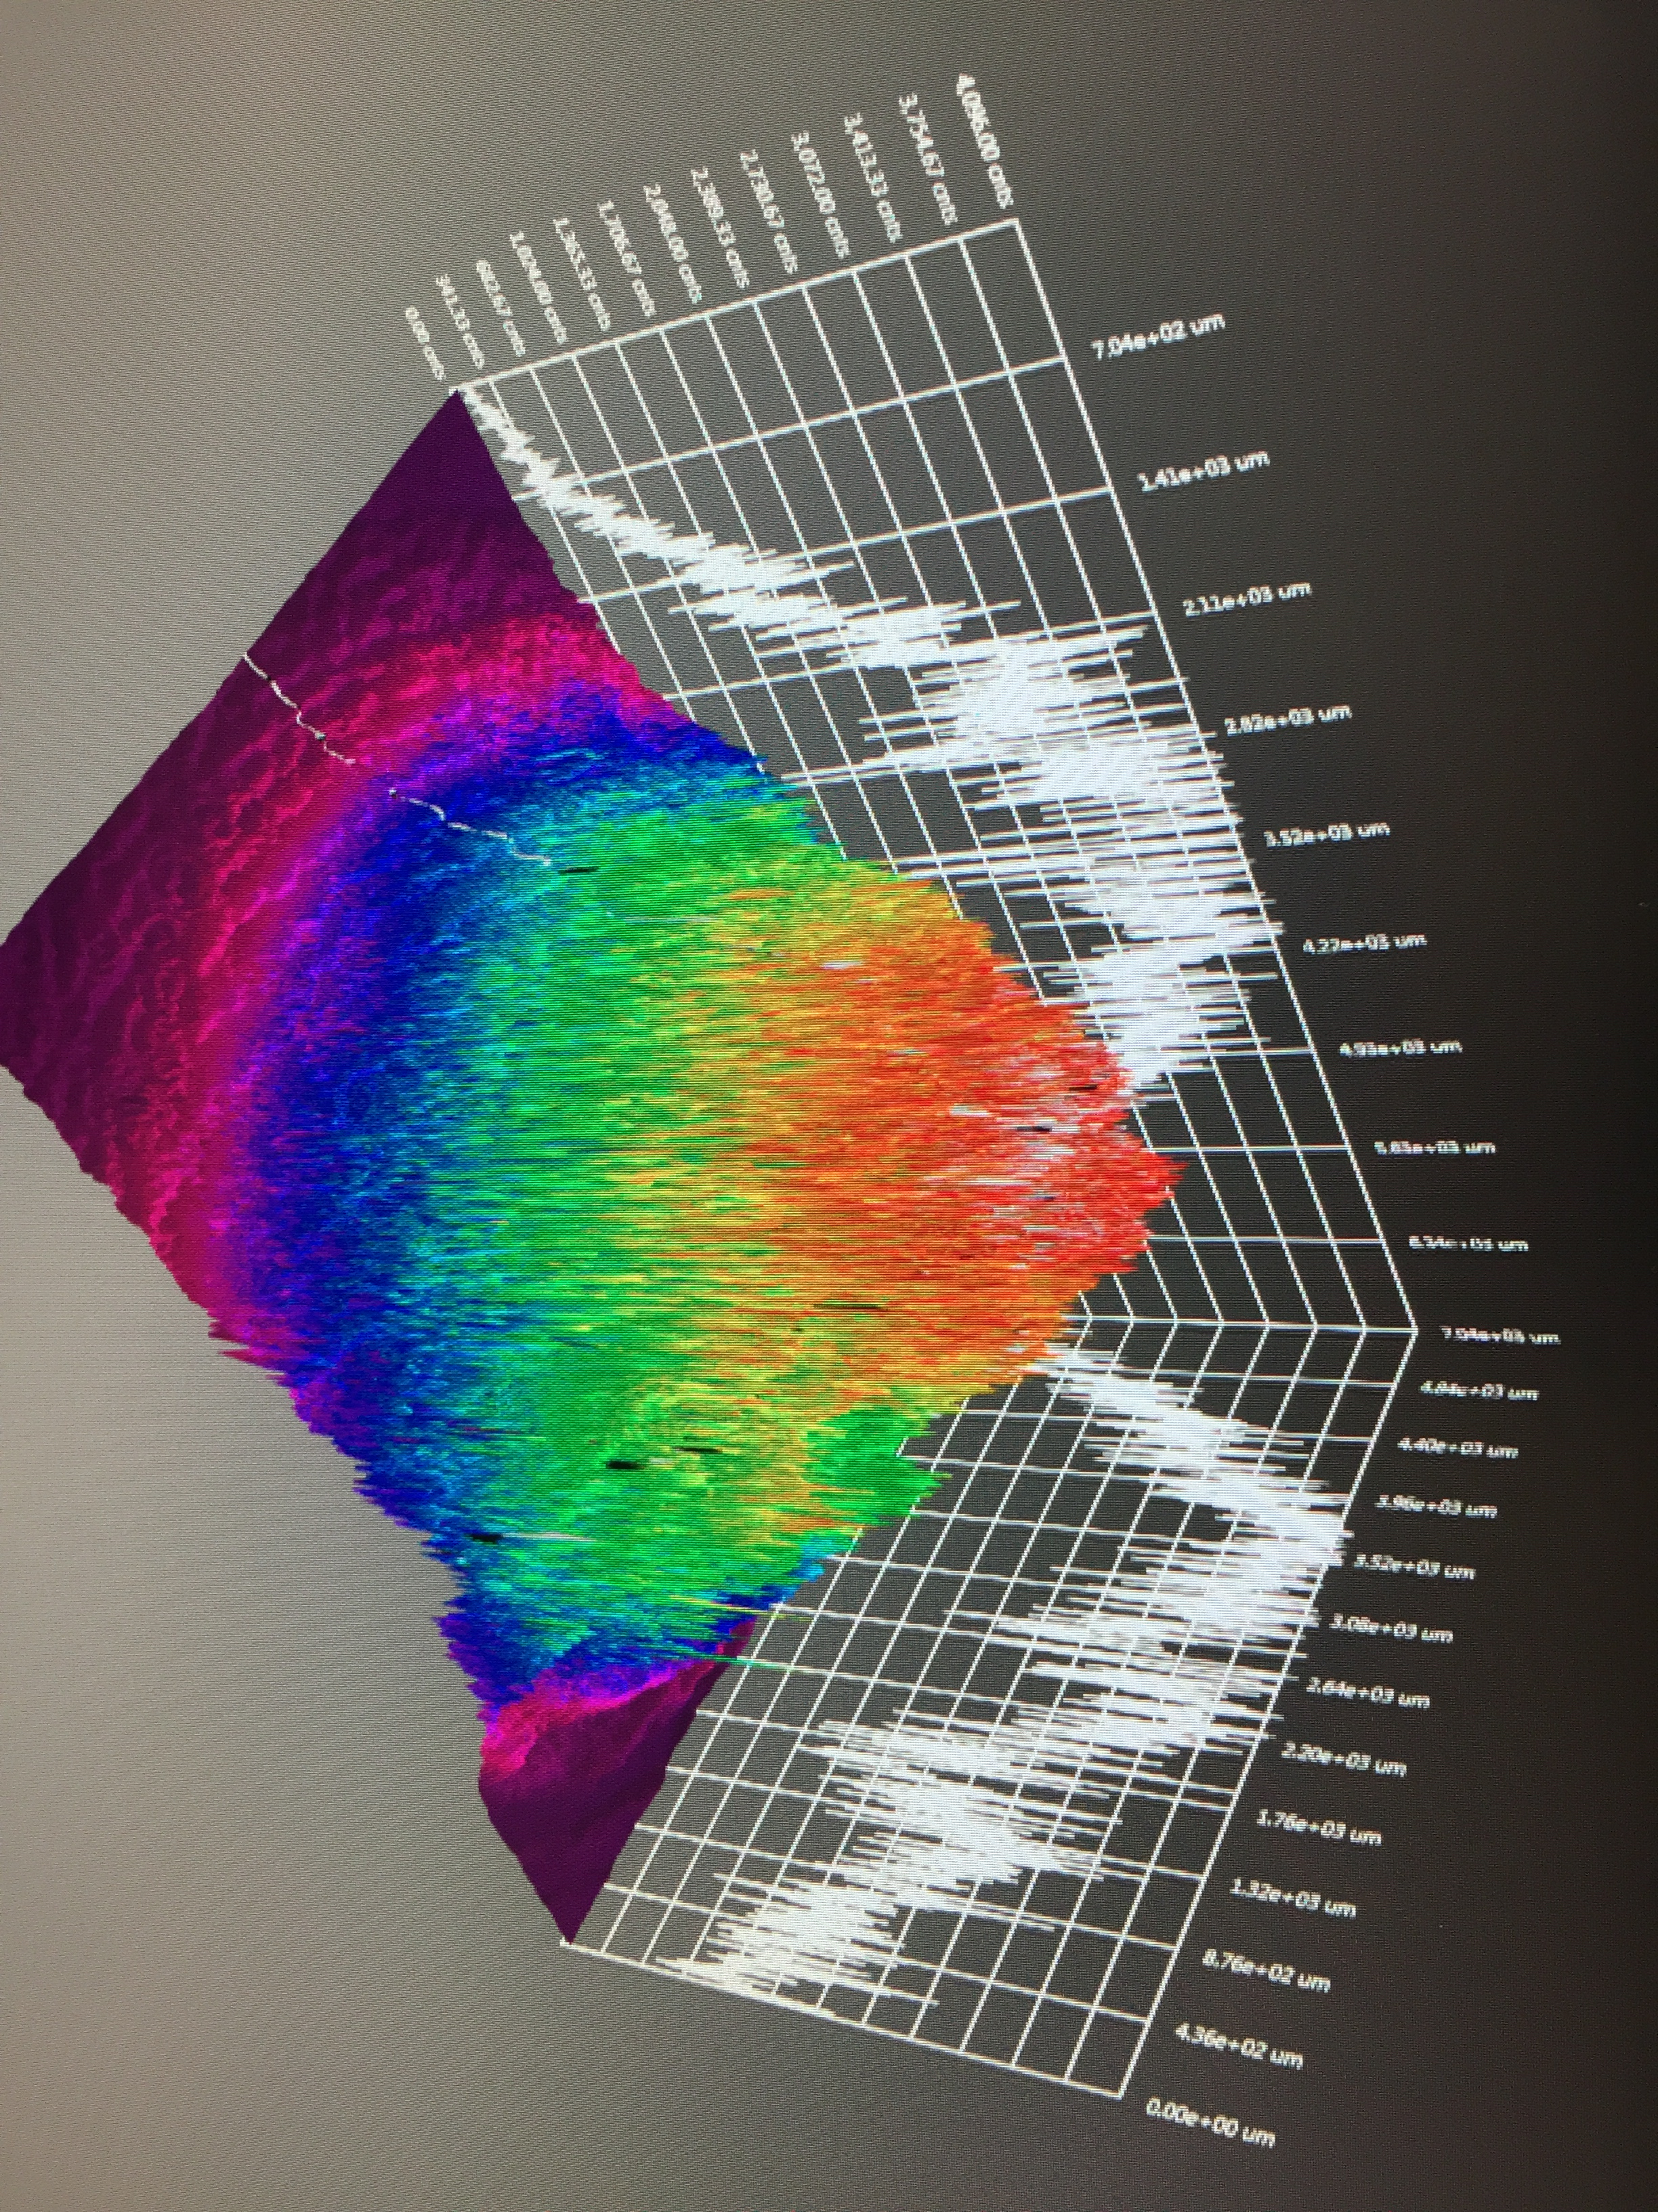
OUT
IN
C1
C2

Slide 3
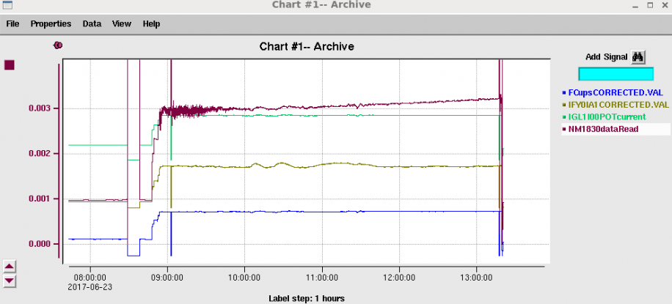
Setting up a run (here is 1.5 mA)
Record pick-off laser (1%)
Lock the gun current
Record A1 (A2 is out)
Record FC1 (termination)

Slide 4
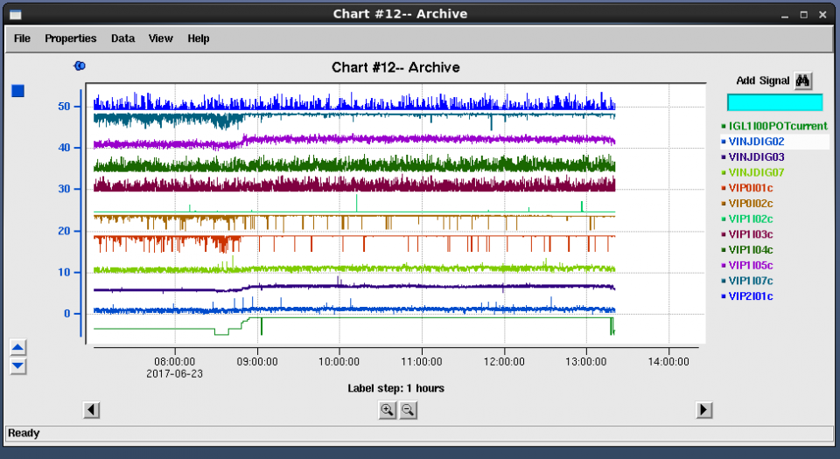
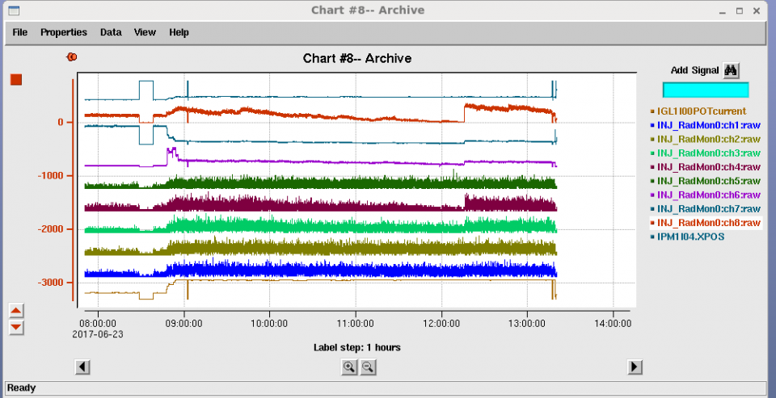
Record vacuum
Record rad-mon

Slide 5
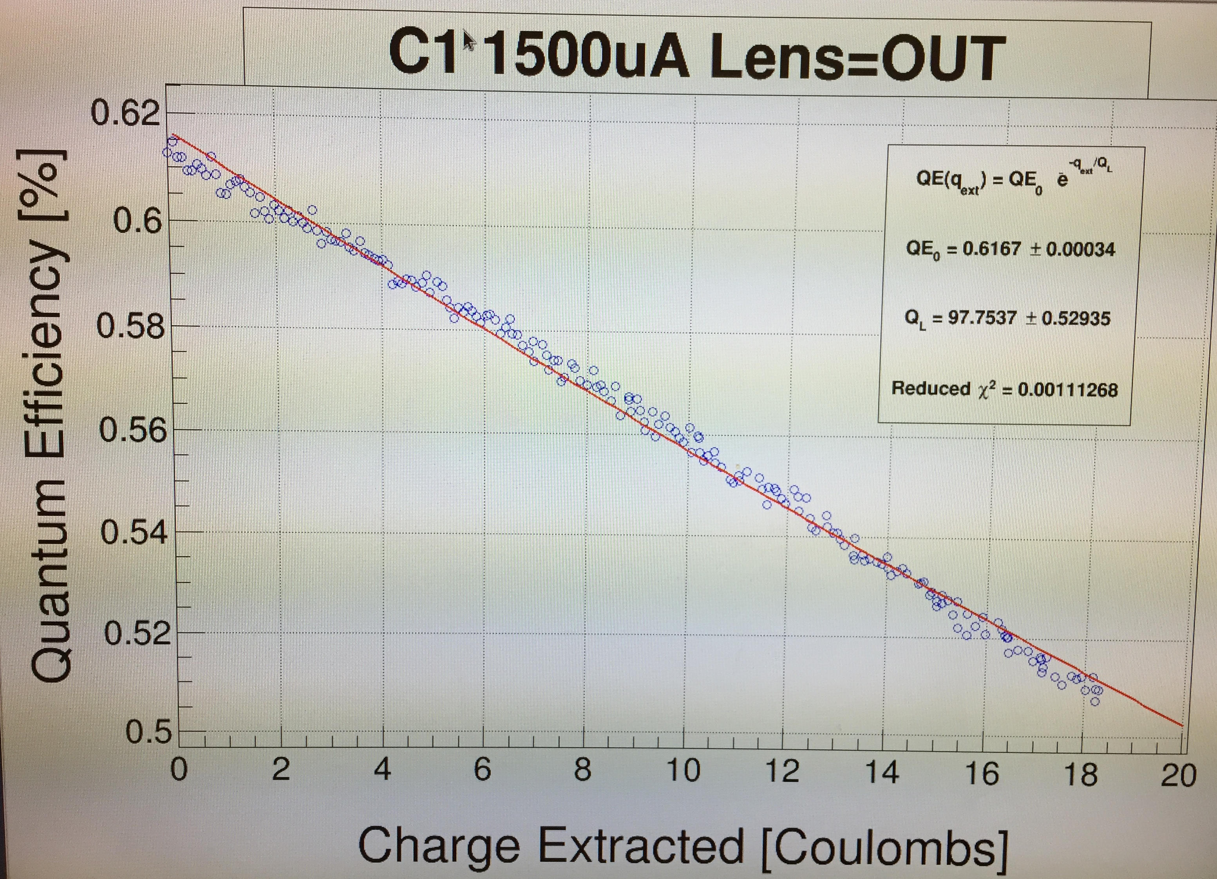
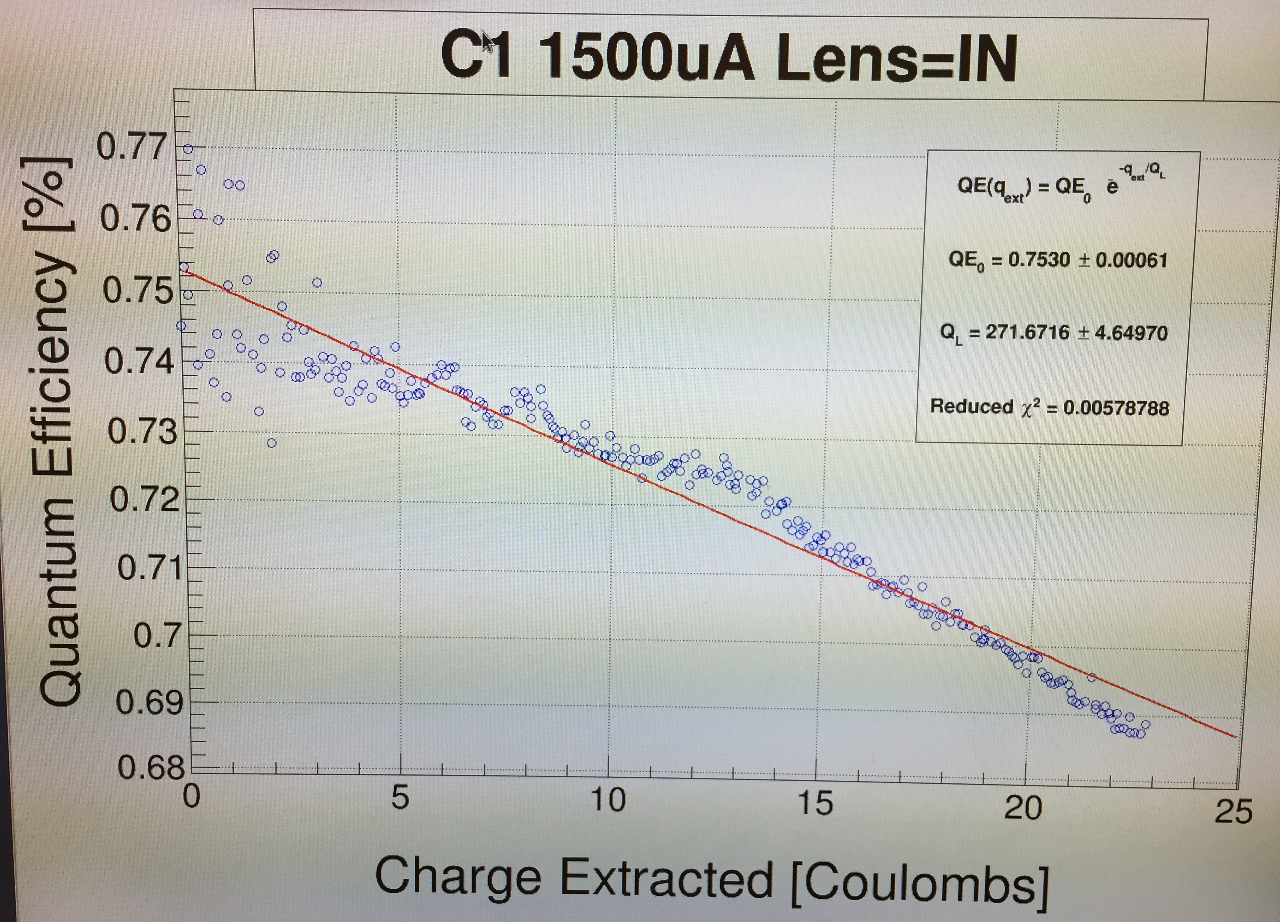
Daniel is implementing analysis tool to extract data from archiver, compute/fit QE vs. Charge and next looking at correlations with vacuum and x-ray signals.
Most runs looks like this
Some runs require more care

Slide 6
0.5 mA
1.0 mA
1.5 mA
2.0 mA
100kV
499MHz
FWHM=0.45mm
200kV
1497MHz
FWHM=0.35mm

Slide 7
0.5 mA
1.0 mA
1.5 mA
2.0 mA

Slide 8
0.5 mA
1.0 mA
1.5 mA
2.0 mA

Slide 9
Next steps…
Implement correlation analysis to precisely understand how the vacuum and x-ray meaningful and seek inflection points in QE vs. Charge data.
Complete studies of SLSP-5756-4
  Perform QE and analyzing power measurement
  Measure beam emittance at 3-4 laser spot sizes at equivalent bunch charge (0.5-2 mA)
  Heat/activate
  Repeat QE and analyzing power measurement
  Continue with 0.5-1.5 mA runs with two more laser areas of about 7 and 15 mm²
Test DBR photocathode
  Load DBR/non-DBR to docking station/bake
  Move suitcase to tunnel for exchange
  Heat/activate
  Measure QE and analyzing power
  Measure polarization
  Resume lifetime measurements

