Slide 1
Gamma Flux Bubble Chamber Expected Rates – Sept 2015
January 20, 2016

Slide 2
Outline
GEANT Model
Gamma Flux vs Electron Kinetic Energy
Expected Natural N₂O Rate
Expected Rates of:
¹⁸O(γ,α)¹⁴C
¹⁷O(γ,n)¹⁶O
¹⁴N(γ,p)¹³C
Remarks

Slide 3
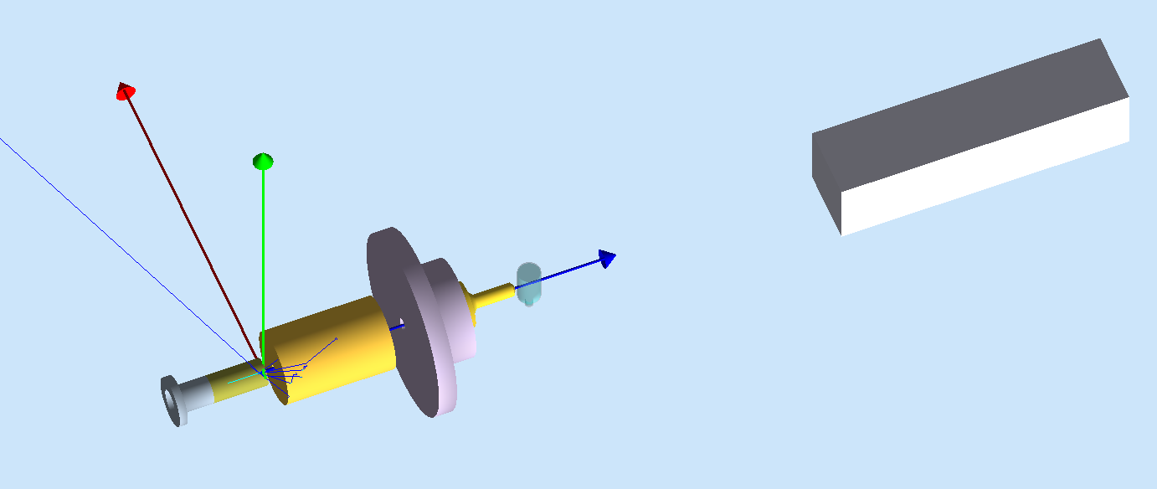
Geant4 Model
Gap between radiator and collimator = 0.59 inches
Distance between radiator and center of glass cell = 14.02 inches

Slide 4
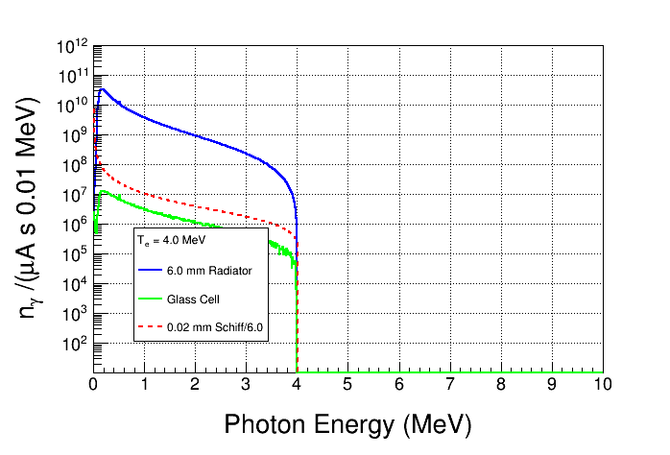
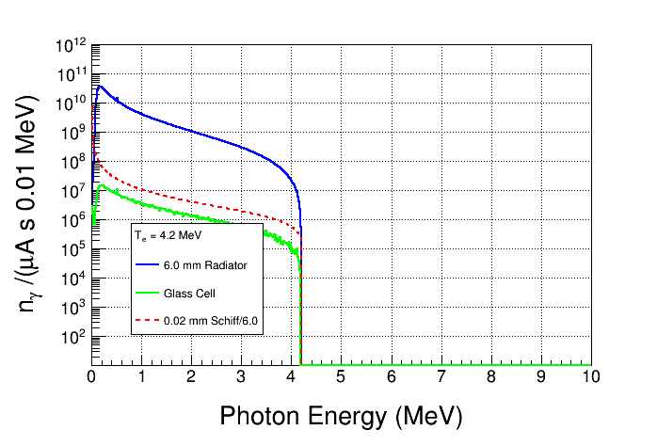
Forward flux from radiator
Total N_{γ} =
9.3 $×$ 10⁸ /(μA s)
GEANT4 Cut = 1 keV
Flux entering glass cell
Total N_{γ} =
1.1 $×$ 10⁹ /(μA s)

Slide 5
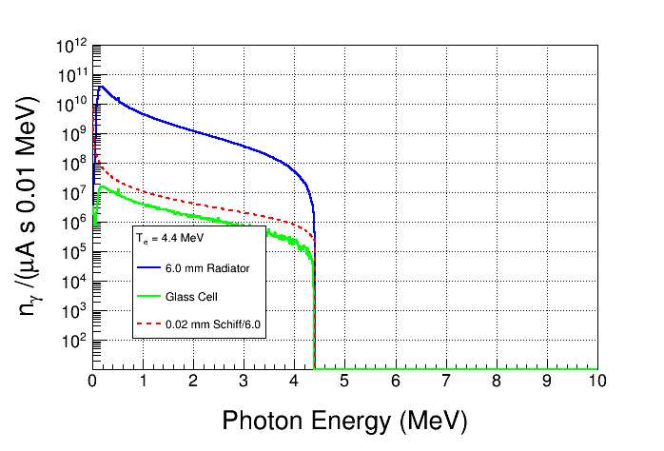
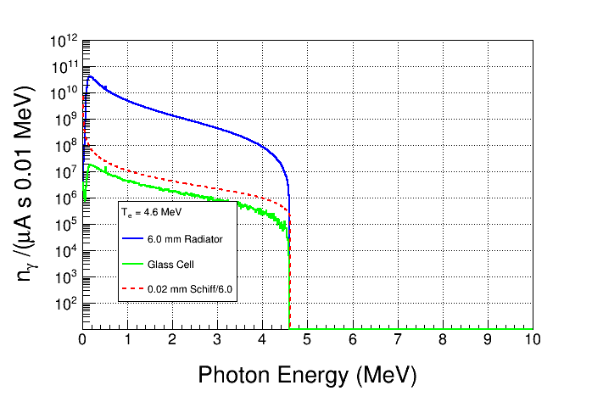
Total N_{γ} =
1.2 $×$ 10⁹ /(μA s)
Total N_{γ} =
1.3 $×$ 10⁹ /(μA s)

Slide 6
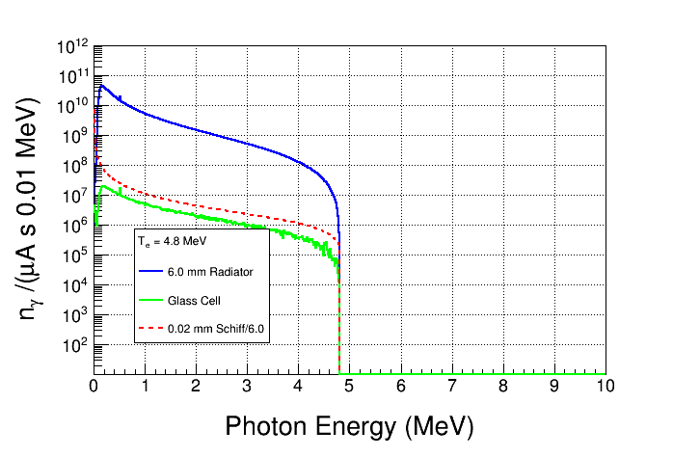
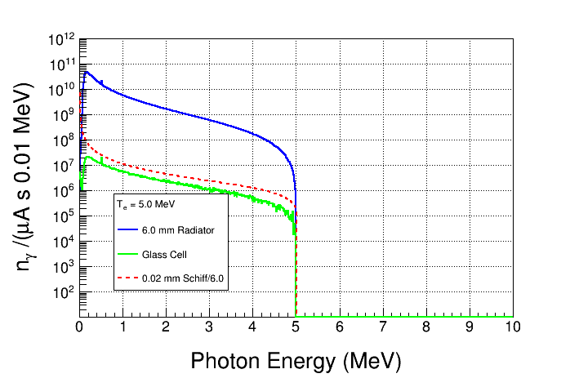
Total N_{γ} =
1.5 $×$ 10⁹ /(μA s)
Total N_{γ} =
1.7 $×$ 10⁹ /(μA s)

Slide 7
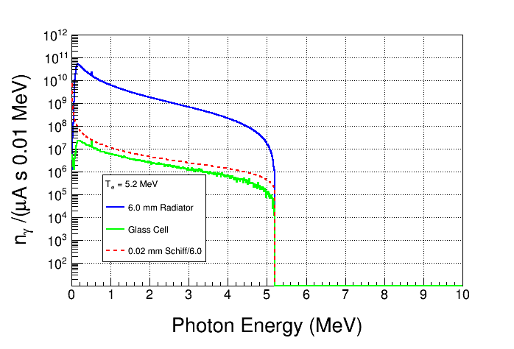
Total N_{γ} =
1.9 $×$ 10⁹ /(μA s)
Total N_{γ} =
2.1 $×$ 10⁹ /(μA s)

Slide 8
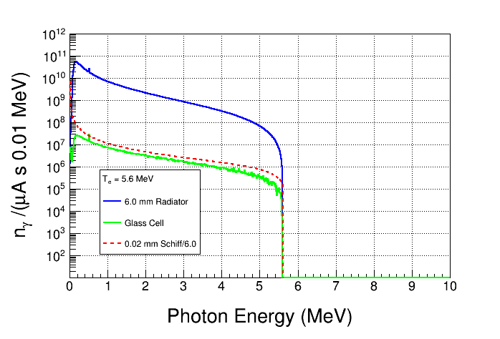
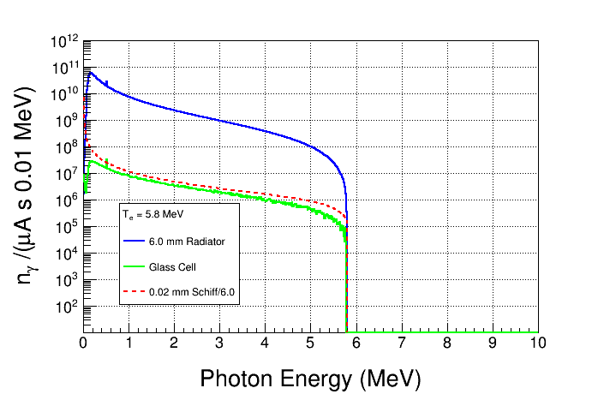
Total N_{γ} =
2.3 $×$ 10⁹ /(μA s)
Total N_{γ} =
2.5 $×$ 10⁹ /(μA s)

Slide 9
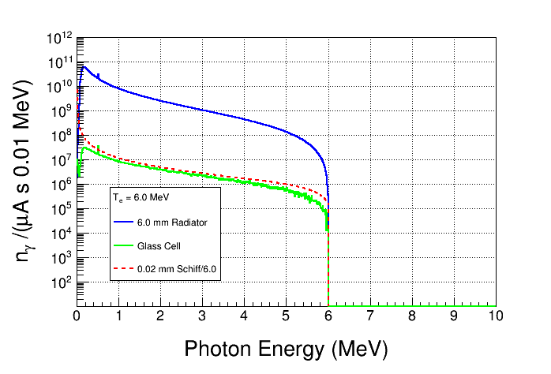
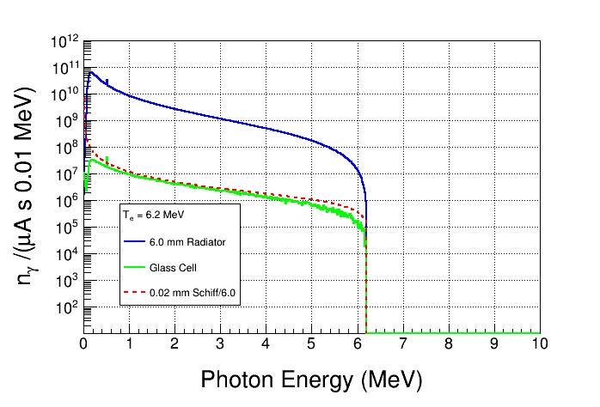
Total N_{γ} =
2.7 $×$ 10⁹ /(μA s)
Total N_{γ} =
3.0 $×$ 10⁹ /(μA s)

Slide 10
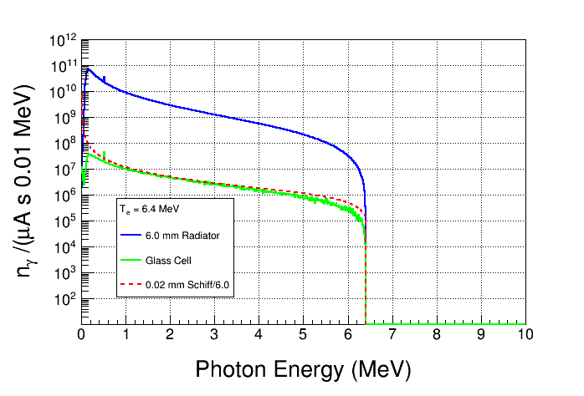
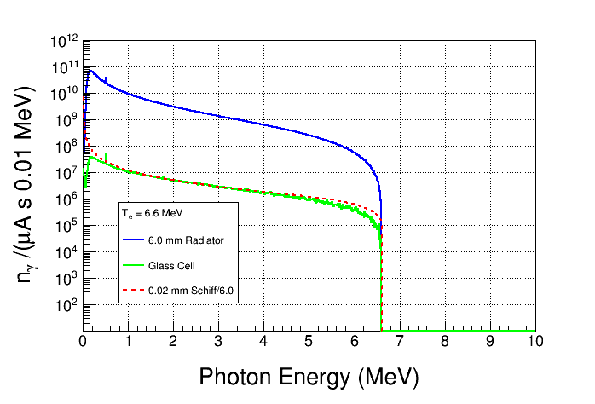
Total N_{γ} =
3.2 $×$ 10⁹ /(μA s)
Total N_{γ} =
3.5 $×$ 10⁹ /(μA s)

Slide 11
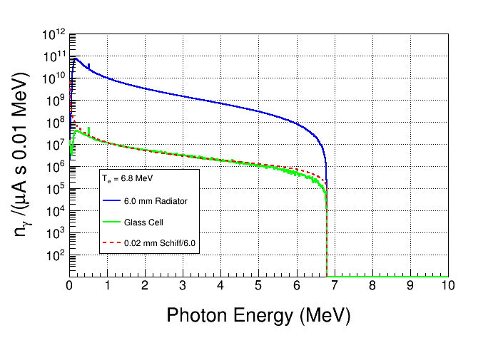
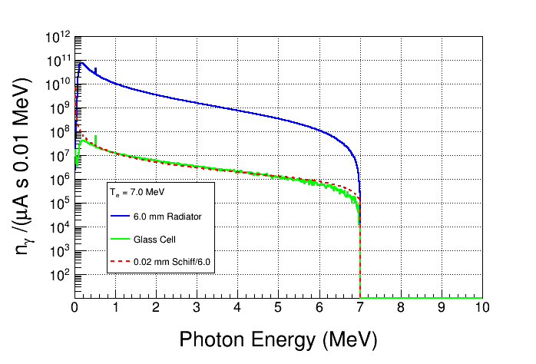
Total N_{γ} =
3.8 $×$ 10⁹ /(μA s)
Total N_{γ} =
4.1 $×$ 10⁹ /(μA s)

Slide 12
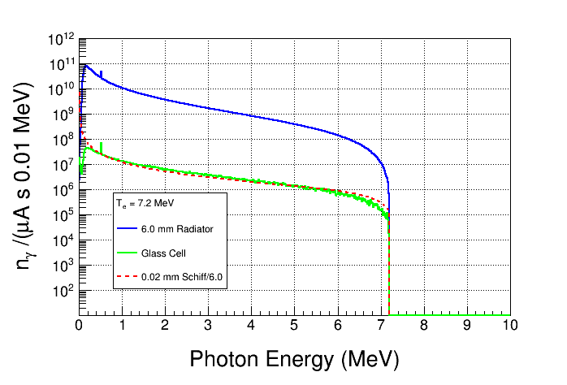
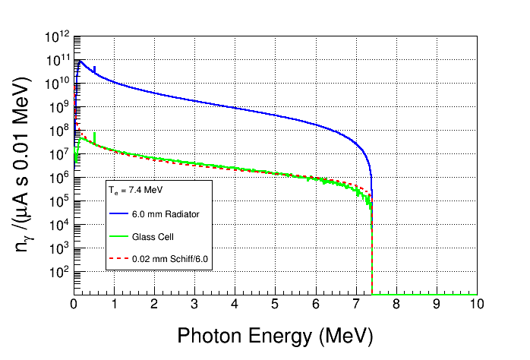
Total N_{γ} =
4.4 $×$ 10⁹ /(μA s)
Total N_{γ} =
4.5 $×$ 10⁹ /(μA s)

Slide 13
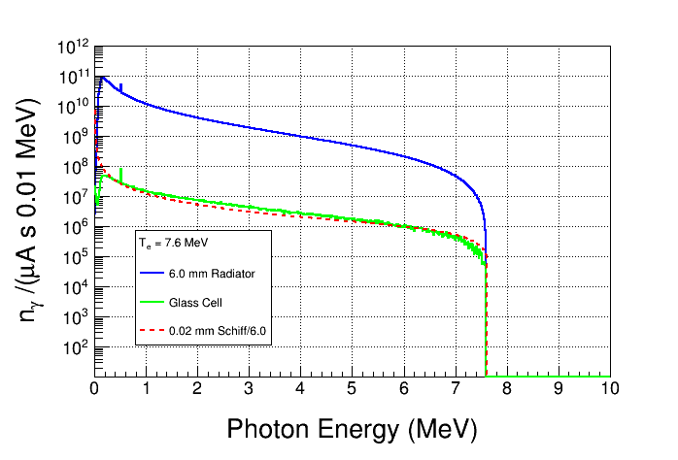
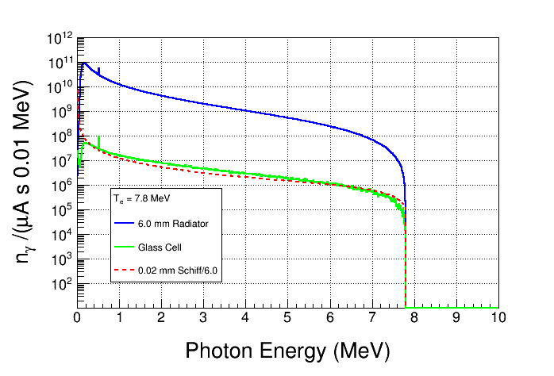
Total N_{γ} =
5.1 $×$ 10⁹ /(μA s)
Total N_{γ} =
5.5 $×$ 10⁹ /(μA s)

Slide 14
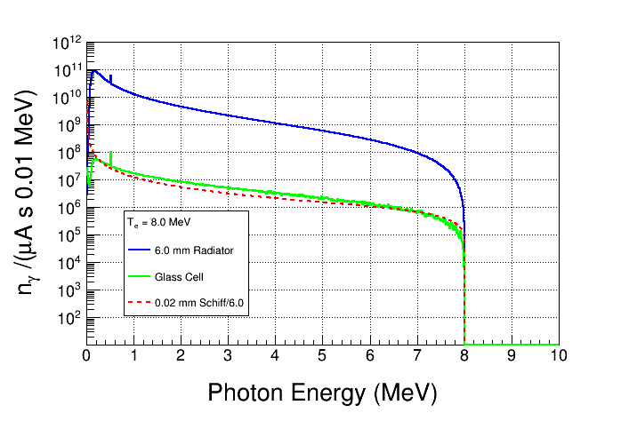
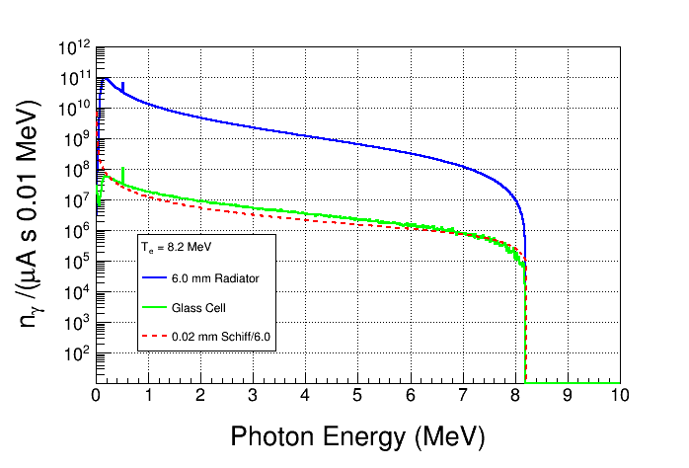
Total N_{γ} =
5.9 $×$ 10⁹ /(μA s)
Total N_{γ} =
6.3 $×$ 10⁹ /(μA s)

Slide 15
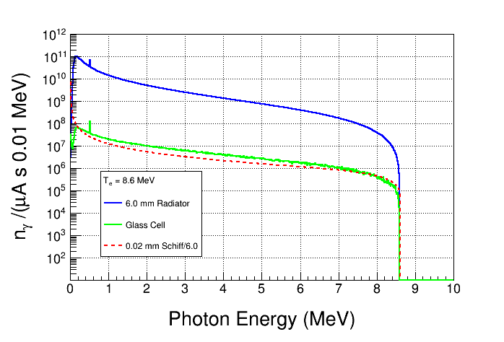
Total N_{γ} =
6.7 $×$ 10⁹ /(μA s)
Total N_{γ} =
7.1 $×$ 10⁹ /(μA s)

Slide 16
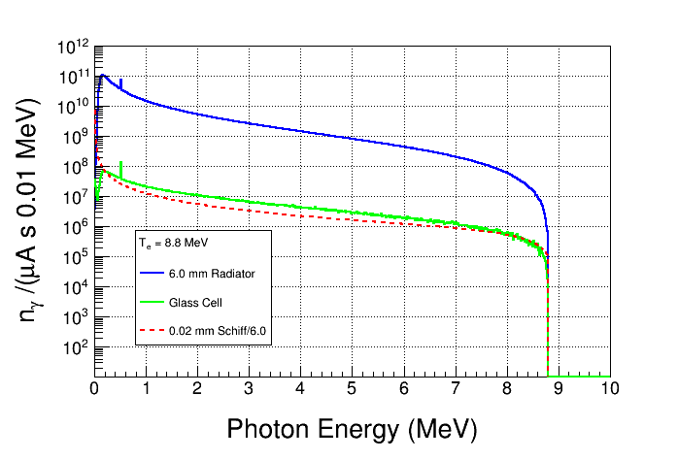
Total N_{γ} =
7.5 $×$ 10⁹ /(μA s)
Total N_{γ} =
8.0 $×$ 10⁹ /(μA s)

Slide 17
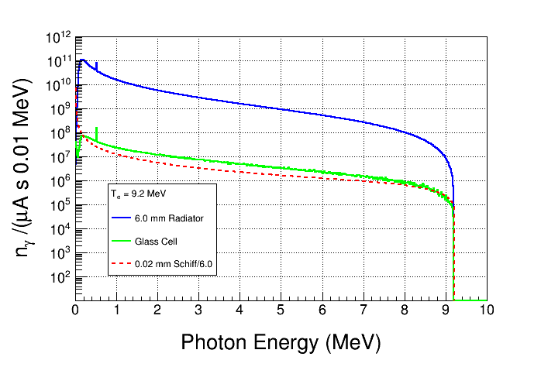
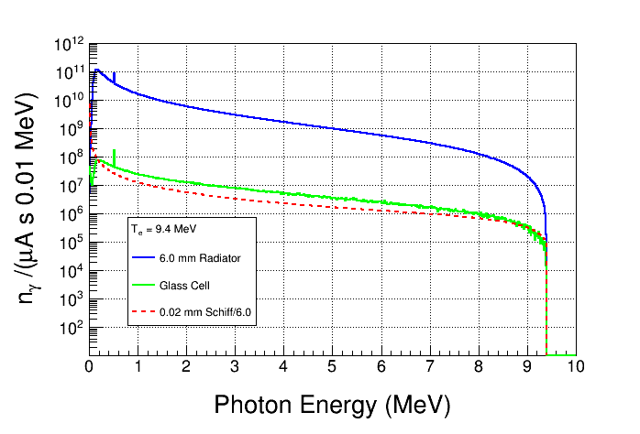
Total N_{γ} =
8.4 $×$ 10⁹ /(μA s)
Total N_{γ} =
8.9 $×$ 10⁹ /(μA s)

Slide 18
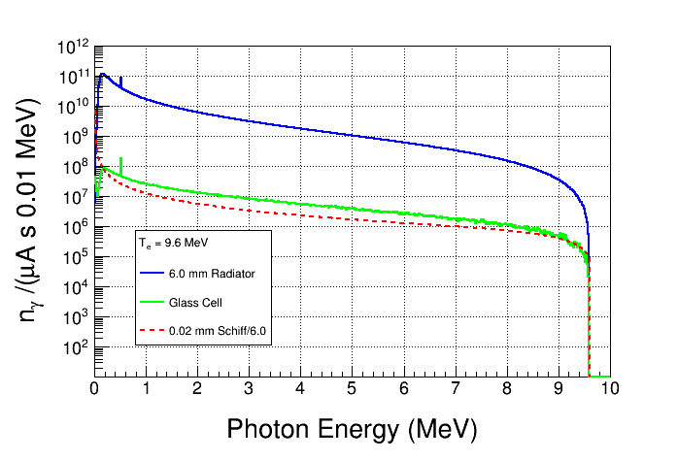
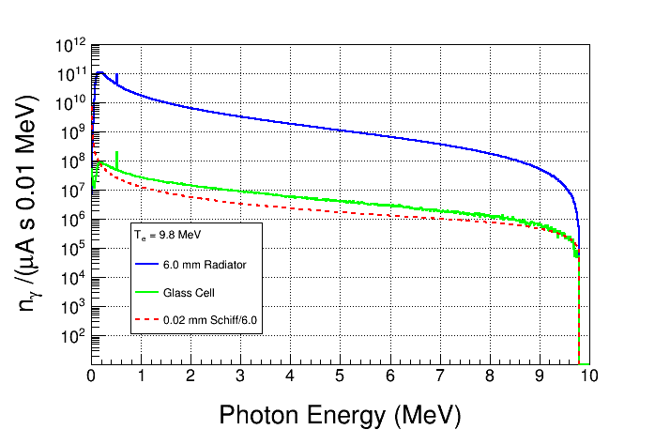
Total N_{γ} =
9.4 $×$ 10⁹ /(μA s)
Total N_{γ} =
9.9 $×$ 10⁹ /(μA s)

Slide 19
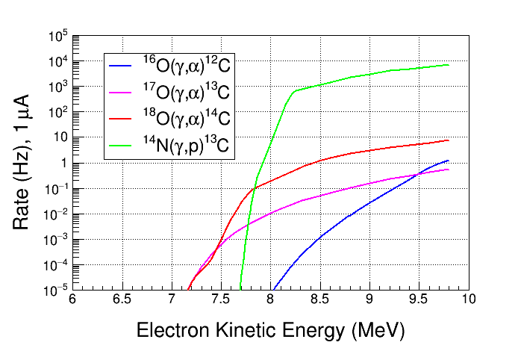
Expected Natural N₂O Rates
For natural N₂O, most events are γ-α from ¹⁸O
No Threshold Cut

Slide 20
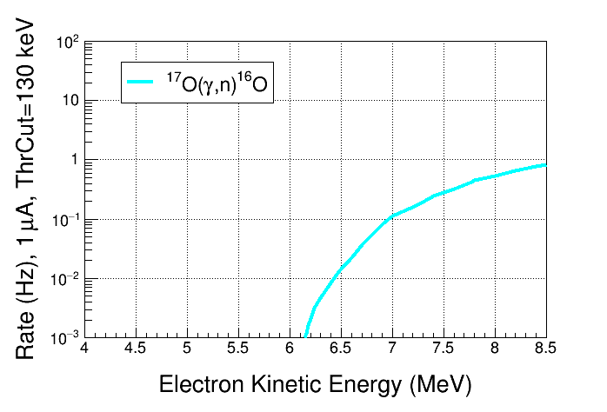
Expected ¹⁷O(γ,n)¹⁶O Rate
Chamber threshold = 130 keV
Elastic neutron scattering – ¹⁶O(n,n) and ¹⁴N(n,n) – is not included

Slide 21
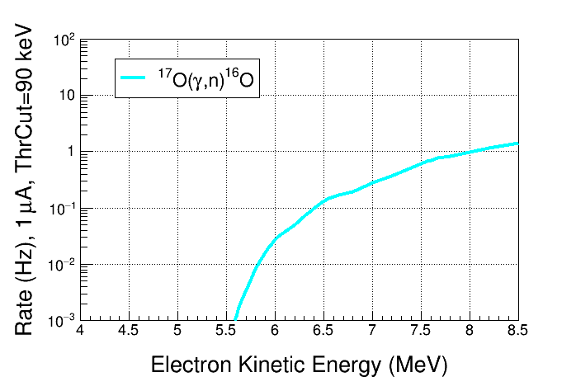
Chamber threshold = 90 keV
Elastic neutron scattering – ¹⁶O(n,n) and ¹⁴N(n,n) – is not included

Slide 22
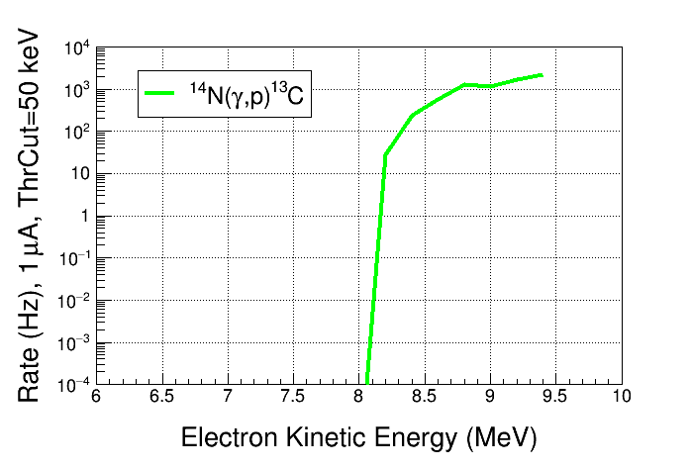
Expected ¹⁴N(γ,p)¹³C Rate
Expected rate from ¹⁴N(γ,p)¹³C with lower operational pressure (Chamber threshold = 50 keV)

Slide 23
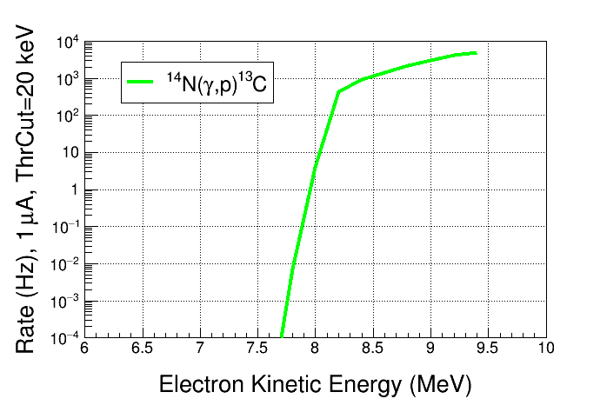
Expected rate from ¹⁴N(γ,p)¹³C with lower operational pressure (Chamber threshold = 20 keV)

Slide 24
Conclusions
Design new radiator to match lower electron energy for ¹⁹F(γ,α)¹⁵N
Must reduce distance between radiator and chamber to increase flux by at least a factor of 10
Use silver (or even gold) radiator?
Use silver collimator

